Slide 1


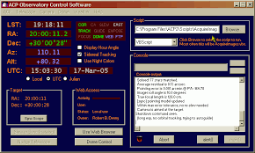
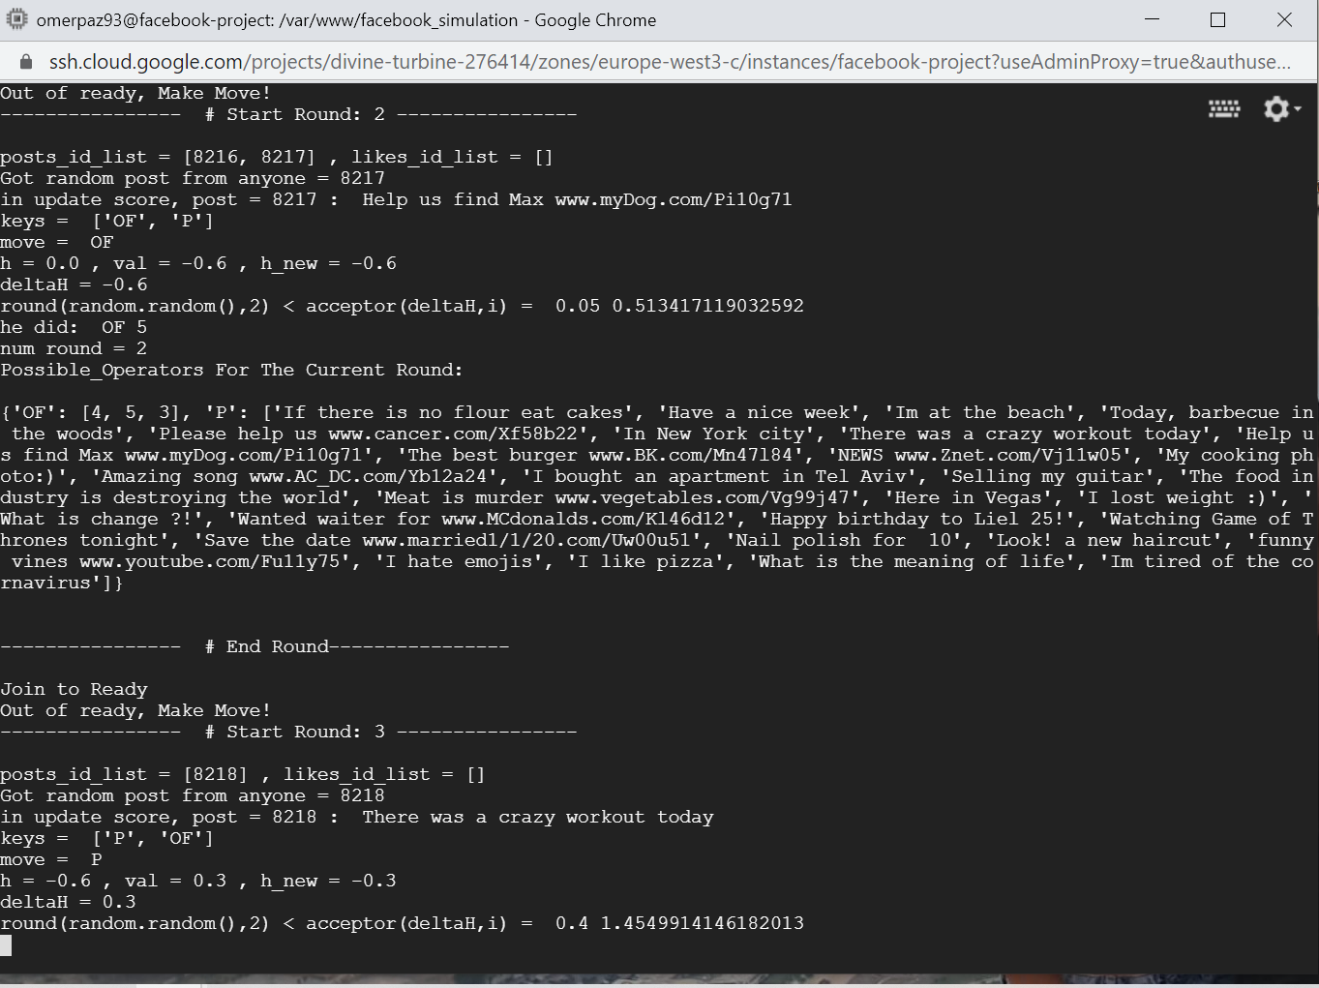



Observatory Weather Control for
ACP Observatory Control Software
Amiel Liberman (206328122) and Shilo Gilor (302537394)
Instructed by Yossi Zaguri
Project goals
Have a Rule-Based decision making based on Outsourcing the Weather forecast to support the ACP Program for Ariel University Observatory.
Introduction
Ariel University has an Observatory and wants to automate the safety weather system that controls the Observatory.
Methods
Scraping Weather sites and gathering the data , then have a simple web site with good visual aid to understand the weather and use Rule-Based guidelines to determent if it is safe for the Observatory.
Selected tools and algorithms server for scraping and storing data: Python, ACP, Django, HTML, CSS, JS, Celery
Decision making for the state of weather: Python Library for Business-rules
The algorithms: Adjustable from the internet site provided by Django
Results
Github Link:
https://github.com/shilogilor90work/ariel_observatory
Weather Link:
http://3.15.42.218/

