Slide 1


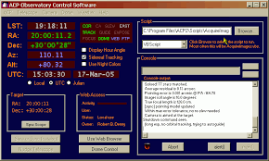
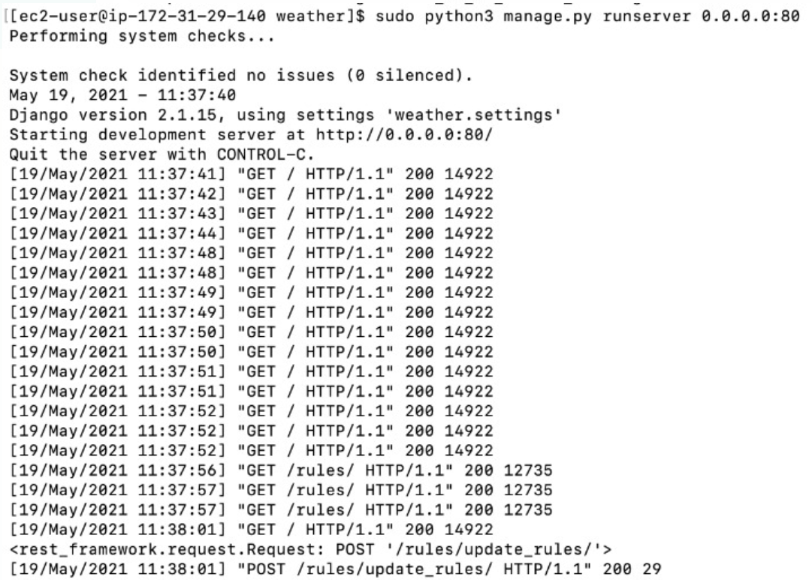



Observatory Weather Control for
ACP Observatory Control Software
Amiel Liberman (206328122) and Shilo Gilor (302537394)
Instructed by Yossi Zaguri
Project goals
Develop Weather Hazzard-Situations monitor Incorporating Flexible Rule Engine Infrastructure for Ariel Star-Observatory. Where the Architecture Supports Incorporation of any Source of Weather Forecast.
Introduction
Ariel’s Astro-Physics research center (AGASS) has built a new Astronomy Observatory including 14” Dome, Telescope and several perifacial that needs to be protected, while from extreme weather situations including : wind above 40 KMH , Rain , Dust Storm etc.
Methods
In order to close Observatory dome, which protects the equipment array, an automated system should monitor, alert and actuate closure in certain conditions, based on current weather condition. Integrative several information sources dealing with weather forecast, capturing data using REST API, Web Scrapping, and potentially reading local weather station telematics.
Selected Tools server for scraping data: Python, ACP, Django, Celery, JS, DI-container
Decision making for the state of weather: Python Business-rules Library
Results
Github Link:
https://github.com/shilogilor90work/ariel_observatory
Weather Link:
http://3.15.42.218/

