Slide 1
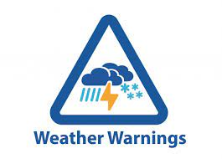
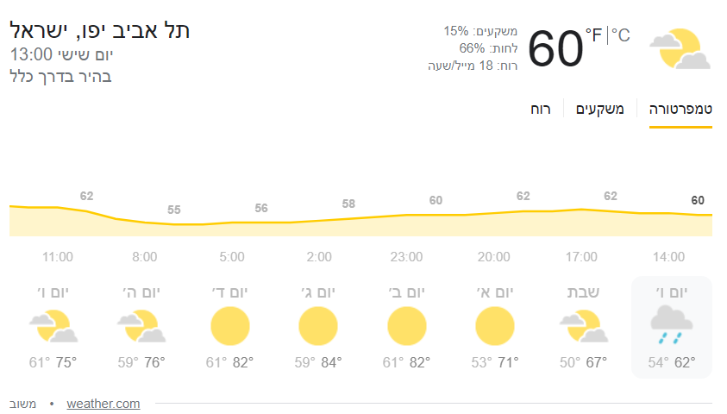
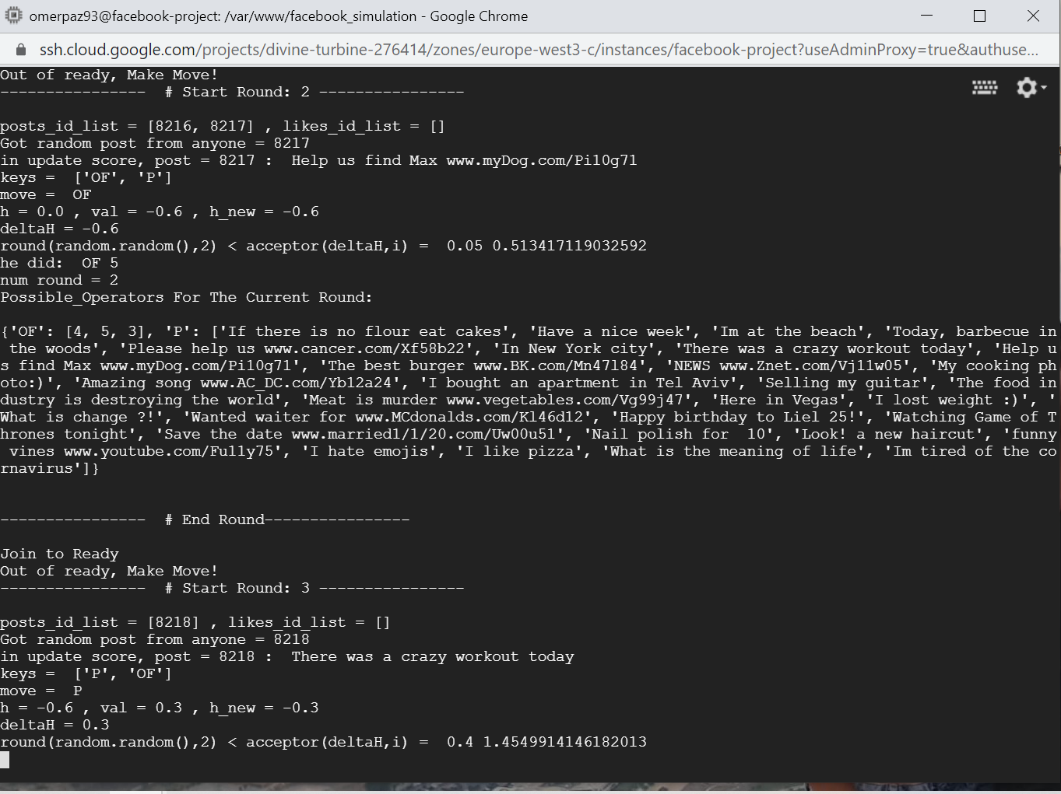
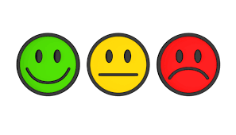

An Automatic and Visual Guide for Weather Prediction for the Ariel Observatory
Amiel Liberman (206328122) and Shilo Gilor (302537394)
Instructed by Yossi Zaguri
Project goals
To Develop an Automatic system that can predict and give planning assistance to the Ariel Observatory, to better perform star sighting while keeping all the equipment safe from the weather.
Introduction
Ariel University has an Observatory, that is run nowadays manually, while wants to have a safety system that can control when the Observatory can and can not be used
Methods
Scraping weather sites and gathering the data into a server that can store the information, and have a simple web site with good visual aid to understand the weather and the, and to be able to supply the information to the Observatory, while providing state of weather.
Selected tools and algorithms server for scraping and storing data: Python, Django, HTML, CSS, JS , Cron-job
Decision making for the state of weather: Python Library for Business-rules
The algorithms: Adjustable from the internet site provided by Django
Results
https://github.com/shilogilor90work/ariel_observatory
http://00.00.00.00/weather
Github Link:
Weather Link:

