Slide 1
Melanoma Classification Device
CS2210-A

Slide 2
Pi
Model
App
Prepare Pi by setting up a virtual environment
Download necessary dependencies
Attach camera module
Collected data and performed data cleaning
Processed images
Trained the model
Save, serialized, and exported the model for future use
Created Flask user interface
Test!

Slide 3
How the device works:
01
02
03
04
05
06
Take picture
Image is saved
Image is displayed
A picture is taken with the RPi 4 camera module
The image is saved to a specific location
Image is displayed on webpage
Classify image
Model is run
Result is displayed
User chooses to classify image
Image input is run on the model
The classification of the image is displayed

Slide 4
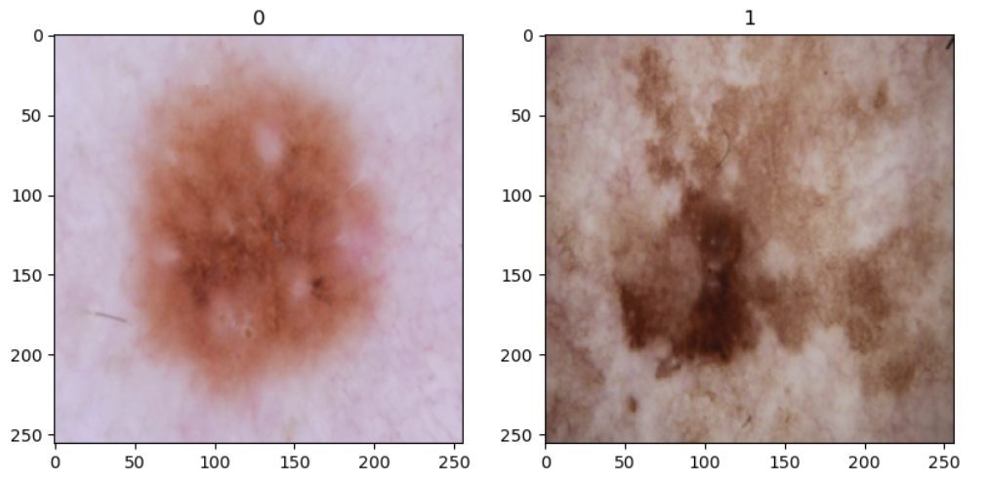
Classification model
Binary image classification model
approx. 85% accuracy
Trained on a dataset of ~ 3,300 images of benign and malignant moles (source: Kaggle)

Slide 5
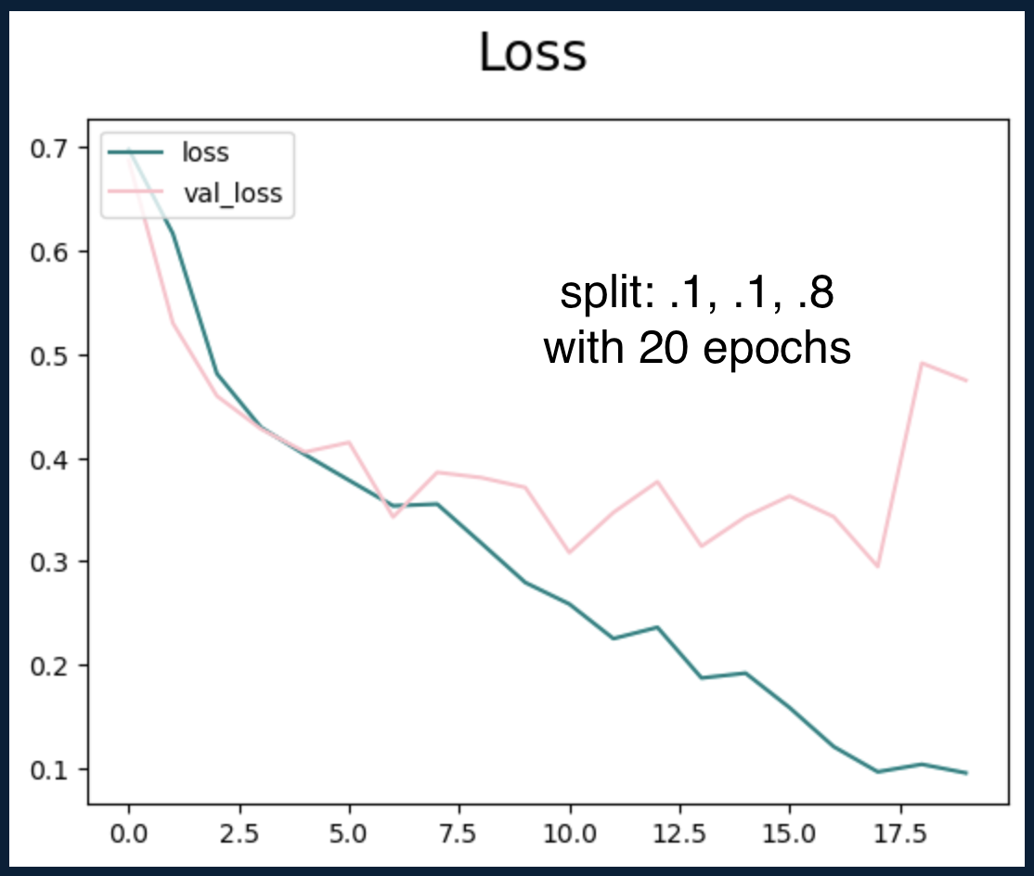
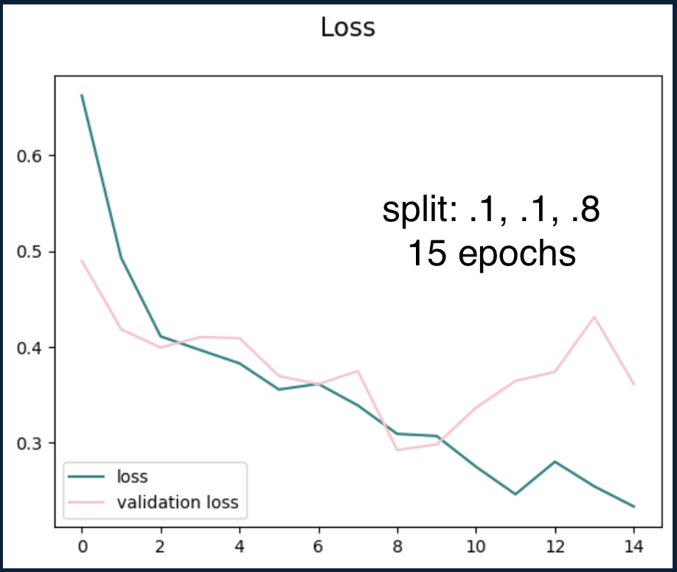
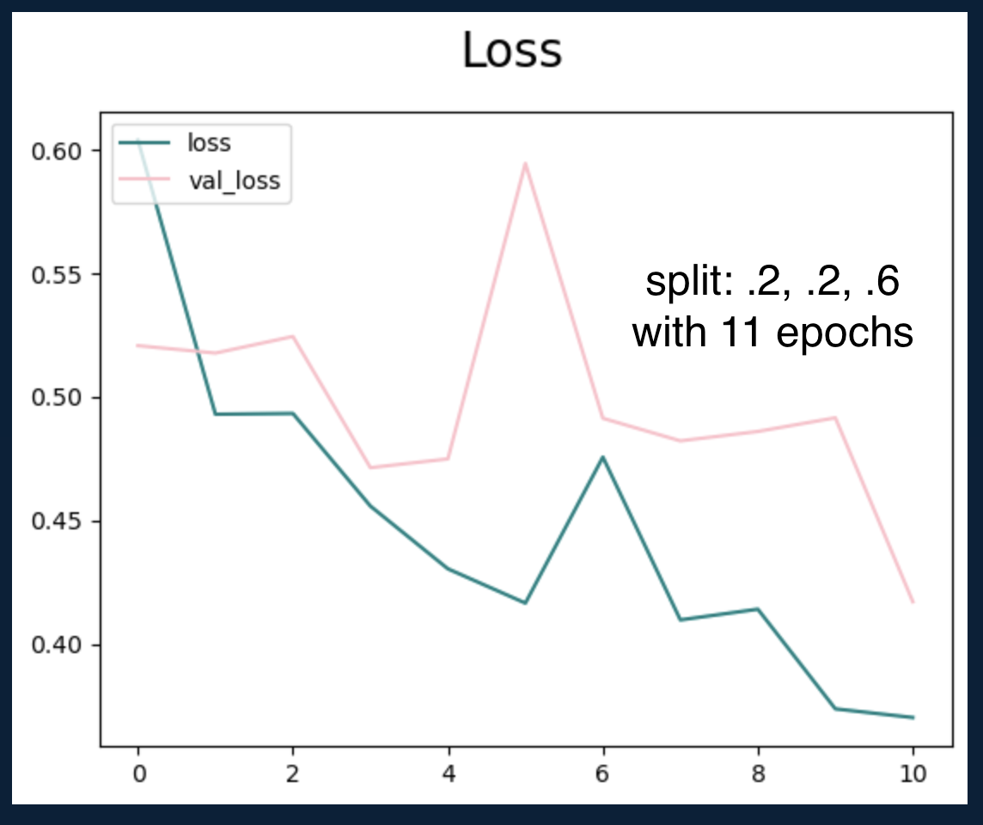
Classification model

Slide 6
Drawbacks + Points for improvement
Data the model is trained on is very specific
More organic image processing needed
Hardware components are limited

