Slide 1
R Shiny (ft. Shinydashboard)

Slide 2
Contents
Static vs. dynamic dashboards
Shiny applications
Structure
Example apps
Shinydashboard applications
Structure
Example apps

Slide 3
Static vs. dynamic dashboards
Static dashboards
Simple
Great for accessibility (if designed well)
Dynamic dashboards
Jazzy and interactive
User can make own inferences into data

Slide 4
Shiny applications
R package
Platform for creating web apps in R
Easy to code – don’t need to know HTML/CSS/Javascript
Free!

Slide 5
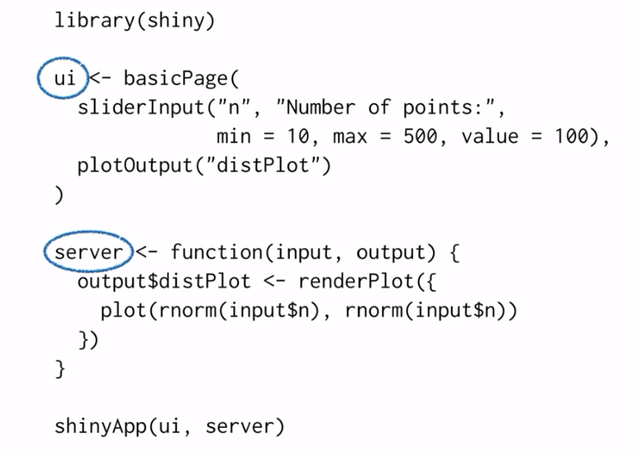
Structure
One file: app.R
User Interface and server components

Slide 6
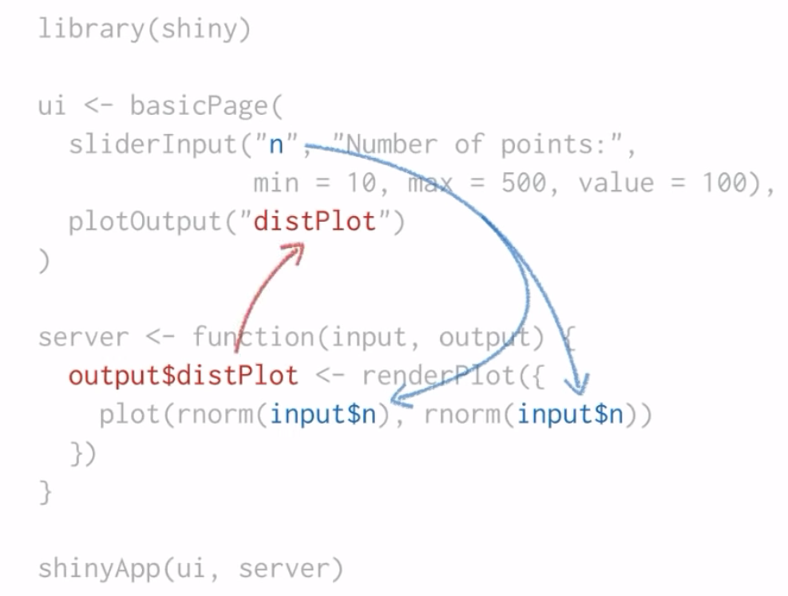
Structure
User inputs and outputs
These inputs and outputs are fed to/from the server

Slide 7
Layout and sidebars
Shiny uses the bootstrap grid for page layout, accessed with the fluidPage() function
Pages made up of 12 equal columns within rows
Sidebars and mainpanels are page layouts that have pre-determined column width
https://getbootstrap.com/

Slide 8
Shinydashboard
Same as before, but wrapped in header, sidebar and body layout
Has some extra widgets and functionality to make dashboards easily
Most of the code (inputs, outputs) will be in the dashboardBody
Can switch between different tabs within the dashboardSidebar

Slide 9
Now for a DAPCATS dashboard

