Slide 1


STREAMING SUBSCRIPTION MANAGEMENT CHALLENGE

Slide 2




OUR GOAL
As we know, college students tend to spend money on unnecessary things at times with a tight budget.
Our goal is to create a design that will detect Capital One consumers’ subscriptions and manage them once they have not been used for 3 months or more.

Slide 3
OUR PLAN FOR CONSUMER INFORMATION
To obtain information from the consumer:
Such as streaming services in which they are subscribed to, examples may include but are not limited to; Spotify, Apple Music, Disney+, HULU, Netflix, etc.
The cost of each subscription.
The start date of each subscription to better individually manage each subscription as time goes on.
We would also allow the consumer to set a personal budget, that is, how much money would they spend on subscription services per month.

Slide 4
OUR JOB TO MANAGE THE INFORMATION PROVIDED
To store the consumers’ information to create a personalized management system for their needs.
To calculate the input from the consumer and determine if their total amount goes above their budget. If it does, we will notify the consumer for crossing their budget. This will allow them to cancel any subscriptions that aren’t being used at that time.
To manage each subscription individually by the start dates. We will notify the consumer before each subscription date to monitor consumer activity.
We will notify the consumer when three months have passed. If the consumer has shown no sign of activity for certain services at all in those months, we will send an alert to cancel the subscription.

Slide 5
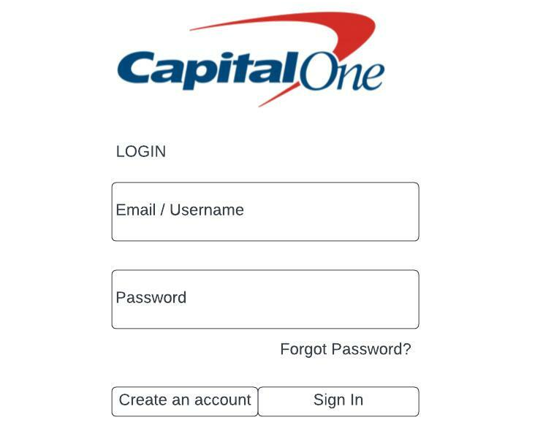
CONTINUATION
Start by creating a webpage that will:
1. Prompt the consumer to sign up or log in to an existing account with Capital One.

Slide 6
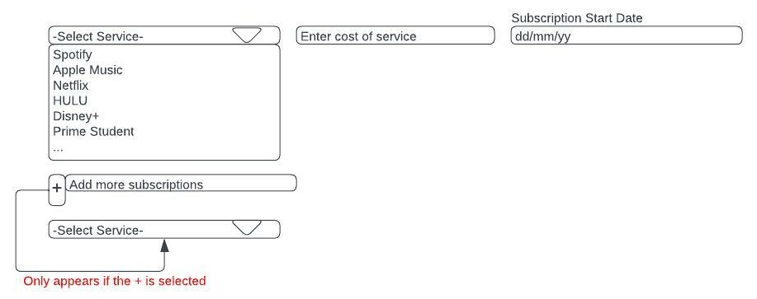
CONTINUATION
2. In the webpage design, create an interface that will prompt the consumer to enter their subscription information. This includes: the subscription service, the cost and the start date of the subscription.

Slide 7
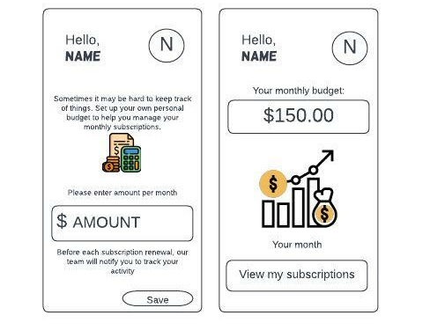
CONTINUATION
In continuation to the previous slide, we would also create a feature that will prompt the user to set up a personal budget for their subscription services per month.
We will store the consumer budget plan and they will be allowed to view their subscriptions.

Slide 8
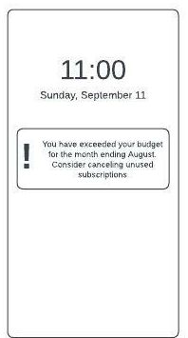
CONTINUATION
3. On our end of the streaming subscription services, using high-level technology and methods, we will be able to use the consumers’ information to calculate their total spent on subscription services per month.
If the consumer crosses their budget, they will be notified to cancel unused subscriptions.

Slide 9
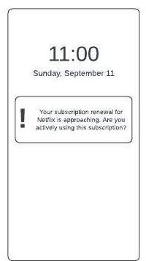
CONTINUATION
In addition to the previous slide, before each subscription date, the consumer will be notified that their renewal is approaching. This will prompt the user to accept or deny activity on their subscription. This will allow the company to monitor the consumers subscription activity.

Slide 10
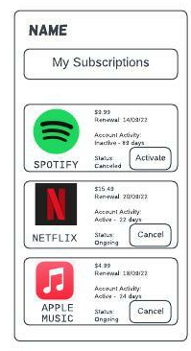
CONTINUATION
4. Lastly, when the subscription approaches the three-month period of inactivity from the consumers’ input, the company will automatically stop the inactive subscriptions.
For the consumer to reactivate or cancel any subscriptions, they need to go into the Capital One portal, and navigate to “View my subscriptions”. From their menu, they can choose to activate or cancel.

Slide 11


