Slide 1
Modeling Personality and Daily Spatial Behavior: A Longitudinal Study in Adolescent Twins
Yuan Zhou, Oct 20, 2021

Slide 2
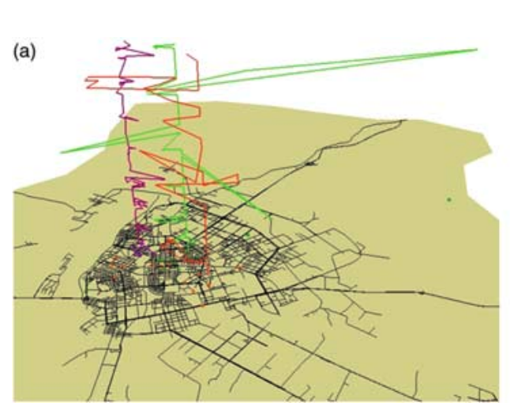
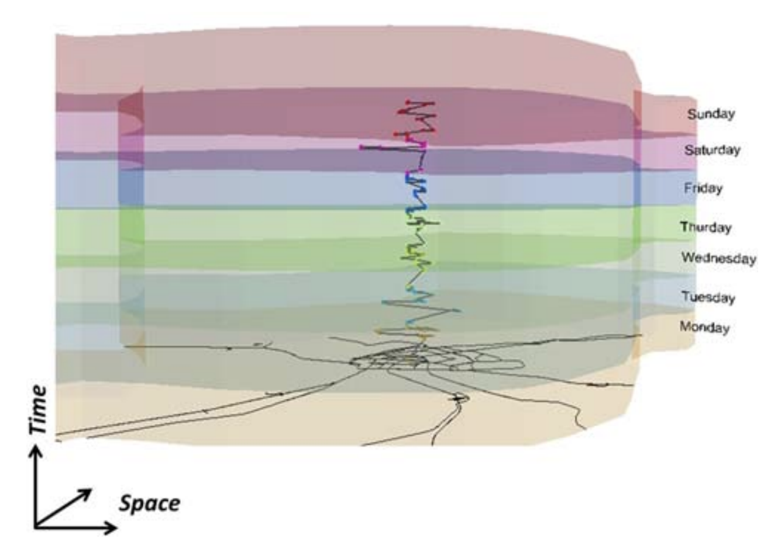
Spatial behavior and individual differences
Spatial Behavior and Individual Differences
Spatial behavior shows individual differences
Number of places visited
Distance traveled
Activity space
Entropy (or predictability)
Space: x-axis and y-axis are latitude and longitude
Gao, 2015

Slide 3
Daily Spatial Behavior and Personality are Related
Spatial Behavior and Personality are Related
Personality and Spatial Behavior Are Related
 | Places Visited | Distance Traveled | Activity Space (Range) | Entropy
Extraversion | + | + | + | +
Openness | + | +
Conscientiousness | -/+ |  |  | -
Agreeableness |  |  | +
Neuroticism | - |  |  | -
Ai, Liu, & Zhao, 2019; Alessandretti et al., 2018; Chorley, Whitaker, & Allen, 2015; de Montjoye et al., 2013; Mønsted, Mollgaard, & Mathiesen, 2018

Slide 4
Our Research Questions
How does spatial behavior develop in adolescence?
How are these behaviors related to personality?
What are the respective roles of genes and environment in spatial behavior?

Slide 5
Colorado Online Twin Study (CoTwins)
CoTwins: An Online Intensively Longitudinal Study of Adolescent Twins
Intensive longitudinal assessment
110 MZ and 225 DZ twin pairs (670 total participants, 400 addt’l twins being recruited now)
77.1% non-Hispanic white, 14.7% Hispanic, ~8% other
55% percent female
Intake assessment at age 14-17 and during which smartphone app is installed
The mean age at intake was 16.1 (SD=1.1)
Follow-up intensive longitudinal assessments for 2 years (now extended to 4 years)

Slide 6
Personality Data Description
Personality Descriptive Statistics
Big Five Inventory scale | Cronbach’s Alpha |  | Mean (SD)
 | CoTwins | Normative Sample | CoTwins | Normative Sample
Extraversion | 0.85 | 0.85 | 3.3 (.82) | 3.9 (.61)
Agreeableness | 0.75 | 0.82 | 4.0 (.56) | 3.6 (.61)
Conscientiousness | 0.75 | 0.84 | 3.7 (.62) | 3.3 (.67)
Neuroticism | 0.81 | 0.85 | 2.7 (.76) | 1.8 (.67)
Openness | 0.72 | 0.80 | 3.5 (.56) | 3.5 (.59)
John, & Srivastava, 1999; Lounsbury, Tatum, Gibson, Park, Sundstrom, Hamrick, & Wilburn.,2003

Slide 7
Location Data Collection and Description
Location Data Collection and Descriptive Statistics
21,016,920 location points collected via smartphone app
Extracted 604,261 Stay Point
Derived four daily spatial behaviors based on stay points
Number of places visited each day
Daily distance traveled
Daily activity space
Daily entropy

Slide 8
Daily Spatial Behavior is Highly Reliable
Daily Spatial Behavior is Highly Reliable
Daily Spatial Behavior is Highly Reliable
Daily Spatial Behaviors | Mean | Standard Deviation | Split-Half Reliability
Number of Places | 3.66 | 2.06 | 0.95
Distance Travelled (km) | 17.60 | 26.86 | 0.92
Activity Space (km) | 9.86 | 17.56 | 0.94
Entropy | 1.34 | 0.8 | 0.85

Slide 9
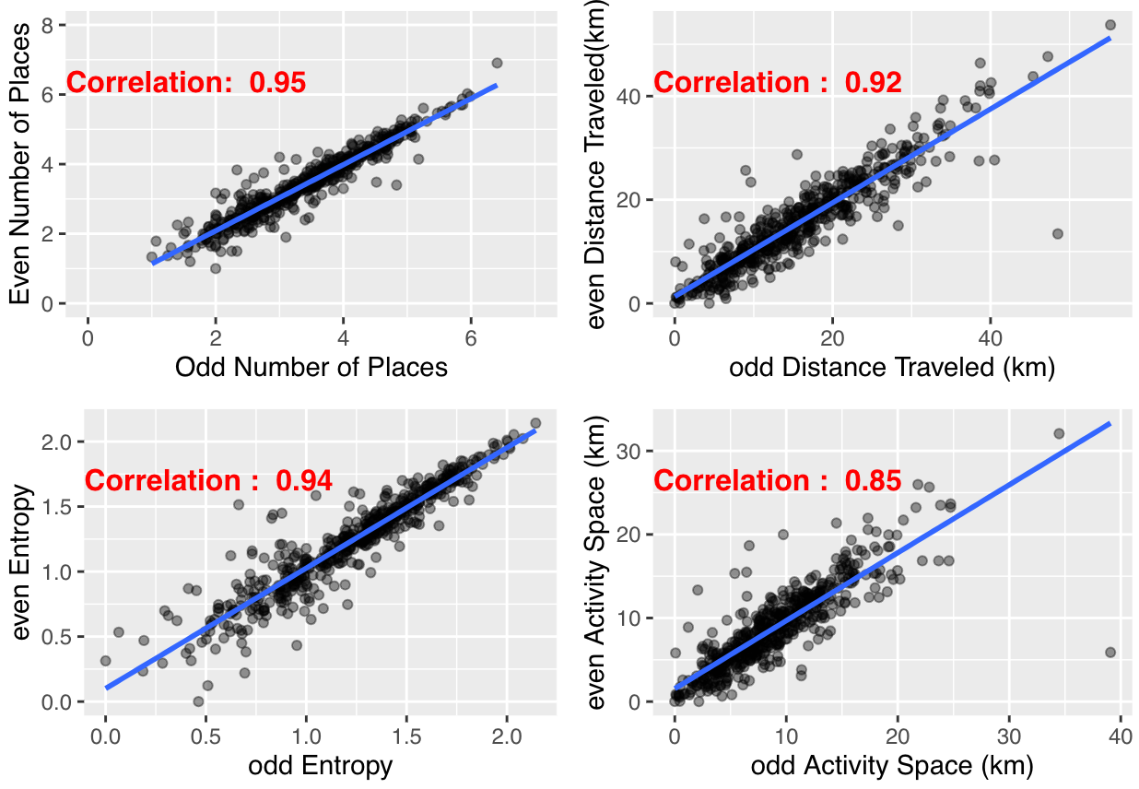
Daily Spatial Behavior is Highly Reliable
Daily Spatial Behavior is Highly Reliable

Slide 10
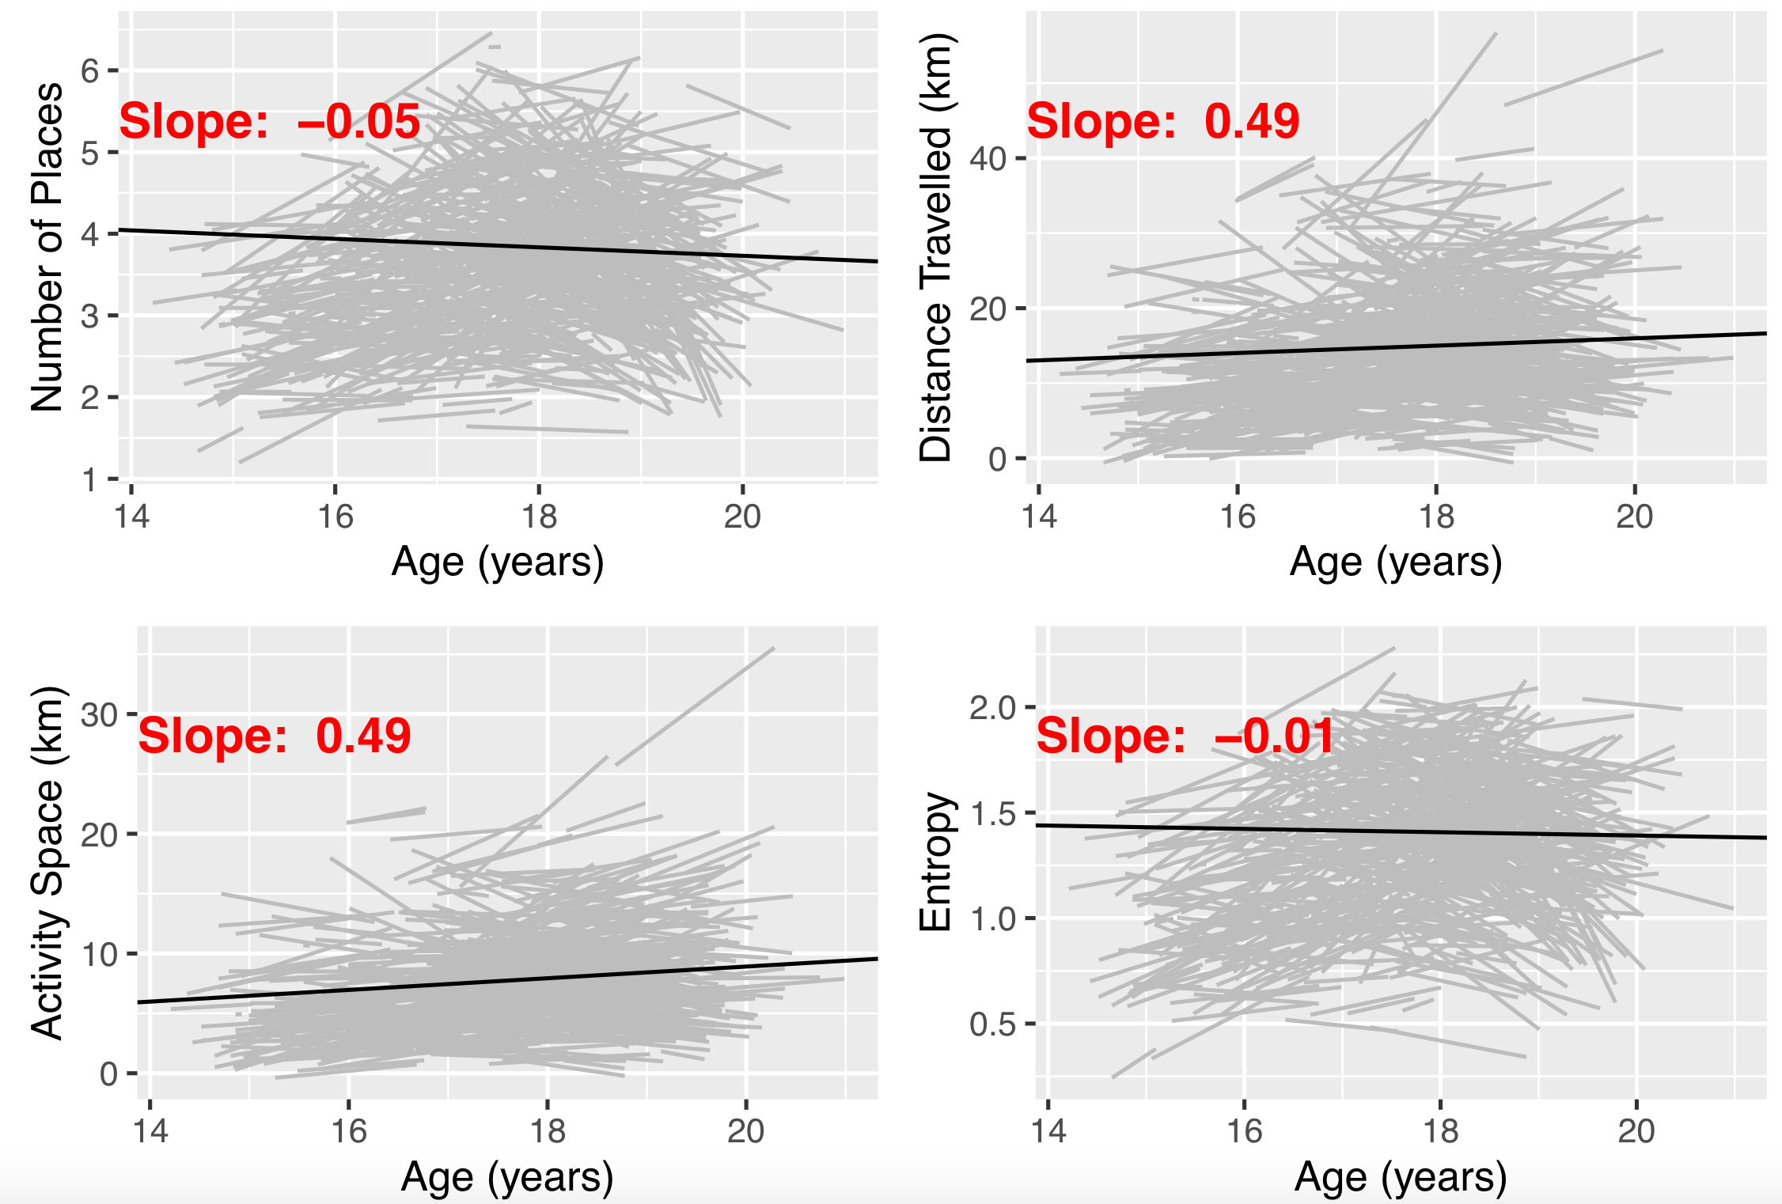
Daily Spatial Behavior is Stable over Time
Daily Spatial Behavior is Stable Over Time
*
p < 0.001 ‘***’, p < 0.001 ‘**’, p < 0.01 ‘*’

Slide 11
Personality and Spatial Behavior are Correlated
Personality and Spatial Behavior are Correlated
 | Number of Places | Distance Travelled | Activity Space | Entropy
Openness | -0.09* | -0.13** | -0.14** | -0.1*
Conscientiousness | 0.07 | 0.13** | 0.14** | 0.08
Extraversion | 0.1* | 0.07 | 0.09* | 0.1*
Agreeableness | ~0.00 | -0.02 | ~0.00 | 0.01
Neuroticism | -0.02 | -0.07 | -0.1* | -0.02
⁎⁎p < 0.01, ⁎p < 0.05

Slide 12
Daily Spatial Behavior is Influenced by Genes and Environment
Spatial Behavior is influenced by Genes and Shared Environment

Slide 13
Summary and Conclusion
Summary and Conclusion
Daily spatial behavior is stable over time
Personality correlates with daily spatial behavior
Heritability of daily spatial behaviors increases substantially between age 16 and 18

Slide 14
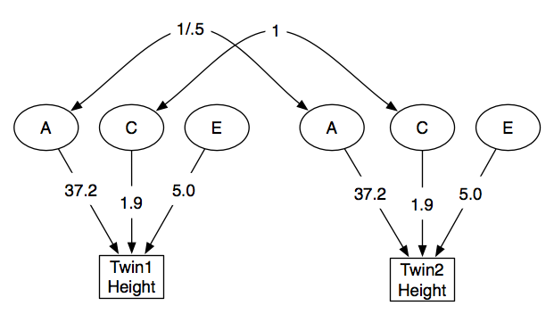
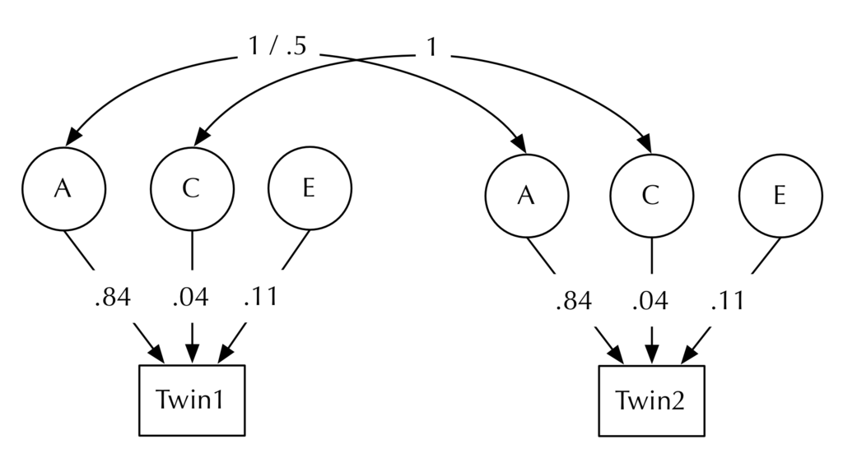
ACE Twin Model Explained
Personality and Spatial Behavior are Correlated
ACE model showing raw (non-standardised) variance coefficients
ACE model showing standardised variance coefficients
* Credit from Wikipedia (Twin Studies)

