Slide 1
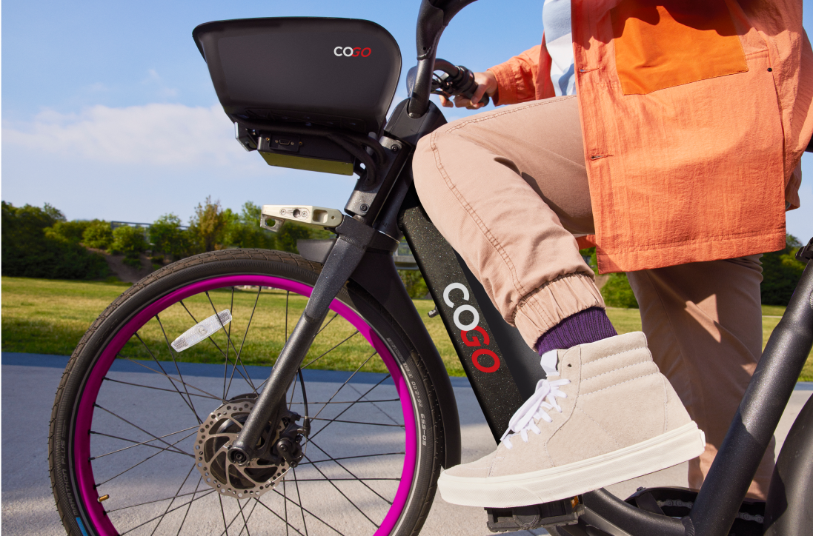
CoGo Bikeshare Data Analysis By
Data Py-oneers
Data-Driven Operations for efficiency and enhancing the Rider Experience
Adrian Tisbe (11845076),
Emma Allen (11935438),
Shilp Patel(11821563)
ADTA5340.400 - Fall 2025 8w1
Notes:
Shilp

Slide 2

Value Statement
Accurate predictions enable more efficient planning and resource allocation. While improving the customer experience.
WWWhy
Notes:
Shilp

Slide 3
Problems of Interest
The city of Columbus, OH is interested in identifying contributing factors and predicting usage factors for their bikeshare program, CoGo.
How is the number of rides taken in a day impacted by relevant factors (weather, day of the week, region of the city) and can we predict an expected number of rides taken for a given day?
  Value: Helps business to monitor feature impact and plan for potential usage surges to optimize usage or potential pricing strategy opportunity.
2. How is trip duration impacted by relevant factors (region of the city the trip originates from, day of the week, if the rider is a member) and can we predict expected trip duration?
  Value: Allows business to get ahead of maintenance impacts or requirements that would be masked by simple summary statistics.
3. Can we identify impact of features (region, weather, ride duration, bike type) on rides taken by members vs leisure riders.
  Value: Allows business to market memberships in most valuable areas (areas/ride characteristics of non-members).
Notes:
Emma’s slide, Columbus by population is slightly smaller than Austin
Q1. Balance bike distribution by region, by season
Q2. Factors for long duration? Air up those tires
Q3. helps stabilize long term demand, it is a competitive market

Slide 4
Available Data
Reference | Bike Trips | Weather
Source | CoGo | NOAA
Granularity | Each ride | Daily
Time Frame | 2022-2024, inclusive | 2018-2025
String/Character Columns | ride_id (unique) rideable_type (type of bike) start_station_name end_station_name | STATION
Numeric/Float Columns | start_station_id, end_station_id start_lat, start_lng end_lat, end_lng | TAVG, TMIN, TMAX (all F) PRCP (inches) SNOW (inches)
Date Time | started_at, ended_at | DATE
Notes:
Quick, Adrian

Slide 5
Methodology
Data Preparation
Predictive Modeling
Validation
We cleaned the data and merged in weather data, and then engineered new features for employment in models.
We built and tested several machine learning models to find to the strongest and most accurate predictors for our research questions.
We trained our models on 2022 - 2023 data and tested their performance on 2024 data to ensure reliable predictions and generalization of results.
Notes:
Quick, Adrian
What are the required assumptions for modeling

Slide 6
Data Wrangling / Exploratory Data Analysis (EDA)
Cleaning:
Limited start and stop coordinates to be within the bounds of Columbus, OH (39.5 to 40.2 latitude, -84.0 to -82.5 longitude)
Remove rows with totally missing start or end coordinates
Removed ride durations that lasted more than 24 hours
Dropped ride instances with a less than 0 minute ride duration
Drop outliers
No significant multicollinearity detected
Bike Dataset: 182,198 instances, each representing an individual trip from 2022 - 2024
Structuring:
Standardized dates and timestamps
Standardized stations names and station IDs
Cleaning:
Identified missing data: removed instances with missing data for starting and end station
Notes:
Shilp

Slide 7
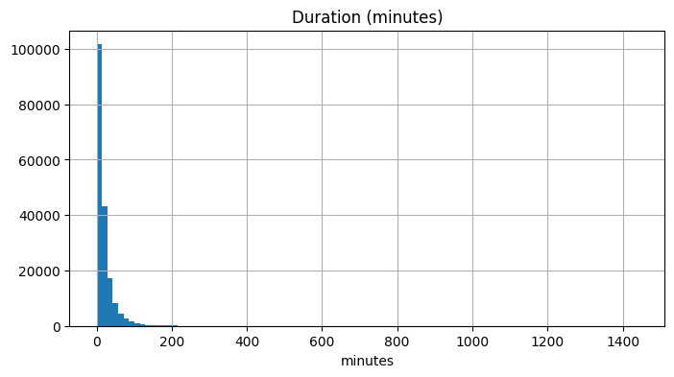
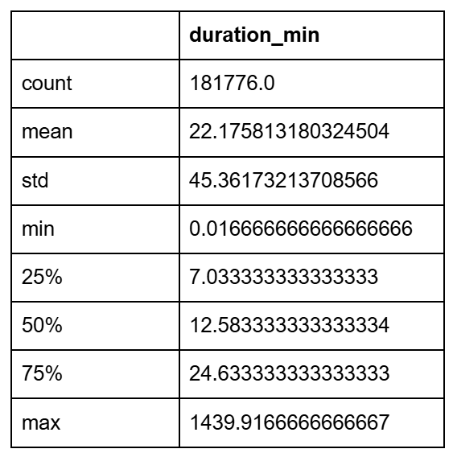
Data Wrangling (cont.)
Enriching
Created new measures
Ride duration (calculated from ride start time and end time)
  Average ride duration is 22.18 min
Ride duration is heavily skewed to the right
Notes:
After the structuring and cleaning, we created new features from the raw data. We first calculated the ride duration using the start and end times for each trip. We found that the average ride duration is about 22 minutes. The histogram is strongly right skewed indicating that there are high values for ride duration pulling the average up

Slide 8
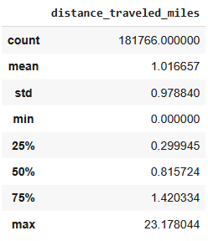
Data Wrangling (cont.)
Enriching
Created new measures
Distance - calculated from start and end latitude and longitude
  On average the distance between start and end of the ride is 1 mile directly
  Actual distance traveled may be more for routing or circles
  Distance for round trips will be 0 miles (Start location = end location)
Notes:
The next measure we created from the raw data is the trip distance. We calculated this new feature using the start and end latitude and longitude. We found that on average the distance between the start and end of the ride is about 1 mile. The actual distance traveled may be more for different routes or trips taken in circles. Distance for round trips would also be calculated as 0 miles, since the start and end location will be the same

Slide 9
Data Wrangling (cont.)
Enriching
Create feature for season
  Winter, spring, summer, fall
  This is useful due to temperature fluctuations in Ohio
Day of the week: Extract day of the week from the datetime stamp for each ride along with a boolean column for weekend or not
Define regions of Columbus
  North, East, South, West by relation to the average (center latitude and longitude)
Adding temperature and precipitation data for Columbus:
Join weather data sources from National Oceanic and Atmospheric Administration (NOAA) for Columbus, OH for the same timeframe, 2022 -2024
Min, max, and average temperature of each day to match ride date
Precipitation and snow in inches
Notes:
Using the date and time features from the raw data we extracted features for the season, and day of the week to see if there are any patterns related to these features. We also defined regions of Columbus into north, south, east and west relative to the center latitude and longitude for the coordinates of Columbus, OH.
And finally we sourced a data set from the National Oceanic and Atmospheric Administration that captured min, max, and average temperature, and precipitation and snow fall in inches and join this to our bike share data set based on the date of the trip instance

Slide 10
Approach
Q1. Predict Rides per Day
Q2. Predict Trip Duration
Q3. Predict Rider membership
Regression model
Multiple linear regression, KNN regressor, decision tree/ensemble (Random forest)
A variety of factors have an expected relationship with the number of trips taken in one day.
We test multiple models that are flexible to many inputs and potential non-linear relationships.
We keep in mind the desire for stakeholder interpretability when selecting the best model
Regression model
Similar to trip demand prediction, multiple linear regression, KNN regressor, decision trees/tree ensemble (random forest).
Trip duration is expected to be impacted by bicycle type and trip distance between start and end stations.
Trees and regression are more interpretable, but KNN non-parametric approach may be more powerful.
Classification model
Models tested are logistic regression, KNN classifier, and decision trees/ tree ensemble (random forest)
Selected features are similar to regression models, including day of the week, precipitation, snow, avg. temperature, trip duration, region of Columbus, and type of bicycle.
There is less risk in classifying a member as a non-member (false negative) than the inverse.
Notes:
Quick, Emma

Slide 11
Assumptions
Date Grouping
Data Collection Errors
Consistent Operations
Trip_start drives ride dates
Rides with duration < 0 minutes are excluded as data errors
Rides with duration > 1,440 minutes (24 hours) are excluded as data errors
No major changes to CoGo operations over this time period
Including but not limited to pricing structure, bike availability, etc. that would have impacted demand
Notes:
Quick, Emma
Model approach assumptions available upon request, they are in the technical documentation

Slide 12
Predictive Modeling
Validation Design
Temporal: Train models on 2022 - 2023, test on 2024
Q1. Predictive Modeling of Bike Demand
Research question: At a given day of the week, location, and weather condition, how many bikes will be needed in a specific region?
Purpose: Helps the company rebalance bikes so regions can meet demand, stations do not run empty or are overcrowded.
Business Value: Predicting the demand for bikes helps CoGo make sure bike fleet is distributed to meet demand, therefore maximizing usage and revenue.
Trained different model types using features:
  day of the week
  precipitation and snow
  region of Columbus
  season
  average temperature
  CoGo membership status
Target variable: ride count
Models tested: multiple linear regression, KNN regression, and decision trees (random forest)

Slide 13
Predictive Modeling
Q1. Predictive Modeling of Bike Demand
Model | RMSE | MAPE | R² | Average Residual
Multivariate Regression, all features | 32.08 | 161% | 0.285 | -2.32
Multivariate Regression, PCA features | 31.49 | 141% | 0.311 | -1.2
KNN, all features | 32.39 | 113% | 0.278 | 3.45
KNN, PCA features | Underperforms KNN all features significantly*
Decision tree | 26.29 | 63% | 0.52 | -0.76
Random forest | 20.48 | 53% | 0.71 | -1.58
Result: With the exception of average residual being slightly better in decision tree model and multivariate-PCA, the random forest had the best model performance statistics. It is the strongest of the fitted models for predicting number of rides taken per day.

Slide 14
Predictive Modeling
Validation Design
Temporal: Train models on 2022 - 2023, test on 2024
Q2. Predictive Modeling of Trip Duration
Research question: Based on the start region, day of the week, and rider type (member/casual), how long will the trip likely last?
Purpose: Helps understand ride habits and predict maintenance requirements and customer experience.
Business Value: This helps CoGo proactively account for possible restock needed at a given station, and potentially maintenance demands since long rides likely put more strain on bike allocation.
Trained different model types using features:
  day of the week
  precipitation and snow
  region of Columbus
  season
  average temperature
  CoGo membership status
  Bike type (classic
Target: trip duration
Models tested: multiple linear regression, KNN regression, and decision trees (random forest)
Notes:
Emma
ML Requirement: Using ML to model the expected ride duration allows the company to get ahead of maintenance impacts, which would be effectively masked/ignored by simple summary statistics.
ML has a large amount of power to capture nonlinear relationships/interactions using a large variety of inputs/features.

Slide 15
Predictive Modeling
Q2. Predictive Modeling of Trip Duration
Model | RMSE | MAPE
Multiple Regression | 13.07 | 253%
KNN | 11.93 | 283%
Decision tree | 15.43 | 268%
Random forest | 12.20 | 254%
Result: None of the models are they currently exist are recommended for use/deployment. While some performed better than others, the MAPE on the withheld 2024 test set is all 200%+ error, which may be worse than a simple average fit.
Notes:
Emma

Slide 16
Classification Modeling
Validation Design
Temporal: Train models on 2022 - 2023, test on 2024
Q3. Rider Behavior Segmentation
Research question: Can we group riders into categories (e.g. daily commuters, leisure riders) based on when, where, and how they ride?
Purpose: Helps the company design better promotions and marketing (e.g., convert casual riders into members).
Business Value: This helps CoGo market to leisure riders to be interested in a membership, stabilizing long term demand and competitive edge.
Trained different model types using features:
  day of the week
  precipitation and snow
  region of Columbus
  season
  average temperature
  CoGo membership status
  distance traveled
  type of bicycle (classic, electric)
Target: membership status
Models tested: logistic regression, KNN classification, and decision trees (random forest)
Notes:
-> ML Requirement: In an effort for the company to target/personalize the bike ride experience, being able to model behavior/environmental impacts on the probability that a ride was taken by a member allows the company to understand behavior differences and potential areas to recruit new members
This will help CoGo market to leisure riders who behavior indicates they might be interested in a membership, stabilizing long term demand and competitive edge in transportation in Columbus.
So we trained different models using the features similar to our last research questions, and here our target variable is the membership status. The models we tested are logistic regression, KNN classifier, and decision tree random forest
While the groups could be summarize, this would come at the sacrifice of being able to identify other areas to market/profit. Especially when transpotation (bikes, scooters, etc.) in downtown Columbus is a competitive market. More members means more market share, which means stable and long lasting demand compared to more leisure riders only. Additionally identify potential advertisement areas to convert non-members to members.

Slide 17
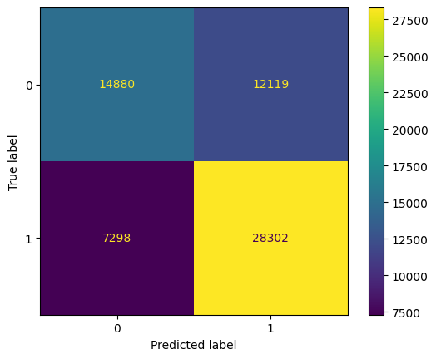
Classification Modeling
Q3. Rider Behavior Segmentation
Logistic Regression Confusion Matrix
Model | Accuracy | Precision | Recall
Logistic Regression | 0.69 | 0.70 | 0.80
KNN | 0.65 | 0.70 | 0.68
Random forest | 0.62 | 0.68 | 0.62
Result: Of the 3 classification models fitted to predict if a ride was taken by a member at default threshold, the Logistic Regression model performed the best on the withheld 2024 test dataset.
Notes:
Adrian: We used 3 metrics to capture the behavior of our fitted models
Accuracy = correct classifications
Precision = how accurate the positive classifications are
Recall = how accurate the true values are classified
This is at a default threshold of 50%

Slide 18
Future Opportunities
Q1. Rides Per Day
Q2. Trip Duration
Q3. Rider Membership
Currently Delivered:
Increased efficiency by defining expected usage for a given day, and enhance customer experience and satisfaction.
Improvement Opportunity:
1.) Potentially value in segmenting model by season to better capture variability.
2.) Incorporate events calendar (concerts, sporting events, etc.) to help predict demand surges.
Currently Delivered:
Preliminary analysis of factors, no current sound model.
Improvement Opportunity:
1.) Collect additional data including bike ids, member data, other available features
2.) Leverage bike IDs to analyze bike usage patterns to predict when a specific bike will need maintenance or charging, reducing downtime.
Currently Delivered:
Defined marketing opportunities by isolating characteristics of non-member riders.
Improvement Opportunity:
1.) Opportunity to alter threshold (model certainty of membership) to lower non-members classified as members and lost potential.
2.) Incorporate events calendar (concerts, sporting events, etc.).
Notes:
Emma, additionally case studies are an area of opportunity to further improve.

Slide 19
Investing in a smarter ride
By leveraging predictive analytics for data-driven operations, CoGo can become a more efficient, profitable, competitive, and user-friendly service.
We are requesting additional data to refine the presented analysis. Proposed end deliverable is a dashboard to track model progression/changes for easy employment for CoGo’s operations and marketing teams.
Notes:
Adrian

Slide 20
Any Questions?
Notes:
Shilp

