Slide 1
ASD formulations
Tg and Tm calculations

Slide 2
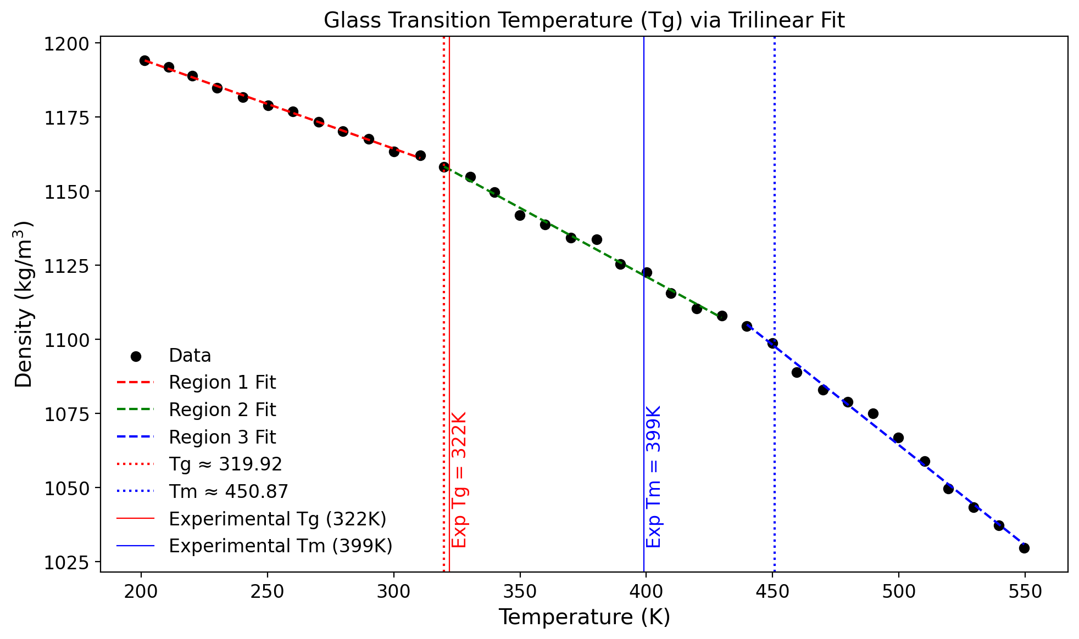
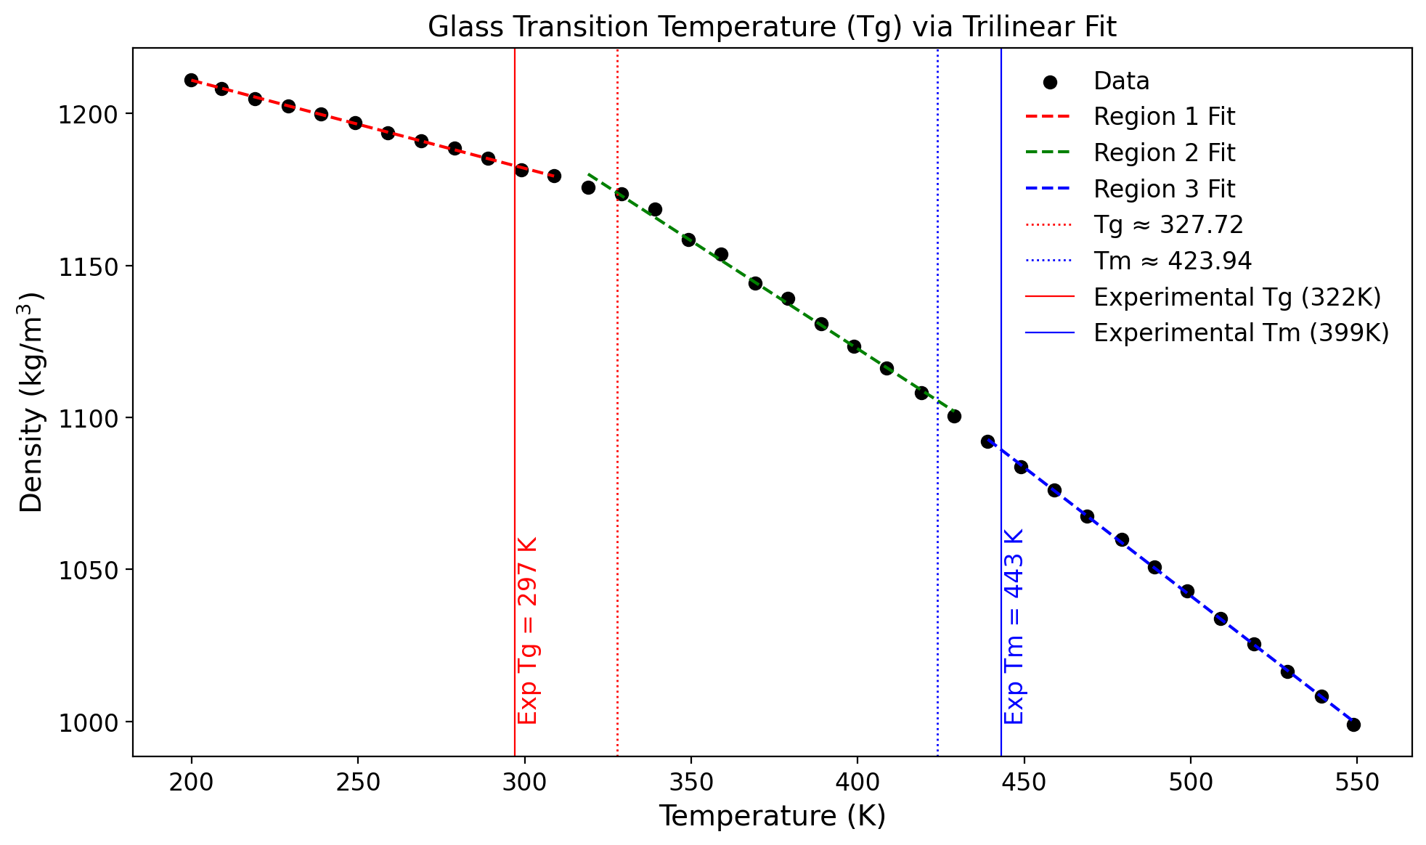
Tg and Tm calculations
$ Total number of atoms in system ~10,000
* Estimated using single MD simulation data
System$ (# of molecules) | Tg (experimental) | Tg (estimated)* | Tm (experimental) | Tm (estimated)*
Ritonavir (102) | 322 | 319 | 399 | 450
Acetaminophen (500) | 297 | 327 | 443 | 423
Ritonavir
Acetaminophen

Slide 3
Key takeaways
1. Thermostat, Barostat, and integrator
-Traditional velocity-rescale thermostat was showing higher fluctuations in the temperature.
-MTTK barostat is maintain pressure well compared to traditional Berendsen barostat
-Velocity-verlet integrator was providing better ensemble compared to leap-frog
2. System size
-A larger system size of 10,000-12,000 atoms provides better ensembles as compared to smaller system size of ~5,000 atoms
3. Data Fitting
-We performed bilinear fitting on density vs. temperature data instead of specific volume vs temperature data (Ref1)

