Slide 1

Project Title - Seasonal Agriculture Performance Analysis
Student Name- Shilpa Dewaram Sirvi
College Name- Smt. Chandibai Himathmal Mansukhani College
AICTE STU ID : STU6a675e61021261785159265

Slide 2

PROBLEM STATEMENT
Agricultural activities are influenced by seasonal variations in environmental conditions, farming practices, resource availability and market conditions. As a result, agricultural performance may differ from one season to another. However, raw agricultural data does not clearly explain how agricultural performance changes across seasons or what patterns can be observed in different seasonal conditions. The problem is to analyze the given agricultural dataset and investigate seasonal differences in agricultural performance by identifying meaningful patterns, trends, relationships and variations within the available data.

Slide 3
Project Description Seasonal Agriculture Performance Analysis is a Python-based data analysis project that focuses on understanding agricultural performance under different seasonal conditions. The project analyzes factors such as rainfall, temperature, soil conditions, irrigation, water usage, crop yield, production, cost, revenue, and profit. The data is cleaned, analyzed, and visualized using Python to identify important patterns, performance differences, resource usage, and relationships between environmental factors and agricultural outcomes. The project also provides meaningful insights and data-driven recommendations that can support better agricultural planning and efficient use of resources.

Slide 4

WHO ARE THE END USERS?
Farmers – to understand crop performance and make better farming decisions.
Agricultural planners – to plan seasonal agricultural activities and resources.
Agricultural departments – to study agricultural patterns and performance.
Researchers and students – to analyze agricultural data and identify useful trends.
Agribusiness organizations – to support decisions related to crop production, resources, and profitability.

Slide 5

Technology Used
Python – Main programming language for data analysis.
Pandas – Data cleaning, manipulation, and analysis.
Matplotlib – Creating graphs and visualizations.
Seaborn – Creating statistical charts and visualizations.
SciPy – Statistical analysis such as ANOVA.
Jupyter Notebook – Platform used to write and execute the analysis.

Slide 6
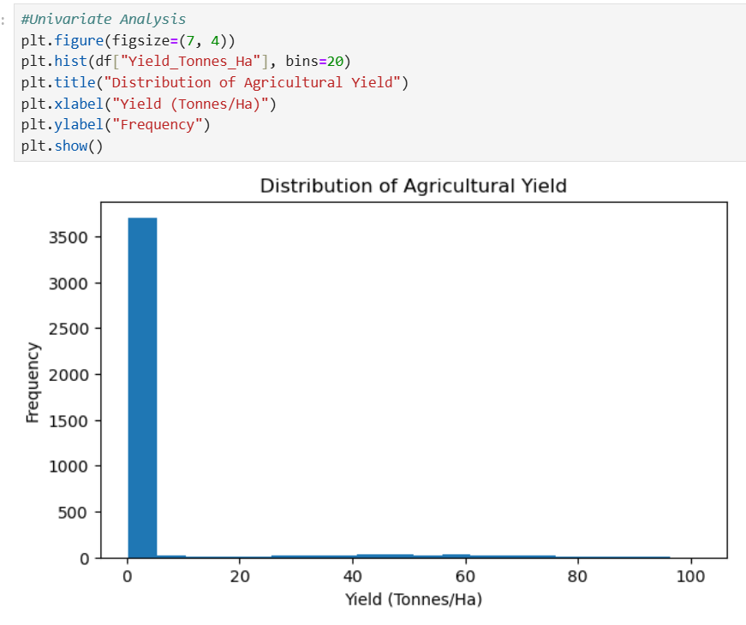
RESULTS
In this analysis, I examined the univariate distribution of agricultural yield across the dataset. The histogram shows a strongly right-skewed distribution, where the vast majority of farms produce yields concentrated between 0 and 5 Tonnes/Ha. A small fraction of records reach higher values up to 100 Tonnes/Ha, representing high-yielding crops or potential outliers.

Slide 7
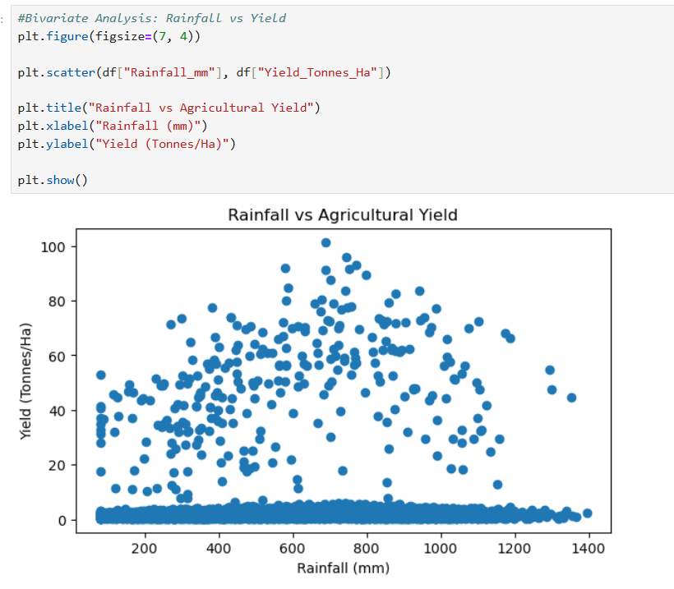
RESULTS
In this analysis, I examined the relationship between rainfall and agricultural yield using a scatter plot. The plot shows that most crops maintain a low yield regardless of the rainfall amount, while higher yields are spread across moderate to high rainfall ranges (around 400 to 1000 mm). This comparison helps us understand how yield varies with water availability; however, this analysis highlights general patterns and differences, and it does not prove that rainfall directly causes higher performance.
[Add screen shots of your code ]

Slide 8
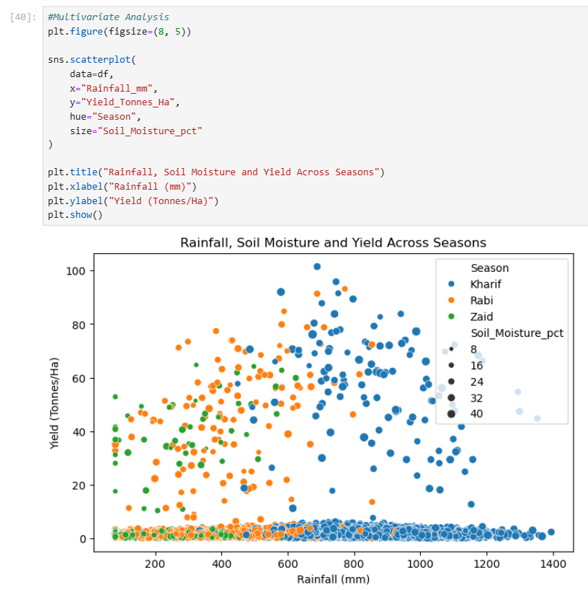
RESULTS
In this analysis, I evaluated the relationship between rainfall, soil moisture, and yield across different seasons using a scatter plot. The plot shows that higher yields are spread across distinct rainfall ranges depending on the season, with Kharif crops occupying the higher rainfall zones. This comparison helps us understand how environmental factors interact during different growing periods; however, it shows general trends rather than proving direct causation.

Slide 9
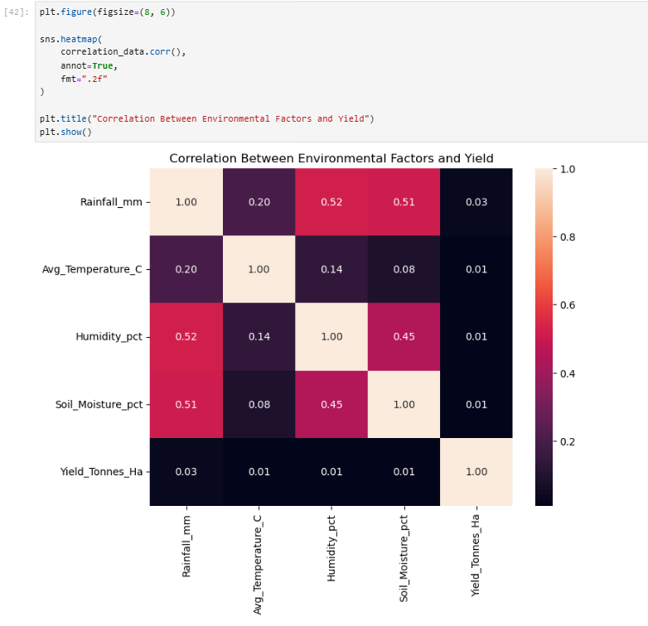
RESULTS
[Add screen shots of your code ]
In this analysis, I evaluated the linear correlation between environmental factors and crop yield using a correlation heatmap. The heatmap shows moderate positive relationships among environmental variables like rainfall, humidity, and soil moisture (values up to 0.52), but very weak linear correlations with crop yield (around 0.01 to 0.03). This comparison helps us understand how environmental features interact with each other; however, it shows linear relationships rather than proving direct causation or capturing non-linear effects.

Slide 10
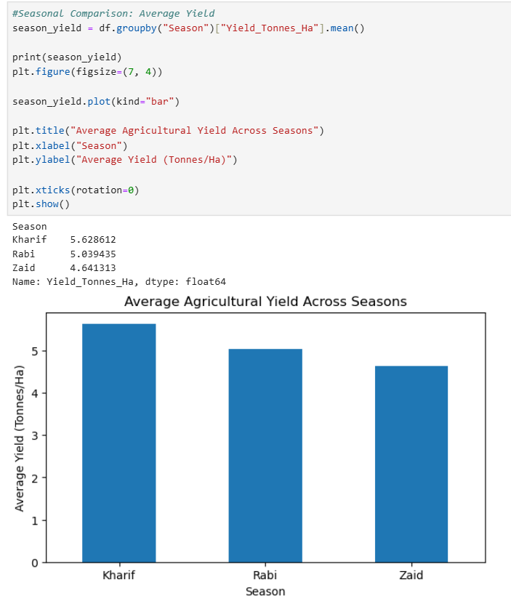
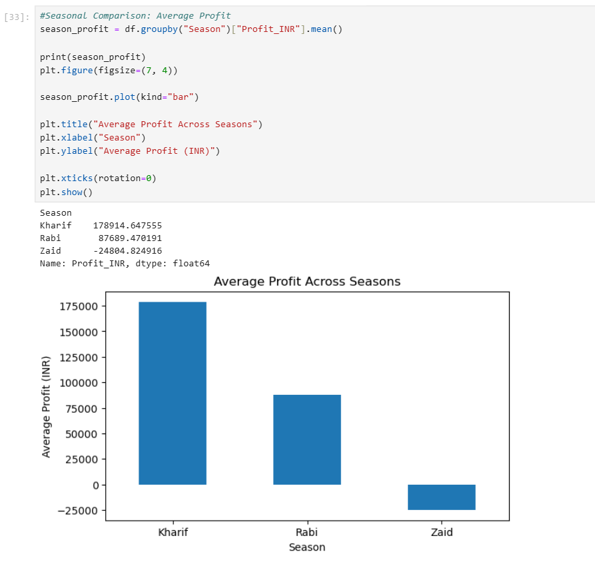
RESULTS
In this analysis, I compared the average yield and average profit across seasons (Kharif, Rabi, and Zaid) using bar charts. The plots show that Kharif leads in both yield and profitability, while Zaid records the lowest yield and negative profit performance. This comparison helps us evaluate seasonal profitability trends; however, it shows general differences across seasons rather than proving direct causation.
[Add screen shots of your code ]

Slide 11
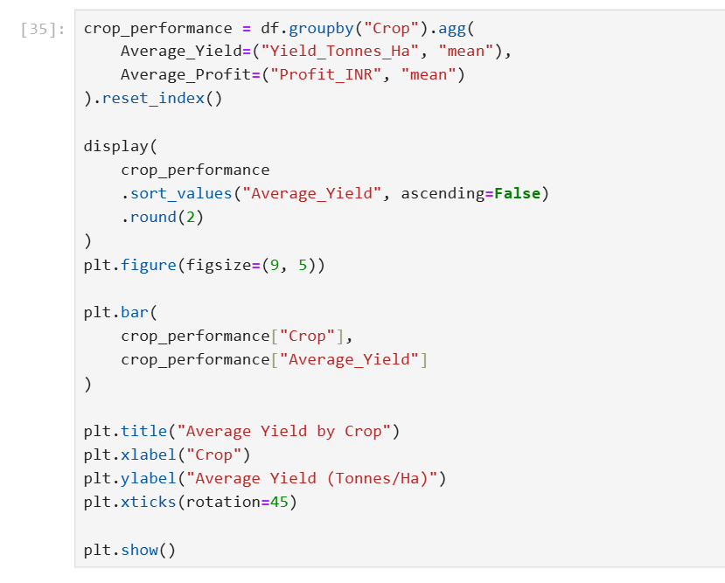
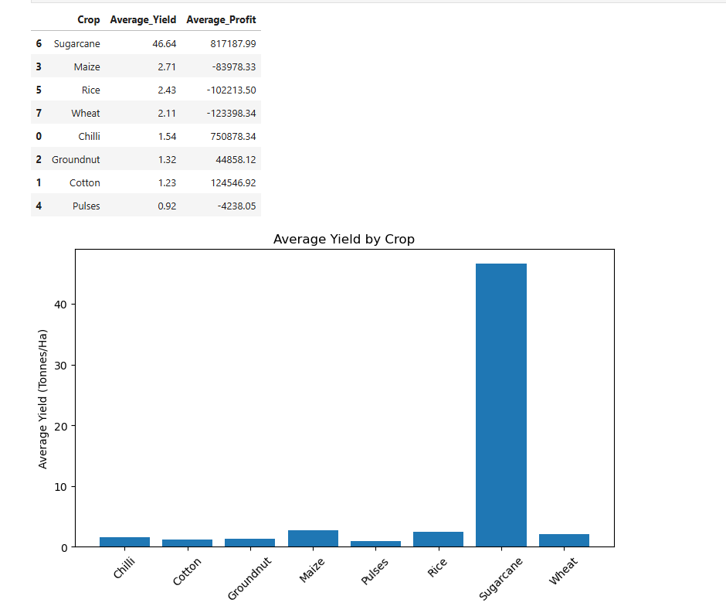
RESULTS
In this student-designed analysis, I evaluated crop performance by comparing average yield and average profit across different crops using a summary table and a bar chart. The analysis shows that Sugarcane achieves a significantly higher average yield (~46.64 Tonnes/Ha) and higher average profit compared to all other crops, which remain under 3 Tonnes/Ha. This comparison helps us identify top-performing crops across performance metrics; however, it shows observed differences rather than proving direct causation.
[Add screen shots of your code ]

Slide 12
Future scope Machine Learning Integration: Crop yield, production, and profit can be predicted using machine learning models. Real-Time Data: Real-time weather and environmental data can be added for more accurate analysis. Interactive Dashboard: A user-friendly dashboard can be developed to display agricultural trends and insights. Larger Dataset: More crops, regions, and data from multiple years can be included for better analysis. Better Recommendations: The system can provide recommendations for crop selection, water usage, and resource management. Advanced Analysis: More statistical and analytical techniques can be added to identify deeper agricultural patterns.

Slide 13
GitHub Link
https://github.com/shilpa01-hub/seasonal_agriculture_performance_analysis.git

Slide 14
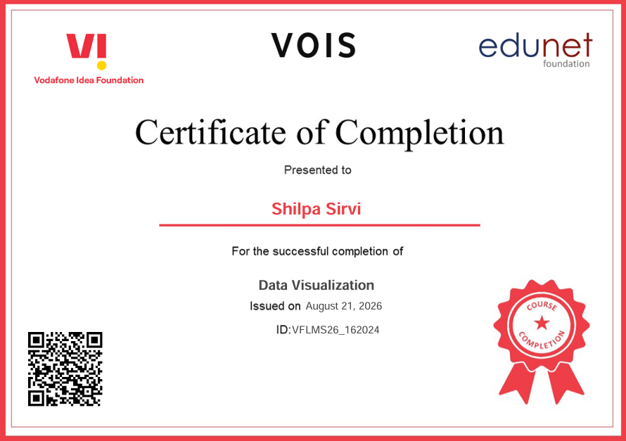
VOIS Course completion certificate - Course name- Data Visualization

Slide 15
Thank you
.
.

