Slide 1
AI-Based Fashion Design System
- Integrating Deep Learning in Fashion Innovation -
Presented by,
Shilpa B
Roll no:44
Project Guide:Dr.Shidha MV
Project Scrum:Ms.Sona Mary Louis

Slide 2
INTRODUCTION
AI is transforming the fashion industry by automating design processes.
Current fashion design is manual, time-consuming, and intuition-based.
Designers face challenges with fast-changing trends and short product lifecycles.
Deep learning enables automated, creative, and trend-driven designs.

Slide 3
PROBLEM STATEMENT
Traditional fashion design relies on manual effort and human intuition.
Time-consuming processes struggle to meet rapid market demands.
Short product lifecycles require constant trend adaptation.
Lack of AI tools that integrate creativity with trend analysis.
Designers need support for data-driven and brand-specific designs.

Slide 4
PROPOSED SOLUTIONS
Develop an AI-based system for automated fashion design.
Use pre-trained stable diffusion model to generate high-quality and creative garment designs.
Integrate data-driven insights for trend analysis and brand-specific outputs.
Utilize deep learning to automate repetitive tasks and support creativity.
Implementing a virtual try-on feature.

Slide 5
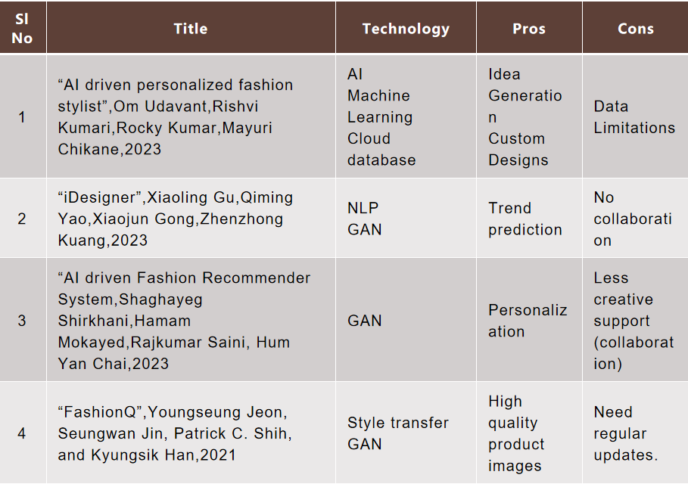
Related Works

Slide 6
Gaps identified
Lack of a virtual try on feature
Limited collaboration with creators
Limited dataset

Slide 7
WORKFLOW: 1.Data Input: Fashion images + text descriptions. 2.Preprocessing: Image and text analysis. 3.Model Training 4.Design Generation: Generate fashion designs based on user inputs. 5.User Interface: Customize designs through the desktop interface(gradio). 6.Virtual try on Implementation(VITON) 7.Final Output: Deliver final designs. .

Slide 8
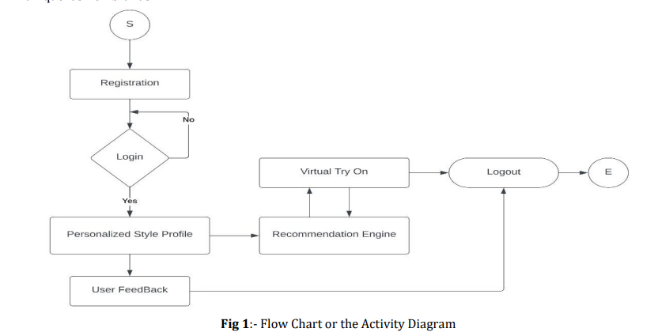

Slide 9
Tools and Technologies
Algorithms:
DIFFUSION
VITON
Front-end:gradio

Slide 10
1. Data Collection and Preprocessing Module
Collect fashion images, text descriptions, and trend-related data.
Text analysis for extracting meaningful descriptions.
2. Design Generation and Customization Module
Allow users to input preferences (e.g., fabric type, color, pattern).
Generate initial designs using the trained diffusion model.
Provide customization options through an interactive desktop interface (drag-and-drop elements, color picker, etc.).

Slide 11
3. Virtual Try-On Module
Integrate realistic try-on experience.
Allow users to upload body measurements to personalize the try-on.
Showcase garments in various poses and lighting conditions.

Slide 12
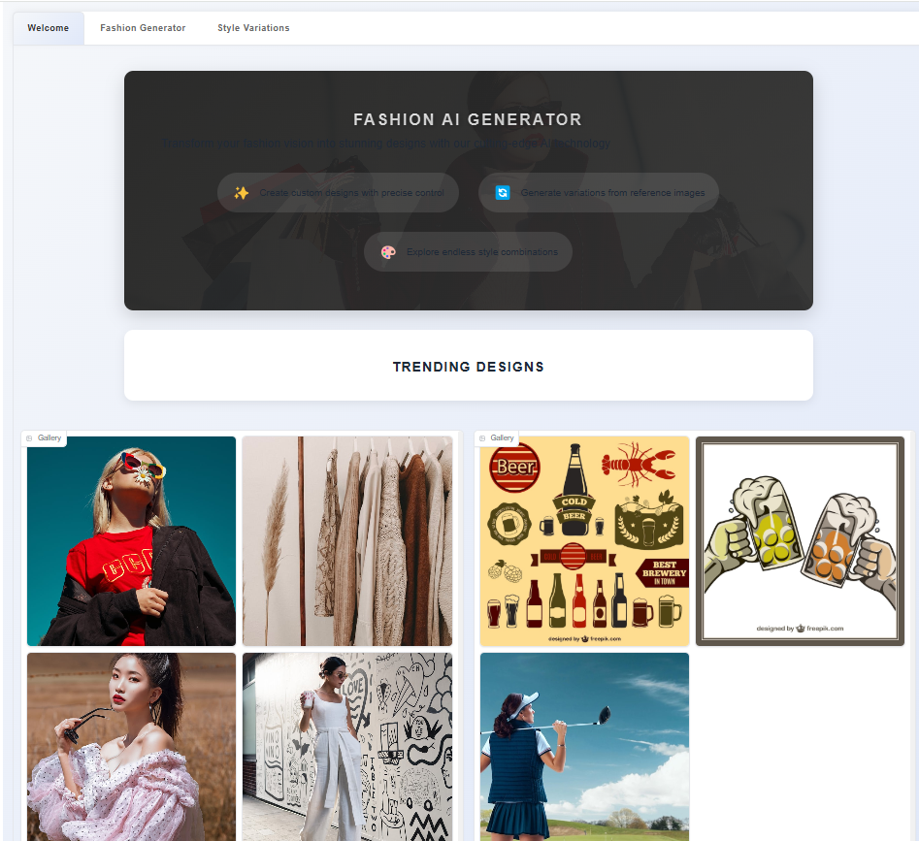
Screenshots

Slide 13
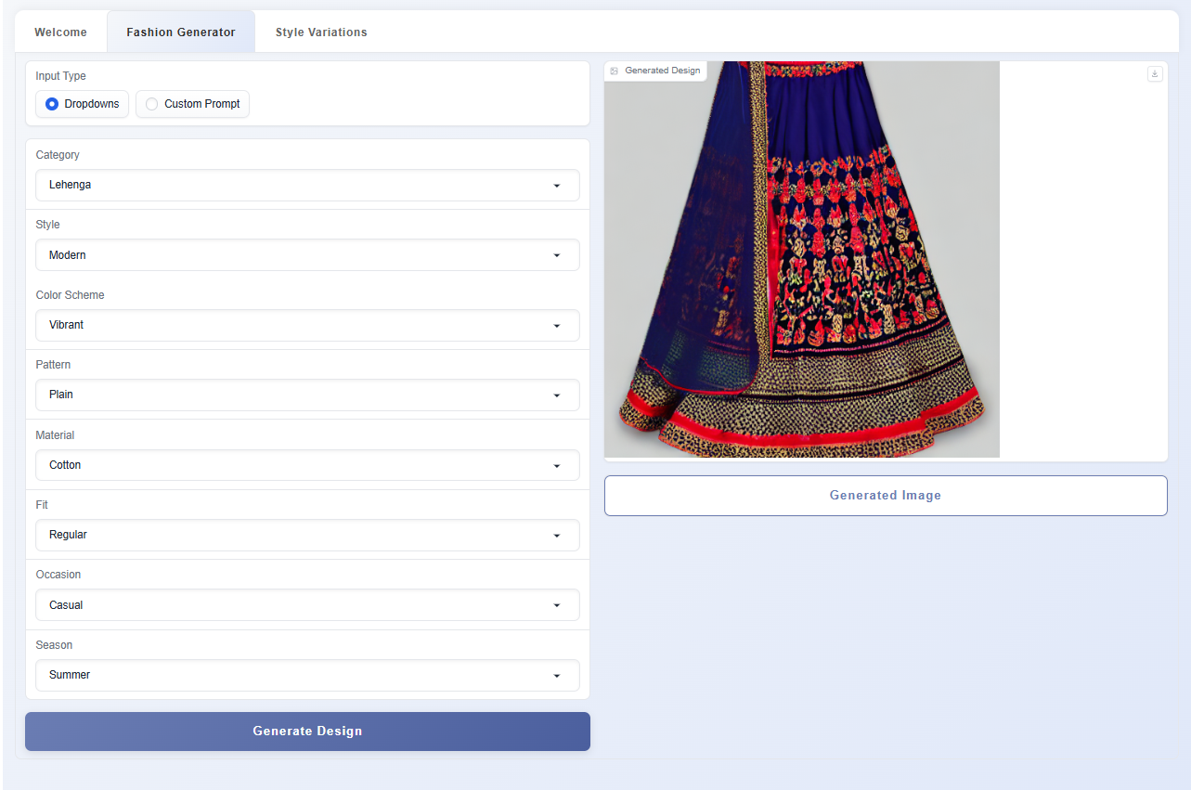

Slide 14
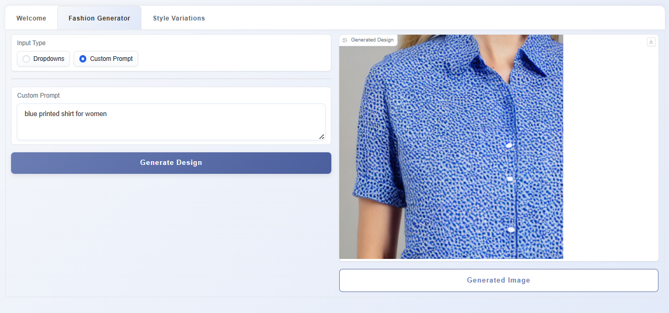

Slide 15
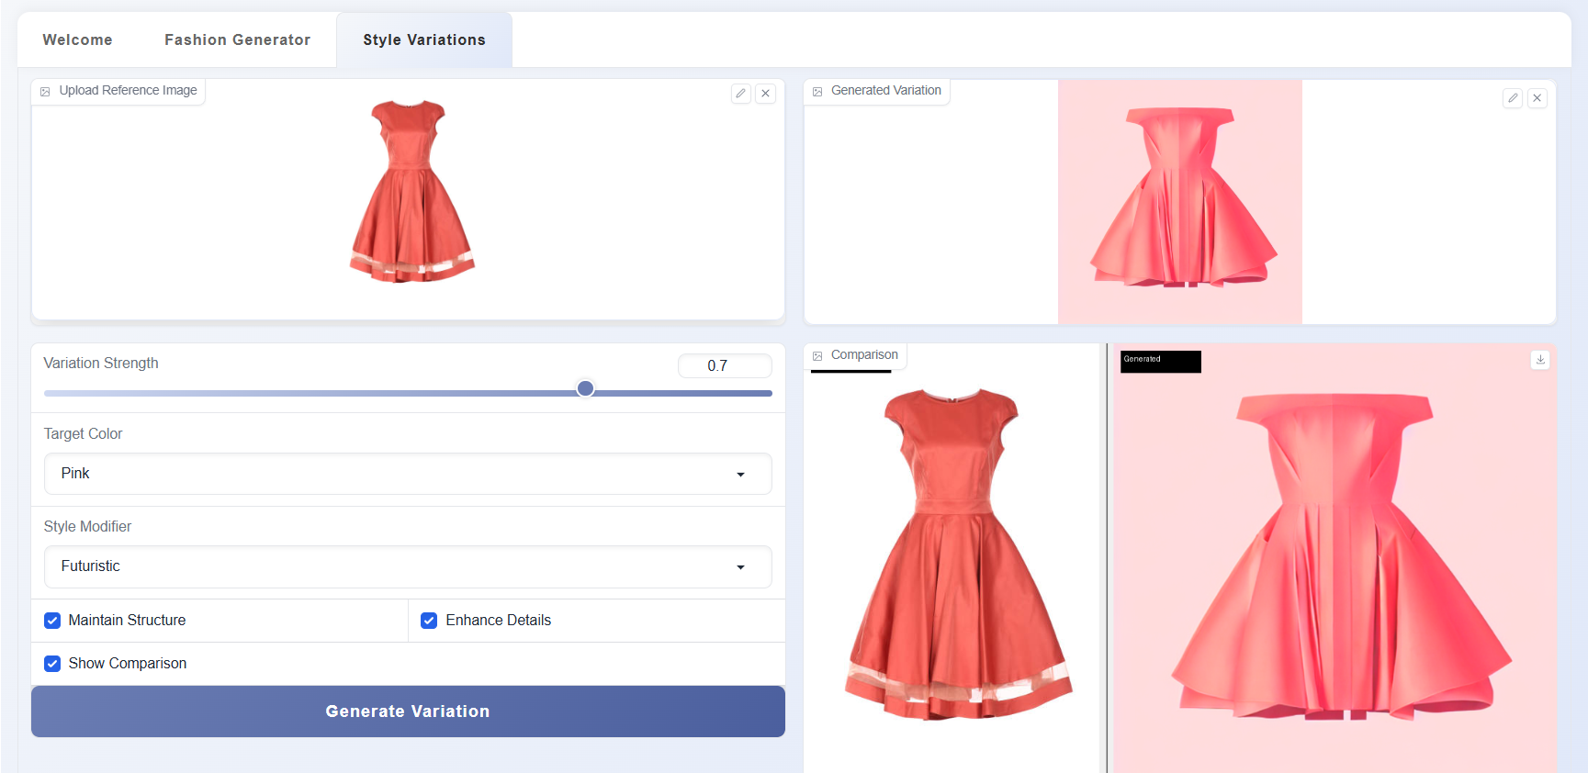

Slide 16
BENEFITS
Automates repetitive and time-consuming fashion design tasks.
Enhances creativity by providing AI-generated design suggestions.
Generates trend-driven and brand-specific designs.
Reduces design time and speeds up product development.
Supports designers with data-driven insights for better decision-making.

Slide 17
Conclusion
In conclusion, the backend of our AI-based fashion design system is the core that supports all essential functionalities, from managing user data and garment catalogs to facilitating virtual try-ons. By leveraging a powerful database solution , integrating advanced AI models like diffusion model, and VITON, we ensure a scalable, responsive, and efficient system. This architecture allows users to effortlessly create, try, and personalize fashion designs, delivering an innovative and engaging experience.

Slide 18
REFERENCES
Revolutionizing Style: Artificial Intelligence (AI) Applications in Fashion Design G.K. Indu, C. Kayalvizhi, J. Hayavadana, Taruna Rajpurohit, S. Priyalatha, R. Priyanka
https://www.afjbs.com/uploads/paper/5dcd47a637ee5fa1cd6b83f9a4edf804.pdf
2. AI Assisted Fashion Design:A review,Ziyue Guo,Zongyang Zhu,Yizhi Li,Shidong Cao,Hanggyue Chen,Gaoang Wang,IEEE Access,2023
https://www.researchgate.net/publication/373205261_AI_Assisted_Fashion_Design_A_Review
3. Study of AI driven Fashion Recommender System,Shaghayeg Shirkhani,Hamam Mokayed,Rajkumar Saini, Hum Yan Chai,2023
https://link.springer.com/article/10.1007/s42979-023-01932-9

Slide 19
THANK YOU..

