Slide 1
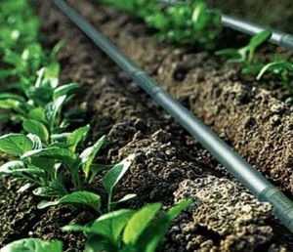
SMART AGRICULTURE SYSTEM
Group Members:
Samiksha Bhilare
Mugdha Asgekar
Shilpa Chandra Guide : Prof. Ramya R.B.

Slide 2
FLOW OF MODULEs
IOT
(automated drip irrigation)
CNN
(automated quality assessment of Crops)
Report status
To farmer

Slide 3
Introduction
Drip irrigation is also known as micro irrigation.
Because in this , water is directly supplied to the root zone through pressurized pipes in drop by drop manner.
Automated smart system does the same work but eases the work of the farmers.
In this the amount of water required for the crop is predicted by the device.

Slide 4
Objectives
Not more not less
Will greatly help in saving the water resources.
Moisture content of the soil can be controlled.
Monitoring of the water flow.
Crop requirement is properly analyzed

Slide 5
LITERATURE REVIEW
IEEE Paper 1
Smart Drip Irrigation System for sustainable Agriculture
DOI: 10.1109/TIAR.2016.7801206
Proposed System by the authors: ?
Proposed System by our team: ?

Slide 6
PROBLEM DEFINITION
BUILD A DSS
Machine to Machine (M2M) INTERACTION
ANALYSIS AND INTELLIGENT PREDICTION

Slide 7
SCOPE
WHAT WE PLAN TO DO? { ML and IOT }
Which ML Algorithm? (KNN)
Target Value? (4 target values)
Output- flow of water through DC water pump

Slide 8
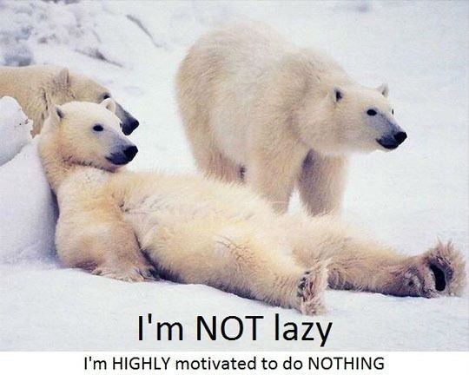
KNN
Lazy Learning:
No learning of the model is required and all of the work happens at the time a prediction is requested. As such, KNN is often referred to as a lazy learning algorithm.
The model representation for KNN is the entire training dataset.
Predictions are made for a new instance (x) by searching through the entire training set for the K most similar instances (the neighbours) and summarizing the output variable for those K instances.
Euclidean distance is calculated as the square root of the sum of the squared differences between a new point (x) and an existing point (xi) across all input attributes j.
Euclidean Distance (x , xi) = sqrt( sum( ( x j – x i j )^2 ))
Hamming distance, Jaccard, Mahalanobis and cosine distance
(Euclidean best when ? ) (Manhattan best when ?) (if Unsure which to use then?)

Slide 9
KNN for Classification
When KNN is used for classification, the output can be calculated as the class with the highest frequency from the K-most similar instances. Each instance in essence votes for their class and the class with the most votes is taken as the prediction.
NOTE
We have 4 target classes so it’s a good idea to keep K as odd.
But why?
KNN works well with a small number of input variables (p), but struggles when the number of inputs is very large.

Slide 10
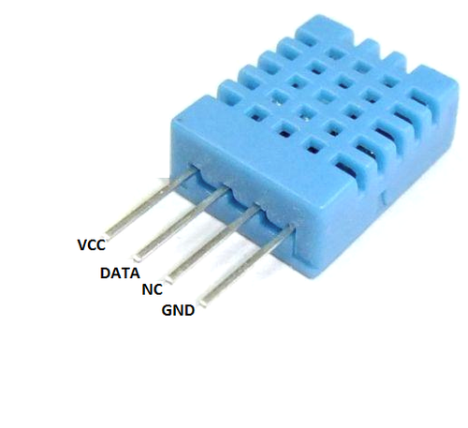
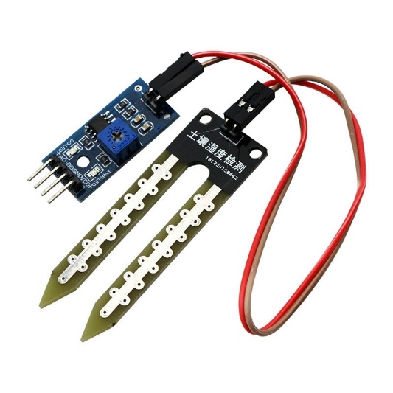
IOT Raspberry Pi3 is used TO INTEGRATE THE SENSORS AND ml MODULES
DHT11
Temperature and Humidity Sensor
FC 28 Soil Moisture
Sensor

Slide 11
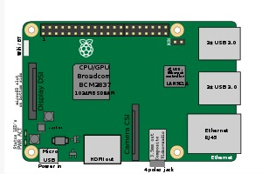
Raspberry Pi 3

Slide 12
TECHNOLOGY STACK
Programming languages Used:
Machine Learning : Python and it’s libraries
Raspberry Pi3 : GPIO (general-purpose input/output) with Python
GUI : HTML/PHP

Slide 13
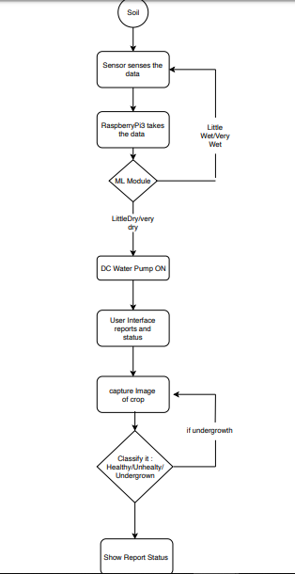
ACTIVITY DIAGRAM

Slide 14
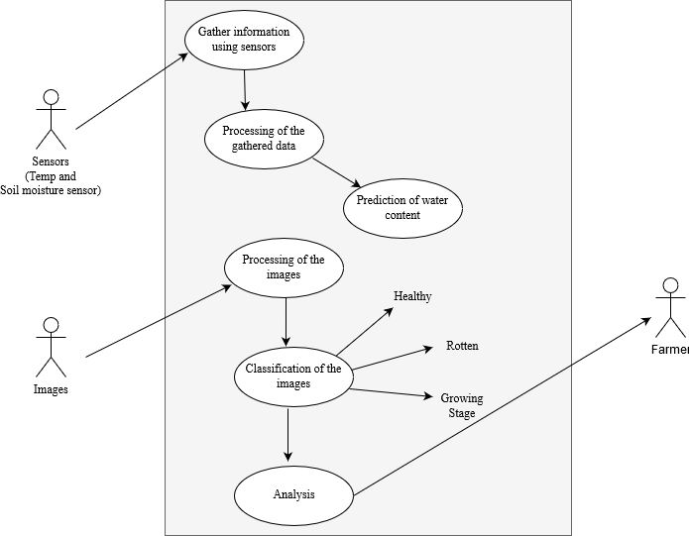
USE CASE
DIAGRAM

Slide 15
Working
RaspberryPi3
Output
DC Water Pump
ML Module
Sensors

Slide 16
Benefits for Environment & Society?
Effective use of water is the mantra of our project.
Some crop requires more water than others.
Water requirements will automatically be detected depending upon on the moisture content of soil, temperature, humidity and climate and also depending upon on the water requirements for the particular crops

Slide 17
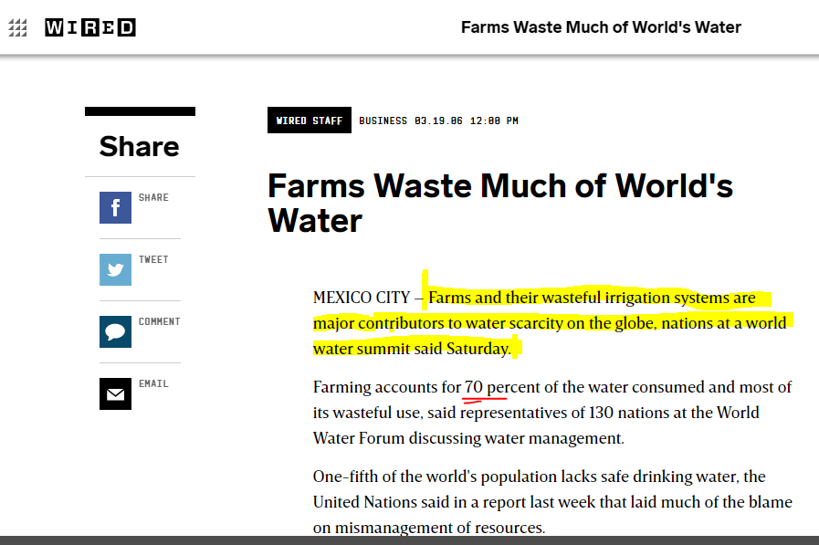

Slide 18
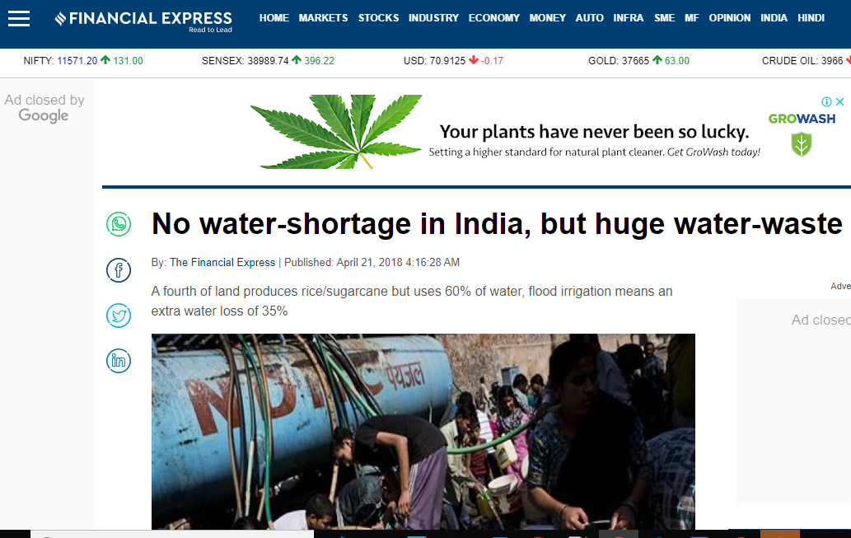

Slide 19
QUALITY ASSESSMENT(THROUGH CNN)
Fruit
Healthy
Unhealthy
Undergrowth

Slide 20
Application ?

