Slide 1


MANGALORE INSTITUTE OF TECHNOLOGY AND ENGINEERING (An ISO 9001:2008 Certified Institution) 2019-2020
DEPARTMENT OF ELECTRONICS AND COMMUNICATION ENGINEERING
A Internship Presentation on
Embedded System and IOT Applications
Presented By, Guided By,
Shilpa. J Mr. SATHISHA
4MT16EC081 Associate Professor
Dept. of E&C Engg
Visvesvaraya Technological University Jnana Sangama, Belgaum-590014

Slide 2
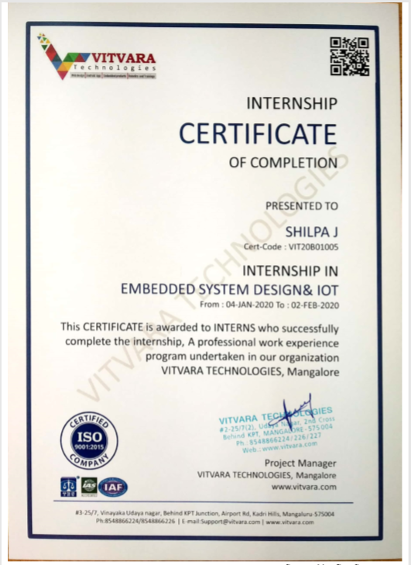
CERTIFICATE

Slide 3
CONTENTS
Company profile
About the trainer
Weekly Overview
Task performed
Conclusion

Slide 4
COMPANY PROFILE Vitvara Technologies
An ISO certified company in Mangalore.
Vitvara is specialized in creating company portfolio websites, Windows and Web applications, Android application and embedded products.
Is specialized for Software development, embedded product development and educational services.

Slide 5

ABOUT THE TRAINER
Mr. Manoj Kumar M is a professional embedded system and software application developer with eight years of experience developing a wide range of application projects.
He has 4 years of experience in Robert Bosch on ‘Embedded design and Development’.
His core skills includes Embedded product design and development, Android application development and Database application development.
He also has efficient programming skills on HTML 5, CSS, Java, XML, php, Embedded C, Python, PLC, and MySQL database.

Slide 6
OVERVIEW OF WEEKLY ACTIVITIES
Week 1 Week 2
Week 3 Week 4
Introduction to Arduino IDE
Introduction to Embedded Systems
Introduction to IoT applications
Working on the Assigned Project

Slide 7
Week 1:Introduction to Arduino IDE
The IDE environment is mainly distributed into three sections
Menu bar
Text Editor
Output Pane

Slide 8
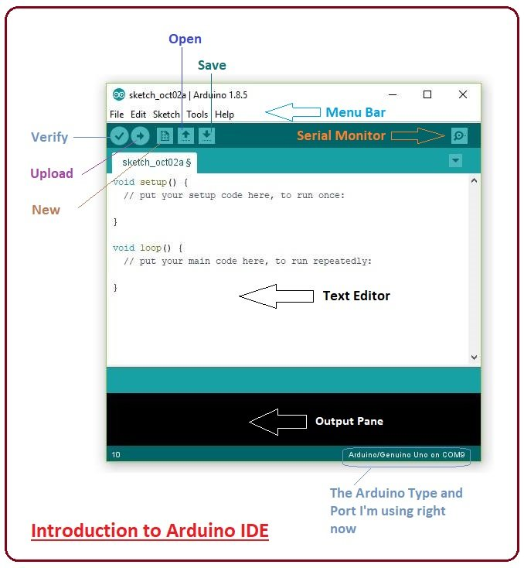
Figure 1 Introduction to Arduino IDE

Slide 9
The bar appearing on the top is called Menu Bar that comes with five different options
File
Edit
Sketch
Tools
Help

Slide 10
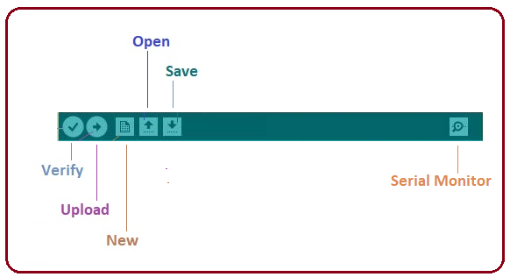
The Six Buttons appearing under the Menu tab are connected with the running program as follows
Figure 2 The Menu tab

Slide 11
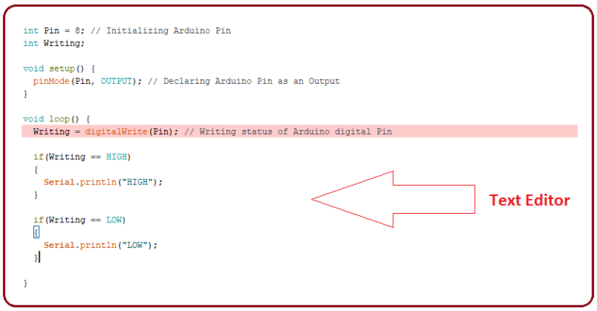
The main screen below the Menu bar is known as a simple text editor used for writing the required code
Figure 3 The Text Editor

Slide 12
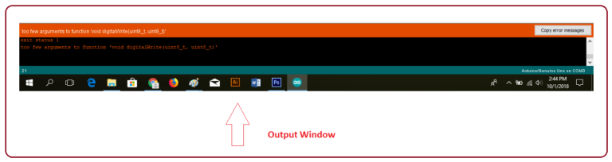
The bottom of the main screen is described as an Output Pane that mainly highlights the compilation status of the running code
Figure 4 The Output window

Slide 13
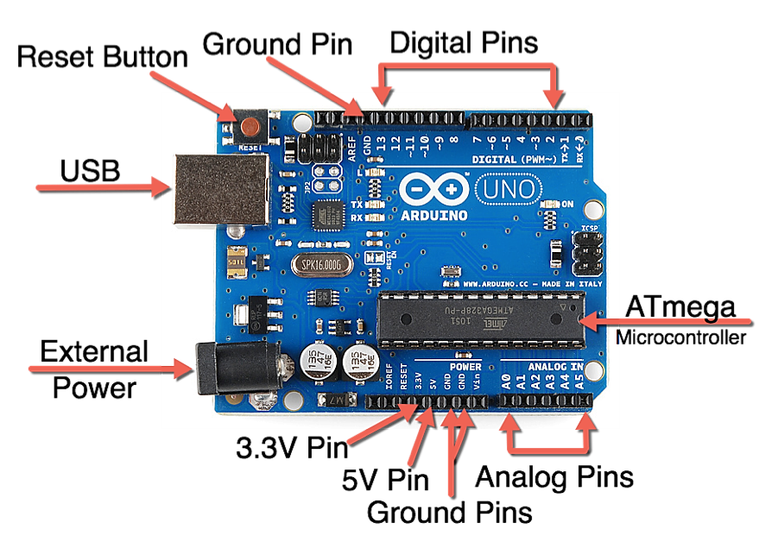
Arduino is a single-board microcontroller meant to make the application more accessible which are interactive objects and its surroundings.
The hardware features with an open-source hardware board designed around an 8-bit Atmel AVR microcontroller or a 32-bit Atmel ARM.
Figure 5 Arduino Uno Board

Slide 14
Week 2:Introduction to Embedded Systems
Microcontrollers are widely used in Embedded System products.
In Embedded system there is only one application software that is typically burn into ROM.

Slide 15
Embedded system
Embedded systems are some specific systems which are designed to perform a specific task.
The task or work provided to these systems are very specific and remain same as once defined by programmer.
Microcontrollers are used in and as embedded systems. As for example automatic street light, home automation system, a simple automated electric stove etc.

Slide 16
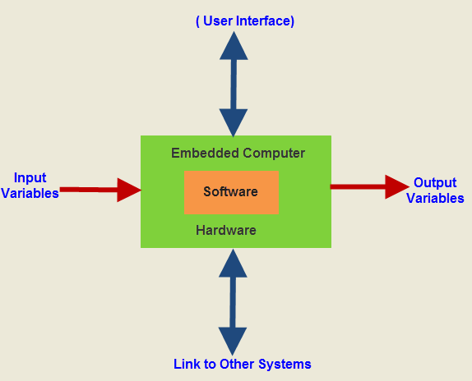
Figure 6 Block diagram of Embedded System

Slide 17
MICROPROCESSOR VS MICROCONTROLLERS
Microprocessors | Microcontrollers
Microprocessors contain no RAM or ROM. | Microcontrollers have an internal RAM and a ROM.
Microprocessors do not have any I/O ports. | Microcontrollers have I/O ports.
Advantage of versatility. | Advantages of less power consumption.
Expensive. | Cheaper in comparison.
With the addition of external RAM and ROM, the system is bulkier | Occupies less space.

Slide 18
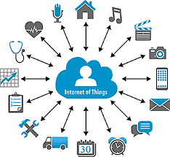
Week 3:Introduction to IoT Applications
Figure 7 IoT Applications

Slide 19
IoT is a network in which all physical objects are connected to the internet through network devices or routers and exchange data.
The goal of IoT is to extend the internet connectivity from standard devices like computer, mobile, tablet to relatively dumb devices like a toaster.
IoT makes virtually everything "smart," by improving aspects of our life with the power of data collection, AI algorithm, and networks.
The thing in IoT can also be a person with a diabetes monitor implant, an animal with tracking devices, etc.

Slide 20
NodeMCU perfect for IoT applications, and other situations where wireless connectivity is required.

Slide 21
Week 4: Working on the Assigned Project
The Project was assigned in the last week of the internship. The project was on IoT based RFID attendance system.
Attendance monitoring system using RFID technology and with the application of Internet of Things (IoT) and cloud technology so that attendance of the students can be monitored in real time.

Slide 22
COMPONENTS REQUIRED
Arduino uno board
Node MCU
RFID cards
RFID card reader
Connecting wires

Slide 23
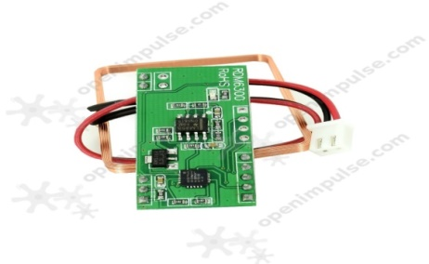
RFID Card Reader
Radio-Frequency Identification uses electromagnetic fields to automatically identify and track tags attached to objects.
An RFID tag consists of a tiny radio transponder, a radio receiver and transmitter.
When triggered by an electromagnetic interrogation pulse from a nearby RFID reader device, the tag transmits digital data, usually an identifying inventory number, back to the reader.
Figure 12 RDM6300 RFID Card Reader

Slide 24
Specifications of RFID Card Reader as follows:
Supports external antenna
Maximum distance: 50 mm
Decoding time: <100 Ms
UART interface
Bi-color LED

Slide 25
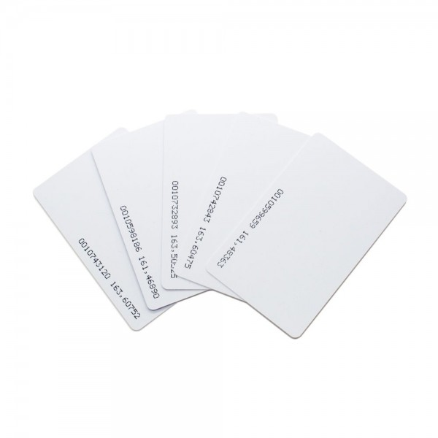
RFID card
RFID is useful for sensing and identifying tagged people and objects for access control, automation, and a whole range of different applications.
This basic RFID tag works in the 125kHz RF range and comes with a unique 32-bit ID.
Figure 13 RFID cards

Slide 26
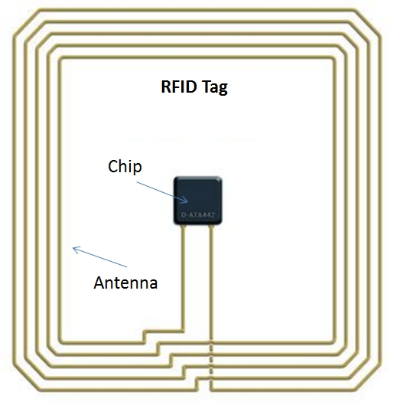
Figure 14 Inner look of RFID card

Slide 27
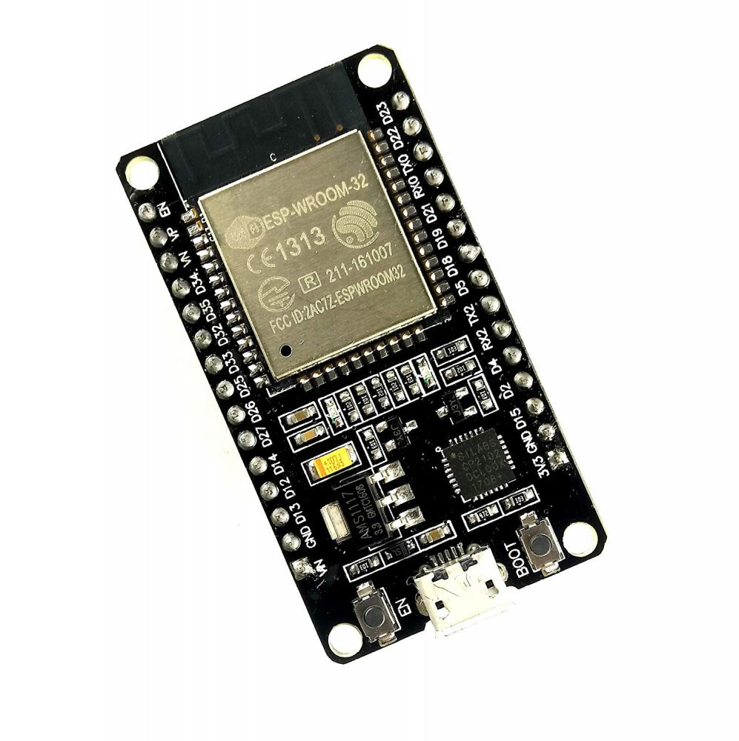
ESP32 NodeMCU
NodeMCU is an open source Lua based firmware for the ESP32 and ESP8266 Wi-Fi SOC from Espressif and uses an on-module flash-based SPIFFS file system.
Figure 15 ESP32 NodeMCU

Slide 28
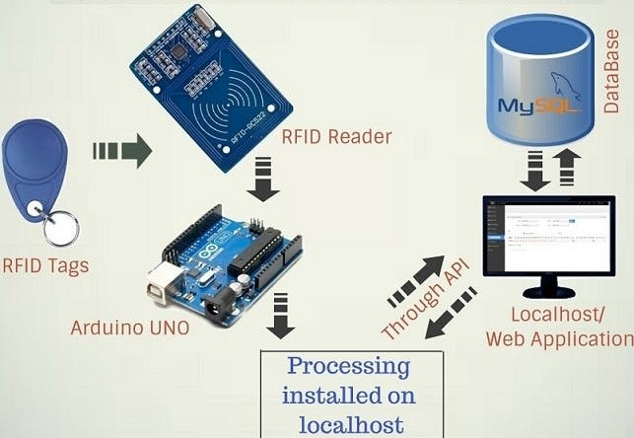
WORKING
Figure 16 Block diagram of IoT based RFID attendance system

Slide 29
Here, an IoT based RFID attendance system is done using RDM6300 RFID Reader, ESP32 NodeMCU, RFID tags and Arduino.
When you swipe an RFID tag next to the RFID reader, it saves the user UID and time in a MySQL database with the help of ESP32 NodeMCU.

Slide 30
Here from laptop power supply is given to both Arduino and Node MCU, then Arduino receiver pin is connected to transmitter pin of Node MCU.
The RX pin of Arduino is connected to TX pin of RFID card reader and the VCC and GND pins of card reader is connected to 5V and GND of Arduino.
In this project, 2 push buttons are used as login and logout and these push buttons are connected to the pins of Arduino. Then RFID tag is swiped on a RFID card reader.
The RFID card reader sends the unique 32-bit ID to the Arduino and this ID is processed. Then, this ID is sent to MySQL database using ESP32 NodeMCU.

Slide 31
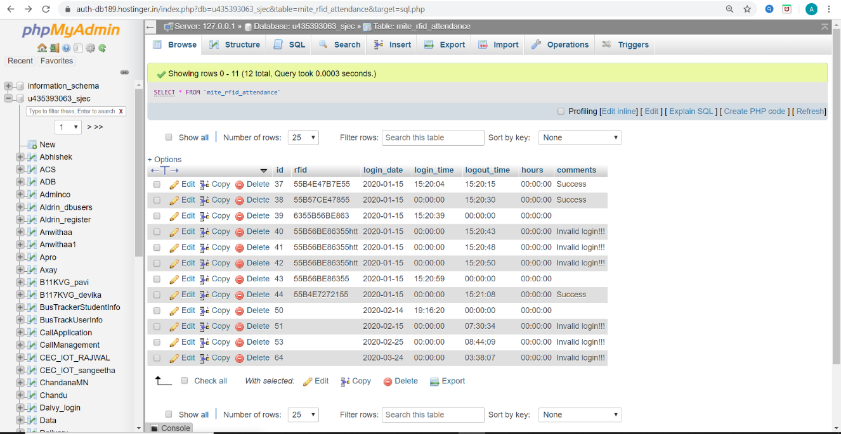
Figure 17 Screenshot of database

Slide 32
CONCLUSION
The knowledge regarding embedded system and IOT have been increased after attending this internship.
The project helped me to analyse all the theoretical concepts behind embedded systems and their practical implementation in the prototyping level

Slide 33
THANK YOU

