Slide 1



PIMPRI CHINCHWAD EDUCATION TRUST’S S.B.PATIL COLLEGE OF Science and Commerce, Ravet
1. Advanced Web Design
Index:
Introduction to HTML5
Forms in HTML5
Cascading Style sheets
Lists in HTML5
Inserting video, audio
Image map in HTML5
Inline Frame
Website Hosting
From:
Mrs. Shilpa Prashant Kate (IT Teacher)
S.B.Patil college of Science & Commerce,Ravet

Slide 2
Web Components
PIMPRI CHINCHWAD EDUCATION TRUST’S S.B.PATIL COLLEGE OF Science and Commerce, Ravet
Webpage : A simple text file created using HTML.
Website : A collection of interlinked web pages containing text, images, audio and videos. For Example, www. ebalbharati.in
Web Browser : A web browser is a software used to view web pages or websites available on the internet For Example Internet Explorer, Google chrome.
Web Server : A Web server is an application or a computer that sends webpages over the internet using the HTTP protocol. For Example Apache, nginx, IIS, etc..
URL(Uniform Resource Locator) : It is an address of a web page on the internet.
HTTP : HTTP (HyperText Transfer Protocol) is a protocol used by WWW for client server communication.
HTML : Hyper Text Markup language

Slide 3

Introduction to HTML5
PIMPRI CHINCHWAD EDUCATION TRUST’S S.B.PATIL COLLEGE OF Science and Commerce, Ravet
HTML5 is the latest and most enhanced version of HTML
It makes your website layout clearer to both website designers and users
Browsers support ‘s features of HTML5 : Google Chrome, Mozilla Firefox, Microsoft Edge, Safari, Opera and Apple.

Slide 4
Basic structure of HTML5
PIMPRI CHINCHWAD EDUCATION TRUST’S S.B.PATIL COLLEGE OF Science and Commerce, Ravet
<html> and </html> : indicates that the document is an html file.
<head> and </head> : It includes <Title> within it, the text within <head> is not displayed on the webpage. This is used for search engine optimization.
<title> and </title> : The content within this displayed on the title bar.
<body> and </body> : This tag includes all content which is to be developed in the web browser. Most of the tags are included in this tag.

Slide 5
Basic structure of HTML5
PIMPRI CHINCHWAD EDUCATION TRUST’S S.B.PATIL COLLEGE OF Science and Commerce, Ravet
An attribute : An attribute defines a property for an element, consists of an attribute/value, and appears within the element's start tag.
<!Doctype html>
<html>
<head>
<title> First Page </title>
</head>
<body bgcolor = green >
attribute value of attribute
This is my first web page
</body>
</html>
Execute Here

Slide 6
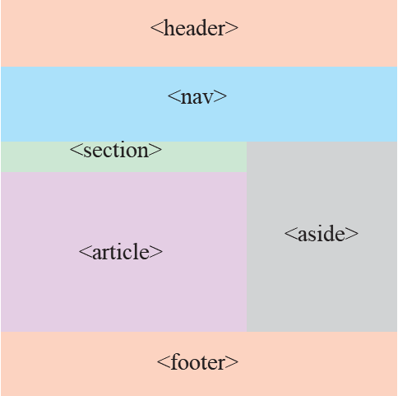
PIMPRI CHINCHWAD EDUCATION TRUST’S S.B.PATIL COLLEGE OF Science and Commerce, Ravet
Defines a header for a document section.
Defines a container for navigation links.
Defines a section in a document
Defines content apart from the content (like a sidebar).
Defines an independent self-contained article.
Defines a footer for a document or a section.
Click here for Example

Slide 7
PIMPRI CHINCHWAD EDUCATION TRUST’S S.B.PATIL COLLEGE OF Science and Commerce, Ravet
FORMS IN HTML5
Forms in HTML is used to accept user input.
Form controls are used to collect different kinds of user inputs, such as contact details like name, address, single or multiple options from group of options, as well as clearing and submitting data etc.
Attributes used with form element and Input element.
Name : It specifies a name to a form.
Action : The action attribute specifies the path where the form is to be submitted.
Method : The method attribute specifies get or post method to be used when submitting the form data. Method of form are GET or POST.
i) GET method : GET method will pass the values via URL ,Passed values will be seen in Address bar.
ii) POST Method :POST method will pass the values via HTTP request.
Passed values not seen in Address bar. So it is a secure method to submit sensitive

Slide 8
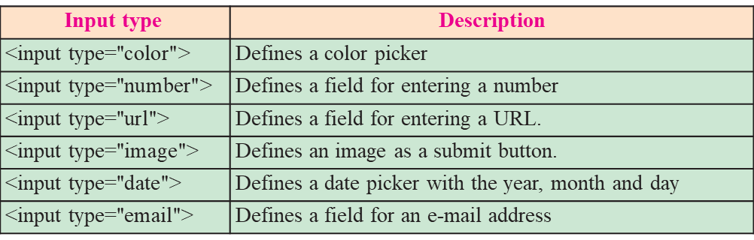
PIMPRI CHINCHWAD EDUCATION TRUST’S S.B.PATIL COLLEGE OF Science and Commerce, Ravet
FORMS IN HTML5
Click to execute

Slide 9
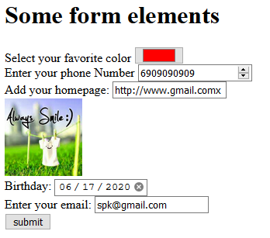
PIMPRI CHINCHWAD EDUCATION TRUST’S S.B.PATIL COLLEGE OF Science and Commerce, Ravet
<form >
<h1>Some form elements</h1>
Select your favorite color <input type="color" >
<br>
Enter your phone Number <input type="Number" >
<br>
<label for="homepage">Add your homepage:</label>
<input type="url" id="homepage" name="homepage">
<br>
<input type="image" src="happy.jpg" alt="Submit" width="100" height="100">
<br>
<label for="birthday">Birthday:</label>
<input type="date" id="birthday" name="birthday">
<br>
<label for="email">Enter your email:</label>
<input type="email" id="email" name="email">
<br>
<input type="submit" value="submit">
</form>

Slide 10
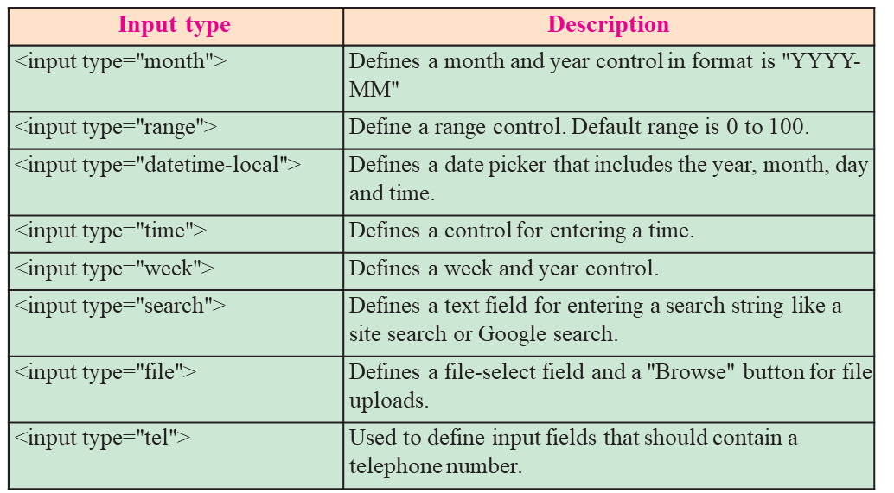
PIMPRI CHINCHWAD EDUCATION TRUST’S S.B.PATIL COLLEGE OF Science and Commerce, Ravet

Slide 11
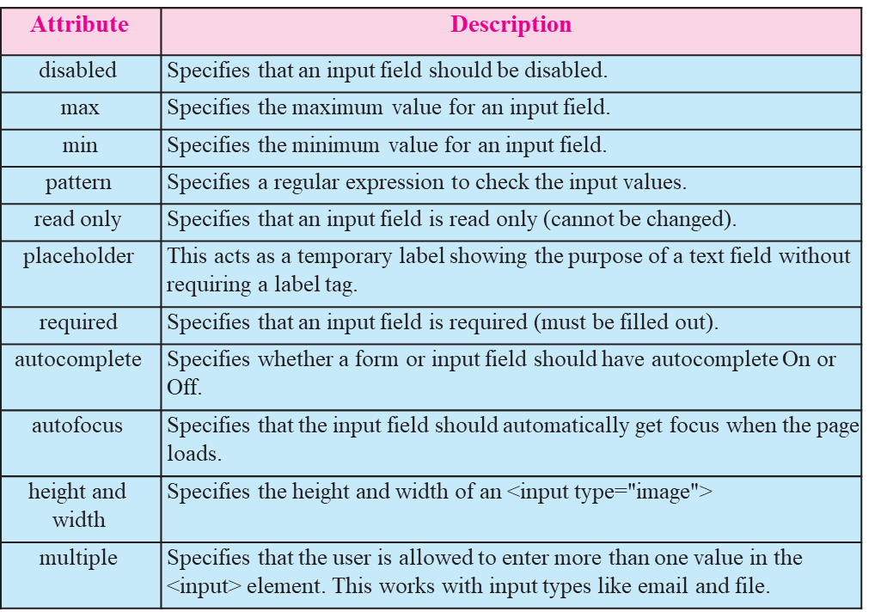
PIMPRI CHINCHWAD EDUCATION TRUST’S S.B.PATIL COLLEGE OF Science and Commerce, Ravet
Input Restrictions
A list of some common input restrictions is given below, few of which can be used for validation purpose.

Slide 12
PIMPRI CHINCHWAD EDUCATION TRUST’S S.B.PATIL COLLEGE OF Science and Commerce, Ravet
Some other useful attributes used with <input> are-
id : This is used to identify the html element uniquely through the document object model.
class: It is used to apply CSS style to the individual input element.

Slide 13
PIMPRI CHINCHWAD EDUCATION TRUST’S S.B.PATIL COLLEGE OF Science and Commerce, Ravet
1.3 <meta> tag
The meta tag is a tag in html that describes some aspects of contents of a webpage.
The HTML <meta> tag is used by search engines to search information that is provided with the webpage.
This is empty tag (singular tag) which carries information within its attributes.
The <meta> tag is placed between the <head>and </head> tags.
Metadata will not be displayed on the webpage.

Slide 14
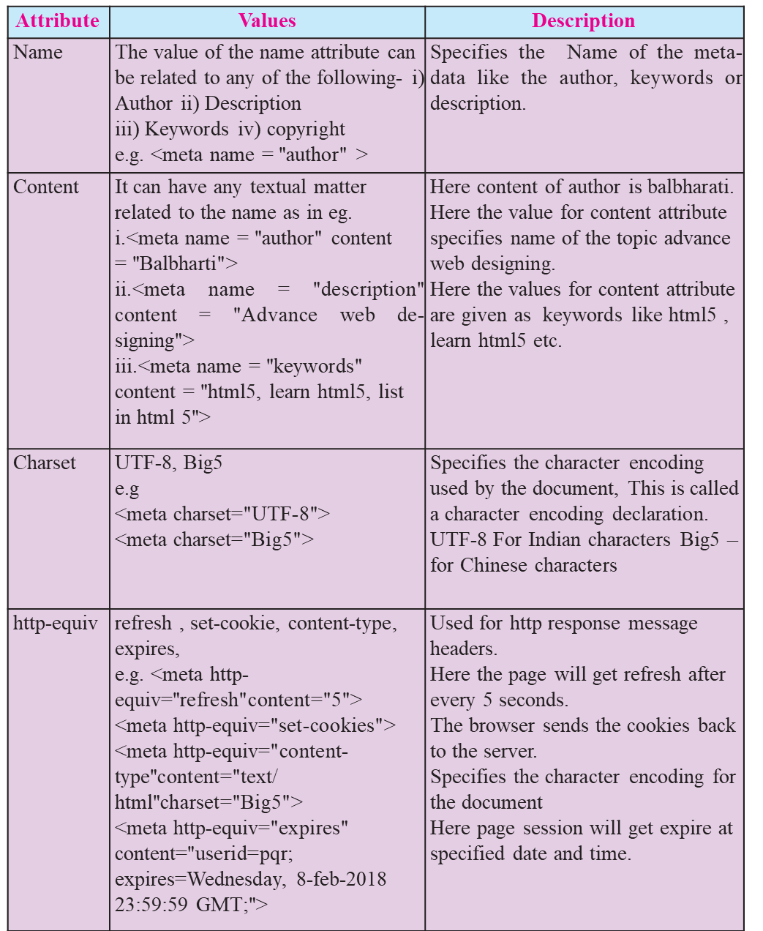
PIMPRI CHINCHWAD EDUCATION TRUST’S S.B.PATIL COLLEGE OF Science and Commerce, Ravet

Slide 15
PIMPRI CHINCHWAD EDUCATION TRUST’S S.B.PATIL COLLEGE OF Science and Commerce, Ravet
<!DOCTYPE html>
<html>
<head>
<title>meta tag examples</title>
<meta name = "authors" content = "Balbharti">
<meta name = "description" content = "Advance web designing">
<meta name = "keywords" content = "html5, learn html5, list in html5">
<meta name="copyright" content= " copyright Balbharti All right Reserve">
</head>
<body>
<p> Welcome to HTML5
</p>
</body>
</html>

Slide 16
PIMPRI CHINCHWAD EDUCATION TRUST’S S.B.PATIL COLLEGE OF Science and Commerce, Ravet
1.4 Cascading Style Sheets (CSS) in HTML5
CSS stands for Cascading Style Sheets.
CSS describes how HTML elements are to be displayed on screen, paper, or in other media.
It can control the layout of multiple web pages all at once.
CSS allows you to control the look and feel of several pages by changing a single source.
A CSS rule set contains
a selector and
a declaration block.

Slide 17
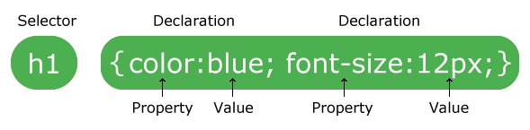
PIMPRI CHINCHWAD EDUCATION TRUST’S S.B.PATIL COLLEGE OF Science and Commerce, Ravet
CSS Syntax
selector points to the HTML element you want to style.
declaration block contains one or more declarations separated by semicolons. Declaration blocks are surrounded by curly braces.
Declaration includes a CSS property name and a value, separated by a colon.
Property : is a type of attribute of HTML element. It could be color, border etc.
Value : Values are assigned to CSS properties. In the above example, value “blue" is assigned to color property.
Selector{Property1: value1; Property2: value2}

Slide 18
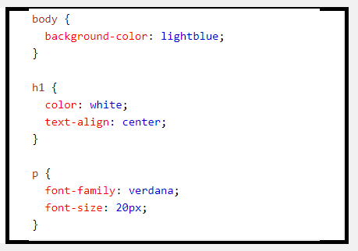
PIMPRI CHINCHWAD EDUCATION TRUST’S S.B.PATIL COLLEGE OF Science and Commerce, Ravet
CSS Syntax

Slide 19
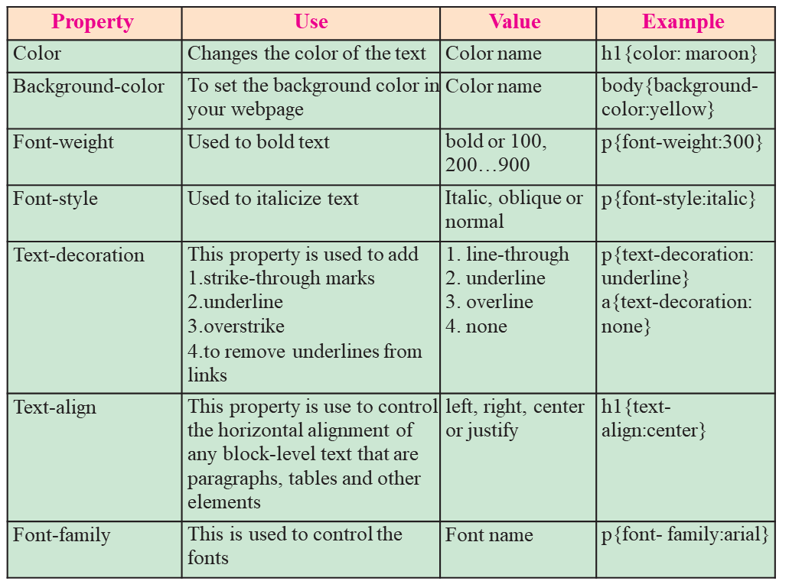
PIMPRI CHINCHWAD EDUCATION TRUST’S S.B.PATIL COLLEGE OF Science and Commerce, Ravet

Slide 20
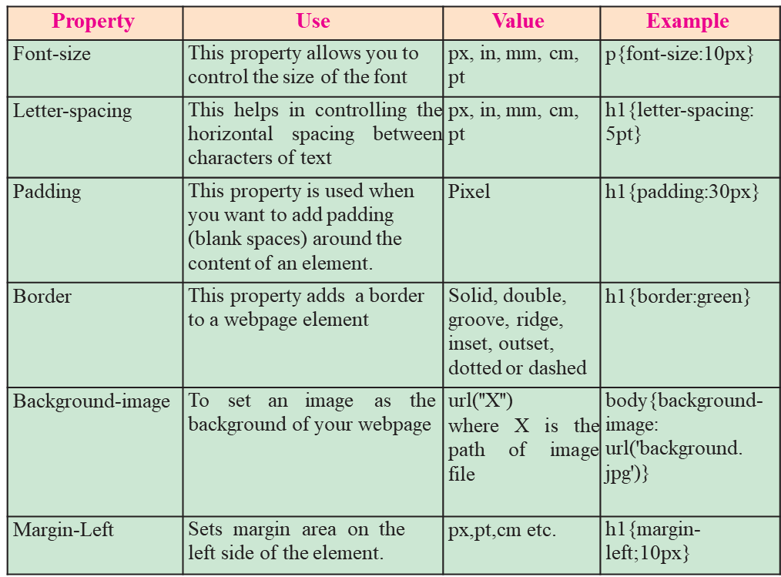
PIMPRI CHINCHWAD EDUCATION TRUST’S S.B.PATIL COLLEGE OF Science and Commerce, Ravet

Slide 21
PIMPRI CHINCHWAD EDUCATION TRUST’S S.B.PATIL COLLEGE OF Science and Commerce, Ravet
Types of CSS
There are three methods of implementing styling
Inline CSS :- It uses the style attribute in the HTML start tag. Inline CSS is used to apply CSS on a single line or element.
For example : <p style="color:blue">Hello CSS</p>
2.Embedded stylesheet or internal CSS : This is used to apply CSS on a single document or page. It can affect all the elements of the page. It is written inside the style tag within head section of html.For example : <style> h1{color: Red;}</style>
3. External CSS: The external style sheet is generally used when you want to make changes on multiple pages. It uses the <link> tag on every page and the <link> tag should be put inside the head section. The external css file should not contain any HTML tags ,open with any text editor it saved with .css extension.
For example : Style.css
h1{color:navy;margin-left:20px}
<link rel="stylesheet" href="style.css">

Slide 22

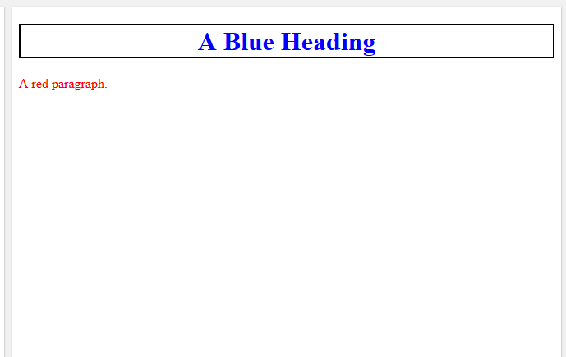
PIMPRI CHINCHWAD EDUCATION TRUST’S S.B.PATIL COLLEGE OF Science and Commerce, Ravet
Inline CSS :- It uses the style attribute in the HTML start tag. Inline CSS is used to apply CSS on a single line or element.
For example : <p style="color: blue">Hello CSS</p>
<!DOCTYPE html>
<html>
<body>
<h1 style="color:blue;
border: 2px solid black;
text-align:center;">
A Blue Heading
</h1>
<p style="color:red;">A red paragraph.</p>
</body>
</html>

Slide 23
PIMPRI CHINCHWAD EDUCATION TRUST’S S.B.PATIL COLLEGE OF Science and Commerce, Ravet
Internal CSS
It is written inside the style tag within head section of html.
For example : <style> h1{color: Red;}</style>
<!DOCTYPE html>
<html>
<Head>
<style> h1{color:blue;
border: 2px solid black;
text-align:center;}
p{ color:red; }
</style>
</head>
<body>
<h1> A Blue Heading </h1>
<p> A red paragraph.</p>
</body>
</html>

Slide 24
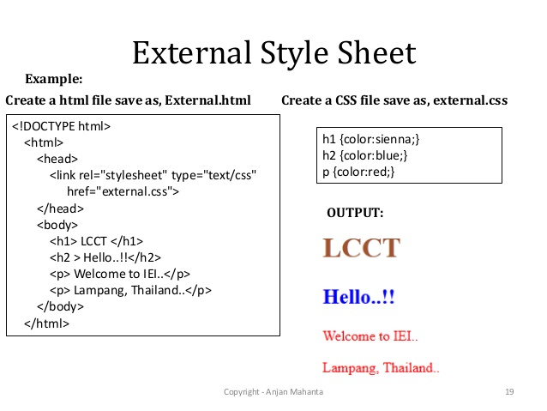
PIMPRI CHINCHWAD EDUCATION TRUST’S S.B.PATIL COLLEGE OF Science and Commerce, Ravet

Slide 25
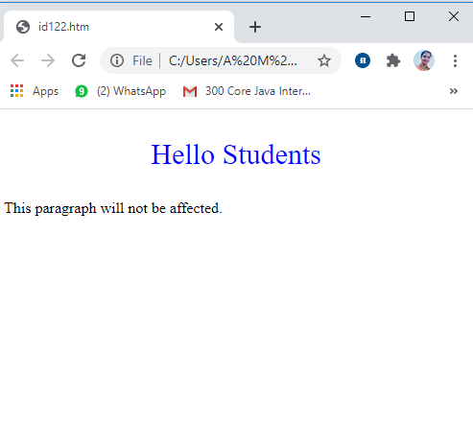
PIMPRI CHINCHWAD EDUCATION TRUST’S S.B.PATIL COLLEGE OF Science and Commerce, Ravet
CSS Id Selector
The Id selector selects the id attribute of an HTML element to select a specific element.
An id is always unique within the page so it is unique element. It is written with the hash character(#), followed by the id name.
<!DOCTYPE html>
<html>
<head>
<style>
#para1{text-align: center; color: blue}
</style>
</head>
<body>
<p id="para1">Hello Students</p>
<p>This paragraph will not be affected.</p>
</body>
</html>

Slide 26
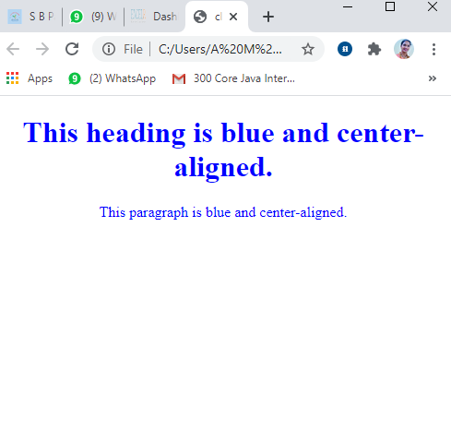
PIMPRI CHINCHWAD EDUCATION TRUST’S S.B.PATIL COLLEGE OF Science and Commerce, Ravet
CSS Class Selector
The class selector selects HTML elements with a specific class attribute.
It is used with a period character '.' (full stop symbol) followed by the class name.
The Class selector is used when you want to change a group of elements within your HTML page. The class name should not start with number.
<!DOCTYPE html>
<html>
<head>
<style>
.intro{text-align:center;color:blue}
</style></head>
<body>
<h1 class="intro">This heading is blue and center-aligned.</h1>
<p class="intro">This paragraph is blue and center-aligned.</p>
</body>
</html>

Slide 27
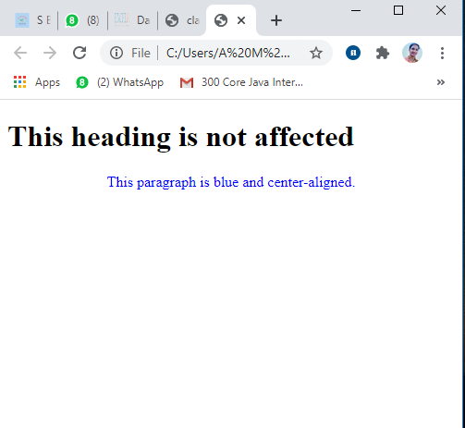
PIMPRI CHINCHWAD EDUCATION TRUST’S S.B.PATIL COLLEGE OF Science and Commerce, Ravet
Class Selector for specific element
To specify only one specific HTML element should be affected then you should use the element name with class selector.
<!DOCTYPE html>
<html>
<head> <style>
p.intro {text-align: center;color: blue}
</style> </head>
<body>
<h1 class="intro">This heading is not affected</h1>
<p class="intro">This paragraph is blue and center-aligned.</p>
</body>
</html>

Slide 28
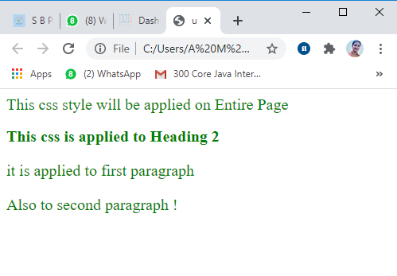
PIMPRI CHINCHWAD EDUCATION TRUST’S S.B.PATIL COLLEGE OF Science and Commerce, Ravet
Universal Selector
The universal selector is used as a wildcard character. It selects all the elements on the Webpages.
<!DOCTYPE html>
<html>
<head> <style>
* { color: green; font-size: 20px;}
</style> </head>
<body>
This css style will be applied on Entire Page
<h2>This css is applied to Heading 2</h2>
<p id="para1“ >it is applied to first paragraph</p>
<p>Also to second paragraph !</p>
</body>
</html>

Slide 29
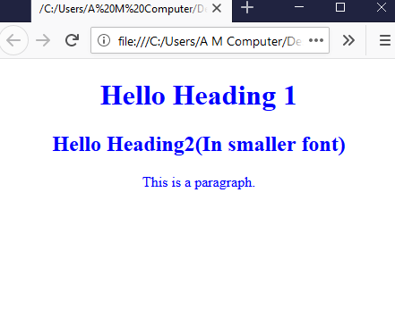
PIMPRI CHINCHWAD EDUCATION TRUST’S S.B.PATIL COLLEGE OF SCIENCE AND COMMERCE, RAVET
Group Selector
The grouping selector is used to select all the elements with the same style definitions. It is used to minimize the code.
Commas are used to separate each selector in grouping.
H1,h2,p{ text-align:center;color:blue}
.
<!DOCTYPE html>
<html>
<head>
<style>
h1,h2,p{text-align: center; color: blue}
</style>
</head>
<body>
<h1> Hello Heading 1</h1>
<h2> Hello Heading2(In smaller font)</h2>
<p> This is a paragraph.</p>
</body>
</html>

Slide 30
PIMPRI CHINCHWAD EDUCATION TRUST’S S.B.PATIL COLLEGE OF SCIENCE AND COMMERCE, RAVET
Positioning in CSS
CSS helps to position the HTML elements.
The position property is used to set position for an element.
The element can be positioned using the top, bottom, left and right properties.
Syntax :
Selector{ position:value; top:value; left:value: bottom:value; right:value }
Where values in positions are static ,fixed, absolute, relative and values of top, bottom, left, right are in pixels
There are four types of positioning in CSS:-
Static Positioning
Fixed Positioning
Relative Positioning
Absolute Positioning

Slide 31
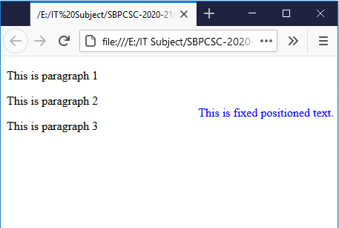
PIMPRI CHINCHWAD EDUCATION TRUST’S S.B.PATIL COLLEGE OF SCIENCE AND COMMERCE, RAVET
Positioning in CSS
Static Positioning This is a by- default position for HTML elements. It is not affected by the top, bottom, left and right properties.
Fixed Positioning : This property helps to put the text fixed on the browser. The FIXED property forces an element into a fixed position relative to the browser window. The fixed element will not move, even when the page is scrolled.
<!DOCTYPE html>
<html>
<head><style> p.fixed{position: fixed; top: 50px; right: 5px; color: blue}
</style></head>
<body>
<p>This is paragraph 1</p>
<p>This is paragraph 2</p>
<p>This is paragraph 3</p>
<p class="fixed">This is fixed positioned text.</p>
</body></html>

Slide 32
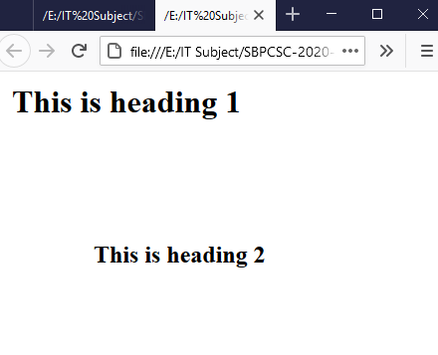
PIMPRI CHINCHWAD EDUCATION TRUST’S S.B.PATIL COLLEGE OF SCIENCE AND COMMERCE, RAVET
Positioning in CSS
Relative Positioning : The relative positioning property is used to set the element relative to its normal position.
Absolute Positioning : This property sets an element in a specific location and it is not affected by the flow of the page. This property positions the element at the specified coordinates relative to your screen top-left corner.
<!DOCTYPE html>
<html>
<head>
<style>
.first{position: relative;top:10px; right:10px;}
h2{position: absolute; left:100px;top:150px}
</style>
<body>
<h1 class="first">This is heading 1</h1>
<h2>This is heading 2</h2>
</body>
</html>

Slide 33
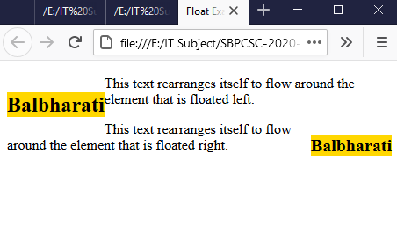
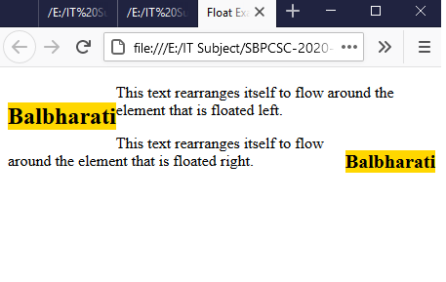
PIMPRI CHINCHWAD EDUCATION TRUST’S S.B.PATIL COLLEGE OF SCIENCE AND COMMERCE, RAVET
Float Property in CSS
Float is a CSS property written in CSS file or directly in the style of an element. The float property defines the flow of content.
Following are the types of floating properties :
float : left : This keeps the element float on left side of the container
float : right : This keeps the element float on right side of container
float : none : This is default property i.e. this shows the element as it is.
<!DOCTYPE html>
<html><head>
<title>Float Example</title>
<style>
.float-left{float:left;font-size:20px;background-color:gold}
.float-right{float: right;
font-size:20px;background-color:gold}
</style></head><body>
<h2 class="float-left">Balbharati</h2>
<p>This text rearranges itself to flow around the element that is floated left.</p>
<h2 class="float-right">Balbharati</h2>
<p>This text rearranges itself to flow around the element that is floated right. </p>
</body>
</html>

Slide 34
PIMPRI CHINCHWAD EDUCATION TRUST’S S.B.PATIL COLLEGE OF SCIENCE AND COMMERCE, RAVET
Display property
The Display property in CSS defines how the components (div, hyperlink, heading, etc) are going to be placed on the web page.
It specifies how the element is displayed. this property is used to define the display of different parts of a web page.
Syntax : Display : value;
Where values are :
Inline : It is used to display an element as an inline element.
Block : It is used to display an element as an block element. It starts on a new line, and takes up the whole width of the browser window.
Block-inline : This value is very similar to inline element but the difference is that you are able to set the width and height.
None : The element is completely removed.

Slide 35
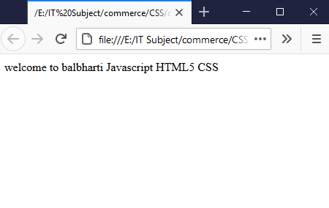
PIMPRI CHINCHWAD EDUCATION TRUST’S S.B.PATIL COLLEGE OF SCIENCE AND COMMERCE, RAVET
Display property
<!DOCTYPE html>
<html>
<head>
<style>
p {
display: inline;
}
</style>
</head>
<body>
<p>welcome to balbharti</p>
<p>Javascript</p>
<p>HTML5</p>
<p>CSS</p></body></html>

Slide 36
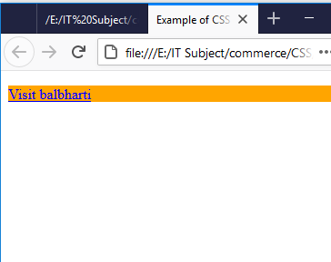
PIMPRI CHINCHWAD EDUCATION TRUST’S S.B.PATIL COLLEGE OF SCIENCE AND COMMERCE, RAVET
Display property
<!DOCTYPE html>
<html lang="en">
<head>
<title>Example of CSS display</title>
<style type="text/css">
a {
display : block; background-color:orange;
}
</style>
</head>
<body>
<p>
<a href="https://www.ebalbharti.in" >
Visit balbharti</a>
<br>
</p></body>
</html>

Slide 37
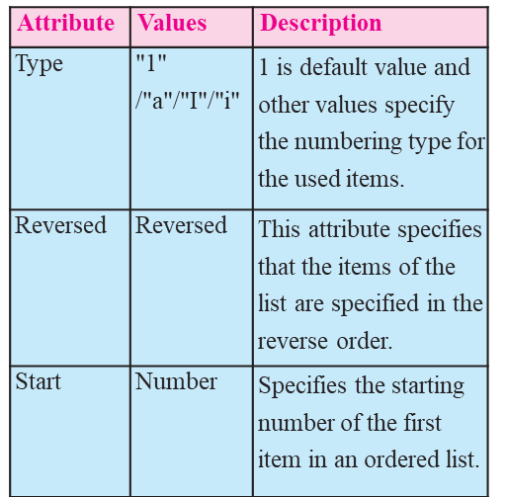
PIMPRI CHINCHWAD EDUCATION TRUST’S S.B.PATIL COLLEGE OF SCIENCE AND COMMERCE, RAVET
Ordered list or numbered list
The <ol> tag defines an ordered list. An ordered list can be numerical or alphabetical.

Slide 38
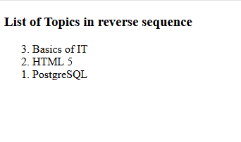
PIMPRI CHINCHWAD EDUCATION TRUST’S S.B.PATIL COLLEGE OF SCIENCE AND COMMERCE, RAVET
Ordered list or numbered list
The <ol> tag defines an ordered list. An ordered list can be numerical or alphabetical.
<!DOCTYPE html>
<html>
<body>
<h3>List of Topics in reverse sequence</h3>
<ol reversed>
<li> Basics of IT </li>
<li> HTML 5 </li>
<li> PostgreSQL</li>
</ol>
</body>
</html>

Slide 39
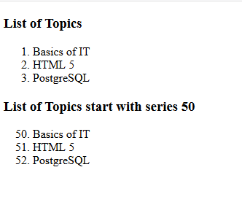
PIMPRI CHINCHWAD EDUCATION TRUST’S S.B.PATIL COLLEGE OF SCIENCE AND COMMERCE, RAVET
Ordered list or numbered list
The <ol> tag defines an ordered list. An ordered list can be numerical or alphabetical.
<!DOCTYPE html>
<html><body>
<h3>List of Topics</h3>
<ol>
<li> Basics of IT</li>
<li> HTML 5 </li>
<li> PostgreSQL </li>
</ol>
<h3>List of Topics start with series 50</h3>
<ol start="50">
<li> Basics of IT</li>
<li> HTML 5 </li>
<li> PostgreSQL </li>
</ol></body></html>

Slide 40
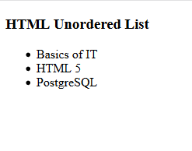
PIMPRI CHINCHWAD EDUCATION TRUST’S S.B.PATIL COLLEGE OF SCIENCE AND COMMERCE, RAVET
1.6 Unordered list or bulleted list
An unordered list created using the
<ul> tag, and each list item starts with the <li> tag. The list items in unordered lists are marked with bullets (small black circles), by default.
<!DOCTYPE html>
<html>
<head>
<title>Example of HTML Unordered List</title>
</head>
<body>
<h3>HTML Unordered List</h3>
<ul>
<li>Basics of IT</li>
<li>HTML 5</li>
<li>PostgreSQL</li>
</ul></body></html>

Slide 41
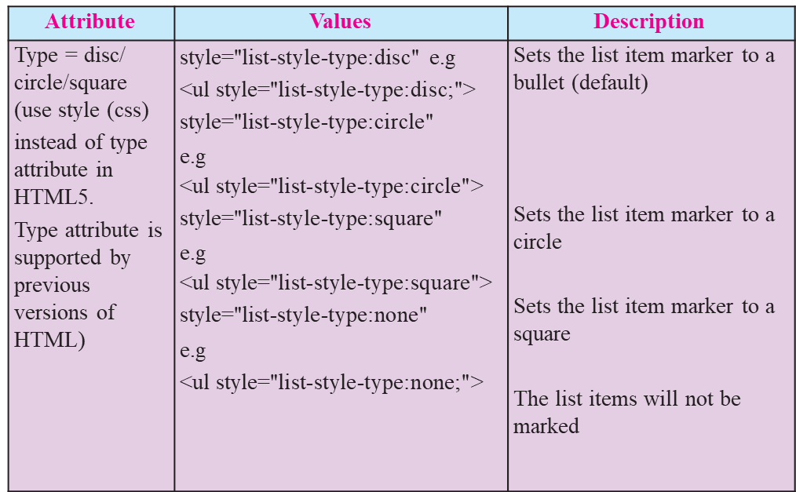
PIMPRI CHINCHWAD EDUCATION TRUST’S S.B.PATIL COLLEGE OF SCIENCE AND COMMERCE, RAVET
1.6 Unordered list or bulleted list
Note : HTML5 does not support bullets, circle and square value of type attribute instead you use CSS style.

Slide 42
PIMPRI CHINCHWAD EDUCATION TRUST’S S.B.PATIL COLLEGE OF SCIENCE AND COMMERCE, RAVET
1.6 Unordered list or bulleted list
An unordered list created using the
<ul> tag, and each list item starts with the <li> tag. The list items in unordered lists are marked with bullets (small black circles), by default.
<!DOCTYPE html>
<html>
<head>
<title>Example of HTML Unordered List</title>
</head>
<body>
<h3>HTML Unordered List</h3>
<ul>
<li>Basics of IT</li>
<li>HTML 5</li>
<li>PostgreSQL</li>
</ul></body></html>

Slide 43
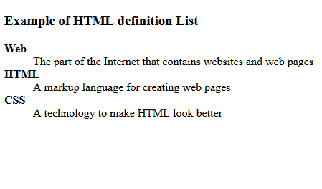
PIMPRI CHINCHWAD EDUCATION TRUST’S S.B.PATIL COLLEGE OF SCIENCE AND COMMERCE, RAVET
1.7 Definition list
To define a definition list <dl> tag is used. You can create items in definition list with the <dt> and <dd> tags. The <dt> tag is used to define the term whereas the <dd>tag is used to define the term’s definition.
<!DOCTYPE html>
<html>
<head>
<title>definition List</title>
</head>
<body>
<h3>Example of HTML definition List</h3>
<dl>
<dt><b>Web</b></dt>
<dd>The part of the Internet that contains websites and web pages</dd>
<dt><b>HTML</b></dt>
<dd>A markup language for creating web pages</dd>
<dt><b>CSS</b></dt>
<dd>A technology to make HTML look better</dd>
</dl>
</body>
</html>

Slide 44
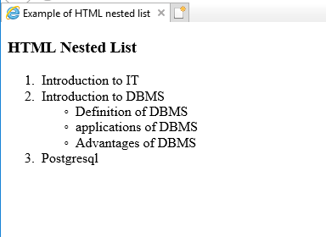
PIMPRI CHINCHWAD EDUCATION TRUST’S S.B.PATIL COLLEGE OF SCIENCE AND COMMERCE, RAVET
1.7 Nested list
List within another list either order list or unordered list is called nested list.
Examples : Single level nested list
<!DOCTYPE html>
<html >
<head>
<title>Example of HTML nested list</ title>
</head>
<body>
<h3>HTML Nested List</h3>
<ol>
<li>Introduction to IT</li>
<li>Introduction to DBMS</li>
<ul style="list-style-type:circle">
<li>Definition of DBMS</li>
<li>applications of DBMS</li>
<li>Advantages of DBMS</li>
</ul>
<li>Postgresql</li>
</ol>
</body>
</html>

Slide 45
PIMPRI CHINCHWAD EDUCATION TRUST’S S.B.PATIL COLLEGE OF SCIENCE AND COMMERCE, RAVET
1.8 Inserting audio and video in HTML 5
HTML5 features include native audio and video support without the need for Flash. HTML5 includes special elements (tags) allowing to include video and audio and to define controls.
Common Audio Formats :
mp3 : An audio format from MPEG(Moving / Motion Pictures Experts Group).
aac : Advanced Audio Coding, standard format on Iphone, youtube etc.
ogg : An Open container and free audio format.

Slide 46

PIMPRI CHINCHWAD EDUCATION TRUST’S S.B.PATIL COLLEGE OF SCIENCE AND COMMERCE, RAVET
< Audio> tag
The <audio> element enables you to embed(or add) audio files on Webpages.
.
Syntax :
<audio src="sample.mp3" type="audio/ mpeg" controls> </audio>
Example :
<!DOCTYPE html>
<html>
<body>
<p>Audio Sample</p>
<audio controls>
<source src="test.mp3“ type=“audio/mp3">
</audio>
</body>
</html>
to add audio controls such as play, pause, and volume.
to specify the audio files which the browser may use

Slide 47
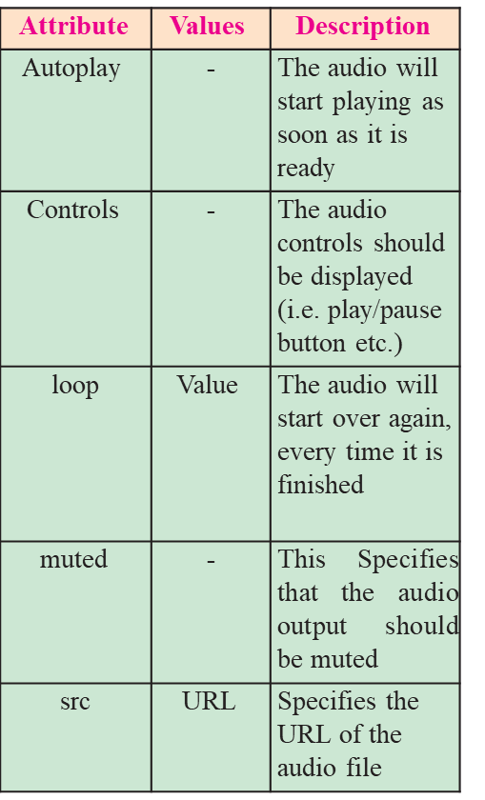
PIMPRI CHINCHWAD EDUCATION TRUST’S S.B.PATIL COLLEGE OF SCIENCE AND COMMERCE, RAVET
Attributes of < audio> tag.

Slide 48
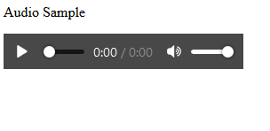
PIMPRI CHINCHWAD EDUCATION TRUST’S S.B.PATIL COLLEGE OF SCIENCE AND COMMERCE, RAVET
Adding audio with multiple sources :
Multiple sources of audios are specified so that if the browser is unable to play the first source then it will automatically jump to the second source.
<source> tag
The <source> tag is used to specify multiple media resources for media elements.
<!DOCTYPE html>
<html>
<body>
<p>Audio Sample</p>
<audio controls autoplay>
<source src="test.mp3" type="audio/mp3">
<source src="test.ogg" type="audio/ogg">
<source src="test.opus" type="audio/ogg">
</audio>
</body>
</html>

Slide 49

PIMPRI CHINCHWAD EDUCATION TRUST’S S.B.PATIL COLLEGE OF SCIENCE AND COMMERCE, RAVET
<video>Tag
The HTML <video> tag is used to embed video into your web page, it has several video sources.
There are three different formats that are commonly supported by web browsers:- .mp4, .Ogg and .WebM.
Syntax : <video src="URL" controls></video>
Example :
<!DOCTYPE html>
<html>
<body>
<video width="320" height="240" controls>
<source src="movie.mp4" type="video/mp4">
<source src="movie.ogg" type="video/ ogg">
Your browser does not support the video tag.
</video>
</body>
</html>

Slide 50
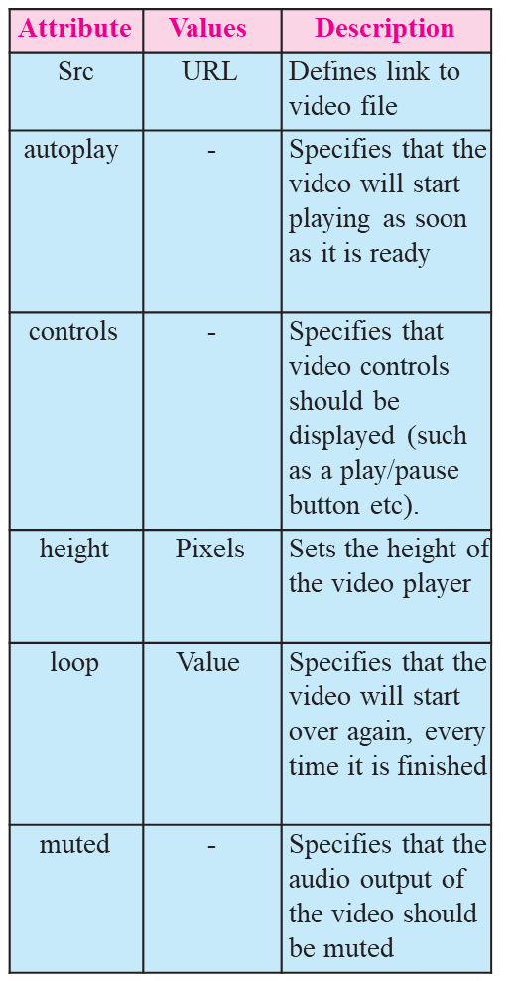
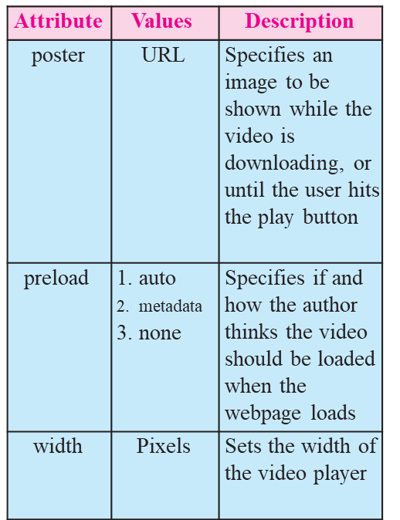
PIMPRI CHINCHWAD EDUCATION TRUST’S S.B.PATIL COLLEGE OF SCIENCE AND COMMERCE, RAVET
Attributes of <video> tag :
The <source> tag is used to specify multiple media resources for video as well as audio media elements.

Slide 51
PIMPRI CHINCHWAD EDUCATION TRUST’S S.B.PATIL COLLEGE OF Science and Commerce, Ravet
1.9 Image map in HTML 5
An image with multiple hyperlinks is called an image map.
Image map is used to connect links to different regions on the webpage. An Image map is created by marking certain regions on an image clickable. These clickable regions are called as hotspots.
Image Maps are of two types; Client Side and Server Side.
The tags used to define client side image map are :-
1. <Img> : It is used to insert an image on a web page. To create a client side image map usemap attribute of <img> is used with value which is preceded with a # symbol. The usemap attribute acts as a pointer which indicates that the image is a client side image map.
2. <map> : specifies name of the image used for client side image map. The value of the name attribute is the value specified in usemap attribute of <img>.
is used to create the map of clickable areas.
3) <area> - It defines specific clickable regions. A given <map> element can contain multiple <area> element within it.<area> is singular tag and <map> is paired.

Slide 52
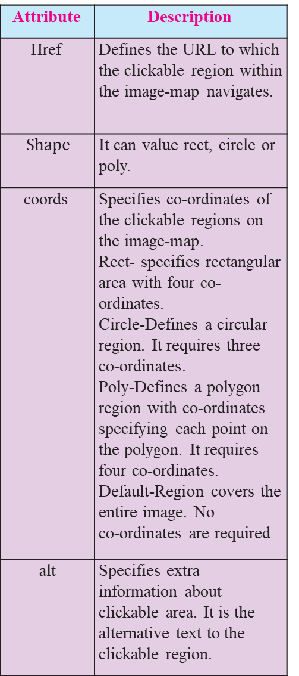
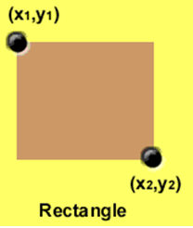
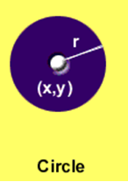
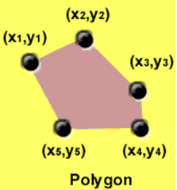
PIMPRI CHINCHWAD EDUCATION TRUST’S S.B.PATIL COLLEGE OF Science and Commerce, Ravet

Slide 53
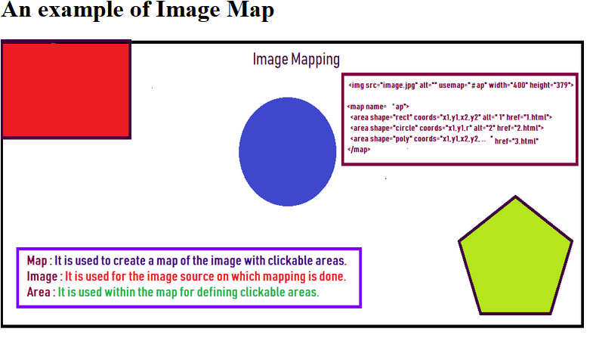
PIMPRI CHINCHWAD EDUCATION TRUST’S S.B.PATIL COLLEGE OF Science and Commerce, Ravet
Example of Image Mapping
<!DOCTYPE HTML>
<html>
<head><title>image map</title></head>
<body> <h1>An example of Image Map</h1>
<img src="image.png" usemap="#imagemap" alt="Image">
<map name="imagemap">
<area href="http://www.google.com" shape="rect" coords="0,0,233,156" alt="google site"/>
<area href=“welcome.html" shape="circle" coords="518,182 ,82" alt=" Welcome page"/>
<area href="http://www,facebook.con.” shape="poly"coords="825,319,931,246,1030,319,864,436,993,436"
alt=“Facebook site"/>
</map></body></html>
(In this program welcome.html is a local file created on the machine.)

Slide 54
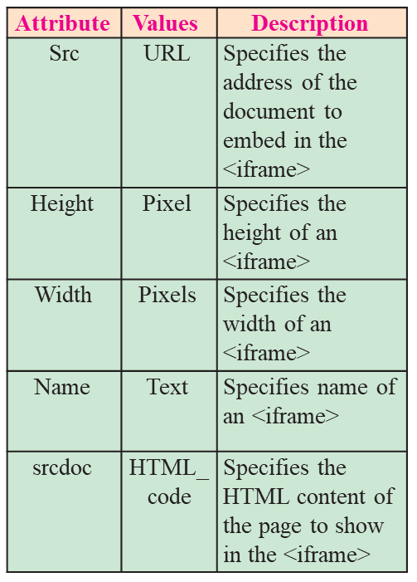
PIMPRI CHINCHWAD EDUCATION TRUST’S S.B.PATIL COLLEGE OF Science and Commerce, Ravet
1.10 INLINE FRAME IN HTML5
The <iframe> element creates an inline frame. Inline frames are often used in online advertising, where the contents of the <iframe> is an advertisement from an external party. HTML5 allows the incorporation to be seamless (no scrollbars, borders, margins etc).

Slide 55
PIMPRI CHINCHWAD EDUCATION TRUST’S S.B.PATIL COLLEGE OF Science and Commerce, Ravet
<Iframe> tag Example
<!DOCTYPE html>
<html>
<body>
<h2>HTML Iframes</h2>
<p>This is the example of iframes.</p>
<iframe src="welcome.html" height="200" width="300"></iframe>
</body>
</html>

Slide 56
PIMPRI CHINCHWAD EDUCATION TRUST’S S.B.PATIL COLLEGE OF Science and Commerce, Ravet
1.11 Website Hosting
What is web hosting?
Web hosting is the service of providing storage space. The website is made available on the Internet with the help of web hosting.
What is Web Host?
The companies that provides web hosting services are called web hosts. Web hosts own and manage web servers. These web servers offer uninterrupted Internet connectivity.
Types of Web hosting :
Types of web hosting are
Shared hosting : It is cost effective. It gives domain name to your website.
Free hosting : There are some hosting websites which provide you free hosting of the website for limited period of time.
Dedicated hosting : These are paid hosting servers for large websites.

Slide 57
PIMPRI CHINCHWAD EDUCATION TRUST’S S.B.PATIL COLLEGE OF Science and Commerce, Ravet
Prerequisites for Free Web Hosting
Three to Four pages website having first or Home Page named as index. html.
Computer with internet connection.
Gmail id with password.
Need to toggle between two websites https://www.000webhost.com/ and http://my.freenom.com
Have to acquire free web space from web server named 000webhost.com.
Have to acquire domain name for your website from my.freenom.com.
Park the website domain address with free server website i.e. with 000web- host.com.
Redirect the domain free server name to the domain website i.e. with my. freenom.com.

Slide 58
PIMPRI CHINCHWAD EDUCATION TRUST’S S.B.PATIL COLLEGE OF Science and Commerce, Ravet
Steps to Acquire free webspace :
Open the website https:// www.000webhost.com/
Click on free signup Login with your email id and password
verification email will be send to your email
open your email and click on "verify email"
Click on "Get Started"
From My Website page click on "+Create New site" button
Type your website name and any password
e.g. website name as :- it-xi-textbook
From File Manager box select "Up- load" option to upload your web pag- es. Home page of the website must be named as "index.html" (Select all webpages including image, audio files etc) and click on "Logout"
10. Your website is ready with the sub domain as 000webhostapp.com e.g.it-xi-textbook.000webhostapp. com

Slide 59
PIMPRI CHINCHWAD EDUCATION TRUST’S S.B.PATIL COLLEGE OF Science and Commerce, Ravet
Steps to Acquire free webspace :
Open the website https:// www.000webhost.com/
Click on free signup Login with your email id and password
verification email will be send to your email
open your email and click on "verify email"
Click on "Get Started"
From My Website page click on "+Create New site" button
Type your website name and any password
e.g. website name as :- it-xi-textbook
From File Manager box select "Up- load" option to upload your web pag- es. Home page of the website must be named as "index.html" (Select all webpages including image, audio files etc) and click on "Logout"
10. Your website is ready with the sub domain as 000webhostapp.com e.g.it-xi-textbook.000webhostapp. com

Slide 60
PIMPRI CHINCHWAD EDUCATION TRUST’S S.B.PATIL COLLEGE OF Science and Commerce, Ravet
Acquire Domain Name
Open the website https://my.freenom. com
From Use social sign in Click on "sign in" Login with your gmail id and give password
Click on "Services" --> Register a New Domain
Type your website name and click on "check availability" button
Choose any domain(e.g. .tk,.ml.cg etc) and click on "Get it now" if avail- able click on "CheckOut" button
Set the free period to host the website, click on "Continue" button
From Review &Checkout page if the Total Due is $0.00 then only select terms and conditions
Click on "Complete Order" button e.g. it-xi-textbook.tk
From Order Confirmation Screen click on "Click here to go to Client Area" button

Slide 61
PIMPRI CHINCHWAD EDUCATION TRUST’S S.B.PATIL COLLEGE OF Science and Commerce, Ravet
Summary
Html5 has introduced new types in <Input> like number, date, Tel, email, search, URL, range, month, week, color.
Few attributes of <Input> can be used for validation purpose.
<meta> is used by search engines to search information that is provided with the webpage. It is inserted in the <head>
CSS- Cascading Style Sheet describes how HTML elements are to be displayed on screen, paper, or in other media.
CSS syntax Selector{Property1: value1; Property2: value2}
The <ol> tag defines an ordered list. An ordered list can be numerical or alphabetical.
An unordered list created using the <ul> tag, and each list item starts with the <li> tag. The list items in unordered lists are marked with bullets (small black circles), by default.
To insert Audio and Video in a web page, <audio> and <video> are used which specifies the source with the file location.
An image with multiple hyperlinks is called an image map. The usemap attribute acts as a pointer which indicates that the image is a client side image map.
The <iframe> element creates an inline frame.

Slide 62
PIMPRI CHINCHWAD EDUCATION TRUST’S S.B.PATIL COLLEGE OF Science and Commerce, Ravet
Thank You

