Slide 1

Presented By: Shilpa Kondreddy
DATA ANALYSIS ON HOTEL BOOKING

Slide 2
About Me
I am Kondreddy Shilpa, a recent Civil Engineering graduate from Sri Krishna Devaraya University College of Engineering & Technology. Though my academic background is in engineering, I have developed a strong interest in data analysis, and this project reflects my effort to apply analytical techniques to real-world datasets and extract meaningful insights.
Why Data Analytics ?
I chose Data Analytics because it blends problem-solving, technology, and decision-making - three areas I truly enjoy. My passion lies in working with data to uncover patterns and transform them into actionable insights for solving real-world problems. Data Analytics excites me as a field full of continuous learning, innovation, and impactful applications across industries.

Slide 3
Analysis of Hotel Booking Dataset
To analyze how Hotel Booking Dataset provides insights into customer behavior, cancellations, lead times, and seasonal demand across City and Resort Hotels.
The dataset helps understand booking patterns, guest demographics, revenue drivers, and market segments-useful for revenue management, marketing, and demand forecasting.
The dataset contains 119,390 rows and 36 columns including 28 numerical columns (lead time, stay duration, ADR, special requests) and 8 categorical columns (hotel type, arrival date, country, market segment, reservation status).
Key Features Include:
Booking Status & Lead Time
Stay Duration (Weekdays & Weekends)
Guest Details (Adults, Children, Babies)
Average Daily Rate (ADR)
Market Segment & Distribution Channel
Deposit Type & Special Requests
Reservation Status & Date

Slide 4
Understanding the Columns in Hotel Booking Dataset
hotel: Type of hotel (Resort or City).
Column Name | Missing Values | Cleaning Required | Importance (Why)
hotel | 0 | No | Type of hotel – City vs Resort.
is_canceled | 0 | No | Target variable – cancellation analysis.
lead_time | 0 | Yes (outliers) | Days between booking & arrival.
arrival_date_year | 0 | No | Yearly booking trends.
arrival_date_month | 0 | No | Seasonal demand patterns.
arrival_date_week_number | 0 | No | Weekly trends in bookings.
arrival_date_day_of_month | 0 | No | Daily arrival insights.
stays_in_weekend_nights | 0 | No | Weekend demand indicator.
stays_in_week_nights | 0 | No | Weekday demand indicator.
adults | 0 | Yes (invalid values) | Core guest count.
children | 4 | Yes (missing/invalid) | Family demand factor.
babies | 0 | No | Niche family segment.

Slide 5
Column Name | Missing Values | Cleaning Required | Importance (Why)
meal | 0 | No | Meal plan – impacts revenue.
country | 488 | Yes (missing) | Guest origin – segmentation.
market_segment | 0 | No | Booking source.
distribution_channel | 0 | No | Sales channel.
is_repeated_guest | 0 | No | Loyalty indicator.
previous_cancellations | 0 | No | Past cancellation behavior.
previous_bookings_not_canceled | 0 | No | Guest reliability.
reserved_room_type | 0 | No | Guest preference.
assigned_room_type | 0 | No | Upgrade/downgrade check.
booking_changes | 0 | No | Flexibility in bookings.
deposit_type | 0 | No | Payment security.
agent | 16,340 | Yes (missing) | Travel agent reference.

Slide 6
Column Name | Missing Values | Cleaning Required | Importance (Why)
company | 112,593 | Yes (mostly missing) | Corporate client ID.
days_in_waiting_list | 0 | No | Demand pressure.
customer_type | 0 | No | Guest segmentation.
adr (Average Daily Rate) | 0 | Yes (outliers) | Revenue per booking.
required_car_parking_spaces | 0 | No | Parking demand.
total_of_special_requests | 0 | No | Service customization.
reservation_status | 0 | No | Final outcome.
reservation_status_date | 0 | Yes (format) | Cancellation timing.
name | 0 | No | Unique guest identifier.
email | 0 | No | Not useful for analysis.
phone-number | 0 | No | Guest contact – not used.
credit_card | 0 | No | Payment reference.

Slide 7
Problem Statement
Problem 1: What factors influence booking cancellations? Goal: Identify key drivers of cancellations (lead time, customer type, deposit type, etc.) to reduce revenue loss.
Problem 2: How do booking trends vary across hotel types (City Hotel vs. Resort Hotel)? Goal: Compare seasonality, customer preferences, and booking behavior to improve marketing strategies.
Problem 3: What is the impact of lead time on cancellations and check-in rates? Goal: Analyze booking lead time patterns to optimize inventory and revenue management.
Problem 4: How do market segments and distribution channels affect booking success? Goal: Evaluate which customer segments and channels bring the highest retention and revenue.
Problem 5: What role do special requests and repeated guests play in booking outcomes? Goal: Understand customer loyalty and preferences to improve guest experience and retention.

Slide 8
Handling Outliers
Identified Outliers in numerical features such as ADR (Average Daily Rate), lead time, and stays in week nights
Techniques Used:
IQR method (Q1 ± 1.5×IQR) to validate statistical thresholds
Findings: Extreme ADR values (above 5400) detected → not realistic for typical bookings
Why It Matters: Outliers can distort averages, mislead pricing insights, and affect demand forecasting
Action Taken: Replaced extreme values with nearest acceptable limits → kept dataset complete
Impact: Cleaner dataset ensures reliable analysis, accurate forecasting, and better business decisions

Slide 9
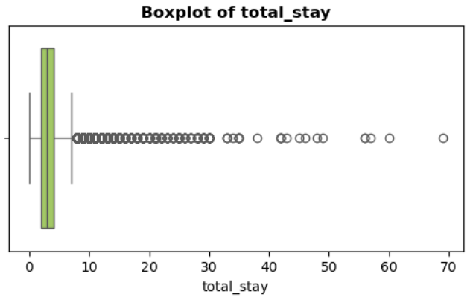
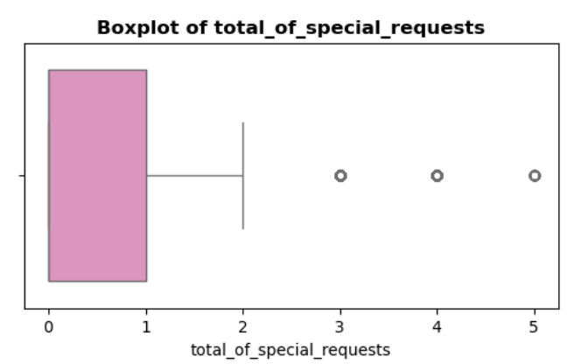
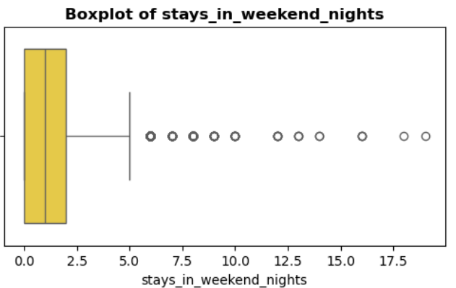
Handling Outliers - Box Plot

Slide 10
Handling Missing Data
Identified Missing Values
children → 4
country → 488
agent → 16,340
company → 112,593
Techniques Used
Median used for numerical column (children)
Mode used for categorical column (country)
Placeholder "Unknown" for categorical IDs (agent, company)
Why It Matters
Missing data can bias results and reduce accuracy of insights
Proper imputation ensures a complete and consistent dataset
Impact
Dataset cleaned with no missing values remaining
Ready for further analysis like cancellations, pricing, and forecasting

Slide 11
Why Duplicates Matter ?
Duplicate rows can occur when the same booking is entered more than once.
They artificially inflate booking counts, which may lead to wrong revenue or cancellation statistics.
Distorts key measures such as Average Daily Rate (ADR), lead time, and stay duration.
Misrepresents customer behavior, especially repeat bookings or cancellation patterns

Slide 12
Handling Duplicates
Detection and Findings
Method: df.duplicated().sum() used to scan for duplicate rows.
Result: 0 duplicates detected in the dataset.
Impact on Analysis
Confirms dataset is already clean and consistent.
No records needed removal → dataset size remains the same (119,390 rows).
Ensures insights on cancellations, seasonal demand, and pricing strategies are trustworthy and free of duplication bias.

Slide 13
Fixing Inconsistencies in Categorical Data
Issue: Some categorical columns like meal, market_segment, and deposit_type had values that needed verification for hidden spaces or inconsistent formatting.
Techniques Used:
Applied .str.strip() to remove extra spaces.
Converted text to a consistent case format (lowercase).
Standardized categorical fields to maintain uniform labels.
Findings:
Categories such as meal (BB, FB, HB, SC), market_segment (Direct, Corporate, Online TA, etc.), and deposit_type (No Deposit, Non Refund, Refundable) were cleaned and verified.
Why It Matters:
Prevents duplicate-like categories (e.g., "Online TA" vs "Online TA ").
Ensures consistency in grouping, visualization, and trend analysis.
Impact:
Dataset is now consistent and standardized, improving the quality of insights for segmentation, cancellations, and pricing analysis.

Slide 14
Data Type Conversion
Some columns stored in unsuitable formats (object instead of category, dates as strings).
Converted categorical fields (hotel, meal, market_segment, deposit_type, customer_type) to category type.
Changed reservation_status_date to datetime format for time-based analysis.
Ensured numerical fields (lead_time, adr, stays_in_week_nights) remained numeric.
8 columns standardized as categorical, 1 column formatted as datetime.
Memory usage reduced and dataset became more structured.
Enabled faster computation, accurate grouping, and reliable analysis.

Slide 15
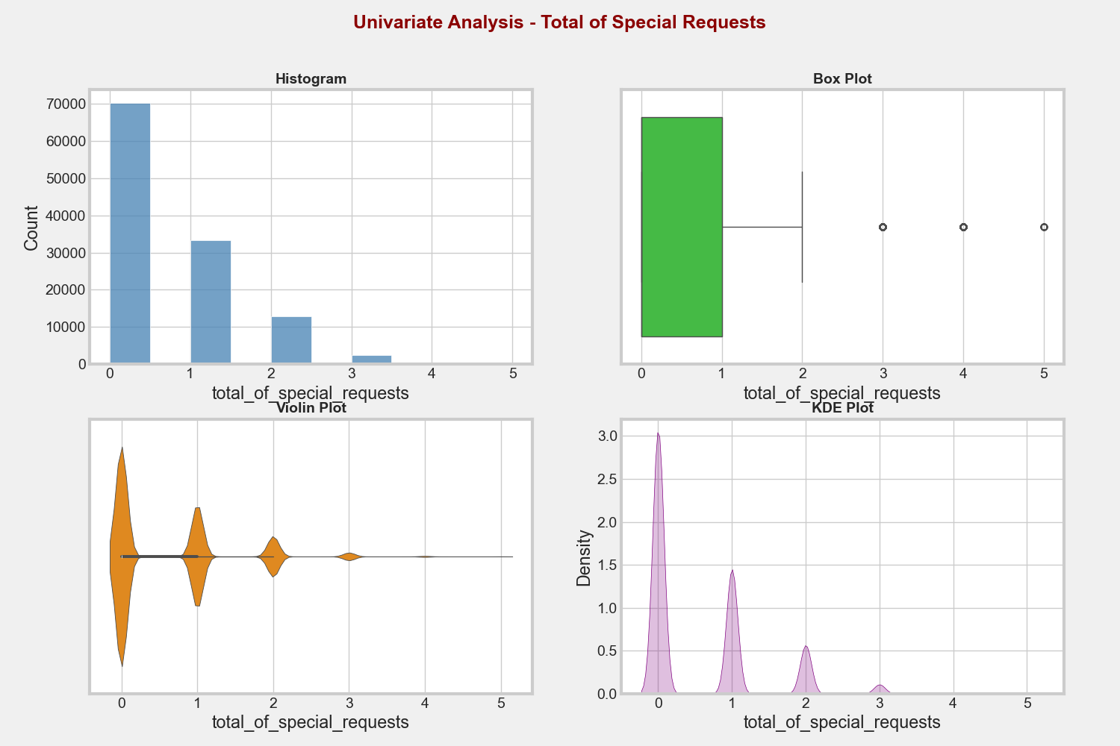
Univariate Analysis
Univariate Analysis examines the distribution and patterns of a single variable (numerical or categorical) to understand its characteristics.
One numerical column
Most bookings have short lead times, low ADR values, and stays of 1–5 weeknights with 0–2 weekend nights, though a few extreme outliers exist.

Slide 16
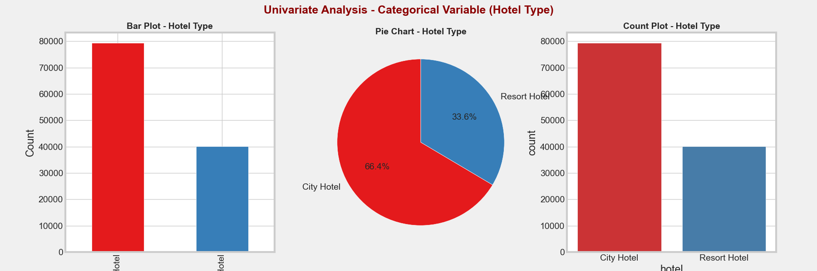
One Categorical Column
City Hotel has significantly more bookings than Resort Hotel, showing higher overall demand.

Slide 17
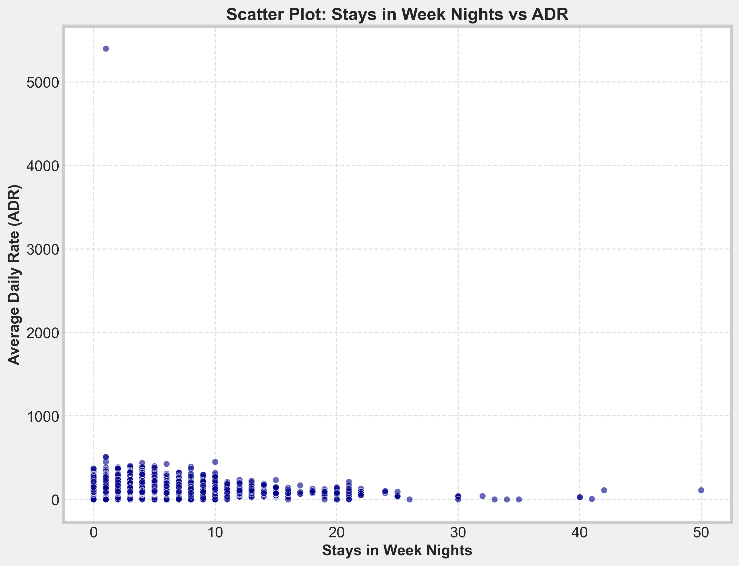
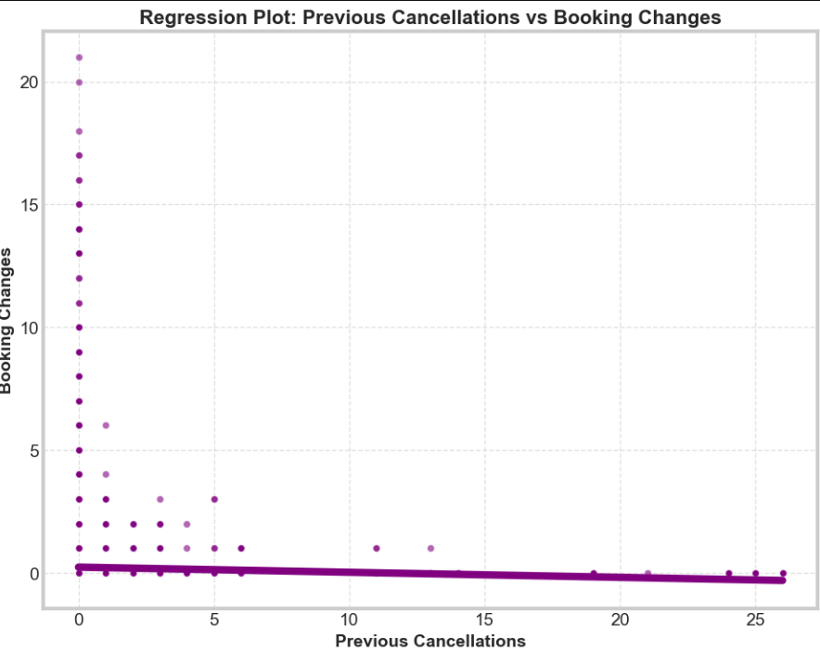
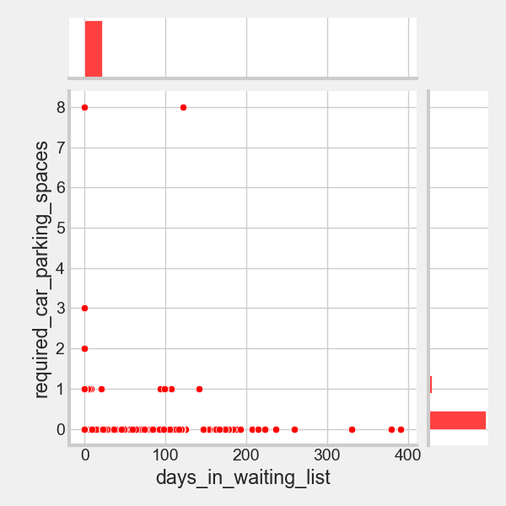
Bivariate Analysis Focused on the relationship between two variables to detect patterns and dependencies.
Two numerical column
City Hotels show higher bookings with moderate ADR and shorter lead times, Resort Hotels have wider ADR variation and longer lead times, No Deposit bookings face more cancellations than Non-Refund, and most guests receive their reserved room type though changes occur.

Slide 18
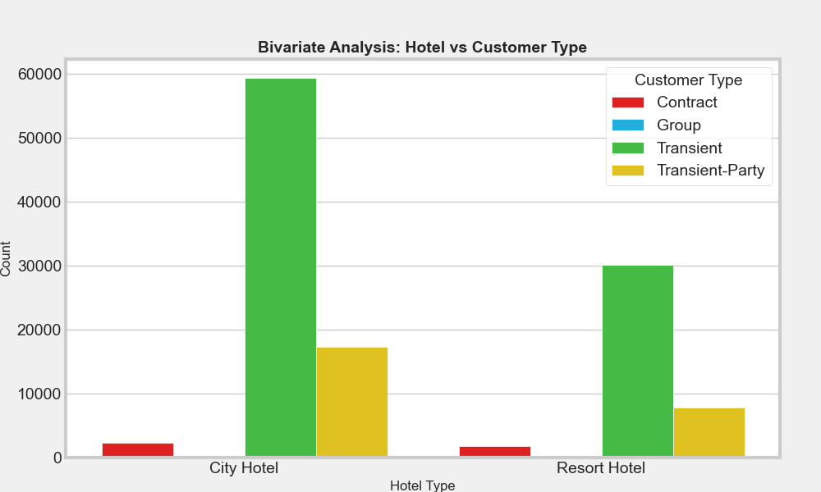
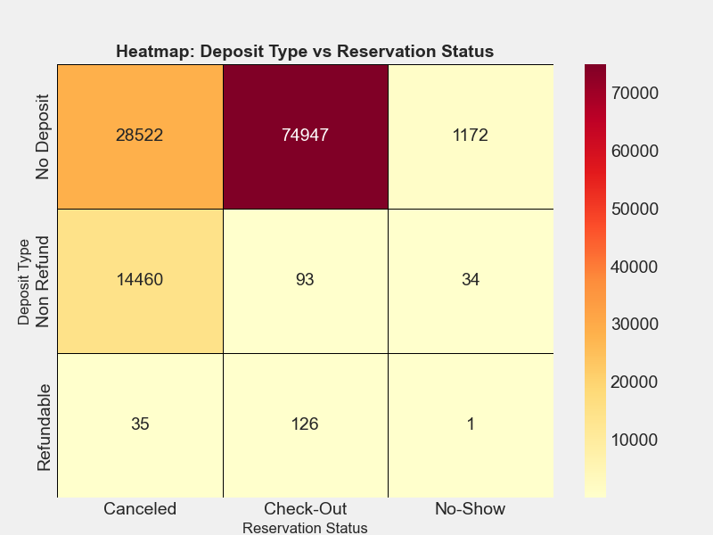
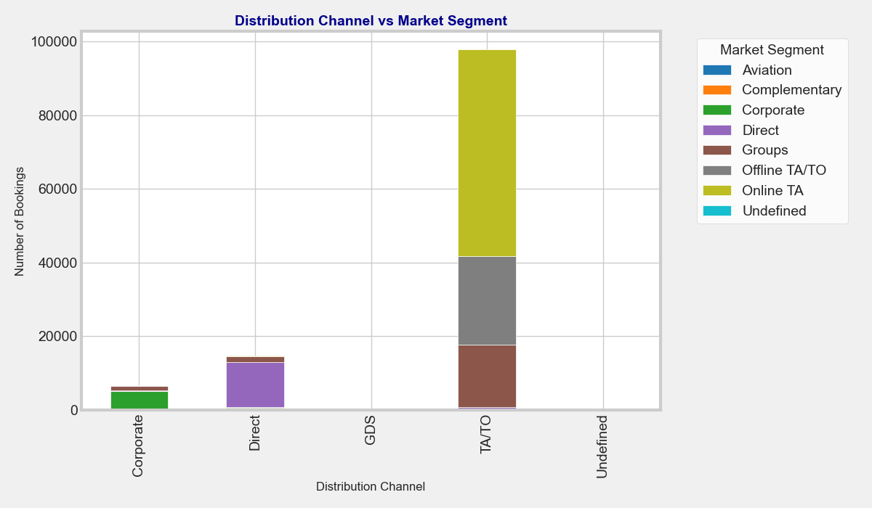
Bivariate Analysis
Focused on the relationship between two variables to detect patterns and dependencies
Two categorical column
No Deposit bookings face higher cancellations than Non-Refund deposits, while City Hotels attract mostly transient customers and Resort Hotels serve more families and groups.

Slide 19
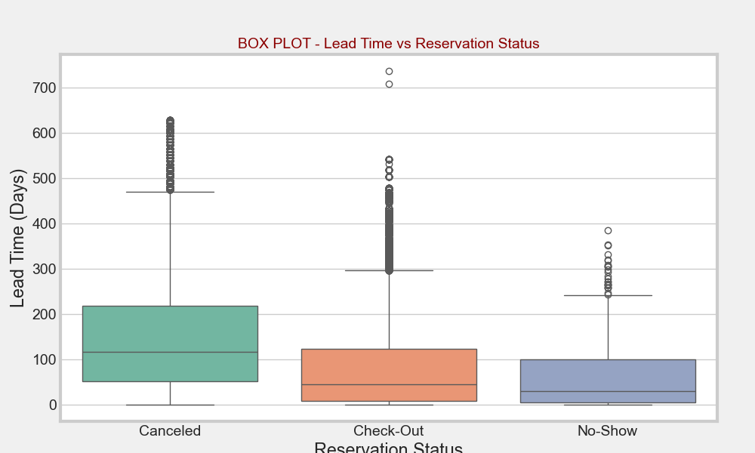
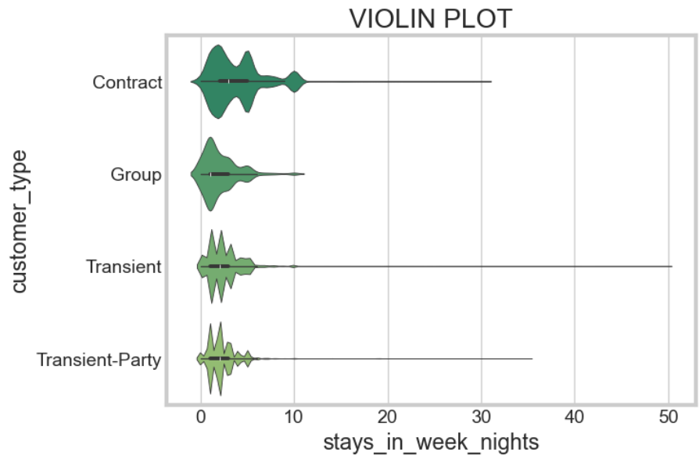
Bivariate Analysis
Focused on the relationship between two variables to detect patterns and dependencies
One categorical and one numerical
City Hotels show higher bookings with generally lower ADR and shorter lead times, while Resort Hotels have higher ADR variation and longer planning periods.
Transient customers dominate bookings with shorter stays, while families and group customers show longer stays during weekdays.

Slide 20
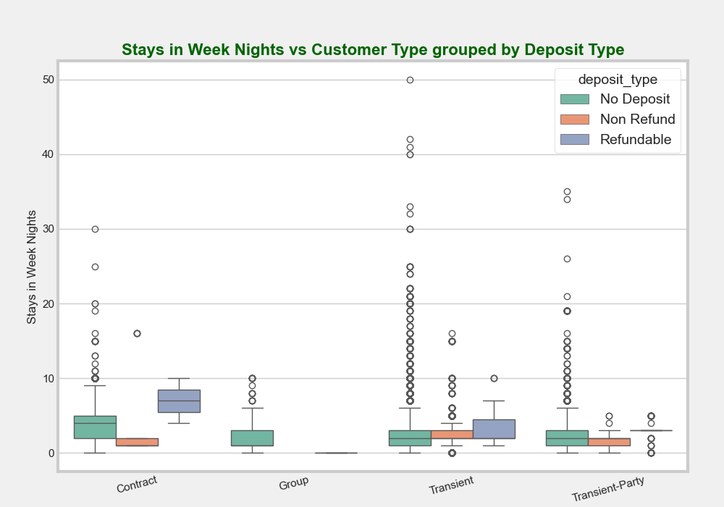
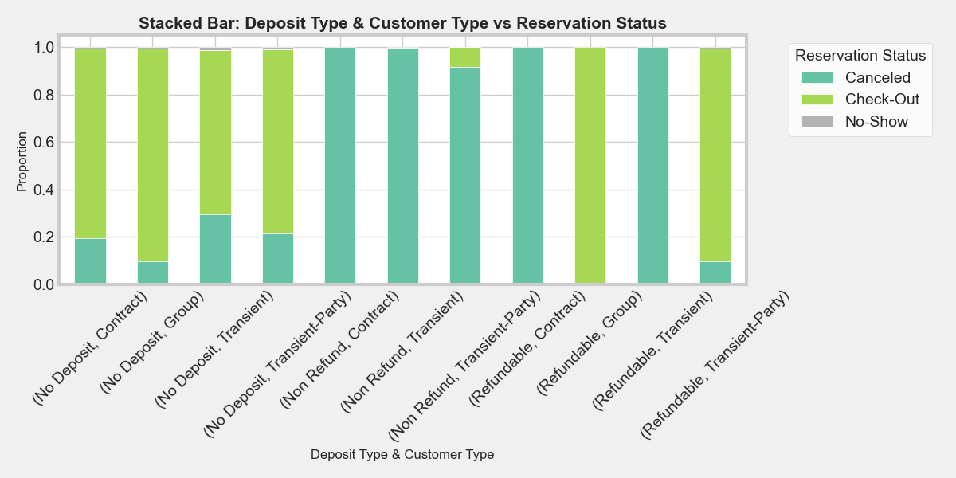
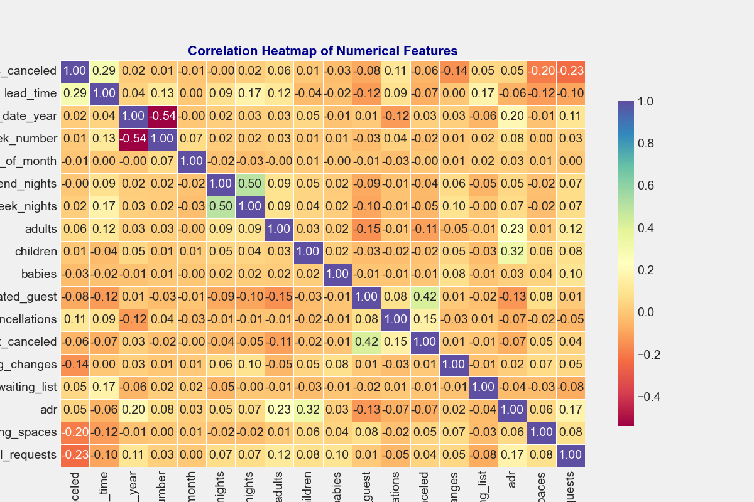
Multivariate Analysis
Focused on the relationship between three or more variables to capture combined effects and complex dependencies.
Box plots showed that booking cancellations depend on both deposit type and hotel type, with Non-Refund deposits strongly reducing cancellations.
Stacked bar charts revealed how customer type and market segment together impact booking counts, with transient customers dominating online channels.
Correlation heatmaps highlighted strong links between lead time, ADR, and cancellations, showing that longer lead times and higher ADRs often correspond to higher cancellation rates.

Slide 21
Insights
High Cancellation Rates -A significant portion of bookings get canceled, influenced by lead time, deposit type, and customer segment.
Seasonal & Hotel Type Trends -City Hotels see higher weekday demand, while Resort Hotels peak during weekends and holidays.
Lead Time Impacts Revenue -Longer lead times are strongly associated with higher cancellation likelihood.
Distribution Channel Dependence -OTAs (Online Travel Agents) drive most bookings but also contribute to high cancellations.
Customer Loyalty Signals - Repeated guests and special requests often indicate higher retention and satisfaction.
Market Segment Variability - Corporate, group, and online customers show distinct booking behaviors requiring tailored strategies.
Data Quality Challenges - Missing values in key columns (e.g., children, agent/company) require imputation for accurate modeling.
Business Value - Insights support revenue optimization, targeted marketing, and improved customer experience strategies.

Slide 22
Conclusion
Hotel booking data reveals clear seasonal and regional patterns in demand.
High cancellation rates highlight the need for better forecasting and customer retention strategies.
Lead time, distribution channel, and deposit type are strong predictors of booking outcomes.
Insights can guide revenue management, targeted marketing, and operational planning.
With proper data cleaning and modeling, the dataset can significantly support decision-making in the hospitality industry.

Slide 23
Future Scope:
Predictive Modeling - Develop ML models to forecast cancellations and optimize occupancy.
Customer Segmentation - Use clustering to identify guest profiles for personalized offers.
Revenue Optimization - Dynamic pricing strategies using booking trends and seasonality.
Integration with External Data - Combine with weather, events, or flight data for richer insights.
Real-time Dashboards - Build interactive BI tools to help hotel managers make quick decisions.
Sustainability Insights - Analyze patterns to reduce resource use and improve eco-friendly practices.

Slide 24

THANK YOU

