Slide 1

Instagram User Analytics (SQL Fundamentals)

Slide 2
Description:
User analysis is the process by which we track how users engage and interact with our digital product (software or mobile application) in an attempt to derive business insights for marketing, product & development teams.
These insights are then used by teams across the business to launch a new marketing campaign, decide on features to build for an app, track the success of the app by measuring user engagement and improve the experience altogether while helping the business grow.
You are working with the product team of Instagram and the product manager has asked you to provide insights on the questions asked by the management team.

Slide 3
AGENDA: The marketing team wants to launch some campaigns, and they need your help with the following
1.Rewarding Most Loyal Users: People who have been using the platform for the longest time. Your Task: Find the 5 oldest users of Instagram from the database provided
SELECT * FROM USERS ORDER BY created_at LIMIT 5 ;

Slide 4
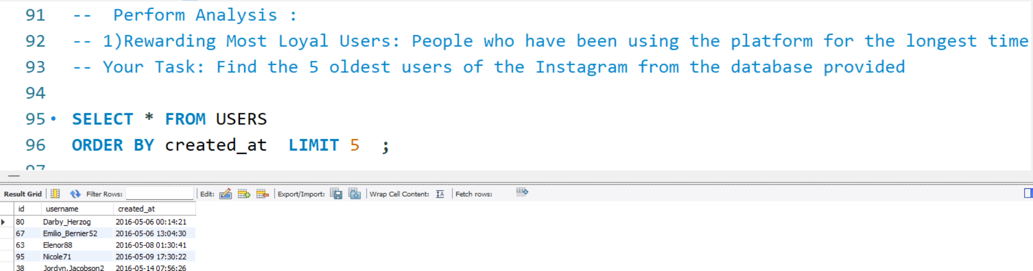

Slide 5
2.Remind Inactive Users to Start Posting: By sending them promotional emails to post their 1st photo. Your Task: Find the users who have never posted a single photo on Instagram
SELECT username from users LEFT JOIN PHOTOS ON users.id = photos.user_id WHERE photos.id is NULL ;

Slide 6
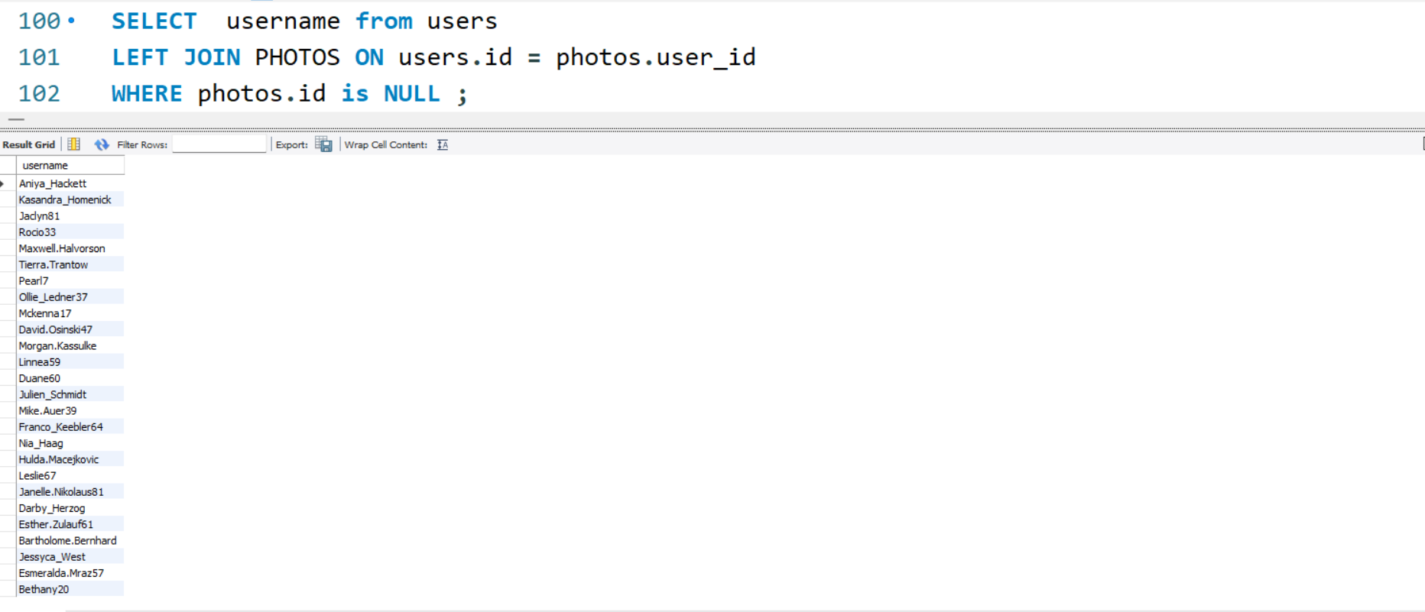

Slide 7
3.Declaring Contest Winner: The team started a contest and the user who gets the most likes on a single photo will win the contest now they wish to declare the winner. Your Task: Identify the winner of the contest and provide their details to the team.
SELECT USERS.USERNAME, PHOTOS.ID, PHOTOS.IMAGE_URL , COUNT(*) AS TOTAL_NO_LIKES FROM LIKES INNER JOIN PHOTOS ON PHOTOS.ID = LIKES.PHOTO_ID INNER JOIN USERS ON USERS.ID = PHOTOS.USER_ID GROUP BY PHOTOS.ID ORDER BY TOTAL_NO_LIKES DESC LIMIT 1 ;

Slide 8
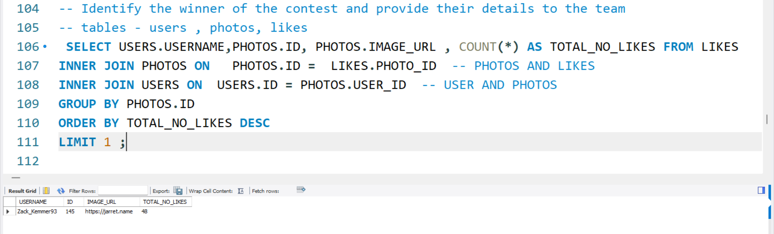

Slide 9
4. Hashtag Researching: A partner brand wants to know, which hashtags to use in the post to reach the most people on the platform. Your Task: Identify and suggest the top 5 most commonly used hashtags on the platform.
SELECT TAG_NAME , COUNT(TAG_NAME) AS NO_OF_TAGS FROM TAGS JOIN PHOTO_TAGS ON TAGS.ID = PHOTO_TAGS.TAG_ID GROUP BY TAGS.ID ORDER BY NO_OF_TAGS DESC LIMIT 5 ;

Slide 10
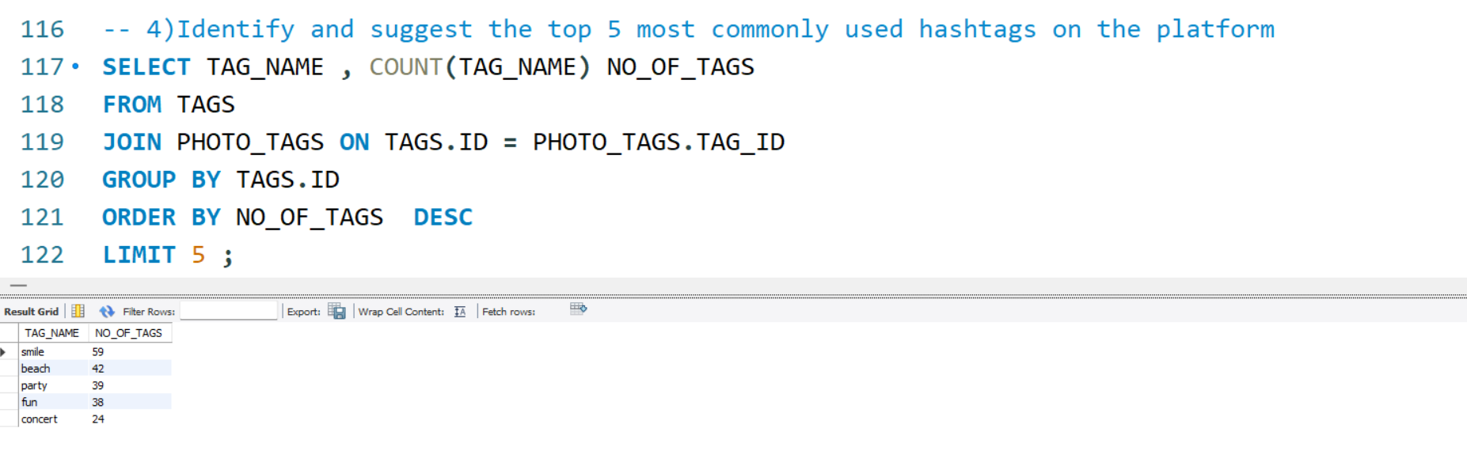

Slide 11
Launch AD Campaign: The team wants to know, which day would be the best day to launch ADs. Your Task: What day of the week do most users register on? Provide insights on when to schedule an ad campaign
SELECT DATE_FORMAT(CREATED_AT , "%W") AS WEEK_DAY , COUNT(*) AS TOTAL_NUMBER_OF_REGISTRATION FROM USERS GROUP BY WEEK_DAY ORDER BY TOTAL_NUMBER_OF_REGISTRATION DESC ;

Slide 12
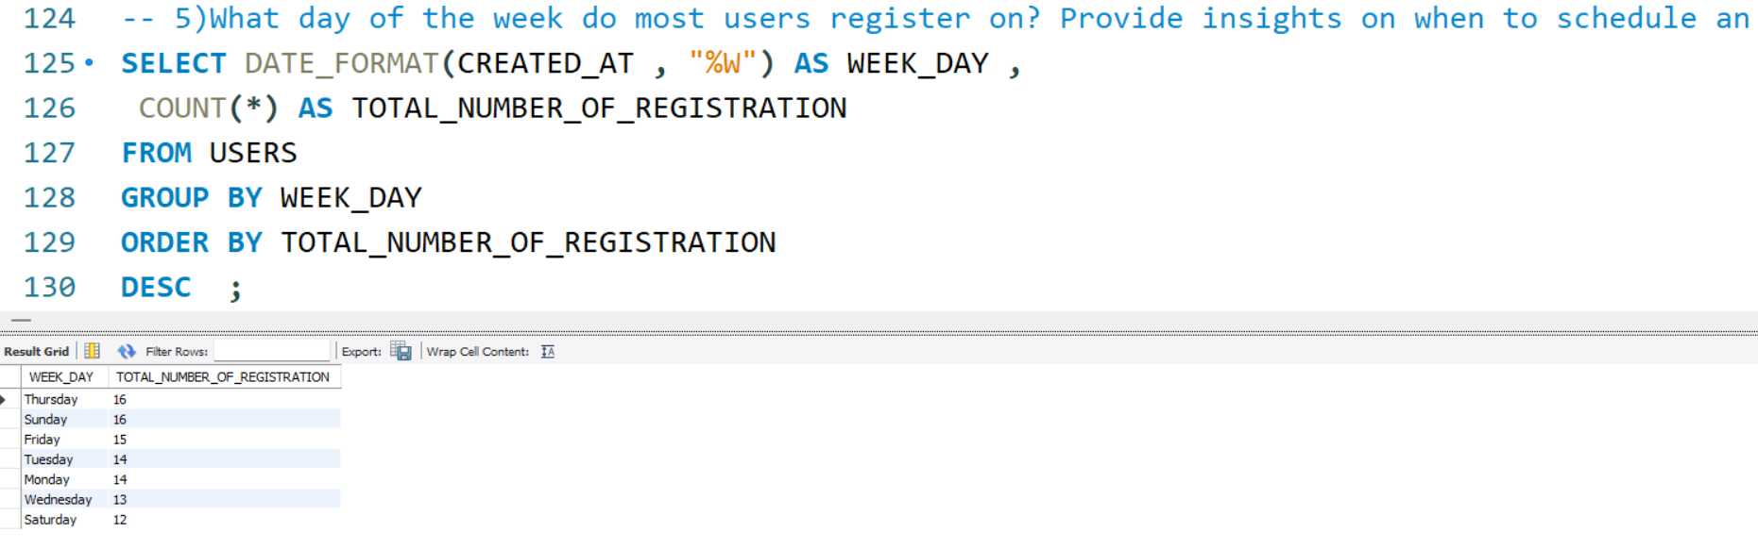

Slide 13
Investor Metrics: Our investors want to know if Instagram is performing well and is not becoming redundant like Facebook, they want to assess the app on the following grounds
User Engagement: Are users still as active and post on Instagram or they are making fewer posts Your Task: Provide how many times does average user posts on Instagram. Also, provide the total number of photos on Instagram/total number of users

Slide 14
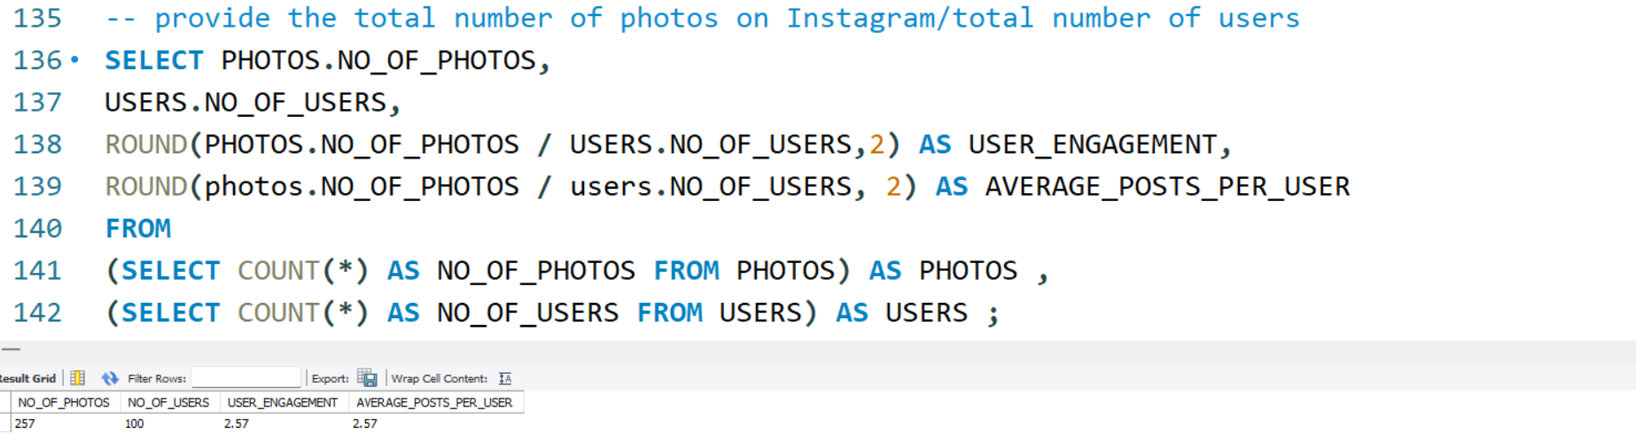
SELECT PHOTOS.NO_OF_PHOTOS, USERS.NO_OF_USERS, ROUND(PHOTOS.NO_OF_PHOTOS / USERS.NO_OF_USERS,2) AS USER_ENGAGEMENT, ROUND(photos.NO_OF_PHOTOS / users.NO_OF_USERS, 2) AS AVERAGE_POSTS_PER_USER FROM (SELECT COUNT(*) AS NO_OF_PHOTOS FROM PHOTOS) AS PHOTOS , (SELECT COUNT(*) AS NO_OF_USERS FROM USERS) AS USERS ;

Slide 15
Bots & Fake Accounts: The investors want to know if the platform is crowded with fake and dummy accounts Your Task: Provide data on users (bots) who have liked every single photo on the site (since any normal user would not be able to do this).
SELECT USERNAME ,COUNT(*) AS NO_OF_LIKES FROM USERS JOIN LIKES ON USERS.ID = LIKES.USER_ID GROUP BY USERS.ID HAVING NO_OF_LIKES = (SELECT COUNT(*) FROM PHOTOS) ;

Slide 16
Conclusion :
This project has enabled me to gain insights that are essential for the product team by addressing their questions effectively. It has enhanced my understanding of data analysis for businesses, specifically through the utilization of MySQL Workbench.

Slide 17
THANK YOU

