Slide 1
Operation Analytics and Investigating Metric Spike Advanced SQL

Slide 2
Project Description:
Operation Analytics is the analysis done for the complete end-to-end operations of a company. With the help of this, the company then finds the areas in which it must improve upon. You work closely with the ops team, support team, marketing team, etc, and help them derive insights from the data they collect. Being one of the most important parts of a company, this kind of analysis is further used to predict the overall growth or decline of a company’s fortune. It means better automation, better understanding between cross-functional teams, and more effective workflows. Investigating metric spikes is also an important part of operation analytics as a Data Analyst you must be able to understand or make other teams understand questions like- Why is there a dip in daily engagement? Why have sales taken a dip? Etc. Questions like these must be answered daily and for that, it’s very important to investigate metric spikes. You are working for a company like Microsoft and designated as Data Analyst Lead and are provided with different data sets, and tables from which you must derive certain insights out of it and answer the questions asked by different departments.

Slide 3
APPROACH

Slide 4
My approach to tackling the problem involved several key steps. First, I thoroughly examined and understood the provided dataset in the project. This involved analyzing the tables and their respective columns, as well as identifying the specific tasks I needed to perform.
To work with the dataset, I utilized MySQL as my database management system. This allowed me to effectively query and manipulate the data to extract the necessary insights.
Once I had a clear understanding of the dataset and the tasks at hand, I proceeded to analyze the data step by step. This involved applying various SQL queries, aggregations, filters and joins to obtain the required information and perform the requested calculations.
Throughout the analysis process, I closely monitored the results and ensured they aligned with the expected outcomes. I paid attention to any patterns, trends, or anomalies observed in the data, which helped me derive meaningful insights and draw relevant conclusions.
By diligently following this approach, I successfully completed the assigned tasks and obtained valuable insights from the dataset. The process involved careful examination, analysis, and interpretation of the data to fulfill the project requirements and provide accurate and meaningful results.

Slide 5


Tech-Stack Used
Prepare Data
Prepare
Process
Analyze Data

Slide 6
INSIGHTS

Slide 7
Throughout the duration of the project, I immersed myself in the concepts of Operation Analysis, which encompassed a range of key skills and techniques. From the very beginning, I focused on implementing these concepts and expanding my knowledge.
I started by gaining a deep understanding of fundamental operations such as counting, summing, calculating percentages, and working with dates and times in SQL. I familiarized myself with essential functions such as window functions, subqueries, handling duplicate values, and utilizing nested queries effectively. This knowledge allowed me to manipulate and analyze the data more efficiently.
Additionally, I learned practical skills like creating tables and inserting values into them. I also acquired the ability to import files into SQL, enabling me to work seamlessly with various datasets and formats.
To further enhance my analytical capabilities, I delved into advanced SQL techniques. I learned how to count rows and use the row number function. I explored the power of partitioning data using the partition by clause and leveraged the group by function for aggregating data. Furthermore, I became adept at sorting data using the order by function, both in ascending (asc) and descending (desc) order. Additionally, I grasped the importance of providing appropriate aliases to derived tables to improve code readability and maintainability.
In summary, from the outset of the project, I immersed myself in the world of Operation Analysis and honed my skills in a wide range of SQL concepts and techniques.

Slide 8
Case Study 1 (Job Data)

Slide 9
Number of jobs reviewed: Amount of jobs reviewed over time. Your task: Calculate the number of jobs reviewed per hour per day for November 2020.
The maximum number of jobs reviewed per hour per day for November 2020 is 218 on “ 28 November”.
The average number of jobs reviewed per hour per day for November 2020 is 35 on “27 November”.
The average number of jobs reviewed per hour per day for November 2020 is 126.

Slide 10
SELECT DS, COUNT(DISTINCT JOB_ID) AS JOB_REVIEWED, SUM(TIME_SPENT) / (60 * 60) AS PER_HOUR_TIME_SPEND, ROUND((COUNT(DISTINCT JOB_ID) / SUM(TIME_SPENT)) * (60 * 60)) AS jobs_reviewed_per_hour_per_day FROM JOB_DATA WHERE DS >= '2020-11-01' AND DS <= '2020-11-30 ‘ GROUP BY DS ORDER BY DS DESC;
DS | JOB_REVIEWED | PER_HOUR_TIME_SPEND | jobs_reviewed_per_hour_per_day
11/30/2020 | 2 | 0.0111 | 180
11/29/2020 | 1 | 0.0056 | 180
11/28/2020 | 2 | 0.0092 | 218
11/27/2020 | 1 | 0.0289 | 35
11/26/2020 | 1 | 0.0156 | 64
11/25/2020 | 1 | 0.0125 | 80

Slide 11
Throughput: It is the no. of events happening per second. Your task: Let’s say the above metric is called throughput. Calculate the 7-day rolling average of throughput. For throughput, do you prefer daily metric or 7-day rolling and why?
The 7-day rolling average of the number of events happening.
WITH DAILY_METRIC AS ( SELECT DS, COUNT(JOB_ID) AS JOB_REVIEW FROM JOB_DATAGROUP BY DS) SELECT DS, JOB_REVIEW, AVG(JOB_REVIEW) OVER (ORDER BY DS ROWS BETWEEN 6 PRECEDING AND CURRENT ROW ) AS THROUGHPUT FROM DAILY_METRIC ORDER BY THROUGHPUT DESC ;
DS | JOB_REVIEW | THROUGHPUT
11/30/2020 | 2 | 1.3333
11/28/2020 | 2 | 1.25
11/29/2020 | 1 | 1.2
11/25/2020 | 1 | 1
11/26/2020 | 1 | 1
11/27/2020 | 1 | 1

Slide 12
Percentage share of each language: Share of each language for different contents. Your task: Calculate the percentage share of each language in the last 30 days.
The Persian language has the highest percentage share 37.5%. Italian, Hindi, French, English, and Arabic are having the same percentage share at 12.5%.
SELECT LANGUAGE,COUNT(LANGUAGE) AS LANGUAGE_COUNT,(COUNT(LANGUAGE)/ (SELECT COUNT(*) FROM JOB_DATA)) * 100 AS Percentage_Share FROM JOB_DATA GROUP BY LANGUAGE ORDER BY LANGUAGE DESC ;
LANGUAGE | LANGUAGE_COUNT | Percentage_Share
Persian | 3 | 37.5
Italian | 1 | 12.5
Hindi | 1 | 12.5
French | 1 | 12.5
English | 1 | 12.5
Arabic | 1 | 12.5

Slide 13
Duplicate rows: Rows that have the same value present in them. Your task: Let’s say you see some duplicate rows in the data. How will you display duplicates from the table?
These rows are having the Duplicate values.
SELECT * FROM (SELECT *,ROW_NUMBER() OVER
(PARTITION BY JOB_ID) AS DUPLICATE_ROWS FROM JOB_DATA ) A_R
WHERE DUPLICATE_ROWS > 1;
DS | JOB_ID | ACTOR_ID | EVENT | LANGUAGE | TIME_SPENT | ORG | DUPLICATE_ROWS
11/28/2020 | 23 | 1005 | transfer | Persian | 22 | D | 2
11/26/2020 | 23 | 1004 | skip | Persian | 56 | A | 3

Slide 14
Case Study 2 (Investigating metric spike)

Slide 15
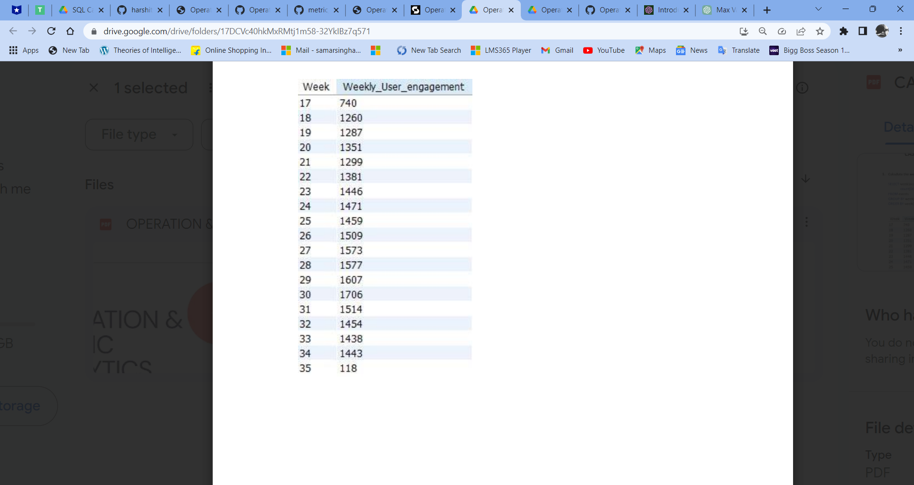
User Engagement: To measure the activeness of a user. Measuring if the user finds quality in a product/service. Your task: Calculate the weekly user engagement.
The highest week is the 30th with 1706 users. And the lowest week is 35th with 118 users.
SELECT EXTRACT(WEEK FROM OCCURED_AT) AS WEEKLY_NUMBER , COUNT( DISTINCT USER_ID) AS WEEKLY_USERS FROM EVENTS WHERE EVENT_TYPE = "ENGAGEMENT" AND EVENT_NAME = "LOGIN“ GROUP BY 1 ORDER BY 1;

Slide 16
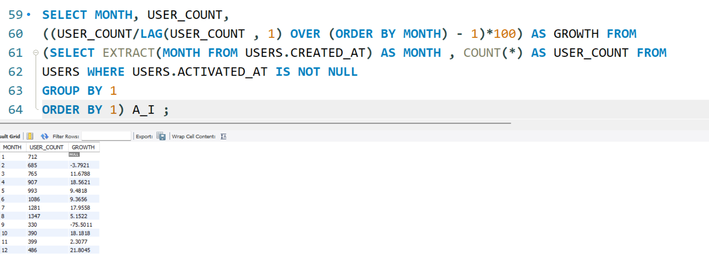
User Growth: Amount of users growing over time for a product. Your task: Calculate the user growth for the product.

Slide 17
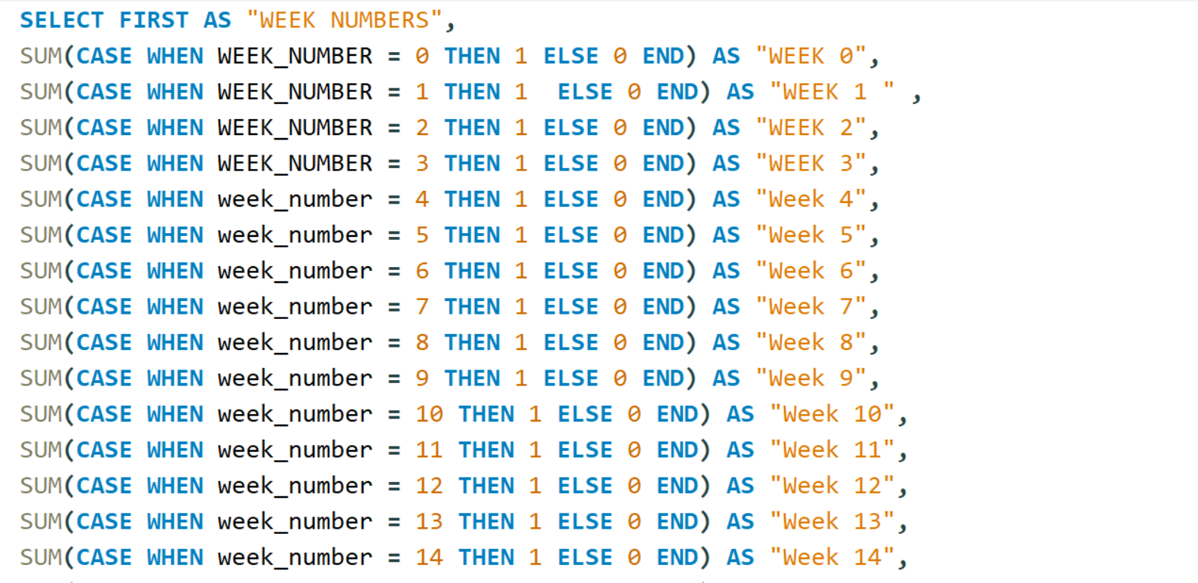
Weekly Retention: Users get retained weekly after signing up for a product. Your task: Calculate the weekly retention of users-sign up cohort.

Slide 18
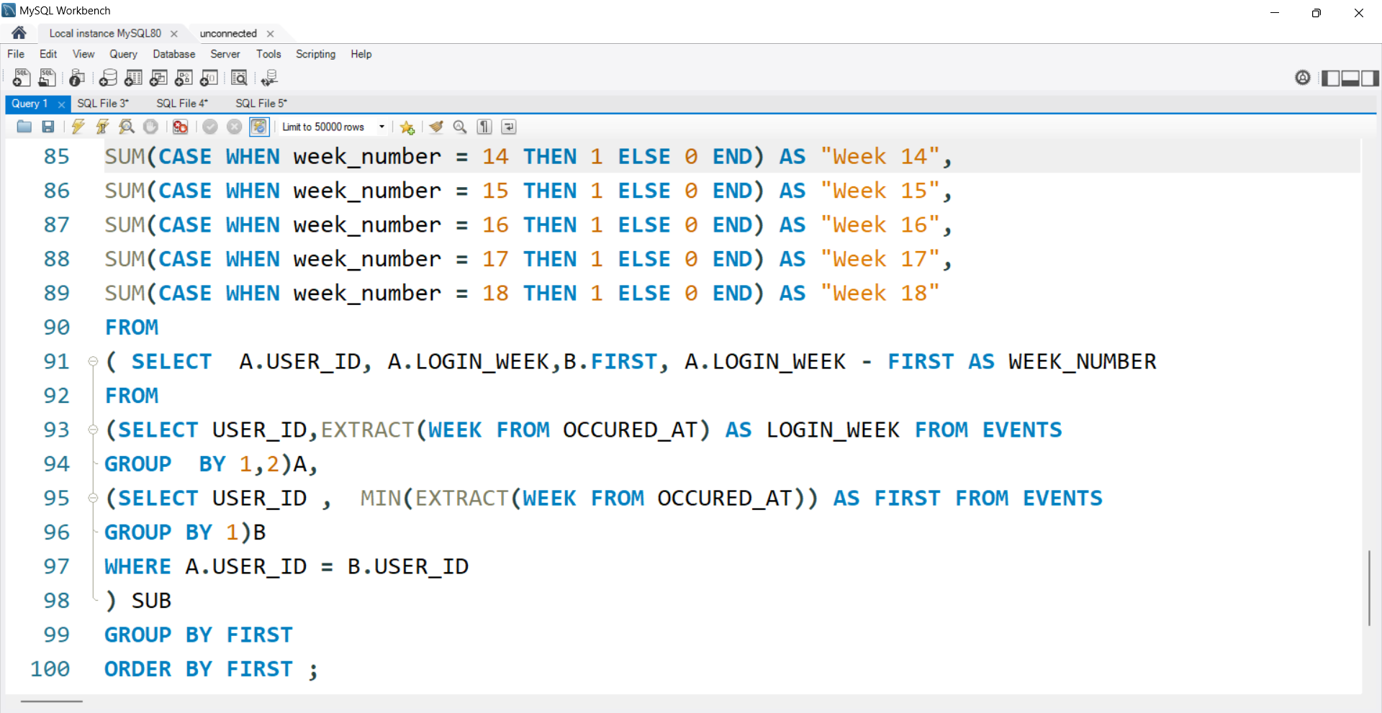

Slide 19
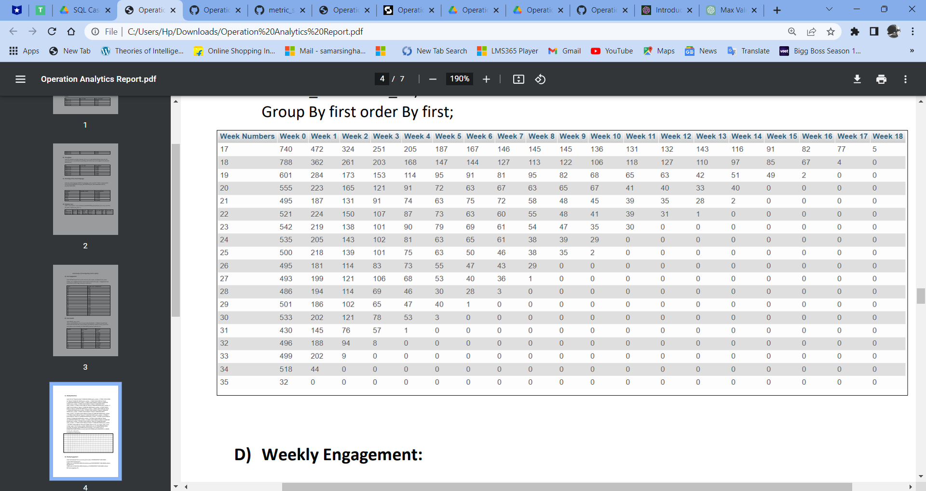

Slide 20
Weekly Engagement: To measure the activeness of a user. Measuring if the user finds quality in a product/service weekly. Your task: Calculate the weekly engagement per device.
SELECT EXTRACT(WEEK FROM OCCURED_AT) AS 'WEEK', COUNT(DISTINCT CASE WHEN e.device IN ('macbook pro') THEN e.user_id ELSE NULL END) AS macbook_pro, COUNT(DISTINCT CASE WHEN e.device IN ('iphone 5') THEN e.user_id ELSE NULL END) AS iphone_5, COUNT(DISTINCT CASE WHEN e.device IN ('samsung galaxy s4') THEN e.user_id ELSE NULL END) AS samsung_galaxy_s4, COUNT(DISTINCT CASE WHEN e.device IN ('lenovo thinkpad') THEN e.user_id ELSE NULL END) AS lenovo_thinkpad, COUNT(DISTINCT CASE WHEN e.device IN ('macbook air') THEN e.user_id ELSE NULL END) AS macbook_air, COUNT(DISTINCT CASE WHEN e.device IN ('nexus 5') THEN e.user_id ELSE NULL END) AS nexus_5,COUNT(DISTINCT CASE WHEN e.device IN ('iphone 5s') THEN e.user_id ELSE NULL END)AS iphone_5s,COUNT(DISTINCT CASE WHEN e.device IN ('dell inspiron notebook') THEN e.user_id ELSE NULL END) AS dell_inspiron_notebook, COUNT(DISTINCT CASE WHEN e.device IN ('asus chromebook') THEN e.user_id ELSE NULL END) AS asus_chromebook, COUNT(DISTINCT CASE WHEN e.device IN ('dell inspiron desktop') THEN e.user_id ELSE NULL END) AS dell_inspiron_desktop, COUNT(DISTINCT CASE WHEN e.device IN ('iphone 4s') THEN e.user_id ELSE NULL END) AS iphone_4s, COUNT(DISTINCT CASE WHEN e.device IN ('nokia lumia 635') THEN e.user_id ELSE NULL END) AS nokia_lumia_635,COUNT(DISTINCT CASE WHEN e.device IN ('acer aspire notebook') THEN e.user_id ELSE NULL END) AS acer_aspire_notebook,COUNT(DISTINCT CASE WHEN e.device IN ('hp pavilion desktop') THEN e.user_id ELSE NULL END) AS hp_pavilion_desktop,COUNT(DISTINCT CASE WHEN e.device IN ('htc one') THEN e.user_id ELSE NULL END) AS htc_one, COUNT(DISTINCT CASE WHEN e.device IN ('acer aspire desktop') THEN e.user_id ELSE NULL END) AS acer_aspire_desktop, COUNT(DISTINCT CASE WHEN e.device IN ('mac mini') THEN e.user_id ELSE NULL END) AS mac_mini, COUNT(DISTINCT CASE WHEN e.device IN ('samsung galaxy note') THEN e.user_id ELSE NULL END) AS samsung_galaxy_note, COUNT(DISTINCT CASE WHEN e.device IN ('amazon fire phone') THEN e.user_id ELSE NULL END) AS amazon_fire_phone, COUNT(DISTINCT CASE WHEN e.device IN ('ipad air') THEN e.user_id ELSE NULL END) AS ipad_air, COUNT(DISTINCT CASE WHEN e.device IN ('nexus 7') THEN e.user_id ELSE NULL END) AS nexus_7, COUNT(DISTINCT CASE WHEN e.device IN ('ipad mini') THEN e.user_id ELSE NULL END) AS ipad_mini, COUNT(DISTINCT CASE WHEN e.device IN ('nexus 10') THEN e.user_id ELSE NULL END) AS nexus_10,COUNT(DISTINCT CASE WHEN e.device IN ('kindle fire') THEN e.user_id ELSE NULL END) AS kindle_fire, COUNT(DISTINCT CASE WHEN e.device IN ('windows surface') THEN e.user_id ELSE NULL END) AS windows_surface, COUNT(DISTINCT CASE WHEN e.device IN ('samsumg galaxy tablet') THEN e.user_id ELSE NULL END) AS samsung_galaxy_tablet FROM events e WHERE e.event_type = 'engagement’ GROUP BY 1 ORDER BY 1 LIMIT 100;

Slide 21
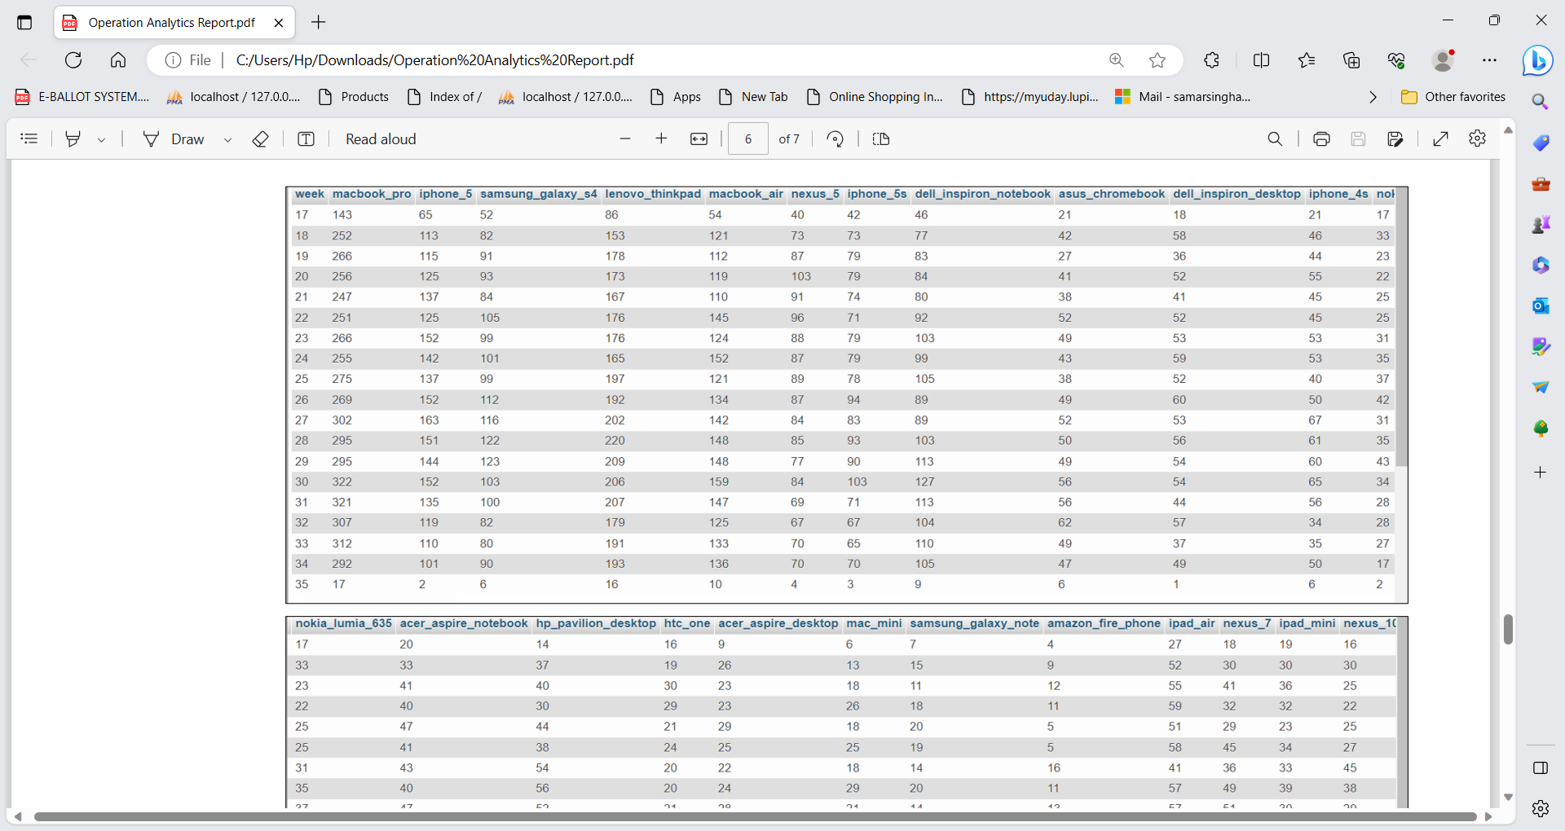
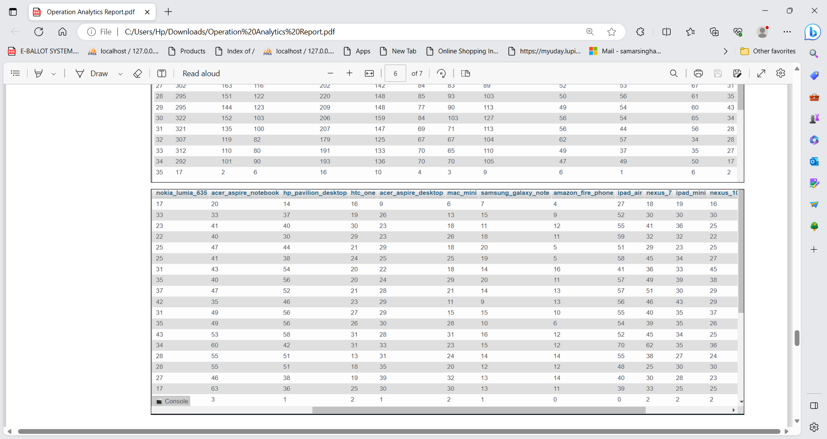
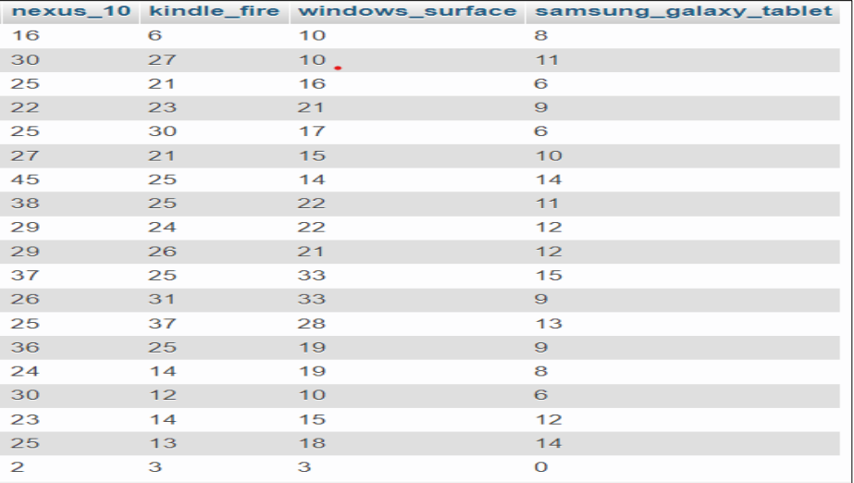

Slide 22
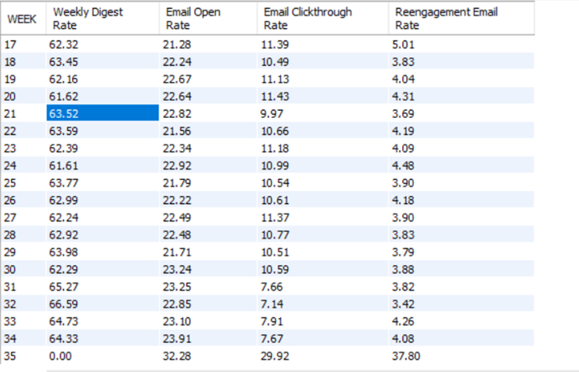
Email Engagement: Users engage with the email service. Your task: Calculate the email engagement metrics.
SELECT WEEK, ROUND((weekly_digest / total * 100), 2) AS ' Weekly Digest Rate', ROUND((email_open / total * 100), 2) AS 'Email Open Rate', ROUND((email_clickthrough / total * 100), 2) AS ' Email Clickthrough Rate', ROUND((reengagement_email / total * 100), 2) AS ' Reengagement Email Rate'FROM (SELECT EXTRACT(WEEK FROM OCCURRED_AT) AS WEEK, COUNT(CASE WHEN ACTION = 'sent_weekly_digest' THEN USER_ID ELSE NULL END) AS WEEKLY_DIGEST, COUNT(CASE WHEN ACTION = 'email_open' THEN USER_ID ELSE NULL END) AS EMAIL_OPEN, COUNT(CASE WHEN ACTION = 'email_clickthrough' THEN USER_ID ELSE NULL END) AS EMAIL_CLICKTHROUGH, COUNT(CASE WHEN ACTION = 'sent_reengagement_email' THEN USER_ID ELSE NULL END) AS REENGAGEMENT_EMAIL, COUNT(USER_ID) AS TOTAL FROM EMAIL_EVENTS GROUP BY 1) SUB GROUP BY 1 ORDER BY 1;

Slide 23
RESULT

Slide 24
Through active participation in this project, I have significantly upskilled my knowledge and gained valuable hands-on experience. This opportunity has allowed me to grasp the strategies employed for analysis and utilize them effectively to conduct thorough analyses. The practical application of these strategies has proven invaluable, providing me with a multifaceted understanding of the project's intricacies. This experience has been instrumental in enhancing my problem-solving abilities, enabling me to approach challenges with newfound confidence and proficiency. Overall, this project has been an enriching journey that has greatly contributed to my professional growth and development.

Slide 25
THANK YOU

