Slide 1
COFFEE SHOP DATA ANALYSIS

Slide 2
Basic Overview
The main objective of this project is to analyze retail sales data to gain actionable insights that will enhance the performance of the coffee shop.

Slide 3
KEY TERMINOLOGIES
FOOTFALL : Total number of customers who visit the coffee shop during a defined time frame, like a day, week, or month.
Average bill per person: This refers to the average amount of money spent by each customer during their visit to the coffee shop.
Average order per person: This refers to the average number of orders placed by each customer during their visit to the coffee shop

Slide 4
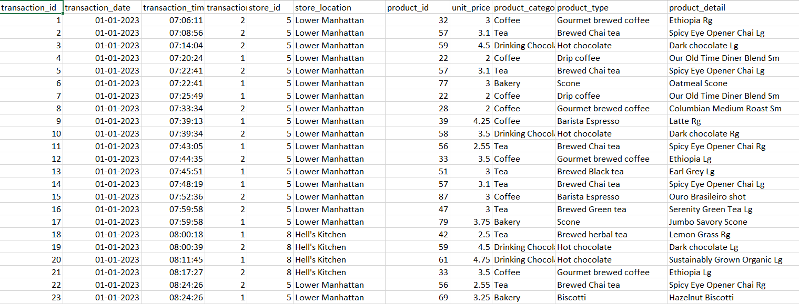
DATASET:
The dataset contains 149456 transactions made by the customers shopping for coffee.
The Raw Data:

Slide 5
Data Preprocessing:
GETTING THE DATASET READY FOR ANALYSIS

Slide 6
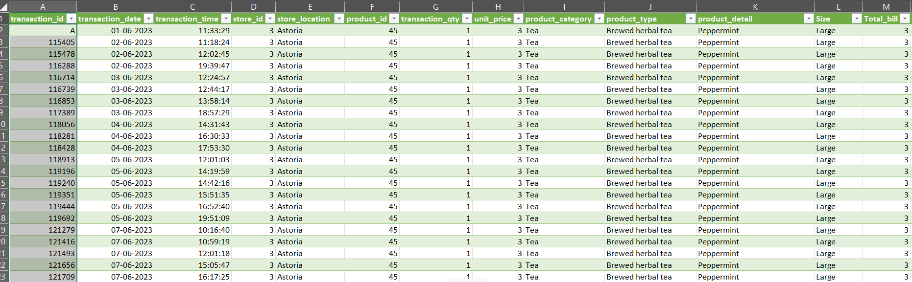
Preprocessed Data:
ADD THE IMAGE HERE XD

Slide 7
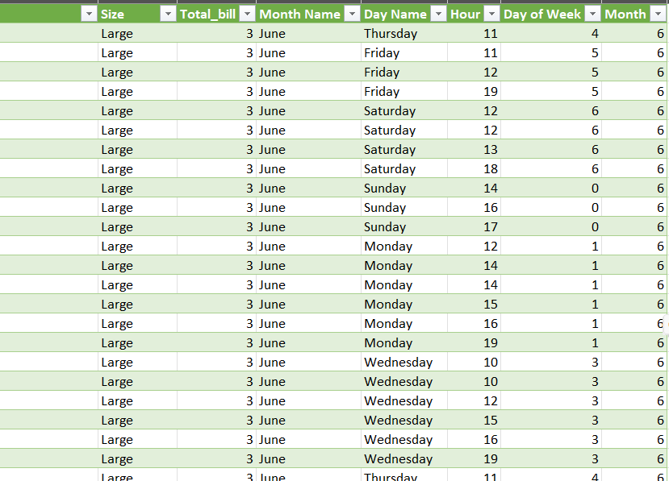

Slide 8
CALCULATION OF KEY METRICS:
Footfall = Sum of the number of customers for each Time period in the dataset.
Top 5 Products
Average Order Per Person = Total Number of Orders / Total Number of Customers.
(using Excel Pivot tables and Power BI

Slide 9
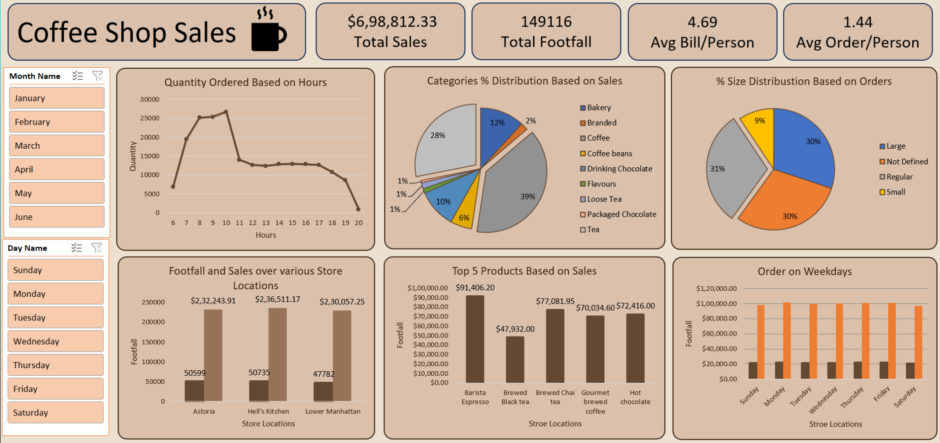
The Dashboard :

Slide 10
Thank You
By :
NIKITH MURALI
SHILPA NAGARAJ
SAFIA RAFI

