Slide 1

Customer Segmentation
Using K-means Algorithm

Slide 2
1. ABSTRACT
Customer Segmentation is one the most important applications of unsupervised learning.
Using clustering techniques, companies can identify the several segments of customers allowing them to target the potential user base.
In this machine learning project, we will make use of K-means algorithm which is the essential
algorithm for clustering unlabeled dataset. Before ahead in this project, learn what actually customer segmentation is.

Slide 3

2.INTRODUCTION
What is K-means Clustering ?
According to the formal definition of K-means clustering – K-means clustering is an iterative algorithm that partitions a group of data containing n values into k subgroups. Each of the n value belongs to the k cluster with the nearest mean.

Slide 4
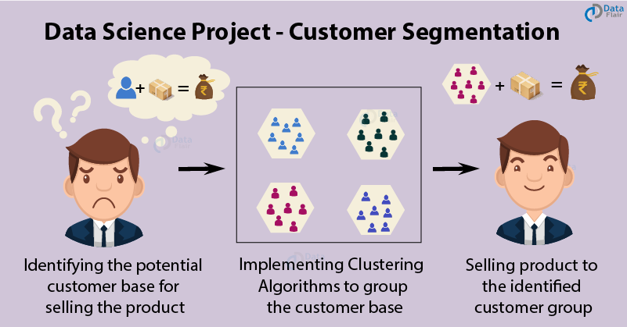

Slide 5

3.Objective
The objective of the K-means clustering is to minimize the Eucledian Distance that each point has from the centroid of the cluster.
This is known as intra-cluster variance.

Slide 6

4. Existing Method
Algorithm for K-means clustering
1.First, we randomly initialize and select the k-points. These k-points are the means.
2.We use the Euclidean distance to find data-points that are closest to their centre W of the cluster.
3.Then we calculate the mean of all the points in the cluster which is finding their centroid.
4.We iteratively repeat step 1, 2 and 3 until all the points are assigned to their respective clusters.
K-Means is a non-hierarchical clustering method.

Slide 7

5.Methodology
The main methodology used in this project is K-means Clusteing.
In the first step of this data science project, we will perform data exploration.
We will import the essential packages required for this role and then read our data.
Finally, we will go through the input data to gain necessary insights about it.

Slide 8

6.Implementation
In this Project, we will use K-means over random data using Python libraries.
The following slides shows how it has been actually implemented.

Slide 9

PROJECT SNAPSHOTS

Slide 10
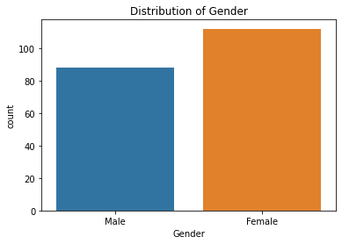

Slide 11
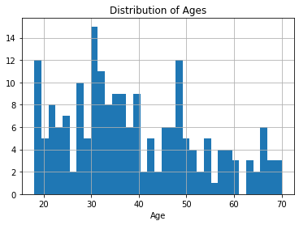
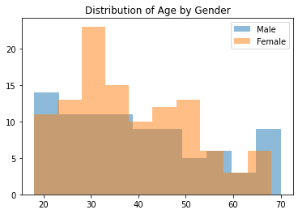

Slide 12
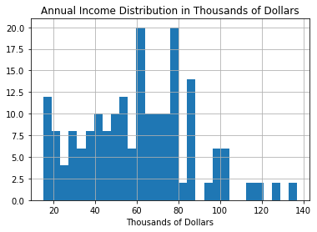
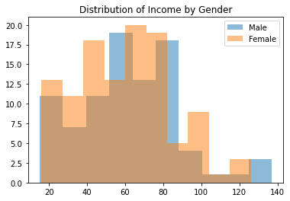

Slide 13
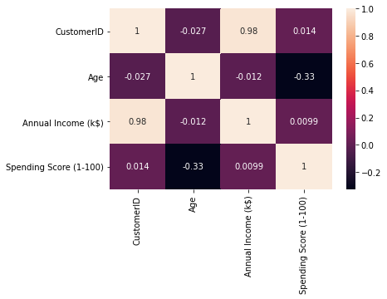
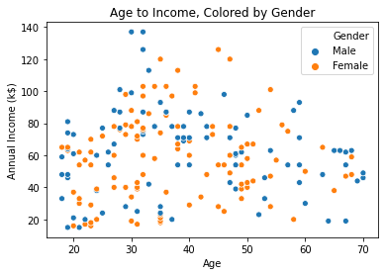

Slide 14
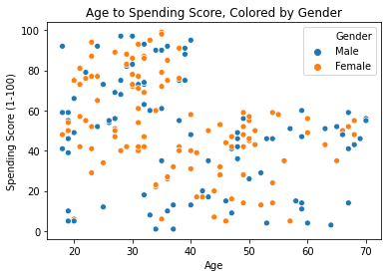

Slide 15
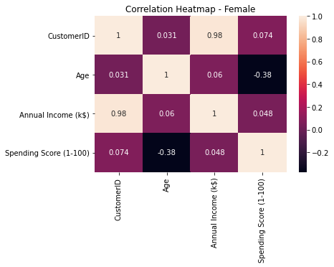
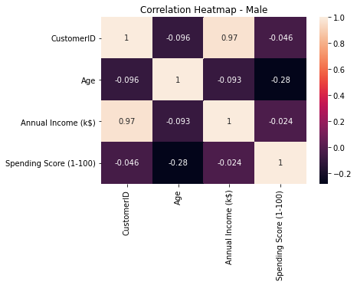

Slide 16
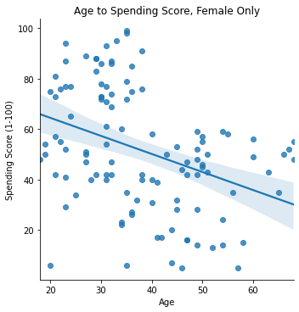
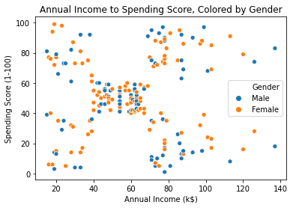

Slide 17
Conclusion
So, in this Project, we went through how actually the K-means algorithm works.
We understood its definition and its application in real-life problem.
We also went through the code implementation using Python Libraries.
Finally, using K-means clustering we visualized the gender and age distributions.
Then analyzed their annual incomes and spending scores.

Slide 18
Name : Shilpa V
E-mail : shilpav20171439@gmail.com
Branch : CSE

Slide 19
THANK YOU

