Slide 1
Unit-4: Transport Layer

Slide 2
Introduction
The transport layer is located between the application layer and the network layer.
It is a 4th layer from the bottom.
It is responsible for message delivery from process running in source computer to the process running in the destination computer.
It does not perform any function in the intermediate nodes.

Slide 3
Introduction (Cont’d)
Data Link Layer is responsible for delivery of frames between two neighbouring nodes over a link.
This is called node-to-node delivery.
Network Layer is responsible for delivery of datagrams between two hosts.
This is called host-to-host delivery.
Transport Layer is responsible for delivery of entire message from one process running on source to another process running on destination.
This is called process-to-process delivery.

Slide 4
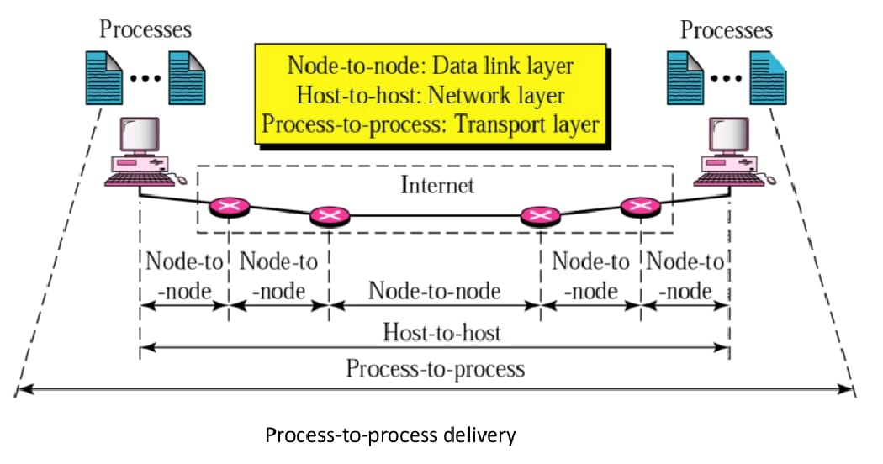
Introduction (Cont’d)

Slide 5
Responsibilities of Transport Layer
The transport layer delivers the message from one process to another process running on two different hosts.
Thus, it has to perform number of functions to ensure the accurate delivery of message.
The different responsibilities (functions) of transport layer are:
Establishing, Maintaining & Releasing Connection
Addressing
Data Transfer
Flow Control
Error Control
Congestion Control

Slide 6
Establishing, Maintaining & Releasing Connection:
The transport layer establishes, maintains & releases end-to-end transport connection on the request of upper layers.
Establishing a connection involves allocation of buffers for storing user data, synchronizing the sequence numbers of packets, etc.
A connection is released at the request of upper layer.

Slide 7
Connection Establishment
Before communicating, the source device must first determine the availability of the other to exchange data.
Path must be found through the network by which the data can be sent.
This is called Connection Establishment.

Slide 8
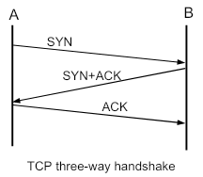
Connection Establishment (Cont’d)
Connection establishment involves Three-Way Handshaking mechanism:
The source sends a connection request packet to the destination. The destination returns a confirmation packet back to the source. The source returns a packet acknowledging the confirmation

Slide 9
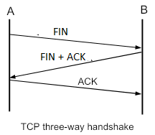
Connection Release
Once all of the data has been transferred, the connection must be released.
Connection establishment involves Three-Way Handshaking mechanism:
The source sends a disconnect request packet to the destination. The destination returns a confirmation packet back to the source. The source returns a packet acknowledging the confirmation.

Slide 10
Addressing
In order to deliver the message from one process to another, an addressing scheme is required.
Several process may be running on a system at a time.
In order to identify the correct process out of the various running processes, transport layer uses an addressing scheme called port number (port address).
Each process has a specific port number.

Slide 11
Addressing (Cont’d)
In order to deliver data from one process to another, address is required.
In order to deliver data from one node to another, MAC address is required.
Such an address is implemented at Data Link Layer and is called Physical Addressing.

Slide 12
Addressing (Cont’d)
In order to deliver data from one network to another, IP address is required.
Such an address is implemented at Network Layer and is called Logical Addressing or IP addressing.
Similarly, in order to deliver data from a process running on source to process running on destination, transport layer defines the Service Point Address or Port Numbers.

Slide 13
Port Numbers
Each communicating process is assigned a specific port number.
In order to select among multiple processes running on a destination host, a port number is required.
The port numbers are 16-bit integers between 0 and 65,535.
Port numbers are assigned by Internet Assigned Number Authority (IANA).

Slide 14
Port Numbers (Cont’d)
IANA has divided the port numbers in three categories:
Well Known Ports: The ports ranging from 0 to 1023.
For e.g.: HTTP: 80, SMTP: 25, FTP: 20, 21.
Registered Ports: The ports ranging from 1024 to 49,151. These are not controlled by IANA.
Dynamic Ports: The ports ranging from 49,152 to 65,535. These can be used by any process.

Slide 15
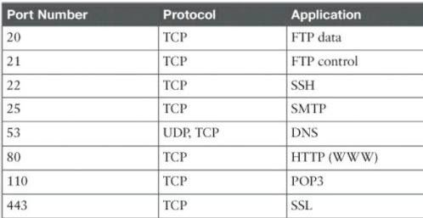
Port Numbers (Cont’d)

Slide 16
Socket Address
Socket address is a combination of IP address and port number.
In order to provide communication between two different processes on different networks, both IP address and port number, i.e. socket address is required

Slide 17
Flow Control
Like data link layer, transport layer also performs flow control.
However, flow control at transport layer is performed end-to-end rather than node-to-node.
Transport Layer uses a sliding window protocol to perform flow control.

Slide 18
Error Control
Transport layer also provides end-to-end error control facility.
Transport layer deals with several different types of errors:
Error due to damaged bits.
Error due to non delivery of TPDUs (Transport Protocol Data Units).
Error due to duplicate delivery of TPDUs
Error due to delivery of TPDU to a wrong destination

Slide 19
Congestion Control
Transport layer also handles congestion in the networks
Several congestion control algorithms are used to avoid congestion.

Slide 20
Transport Layer Services
Transport layer protocols can provide two types of services:
Connection Oriented Service
Connectionless Service

Slide 21
Connection Oriented Service
In connection oriented service, a connection is first established between sender and the receiver.
Then, transfer of user data takes place.
At the end, connection is released.
The connection oriented service is generally reliable.
Transport layer protocols that provide connection oriented services are TCP and SCTP (Stream Control Transmission Protocol).

Slide 22
Connectionless Service
In the service, the packets are sent from sender to receiver without the establishment of connection.
In such service, packets are not numbered.
The packets may be lost, corrupted, delayed or disordered.
Connectionless service is unreliable.
Transport layer protocol that provides this service is UDP (User Datagram Protocol).

Slide 23
Transmission Control Protocol (TCP)

Slide 24
Contents
Process-to-Process Communication
TCP Header
TCP Services
TCP Segments
Sequence Number and Acknowledgement Number
TCP Operation

Slide 25
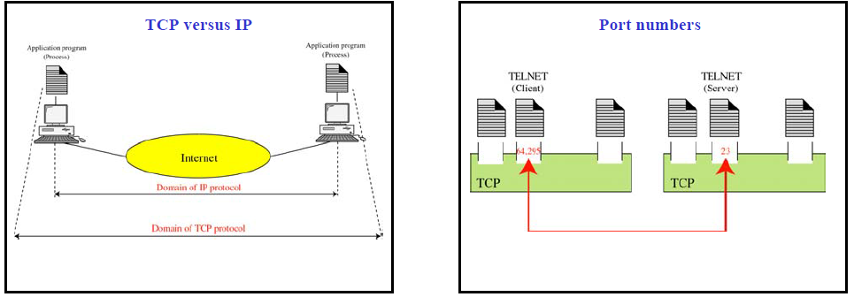
Process-to-Process Communication

Slide 26
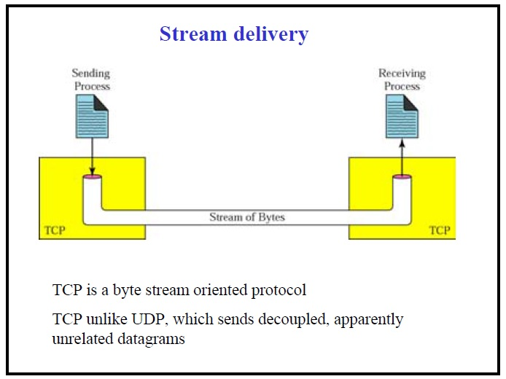
TCP Services

Slide 27
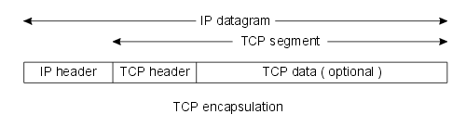
TCP Header
TCP is the primary transport protocol used to provide reliable, full-duplex connections.
The most common use of TCP is to exchange TCP data encapsulated in an IP datagram.
Although IP is implemented on both hosts and routers, TCP is typically implemented on hosts only to provide reliable end-to-end data delivery.

Slide 28
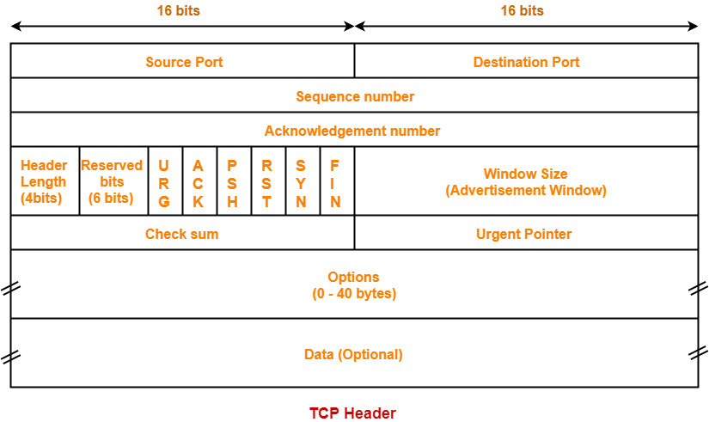
TCP Header (Cont’d)

Slide 29
TCP Header (Cont’d
Source and Destination Port Number: Identification of the sending and receiving application. Along with the source and destination IP addresses in the IP Header identify the connection as a socket.
Sequence Number: The sequence number of the first data byte in this segment. If the SYN bit is set, the sequence number is the initial sequence number and the first data byte is initial sequence number + 1.
Acknowledgement Number: If the ACK bit is set, this field contains the value of the next sequence number the sender of the segment is expecting to receive. Once a connection is established this is always sent.

Slide 30
TCP Header (Cont’d
Header Length: The number of 32-bit words in the TCP header. This indicates where the data begins. The length of the TCP header is always a multiple of 32 bits.
Flags: There are six flags in the TCP header. One or more can be turned on at the same time.
URG - The URGENT POINTER field contains valid data
ACK - The acknowledgement number is valid
PSH - The receiver should pass this data to the application as soon as possible
RST - Reset the connection
SYN - Synchronize sequence numbers to initiate a connection.
FIN - The sender is finished sending data.

Slide 31
TCP Header (Cont’d
Window Size: This is the number of bytes, starting with the one specified by the acknowledgment number field, that the receiver is willing to accept. This is a 16-bit field, limiting the window to 65535 bytes.
Checksum: This is a mandatory field that must be calculated and stored by the sender, and then verified by the receiver.
Urgent Pointer: The urgent pointer is valid only if the URG flag is set. TCP's urgent mode is a way for the sender to transmit emergency data to the other end. This feature is rarely used.

Slide 32
TCP Segments
The IP layer, as a service provider for TCP, needs to send data in packets, not as stream of bytes
TCP groups a number of bytes together into a packet called a segment
Segment encapsulated into an IP datagram
Each segment can be a different size
Process transparent to sending/receiving processes

Slide 33
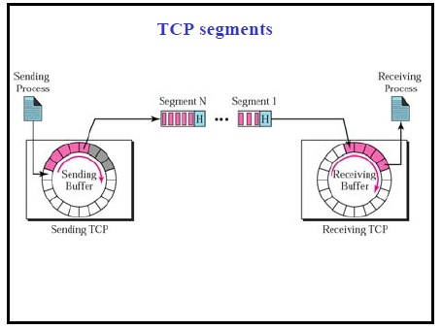
TCP Segments (Cont’d)

Slide 34
TCP Properties
Full-Duplex Service
Segments can flow in both directions
Each TCP has sending & receiving buffers
Connection-Oriented Service
Source TCP informs destination TCP & gets approval from destination
Source & destination TCP exchange data in both directions
When both complete Source & destination destroy their buffers
Reliable Service

Slide 35
Sequence Number (Syn no.)
Packets in TCP are called segments.
All bytes in a TCP connection are numbered.
Number does not start with 0.
Initially, TCP generates random number between 0 to 2^32-1.
After bytes numbered, sequence number assigned to each segment.
Sequence number for each segment is the number of the first byte carried in that segment

Slide 36
Example
Imagine a TCP connection is transferring a file of 6000 bytes. The first byte is numbered 10010. What are the sequence numbers for each segment if data is sent in five segments with the first four segments carrying 1,000 bytes and the last segment carrying 2,000 bytes?

Slide 37
Solution
The following shows the sequence number for each segment:
Segment 1 Î10,010 (10,010 to 11,009)
Segment 2 Î11,010 (11,010 to 12,009)
Segment 3 Î12,010 (12,010 to 13,009)
Segment 4 Î13,010 (13,010 to 14,009)
Segment 5 Î14,010 (14,010 to 16,009)

Slide 38
Acknowledgement number (Ack no)
Communication in TCP is full duplex
Each party numbers bytes, usually with a different starting byte number.
The sequence number in each direction shows the number of the first byte carried by the segment
Each party also uses an ack no to confirm bytes it received
Ack no indicates number of next byte that the party expects to receive

Slide 39
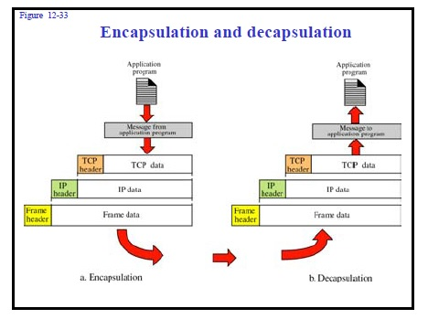
TCP Operation
Encapsulation: the data moves from upper layer to the lower layer, and each layer includes a bundle of information known as a header along with the actual data.
Decapsulation: the data moves from the lower layer to the upper layers, and each layer unpacks the corresponding headers to obtain the actual data

Slide 40
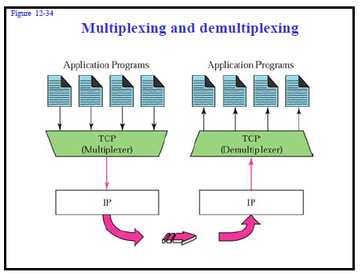
TCP Operation (Cont’d)
Multiplexing: Transport layer gathers chunks of data it receives from different sockets and encapsulate them with transport headers. Passing these resulting segments to the network layer is called multiplexing.
Demultiplexing: The reverse process which is delivering data to the correct socket by the transport layer is called demultiplexing.

Slide 41
Thank You

Slide 42
User Datagram Protocol (UDP)
Ashutosh Kumar Singh
www.ashutoshksingh.in

Slide 43
User Datagram Protocol (UDP)
The User Datagram Protocol (UDP) is called a connectionless, unreliable transport protocol.
It does not add anything to the services of IP except to provide process-to-process communication instead of host-to-host communication.

Slide 44
User Datagram Protocol (UDP)
Connection less
Unreliable
No-order
Port Number
Max port number (2¹⁶-1) i.e. 65535 where 0 to 1023 are called well known port number.
UDP header is of 8 Bytes

Slide 45
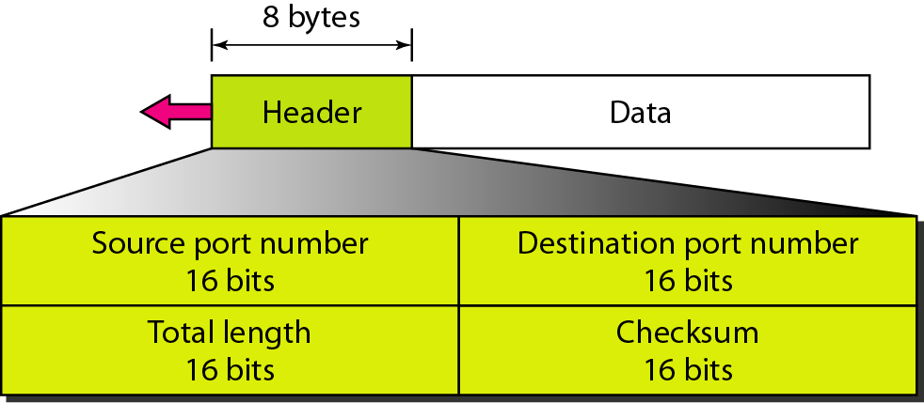
User datagram format

Slide 46
User datagram format
Port Number
Max port number (2¹⁶-1) ie 65535 where 0 to 1023 are called well known port number.

Slide 47
User datagram format
Total Length
(2¹⁶-1) ie 65535 it means max segment size will be 65535.
We know header size is 8 Byte so payload will be 65527

Slide 48
User datagram format
Checksum
It is used for error control
Checksum=UDP header + UDP data + pseudo header of IP
Checksum is optional in IPv4 but not in IPv6

Slide 49
UDP Application
Query response protocol
One request one reply (DNS, DHCP)
Speed (Online Game, Voice over IP)
Broad Casting / multicasting (RIP)
Continuous Streaming (YouTube, Skype)

Slide 50
Session Layer
Session Layer
Ashutosh Kumar Singh
www.ashutoshksingh.in
n Layer

Slide 51
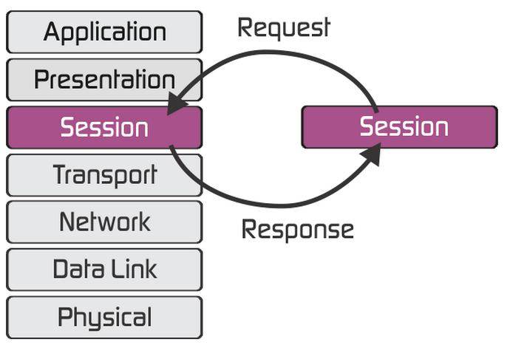

Slide 52
Responsibility of Session Layer
Authentication
Authorization
Session Restoration
Dialog Control
Syncronization

Slide 53
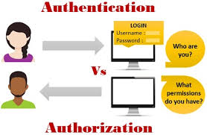
Responsibility of Session Layer
Authentication
Authorization
Session Restoration
Dialog Control
Syncronization

Slide 54
Responsibility of Session Layer
Authentication
Authorization
Session Restoration
Dialog Control
Syncronization

Slide 55
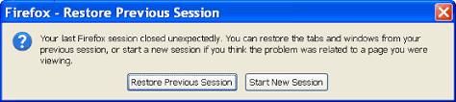
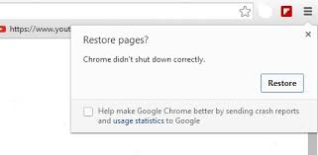
Responsibility of Session Layer
Authentication
Authorization
Session Restoration
Dialog Control
Syncronization

Slide 56
Responsibility of Session Layer
Authentication
Authorization
Session Restoration
Dialog Control
Syncronization

Slide 57
Responsibility of Session Layer
Authentication
Authorization
Session Restoration
Dialog Control
Synchronization
Amount of data sent
Which device communicate first

Slide 58
Responsibility of Session Layer
Authentication
Authorization
Session Restoration
Dialog Control
Synchronization

Slide 59
Presentation Layer
Ashutosh Kumar Singh
www.ashutoshksingh.in

Slide 60
Application
Presentation
Session
Network
Transport
Data Link
Physical
Application
Presentation
Session
Network
Transport
Data Link
Physical

Slide 61
Responsibility of Presentation Layer
Translation
Encryption/Decryption
Compression/Decompression

Slide 62
Responsibility of Presentation Layer
Translation
Encryption/Decryption
Compression/Decompression
Presentation Layer changes information from its sender dependent format into a common format that will be accepted by the recieving device.

Slide 63

Responsibility of Presentation Layer
Translation
Encryption/Decryption
Compression/Decompression
ASCII
EBCDIC

Slide 64
Responsibility of Presentation Layer
Translation
Encryption/Decryption
Compression/Decompression
Encription is a process in
which the data is converted
into a form that prevents
unauthorized user from reading.

Slide 65
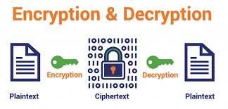
Responsibility of Presentation Layer
Translation
Encryption/Decryption
Compression/Decompression

Slide 66
Responsibility of Presentation Layer
Translation
Encryption/Decryption
Compression/Decompression
Compression is the process
that Reduces the number of
bits to Represent the
information.

Slide 67
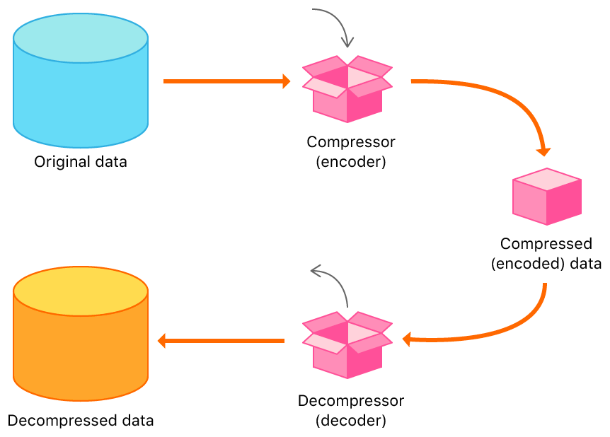
Responsibility of Presentation Layer
Translation
Encryption/Decryption
Compression/Decompression

Slide 68
Responsibility of Presentation Layer
Translation
Encryption/Decryption
Compression/Decompression
Lossless Compression
Lossy Compression

Slide 69
Responsibility of Presentation Layer
Translation
Encryption/Decryption
Compression/Decompression

Slide 70
Cryptography: An Introduction
Ashutosh Kumar Singh
www.ashutoshksingh.in

Slide 71
Content
Introduction
Security Goals
Cryptography
Symmetric and Asymmetric Cryptography
RSA Cryptosystem

Slide 72
Introduction
We are living in the information age. An information needs to be secured from attacks.
To be secured, information needs to be hidden from
unauthorized access (confidentiality),
protected from unauthorized change (integrity), and
available to an authorized entity when it is needed (availability).

Slide 73

Security Goals (CIA)
Confidentiality:
Keep data and communication secret
Privacy of personal financial/health records, etc.
Military and commercial relevance
Integrity:
Protect reliability of data against tampering
Can we be sure of the source and content of information?
Availability:
Data/resources should be accessible when needed
Protection against denial of service attacks Source: Internet

Slide 74
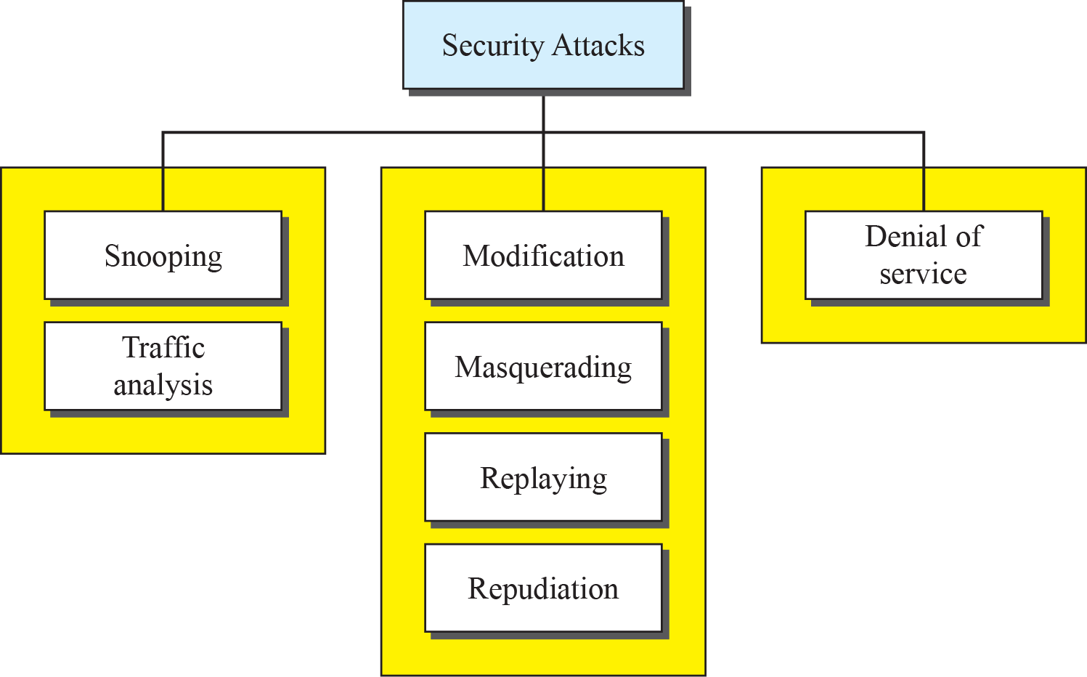



Attacks
Our three goals of security, confidentiality, integrity, and availability, can be threatened by security attacks.
Source: DCN

Slide 75
Cryptography
Cryptography is the art (and sometimes science) of secret writing.
Cryptography is the science and art of transforming message to make them secure and immune to attacks.
Cryptographers create ciphers – Cryptography
Cryptanalyst break ciphers - Cryptanalysis

Slide 76
Cryptosystem
A cryptosystem is a 5-tuple consisting of (E,D,M,K,C)
Where
E is an encryption algorithm
D is an decryption algorithm
M is the set of plaintexts
K is the set of keys
C is the set of ciphertexts
E:M×K→C D:C×K→M

Slide 77
Confidentiality
We now look at the first goal of security, confidentiality.
Confidentiality can be achieved using ciphers.
Ciphers can be divided into two broad categories:
Symmetric-key
Asymmetric-key (Public-key).

Slide 78
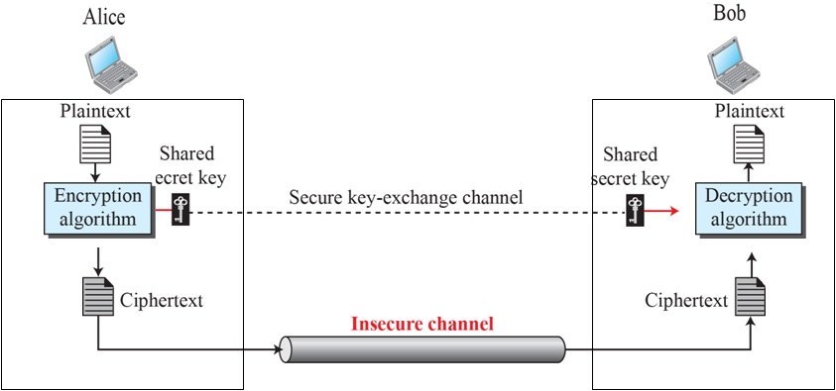
Symmetric-Key Cryptography
A symmetric-key cryptography uses the same key for both encryption and decryption, and the key can be used for bidirectional communication, that is why it is called symmetric.
Source: DCN

Slide 79
Types of Symmetric-Key Cryptography
AES (Advanced Encryption Standard)
DES (Data Encryption Standard)
RC4 (Rivest Cipher 4)
RC5 (Rivest Cipher 5)
RC6 (Rivest Cipher 6)
Source: DCN

Slide 80
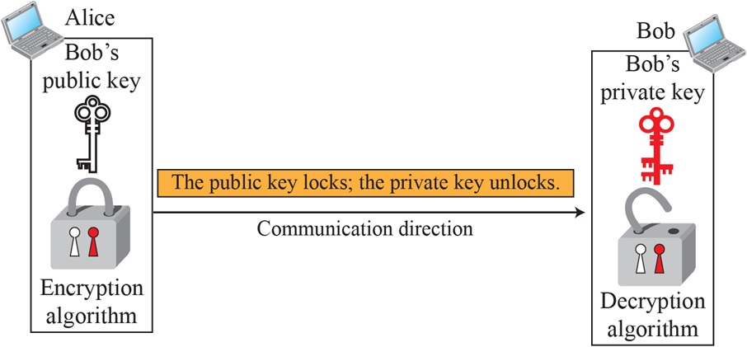
Asymmetric-Key Ciphers
An asymmetric-key cryptography uses the two different keys, one (public) for encryption and other (private) for decryption that is why it is called asymmetric.
Source: DCN

Slide 81
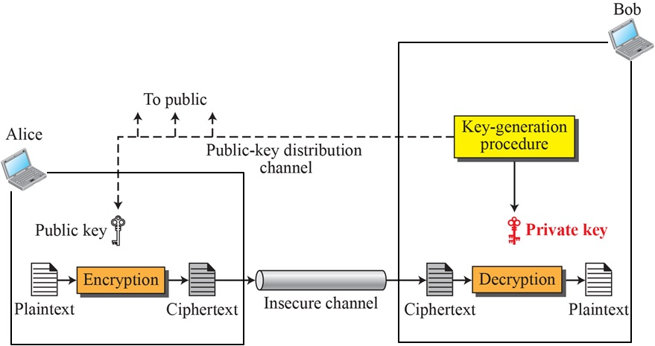
Asymmetric-Key Ciphers (Cont’d)
Source: DCN

Slide 82
Types of Asymmetric-Key Cryptography
EIGamal
RSA (Rivest, Shamir and Adleman)
DSA (Digital Signature Algorithm)
Elliptic Curve Cryptography
PKCS (Public Key Cryptography Standards)

Slide 83
RSA Cryptosystem
The RSA (Rivest,Shamir and Adleman) public key encryption algorithm was the first practical implementation of public key cryptography.
It remains the most widely used public key encryption algorithm today.
It is based on belief that it is easy to multiply two very large prime numbers but it is hard to factorize.

Slide 84
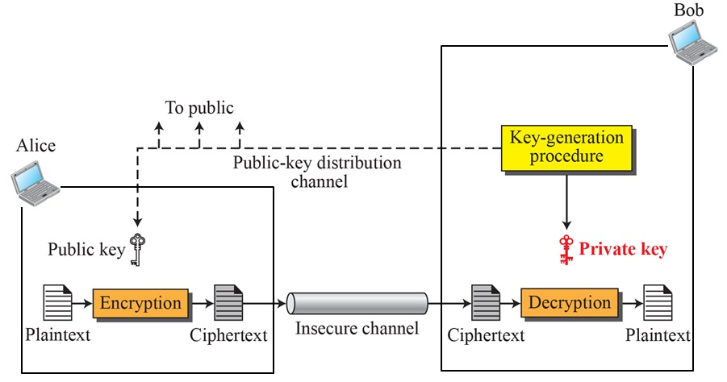
RSA Cryptosystem (Cont’d)
Source: DCN

Slide 85
RSA Cryptosystem (Cont’d)
Let n be product of two large prime numbers p and q
Large mean at least 512 bits
n=p×q
Calculate ø(n)=(p-1)×(q-1)
Select a special number e such that 1<e<ø(n) and gcd(e,ø(n))=1
Publish the pair of numbers (n,e) that is public key
Calculate d such that (e×d)modø(n)=1
d is the private key

Slide 86
RSA Cryptosystem (Cont’d)
Represent the plaintext M as a series of numbers.
The encryption process is
C = Me mod n
The decryption process is
M = C^{d} mod n

Slide 87
RSA Cryptosystem: Example
Let p=7, q=11
n=7×11=77
ø(n)=(p-1)(q-1)=(7-1)(11-1)=6×10=60
select e as 13 as gcd(13,60)=1 and 13<60
The private key d=37 as (13×37)mod60=1
(The Euclidean Algorithm is the process that you need to follow in order to compute d)
Suppose that plaintext M=“F”, converting into numbers we get M=5 (0-25 alphabet set position of “F”)
Plain text M=5 Cipher text C=26
C=5¹³mod77=26 M=26³⁷ mod77=5
(Plaintext=“F”)

Slide 88
Thank You

