Slide 1
UNIT - 2
Medium Access Sub Layer
Copyright © The McGraw-Hill Companies, Inc. Permission required for reproduction or display.

Slide 2
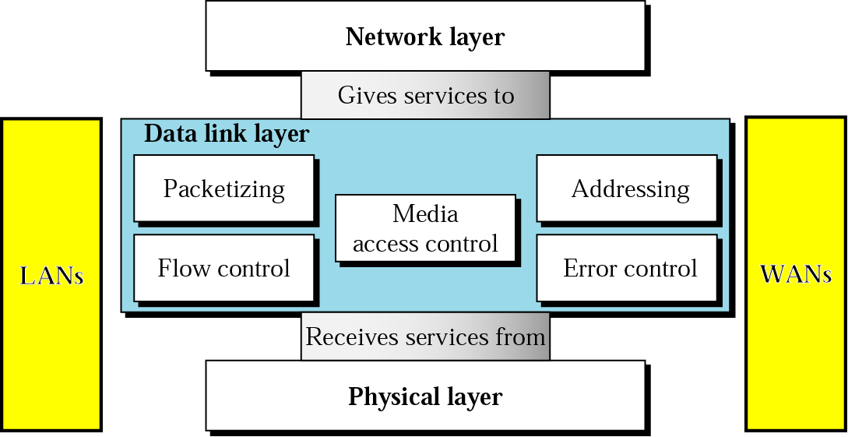
Data Link Layer

Slide 3
9.2.1 Three Types of addresses
Some link-layer protocols define three types of addresses: unicast, multicast, and broadcast.

Slide 4
Example 9.1
The unicast link-layer addresses in the most common LAN, Ethernet, are 48 bits (six bytes) that are presented as 12 hexadecimal digits separated by colons. For example, the following is a link-layer address of a computer. The second digit needs to be an odd number.
A3:34:45:11:92:F1
9.4

Slide 5
Example 9.2
As we will see in Chapter 13, the multicast link-layer addresses in the most common LAN, Ethernet, are 48 bits (six bytes) that are presented as 12 hexadecimal digits separated by colons. The second digit, however, needs to be an even number in hexadecimal. The following shows a
multicast address:
A2:34:45:11:92:F1
9.5

Slide 6
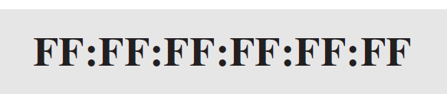
Example 9.3
As we will see in Chapter 13, the broadcast link-layer addresses in the most common LAN, Ethernet, are 48 bits, all 1s, that are presented as 12 hexadecimal digits separated by colons. The following shows a broadcast address:
9.6

Slide 7
FRAMING
Framing in the data link layer divides a message from one source to a destination by adding a sender address and a destination address.
The destination address defines where the packet is to go; the sender address helps the recipient acknowledge the receipt.

Slide 8
FRAMING
Fixed-Size Framing:
There is no need for defining the boundaries of the frames; the size itself can be used as a delimiter.
An example of this type of framing is the ATM wide-area network, which uses frames of fixed size called cells.

Slide 9
Variable-Size Framing:
We need a way to define the end of the frame and the beginning of the next.
An example : two approaches were used for this purpose: a character-oriented approach and a bit-oriented approach

Slide 10
FRAMING
In a character-oriented protocol, data to be carried are 8-bit characters from a coding system such as ASCII .
2. The header, which normally carries the source
and destination addresses and other control information, and the trailer, which carries error detection or error correction redundant bits, are also multiples of 8 bits.
3. To separate one frame from the next, an 8-bit (I-byte) flag is added at the beginning and the end of a frame. The flag, composed of protocol-dependent special characters, signals the start or
end of a frame.

Slide 11
FRAMING
Any pattern used for the flag could also be part of the information. If this happens,the receiver, when it encounters this pattern in the middle of the data, thinks it hasreached the end of the frame.
To fix this problem, a byte-stuffing strategy was added to
character-oriented framing.

Slide 12
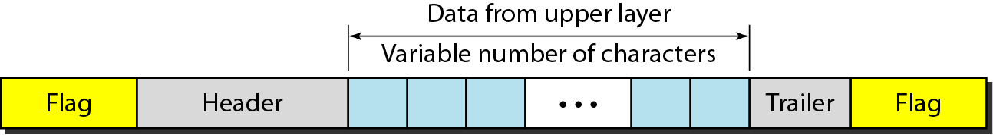
Figure 11.1 A frame in a character-oriented protocol

Slide 13
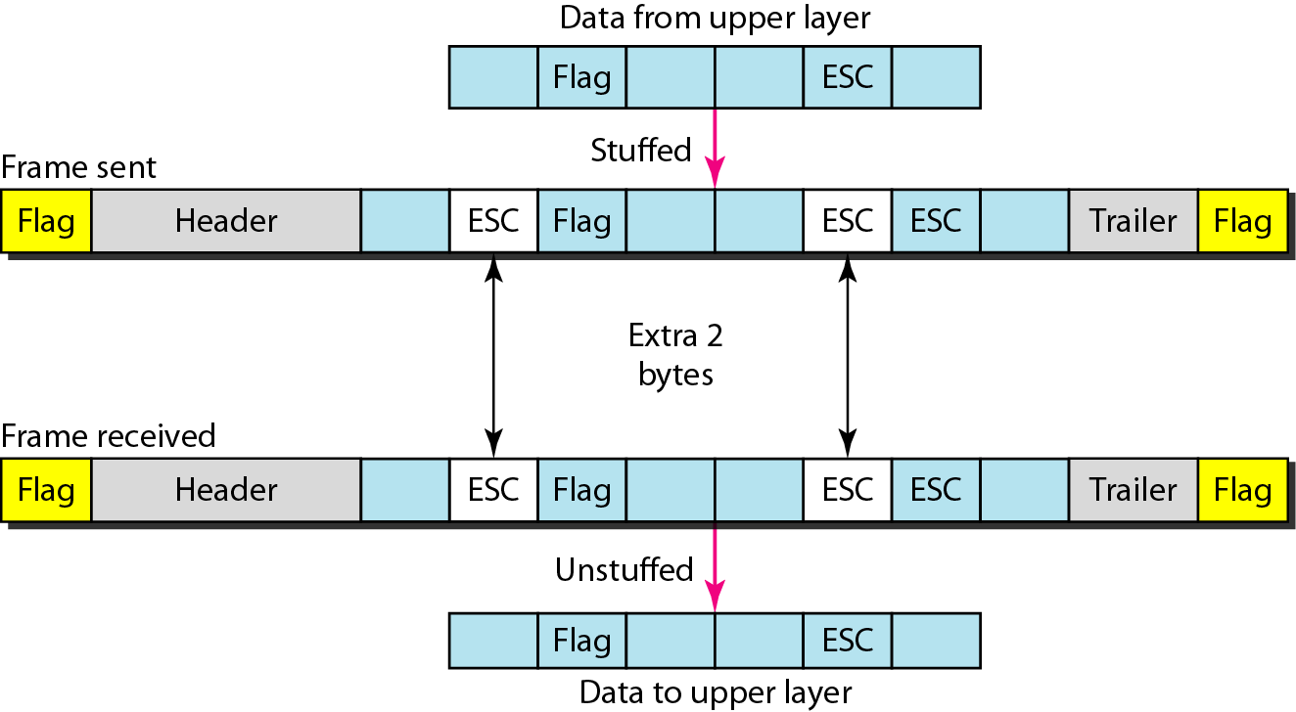
Figure 11.2 Byte stuffing and unstuffing

Slide 14

Note
Byte stuffing is the process of adding 1 extra byte whenever there is a flag or escape character in the text.

Slide 15
Bit stuffing
In a bit-oriented protocol, the data section of a frame is a sequence of bits to be interpreted by the upper layer as text, graphic, audio, video, and so on. we still need a delimiter to separate one frame fromthe other.
Most protocols use a special 8-bit pattern flag 01111110 as the delimiter to define the beginning and the end of the frame.

Slide 16
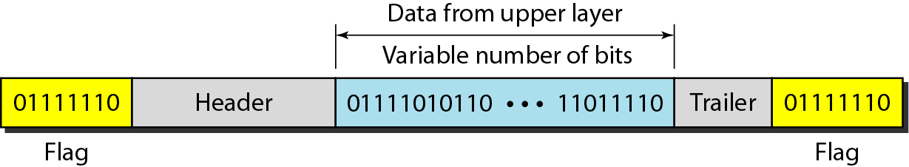
Figure 11.3 A frame in a bit-oriented protocol

Slide 17
Note
Bit stuffing is the process of adding one extra 0 whenever five consecutive 1s follow a 0 in the data, so that the receiver does not mistake
the pattern 0111110 for a flag.

Slide 18
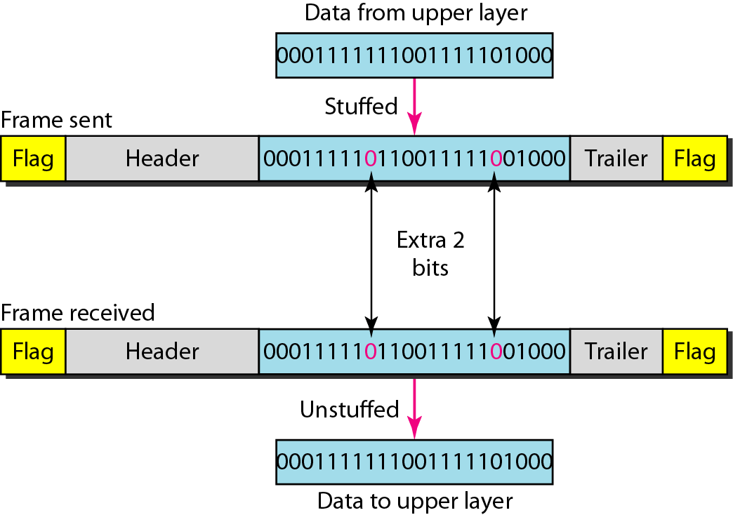
Figure 11.4 Bit stuffing and unstuffing

Slide 19
Flow control refers to a set of procedures used to restrict the amount of data
that the sender can send before
waiting for acknowledgment.

Slide 20
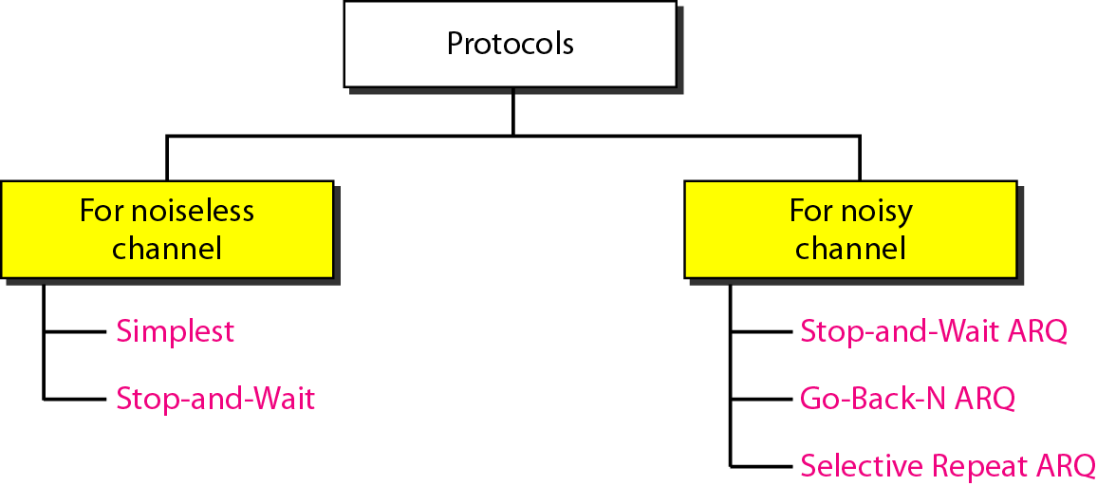
Figure 11.5 Taxonomy of protocols discussed in this chapter

Slide 21
11-4 NOISELESS CHANNELS
Let us first assume we have an ideal channel in which no frames are lost, duplicated, or corrupted. We introduce two protocols for this type of channel.
Topics discussed in this section:
Simplest Protocol Stop-and-Wait Protocol

Slide 22
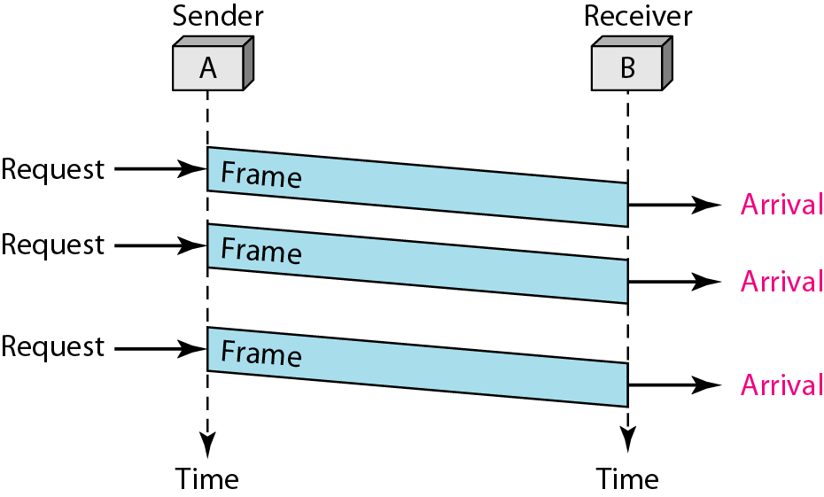
Figure 11.7 Flow diagram for Example 11.1

Slide 23
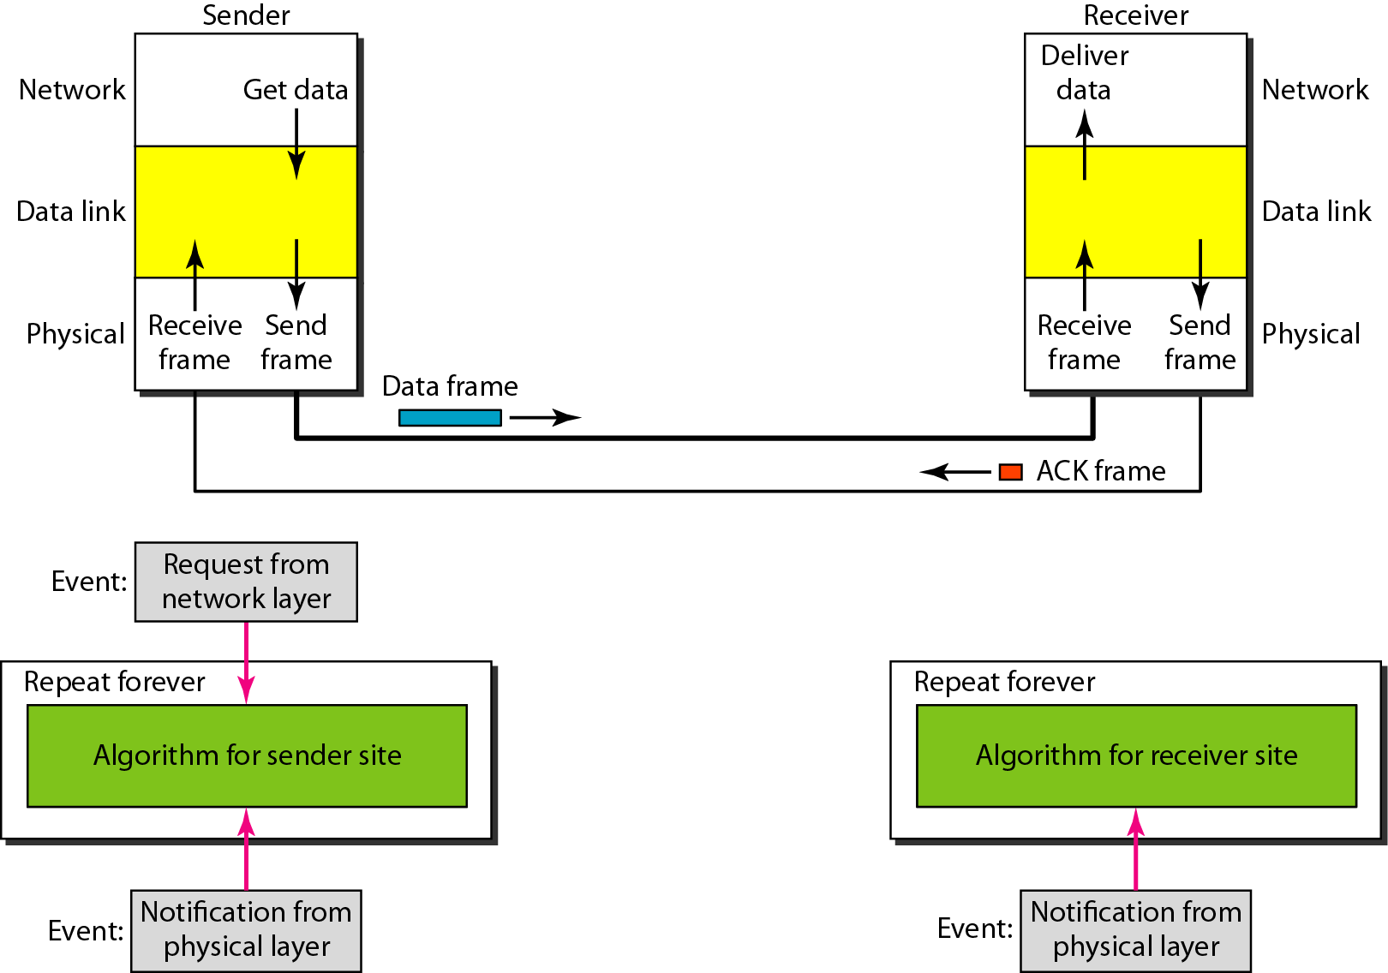
Figure 11.8 Design of Stop-and-Wait Protocol

Slide 24
Example 11.2
Figure 11.9 shows an example of communication using this protocol. It is still very simple. The sender sends one frame and waits for feedback from the receiver. When the ACK arrives, the sender sends the next frame. Note that sending two frames in the protocol involves the sender in four events and the receiver in two events.

Slide 25
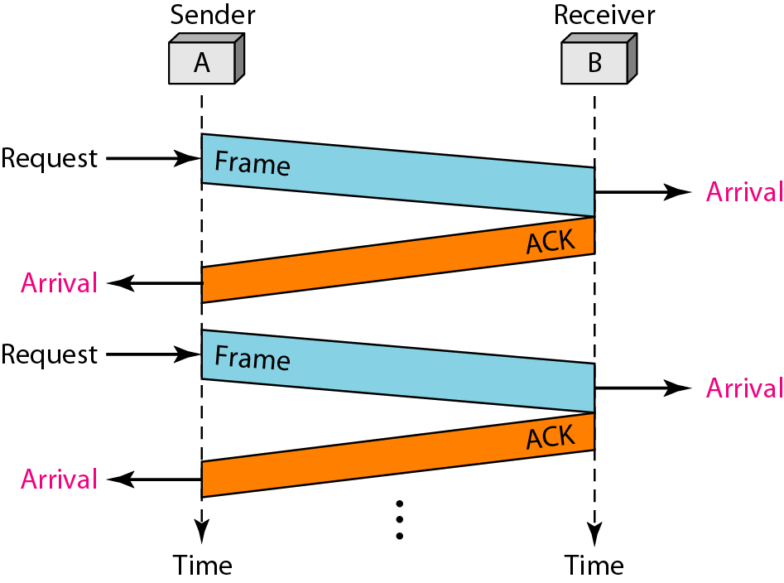
Figure 11.9 Flow diagram for Example 11.2

Slide 26
11-5 NOISY CHANNELS
Although the Stop-and-Wait Protocol gives us an idea of how to add flow control to its predecessor, noiseless channels are nonexistent. We discuss three protocols in this section that use error control.
Topics discussed in this section:
Stop-and-Wait Automatic Repeat Request Go-Back-N Automatic Repeat Request Selective Repeat Automatic Repeat Request

Slide 27
Note
Error correction in Stop-and-Wait ARQ is done by keeping a copy of the sent frame and retransmitting of the frame when the timer expires.

Slide 28
Note
In Stop-and-Wait ARQ, we use sequence numbers to number the frames.
The sequence numbers are based on modulo-2 arithmetic.

Slide 29
Note
In Stop-and-Wait ARQ, the acknowledgment number always announces in modulo-2 arithmetic the sequence number of the next frame expected.

Slide 30
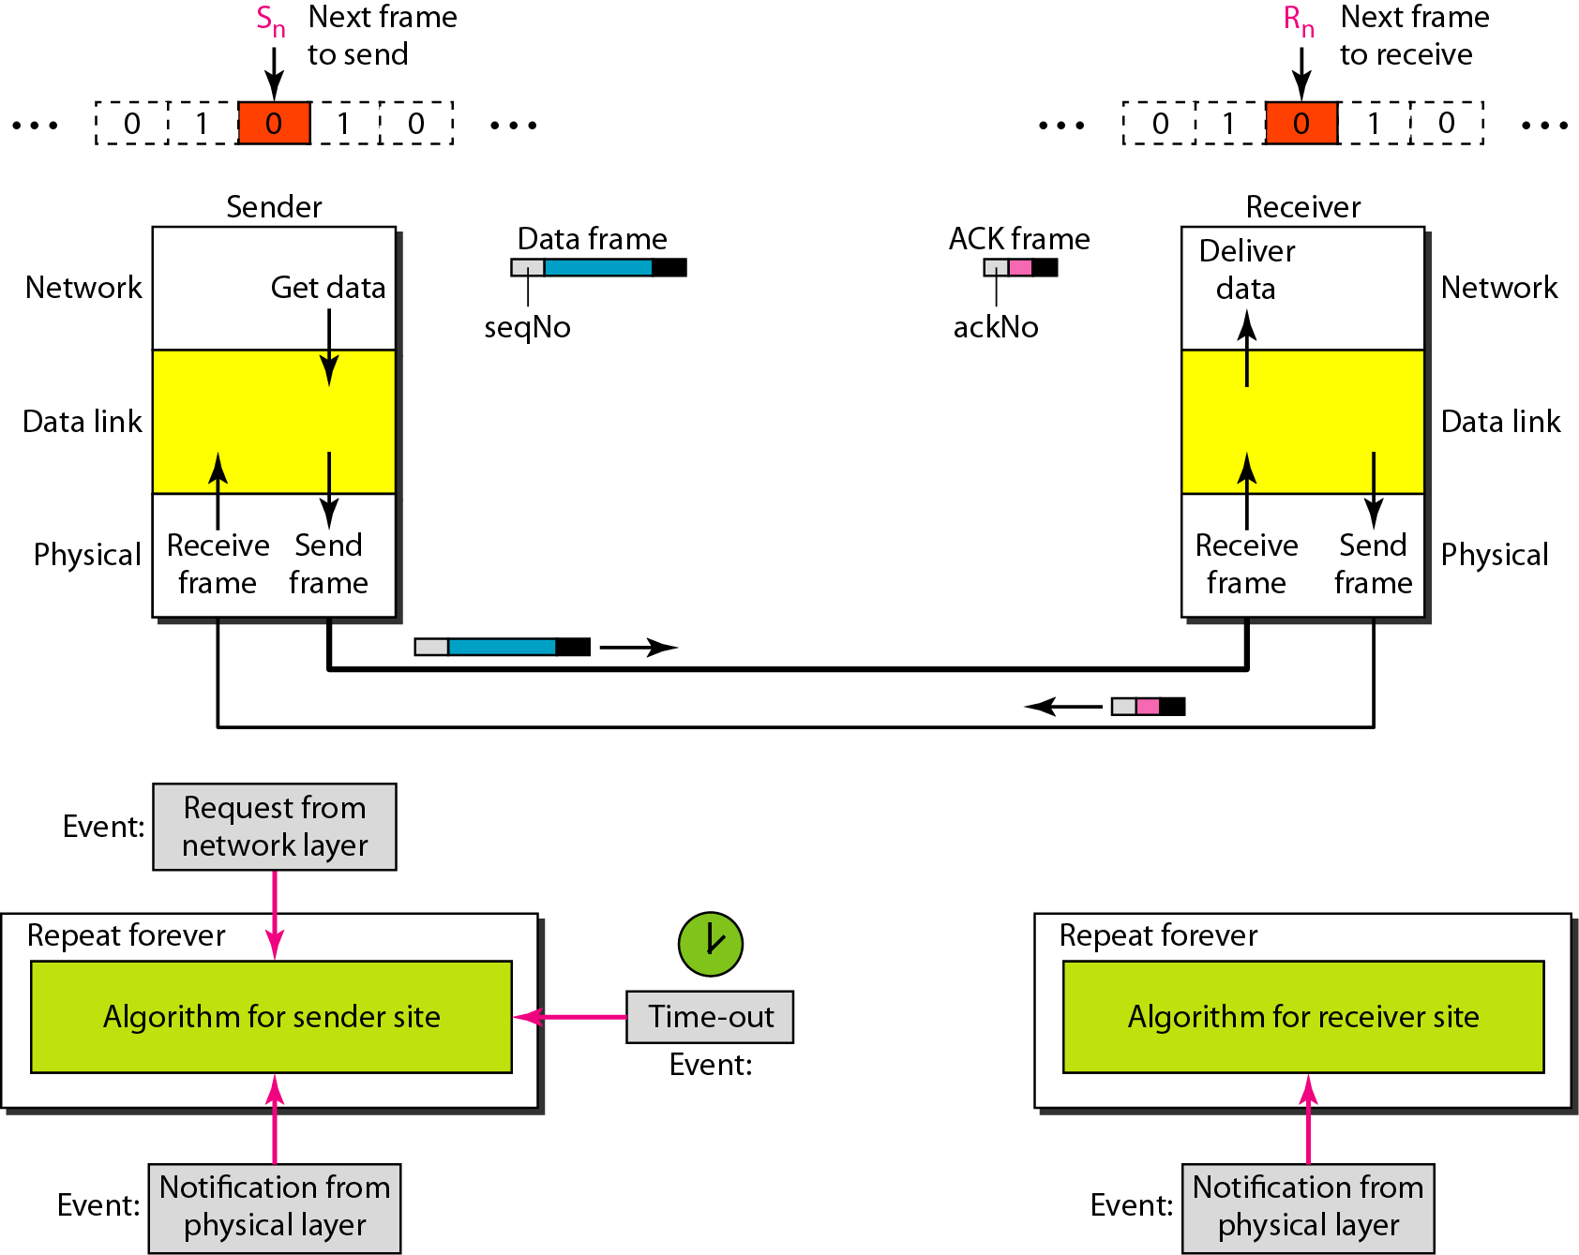
Figure 11.10 Design of the Stop-and-Wait ARQ Protocol

Slide 31
Example 11.3
Figure 11.11 shows an example of Stop-and-Wait ARQ. Frame 0 is sent and acknowledged. Frame 1 is lost and resent after the time-out. The resent frame 1 is acknowledged and the timer stops. Frame 0 is sent and acknowledged, but the acknowledgment is lost. The sender has no idea if the frame or the acknowledgment is lost, so after the time-out, it resends frame 0, which is acknowledged.

Slide 32
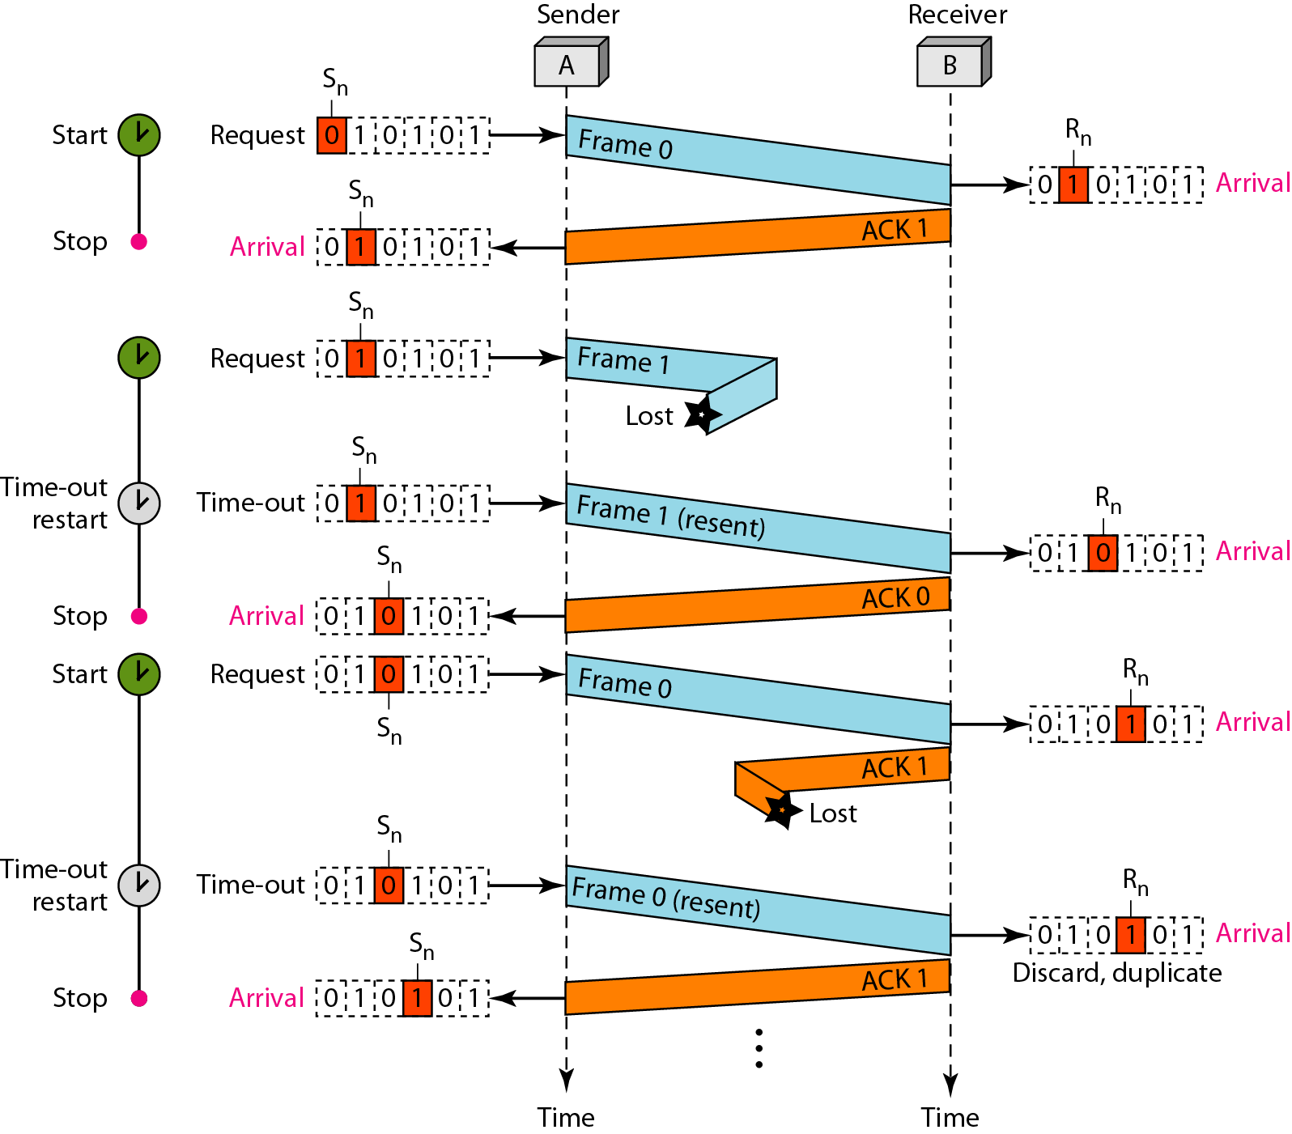
Figure 11.11 Flow diagram for Example 11.3

Slide 33
Example 11.4
Assume that, in a Stop-and-Wait ARQ system, the bandwidth of the line is 1 Mbps, and 1 bit takes 20 ms to make a round trip. What is the bandwidth-delay product? If the system data frames are 1000 bits in length, what is the utilization percentage of the link?
Solution
The bandwidth-delay product is

Slide 34
Example 11.4 (continued)
The system can send 20,000 bits during the time it takes for the data to go from the sender to the receiver and then back again. However, the system sends only 1000 bits. We can say that the link utilization is only 1000/20,000, or 5 percent. For this reason, for a link with a high bandwidth or long delay, the use of Stop-and-Wait ARQ wastes the capacity of the link.

Slide 35
Note
In the Go-Back-N Protocol, the sequence numbers are modulo 2^{m},
where m is the size of the sequence number field in bits.

Slide 36
Note
The send window is an abstract concept defining an imaginary box of size 2^{m} − 1 with three variables: Sf, Sn, and S_{size}.

Slide 37
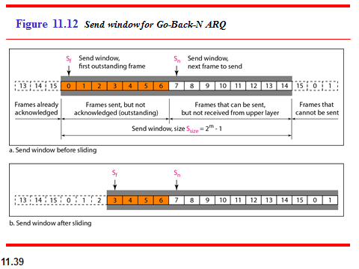
Example 11.5
What is the utilization percentage of the link in Example 11.4 if we have a protocol that can send up to 15 frames before stopping and worrying about the acknowledgments?

Slide 38
Note
The send window can slide one or more slots when a valid acknowledgment arrives.

Slide 39
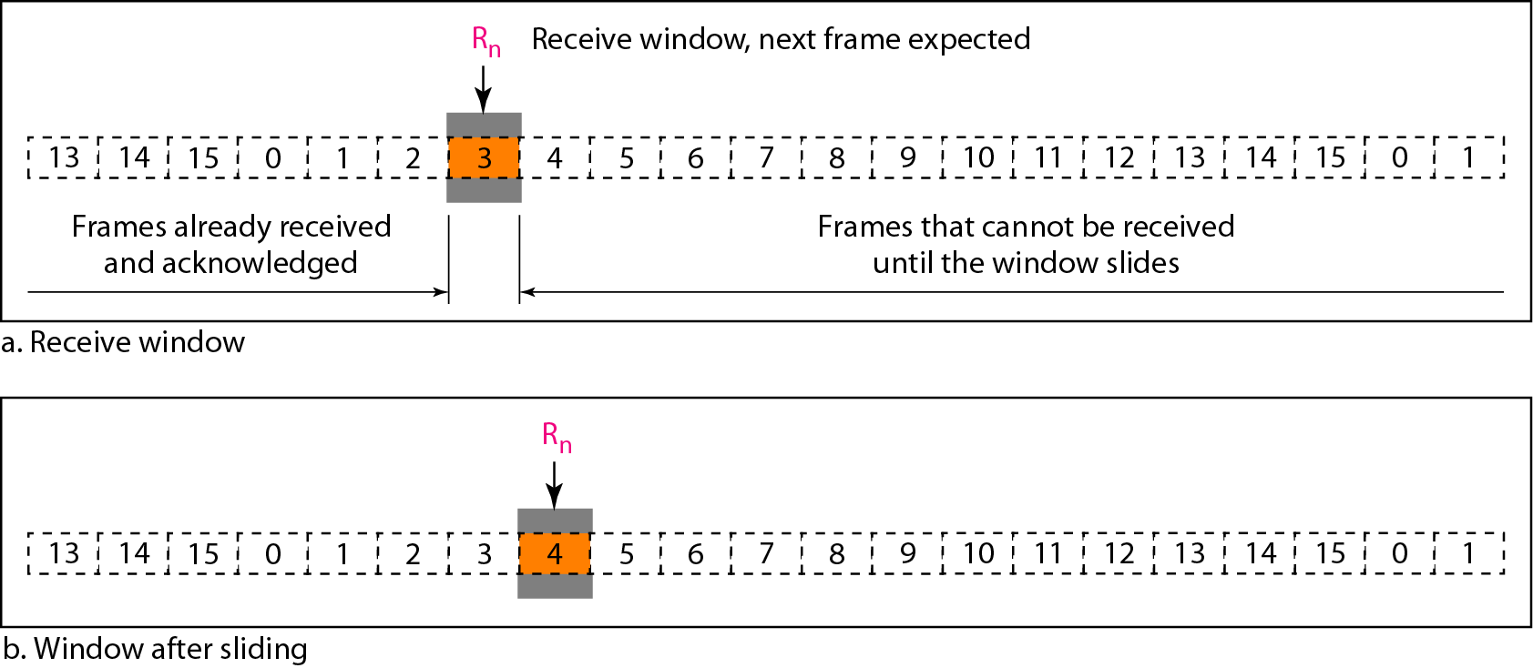
Figure 11.13 Receive window for Go-Back-N ARQ

Slide 40
The receive window is an abstract concept defining an imaginary box
of size 1 with one single variable R_{n}. The window slides
when a correct frame has arrived; sliding occurs one slot at a time.

Slide 41
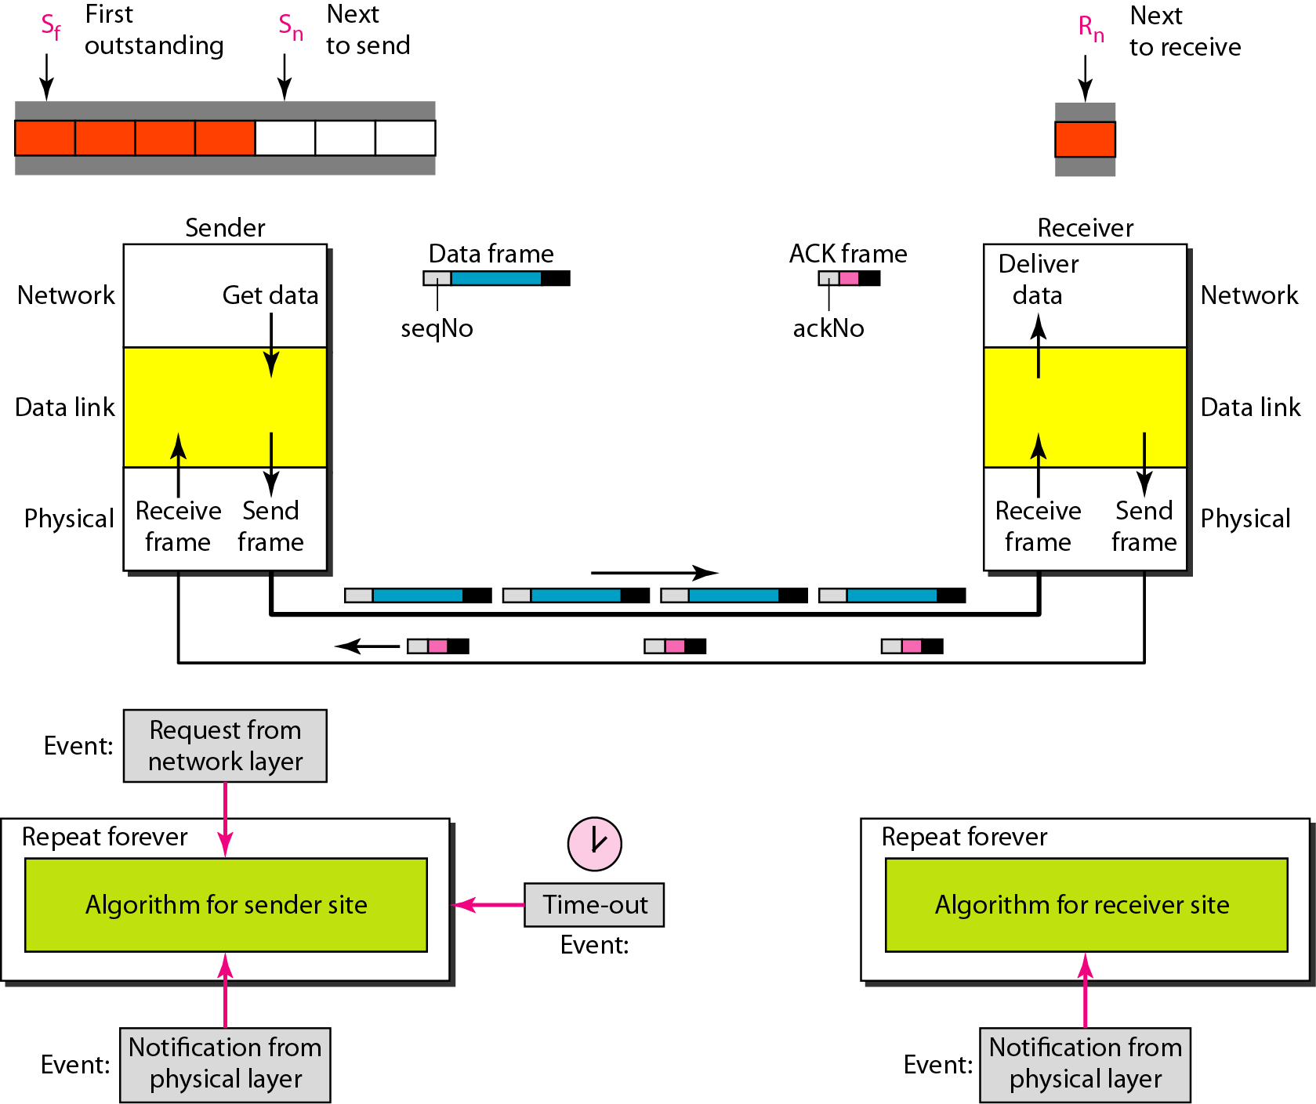
Figure 11.14 Design of Go-Back-N ARQ

Slide 42
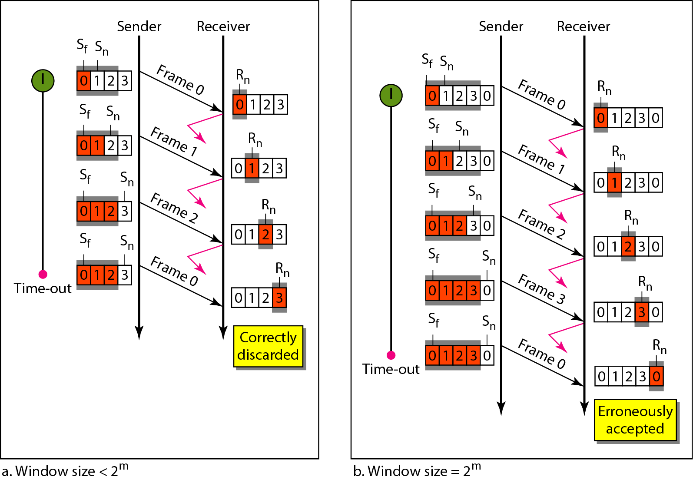
Figure 11.15 Window size for Go-Back-N ARQ

Slide 43
Note
In Go-Back-N ARQ, the size of the send window must be less than 2^{m};
the size of the receiver window is always 1.

Slide 44
Example 11.6
Figure 11.16 shows an example of Go-Back-N. This is an example of a case where the forward channel is reliable, but the reverse is not. No data frames are lost, but some ACKs are delayed and one is lost. The example also shows how cumulative acknowledgments can help if acknowledgments are delayed or lost. After initialization, there are seven sender events. Request events are triggered by data from the network layer; arrival events are triggered by acknowledgments from the physical layer. There is no time-out event here because all outstanding frames are acknowledged before the timer expires. Note that although ACK 2 is lost, ACK 3 serves as both ACK 2 and ACK 3.

Slide 45
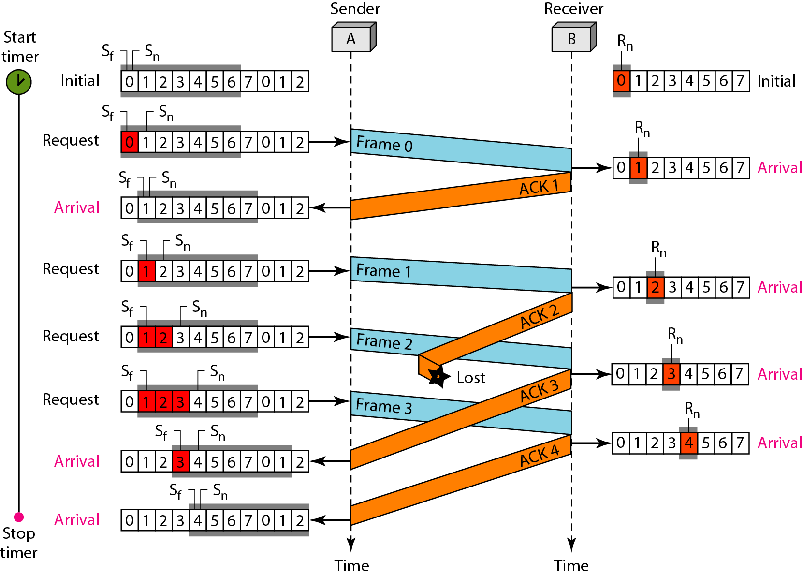
Figure 11.16 Flow diagram for Example 11.6

Slide 46
Example 11.7
Figure 11.17 shows what happens when a frame is lost. Frames 0, 1, 2, and 3 are sent. However, frame 1 is lost. The receiver receives frames 2 and 3, but they are discarded because they are received out of order. The sender receives no acknowledgment about frames 1, 2, or 3. Its timer finally expires. The sender sends all outstanding frames (1, 2, and 3) because it does not know what is wrong. Note that the resending of frames 1, 2, and 3 is the response to one single event. When the sender is responding to this event, it cannot accept the triggering of other events. This means that when ACK 2 arrives, the sender is still busy with sending frame 3.

Slide 47
Example 11.7 (continued)
The physical layer must wait until this event is completed and the data link layer goes back to its sleeping state. We have shown a vertical line to indicate the delay. It is the same story with ACK 3; but when ACK 3 arrives, the sender is busy responding to ACK 2. It happens again when ACK 4 arrives. Note that before the second timer expires, all outstanding frames have been sent and the timer is stopped.

Slide 48
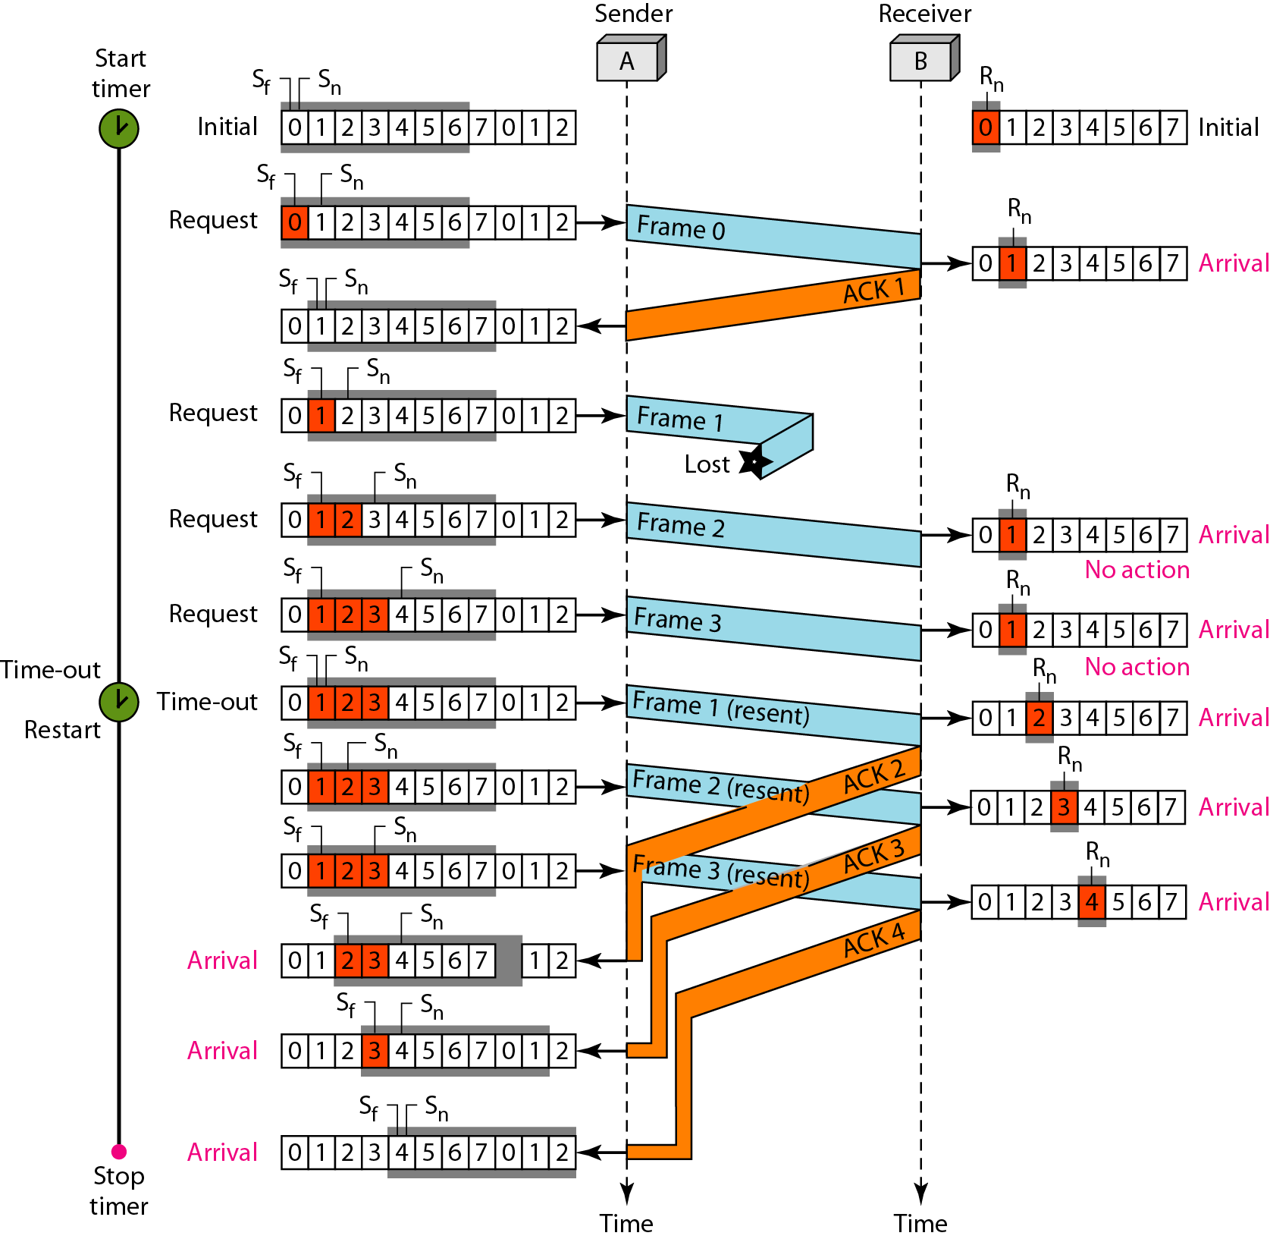
Figure 11.17 Flow diagram for Example 11.7

Slide 49
Note
Stop-and-Wait ARQ is a special case of Go-Back-N ARQ in which the size of the send window is 1.

Slide 50
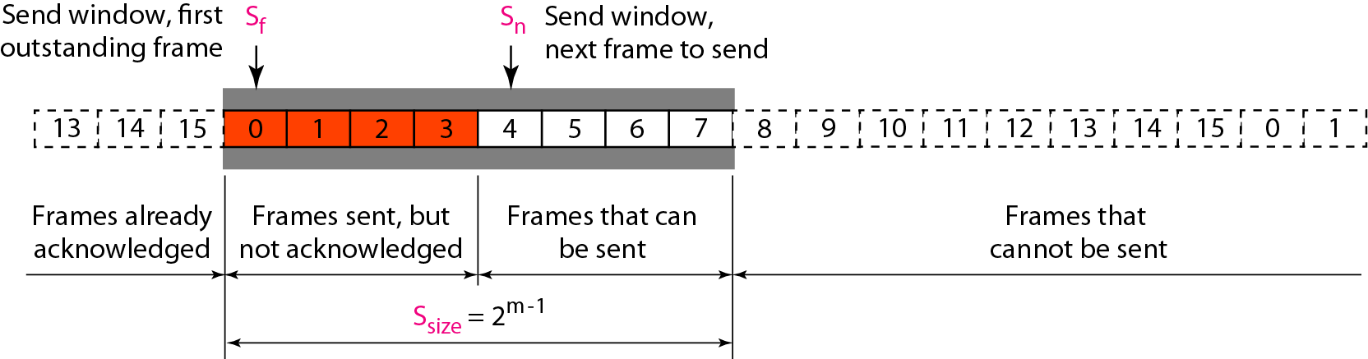
Figure 11.18 Send window for Selective Repeat ARQ

Slide 51
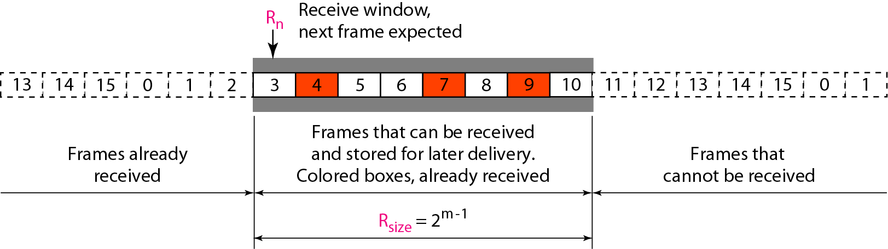
Figure 11.19 Receive window for Selective Repeat ARQ

Slide 52
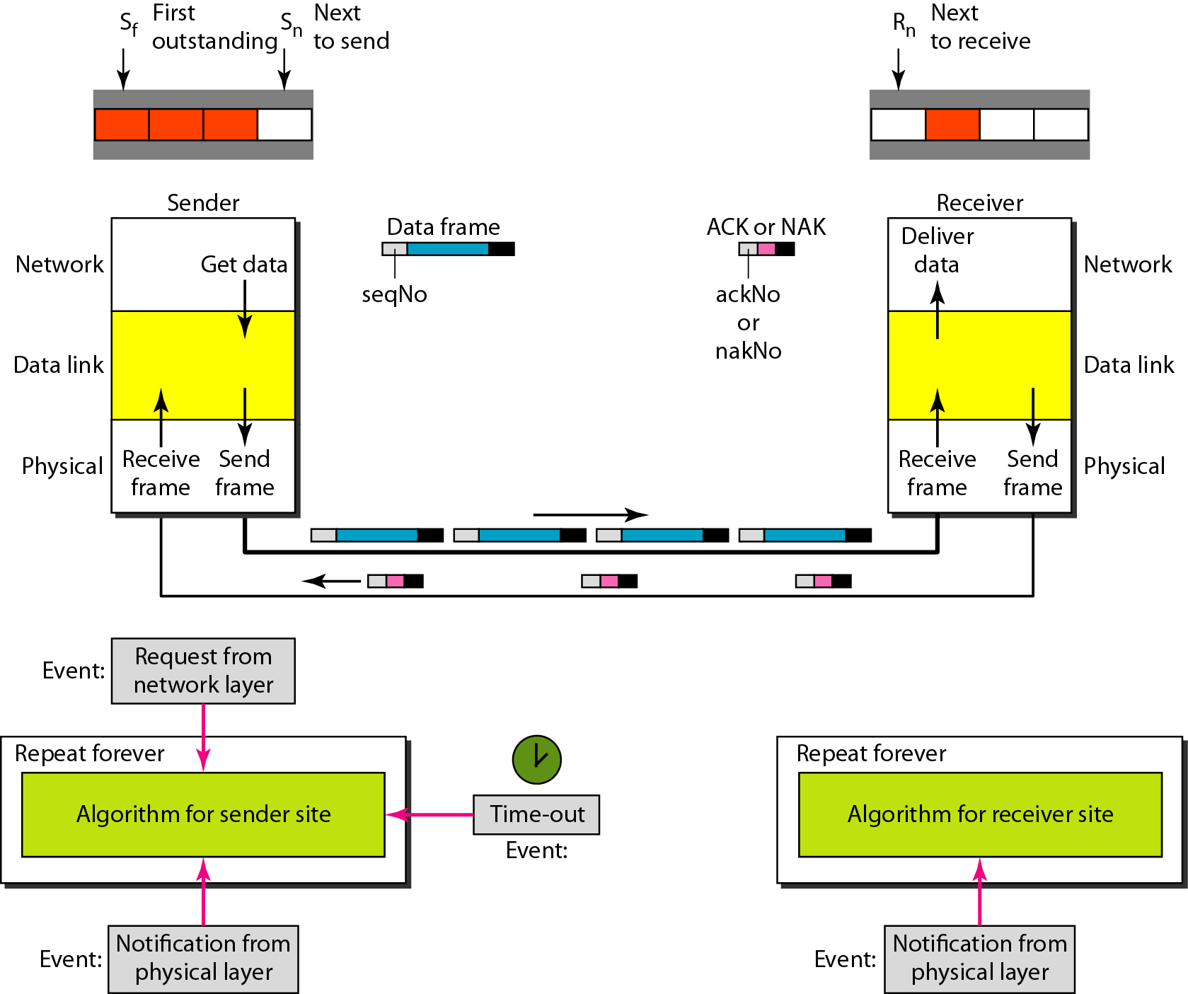
Figure 11.20 Design of Selective Repeat ARQ

Slide 53
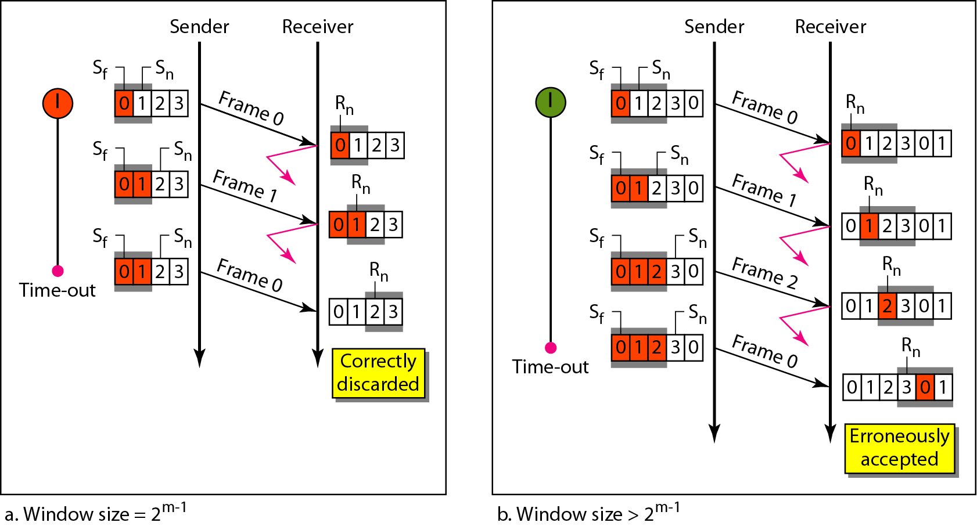
Figure 11.21 Selective Repeat ARQ, window size

Slide 54
Note
In Selective Repeat ARQ, the size of the sender and receiver window
must be at most one-half of 2^{m}.

Slide 55
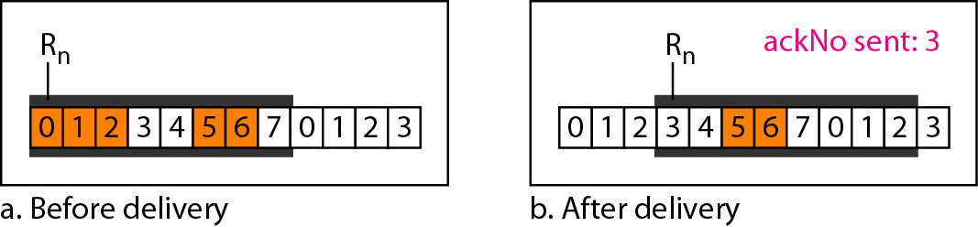
Figure 11.22 Delivery of data in Selective Repeat ARQ

Slide 56
Example 11.8
This example is similar to Example 11.3 in which frame 1 is lost. We show how Selective Repeat behaves in this case. Figure 11.23 shows the situation. One main difference is the number of timers. Here, each frame sent or resent needs a timer, which means that the timers need to be numbered (0, 1, 2, and 3). The timer for frame 0 starts at the first request, but stops when the ACK for this frame arrives. The timer for frame 1 starts at the second request, restarts when a NAK arrives, and finally stops when the last ACK arrives. The other two timers start when the corresponding frames are sent and stop at the last arrival event.

Slide 57
Example 11.8 (continued)
At the receiver site we need to distinguish between the acceptance of a frame and its delivery to the network layer. At the second arrival, frame 2 arrives and is stored and marked, but it cannot be delivered because frame 1 is missing. At the next arrival, frame 3 arrives and is marked and stored, but still none of the frames can be delivered. Only at the last arrival, when finally a copy of frame 1 arrives, can frames 1, 2, and 3 be delivered to the network layer. There are two conditions for the delivery of frames to the network layer: First, a set of consecutive frames must have arrived. Second, the set starts from the beginning of the window.

Slide 58
Example 11.8 (continued)
Another important point is that a NAK is sent after the second arrival, but not after the third, although both situations look the same. The reason is that the protocol does not want to crowd the network with unnecessary NAKs and unnecessary resent frames. The second NAK would still be NAK1 to inform the sender to resend frame 1 again; this has already been done. The first NAK sent is remembered (using the nakSent variable) and is not sent again until the frame slides. A NAK is sent once for each window position and defines the first slot in the window.

Slide 59
Example 11.8 (continued)
The next point is about the ACKs. Notice that only two ACKs are sent here. The first one acknowledges only the first frame; the second one acknowledges three frames. In Selective Repeat, ACKs are sent when data are delivered to the network layer. If the data belonging to n frames are delivered in one shot, only one ACK is sent for all of them.

Slide 60
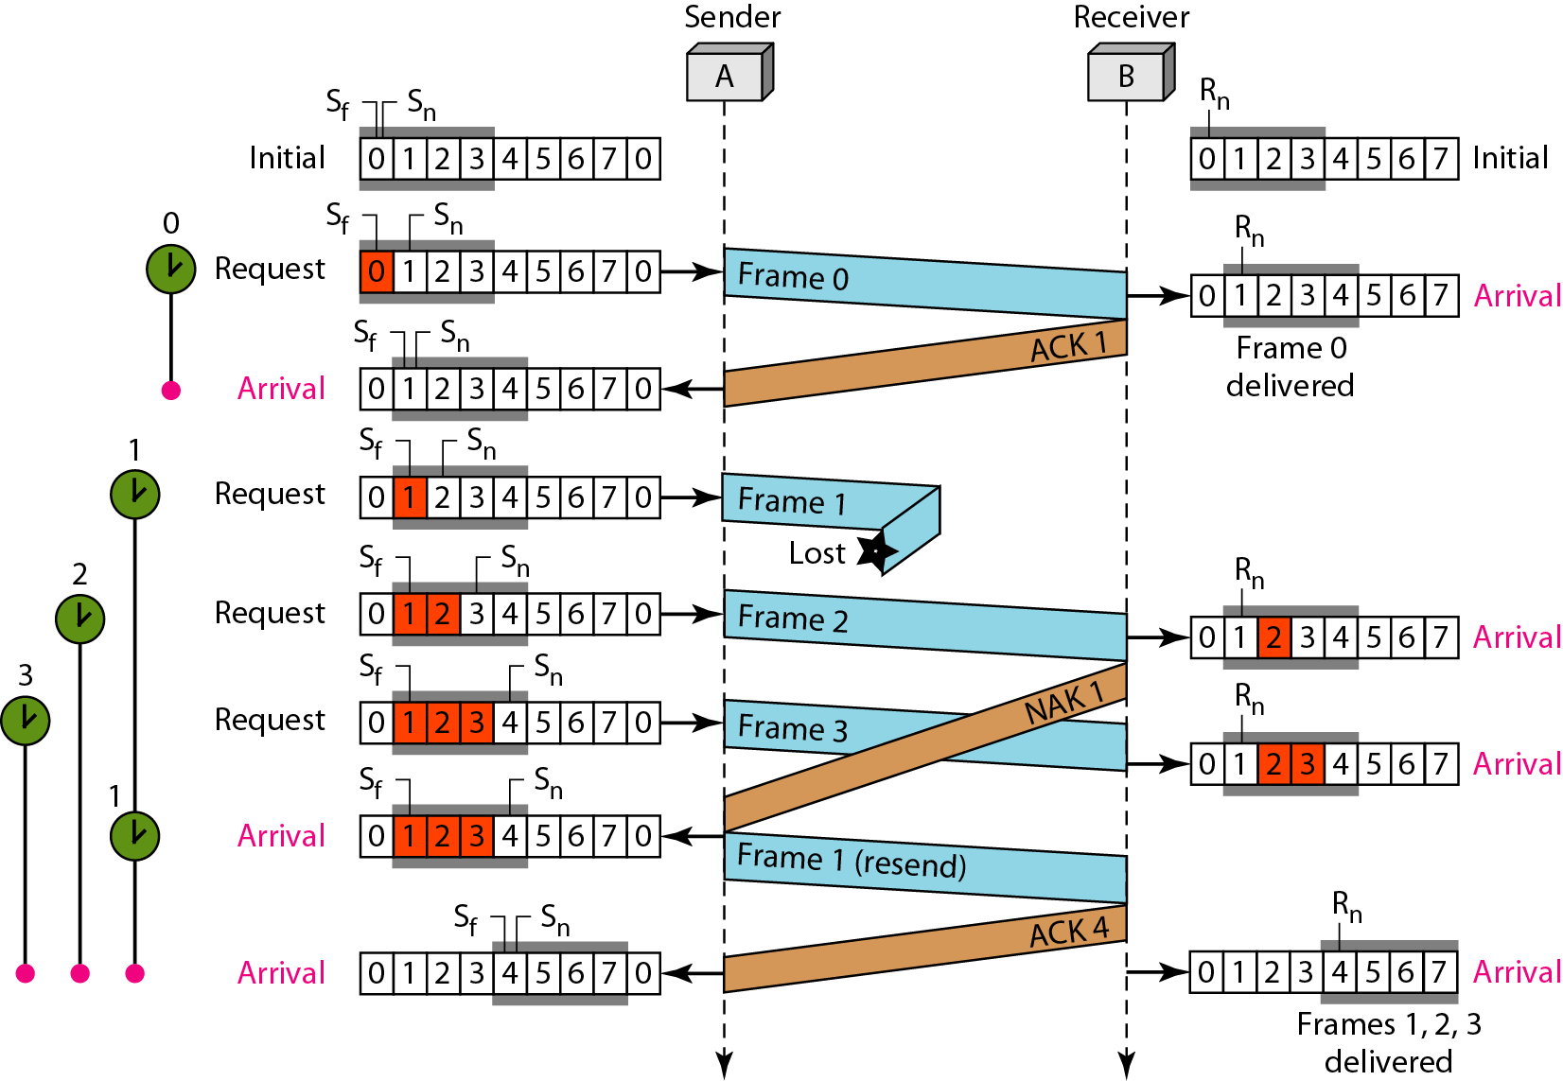
Figure 11.23 Flow diagram for Example 11.8

Slide 61
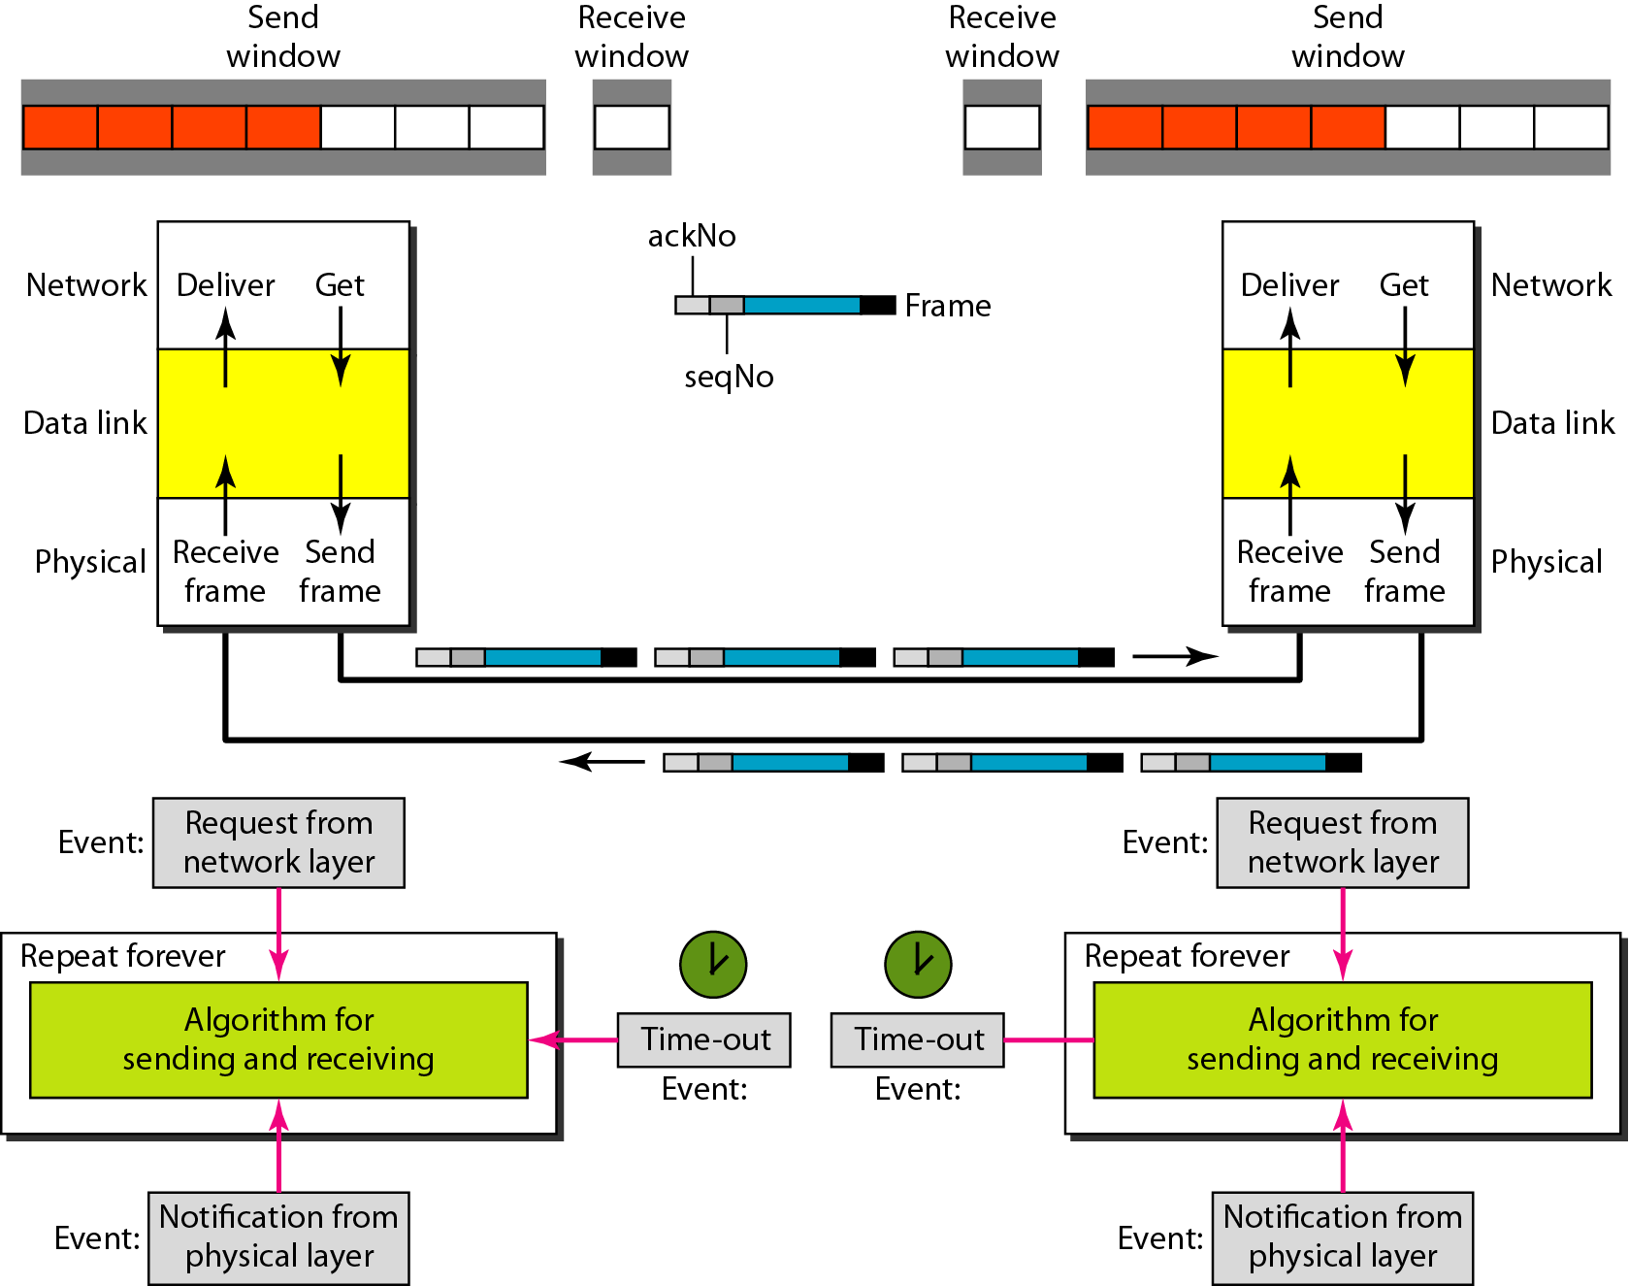
Figure 11.24 Design of piggybacking in Go-Back-N ARQ

Slide 62
11-6 HDLC
High-level Data Link Control (HDLC) is a bit-oriented protocol for communication over point-to-point and multipoint links. It implements the ARQ mechanisms we discussed in this chapter.
Topics discussed in this section:
Configurations and Transfer Modes Frames Control Field

Slide 63
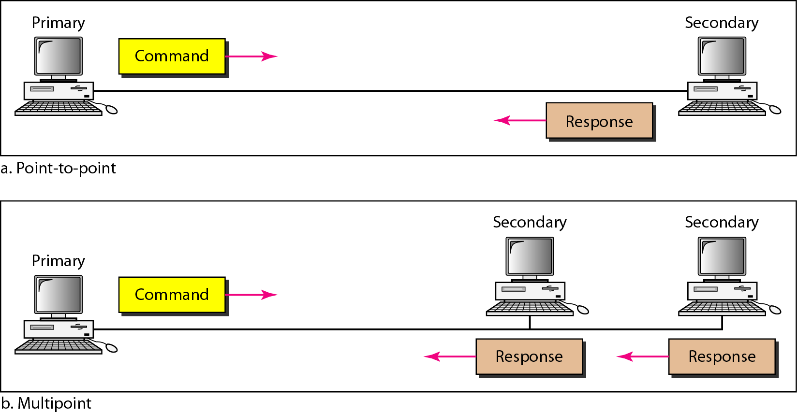
Figure 11.25 Normal response mode

Slide 64
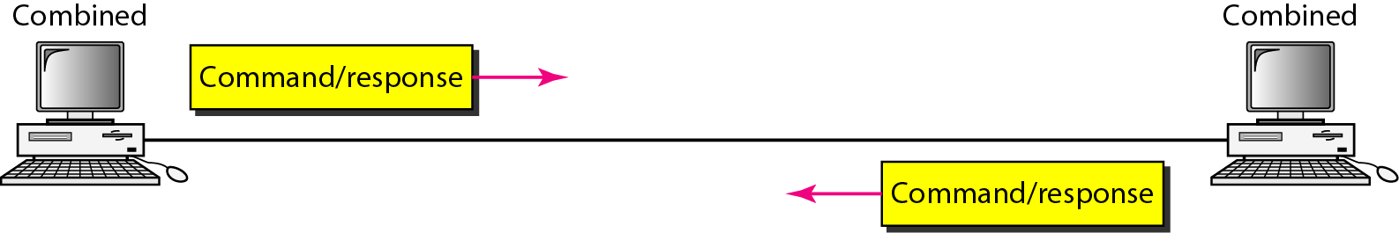
Figure 11.26 Asynchronous balanced mode

Slide 65
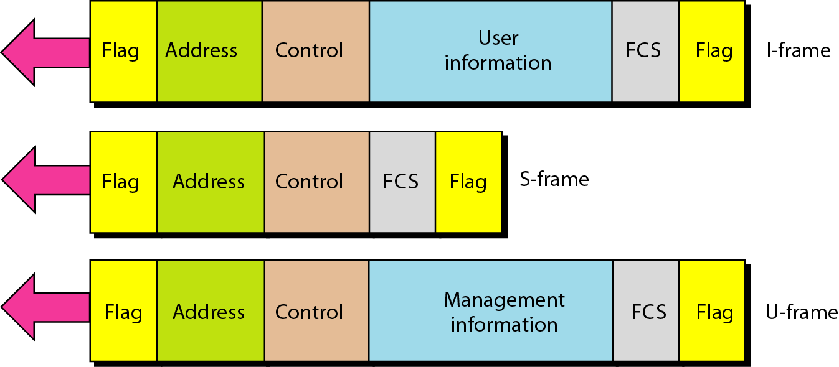
Figure 11.27 HDLC frames

Slide 66
11-7 POINT-TO-POINT PROTOCOL
Although HDLC is a general protocol that can be used for both point-to-point and multipoint configurations, one of the most common protocols for point-to-point access is the Point-to-Point Protocol (PPP). PPP is a byte-oriented protocol.
Topics discussed in this section:
Framing
Transition Phases
Multiplexing
Multilink PPP

Slide 67
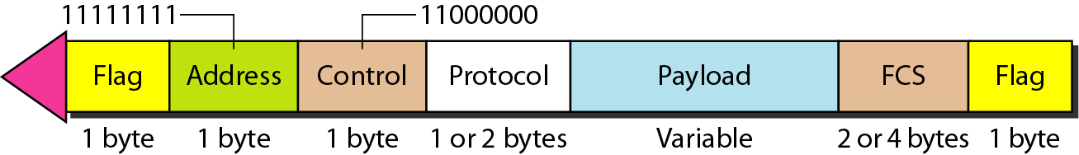
Figure 11.32 PPP frame format

Slide 68
Note
PPP is a byte-oriented protocol using byte stuffing with the escape byte 01111101.

Slide 69
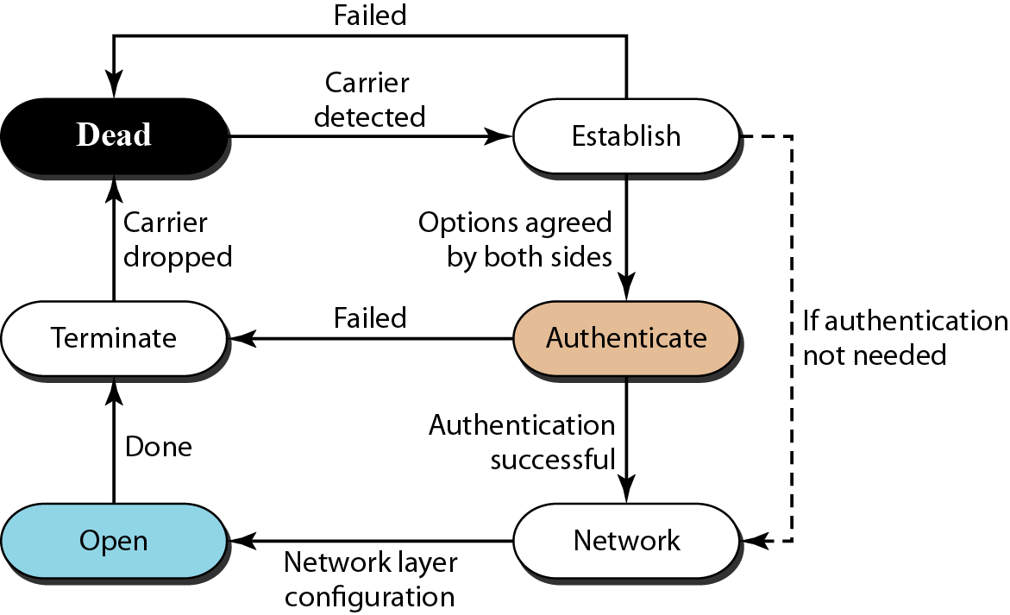
Figure 11.33 Transition phases

Slide 70
ERROR HANDELING
Let us first discuss some issues related, directly or indirectly, to error detection and correction.

Slide 71
10.10.1 Types of Errors
Whenever bits flow from one point to another, they are subject to unpredictable changes because of interference. This interference can change the shape of the signal. The term single-bit error means that only 1 bit of a given data unit (such as a byte, character, or packet) is changed from 1 to 0 or from 0 to 10. The term burst error means that 2 or more bits in the data unit have changed from 1 to 0 or from 0 to 10. Figure 10.1 shows the effect of a single-bit and a burst error on a data unit.

Slide 72
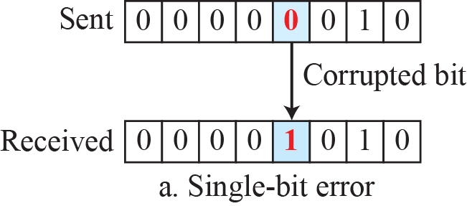
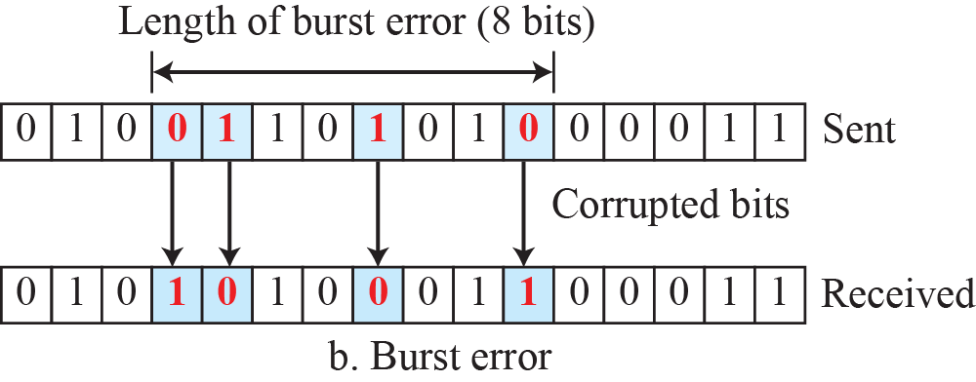
Figure 10.1: Single-bit and burst error

Slide 73
10.10.2 Redundancy
The central concept in detecting or correcting errors is redundancy. To be able to detect or correct errors, we need to send some extra bits with our data. These redundant bits are added by the sender and removed by the receiver. Their presence allows the receiver to detect or correct corrupted bits.

Slide 74
10.10.3 Detection versus Correction
The correction of errors is more difficult than the detection.
In error detection, we are only looking to see if any error has occurred. The answer is a simple yes or no. We are not even interested in the number of corrupted bits. A single-bit error is the same for us as a burst error.
In error correction, we need to know the exact number of bits that are corrupted and, more importantly, their location in the message.

Slide 75
10.10.4 Coding
Redundancy is achieved through various coding schemes. The sender adds redundant bits through a process that creates a relationship between the redundant bits and the actual data bits. The receiver checks the relationships between the two sets of bits to detect errors. The ratio of redundant bits to data bits and the robustness of the process are important factors in any coding scheme.

Slide 76
10-2 BLOCK CODING
In block coding, we divide our message into blocks, each of k bits, called datawords. We add r redundant bits to each block to make the length n = k + r. The resulting n-bit blocks are called codewords. How the extra r bits are chosen or calculated is something
we will discuss later.

Slide 77
10.2.1 Error Detection
How can errors be detected by using block coding? If the following two conditions are met, the receiver can detect a change in the original codeword.
1. The receiver has (or can find) a list of valid codewords.
2. The original codeword has changed to an invalid one.

Slide 78
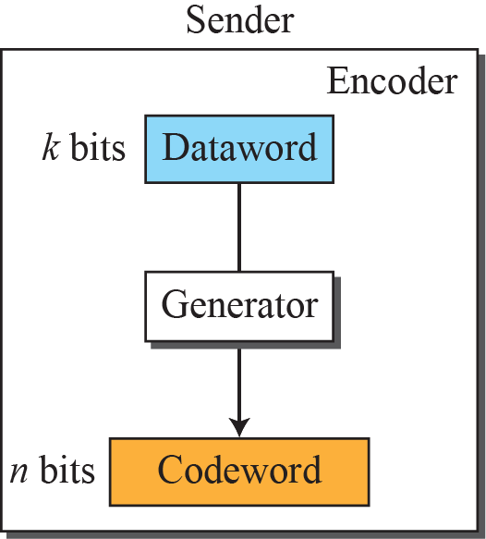
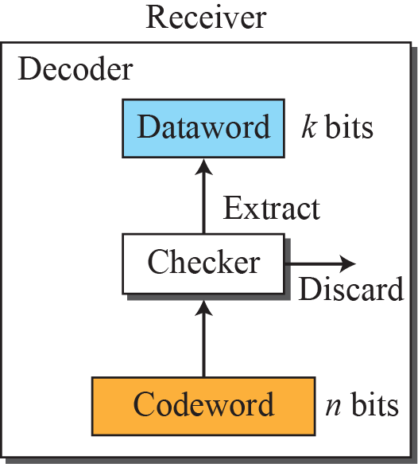

Figure 10.2: Process of error detection in block coding
10.78

Slide 79
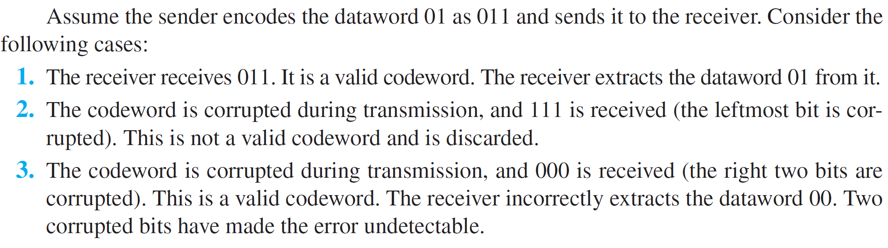
Example 10.1
Let us assume that k = 2 and n = 3. Table 10.1 shows the list of datawords and codewords. Later, we will see how to derive a codeword from a dataword.
Table 10.1: A code for error detection in Example 10.1
10.79

Slide 80
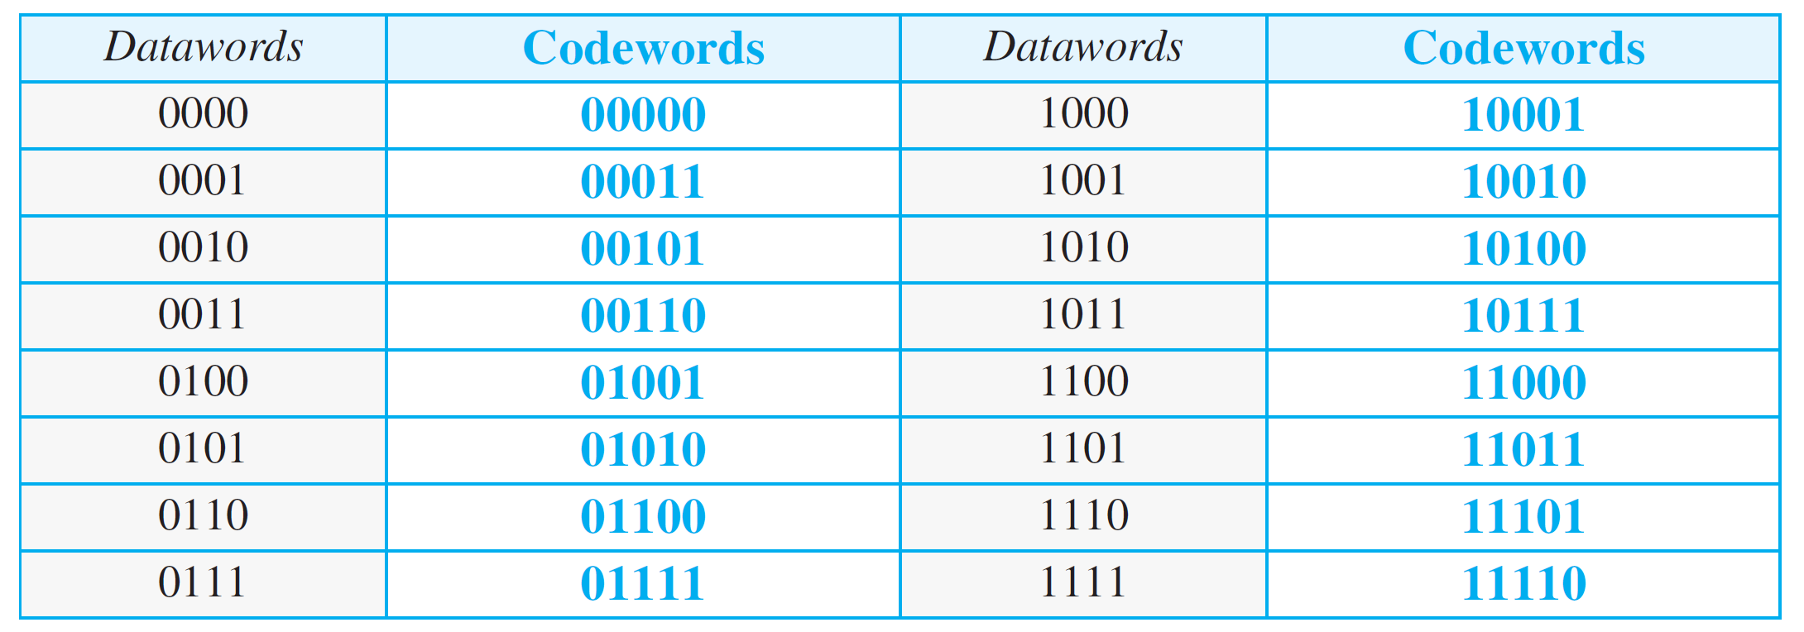
Table 10.2: Simple parity-check code C(5, 4)
10.80

Slide 81
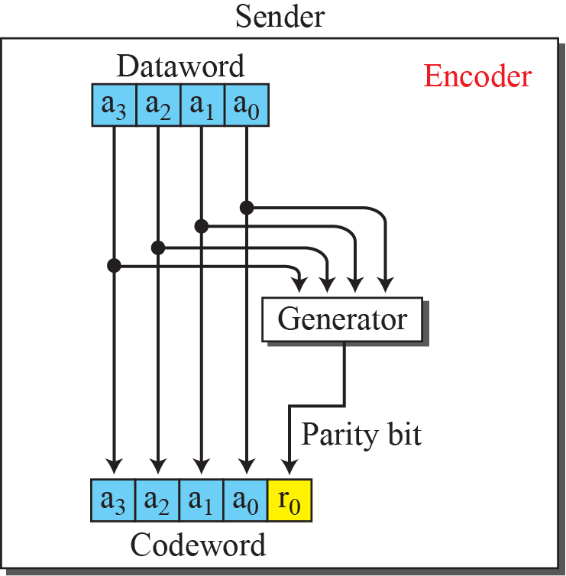
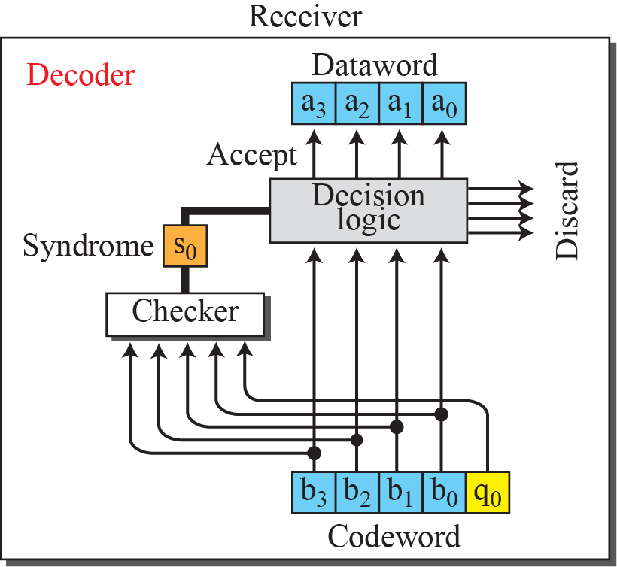
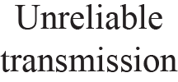
Figure 10.4: Encoder and decoder for simple parity-check code

Slide 82
10-3 CYCLIC CODES
Cyclic codes are special linear block codes with one extra property. In a cyclic code, if a codeword is cyclically shifted (rotated), the result is another codeword. For example, if 1011000 is a codeword and we cyclically left-shift, then 0110001 is also a codeword.

Slide 83
10.3.1 Cyclic Redundancy Check
We can create cyclic codes to correct errors. However, the theoretical background required is beyond the scope of this book. In this section, we simply discuss a subset of. cyclic codes called the cyclic redundancy check (CRC), which is used in networks such as LANs and WANs.

Slide 84
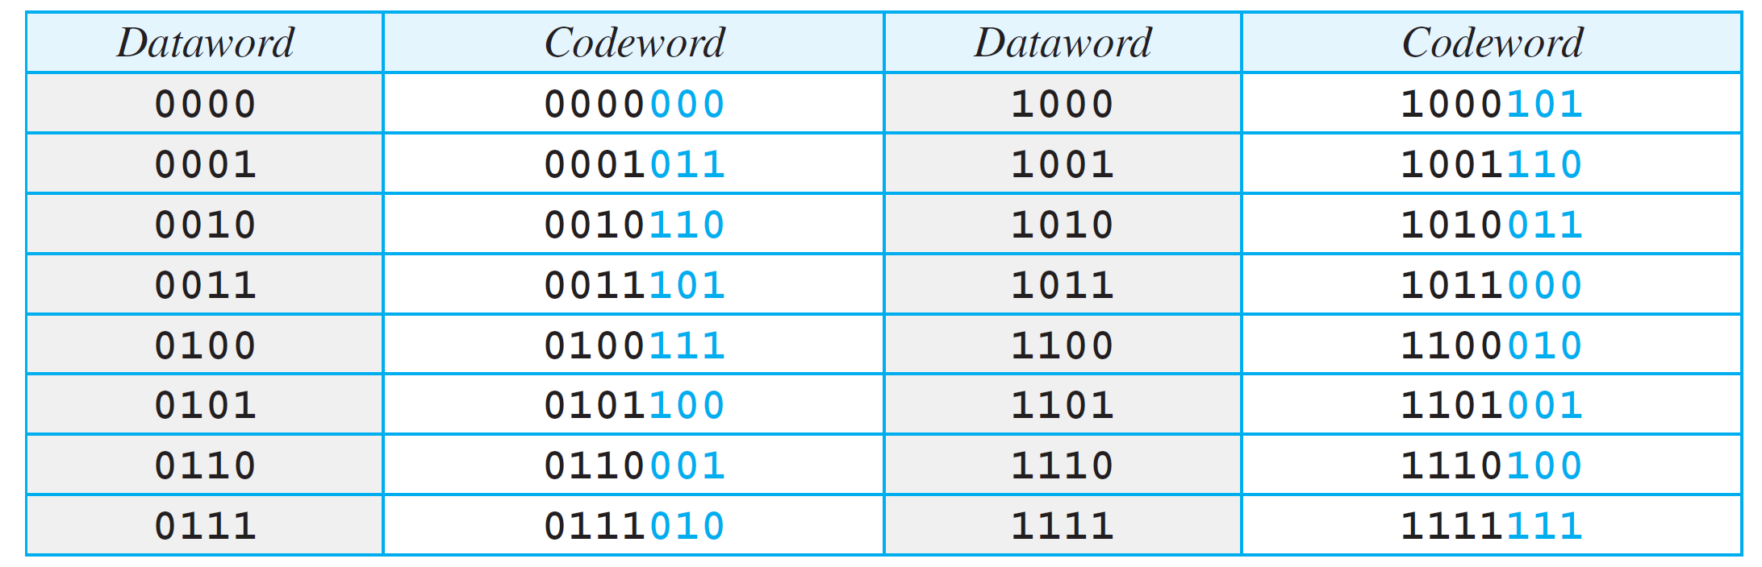
Table 10.3: A CRC code with C(7, 4)
10.84

Slide 85
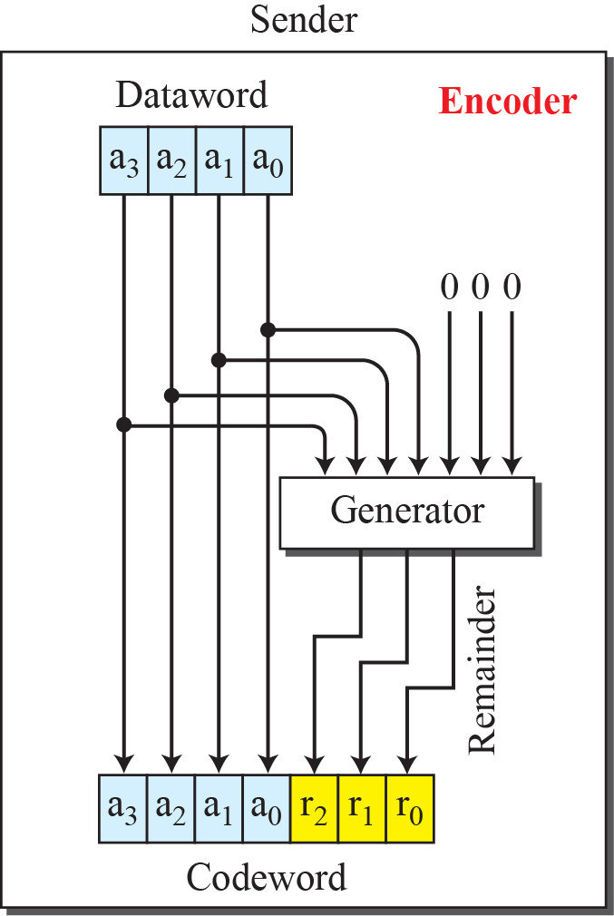
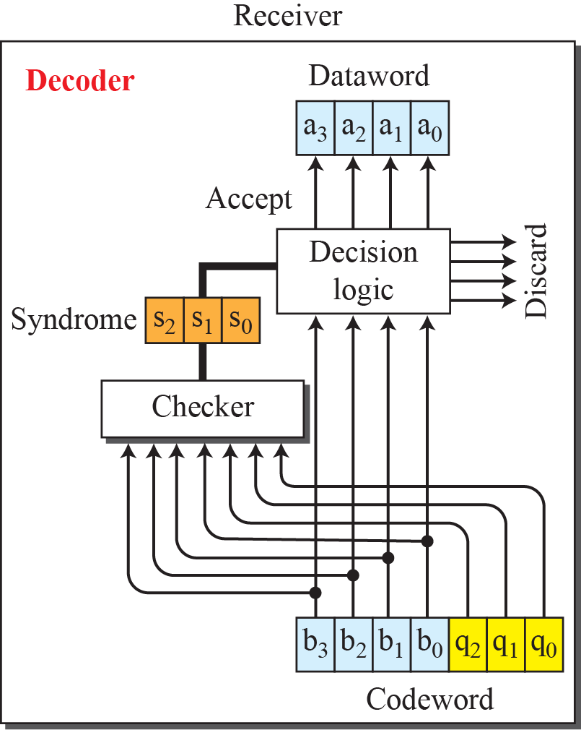
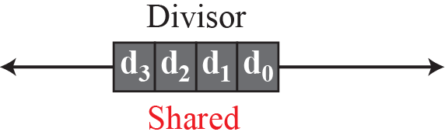
Figure 10.5: CRC encoder and decoder

Slide 86
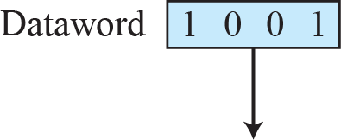
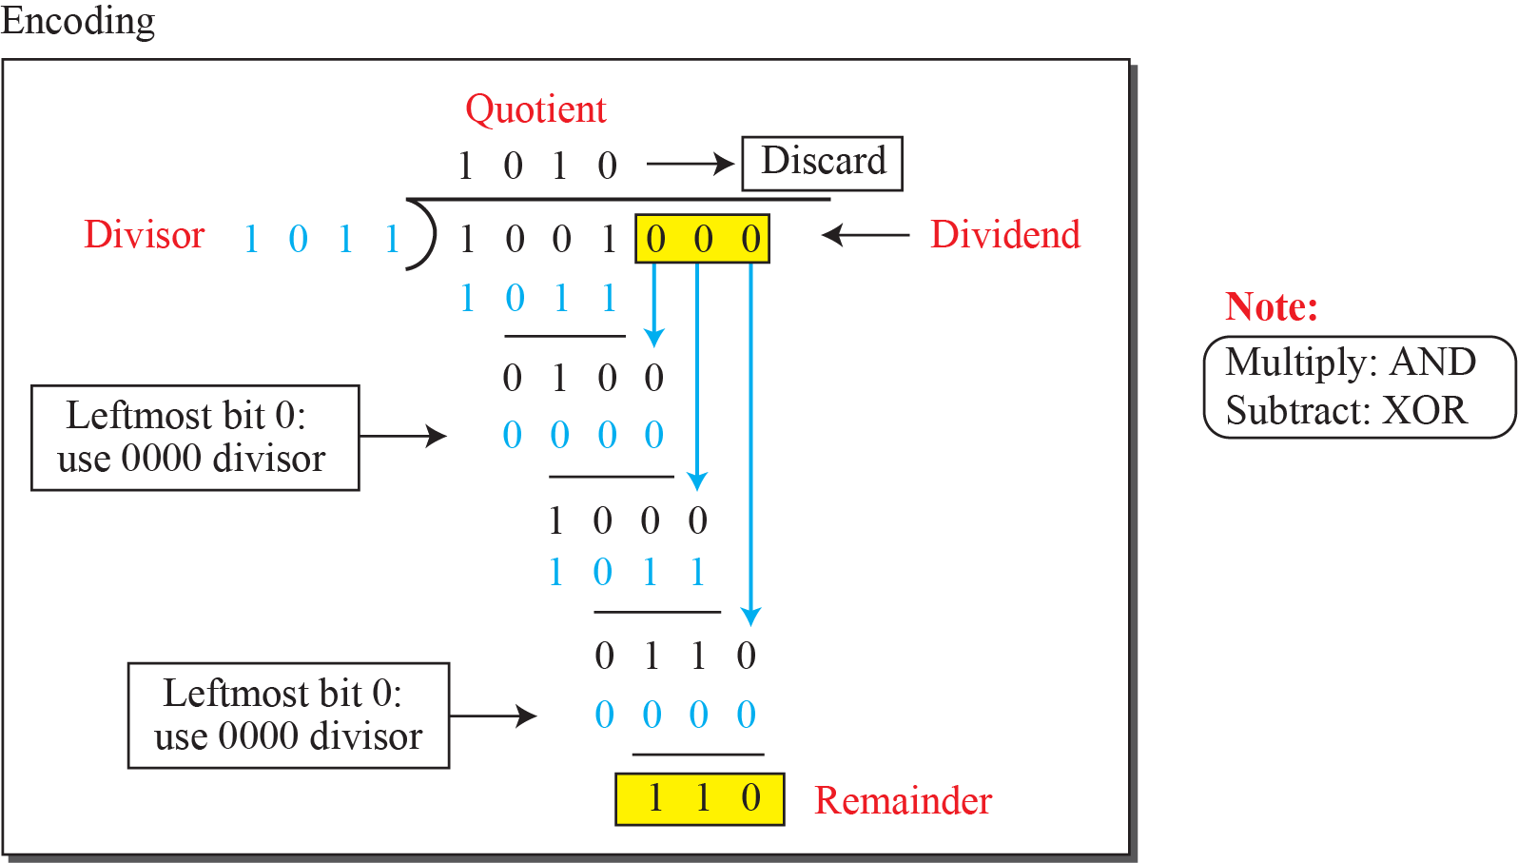
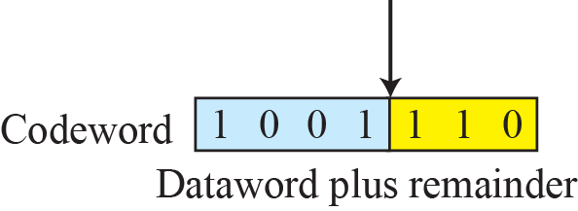
Figure 10.6: Division in CRC encoder

Slide 87
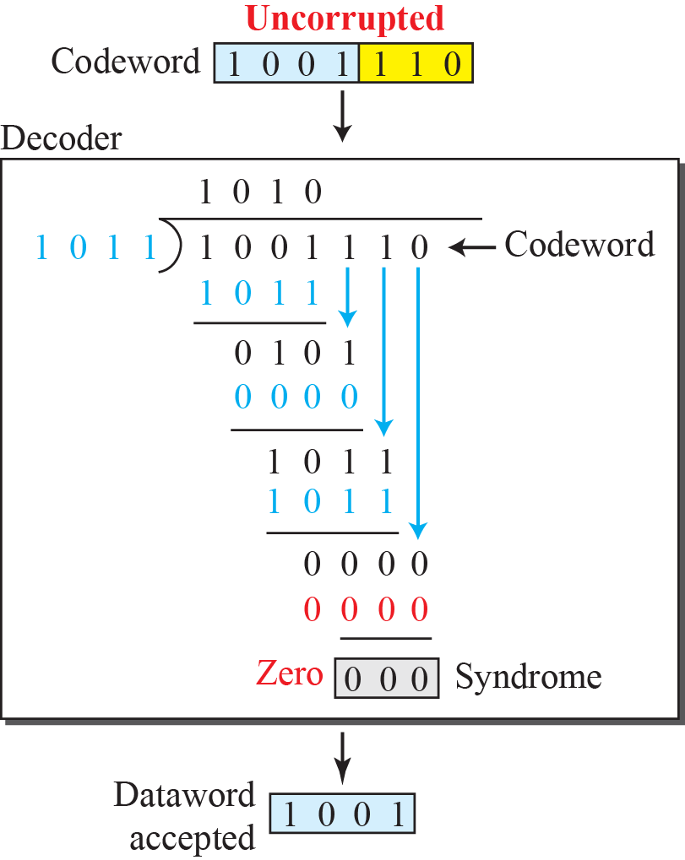
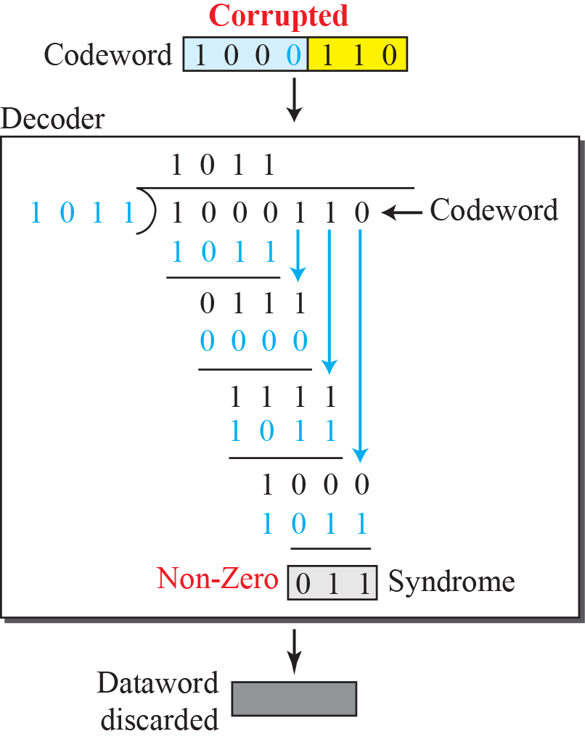
Figure 10.7: Division in the CRC decoder for two cases

Slide 88
10.3.2 Polynomials
A better way to understand cyclic codes and how they can be analyzed is to represent them as polynomials. A pattern of 0s and 1s can be represented as a polynomial with coefficients of 0 and 10. The power of each term shows the position of the bit; the coefficient shows the value of the bit. Figure 10.8 shows a binary pattern and its polynomial representation.

Slide 89
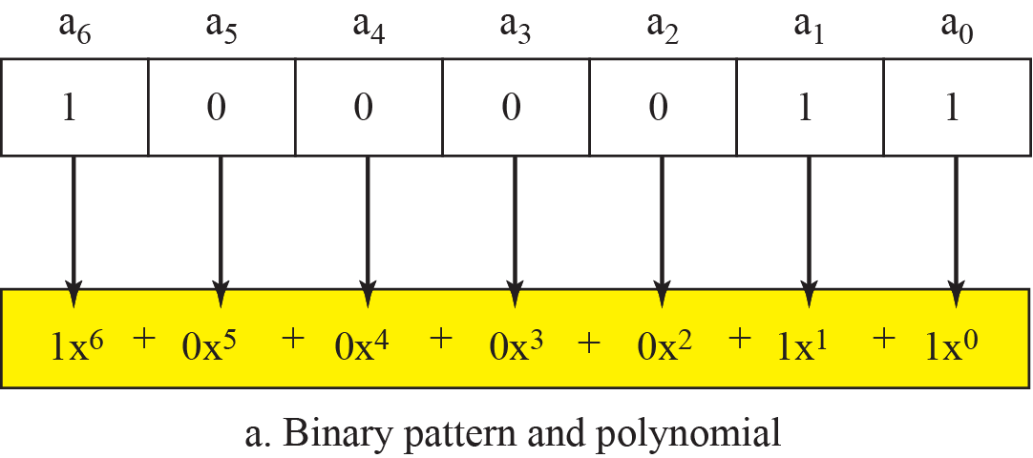
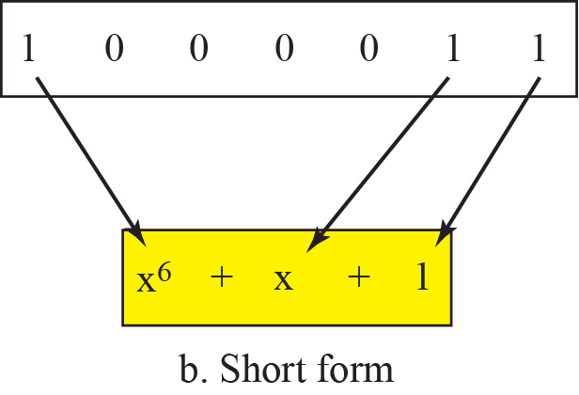
Figure 10.8: A polynomial to represent a binary word

Slide 90
10.3.3 Encoder Using Polynomials
Now that we have discussed operations on polynomials, we show the creation of a codeword from a dataword. Figure 10.9 is the polynomial version of Figure 10.6. We can see that the process is shorter.

Slide 91

Figure 10.9: CRC division using polynomials

Slide 92


10.3.4 Cyclic Code Analysis
We can analyze a cyclic code to find its capabilities by using polynomials. We define the following, where f(x) is a polynomial with binary coefficients.

Slide 93
Example 10.8
Which of the following g(x) values guarantees that a single-bit error is caught? x + 1, x³ and 1
Solution
10.93

Slide 94

Figure 10.10: Representation of isolated single-bit errors

Slide 95

Strength of CRC
If G(x) contains at least two terms, then all single-bit errors can be detected
If G(x) cannot divide x^{t} + 1 (0 ≤ t < n), then all isolated double errors can be detected
If G(x) contains a factor of (x+1), all odd-numbered errors can be detected

Slide 96
Properties of Good Polynomial
It should have at least two terms
The coefficient of the term x⁰ should be 1
It should not divide x^{t} + 1, for t between 2 and n − 1
It should have the factor x + 1

Slide 97
CRC's Strength Summary
All burst errors with L ≤ n will be detected
All burst errors with L = n + 1 will be detected with probability 1 – (1/2)^{n–1}
All burst errors with L > n + 1 will be detected with probability 1 – (1/2)^{n}

Slide 98

Example 10.9
Find the suitability of the following generators in relation to burst errors of different lengths: x⁶ + 1, x¹⁸ + x⁷ + x + 1, and x³² + x²³ + x⁷ + 10.
Solution
10.98

Slide 99

Example 10.10
Find the status of the following generators related to two isolated, single-bit errors: x + 1, x⁴ + 1, x⁷ + x⁶ + 1, and x¹⁵ + x¹⁴ + 1
Solution
10.99

Slide 100

Table 10.4: Standard polynomials
10.100

Slide 101

Figure 12.1 Data link layer divided into two
Functionality oriented sub-layers

Slide 102

Figure 12.2 Taxonomy of multiple-access protocols

Slide 103

Figure 12.3 Frames in a pure ALOHA network

Slide 104

Figure 12.4 Procedure for pure ALOHA protocol

Slide 105

Figure 12.5 Vulnerable time for pure ALOHA protocol

Slide 106
Note
The throughput for pure ALOHA is S = G × e ^{−2G} .
The maximum throughput
S_{max} = 0.184 when G= (1/2).

Slide 107

Figure 12.6 Frames in a slotted ALOHA network

Slide 108
Note
The throughput for slotted ALOHA is S = G × e^{−G} .
The maximum throughput S_{max} = 0.368 when G = 1.

Slide 109

Figure 12.7 Vulnerable time for slotted ALOHA protocol

Slide 110

Figure 12.8 Space/time model of the collision in CSMA

Slide 111

Figure 12.9 Vulnerable time in CSMA

Slide 112

Figure 12.10 Behavior of three persistence methods

Slide 113

Figure 12.11 Flow diagram for three persistence methods

Slide 114

Figure 12.12 Collision of the first bit in CSMA/CD

Slide 115

Figure 12.13 Collision and abortion in CSMA/CD

Slide 116

Figure 12.14 Flow diagram for the CSMA/CD

Slide 117

Figure 12.15 Energy level during transmission, idleness, or collision

Slide 118

Figure 12.16 Timing in CSMA/CA

Slide 119
Note
In CSMA/CA, the IFS can also be used to define the priority of a station or a frame.

Slide 120
Note
In CSMA/CA, if the station finds the channel busy, it does not restart the timer of the contention window;
it stops the timer and restarts it when the channel becomes idle.

Slide 121

Figure 12.17 Flow diagram for CSMA/CA

Slide 122

Figure 12.21 Frequency-division multiple access (FDMA)

Slide 123
Note
In FDMA, the available bandwidth of the common channel is divided into bands that are separated by guard bands.

Slide 124

Figure 12.22 Time-division multiple access (TDMA)

Slide 125
Note
In TDMA, the bandwidth is just one channel that is timeshared between different stations.

Slide 126
Note
In CDMA, one channel carries all transmissions simultaneously.

Slide 127

Figure 12.23 Simple idea of communication with code

Slide 128
Figure 12.24 Chip sequences

Slide 129
Figure 12.25 Data representation in CDMA

Slide 130

Figure 12.26 Sharing channel in CDMA

Slide 131

Figure 12.27 Digital signal created by four stations in CDMA

Slide 132

Figure 12.28 Decoding of the composite signal for one in CDMA

