Slide 1
Unit-5 : Application Layer
Ashutosh Kumar Singh
www.ashutoshksingh.in

Slide 2
Content
DNS
TELNET
E-Mail
MIME
POP3
IMAP4
SMTP
FTP
HTPP
SNMP

Slide 3
Domain Name System (DNS)
The Domain Name System (DNS) is the phonebook of the Internet.
Humans access information online through domain names, like google.com or facebook.com.
Web browsers interact through Internet Protocol (IP) addresses. DNS translates domain names to IP addresses so browsers can load Internet resources.

Slide 4
Domain Name System (Cont’d)
The tree can have only 128 levels: level 0 (root) to level 127

Slide 5
Domain Name System (Cont’d)
Label: Each node in the tree has a label, which is a string with a maximum of 63 characters. The root label is a null string (empty string).
Domain Name: Each node in the tree has a domain name. A full domain name is a sequence of labels separated by dots (.). The domain names are always read from the node up to the root. The last label is the label of the root (null).

Slide 6
Domain Name System (Cont’d)
Fully Qualified Domain Name If a label is terminated by a null string, it is called a fully qualified domain name (FQDN). An FQDN is a domain name that contains the full name of a host.
Example: challenger.ate.tbda.edu.
Partially Qualified Domain Name If a label is not terminated by a null string, it is called a partially qualified domain name (PQDN). A PQDN starts from a node, but it does not reach the root. It is used when the name to be resolved belongs to the same site as the client.
Example: challenger

Slide 7
Domain
A domain is a sub-tree of the domain name space. The name of the domain is the domain name of the node at the top of the sub-tree.
Note that a domain may itself be divided into domains (or subdomains as they are sometimes called).

Slide 8
DNS in the Internet
DNS is a protocol that can be used in different platforms.
In the Internet, the domain name space (tree) is divided into three different sections:
generic domains,
country domains, and
the inverse domain.

Slide 9
DNS in the Internet
Generic Domains: The generic domains define registered hosts according to their generic behavior. Each node in the tree defines a domain, which is an index to the domain name space database.
Example:
com -Commercial organizations
edu-Educational institutions ,
gov- Government institutions ,
info -Information service providers
int-International organizations,
net - Network support centers ,
org -Nonprofit organizations

Slide 10
DNS in the Internet
Country Domains: The country domains section uses two-character country abbreviations (e.g., us for United States and in for India).
Example www.ashutoshksingh.in
Inverse domain: It is used to map an address to a name. This may happen, for example, when a server has received a request from a client to do a task. This type of query is called an inverse or pointer (PTR) query.

Slide 11
TELNET
TELNET is an abbreviation for TErminaL NETwork. It is the standard TCP/IP protocol for virtual terminal service as proposed by the International Organization for Standards (ISO).
TELNET enables the establishment of a connection to a remote system in such a way that the local terminal appears to be a terminal at the remote system.
Note: TELNET is a general purpose client/server application program.

Slide 12
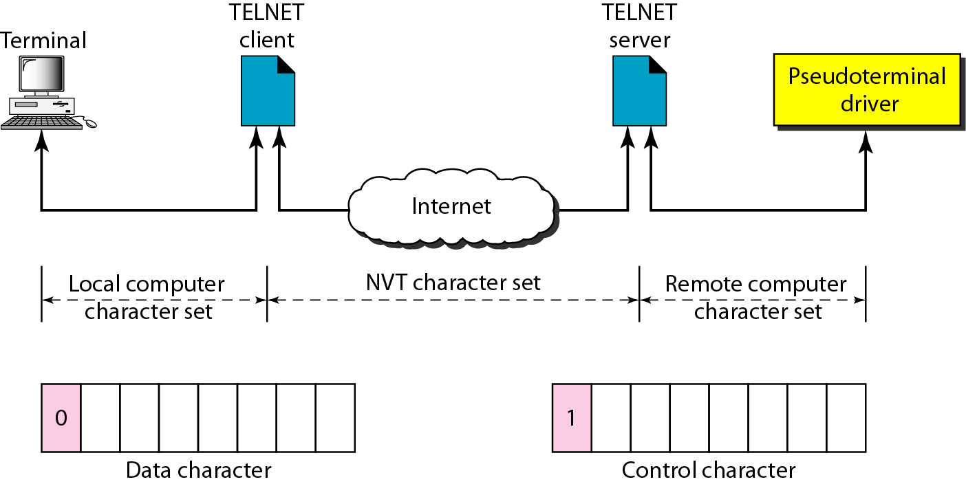
TELNET

Slide 13
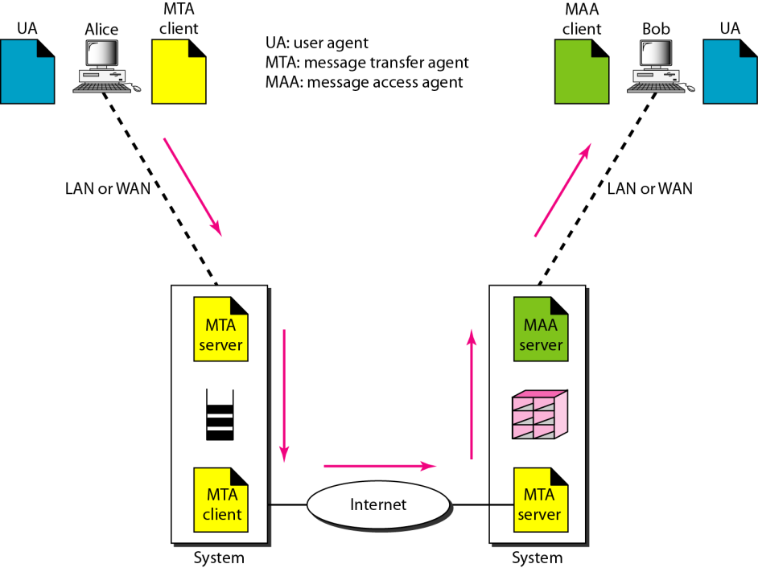
Electronic Mail
Electronic mail (email or e-mail) is a method of exchanging messages ("mail") between people using electronic devices.

Slide 14
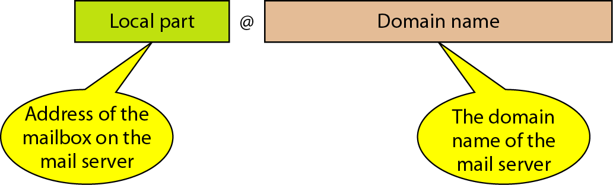
Electronic Mail
The local part defines the name of a special file, called the user mailbox, where all the mail received for a user is stored for retrieval by the message access agent.
Domain Name : The second part of the address is the domain name. An organization usually selects one or more hosts to receive and send e-mail; the hosts are sometimes called mail servers or exchangers.

Slide 15
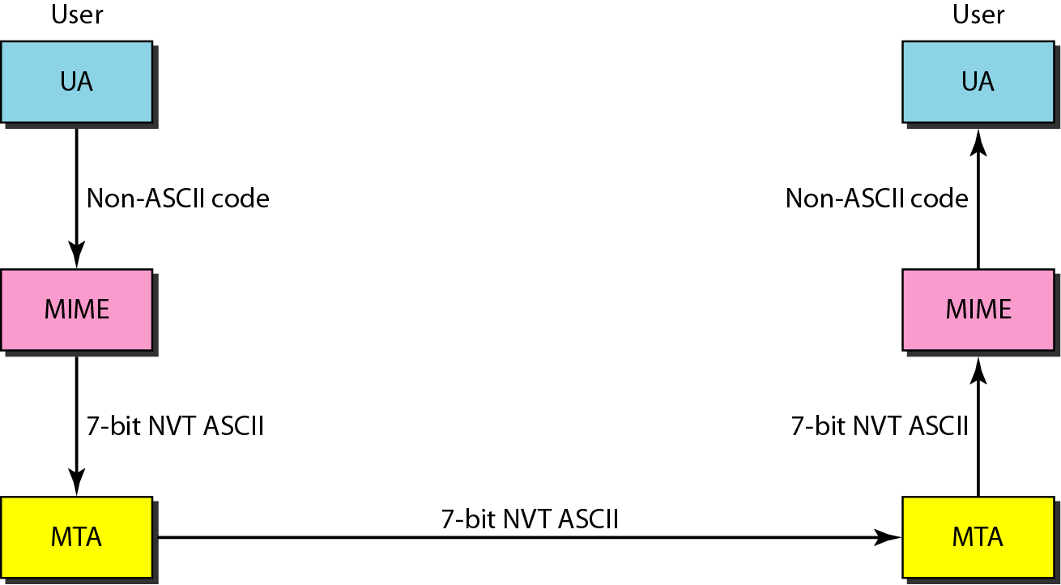
MIME
MIME stands for Multipurpose Internet Mail Extensions
MIME is a supplementary protocol that allows non-ASCII data to be sent through e-mail.

Slide 16
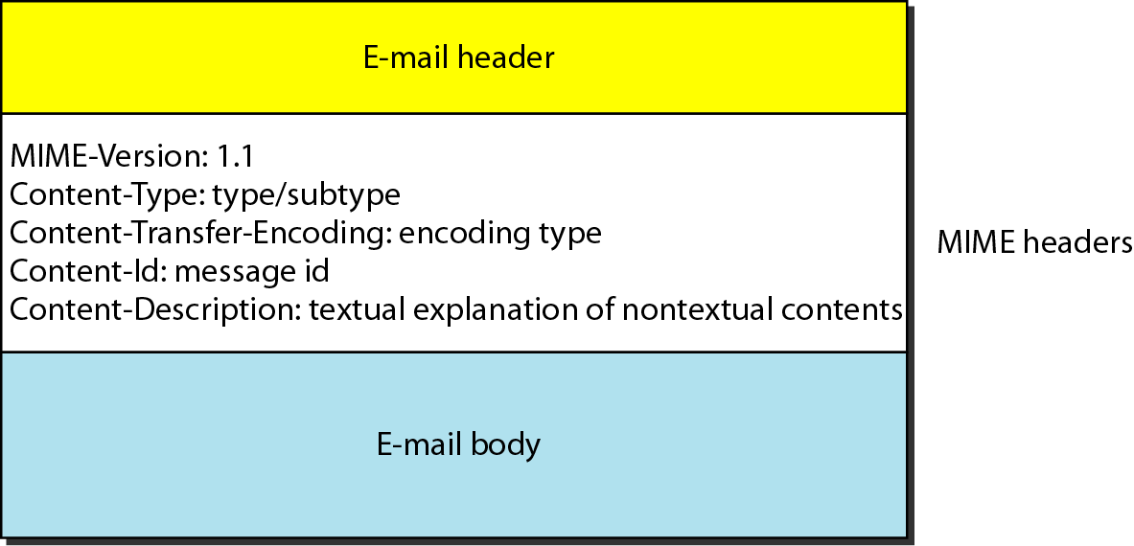
MIME
MIME defines five headers that can be added to the original e-mail header section to define the transformation parameters:

Slide 17
MIME
MIME-Version: This header defines the version of MIME used. The current version is 1.1.
Content-Type : This header defines the type of data used in the body of the message. The content type and the content subtype are separated by a slash.
Content-Transfer-Encoding: This header defines the method used to encode the messages into 0s and 1s for transport.
Content-Id : This header uniquely identifies the whole message in a multiple-message environment.
Content-Description : This header defines whether the body is image, audio, or video

Slide 18
SMTP
SMTP stands for Simple Mail Transfer Protocol.
The actual mail transfer is done through Message Transfer Agents (MTA).
To send mail, a system must have the client MTA, and to receive mail, a system must have a server MTA. The formal protocol that defines the MTA client and server in the Internet is called the Simple Mail Transfer Protocol (SMTP).
SMTP is used two times, between the sender and the sender's mail server and between the two mail servers.
SMTP simply defines how commands and responses must be sent back and forth.

Slide 19
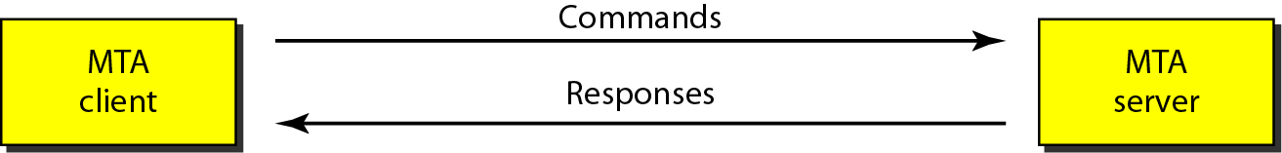
SMTP
Commands and Responses: MTP uses commands and responses to transfer messages between an MTA client and an MTA server.

Slide 20
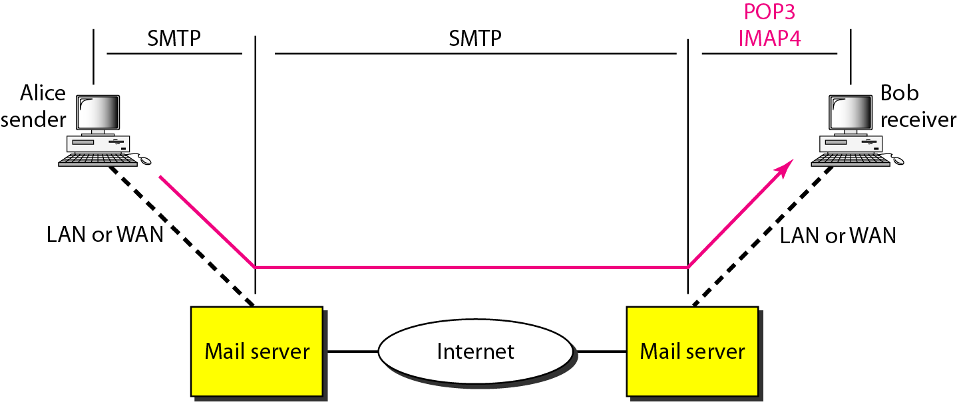
Message Access Agent: POP and IMAP
SMTP is a push protocol; it pushes the message from the client to the server. In other words, the direction of the bulk: data (messages) is from the client to the server.
On the other hand, the third stage needs a pull protocol; the client must pull messages from the server. The direction of the bulk data is from the server to the client. The third stage uses a Message Access Agent.

Slide 21
POP-3
Post Office Protocol, version 3 (POP3) is simple and limited in functionality.
POP3 has two modes: the delete mode and the keep mode.
In the delete mode, the mail is deleted from the mailbox after each retrieval.
In the keep mode, the mail remains in the mailbox after retrieval.
The delete mode is normally used when the user is working at her permanent computer and can save and organize the received mail after reading or replying.
The keep mode is normally used when the user accesses her mail away from her primary computer (e.g., a laptop). The mail is read but kept in the system for later retrieval and organizing

Slide 22
IMAP4
Another mail access protocol is Internet Mail Access Protocol, version 4 (IMAP4). IMAP4 is similar to POP3, but it has more features; IMAP4 is more powerful and more complex.
POP3 is deficient in several ways. It does not allow the user to organize her mail on the server; the user cannot have different folders on the server. POP3 does not allow the user to partially check the contents of the mail before downloading.

Slide 23
IMAP4
IMAP4 provides the following extra functions:
A user can check the e-mail header prior to downloading.
A user can search the contents of the e-mail for a specific string of characters prior to downloading.
A user can partially download e-mail. This is especially useful if bandwidth is limited and the e-mail contains multimedia with high bandwidth requirements.
A user can create, delete, or rename mailboxes on the mail server.
A user can create a hierarchy of mailboxes in a folder for e-mail storage.

Slide 24
FTP
FTP stands for File Mail Transfer Protocol.
File Transfer Protocol (FTP) is the standard mechanism provided by TCP/IP for copying a file from one host to another. Although transferring files from one system to another.
FTP differs from other client/server applications in that it establishes two connections between the hosts. One connection is used for data transfer, the other for control information (commands and responses).
The well-known port 21 is used for the control connection and the well-known port 20 for the data connection.

Slide 25
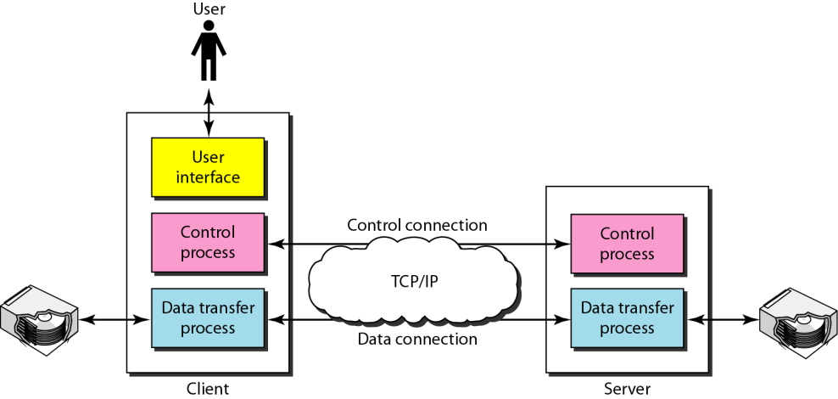
FTP
The control connection remains connected during the entire interactive FTP session.
The data connection is opened and then closed for each file transferred. It opens each time commands that involve transferring files are used, and it closes when the file is transferred.

Slide 26
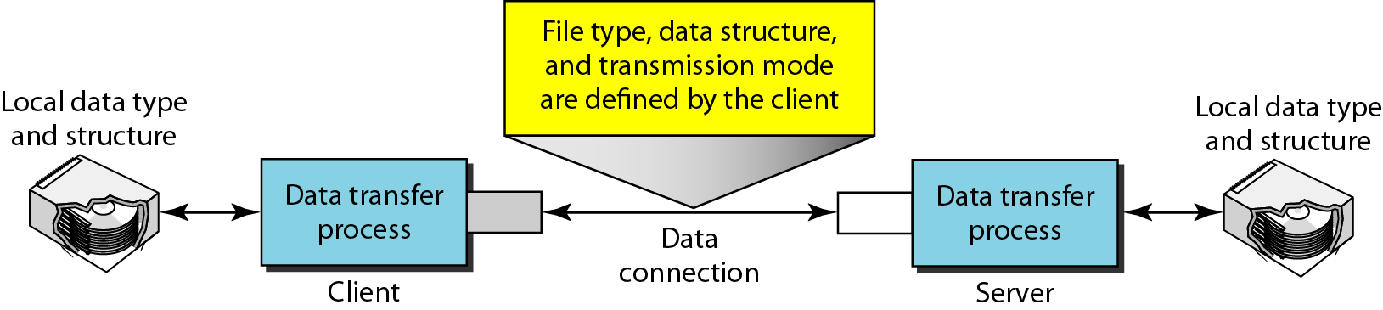
FTP
We should remember that file transfer in FTP means one of three things:
A file is to be copied from the server to the client. This is called retrieving a file. It is done under the supervision of the RETR command,
A file is to be copied from the client to the server. This is called storing a file. It is done under the supervision of the STOR command.
A list of directory or file names is to be sent from the server to the client. It is done under the supervision of the LIST command. Note that FTP treats a list of directory or file names as a file. It is sent over the data connection.

Slide 27
HTTP
HTTP stands for Hypertext Transfer Protocol.
HTTP is a protocol used mainly to access data on the World Wide Web.
HTTP functions as a combination of FTP and SMTP.
It is similar to FTP because it transfers files and uses the services of TCP. However, it is much simpler than FTP because it uses only one TCP connection.
There is no separate control connection; only data are transferred between the client and the server.

Slide 28
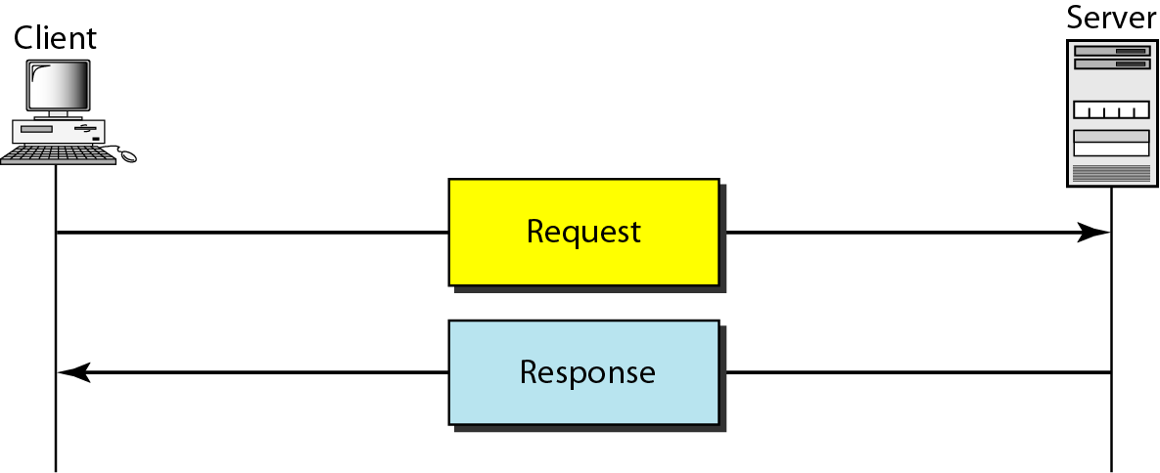
HTTP
HTTP is like SMTP because the data transferred between the client and the server look like SMTP messages.
HTTP uses the services of TCP on well-known port 80.

Slide 29
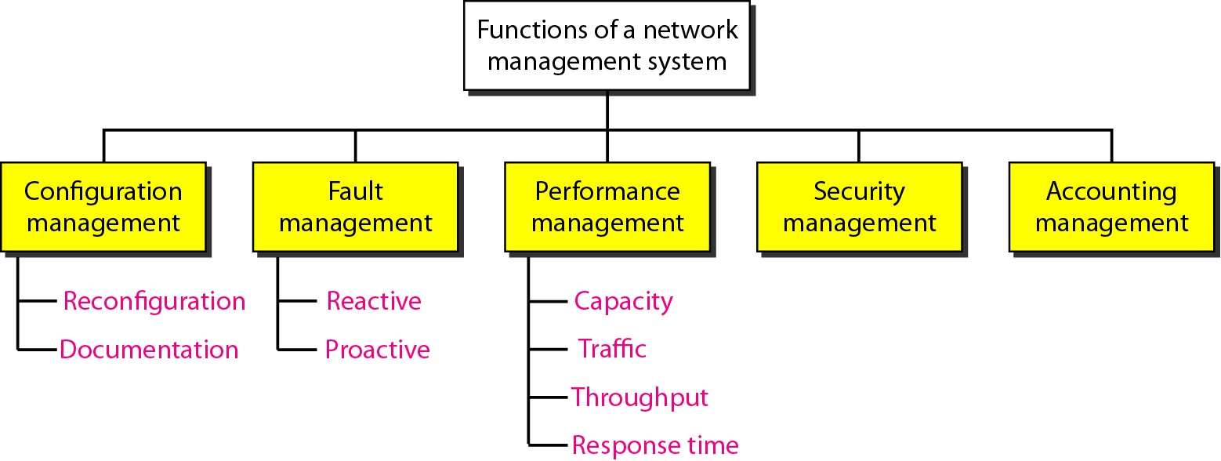
Network Management
We can define network management as monitoring, testing, configuring, and troubleshooting network components to meet a set of requirements defined by an organization.

Slide 30
SNMP
SNMP stands for Simple Network Management Protocol .
SNMP is a framework for managing devices in an internet using the TCP/IP protocol suite.
It provides a set of fundamental operations for monitoring and maintaining an internet.
SNMP uses the concept of manager and agent. That is, a manager, usually a host, controls and monitors a set of agents, usually routers.
The protocol is designed at the application level so that it can monitor devices made by different manufacturers and installed on different physical networks.

Slide 31
Thank You

