Slide 1
Network Layer: Part-1

Slide 2
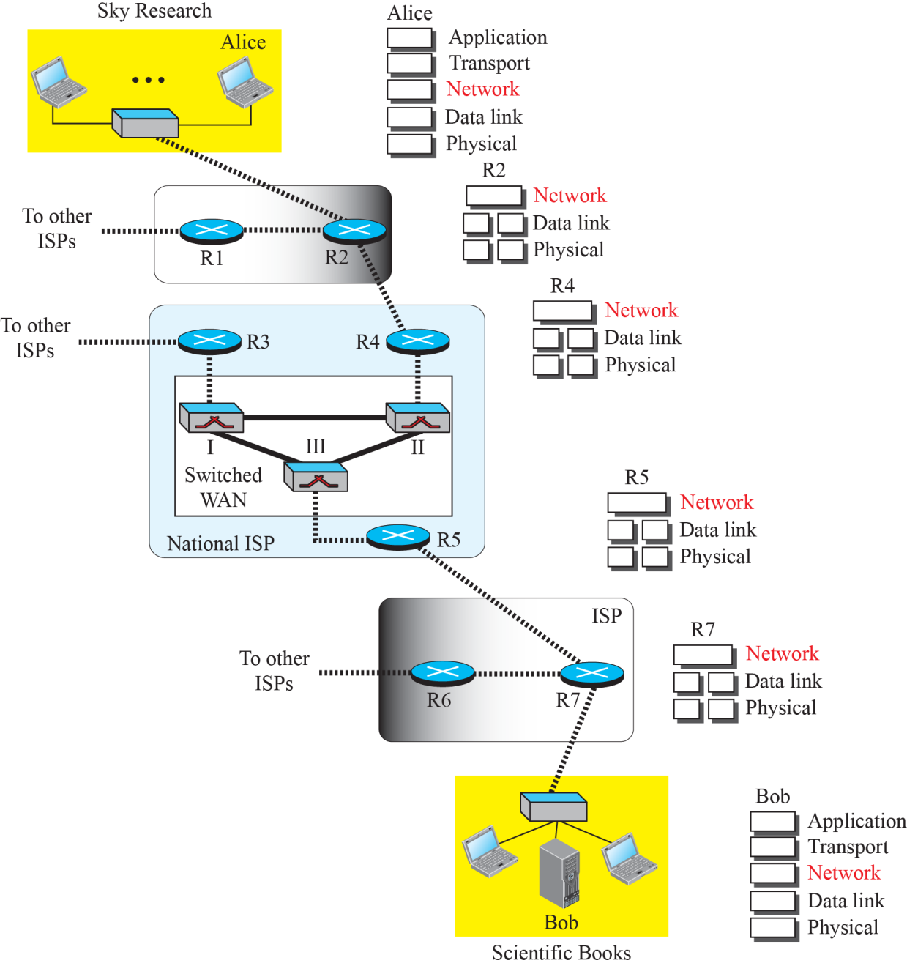
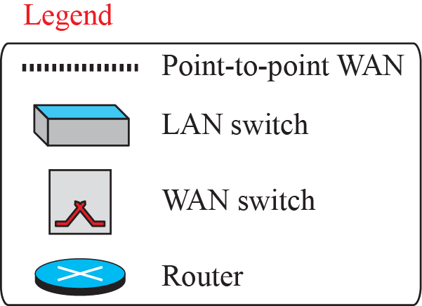
Figure 1: Communication at the network layer

Slide 3
Funtions of Network Layer: Packetizing,
Routing and Forwaring
The first duty of the network layer is definitely packetizing: encapsulating the payload in a network-layer packet at the source and de-capsulating the payload from the network-layer packet at the destination.
In other words, one duty of the network layer is to carry a payload from the source to the destination without changing it or using it.
The network layer is doing the service of a carrier such as the postal office, which is responsible for delivery of packages from a sender to a receiver without changing or using the contents.

Slide 4
Routing and Forwarding
Routing: The process of transferring packets received from the data link layer of source network to the data link layer of the correct destination network is called routing.
Forwarding: Forwarding means to place the packet in its route to its destination. Forwarding requires a host or a router to have a routing table. When a host has a packet to send or when a router has received a packet to be forwarded, it looks at this table to find the route to the final destination

Slide 5
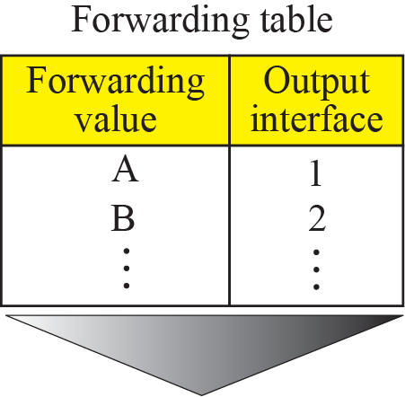

Figure 18.2: Forwarding process

Slide 6
NETWORK-LAYER PERFORMANCE
The upper-layer protocols that use the service of the network layer expect to receive an ideal service, but the network layer is not perfect.
The performance of a network can be measured in terms of delay, throughput, and packet loss. Congestion control is an issue that can improve the performance.

Slide 7

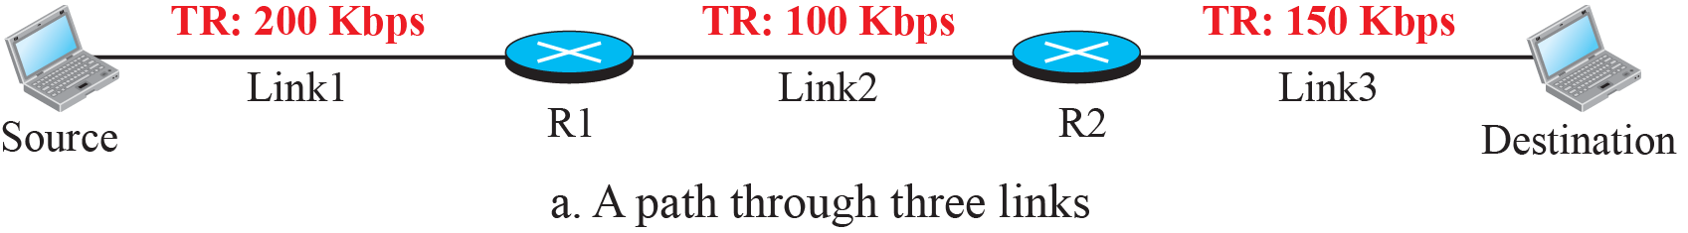

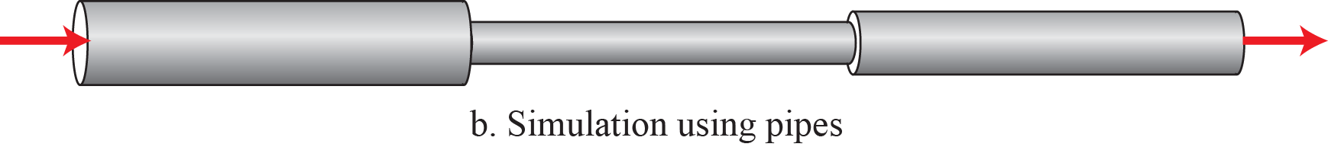
Figure 18.10: Throughput in a path with three links in a series

Slide 8
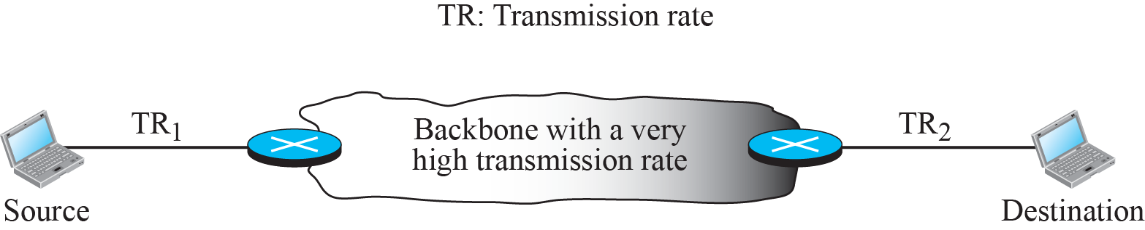
Figure 18.11: A path through the Internet backbone

Slide 9
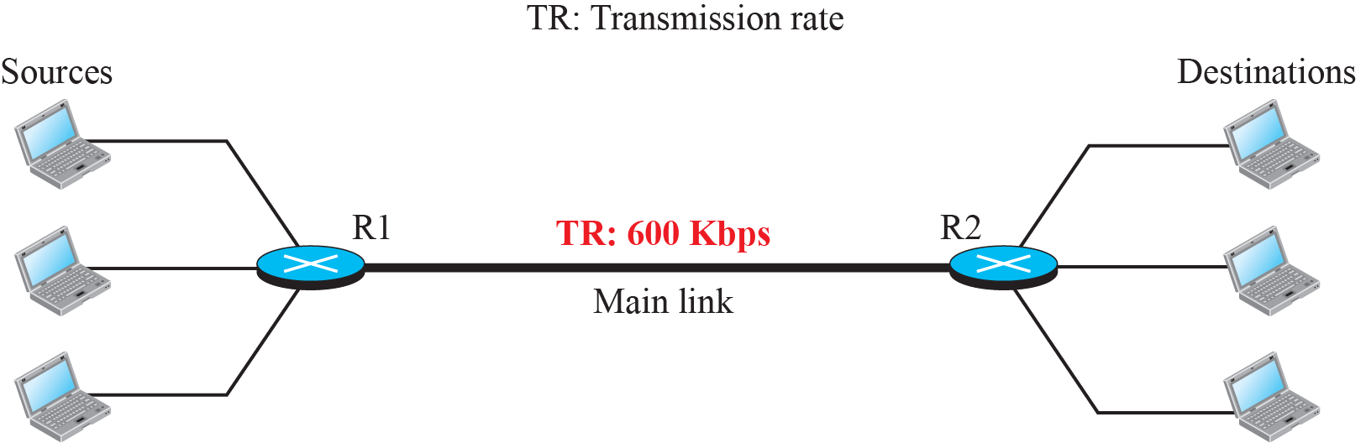
Figure 18.12: Effect of throughput in shared links

Slide 10
18.3.3 Packet Loss
Another issue that severely affects the performance of communication is the number of packets lost during transmission.
When a router receives a packet while processing another packet, the received packet needs to be stored in the input buffer waiting for its turn.
A router, however, has an input buffer with a limited size. A time may come when the buffer is full and the next packet needs to be dropped.
The effect of packet loss on the Internet network layer is that the packet needs to be resent, which in turn may create overflow and cause more packet loss.

Slide 11
18.3.4 Congestion Control
Congestion control is a mechanism for improving performance.
In next unit, we will discuss congestion at the transport layer.
Congestion at the network layer is related to two issues, throughput and delay.

Slide 12
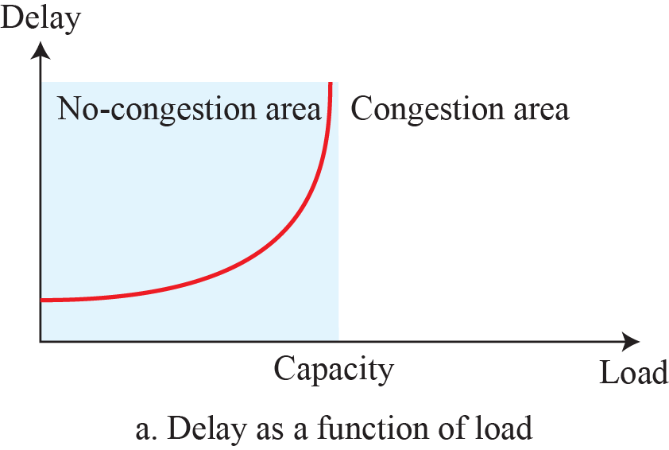
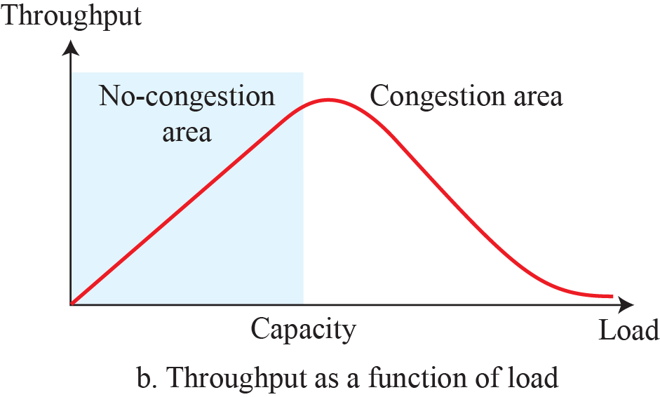
Figure 18.13. Packet delay and throughput as functions of load

Slide 13
18.4.4 DHCP
After a block of addresses are assigned to an organization, the network administration can manually assign addresses to the individual hosts or routers.
However, address assignment in an organization can be done automatically using the Dynamic Host Configuration Protocol (DHCP).
DHCP is an application-layer program, using the client-server paradigm, that actually helps TCP/IP at the network layer.

Slide 14
18.4.5 NAT
In most situations, only a portion of computers in a small network need access to the Internet simultaneously.
A technology that can provide the mapping between the private and universal addresses, and at the same time support virtual private networks, is Network Address Translation (NAT).
The technology allows a site to use a set of private addresses for internal communication and a set of global Internet addresses (at least one) for communication with the rest of the world.

Slide 15
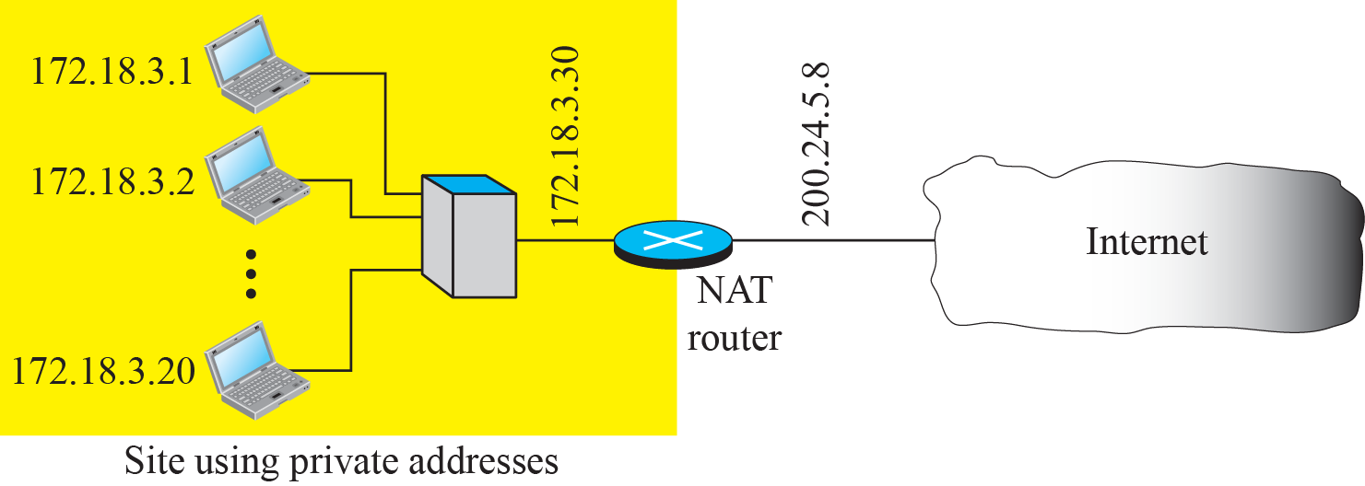
Figure 18.29: NAT

Slide 16
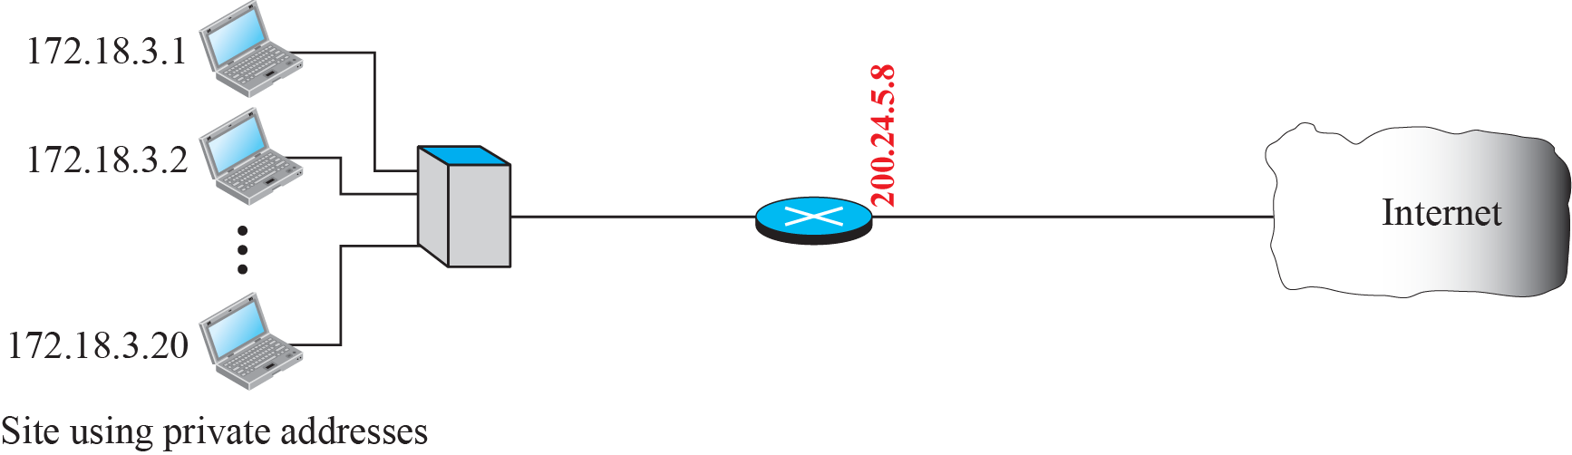
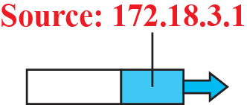
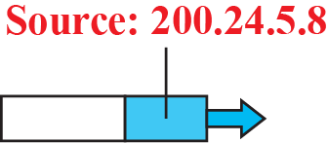
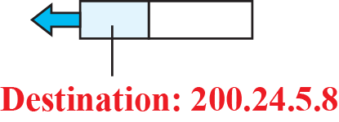
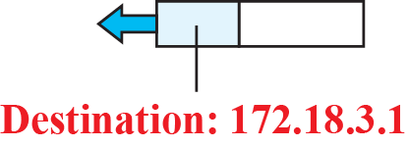
Figure 18.30: Address translation
18.16

Slide 17
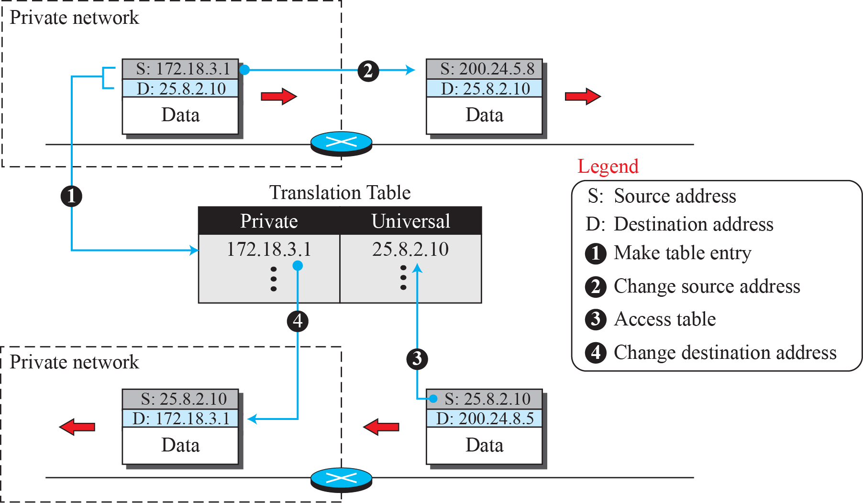
Figure 18.31: Translation

Slide 18
18-5 FORWARDING OF IP PACKETS
We discussed the concept of forwarding at the network layer earlier in this chapter. In this section, we extend the concept to include the role of IP addresses in forwarding. As we discussed before, forwarding means to place the packet in its route to its destination.

Slide 19
18.5.1 Destination Address Forwarding
We first discuss forwarding based on the destination address. This is a traditional approach, which is prevalent today. In this case, forwarding requires a host or a router to have a forwarding table. When a host has a packet to send or when a router has received a packet to be forwarded, it looks at this table to find the next hop to deliver the packet to.

Slide 20
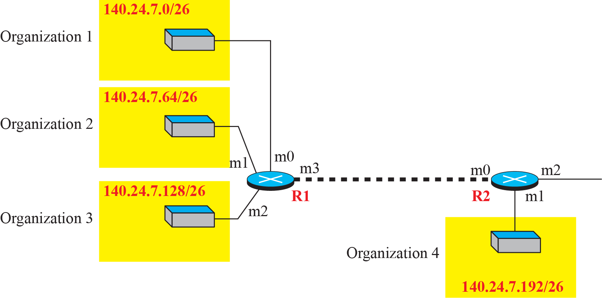
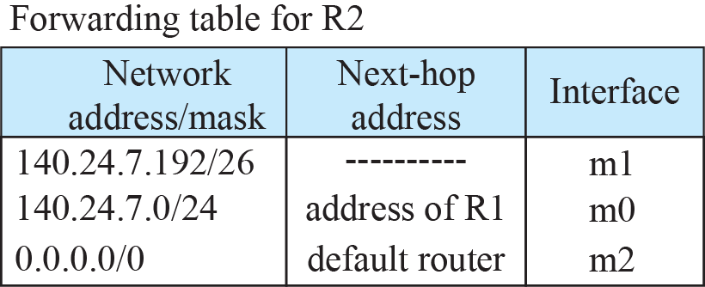
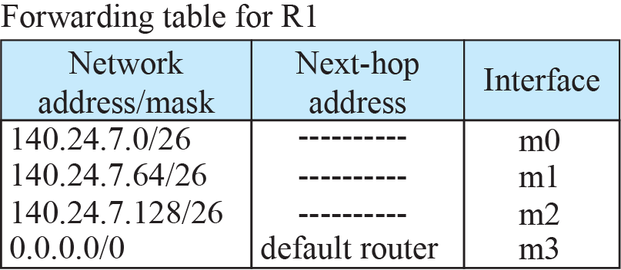
Figure 18.35: Longest mask matching

