Slide 1
Network Layer: Part-2

Slide 2
IP Addresses:
Classful Addressing

Slide 3

What is an IP Address?
An IP address is a 32-bit address.
The IP addresses are unique.

Slide 4
Address space rule
…………..
…………..
addr1
addr15
addr2
…………..
The address space in a protocol
That uses n-bits to define an
Address is: 2^{n}
…………..
…………..
addr41
addr226
addr31
…………..
…………..

Slide 5
IPv4 address space
The address space of IPv4 is
2³² or 4,294,967,296.

Slide 6
Binary Notation
01110101 10010101 00011101 11101010

Slide 7
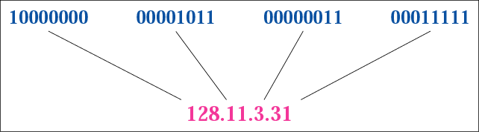
Figure 4-1
Dotted-decimal notation

Slide 8
Example 1
Change the following IP address from binary notation to dotted-decimal notation.
10000001 00001011 00001011 11101111
Solution
129.11.11.239

Slide 9
Example 2
Change the following IP address from dotted-decimal notation to binary notation: 111.56.45.78
Solution
01101111 00111000 00101101 01001110

Slide 10
Example 3 (continued)
Find the error in the following IP Address
75.45.301.14
Solution
In decimal notation each number <= 255
301 is out of the range

Slide 11
Example 4
Change the following binary IP address
Hexadecimal notation
10000001 00001011 00001011 11101111
Solution
0X810B0BEF or 810B0BEF16

Slide 12
CLASSFUL
ADDRESSING

Slide 13
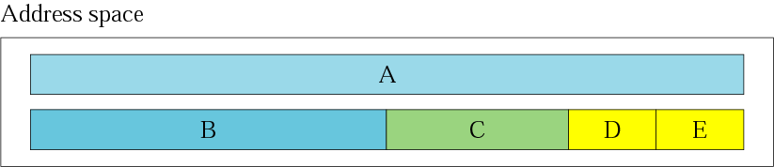
Figure 4-2
Occupation of the address space

Slide 14
In classful addressing the address space is
divided into 5 classes:
A, B, C, D, and E.

Slide 15
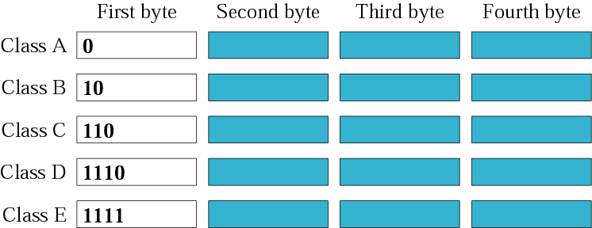
Figure 4-3
Finding the class in binary notation

Slide 16
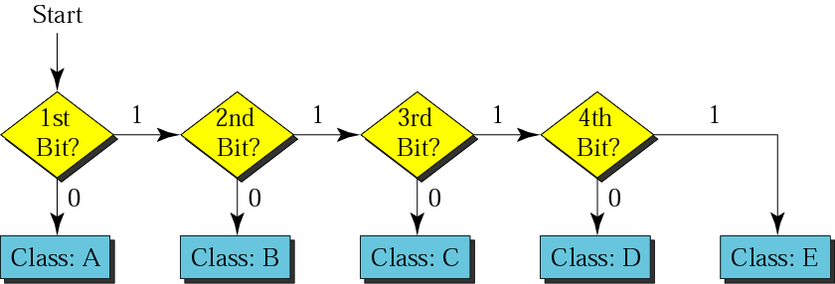
Figure 4-4
Finding the address class

Slide 17
Example 5
Show that Class A has
2³¹ = 2,147,483,648 addresses

Slide 18
Example 6
Find the class of the following IP addresses
00000001 00001011 00001011 11101111
11000001 00001011 00001011 11101111
Solution
00000001 00001011 00001011 11101111
1st is 0, hence it is Class A
11000001 00001011 00001011 11101111
1st and 2nd bits are 1, and 3rd bit is 0 hence, Class C

Slide 19
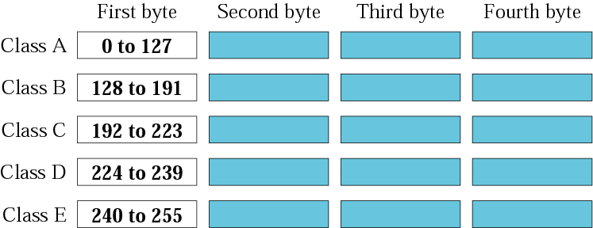
Figure 4-5
Finding the class in decimal notation

Slide 20
Example 7
Find the class of the following addresses
158.223.1.108
227.13.14.88
Solution
158.223.1.108
1st byte = 158 (128<158<191) class B
227.13.14.88
1st byte = 227 (224<227<239) class D

Slide 21
IP address with appending port number
158.128.1.108:25
the for octet before colon is the IP address
The number of colon (25) is the port number

Slide 22
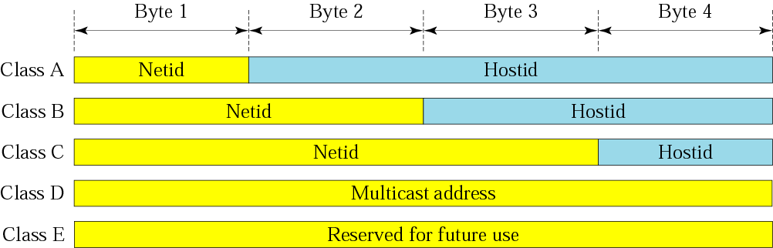
Figure 4-6
Netid and hostid

Slide 23
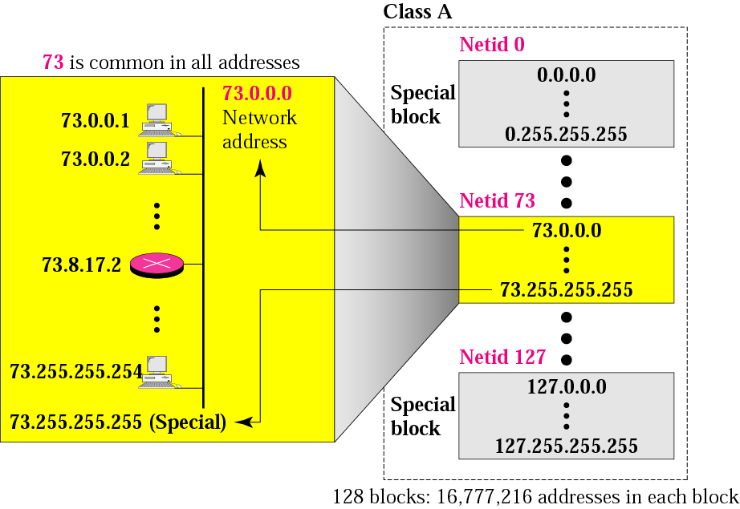
Figure 4-7
Blocks in class A

Slide 24

Millions of class A addresses are wasted.

Slide 25
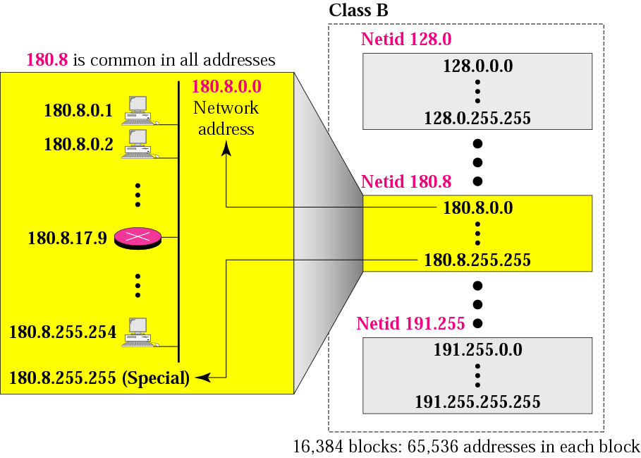
Figure 4-8
Blocks in class B

Slide 26
Many class B addresses are wasted.

Slide 27
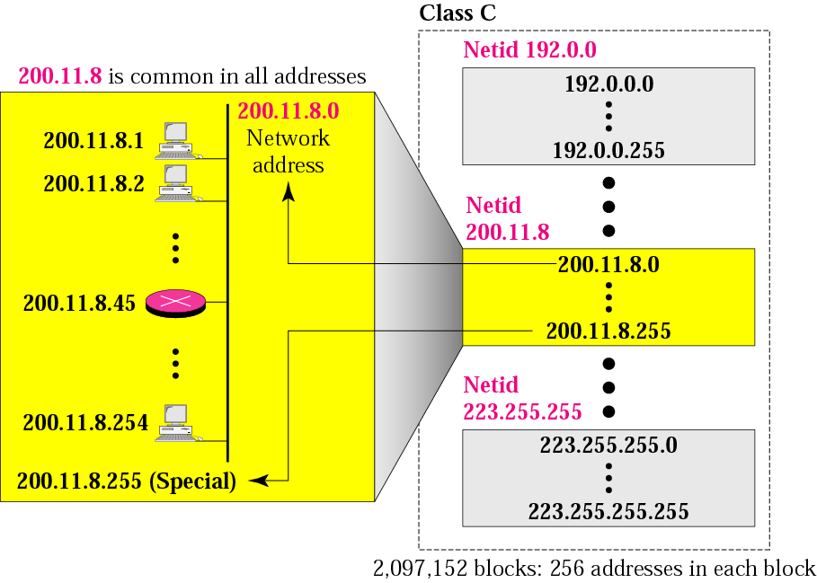
Figure 4-9
Blocks in class C

Slide 28
The number of addresses in a class C block is smaller than the needs of most organizations.

Slide 29
Class D addresses are used for multicasting; there is only one block in this class.

Slide 30
Class E addresses are reserved for special purposes; most of the block is wasted.

Slide 31
In classful addressing, the network address (the first address in the block) is the one that is assigned to the organization.

Slide 32
Example 8
Given the network address 132.21.0.0, find the
class, the block, and the range of the addresses
Solution
The 1st byte is between 128 and 191.
Hence, Class B
The block has a netid of 132.21.
The addresses range from
132.21.0.0 to 132.21.255.255.

Slide 33
Mask
A mask is a 32-bit binary number.
The mask is ANDeD with IP address to get
The bloc address (Network address)
Mask And IP address = Block Address

Slide 34
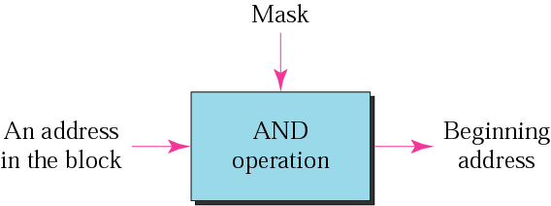
Figure 4-10
Masking concept

Slide 35
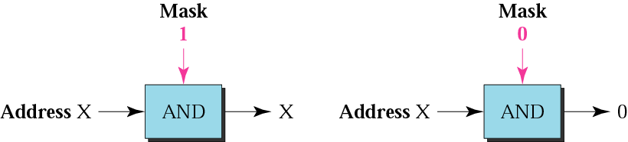
Figure 4-11
AND operation

Slide 36
The network address is the beginning address of each block. It can be found by applying the default mask to any of the addresses in the block (including itself). It retains the netid of the block and sets the hostid to zero.

Slide 37
Default Mak
Class A default mask is 255.0.0.0
Class B default mask is 255.255.0.0
Class C Default mask 255.255.255.0

Slide 38
5.1
SUBNETTING

Slide 39
IP addresses are designed with two levels of hierarchy.

Slide 40
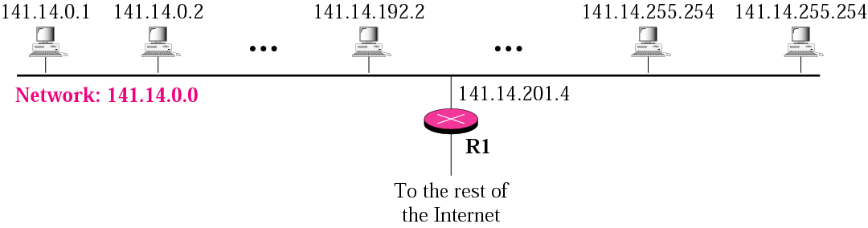
Figure 5-1
A network with two levels of hierarchy (not subnetted)

Slide 41
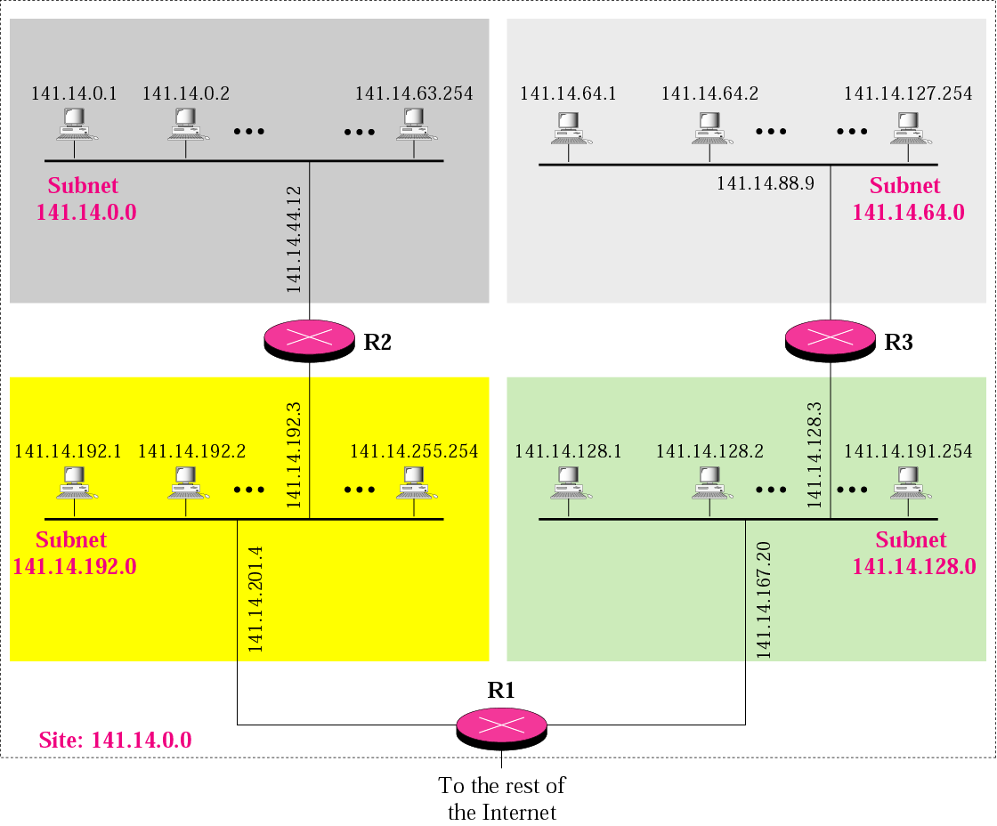
Figure 5-2
A network with three levels of
hierarchy (subnetted)

Slide 42
Note
Subnetting is done by borrowing bits from the host part and add them the network part

Slide 43
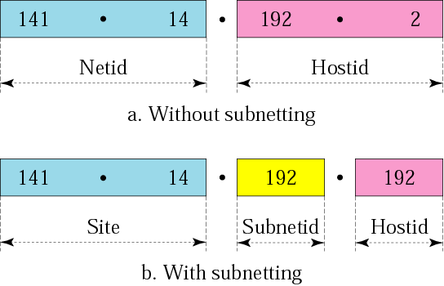
Figure 5-3
Addresses in a network with and without subnetting

Slide 44
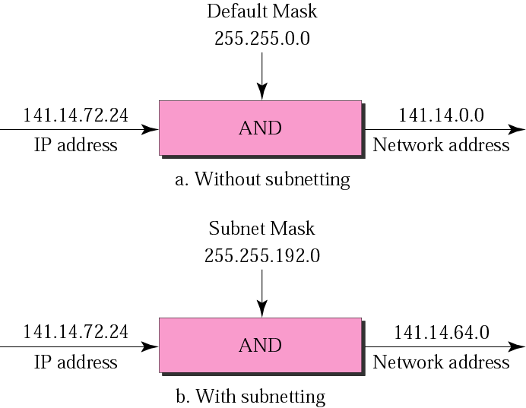
Figure 5-5
Default mask and subnet mask

Slide 45
Finding the Subnet Address
Given an IP address, we can find the subnet address the same way we found the network address. We apply the mask to the address. We can do this in two ways: straight or short-cut.

Slide 46
Straight Method
In the straight method, we use binary notation for both the address and the mask and then apply the AND operation to find the subnet address.

Slide 47
Example 9
What is the subnetwork address if the destination address is 200.45.34.56 and the subnet mask is 255.255.240.0?

Slide 48
Solution
11001000 00101101 00100010 00111000
11111111 11111111 11110000 00000000
11001000 00101101 00100000 00000000
The subnetwork address is 200.45.32.0.

Slide 49
Short-Cut Method
** If the byte in the mask is 255, copy the byte in the address.
** If the byte in the mask is 0, replace the byte in the address with 0.
** If the byte in the mask is neither 255 nor 0, we write the mask and the address in binary and apply the AND operation.

Slide 50
Example 10
What is the subnetwork address if the destination address is 19.30.80.5 and the mask is 255.255.192.0?
Solution
See next slide

Slide 51
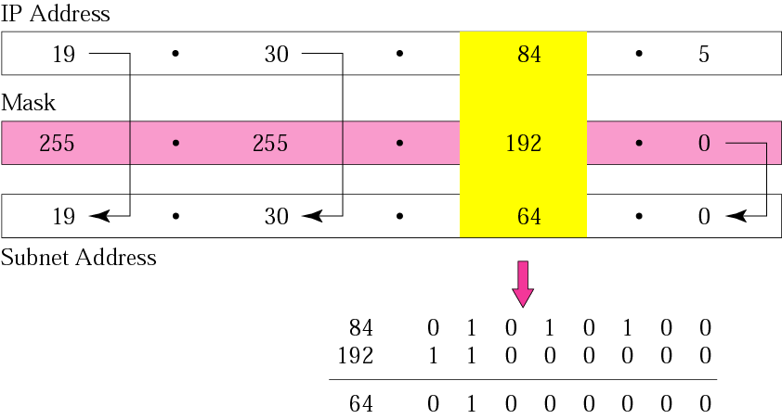
Figure 5-6
Solution

Slide 52
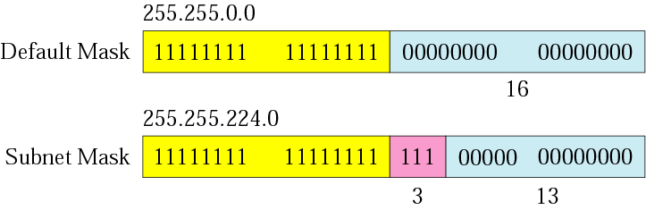
Figure 5-7
Comparison of a default mask and
a subnet mask

Slide 53
The number of subnets must be a power of 2.

Slide 54
Example 11
A company is granted the site address 201.70.64.0 (class C). The company needs six subnets. Design the subnets.
Solution
The number of 1s in the default mask is 24 (class C).

Slide 55
Solution (Continued)
The company needs six subnets. This number 6 is not a power of 2. The next number that is a power of 2 is 8 (2³). We need 3 more 1s in the subnet mask. The total number of 1s in the subnet mask is 27 (24 + 3).
The total number of 0s is 5 (32 − 27). The mask is

Slide 56
Solution (Continued)
11111111 11111111 11111111 11100000
or
255.255.255.224
The number of subnets is 8.
The number of addresses in each subnet is 2⁵ (5 is the number of 0s) or 32.
See Next slide

Slide 57
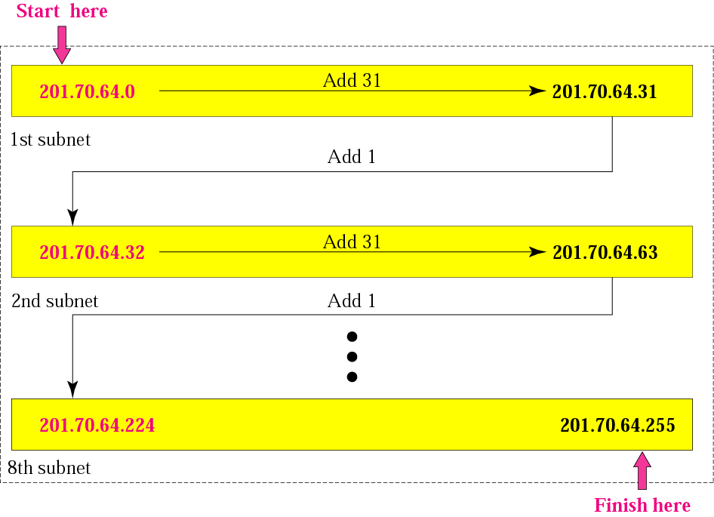
Figure 5-8
Example 3

Slide 58
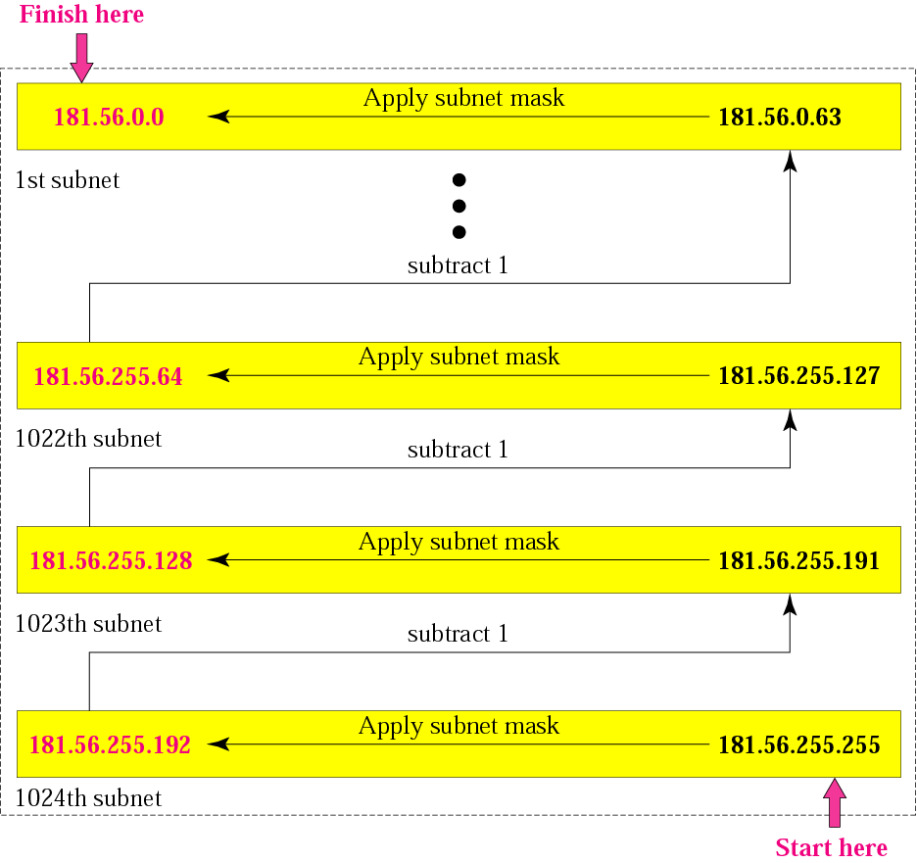
Figure 5-9
Example 4

Slide 59
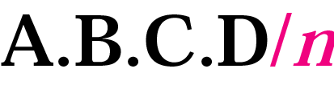
Figure 5-14
Slash notation

Slide 60
Example 17
A small organization is given a block with the beginning address and the prefix length 205.16.37.24/29 (in slash notation). What is the range of the block?

Slide 61
Solution
The beginning address is 205.16.37.24. To find the last address we keep the first 29 bits and change the last 3 bits to 1s.
Beginning: 11001111 00010000 00100101 00011000
Ending : 11001111 00010000 00100101 00011111
There are only 8 addresses in this block.

Slide 62
Example 17 cont’d
We can find the range of addresses in Example 17 by another method. We can argue that the length of the suffix is 32 − 29 or 3. So there are 2³ = 8 addresses in this block. If the first address is 205.16.37.24, the last address is 205.16.37.31 (24 + 7 = 31).

Slide 63
A block in classes A, B, and C can easily be represented in slash notation as A.B.C.D/ n where n is either 8 (class A), 16 (class B), or 24 (class C).

Slide 64
Example 18
What is the network address if one of the addresses is 167.199.170.82/27?
Solution
The prefix length is 27, which means that we must keep the first 27 bits as is and change the remaining bits (5) to 0s. The 5 bits affect only the last byte. The last byte is 01010010. Changing the last 5 bits to 0s, we get 01000000 or 64. The network address is 167.199.170.64/27.

Slide 65
Example 19.10
An ISP is granted a block of addresses starting with 190.100.0.0/16 (65,536 addresses). The ISP needs to distribute these addresses to three groups of customers as follows:
a. The first group has 64 customers; each needs 256 addresses.
b. The second group has 128 customers; each needs 128 addresses.
c. The third group has 128 customers; each needs 64 addresses.
Design the subblocks and find out how many addresses are still available after these allocations.

Slide 66
Example 19.10 (continued)
Solution
Figure 19.9 shows the situation.
Group 1
For this group, each customer needs 256 addresses. This means that 8 (log2 256) bits are needed to define each host. The prefix length is then 32 − 8 = 24. The addresses are

Slide 67
Example 19.10 (continued)
Group 2
For this group, each customer needs 128 addresses. This means that 7 (log2 128) bits are needed to define each host. The prefix length is then 32 − 7 = 25. The addresses are

Slide 68
Example 19.10 (continued)
Group 3
For this group, each customer needs 64 addresses. This means that 6 (log₂64) bits are needed to each host. The prefix length is then 32 − 6 = 26. The addresses are
Number of granted addresses to the ISP: 65,536
Number of allocated addresses by the ISP: 40,960
Number of available addresses: 24,576

Slide 69
Solution (Continued)
Number of granted addresses: 65,536
Number of allocated addresses: 40,960
Number of available addresses: 24,576

Slide 70
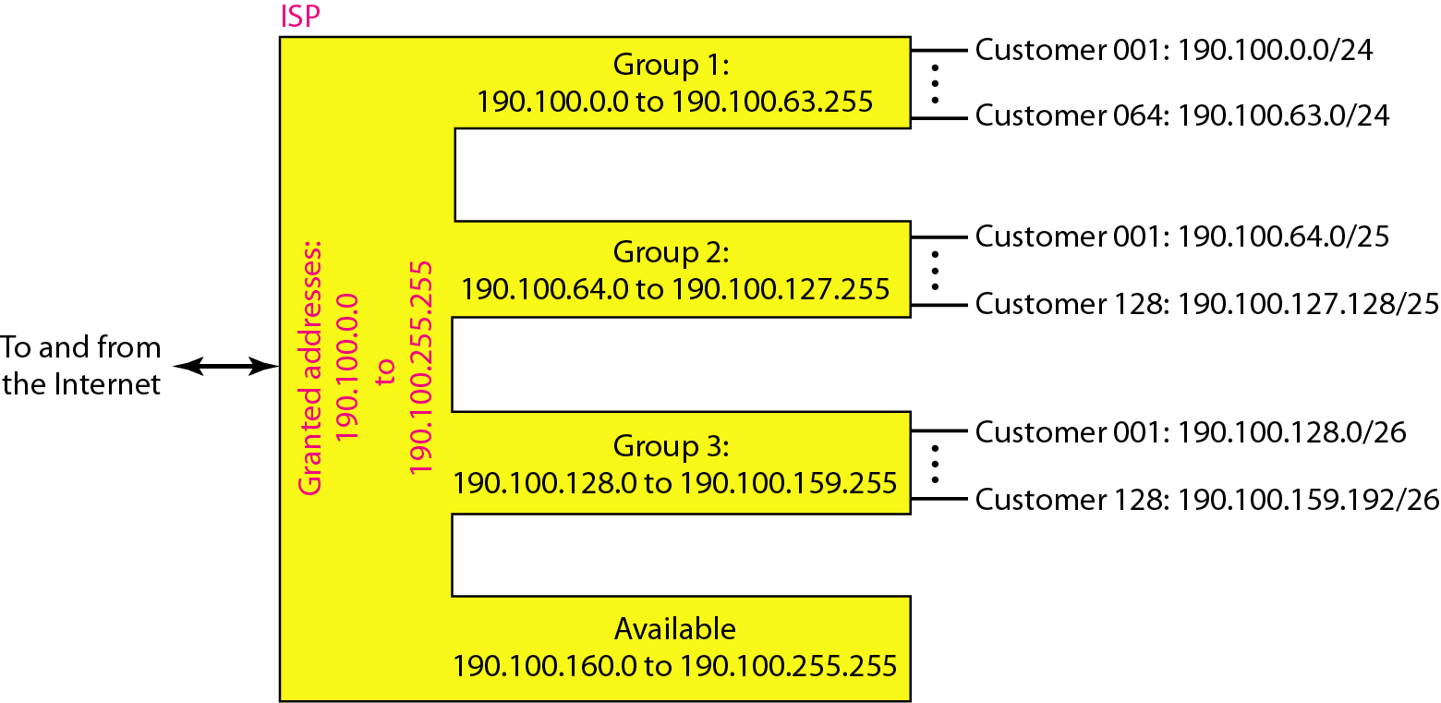
Figure 19.9 An example of address allocation and distribution by an ISP

Slide 71
19-2 IPv6 ADDRESSES
Despite all short-term solutions, address depletion is still a long-term problem for the Internet. This and other problems in the IP protocol itself have been the motivation for IPv6.
Topics discussed in this section:
Structure Address Space

Slide 72

Note
An IPv6 address is 128 bits long.

Slide 73
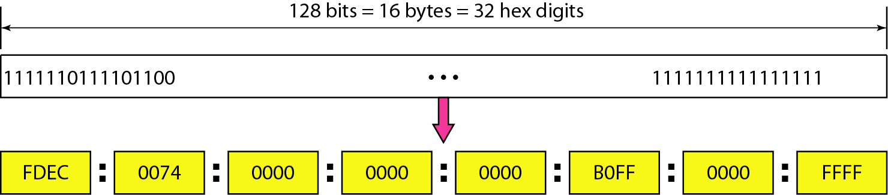
Figure 19.14 IPv6 address in binary and hexadecimal colon notation

Slide 74
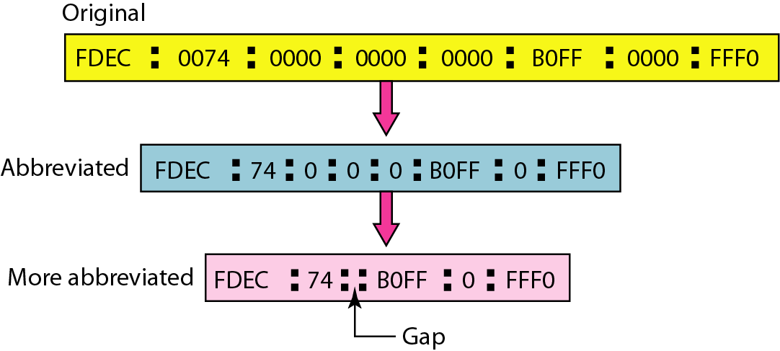
Figure 19.15 Abbreviated IPv6 addresses

Slide 75
Example 19.11
Expand the address 0:15::1:12:1213 to its original.
Solution
We first need to align the left side of the double colon to the left of the original pattern and the right side of the double colon to the right of the original pattern to find how many 0s we need to replace the double colon.
This means that the original address is.

Slide 76
Table 19.5 Type prefixes for IPv6 addresses

Slide 77
Table 19.5 Type prefixes for IPv6 addresses (continued)

Slide 78
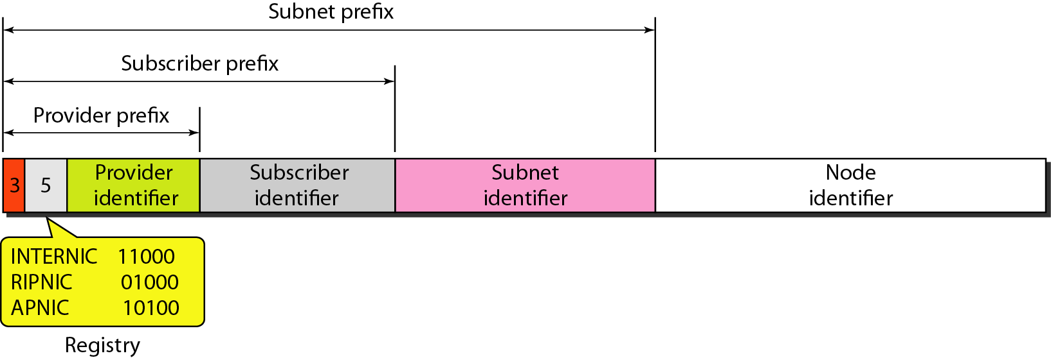
Figure 19.16 Prefixes for provider-based unicast address

Slide 79
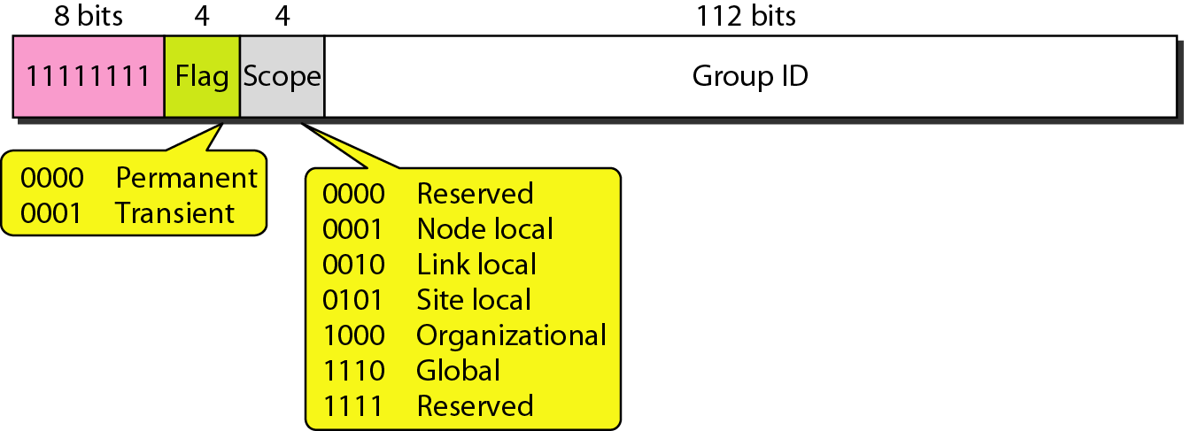
Figure 19.17 Multicast address in IPv6

Slide 80
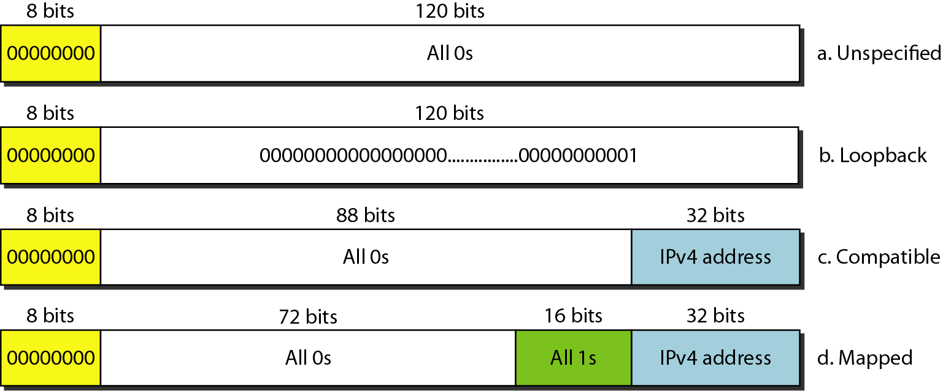
Figure 19.18 Reserved addresses in IPv6

Slide 81
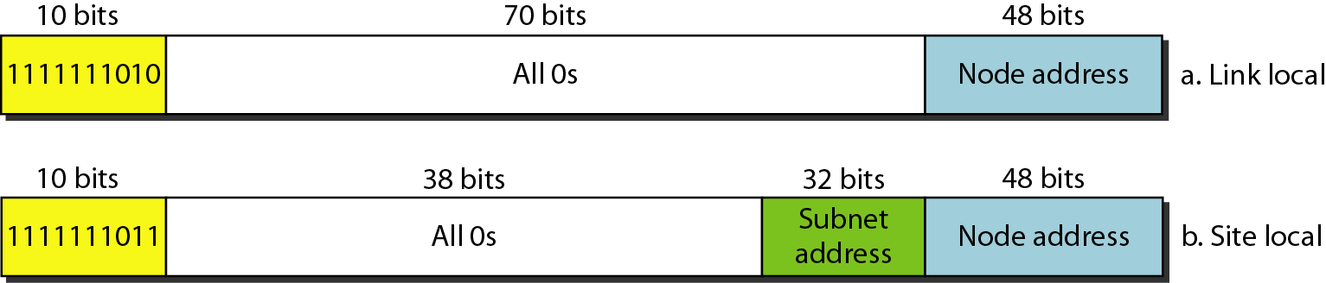
Figure 19.19 Local addresses in IPv6

