Slide 1
Network Layer: Part-3
Copyright © The McGraw-Hill Companies, Inc. Permission required for reproduction or display.

Slide 2
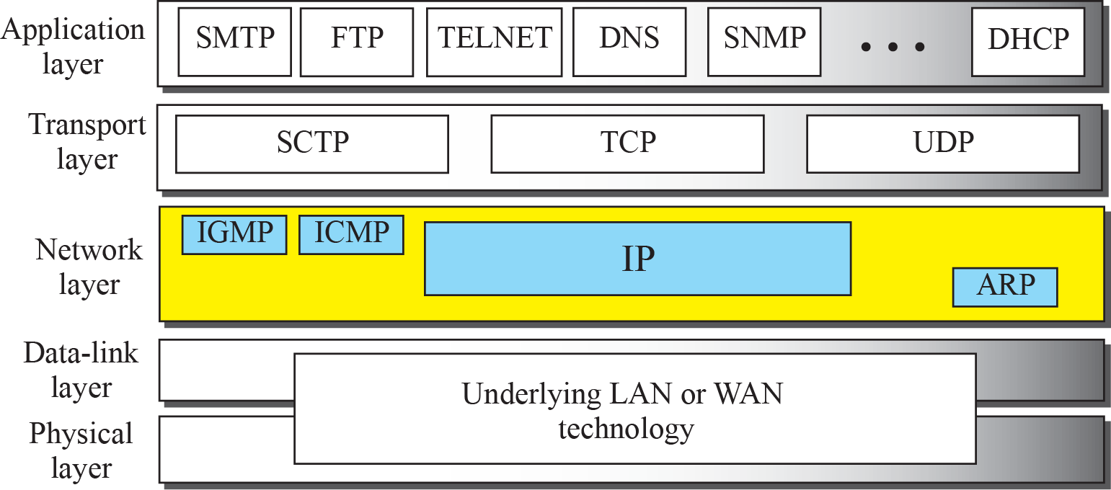
Figure 19.1: Position of IP and other network-layer protocols in TCP/IP protocol suite

Slide 3
22-1 IPv4 Addressing
The Internet Protocol version 4 (IPv4) is the delivery mechanism used by the TCP/IP protocols.
IPv4 is an unreliable and connectionless datagram protocol-a best-effort delivery
service.
The term best-effort means that IPv4 provides no error control or flow control

Slide 4
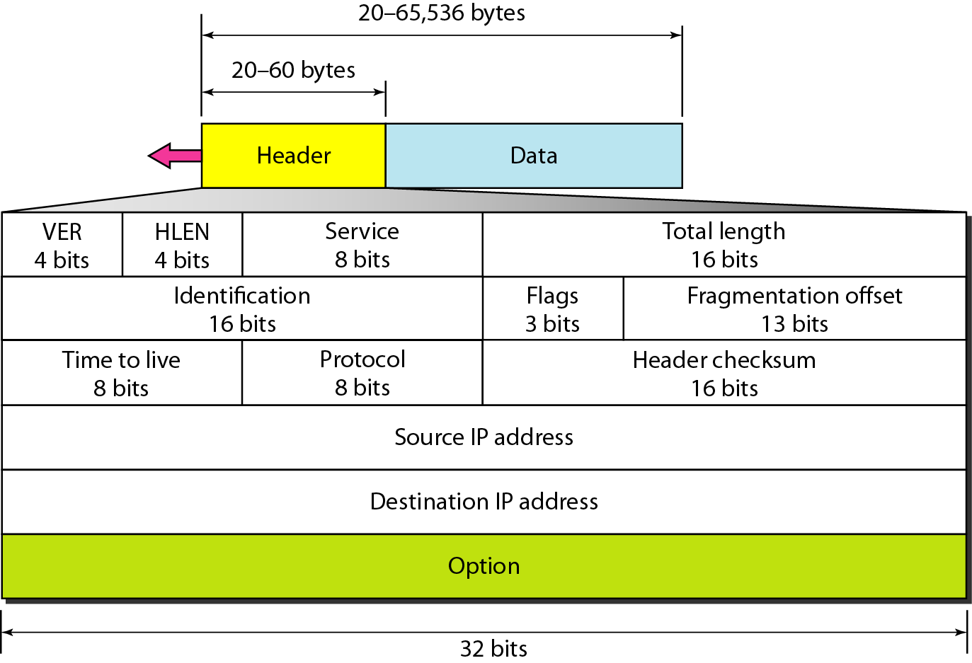
IPv4 datagram format / IP Packet format

Slide 5
22-1 IPv6 Addressing
The main reason for migration from IPv4 to IPv6 is the small size of the address space in IPv4. In this section, we show how the huge address space of IPv6 prevents address depletion in the future. We also discuss how the new addressing responds to some problems in the IPv4 addressing mechanism. An IPv6 address is 128 bits or 16 bytes (octets) long, four times the address length in IPv4.

Slide 6
22.22.1 Representation
A computer normally stores the address in binary, but it is clear that 128 bits cannot easily be handled by humans. Several notations have been proposed to represent IPv6 addresses when they are handled by humans. The following shows two of these notations: binary and colon hexadecimal.

Slide 7
22.22.2 Address Space
The address space of IPv6 contains 2¹²⁸ addresses. This address space is 2⁹⁶ times the IPv4 address—definitely no address depletion—as shown, the size of the space is

Slide 8
22.22.3 Address Space Allocation
Like the address space of IPv4, the address space of IPv6 is divided into several blocks of varying size and each block is allocated for a special purpose. Most of the blocks are still unassigned and have been set aside for future use. Table 22.1 shows only the assigned blocks. In this table, the last column shows the fraction each block occupies in the whole address space..

Slide 9
22-2 THE IPv6 PROTOCOL
The change of the IPv6 address size requires the change in the IPv4 packet format. The designer of IPv6 decided to implement remedies for other shortcomings now that a change is inevitable. The following shows other changes implemented in the protocol in addition to changing address size and format.

Slide 10
22.2.1 Packet Format
The IPv6 packet is shown in Figure 22.6. Each packet is composed of a base header followed by the payload. The base header occupies 40 bytes, whereas payload can be up to 65,535 bytes of information. The description of fields follows.

Slide 11
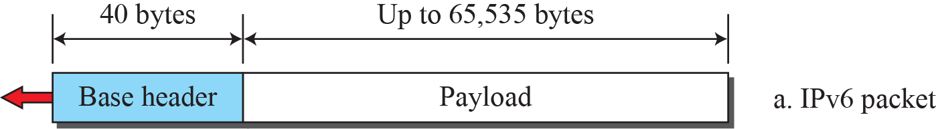
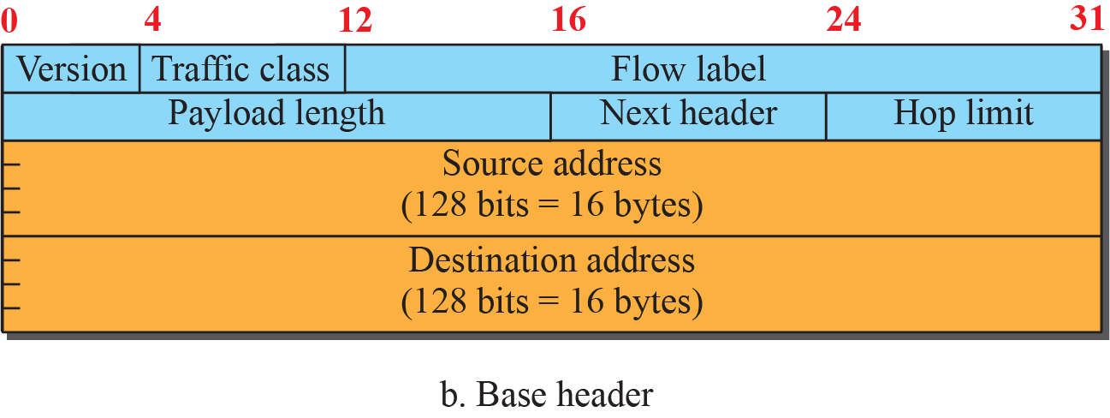
Figure 22.6: IPv6 datagram

Slide 12
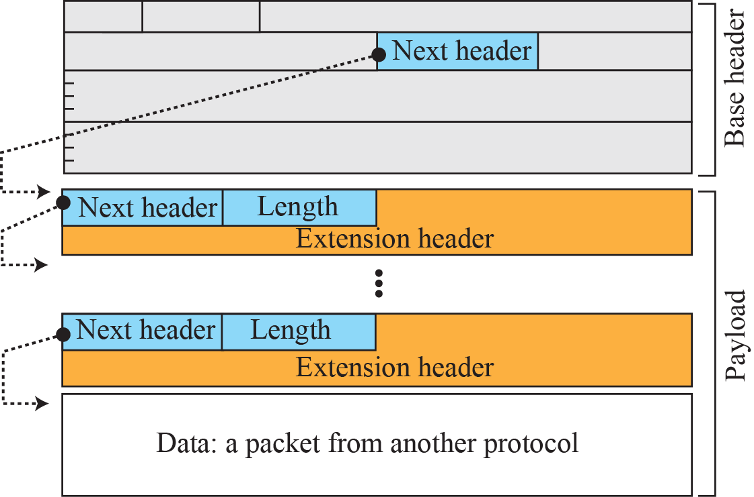
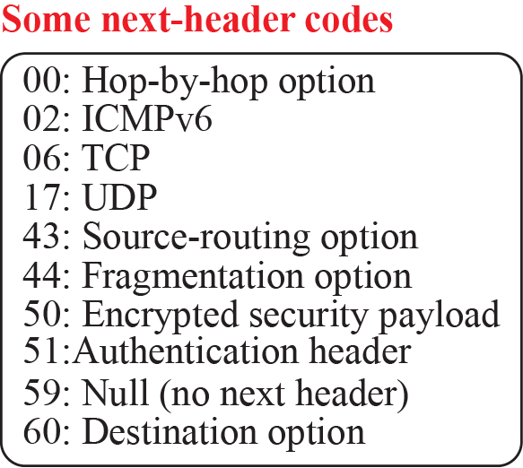
Figure 22.7: Payload in an IPv6 datagram

Slide 13
22.2.2 Extension Header
An IPv6 packet is made of a base header and some extension headers. The length of the base header is fixed at 40 bytes. However, to give more functionality to the IP datagram, the base header can be followed by up to six extension headers. Many of these headers are options in IPv4. Six types of extension headers have been defined. These are hop-by-hop option, source routing, fragmentation, authentication, encrypted security payload, and destination option (see Figure 22.8).

Slide 14
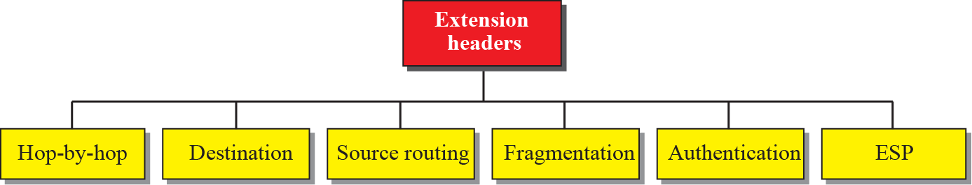
Figure 22.8: Extension Header Types

Slide 15
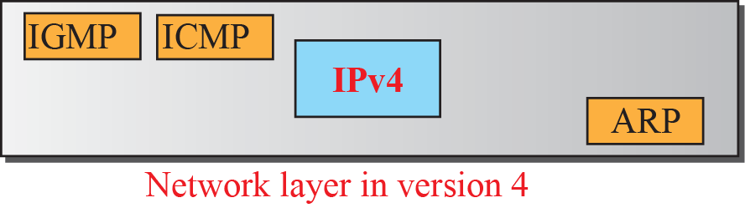
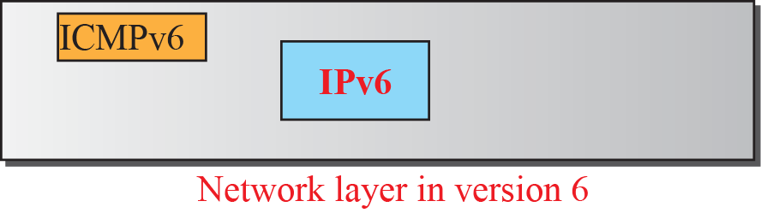
Figure 22.9: Comparison of network layer in version 4 and version 6

Slide 16
22-4 TRANSITION FROM IPv4 TO IPv6
Although we have a new version of the IP protocol, how can we make the transition to stop using IPv4 and start using IPv6? in the Internet can move The transition must be smooth to prevent any problems between IPv4 and IPv6 systems.

Slide 17
22.4.1 Strategies
Three strategies have been devised for transition: dual stack, tunneling, and header translation. One or all of these three strategies can be implemented during the transition
period..

Slide 18
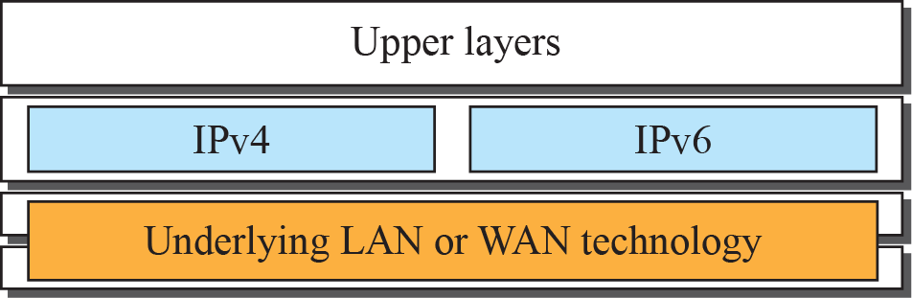


Figure 22.11: Dual stack

Slide 19
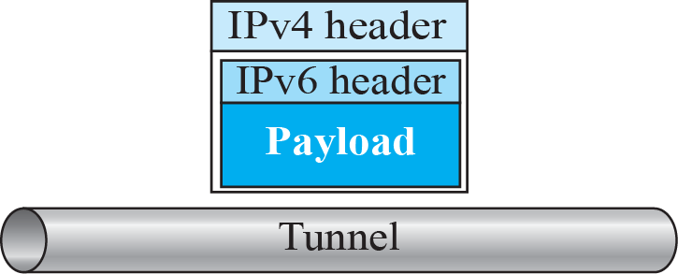
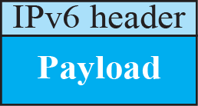
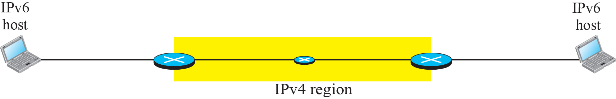
Figure 22.12: Tunneling strategy

Slide 20
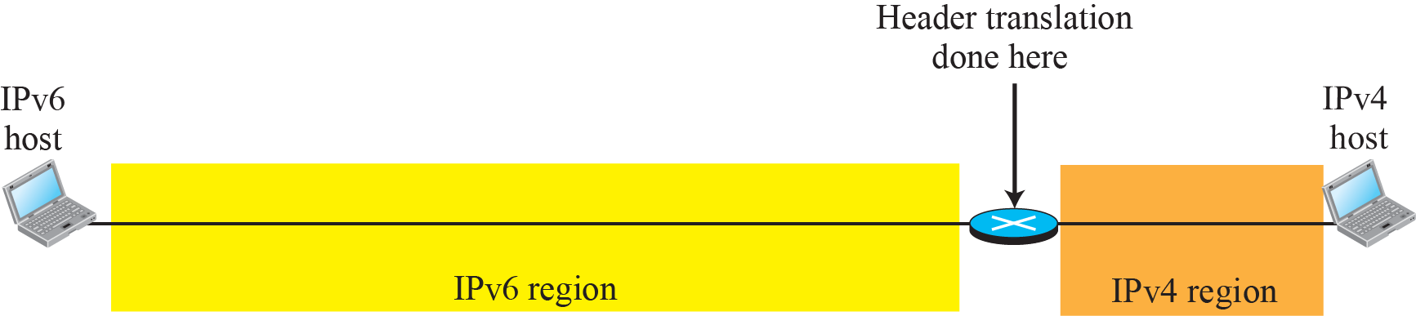
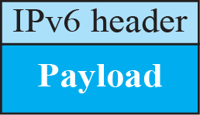
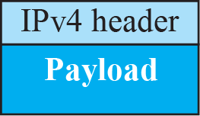
Figure 22.13: Header translation strategy

Slide 21
22.4.2 Use of IP Addresses
During the transition a host may need to use two addresses, IPv4 and IPv6. When the transition is complete, IPv4 addresses should disappear. The DNS servers (see Chapter 26) need to be ready to map a host name to either address type during the transition, but the IPv4 directory will disappear after all hosts in the world have migrated to IPv6.

