Slide 1
Network Layer: Part-4
Copyright © The McGraw-Hill Companies, Inc. Permission required for reproduction or display.

Slide 2
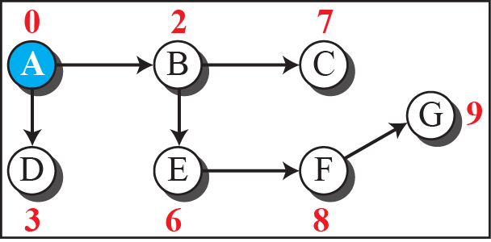
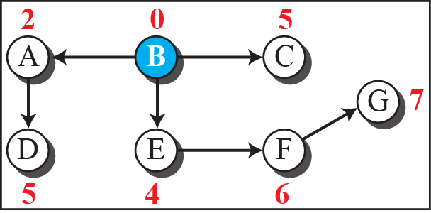
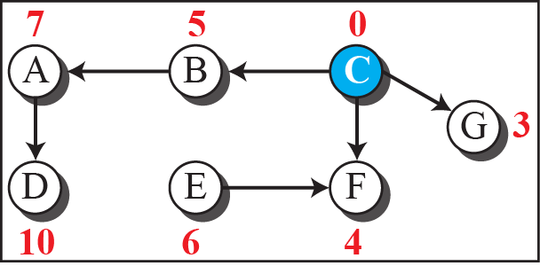
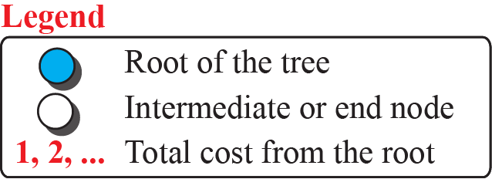
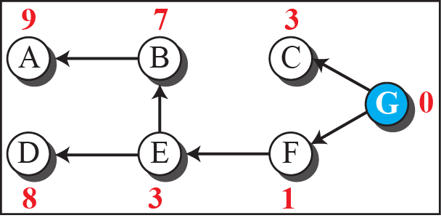
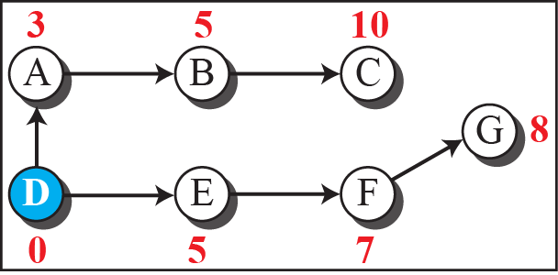
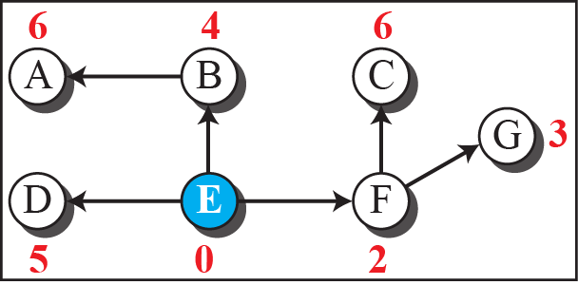
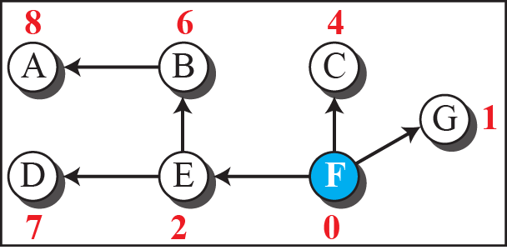
Figure 20.2: Least-cost trees for nodes in the internet of Figure 4.56

Slide 3
20-2 ROUTING ALGORITHMS
Several routing algorithms have been designed in the past. The differences between these methods are in the way they interpret the least cost and the way they create the least-cost tree for each node. In this section, we discuss the common algorithms; later we show how a routing protocol in the Internet implements one of these algorithms.

Slide 4
20.2.1 Distance-Vector Routing
The distance-vector (DV) routing uses the goal we discussed in the introduction, to find the best route. In distance-vector routing, the first thing each node creates is its own least-cost tree with the rudimentary information it has about its immediate neighbors. The incomplete trees are exchanged between immediate neighbors to make the trees more and more complete and to represent the whole internet. We can say that in distance-vector routing, a router continuously tells all of its neighbors what it knows about the whole internet (although the knowledge can be incomplete).

Slide 5
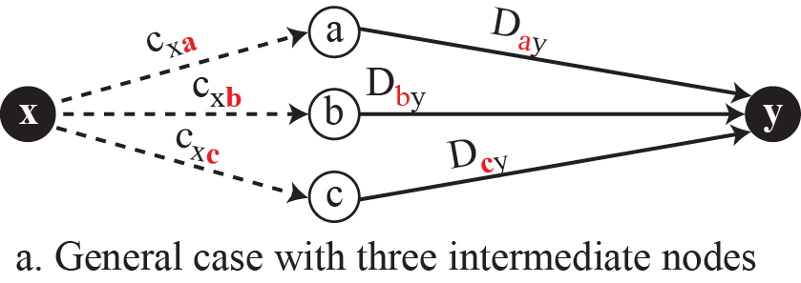
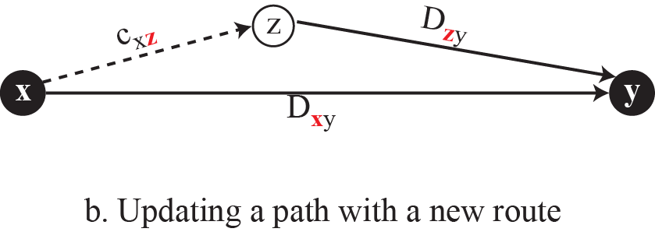
Figure 20.3: Graphical idea behind Bellman-Ford equation

Slide 6
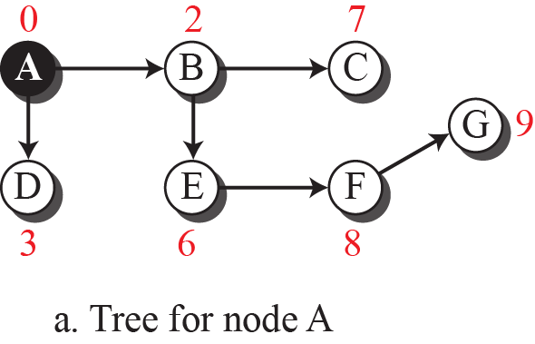
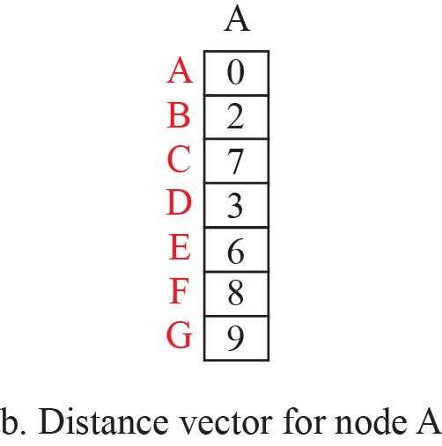
Figure 20.4: The distance vector corresponding to a tree

Slide 7
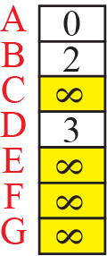
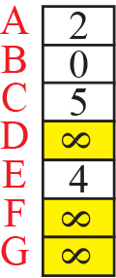
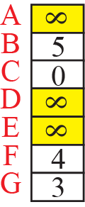
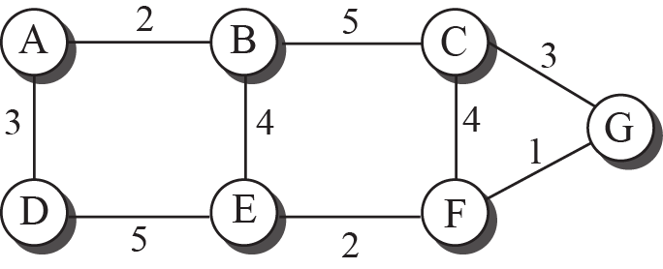
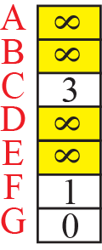
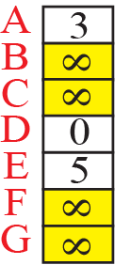
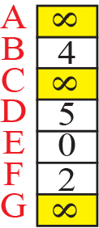
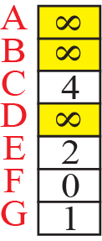
Figure 20.5: The first distance vector for an internet

Slide 8
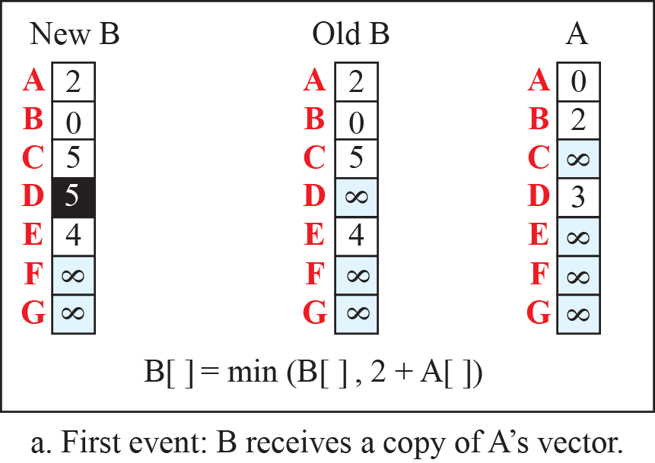
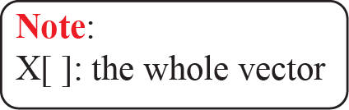
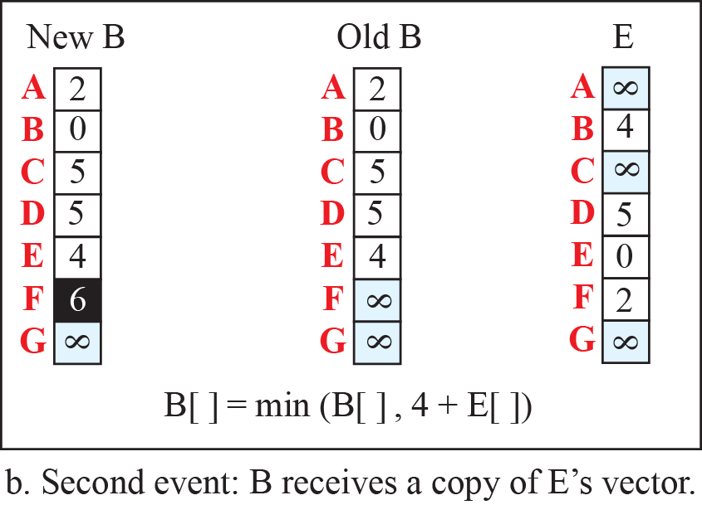
Figure 20.6: Updating distance vectors

Slide 9
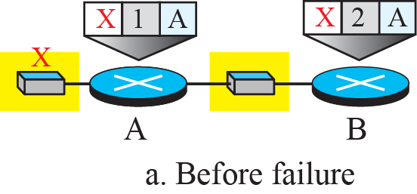
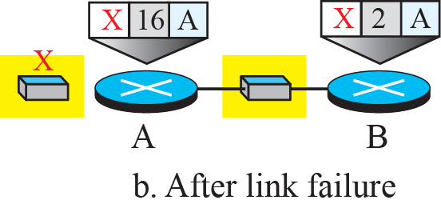
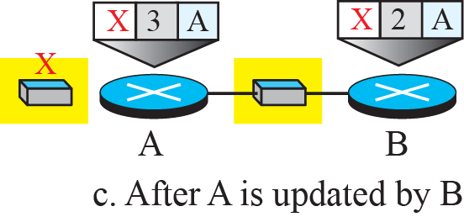
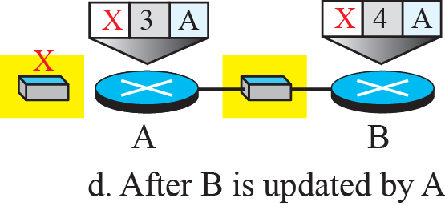
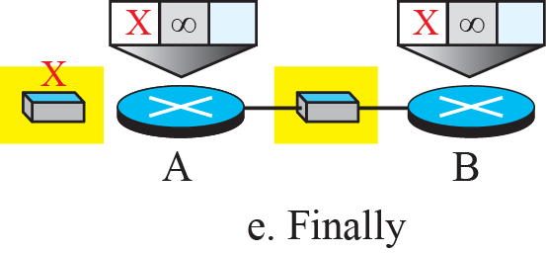
Figure 20.7: Two-node instability

Slide 10
20.2.2 Link-State Routing
A routing algorithm that directly follows our discussion for creating least-cost trees and forwarding tables is link-state (LS) routing. This method uses the term link-state to define the characteristic of a link (an edge) that represents a network in the internet. In this algorithm the cost associated with an edge defines the state of the link. Links with lower costs are preferred to links with higher costs; if the cost of a link is infinity, it means that the link does not exist or has been broken.

Slide 11
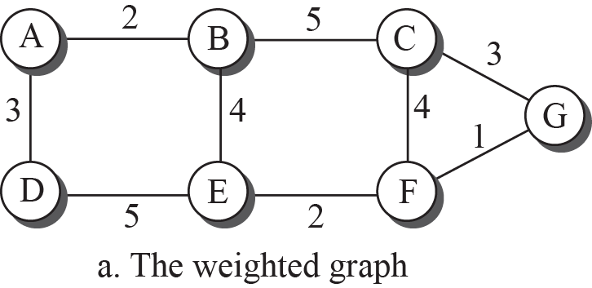
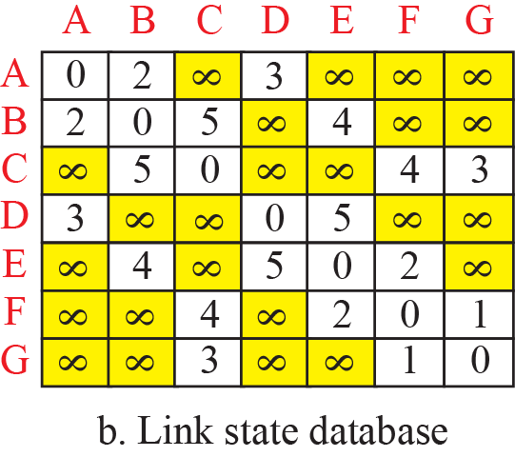
Figure 20.8: Example of a link-state database

Slide 12
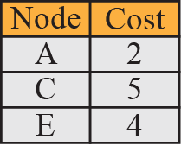
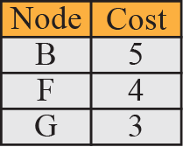
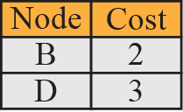
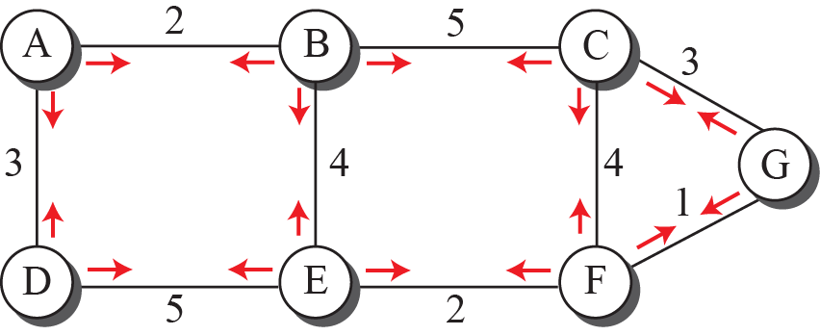
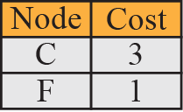
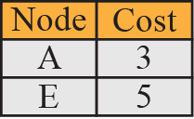
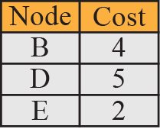
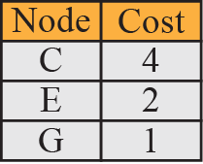
Figure 20.9: LSPs created and sent out by each node to build LSDB

Slide 13
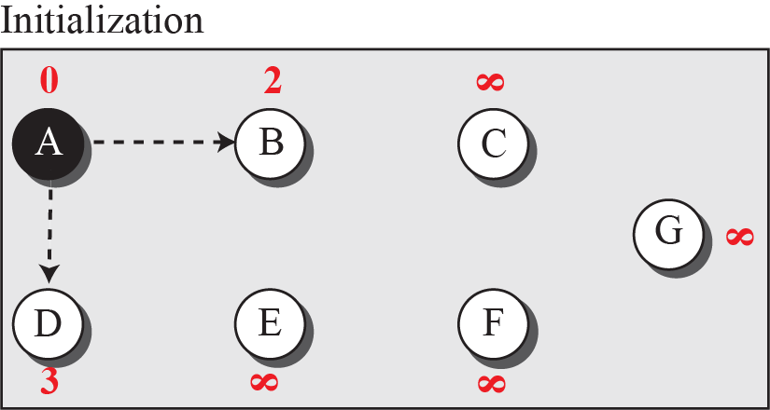

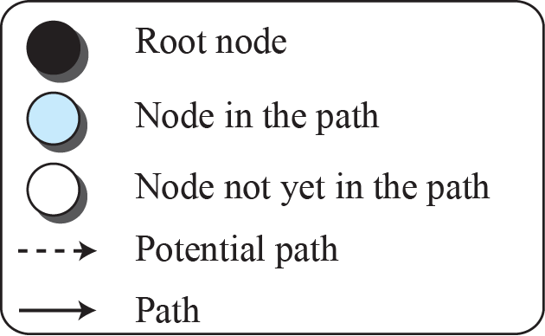
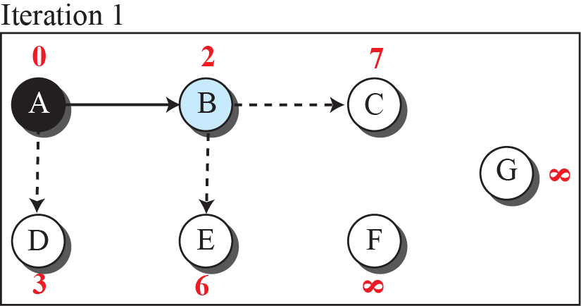
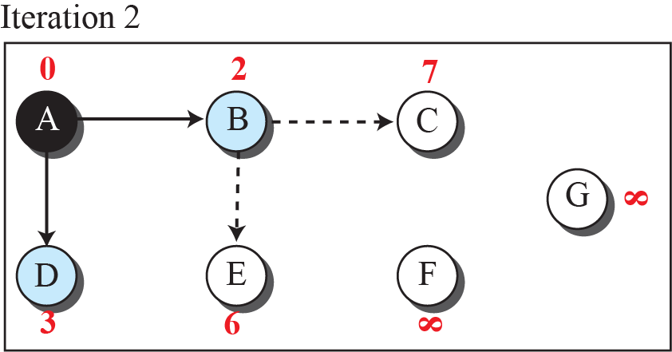
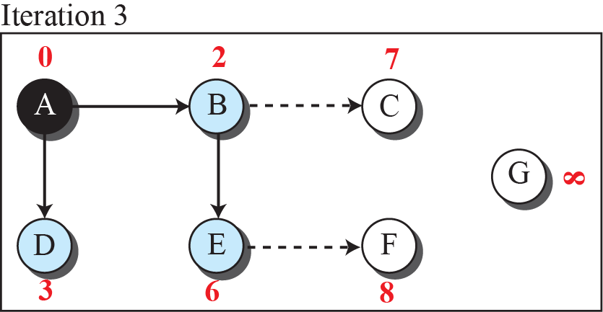
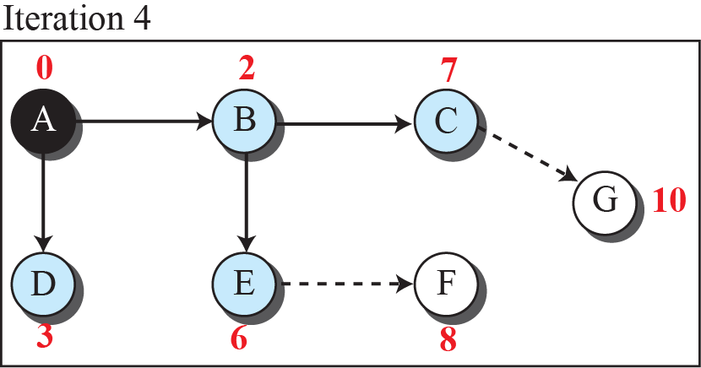
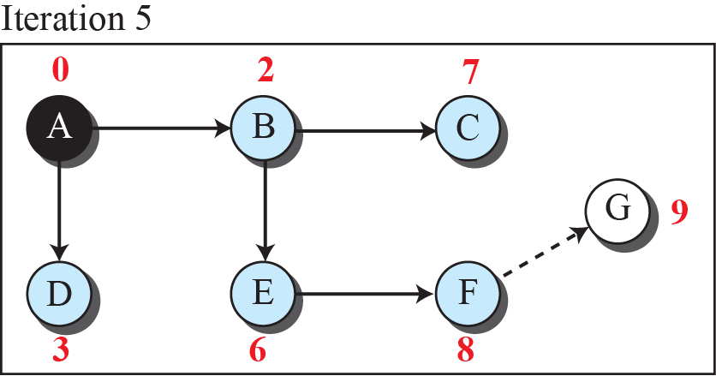
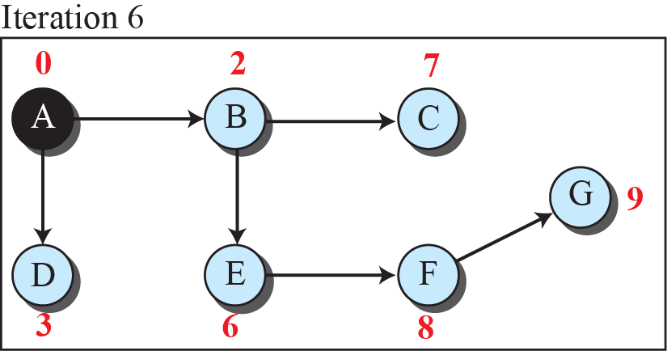
Figure 20.10: Least-cost tree

Slide 14
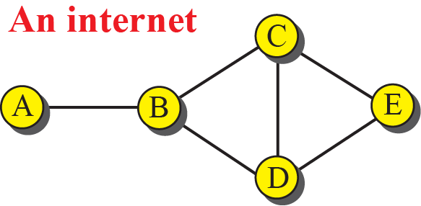
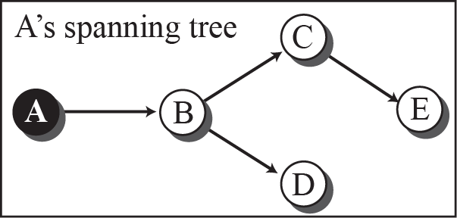
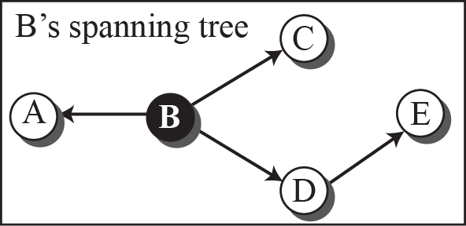
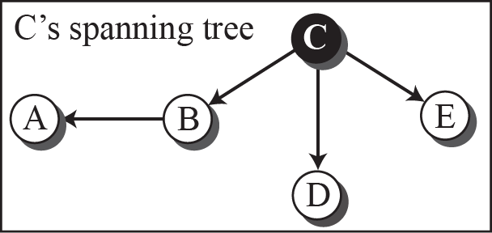


Figure 20.11: Spanning trees in path-vector routing

Slide 15
20.2.3 Path-Vector Routing
Both link-state and distance-vector routing are based on the least-cost goal. However, there are instances where this goal is not the priority. For example, assume that there are some routers in the internet that a sender wants to prevent its packets from going through. In other words, the least-cost goal, applied by LS or DV routing, does not allow a sender to apply specific policies to the route a packet may take. To respond to these demands, a third routing algorithm, called path-vector (PV) routing has been devised.

Slide 16








Figure 20.12: Path vectors made at booting time

Slide 17



Figure 20.13: Updating path vectors

Slide 18
20-3 UNICAST ROUTING PROTOCOLS
After an introduction, we discuss three common protocols used in the Internet: Routing Information Protocol (RIP), based on the distance-vector algorithm, Open Shortest Path First (OSPF), based on the link-state algorithm, and Border Gateway Protocol (BGP), based on the path-vector algorithm.

Slide 19
20.3.1 Internet Structure
Before discussing unicast routing protocols, we need to understand the structure of today’s Internet. The Internet has changed from a tree-like structure, with a single backbone, to a multi-backbone structure run by different private corporations today. Although it is difficult to give a general view of the Internet today, we can say that the Internet has a structure similar to what is shown in Figure 20.14.

Slide 20
20.3.2 Routing Information Protocol
The Routing Information Protocol (RIP) is one of the most widely used intradomain routing protocols based on the distance-vector routing algorithm we described earlier. RIP was started as part of the Xerox Network System (XNS), but it was the Berkeley Software Distribution (BSD) version of UNIX that helped make the use of RIP widespread.

Slide 21

Figure 20.14: Internet structure

Slide 22

Figure 20.15: Hop counts in RIP

Slide 23



Figure 20.16: Forwarding tables

Slide 24


Figure 20.17: RIP message format

Slide 25
Example 20.1
Figure 20.18 shows a more realistic example of the operation of RIP in an autonomous system. First, the figure shows all forwarding tables after all routers have been booted. Then we show changes in some tables when some update messages have been exchanged. Finally, we show the stabilized forwarding tables when there is no more change.
20.25

Slide 26



Figure 20.18: Example of an autonomous system using RIP (Part I)

Slide 27


Figure 20.18: Example of an autonomous system using RIP (Part II)

Slide 28
20.3.3 Open Shortest Path First
Open Shortest Path First (OSPF) is also an intradomain routing protocol like RIP, but it is based on the link-state routing protocol we described earlier in the chapter. OSPF is an open protocol, which means that the specification is a public document.

Slide 29


Figure 4.73: Example of an autonomous system using RIP (Part III)

Slide 30

Figure 20.19: Metric in OSPF

Slide 31




Figure 20.20: Forwarding tables in OSPF

Slide 32

Figure 20.21: Areas in an autonomous system

Slide 33


Figure 20.22: Five different LSPs (Part I)

Slide 34



Figure 20.22: Five different LSPs (Part II)

Slide 35




Figure 20.23: OSPF message formats (Part I)
Attention

Slide 36



Figure 20.23: OSPF message formats (Part II)
Attention

Slide 37
20.3.4 Border Gateway Protocol
The Border Gateway Protocol version 4 (BGP4) is the only interdomain routing protocol used in the Internet today. BGP4 is based on the path-vector algorithm we described before, but it is tailored to provide information about the reachability of networks in the Internet.

Slide 38


Figure 20.24: A sample internet with four ASs

Slide 39





Figure20.25: eBGP operation

Slide 40






Figure 20.26: Combination of eBGP and iBGP sessions in our internet

Slide 41



Figure 20.27: Finalized BGP path tables (Part I)

Slide 42



Figure 20.27: Finalized BGP path tables (Part II)

Slide 43



Figure 20.27: Finalized BGP path tables (Part III)

Slide 44




Figure 20.28: Forwarding tables after injection from BGP (Part I)

Slide 45





Figure 20.28: Forwarding tables after injection from BGP (Part II)

