Slide 1

TRANSMISSION MEDIA

Slide 2
Lecture Overview
Tranmission media
Definition Types of Transmission Media Guided Media Twisted Pair cable Coaxial Cables Optical Fiber Unguided media Microwave Infrared Bluetooth WI-FI (Wireless Fidelity) Applications

Slide 3
What is Transmission Media
Transmission
Sending of data from one device to another is called transmission of data
Media
Medium used to transmit the data is called Media
Transmission Media
Transmission of data through Medium is called Transmission Media

Slide 4
Types Of Transmission Media
Transmission Media
Guided Media
Twisted Pair
Co-Axial Cables
Un-Guided Media
Microwave
Optic fibres
Infrared
Others
Guided (Wired)
Twisted Pair
Coaxial cable
Fiber Optics
Unguided (Wireless)
Wi-Fi
Bluetooth
Infrared
Microwave
Lasers

Slide 5
Guided ( Wired )
The medium itself is more important in determining the limitations of transmission.
The transmission capacity, in terms of either data rate or bandwidth, depends critically on the distance and on whether the medium is point-to-point or multipoint.

Slide 6

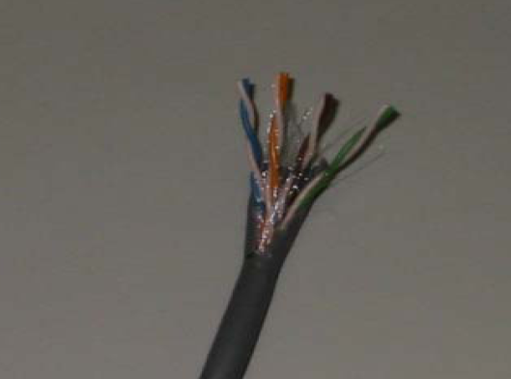
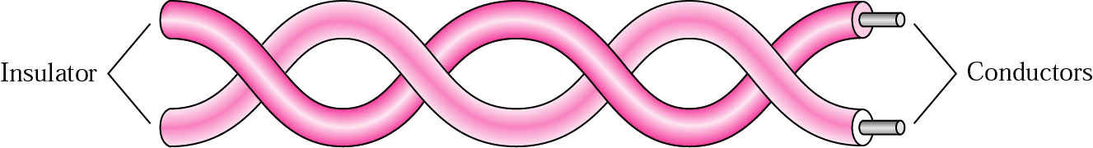
Twisted Pair
A twisted pair consists of two insulated copper wires arranged in a regular spiral pattern.
The twisting tends to decrease the crosstalk interference between adjacent pairs in a cable.
Twisted pair may be used to transmit both analog and digital transmission.
Twisted pair is limited in distance, bandwidth, and data rate.
The attenuation for twisted pair is a very strong function of frequency

Slide 7
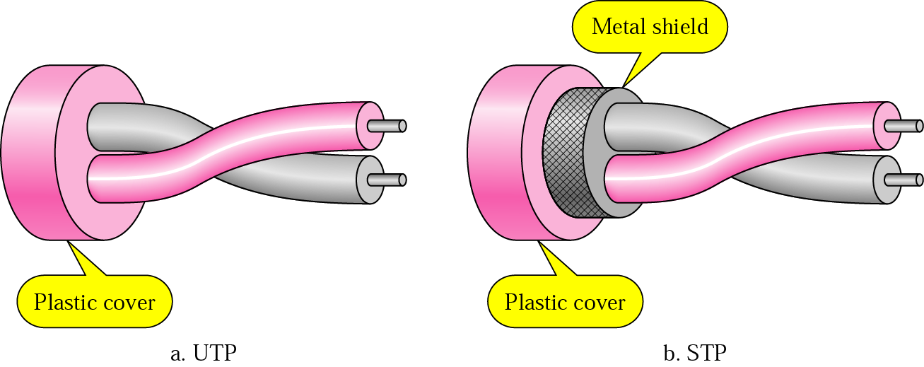
Twisted Pair Types
Unshielded Twisted Pair (UTP)
ordinary telephone wire
cheapest
easiest to install
suffers from external EM interference
Shielded Twisted Pair (STP)
metal braid or sheathing that reduces interference
more expensive
easiest to install
harder to handle (thick, heavy)

Slide 8
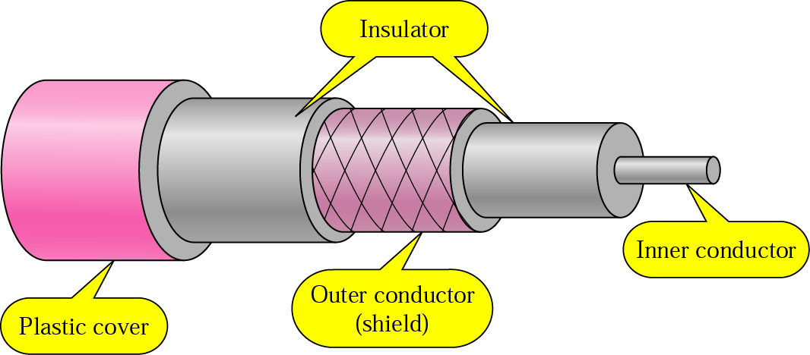
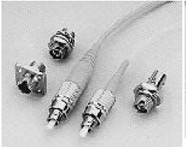
Coaxial cable
Coaxial cable consist the followings layers in its construction
The copper conductor
Insulation layer of plastic foam
Second conductor or shield of wire mesh tube or metallic foil
Outer jacket of tough plastic
Coaxial cable can be used over longer distances and support more stations on a shared line than twisted pair.

Slide 9
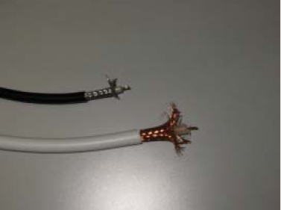
Continue…
Coaxial cable is a versatile transmission medium, used in a wide variety of applications, including:
• Television distribution - aerial to TV systems.
Characteristics
It is comparatively inexpensive
Its installation us comparatively simple
It must be grounded properly in a network connection
Its bandwidth capacity is around 10 Mbps
It is thin Ethernet connection maximum 30 nodes and in thick Ethernet connection maximum 100 nodes can be successfully interlinked with this cable connection
It suffers from data attenuation

Slide 10
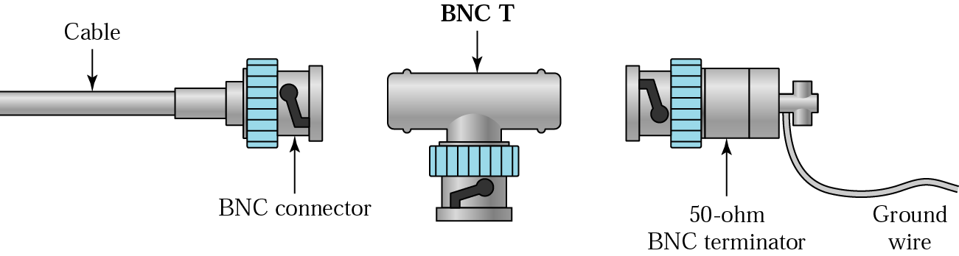
BNC connectors
BNC Connectors are used for connecting to co-axial cables together at connecting points is when repeaters are required

Slide 11
Fiber Optics
Fiber optic cable is known as most sophisticated cables used in long distance network connection.
Through this cable data transmission is done through « Light ray signal transmission» rather than electrical signal transmission.
It has inner core of glass that conducts light.This inner core is surrounded by cladding.
Cladding is nothing but layer of glass material that reflects light back into the core.
Each fiber is then surrounded by plastic sheath

Slide 12
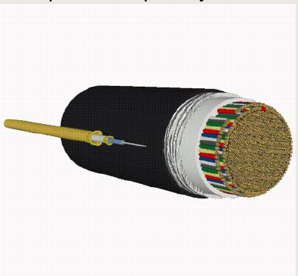
Benefits of Fiber Optics
The bandwidth of the signal produced by the transmitting antenna is more important than the medium in determining transmission characteristics.
Optical Fiber – Benefits
greater capacity
data rates of hundreds of Gbps
smaller size & weight
lower attenuation
electromagnetic isolation
greater repeater spacing
10s of km at least

Slide 13
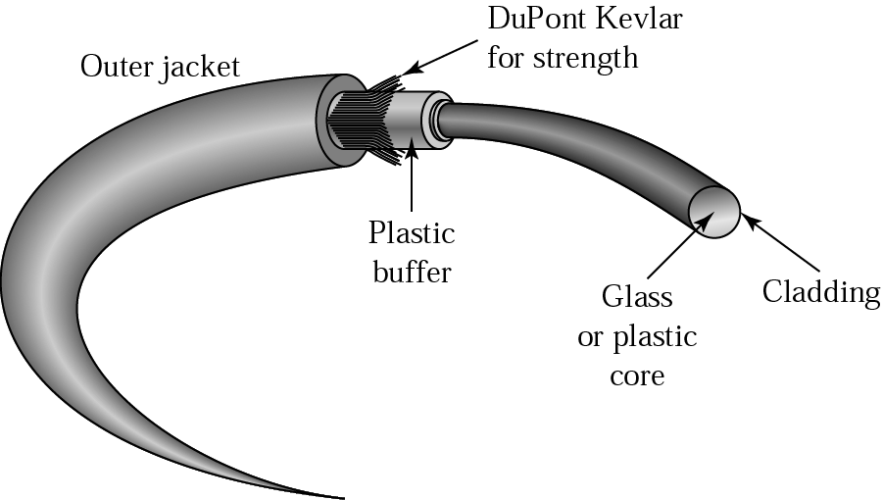
Distinguish optical fiber from twisted pair or coaxial cable:
Greater capacity: The potential bandwidth, and hence data rate, of optical fiber is immense; data rates of hundreds of Gbps over tens of kilometers have been demonstrated.
Smaller size and lighter weight: Optical fibers are considerably thinner than coaxial cable or bundled twisted-pair cable.
Lower attenuation: Attenuation is significantly lower for optical fiber than for coaxial cable or twisted pair, and is constant over a wide range.
Electromagnetic isolation: Optical fiber systems are not affected by external electromagnetic fields. Thus the system is not vulnerable to interference, impulse noise, or crosstalk
Greater repeater spacing: Fewer repeaters mean lower cost and fewer sources of error.

Slide 14
Types of Optic fibre
Rays at shallow angles are reflected and propagated along the fiber; other rays are absorbed by the surrounding material. This form of propagation is called step-index multimode
by varying the index of refraction of the core, a second type of transmission, known as graded-index multimode, is possible
When the fiber core radius is reduced, fewer angles will reflect. By reducing the radius of the core to the order of a wavelength, only a single angle or mode can pass: the axial ray. This is single-mode propagation

Slide 15
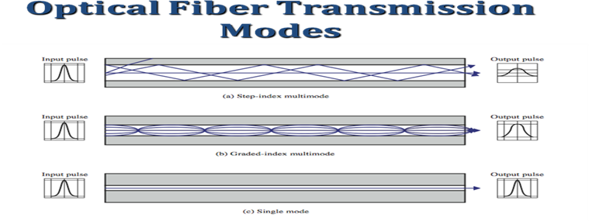
Optical Fibre Transmission Mode

Slide 16
Optical Fiber - Transmission Characteristics
It uses total internal reflection to transmit light
effectively acts as wave guide for 10¹⁴ to 10¹⁵ Hz
It can use several different light sources
Light Emitting Diode (LED)
cheaper, wider operating temp range, lasts longer
Injection Laser Diode (ILD)
more efficient, has greater data rate

Slide 17
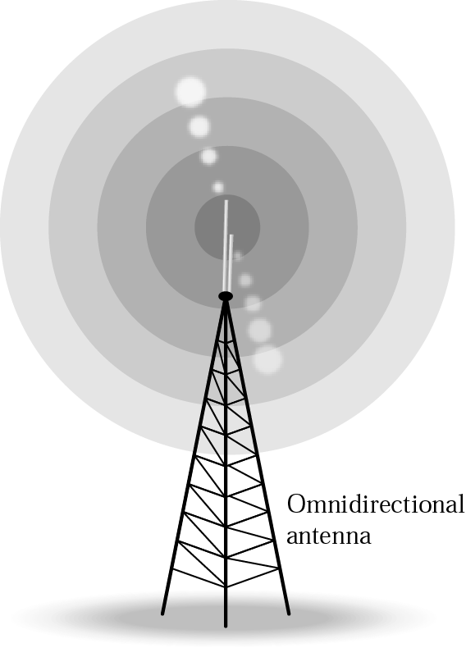
Wireless Transmission Frequencies
2GHz to 40GHz
microwave
highly directional
point to point
Satellite
30MHz to 1GHz
Omni directional
broadcast radio
3 x 10¹¹ to 2 x 10¹⁴
infrared
local

Slide 18
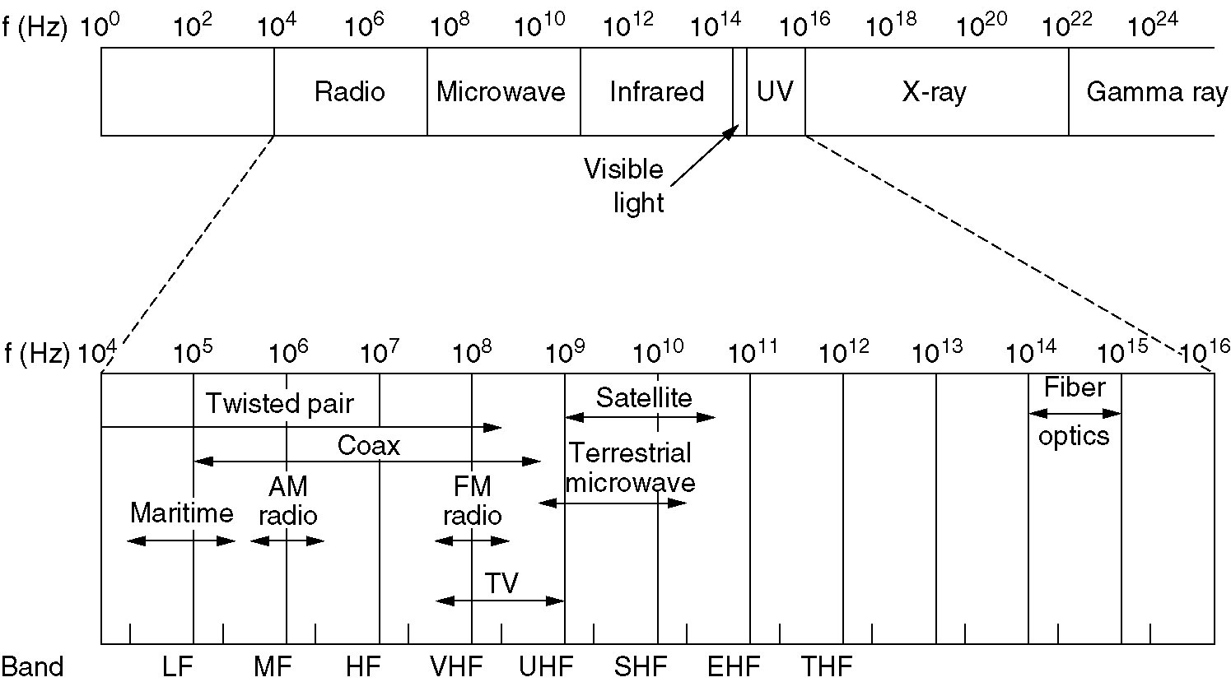
The Electromagnetic Spectrum
The electromagnetic spectrum and its uses for communication.

Slide 19
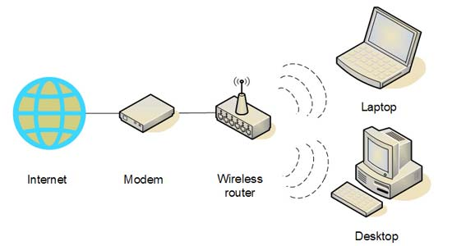
Continue….

Slide 20
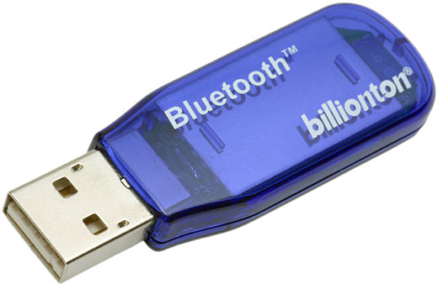
Bluetooth
“Bluetooth is a low-cost, low power, short range wireless communication technology used in. networking, mobile phones and other portable device. Bluetooth wireless technology also enables devices to communicate with each other as soon as-they come within range; no need to connect, plug into, install, enable or configure anything.”

Slide 21
What Bluetooth Does Best
Imagine you will be able to connect to the Internet on a dial-up connection you access through your mobile phone. Surfing the Internet then becomes possible anywhere your mobile phone can connect to your internet service provider.
Perhaps you prefer to use a traditional mouse with your laptop. Choose a Bluetooth-enabled mouse and you won’t have to keep track of a mouse cable.
If you have a Bluetooth-enabled mobile phone that stores your business information in the Vcard format, you can easily share this information with your colleagues. Swap your Vcard with theirs, by wirelessly connecting to their Bluetooth-enabled mobile phones.

Slide 22
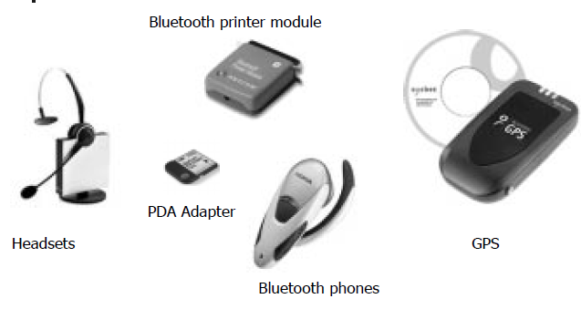
Bluetooth

Slide 23
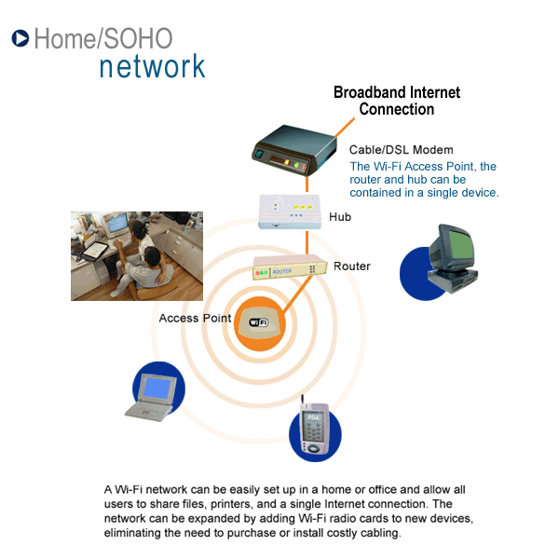
Wi-Fi
“WiFi or Wireless Fidelity refers to the technology surrounding the radio transmission of internet protocol data from an internet connection wirelessly to a host computer. Most often the internet connection is a higher speed one such as satellite, DSL or cable rather than slower dial-up connections.”

Slide 24
How a Wi-Fi Network Works
Basic concept is same as Walkie talkies.
A Wi-Fi hotspot is created by installing an access point to an internet connection.
An access point acts as a base station.
When Wi-Fi enabled device encounters a hotspot the device can then connect to that network wirelessly.
A single access point can support up to 30 users and can function within a range of 100 – 150 feet indoors and up to 300 feet outdoors.
Many access points can be connected to each other via Ethernet cables to create a single large network.

Slide 25
Wi-Fi Applications
Home
Small Businesses
Large Corporations & Campuses
Health Care
Wireless ISP (WISP)
Travellers

Slide 26
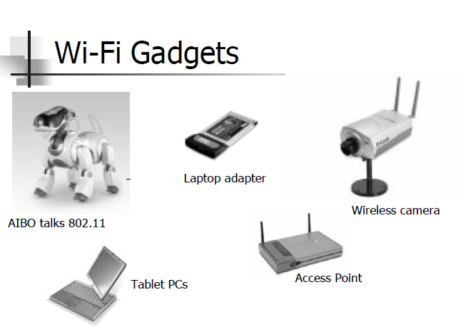
Wi-Fi Gadgets

Slide 27
Satellite Communication
Satellite is relay station
Receives on one frequency, amplifies or repeats signal and transmits on another frequency
Eg. Uplink 5.925-6.425 ghz & downlink 3.7-4.2 ghz
Typically requires geo-stationary orbit
Height of 35,784km
Spaced at least 3-4° apart
Typical uses
Television
Long distance telephone
Private business networks
Global positioning

Slide 28
Types of Satellite Communication
Satellite Point-to-Point Link
Satellite Broadcasting links

Slide 29
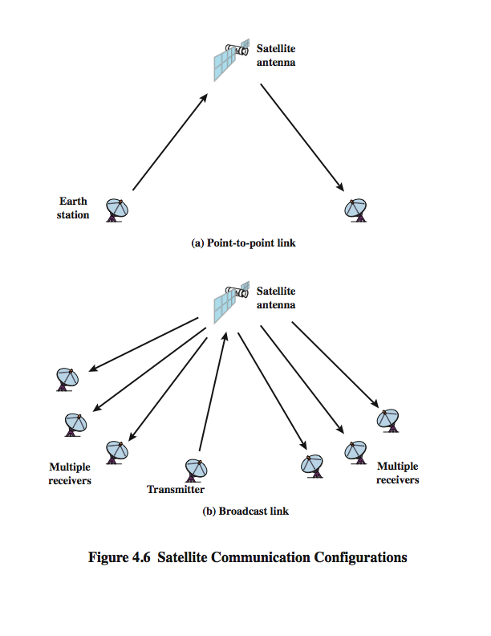
Satellite Point to Point Link

Slide 30
Satellite Broadcast Link

Slide 31
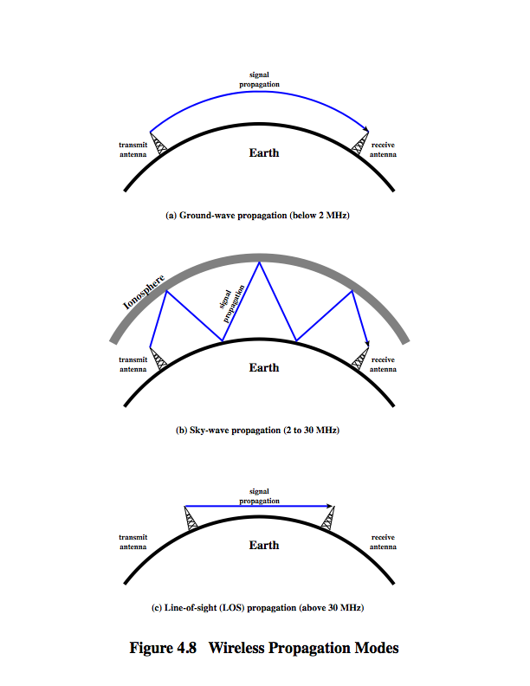
Continue….

Slide 32
Infrared
“Infrared technology allows computing devices to communicate via short-range wireless signals. With infrared, computers can transfer files and other digital data bi-directionally. The infrared transmission technology used in computers is similar to that used in consumer product remote control units.”
Infrared
Works in the line of Sight
Are blocked by walls
No licenses required
Typical used in TV remote control

Slide 33
Infrared
Installation and Usage - Computer infrared network adapters both transmit and receive data through ports on the rear or side of a device. Infrared adapters are installed in many laptops and handheld personal devices
Range - Infrared communications span very short distances. Place two infrared devices within a few feet (no more than 5 meters) of each other when networking them. Unlike Wi-Fi and Bluetooth technologies, infrared network signal cannot penetrate walls or other obstructions and work only in the direct "line of sight.“
Performance - Infrared technology used in local networks exists in three different forms:
IrDA-SIR (slow speed) infrared supporting data rates up to 115 Kbps
IrDA-MIR (medium speed) infrared supporting data rates up to 1.15 Mbps
IrDA-FIR (fast speed) infrared supporting data rates up to 4 Mbps

Slide 34
IR Advantages:
Low power requirements: therefore ideal for laptops, telephones, personal digital assistants
Low circuitry costs: $2-$5 for the entire coding/decoding circuitry
Simple circuitry: no special or proprietary hardware is required, can be incorporated into the integrated circuit of a product
Higher security: directionality of the beam helps ensure that data isn't leaked or spilled to nearby devices as it's transmitted
Portable

Slide 35
IR Disadvantages:
Line of sight: transmitters and receivers must be almost directly aligned (i.e. able to see each other) to communicate
Blocked by common materials: people, walls, plants, etc. can block transmission
Short range: performance drops off with longer distances
Light, weather sensitive: direct sunlight, rain, fog, dust, pollution can affect transmission
Speed: data rate transmission is lower than typical wired transmission

Slide 36
THANK YOU
Comparisiom of Major Wireless Transmission Media
Medium | Description and Advantages | Limitations and Drawbacks
Microwave | Point-to-point communication in lineof-sight path. | Must have visual contact between antennas.
 | Antennas are used (30 miles apart). | Susceptible to environmental interferences
 | Provide large capacity.
 | Can be done quickly at lower cost
Satellites | Can be at high, medium, or low orbit; used in GPSs. | Expensive to build and maintain.
 | Complete global coverage is available with three satellites.
Radio/electromagnatic | Effective for short ranges; used in LANs | Limited range; difficult to secure.
 | Inexpensive and easy to install. | Can create interference with communication devices.

Slide 37
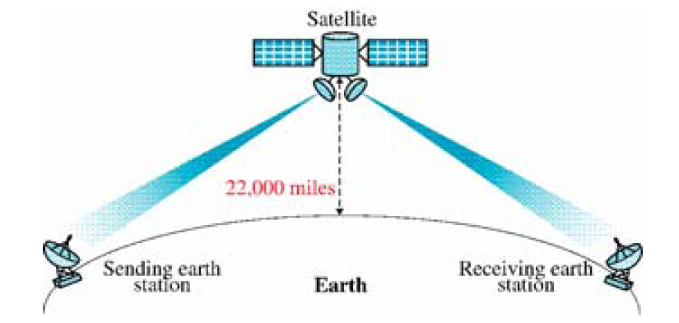
Applications

Slide 38
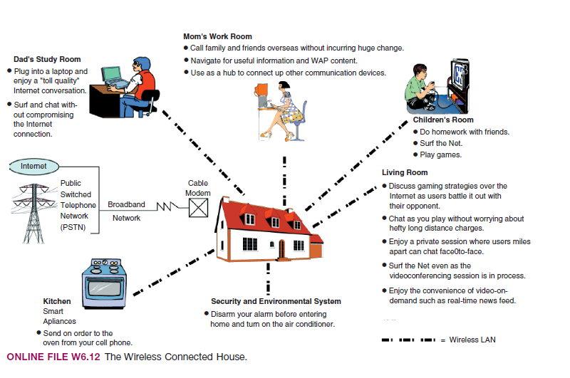
A Wireless Connected home

Slide 39
Thank-You

