Slide 1
DBMS: Introduction
Unit-1

Slide 2
DBMS: Varieties
Traditional Database applications
  most of the information that is stored and accessed is either textual or numeric.
Multimedia Databases: can store images, audio clips, and video streams digitally
Geographic information systems (GIS):
  can store and analyze maps, weather data, and satellite images
Data warehouses and online analytical processing (OLAP) systems:
  To extract and analyze useful business information from very large dataases to support decision making.

Slide 3
DBMS: Varieties
Real-time and active database technology:
  Used to control industrial and manufacturing processes
  Placement Questions:
  Mention different types of Database Applications?[TCS]
  What do you mean by GIS System [Infosys]
  Explain OLAP System[TCS, Wipro]

Slide 4
DBMS: Taxonomy
Database: is a collection of related data.
DBMS:
  collection of programs that enables users to create and maintain a database.
  It facilitates the processes of defining, constructing, manipulating, and sharing databases among various users and applications.
  Placement Questions:
  Differentiate between Database and DBMS [TCS, Infosys]
  Define Database [TCS, Wipro]
  Define DBMS[Infosys, CoCubes]

Slide 5
DBMS
Defining a database:
  It involves specifying the data types, structures, and constraints of the data to be stored in the database.
  The database definition or descriptive information is also stored by the DBMS in the form of a database catalog or dictionary; it is called meta-data.
Constructing the database: process of storing the data on some storage medium that is controlled by the DBMS.
Manipulating a database: includes functions such as querying the database to retrieve specific data, updating the database to reflect changes
Sharing a database: allows multiple users and programs to access the database simultaneously.

Slide 6
DBMS
An application program: accesses the database by sending queries or requests for data to the DBMS.
Query: typically causes some data to be retrieved
Protection: includes system protection against hardware or software malfunction (or crashes) and security protection against unauthorized or malicious access

Slide 7
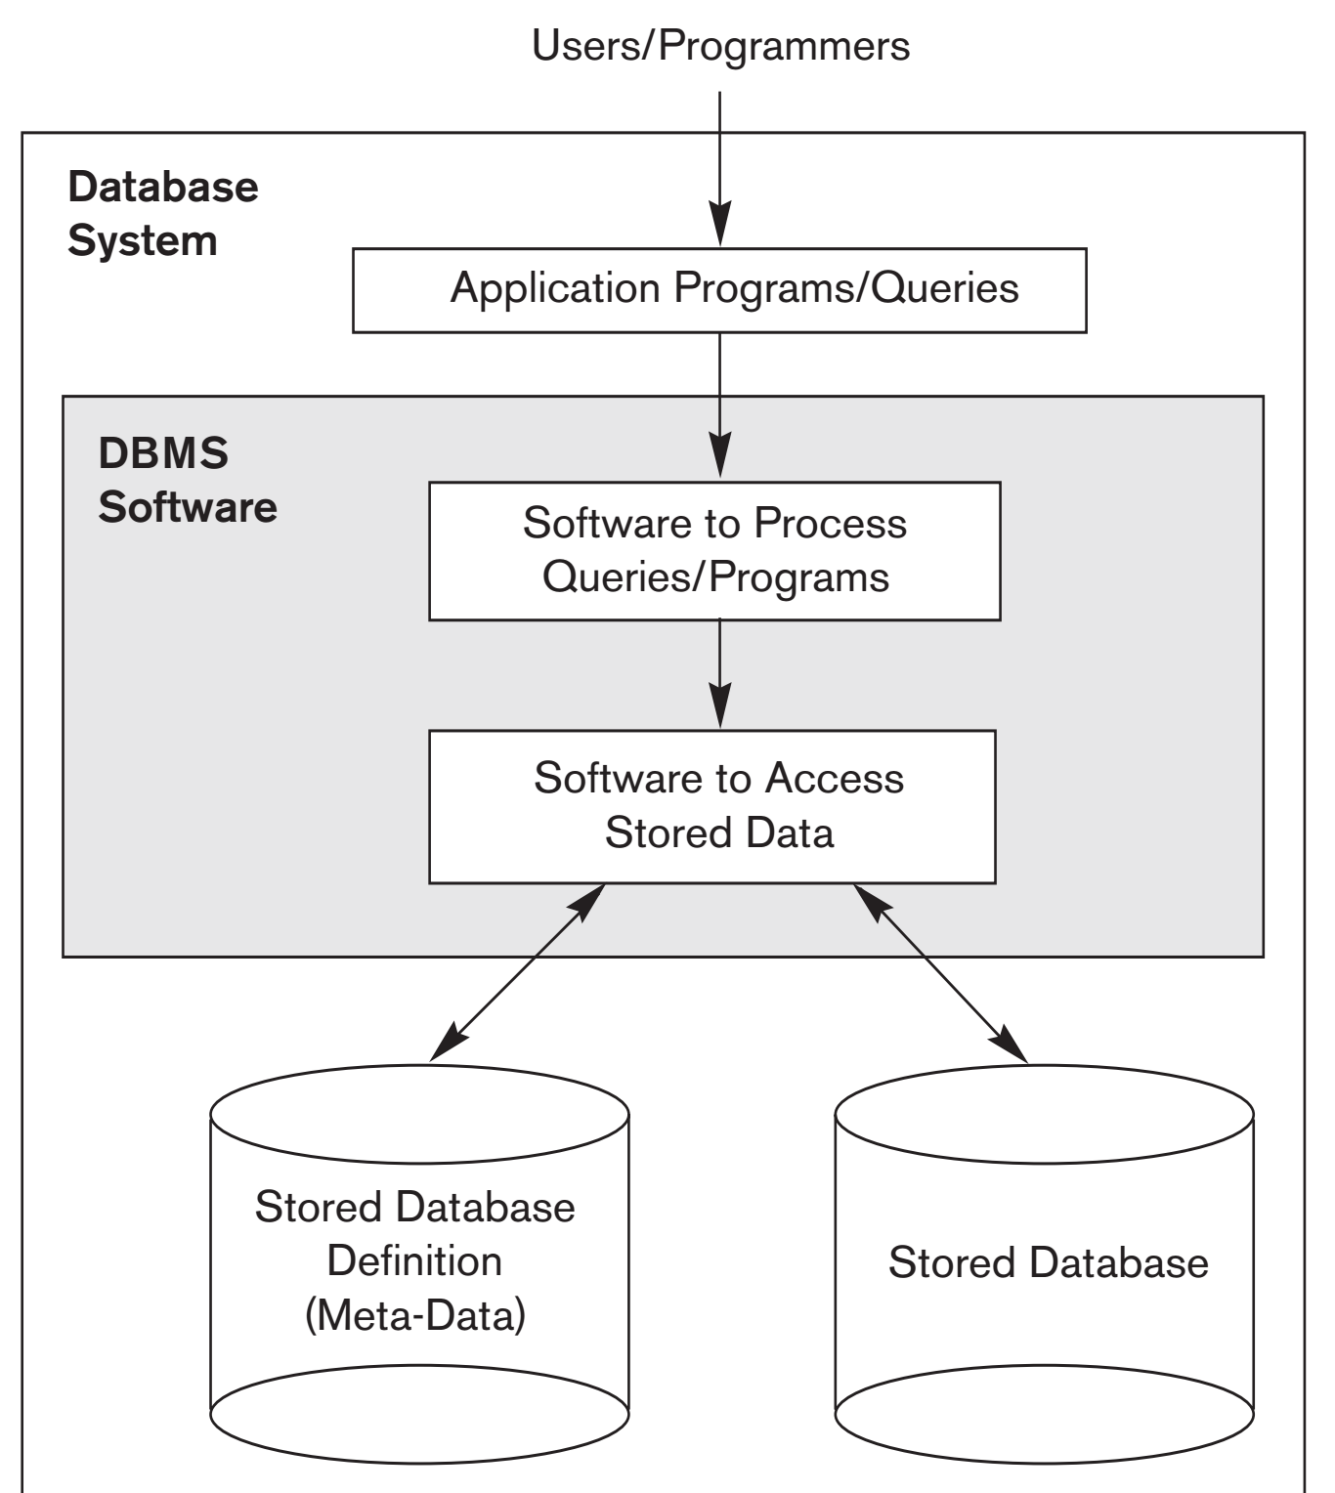

Slide 8
Charactersitics of Database Approach
In the database approach, a single repository maintains data that is defined once and then accessed by various users whereas In traditional file processing, each user defines and implements the files needed for a specific software application as part of programming the application.

Slide 9
Charactersitics of Database Approach Contd...
The main characteristics of the database approach versus the file-processing approach are the following:
  Self-describing nature of a database system
  Insulation between programs and data, and data abstraction
  Support of multiple views of the data
  Sharing of data and multiuser transaction processing

Slide 10
Charcteristics:Self Describing Nature
A database system contains not only the database itself but also a complete definition or description of the database structure and constraints.
This definition is stored in the DBMS catalog, which contains information such as the structure of each file, the type and storage format of each data item, and various constraints on the data.
The information stored in the catalog is called meta-data, and it describes the structure of the primary databas

Slide 11
Insulation between Programs and Data, and Data Abstraction
In traditional file processing, the structure of data files is embedded in the application programs, so any changes to the structure of a file may require changing all programs that access that file.
By contrast, DBMS access programs do not require such changes in most cases.
The structure of data files is stored in the DBMS catalog separately from the access programs.
This property is called as program-data independence.

Slide 12
Insulation between Programs and Data, and Data Abstraction Contd...
The implementation (or method) of the operation is specified separately and can be changed without affecting the interface.
User application programs can operate on the data by invoking these operations through their names and arguments, regardless of how the operations are implemented.
It is known as program-operation independence.

Slide 13
Insulation between Programs and Data, and Data Abstraction Contd...
The characteristic that allows program-data independence and program-operation independence is called data abstraction.
A DBMS provides users with a conceptual representation of data that does not include many of the details of how the data is stored or how the operations are implemented.
Informally, a data model is a type of data abstraction that is used to provide this conceptual representation

Slide 14
Sharing of Data and Multiuser Transaction Processing
A multiuser DBMS, as its name implies, must allow multiple users to access the database at the same time. This is essential if data for multiple applications is to be integrated and maintained in a single database.
The DBMS must include concurrency control software to ensure that several users trying to update the same data do so in a controlled manner so that the result of the updates is correct.

Slide 15
Users: Database Administrators
In a database environment, the primary resource is the database itself, and the secondary resource is the DBMS and related software. Administering these resources is the responsibility of the database administrator (DBA).
The DBA is responsible for authorizing access to the database, coordinating and monitoring its use, and acquiring software and hardware resources as needed.
The DBA is accountable for problems such as security breaches and poor system response time.

Slide 16
Users: Database Designers
Database designers are responsible for identifying the data to be stored in the database and for choosing appropriate structures to represent and store this data.
It is the responsibility of database designers to communicate with all prospective database users in order to understand their requirements and to create a design that meets these requirements.

Slide 17
Users: End Users
End users are the people whose jobs require access to the database for querying, updating, and generating reports
  Casual end users occasionally access the database, but they may need different information each time.
  They use a sophisticated database query language to specify their requests and are typically middle- or high-level managers or other occasional browsers.

Slide 18
Users: End Users Contd...
Naive or parametric end users make up a sizable portion of database end users.
Their main job function revolves around constantly querying and updating the database, using standard types of queries and updates—called canned transactions—that have been carefully programmed and tested.

Slide 19
Users: End Users Contd...
Sophisticated end users include engineers, scientists, business analysts, and others who thoroughly familiarize themselves with the facilities of the DBMS in order to implement their own applications to meet their complex requirements.
Standalone users maintain personal databases by using ready-made program packages that provide easy-to-use menu-based or graphics-based interfaces.

Slide 20
DBMS Approach: Advantages
Controlled Redundancy
Restricting Unauthorized Access
Persistent Storage for Program Objects
Storage Structures and Search techniques for Efficient Query Processing
Backup and Recovery
Multiple User Interfaces
Representing Complex Relationships among Data

Slide 21
DBMS Approach: Advantages Contd...
Enforcing Integrity Constraints
  The simplest type of integrity constraint involves specifying a data type for each data item
  Referential Integrity (a record in one file must be related to records in other files)
  Key or uniqueness constraint( uniqueness on data item values)
Permitting Inferencing and Actions Using Rules
  Some database systems provide capabilities for defining deduction rules forinferencing new information from the stored database facts. Such systems are called deductive database systems.

Slide 22
Support of Multiple Views of the Data
A database typically has many users, each of whom may require a different perspective or view of the database.
A view may be a subset of the database or it may contain virtual data that is derived from the database files but is not explicitly stored.

Slide 23
Database Applications: History
Hierarchical and Network Systems
  Hierarchical model organizes data in a tree-like structure while network model arranges data in a graph structure and relational database model organizes data in tables.
  Hierachichal model represents one to many relationship whereas network model represents many to many relationships
  Hierarchical model uses parent child relationships whereas in Network model multiple records can be linked to the same owner file.

Slide 24
DBMS: Historical Developments
Hierarchical and Network
  Hierarchical model organizes data in a tree-like structure while network model arranges data in a graph structure
  Relational
  Separates the physical storage of data from its conceptual representation, supporting data abstraction and program-data independence
Object Oriented Databases (OODB)
  Store and share complex, structured object
Interchanging Data on the Web for E-Commerce Using XML
  eXtended Markup Language (XML) is considered to be the primary standard for interchanging data among various types of databases and Web pages.
Extending Database Capabilities for New Applications
  Storing large amounts of data resulting from scientific experiments
  Storage and retrieval of images
  Storage and retrieval of videos,
  Data mining applications that analyze large amounts of data
  Spatial applications that store spatial locations of data
  Time series applications that store information such as economic data at
  regular points in time

Slide 25
DBMS: Limitations
High initial investment in hardware, software, and training
The generality that a DBMS provides for defining and processing data
Overhead for providing security, concurrency control, recovery, and integrity functions

Slide 26
Next Chapter
Database System Concept and Architecture

