Slide 1
Relational Calculus
∃
∀

Slide 2
Review – Why do we need Query Languages anyway?
Two key advantages
  Less work for user asking query
  More opportunities for optimization
Relational Algebra
  Theoretical foundation for SQL
  Higher level than programming language
    but still must specify steps to get desired result
Relational Calculus
  Formal foundation for Query-by-Example
  A first-order logic description of desired result
  Only specify desired result, not how to get it

Slide 3
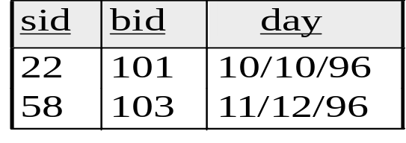
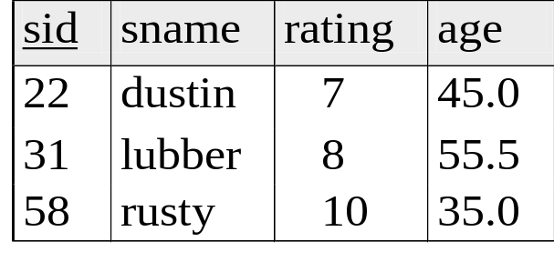
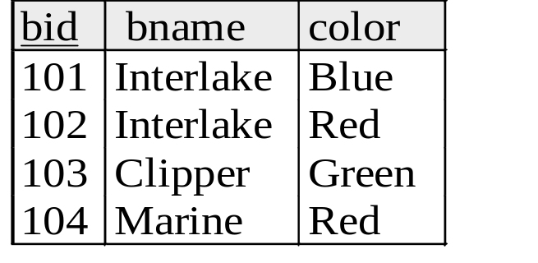
Relational Algebra Review
Reserves
Sailors
Boats
Basic operations:
Selection ( σ )
Projection ( π )
Cross-product ( × )
Set-difference ( — )
Union ( ∪ )
: gives a subset of rows.
: deletes unwanted columns.
: combine two relations.
: tuples in relation 1, but not 2
: tuples in relation 1 and 2.
Query Optimization
and Execution
Prediction: These relational operators are going to look hauntingly familiar when we get to them…!
Relational Operators
Files and Access Methods
Buffer Management
Additional operations:
Intersection (∩)
Join ( )
Division ( / )
:tuples in both relations.
:like × but only keep tuples where common fields are equal.
:tuples from relation 1 with matches in relation 2
Disk Space Management
DB

Slide 4
Relational Algebra Review
Reserves
Sailors
Boats
Basic operations:
Selection ( σ )
Projection ( π )
Cross-product ( × )
Set-difference ( — )
Union ( ∪ )
Find names of sailors who’ve reserved a green boat
σ
π
( _{sname} )
( _{color=‘Green’}Boats)
( Reserves)
( Sailors)
Additional operations:
Intersection (∩)
Join ( )
Division ( / )

Slide 5
Relational Algebra Review
Reserves
Sailors
Boats
Or better yet:
Find names of sailors who’ve reserved a green boat
σ
( _{color=‘Green’}Boats)
( _{bid} )
π
( Reserves)
π
( _{sid} )
( Sailors)
π
( _{sname} )
Given the previous algebra, a query optimizer would replace it with this!

Slide 6
Intermission
Some algebra exercises for you to practice with are out on the class web site
Algebra and calculus exercises make for good exam questions!

Slide 7
Today: Relational Calculus
High-level, first-order logic description
  A formal definition of what you want from the database
e.g. English:
“Find all sailors with a rating above 7”
In Calculus:
{S |S ∈ Sailors ∧ S.rating > 7}
“From all that is, find me the set of things that are tuples in the Sailors relation and whose rating field is greater than 7.”
Two flavors:
  Tuple relational calculus (TRC) (Like SQL)
  Domain relational calculus (DRC) (Like QBE)

Slide 8
Relational Calculus Building Blocks
Variables
  TRC: Variables are bound to tuples.
  DRC: Variables are bound to domain elements (= column values)
Constants
  7, “Foo”, 3.14159, etc.
Comparison operators
  =, <>, <, >, etc.
Logical connectives
  ¬ - not
  ∧ – and
  - or
  - implies
  ∈ - is a member of
Quantifiers
  ∀X(p(X)): For every X, p(X) must be true
  ∃X(p(X)): There exists at least one X such that p(X) is true

Slide 9
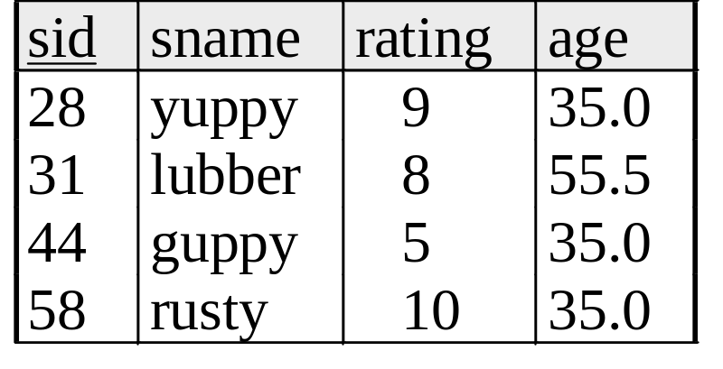
Relational Calculus
English example: Find all sailors with a rating above 7
  Tuple R.C.:
    {S |S ∈Sailors ∧ S.rating > 7}
“From all that is, find me the set of things that are tuples in the Sailors relation and whose rating field is greater than 7.”
  Domain R.C.:
    {<S,N,R,A>| <S,N,R,A> ∈Sailors ∧ R > 7}
  “From all that is, find me column values S, N, R, and A, where S is an integer, N is a string, R is an integer, A is a floating point number, such that <S, N, R, A> is a tuple in the Sailors relation and R is greater than 7.”

Slide 10
Tuple Relational Calculus
Query form: {T | p(T)}
  T is a tuple and p(T) denotes a formula in which tuple variable T appears.
Answer:
  set of all tuples T for which the formula p(T) evaluates to true.
Formula is recursively defined:
  Atomic formulas get tuples from relations or compare values
  Formulas built from other formulas using logical operators.

Slide 11
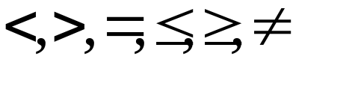
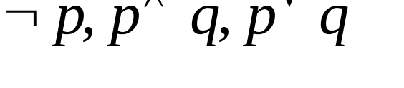


TRC Formulas
An atomic formula is one of the following:
  R ∈ Rel
  R.a op S.b
  R.a op constant, where
    op is one of
A formula can be:
  an atomic formula
  where p and q are formulas
  where variable R is a tuple variable
  where variable R is a tuple variable

Slide 12
Free and Bound Variables
The use of quantifiers ∀X and ∃X in a formula is said to bind X in the formula.
  A variable that is not bound is free.
Important restriction
{T | p(T)}
  The variable T that appears to the left of `|’ must be the only free variable in the formula p(T).
  In other words, all other tuple variables must be bound using a quantifier.

Slide 13
Use of ∀ (For every)
∀x (P(x)):
  only true if P(x) is true for every x in the universe:
  e.g. ∀x ((x.color = “Red”)
  means everything that exists is red
Usually we are less grandiose in our assertions:
  ∀x ( (x ∈ Boats) ⇒ (x.color = “Red”)
⇒ is a logical implication
  a ⇒ b means that if a is true, b must be true
  a ⇒ b is the same as ¬a ∨ b

Slide 14
a ⇒ b is the same as ¬a ∨ b
b
If a is true, b must be true!
  If a is true and b is false, the expression evaluates to false.
If a is not true, we don’t care about b
  The expression is always true.
T F
T
T
F
a
F
T
T

Slide 15
Quantifier Shortcuts
∀x ((x ∈ Boats) ⇒ (x.color = “Red”))
“For every x in the Boats relation, the color must be Red.”
Can also be written as:
  ∀x ∈ Boats(x.color = “Red”)
∃x ( (x ∈ Boats) ∧ (x.color = “Red”))
“There exists a tuple x in the Boats relation whose color is Red.”
Can also be written as:
  ∃x ∈ Boats (x.color = “Red”)

Slide 16
Selection and Projection
S1
Selection
Find all sailors with rating above 8
S1
{S |S ∈Sailors ∧ S.rating > 8}
S1
S1
Projection
Find names and ages of sailors with rating above 8.
sname | age
{S | ∃S1 ∈Sailors(S1.rating > 8
∧ S.sname = S1.sname
∧ S.age = S1.age)}
S
yuppy
35.0
S
rusty
35.0
S is a tuple variable of 2 fields (i.e. {S} is a projection of Sailors)

Slide 17
Joins
Find sailors rated > 7 who’ve reserved boat #103
S
S
S
{S | S∈Sailors ∧ S.rating > 7 ∧
∃R(R∈Reserves ∧ R.sid = S.sid
∧ R.bid = 103)}
R
R
Note the use of ∃ to find a tuple in Reserves that `joins with’ the Sailors tuple under consideration.
What if there was another tuple {58, 103, 12/13/96} in the Reserves relation?

Slide 18
Joins (continued)
What does this expression compute?
Find sailors rated > 7 who’ve reserved a red boat
{S | S∈Sailors ∧ S.rating > 7 ∧
∃R(R∈Reserves ∧ R.sid = S.sid
∧ ∃B(B∈Boats ∧ B.bid = R.bid
∧ B.color = ‘red’))}
Notice how the parentheses control the scope of each quantifier’s binding.

Slide 19
Division
Recall the algebra expression A/B…
A value x in A is disqualified if by attaching a y value from B, we obtain an xy tuple that is not in A. (e.g: only give me A tuples that have a match in B.
In calculus, use the ∀ operator:
e.g. Find sailors who’ve reserved all boats:
{S | S∈Sailors ∧
∀B∈Boats (∃R∈Reserves
(S.sid = R.sid
∧ B.bid = R.bid))}
Find all sailors S such that…
For all tuples B in Boats…
There is at least one tuple in Reserves…
showing that sailor S has reserved B.

Slide 20
More Calculus exercises on the web site…

Slide 21
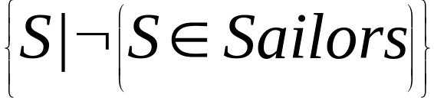
Unsafe Queries, Expressive Power
∃ syntactically correct calculus queries that have an infinite number of answers! These are unsafe queries.
  e.g.,
  Solution???? Don’t do that!
Expressive Power (Theorem due to Codd):
  Every query that can be expressed in relational algebra can be expressed as a safe query in DRC / TRC; the converse is also true.
Relational Completeness: Query languages (e.g., SQL) can express every query that is expressible in relational algebra/calculus. (actually, SQL is more powerful, as we will see…)

Slide 22
Relational Completeness means…
Theory
Practice
Relational Calculus
Query Optimization
and Execution
Relational Operators
Relational Algebra
Files and Access Methods
Buffer Management
Relational Model
Disk Space Management
DB

Slide 23
Now we can study SQL!
Practice
SQL
Query Optimization
and Execution
Relational Operators
Files and Access Methods
Buffer Management
Disk Space Management
DB

Slide 24
Summary
The relational model has rigorously defined query languages that are simple and powerful.
  Algebra and safe calculus have same expressive power
Relational algebra is more operational
  useful as internal representation for query evaluation plans.
  … they’ll be baa-aack….
Relational calculus is more declarative
  users define queries in terms of what they want, not in terms of how to compute it.
Almost every query can be expressed several ways
  and that’s what makes query optimization fun!

