Slide 1

Interview based Questions DBMS: General
Vijay Kumar Dwivedi
ASST. PROFESSOR, CS/IT
UCER, Prayagraj
Mob. No. 9235668045
Vijay.kr.dwivedi@gmail.com

Slide 2
Question 1: What is database?

Slide 3
Question 1: What is database?
Answer: A database is a logically coherent collection of data with some inherent meaning, representing some aspect of real world and which is designed, built and populated with data for a specific purpose.

Slide 4
Question 2: What is a Database system?

Slide 5
Question 2: What is a Database system?
Answer: The database and DBMS software together is called as Database system.

Slide 6
Question 3: What are the advantages of DBMS?

Slide 7
Question 3: What are the advantages of DBMS?
Answer: The advantages of DBMS are as follows:
Redundancy is controlled
Unauthorized access is restricted
Providing multiple user interfaces
Enforcing integrity constraints
Providing backup and recovery

Slide 8
Question 4: What is normalization?

Slide 9
Question 4: What is normalization?
Answer: It is a process of analysing the given relation schemas based on their Functional Dependencies (FDs) and primary key to achieve the properties:
Minimizing redundancy
Minimizing insertion, deletion and update anomalies.

Slide 10
Question 5: What is DDL (Data Definition Language)?

Slide 11
Question 5: What is DDL (Data Definition Language)?
Answer: A data base schema is specifies by a set of definitions expressed by a special language called DDL.

Slide 12
Question 6: What is Functional Dependency?

Slide 13
Question 6: What is Functional Dependency?
Answer: Functional dependency is a relationship that exists when one attribute uniquely determines another attribute. Functional dependency in a database serves as a constraint between two sets of attributes.

Slide 14
Question 7: What is 2NF?

Slide 15
Question 7: What is 2NF?
Answer: A relation schema R is in 2NF if it is in 1NF and every non-prime attribute A in R is fully functionally dependent on primary key

Slide 16
Question 8: What is the difference between primary key and unique constraints?

Slide 17
Question 8: What is the difference between primary key and unique constraints?
Answer: Primary key cannot have NULL value, the unique constraints can have NULL values.
One primary key can exist a table, but there can be multiple unique constrains in the same table.

Slide 18
Question 9: What is SQL?

Slide 19
Question 9: What is SQL?
Structured Query Language (SQL) is a standard computer language for relational database management and data manipulation. SQL is used to query, insert, update and modify data

Slide 20
Question 10: What is a view in SQL? How to create it?

Slide 21
Question 10: What is a view in SQL? How to create it?
A view is a virtual table created according to the result set of an SQL statement.
A view contains rows and columns, just like a real table.
The columns in the view are the columns from one or more real tables in the database.
SQL functions, WHERE, and JOIN statements can also be added to the view.
Create View Statement is used to create view in SQL
  CREATE VIEW view_name AS
  SELECT column1, column2, ...
  FROM table_name
  WHERE condition;

Slide 22
:
Question 11: What is a data Model?

Slide 23
:
Question 11: What is a data Model?
Ans: A collection of conceptual tools for describing data, data relationships data semantics and constraints.

Slide 24
:
Question 11: What is a ER- Model?

Slide 25
:
Question 11: What is a ER- Model?
Ans:
This data model is based on real world that consists of basic objects called entities and of relationship among these objects.
Entities are described in a database by a set of attributes.

Slide 26
Question 12: What is Query Evaluation Engine ?

Slide 27
Question 12: What is Query Evaluation Engine ?
  Query evaluation engine is importent part of SQL(structured query language) because all the query evaluated in SQL with help of query evaluation engine.
  It executes low-level instruction generates by compiler. and provides specific output.

Slide 28
Question 13: What is meant by query optimization?

Slide 29
Question 13: What is meant by query optimization?
The phase that identifies an efficient execution plan for evaluating a query that has the least estimated cost is referred to as query optimization.

Slide 30
Question 14: Differentiate between DBMS and RDBMS?

Slide 31
Question 14: Differentiate between DBMS and RDBMS?
DBMS provides a systematic and organized way of storing, managing and retrieving from collection of logically related information. RDBMS also provides what DBMS provides but above that it provides relationship integrity.

Slide 32
Question 15: What is SQL?

Slide 33
Question 15: What is SQL?
SQL stands for Structured Query Language. SQL is an ANSI (American National Standards Institute) standard computer language for accessing and manipulating database systems. SQL statements are used to retrieve and update data in a database.

Slide 34
Question 16: What is Stored Procedure?

Slide 35
Question 16: What is Stored Procedure?
A stored procedure is a named group of SQL statements that have been previously created and stored in the server database.

Slide 36
Question 17: What is Trigger?

Slide 37
Question 17: What is Trigger?
A trigger is a SQL procedure that initiates an action when an event (INSERT, DELETE or UPDATE) occurs.

Slide 38
Question 18: What is Index?

Slide 39
Question 18: What is Index?
Indexes are special lookup tables that the database search engine can use to speed up data retrieval.
An index is a pointer to data in a table

Slide 40
Question 19: What is extension and intension?

Slide 41
Question 19: What is extension and intension?
Extension -It is the number of tuples present in a table at any instance. This is time dependent.
Intension -It is a constant value that gives the name, structure of table and the constraints laid on it.

Slide 42
Question 20: What do you mean by atomicity and aggregation?

Slide 43
Question 20: What do you mean by atomicity and aggregation?
Ans: Atomicity-Atomicity states that database modifications must follow an all or nothing rule. Each transaction is said to be atomic. If one part of the transaction fails, the entire transaction fails.
Aggregation - A feature of the entity relationship model that allows a relationship set to participate in another relationship set. This is indicated on an ER diagram by drawing a dashed box around the aggregation.

Slide 44
Qustion 21: What is VDL ?

Slide 45
Qustion 21: What is VDL ?
It stands for View defintion language
It specifies user views and their mappings to the conceptual schema.

Slide 46
Question 22: What is SDL?

Slide 47
Question 22: What is SDL?
It stands for Storage Defintion Language
This language is to specify the internal schema.
This language may Specify the mapping between two schemas.

Slide 48
Question 23: Describe Concurrency Control?

Slide 49
Question 23: Describe Concurrency Control?
Concurrency control is the process managing simultaneous operations against a database so that database integrity is no compromised. There are two approaches to concurrency control.
The pessimistic approach involves locking and the optimistic approach involves versioning.

Slide 50
Question 24: Describe the difference between homogeneous and heterogeneous distributed database?

Slide 51
Question 24: Describe the difference between homogeneous and heterogeneous distributed database?
A homogenous database is one that uses the same DBMS at each node.
A heterogeneous database is one that may have a different DBMS at each node.

Slide 52
Question 25: What is a distributed database?

Slide 53
Question 25: What is a distributed database?
A distributed database is a single logical database that is spread across more than one node or locations that are all connected via some communication link.

Slide 54
Question 26: Explain the difference between two and three-tier architectures?

Slide 55
Question 26: Explain the difference between two and three-tier architectures?
Three-tier architecture includes a client and two server layers.
The application code is stored on the application server and the database is stored on the database server.
A two-tier architecture includes a client and one server layer. The database is stored on the database server.

Slide 56
Question 27: Explain the differences between an intranet and an extranet databases?

Slide 57
Question 27: Explain the differences between an intranet and an extranet databases?
An Internet database is accessible by everyone who has access to a Web site.
An intranet database limits access to only people within a given organization.

Slide 58
Question 28: What is SQL Deadlock?

Slide 59
Question 28: What is SQL Deadlock?
Deadlock is a unique situation in a multi user system that causes two or more users to wait indefinitely for a locked resource.

Slide 60
Question 29: What is a Catalog?

Slide 61
Question 29: What is a Catalog?
A catalog is a table that contains the information such as structure of each file, the type and storage format of each data item and various constraints on the data .
The information stored in the catalog is called Metadata.

Slide 62
Question 30: What is data ware housing & OLAP?

Slide 63
Question 30: What is data ware housing & OLAP?
Data warehousing and OLAP (online analytical processing) systems are the techniques used in many companies to extract and analyze useful information from very large databases for decision making .

Slide 64
Quesion 31: Describe the three levels of data abstraction?

Slide 65
Quesion 31: Describe the three levels of data abstraction?
Physical level: The lowest level of abstraction describes how data are stored.
Logical level: The next higher level of abstraction, describes what data are stored in database and what relationship among those data.
View level: The highest level of abstraction describes only part of entire database.

Slide 66
Question 32: What is Data Independence?

Slide 67
Question 32: What is Data Independence?
Data independence means that the application is independent of the storage structure and access strategy of data.

Slide 68
Question 33: What is Collation?

Slide 69
Question 33: What is Collation?
Collation refers to a set of rules that determine how data is sorted and compared.

Slide 70
Question 34: What is difference between DELETE & TRUNCATE commands?

Slide 71
Question 34: What is difference between DELETE & TRUNCATE commands?
Delete command removes the rows from a table based on the condition that we provide with a WHERE clause.
Truncate will actually remove all the rows from a table and there will be no data in the table after we run the truncate command.

Slide 72
Question 34: What is a Transaction?

Slide 73
Question 34: What is a Transaction?
A transaction is a logical unit of database processing that includes one or more database access operations.

Slide 74
Question 35: What are the different phases of Transaction?

Slide 75
Question 35: What are the different phases of Transaction?
Analysis phase
Redo phase
Undo phase

Slide 76
Question 36: What is transparent dbms?

Slide 77
Question 36: What is transparent dbms?
It is one, which keeps its physical structure hidden from user.

Slide 78
Question 37: Explain the differences between structured data and unstructured data.

Slide 79
Question 37: Explain the differences between structured data and unstructured data.
Structured data are facts concerning objects and events. The most important structured data are numeric, character, and dates.
Structured data are stored in tabular form. Unstructured data are multimedia data such as documents, photographs, maps, images, sound, and video clips. Unstructured data are most commonly found on Web servers and Web-enabled databases.

Slide 80
Question 38: What is a dependency graph?

Slide 81
Question 38: What is a dependency graph?
A dependency graph is a diagram that is used to portray the connections between database elements.

Slide 82
Question 39: Explain the difference between an exclusive lock and a shared lock?

Slide 83
Question 39: Explain the difference between an exclusive lock and a shared lock?
An exclusive lock prohibits other users from reading the locked resource; a shared lock allows other users to read the locked resource, but they cannot update it.

Slide 84
Question 40: Why should we use triggers?

Slide 85
Question 40: Why should we use triggers?
(1)Providing default values
(2) Enforcing data constraints
(3) Updating views and
(4) Enforcing referential integrity

Slide 86
Question 41: What are the advantages of using stored procedures?

Slide 87
Question 41: What are the advantages of using stored procedures?
The advantages of stored procedures are:
(1) Greater security
(2) Decreased network traffic
(3) SQL can be optimized and
(4) Code sharing which leads to less work, standardized processing, and specialization among developers.

Slide 88
Question 42: Describe the difference between embedded and dynamic SQL?

Slide 89
Question 42: Describe the difference between embedded and dynamic SQL?
Embedded SQL is the process of including hard coded SQL statements. These statements do not change unless the source code is modified.
Dynamic SQL is the process of generating SQL on the fly.The statements generated do not have to be the same each time.

Slide 90
Question 43: Explain a join between tables

Slide 91
Question 43: Explain a join between tables
A join allows tables to be linked to other tables when a relationship between the tables exists. The relationships are established by using a common column in the tables and often uses the primary/foreign key relationship.

Slide 92
Question 44: Describe a subquery.

Slide 93
Question 44: Describe a subquery.
A subquery is a query that is composed of two queries. The first query (inner query) is within the WHERE clause of the other query (outer query).

Slide 94
Question 45: Explain the difference between a dynamic and materialized view.

Slide 95
Question 45: Explain the difference between a dynamic and materialized view.
A dynamic view may be created every time that a specific view is requested by a user.
A materialized view is created and or updated infrequently and it must be synchronized with its associated base table(s).

Slide 96
Question 46: Explain minimum and maximum cardinality?

Slide 97
Question 46: Explain minimum and maximum cardinality?
Minimum cardinality is the minimum number of instances of an entity that can be associated with each instance of another entity.
Maximum cardinality is the maximum number of instances of an entity that can be associated with each instance of another entity.

Slide 98
Question 47: Explain what we mean by an ACID transaction.

Slide 99
Question 47: Explain what we mean by an ACID transaction.
An ACID transaction is one that is atomic, consistent, isolated, and durable.
Durable means that database changes are permanent.
Consistency can mean either statement level or transaction level consistency.
With transaction level consistency, a transaction may not see its own changes.
Atomic means it is performed as a unit.

Slide 100
Question 48: What is Specialization?

Slide 101
Question 48: What is Specialization?
It is the process of defining a set of subclasses of an entity type where each subclass contain all the attributes and relationships of the parent entity and may have additional attributes and relationships which are specific to itself.

Slide 102
Question 48: What is generalization?

Slide 103
Question 48: What is generalization?
It is the process of finding common attributes and relations of a number of entities and defining a common super class for them.

Slide 104
Question 49: What is Lossless join property?

Slide 105
Question 49: What is Lossless join property?
It guarantees that the spurious tuple generation does not occur with respect to relation schemas after decomposition.

Slide 106
Question 50: What is schema?

Slide 107
Question 50: What is schema?
The description of a data base is called the database schema , which is specified during database design and is not expected to change frequently.
A displayed schema is called schema diagram.

Slide 108
Why we need keys in DBMS ?

Slide 109
Why we need keys in DBMS ?
Keys help you to identify any row of data in a table.
Allows to establish a relationship between and identify the relation between tables
Helps to enforce identity and integrity in the relationship.

Slide 110
Keys in DBMS

Slide 111
Keys in DBMS
Super Key
Primary Key
Candidate Key
Alternate Key
Foreign Key
Compound Key
Composite Key
Surrogate Key

Slide 112
Normalization
Normalization in DBMS:
Normalization is a process of organizing the data in database to avoid data redundancy, insertion , updation & deletion anomaly.
First Normal Form (1NF) is a simple form of Normalization.
Second Normal Form (2NF) In 2NF, the table is required in 1NF.
Third Normal Form (3NF)
BCNF (Boyce – Code Normal Form)
Fourth Normal Form (4NF)
Fifth Normal Form (5NF)
DKNF (Domain Key Normal Form)

Slide 113
Normalization
Normalization in DBMS:
Normalization is a process of organizing the data in database to avoid data redundancy, insertion , updation & deletion anomaly.
First Normal Form (1NF) is a simple form of Normalization.
Second Normal Form (2NF) In 2NF, the table is required in 1NF.
Third Normal Form (3NF)
BCNF (Boyce – Code Normal Form)
Fourth Normal Form (4NF)
Fifth Normal Form (5NF)
DKNF (Domain Key Normal Form)

Slide 114
Functional Dependency
Functional dependency is a constraint that describes the relationship between attributes in a relation.
1NF – UNIQUE VALUE
2NF – REMOVAL OF PARTIAL FD
3NF – REMOVAL OF TRANSITIVE FD
3.5 NF – BCNF : LEFT HAND SIDE MUST BE A Super KEY
4NF – REMOVAL OF MULTIVALUED FD
5NF – REMOVAL OF JOIN FD

Slide 115
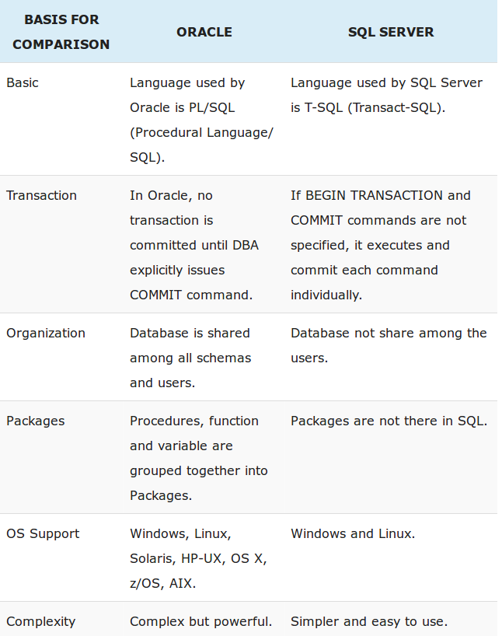

Slide 116
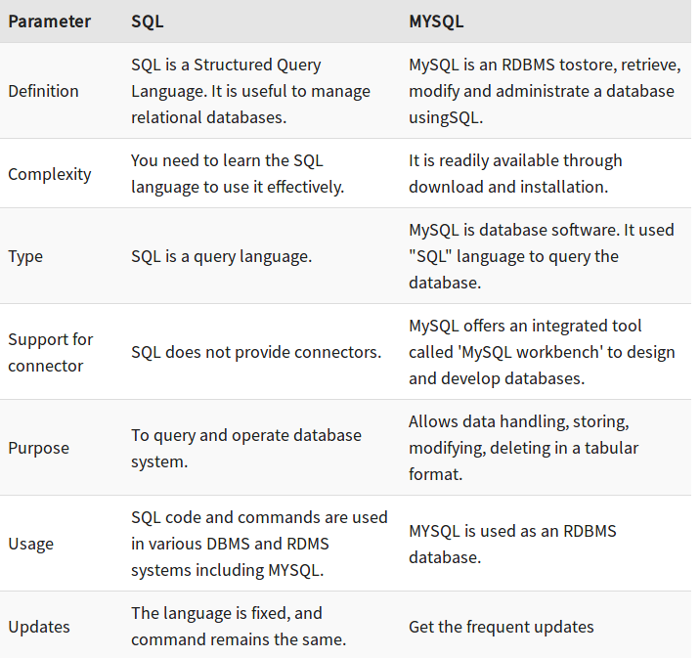
Difference between SQL and MySQL

Slide 117
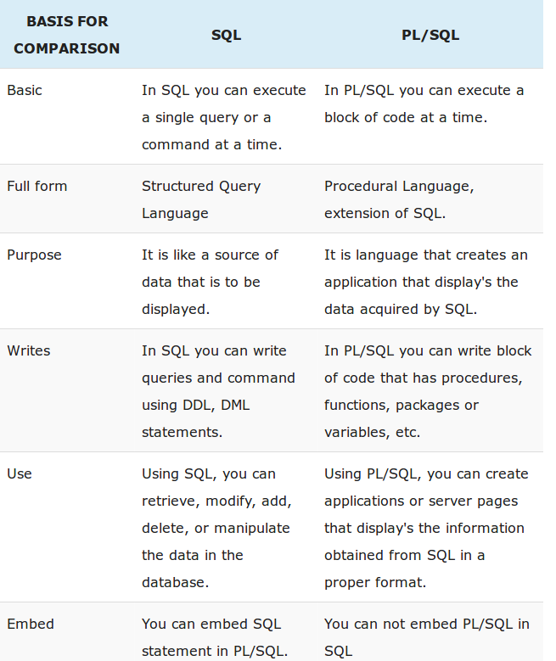


Slide 118
