Slide 1
Data Modeling
Using the Entity Relationship Model

Slide 2
Entity
An entity, which is a thing in the real world with an independent existence.
An entity may be an object with a physical existence (for example, a particular person, car,house, or employee) or it may be an object with a conceptual existence (for instance, a company, a job, or a university course).

Slide 3
Attributes
The particular properties that describe it
For example, an EMPLOYEE entity may be described by the employee’s name, age, address, salary, and job.
Types of attributes:
  Simple versus composite,
  singlevalued versus multivalued,
  stored versus derived

Slide 4
Composite versus Simple (Atomic) Attributes
Composite attributes can be divided into smaller subparts, which represent more basic attributes with independent meanings.
Attributes that are not divisible are called simple or atomic attributes.
Composite attributes can form a hierarchy
The value of a composite attribute is the concatenation of the values of its component simple attributes.

Slide 5
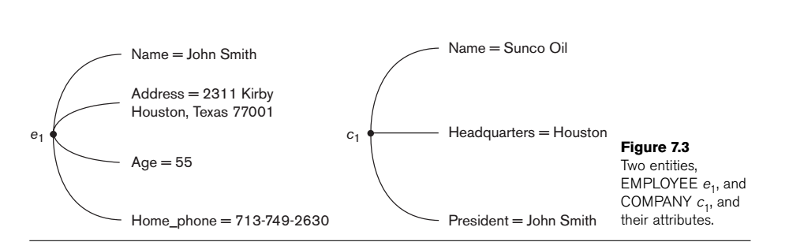
Composite versus Simple (Atomic) Attributes

Slide 6
Single-Valued versus Multivalued Attributes
Most attributes have a single value for a particular entity; such attributes are called single-valued
If an attribute can have a set of values for the same entity, it is known as multivalued attributes
A multivalued attribute may have lower and upper bounds to constrain the number of values allowed for each individual entity.

Slide 7
Stored versus Derived Attributes.
Some attribute values can be derived from related entities; those are known as derived attributes
For a particular person entity, the value of Age can be determined from the current (today’s) date and the value of that person’s Birth_date. The Age attribute is hence called a derived attribute and is said to be derivable from the Birth_date attribute, which is called a stored attribute.

Slide 8
Complex Attributes
Composite and multivalued attributes can be nested arbitrarily
It can be represented as the grouping components of a composite attribute between parentheses () and separating the components with commas, and by displaying multivalued attributes between braces { }
For example, if a person can have more than one residence and each residence can have a single address and multiple phones can be represented as:
{Address_phone( {Phone(Area_code,Phone_number)},Address(Street_address(Number,Street,Apartment_number),City,State,Zip) )}

Slide 9
Entity Types
Defines a collection (or set) of entities that have the same attributes
Described by its name and attributes.
The collection of all entities of a particular entity type in the database at any point in time is called an entity set;
The entity set is usually referred to using the same name as the entity type
An entity type describes the schema or intension for a set of entities that share the same structure.
The collection of entities of a particular entity type is grouped into an entity set, which is also called the extension of the entity type.

Slide 10
Representation
An entity type is represented in ER diagrams as a rectangular box by enclosing the entity type name.
Attribute names are enclosed in ovals and are attached to their entity type by straight lines.
Composite attributes are attached to their component attributes by straight lines.
Multivalued attributes are displayed in double ovals.
Each key attribute has its name underlined inside the oval.

Slide 11
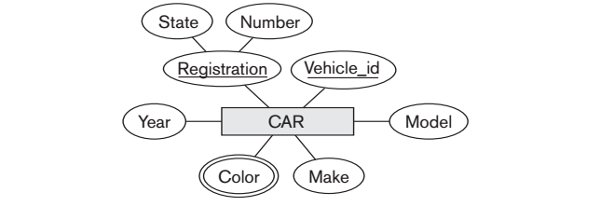
CAR: Entity

Slide 12
Example
An entity type DEPARTMENT with attributes Name, Number, Locations, Manager, and Manager_start_date. Locations is the only multivalued attribute.
We can specify that both Name and Number are (separate) key attributes because each was specified to be unique.

Slide 13
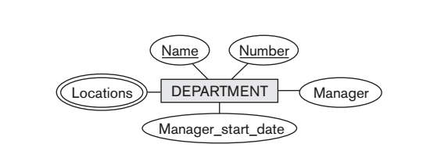
ERDiagram

Slide 14
Example
An entity type PROJECT with attributes Name, Number, Location, and Controlling_department. Both Name and Number are (separate) key attributes

Slide 15
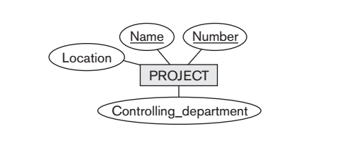
ER-Diagram

Slide 16
Example
An entity type EMPLOYEE with attributes Name, Ssn, Sex, Address, Salary, Birth_date, Department, and Supervisor.
Both Name and Address may be composite attributes; however, this was not specified in the requirements.
We must go back to the users to see if any of them will refer to the individual components of Name—First_name, Middle_initial, Last_name—or of Address.

Slide 17
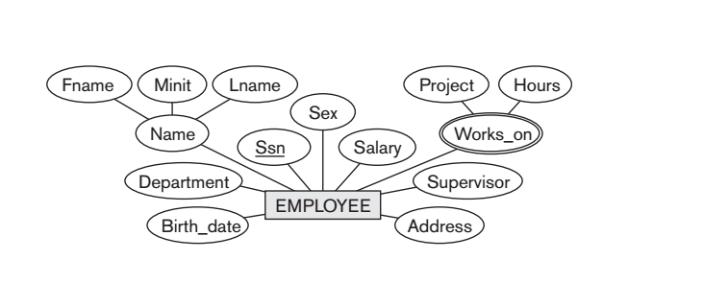
ER-Diagram

Slide 18
Example
An entity type DEPENDENT with attributes Employee, Dependent_name, Sex, Birth_date, and Relationship (to the employee).

Slide 19
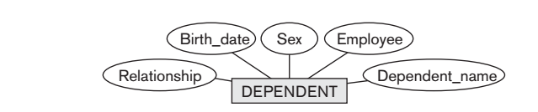
ER- Diagram

Slide 20
Relationship Types, Sets, and Instances
A relationship type R among n entity types E 1 , E 2 , ..., E n defines a set of associations—or a relationship set—among entities from these entity types

Slide 21
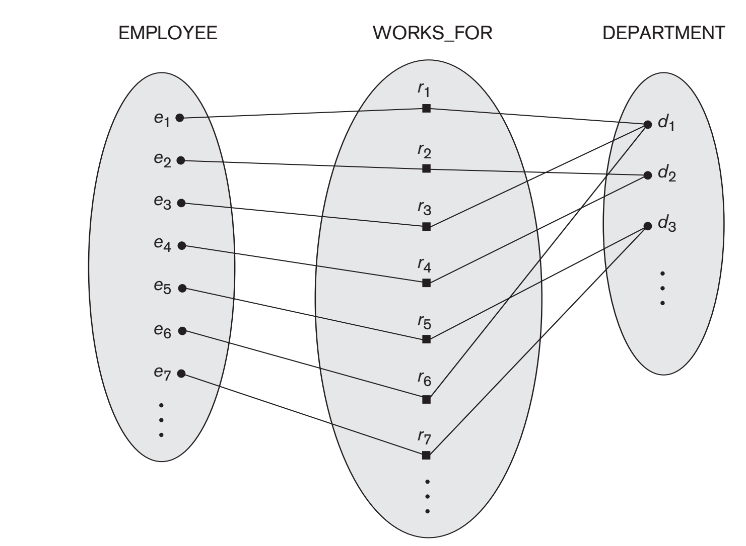
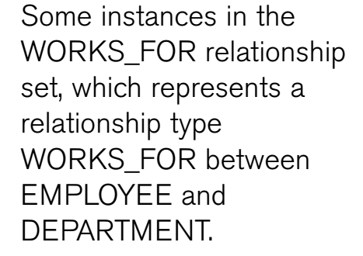

Slide 22
Relationship Degree, Role Names, and Recursive Relationships
Degree of a Relationship Type
  The degree of a relationship type is the number of participating entity types.
  WORKS_FOR relationship is of degree two.
A relationship type of degree two is called binary, and one of degree three is called ternary.

Slide 23
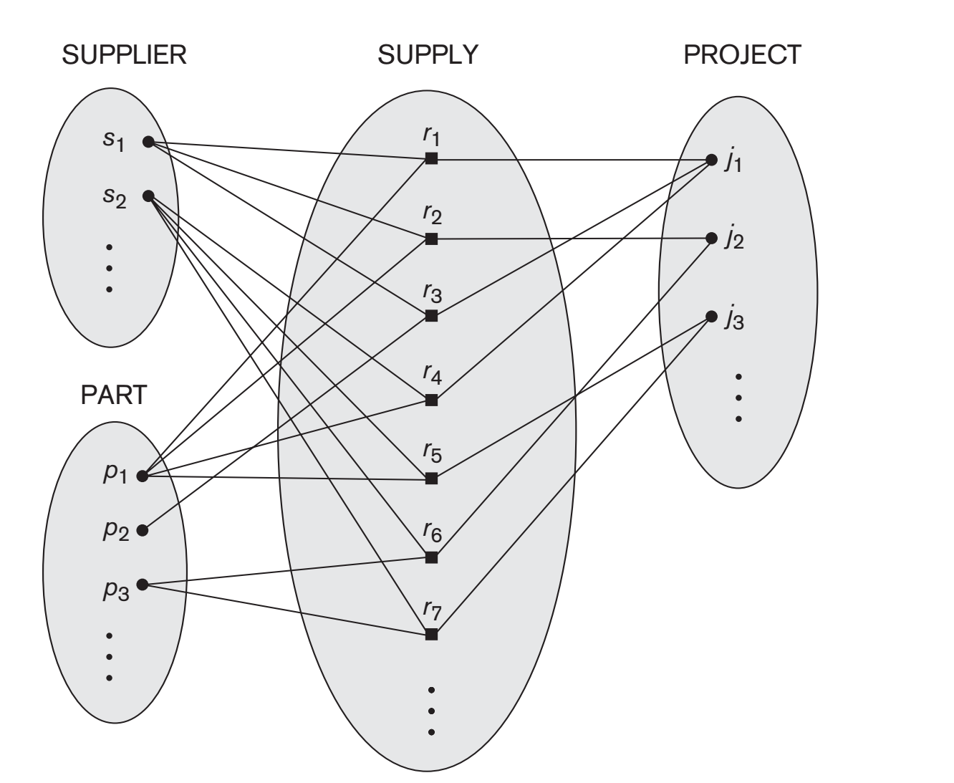
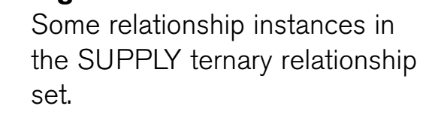
Ternary Relationship

Slide 24
Role Names and Recursive Relationships
Each entity type that participates in a relationship type plays a particular role in the relationship.
The role name signifies the role that a participating entity from the entity type plays in each relationship instance, and helps to explain what the relationship means.
In WORKS_FOR relationship type, EMPLOYEE plays the role of employee or worker and DEPARTMENT plays the role of department or employer.

Slide 25
Recursive Relationship
If same entity type participates more than once in a relationship type in different roles.
In such cases the role name becomes essential for distinguishing the meaning of the role that each participating entity plays.
Such relationship types are called recursive relationships.
Eg: The SUPERVISION relationship type relates an employee to a supervisor, where both employee and supervisor entities are members of the same EMPLOYEE entity set.
Hence, the EMPLOYEE entity type participates twice in SUPERVISION : once in the role of supervisor (or boss), and once in the role of supervisee (or subordinate).

Slide 26
Constraints on Binary Relationship Types
Relationship types usually have certain constraints that limit the possible combinations of entities that may participate in the corresponding relationship set.
Eg: if the company has a rule that each employee must work for exactly one department, it can be represented as shown in Works_for relationship

Slide 27
Cardinality Ratios for Binary Relationships
The cardinality ratio for a binary relationship specifies the maximum number of relationship instances that an entity can participate in.
Eg: WORKS_FOR binary relationship type, DEPARTMENT:EMPLOYEE is of cardinality ratio 1:N, meaning that each department can be related to (that is, employs) any number of employees, but an employee can be related to (work for) only one department.
The possible cardinality ratios for binary relationship types are 1:1, 1:N, N:1, and M:N.

Slide 28
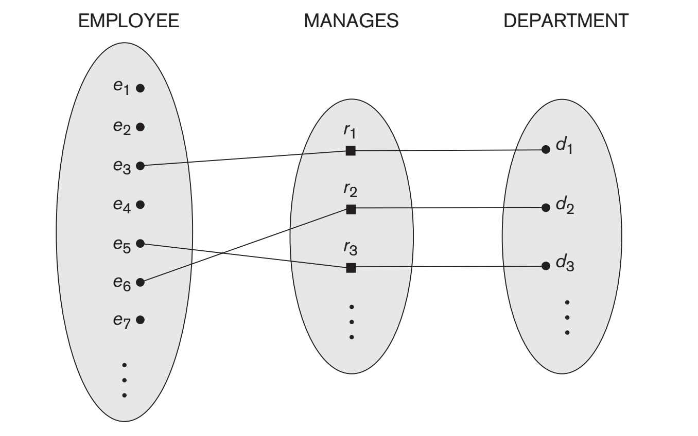
1:1 Relationships
Eg: An employee can manage one department only and a department can have one manager only.

Slide 29
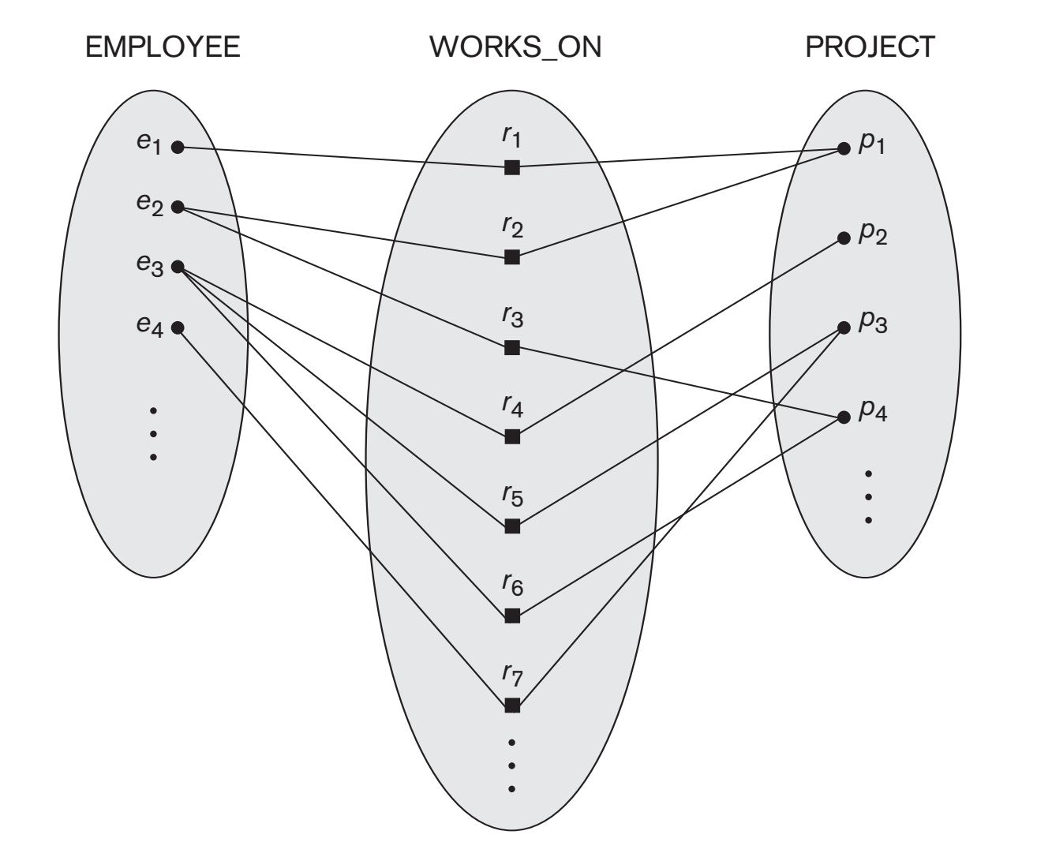
M:N Relationships

Slide 30
