Slide 1

Database Management System (KCS-501)
B.Tech- Computer Science & Engineering
Year/Semester- 3rd /5th
Session- 2020-21
Unit-2 [PPT-1/10]
Himanshu Srivastava
Department of Computer Science & Engineering
United College of Engineering & Management
DBMS(KCS-501) Himanshu Srivastava

Slide 2
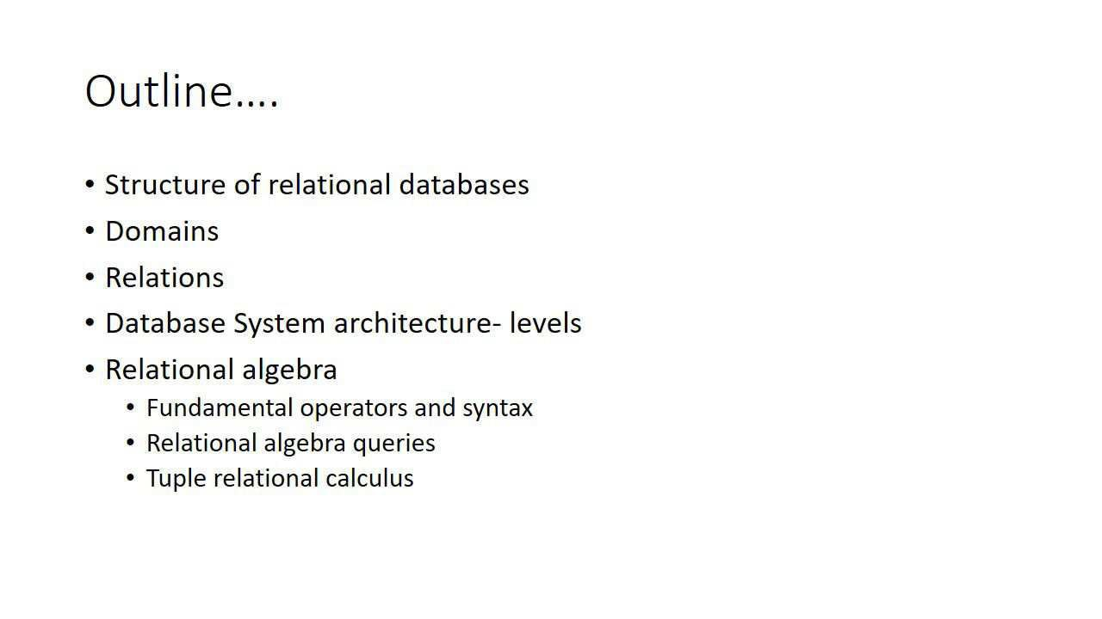
DBMS(KCS-501) Himanshu Srivastava

Slide 3
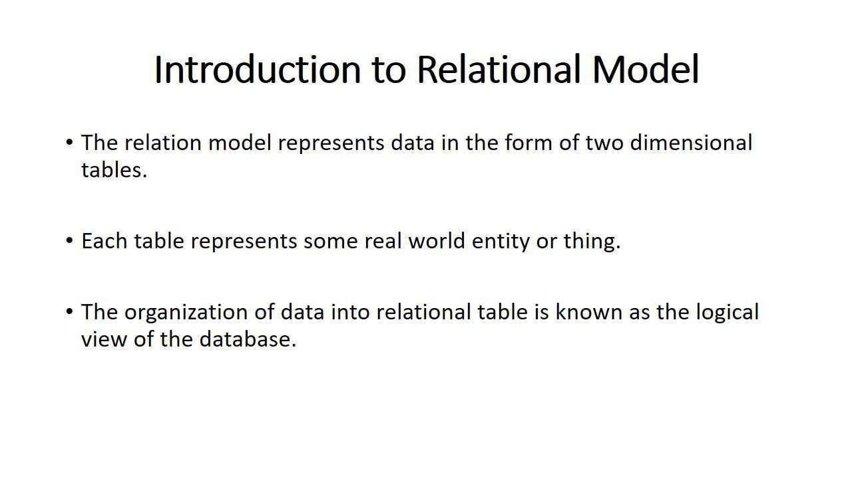
DBMS(KCS-501) Himanshu Srivastava

Slide 4
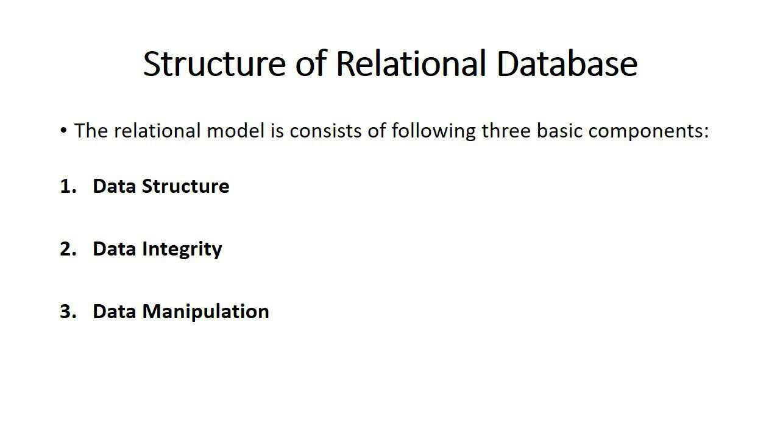
DBMS(KCS-501) Himanshu Srivastava

Slide 5
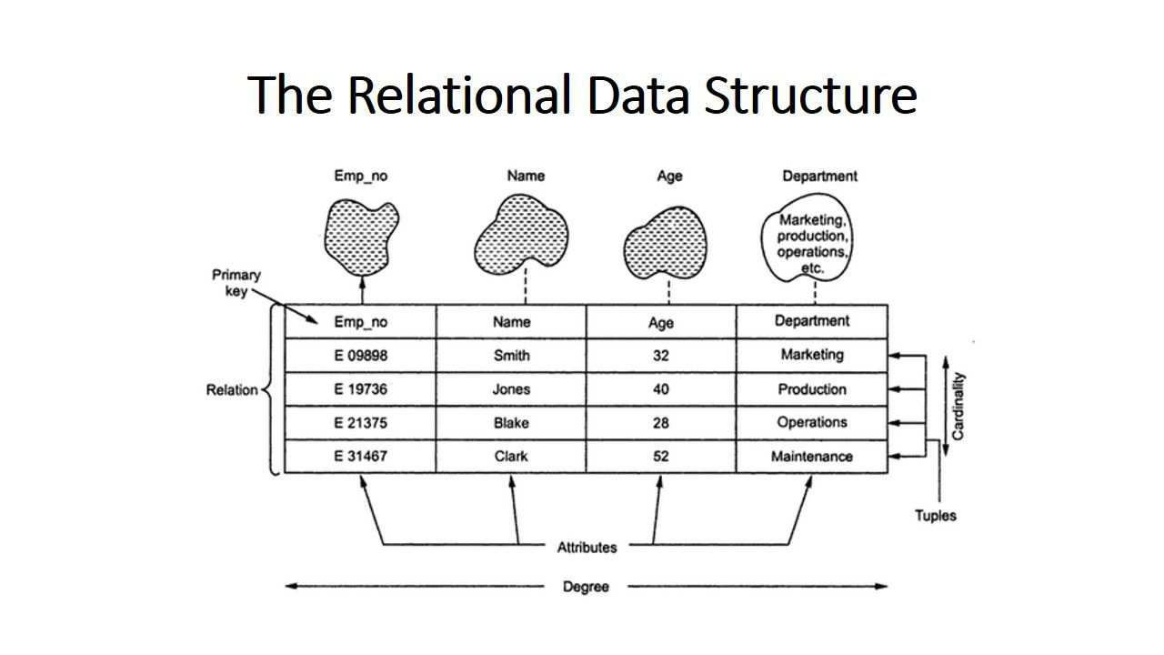
DBMS(KCS-501) Himanshu Srivastava

Slide 6
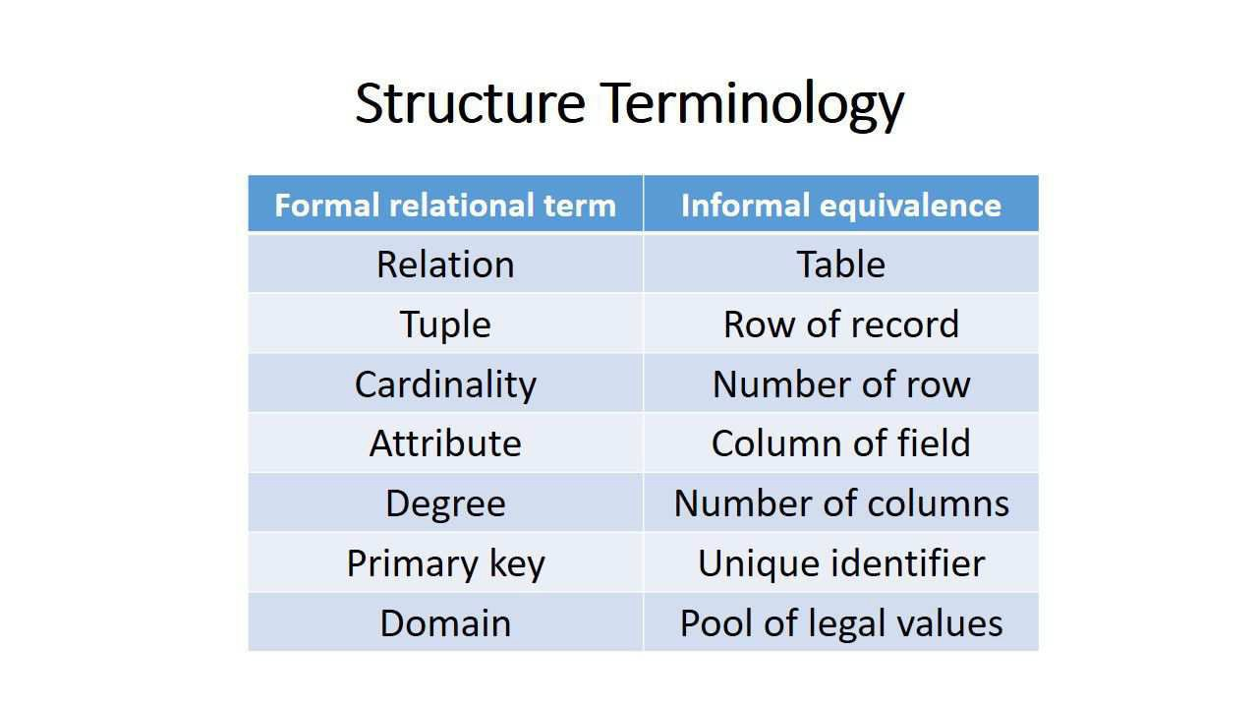
DBMS(KCS-501) Himanshu Srivastava

Slide 7
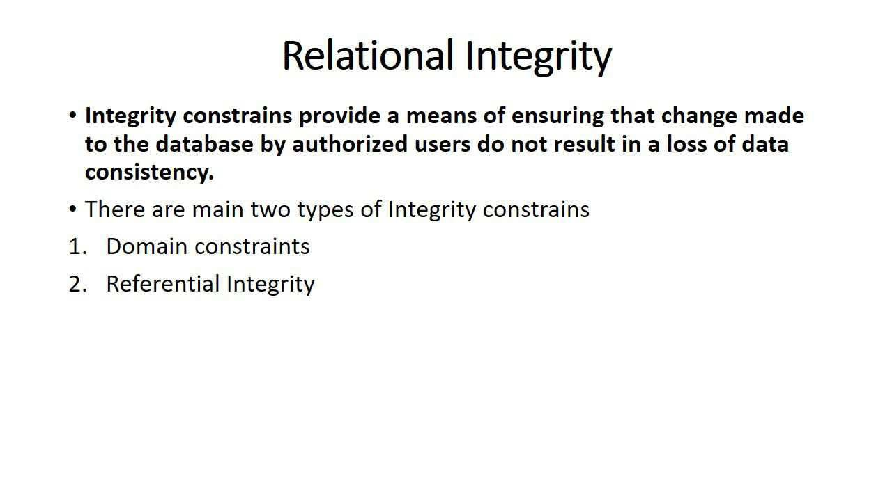
DBMS(KCS-501) Himanshu Srivastava

Slide 8
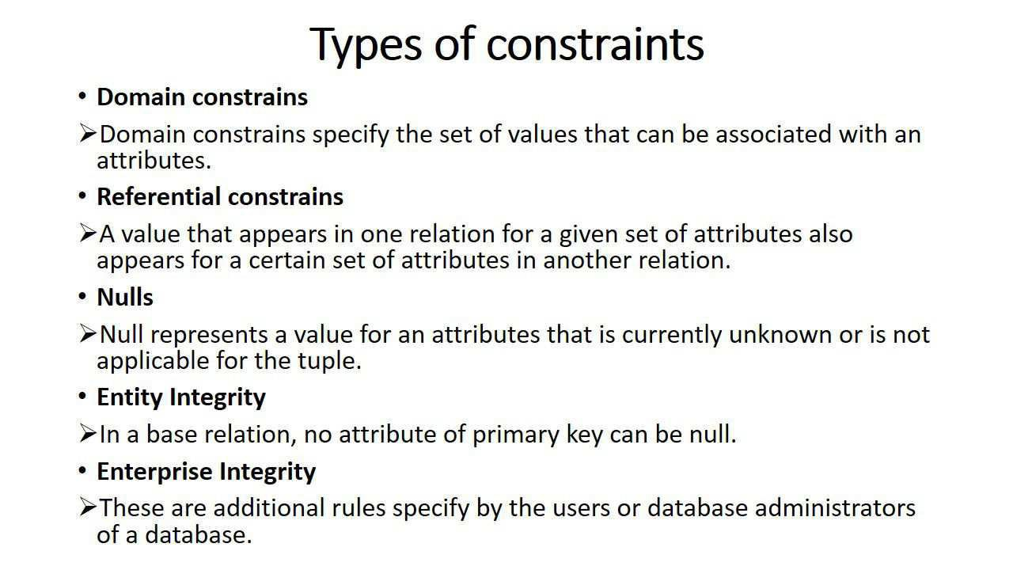
DBMS(KCS-501) Himanshu Srivastava

Slide 9
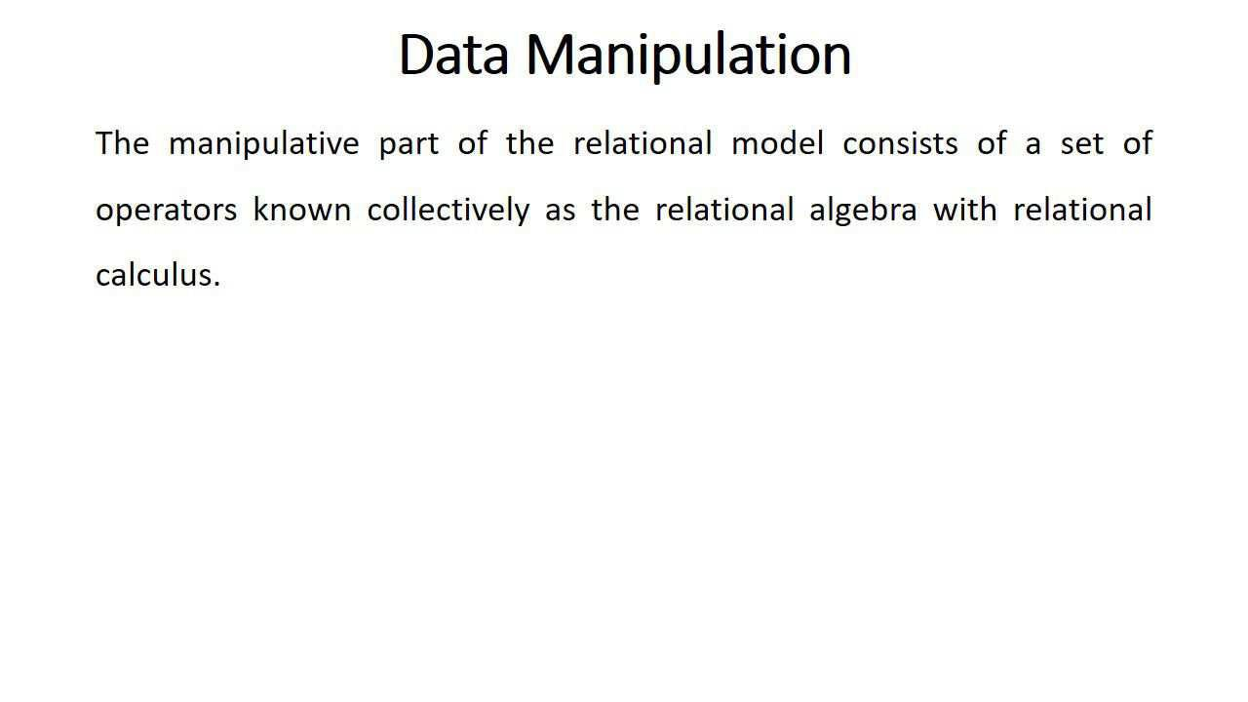
DBMS(KCS-501) Himanshu Srivastava

Slide 10
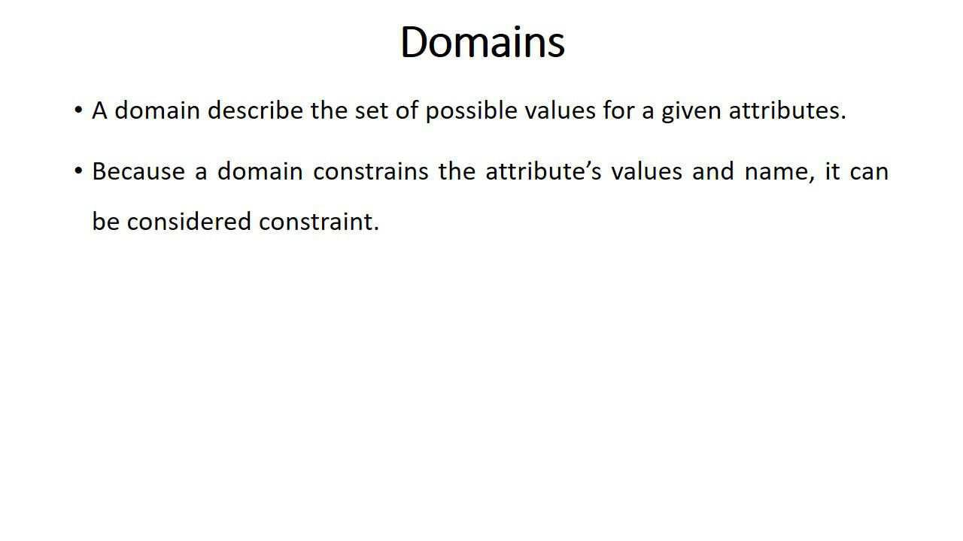
DBMS(KCS-501) Himanshu Srivastava

Slide 11
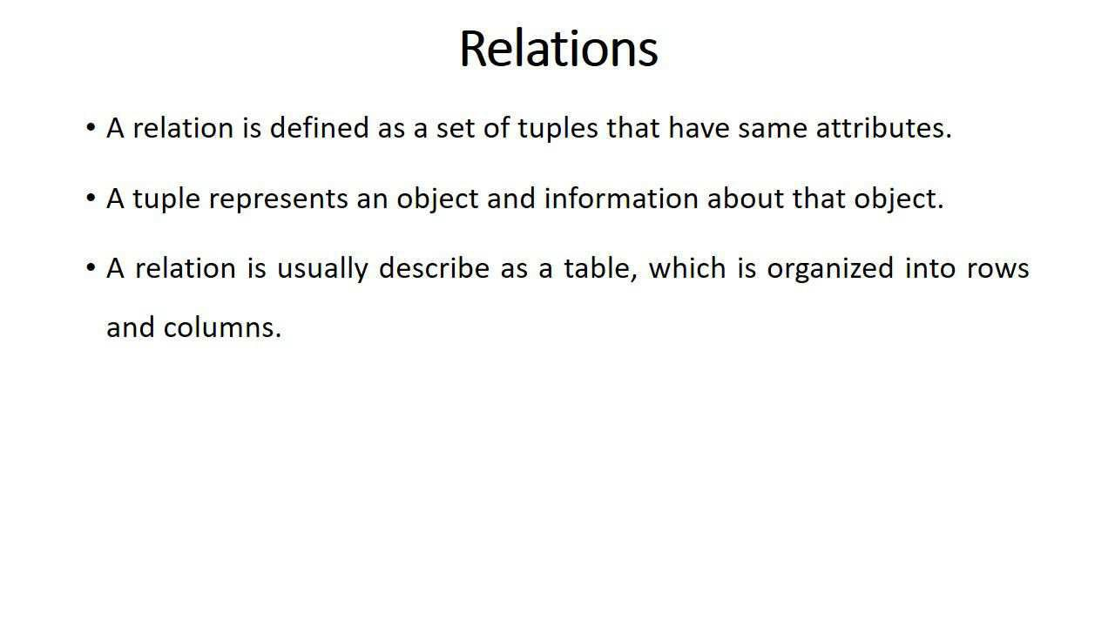
DBMS(KCS-501) Himanshu Srivastava

