Slide 1

Database Management System (KCS-501)
B.Tech- Computer Science & Engineering
Year/Semester- 3rd /5th
Session- 2020-21
Unit-2 [PPT-2/10]
Himanshu Srivastava
Department of Computer Science & Engineering
United College of Engineering & Management
DBMS(KCS 501) Himanshu Srivastava

Slide 2
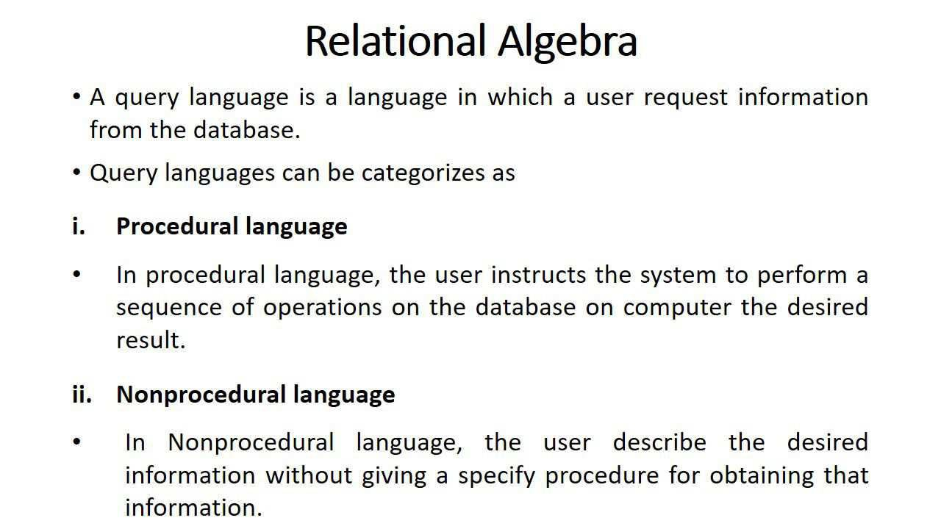
DBMS(KCS 501) Himanshu Srivastava

Slide 3
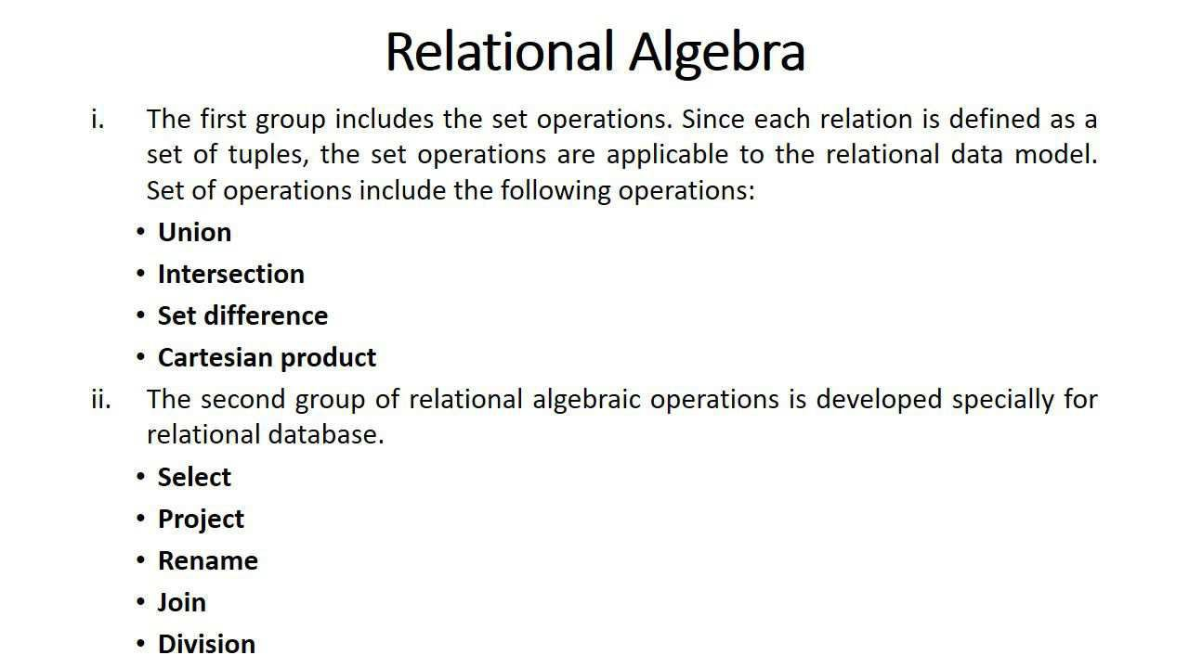
DBMS(KCS 501) Himanshu Srivastava

Slide 4
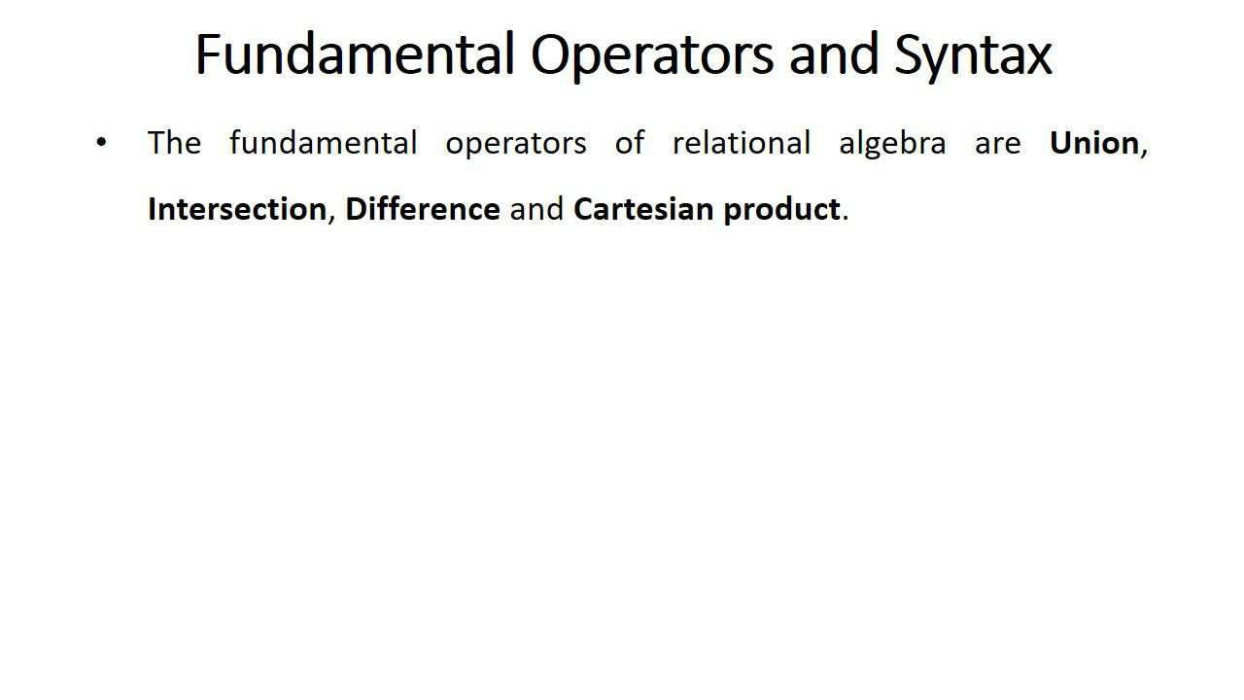
DBMS(KCS 501) Himanshu Srivastava

Slide 5
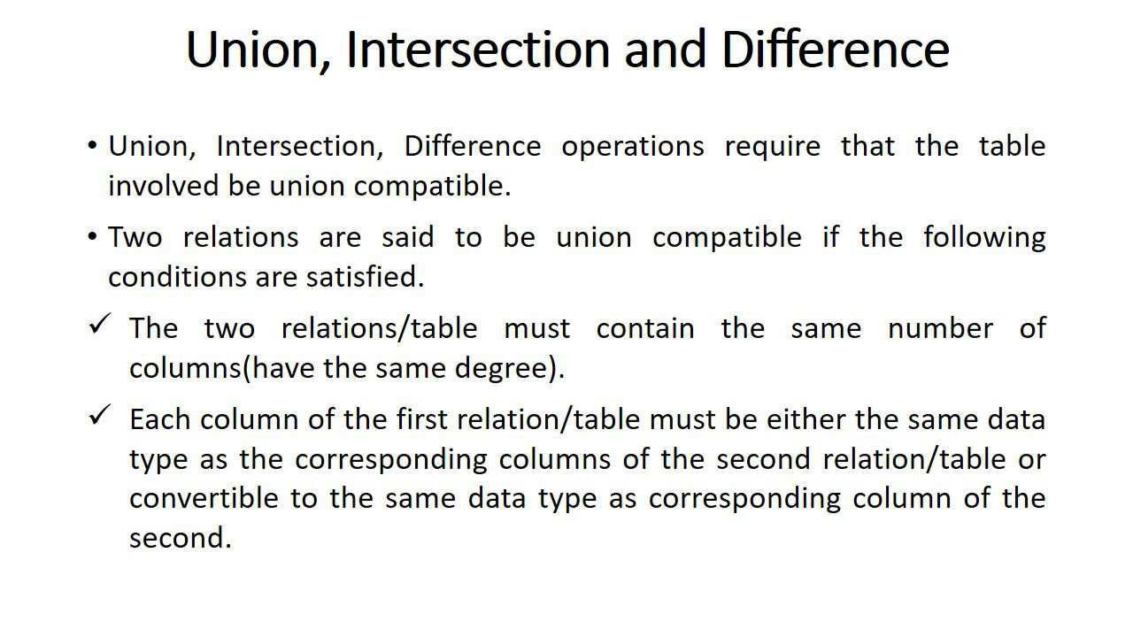
DBMS(KCS 501) Himanshu Srivastava

Slide 6
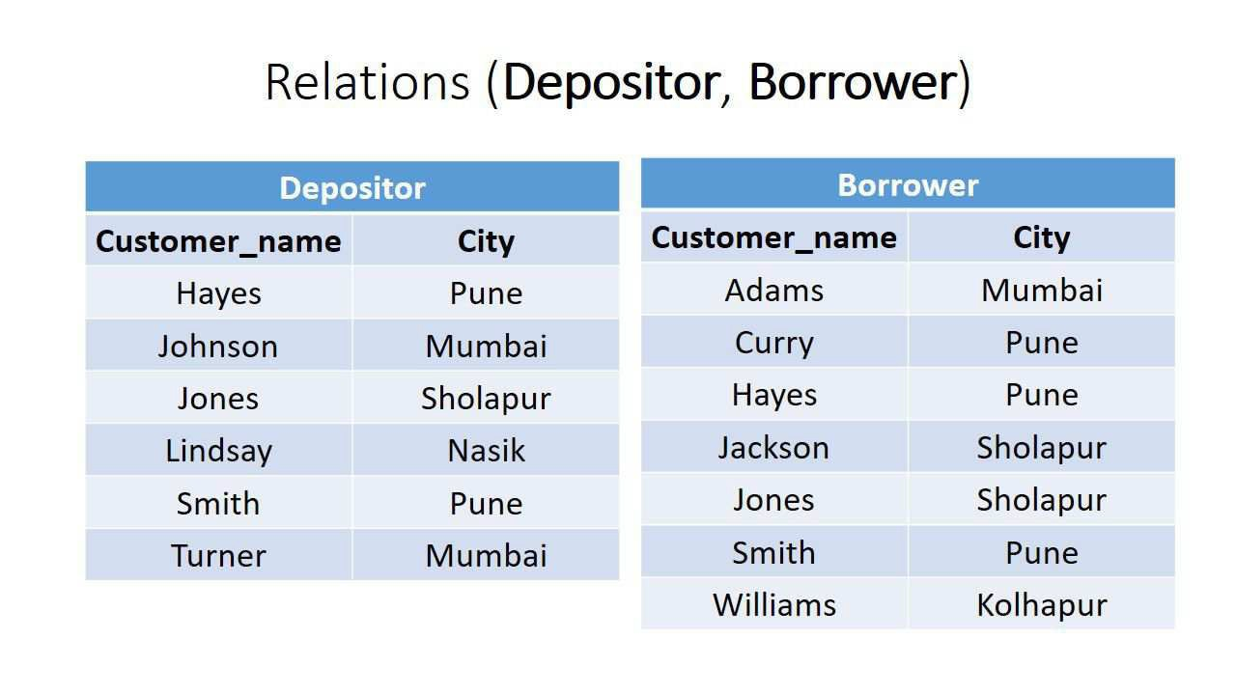
DBMS(KCS 501) Himanshu Srivastava

Slide 7
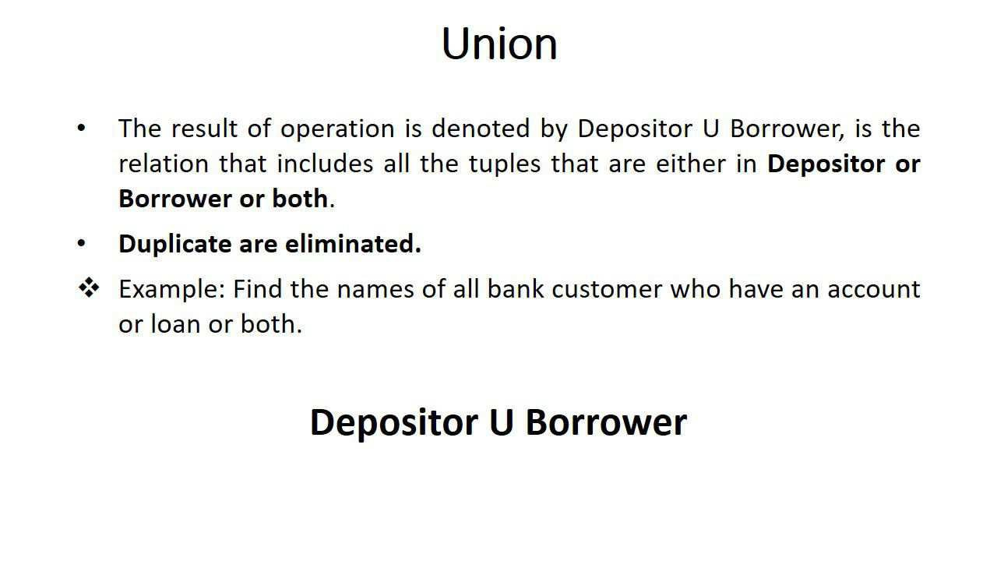
DBMS(KCS 501) Himanshu Srivastava

Slide 8
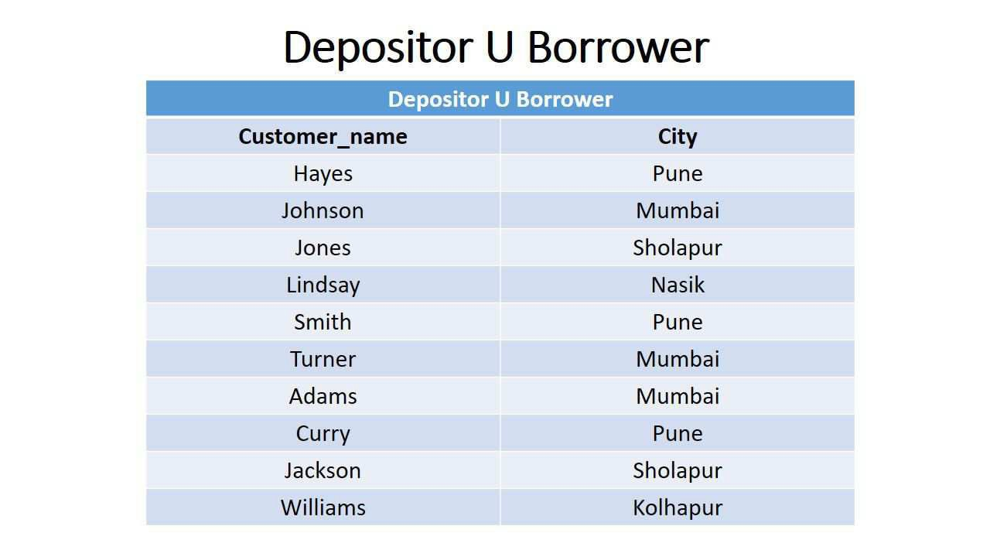
DBMS(KCS 501) Himanshu Srivastava

Slide 9
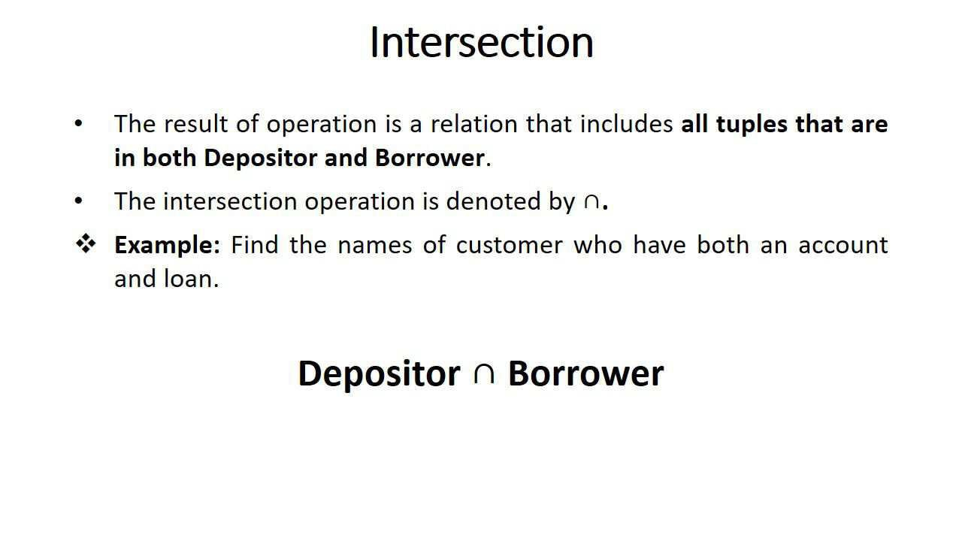
DBMS(KCS 501) Himanshu Srivastava

Slide 10
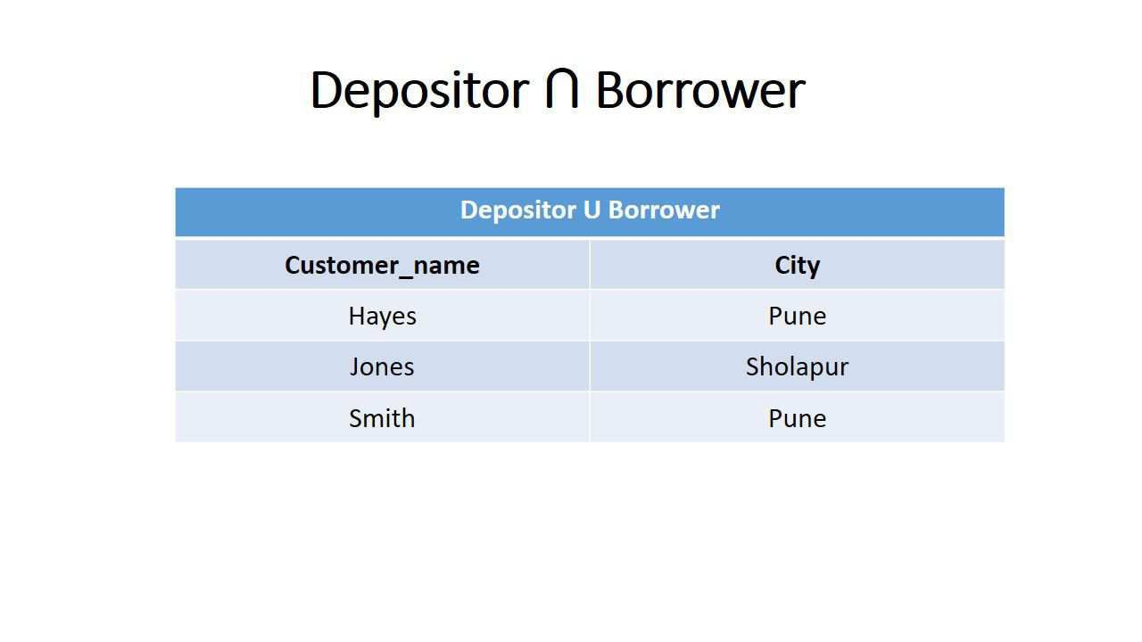
DBMS(KCS 501) Himanshu Srivastava

Slide 11
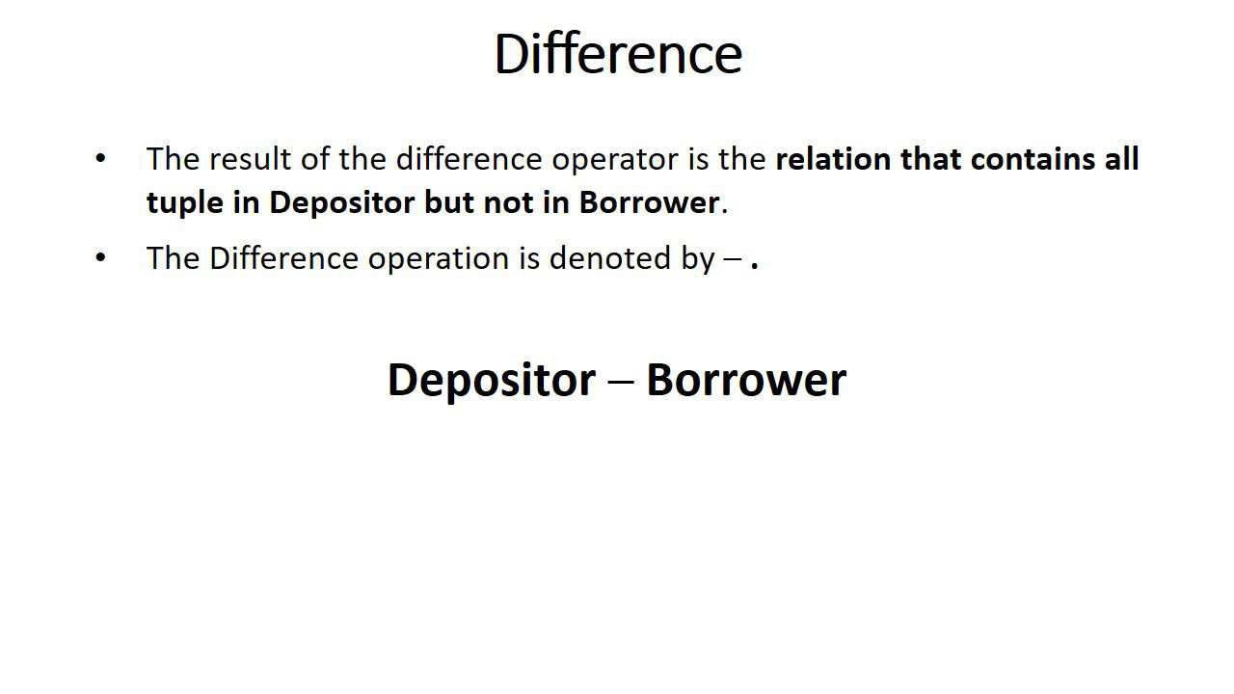
DBMS(KCS 501) Himanshu Srivastava

Slide 12
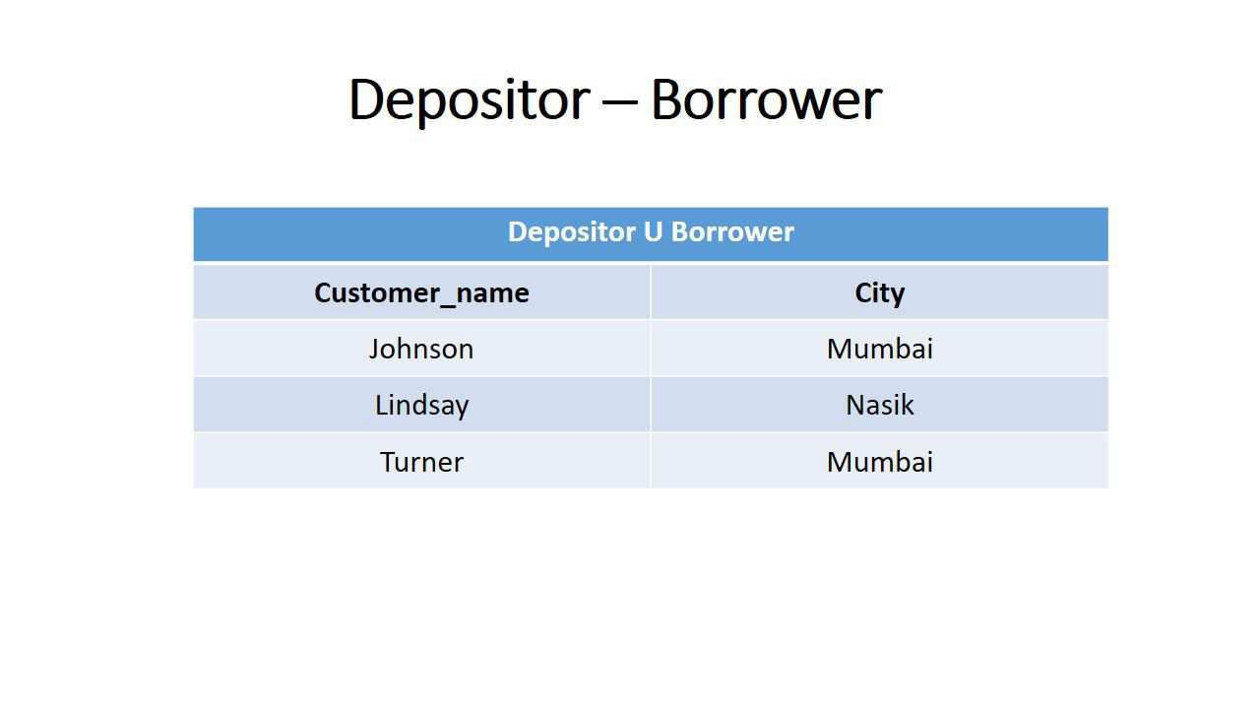
DBMS(KCS 501) Himanshu Srivastava

Slide 13
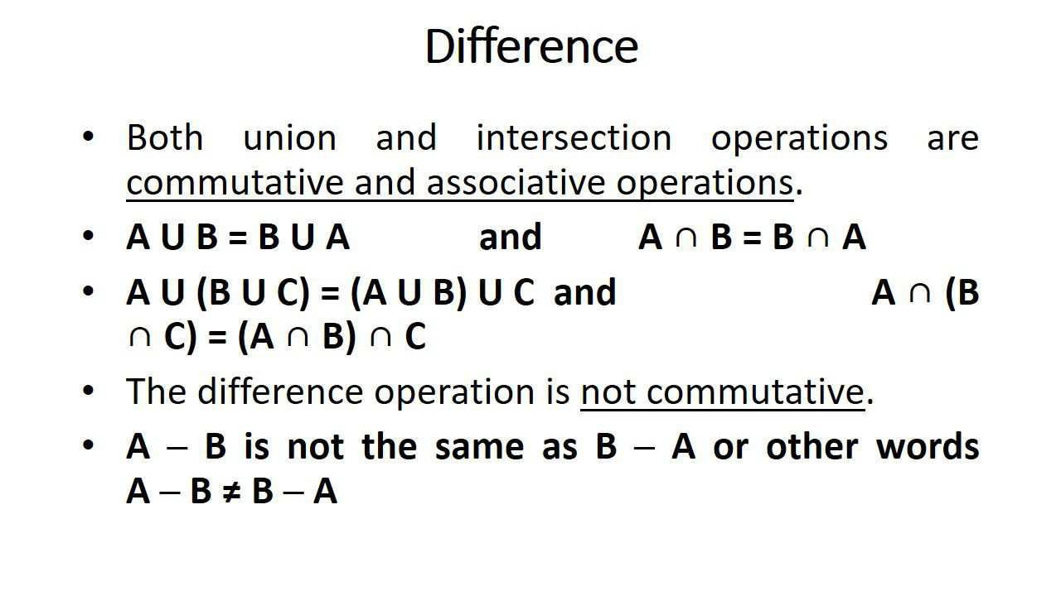
DBMS(KCS 501) Himanshu Srivastava

Slide 14
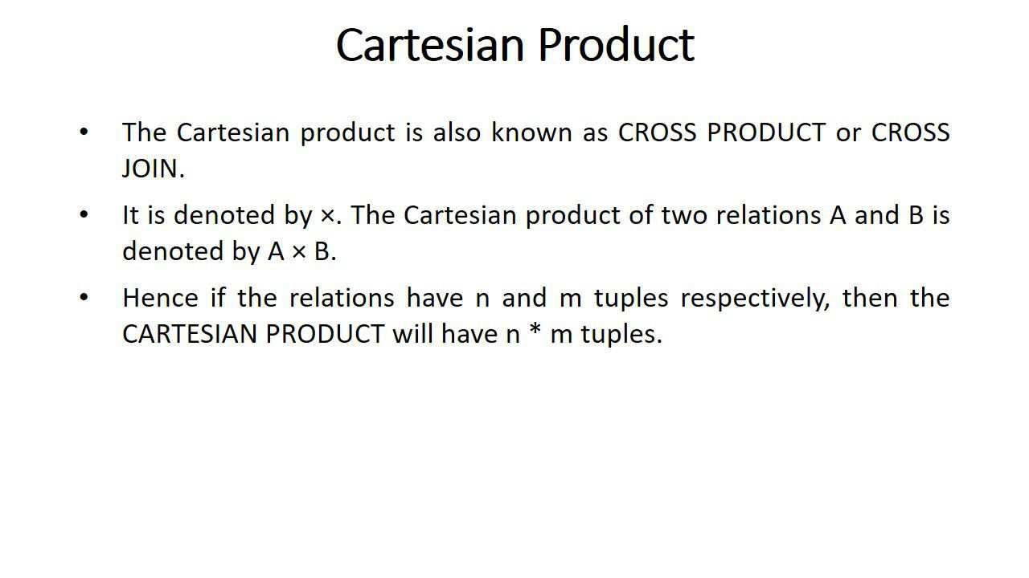
DBMS(KCS 501) Himanshu Srivastava

Slide 15
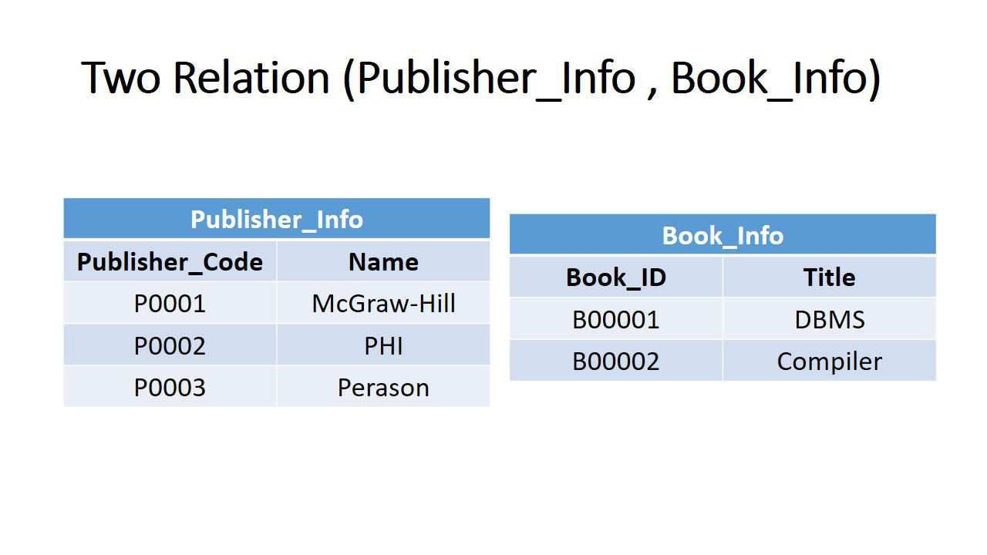
DBMS(KCS 501) Himanshu Srivastava

Slide 16
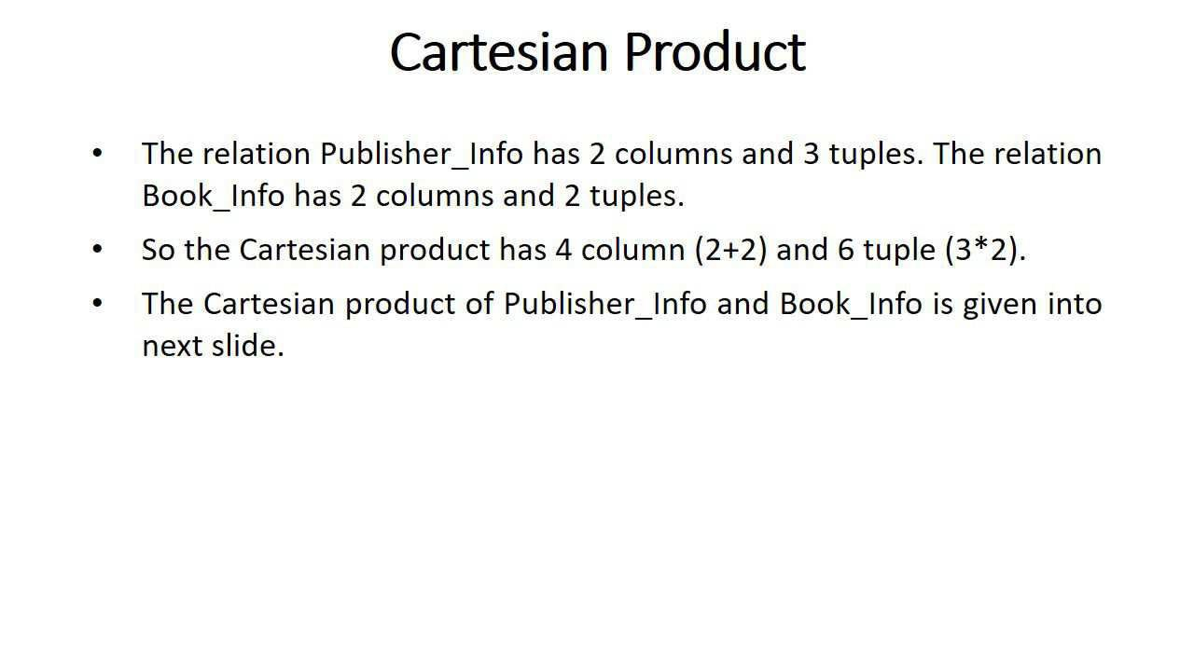
DBMS(KCS 501) Himanshu Srivastava

Slide 17
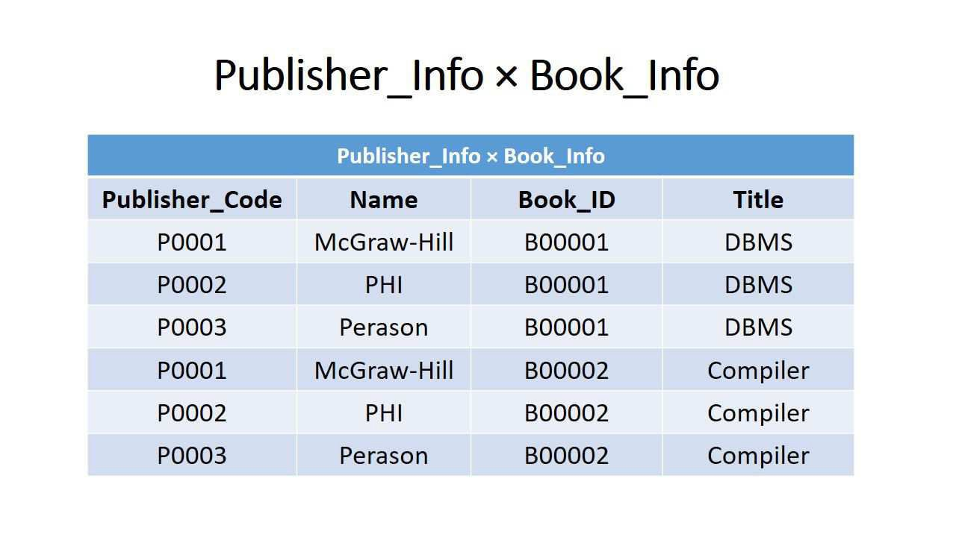
DBMS(KCS 501) Himanshu Srivastava

