Slide 1
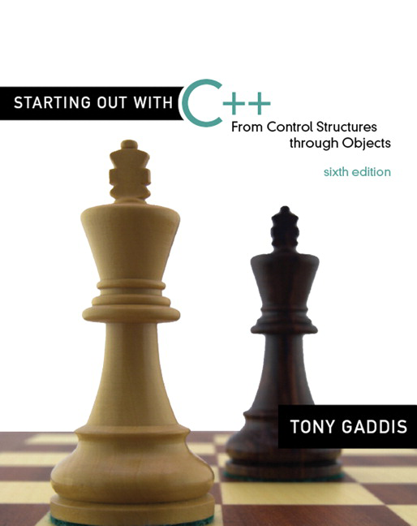

Chapter 2:
Introduction to C++
Copyright © 2009 Pearson Education, Inc. Publishing as Pearson Addison-Wesley
2-<number>

Slide 2
2.1
Parts of a C++ Program

Slide 3
Parts of a C++ Program
comment
// sample C++ program
#include <iostream>
using namespace std;
int main()
{
cout << "Hello, there!";
return 0;
}
preprocessor
directive
which namespace
to use
beginning of
function named main
beginning of
block for main
output
statement
string
literal
end of block
for main
send 0 to
operating system
2-<number>

Slide 4
Special Characters
Character | Name | Meaning
// | Double slash | Beginning of a comment
# | Pound sign | Beginning of preprocessor directive
< > | Open/close brackets | Enclose filename in #include
( ) | Open/close parentheses | Used when naming a function
{ } | Open/close brace | Encloses a group of statements
" " | Open/close quotation marks | Encloses string of characters
; | Semicolon | End of a programming statement
2-<number>

Slide 5
2.2
The cout Object

Slide 6
The cout Object
Displays output on the computer screen
You use the stream insertion operator << to send output to cout:
  cout << "Programming is fun!";
2-<number>

Slide 7
The cout Object
Can be used to send more than one item to cout:
  cout << "Hello " << "there!";
  Or:
  cout << "Hello ";
  cout << "there!";
2-<number>

Slide 8
The cout Object
This produces one line of output:
cout << "Programming is ";
cout << "fun!";
2-<number>

Slide 9
The endl Manipulator
You can use the endl manipulator to start a new line of output. This will produce two lines of output:
cout << "Programming is" << endl;
cout << "fun!";
2-<number>

Slide 10

The endl Manipulator
cout << "Programming is" << endl;
cout << "fun!";
Programming is
fun!
2-<number>

Slide 11
The endl Manipulator
You do NOT put quotation marks around endl
The last character in endl is a lowercase L, not the number 1.
endl
This is a lowercase L
2-<number>

Slide 12
The \n Escape Sequence
You can also use the \n escape sequence to start a new line of output. This will produce two lines of output:
cout << "Programming is\n";
cout << "fun!";
Notice that the \n is INSIDE the string.
2-<number>

Slide 13
The \n Escape Sequence
cout << "Programming is\n";
cout << "fun!";
Programming is
fun!
2-<number>

Slide 14
2.3
The #include Directive

Slide 15
The #include Directive
Inserts the contents of another file into the program
This is a preprocessor directive, not part of C++ language
#include lines not seen by compiler
Do not place a semicolon at end of #include line
2-<number>

Slide 16
2.4
Variables and Literals

Slide 17
Variables and Literals
Variable: a storage location in memory
  Has a name and a type of data it can hold
  Must be defined before it can be used:
  int item;
2-<number>

Slide 18
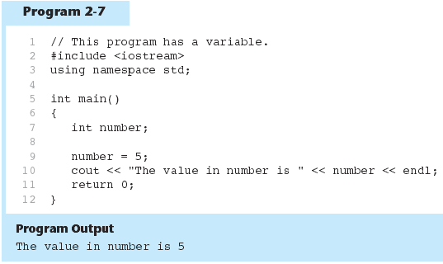
Variable Definition
2-<number>

Slide 19
Literals
Literal: a value that is written into a program’s code.
"hello, there" (string literal)
12 (integer literal)
2-<number>

Slide 20
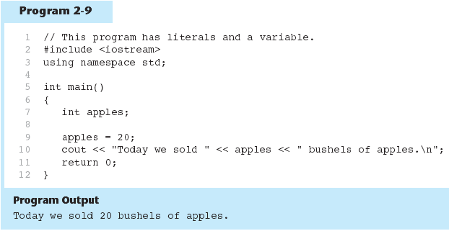
20 is an integer literal
2-<number>

Slide 21
This is a string literal
2-<number>

Slide 22
This is also a string literal
2-<number>

Slide 23
2.5
Identifiers

Slide 24
Identifiers
An identifier is a programmer-defined name for some part of a program: variables, functions, etc.
2-<number>

Slide 25
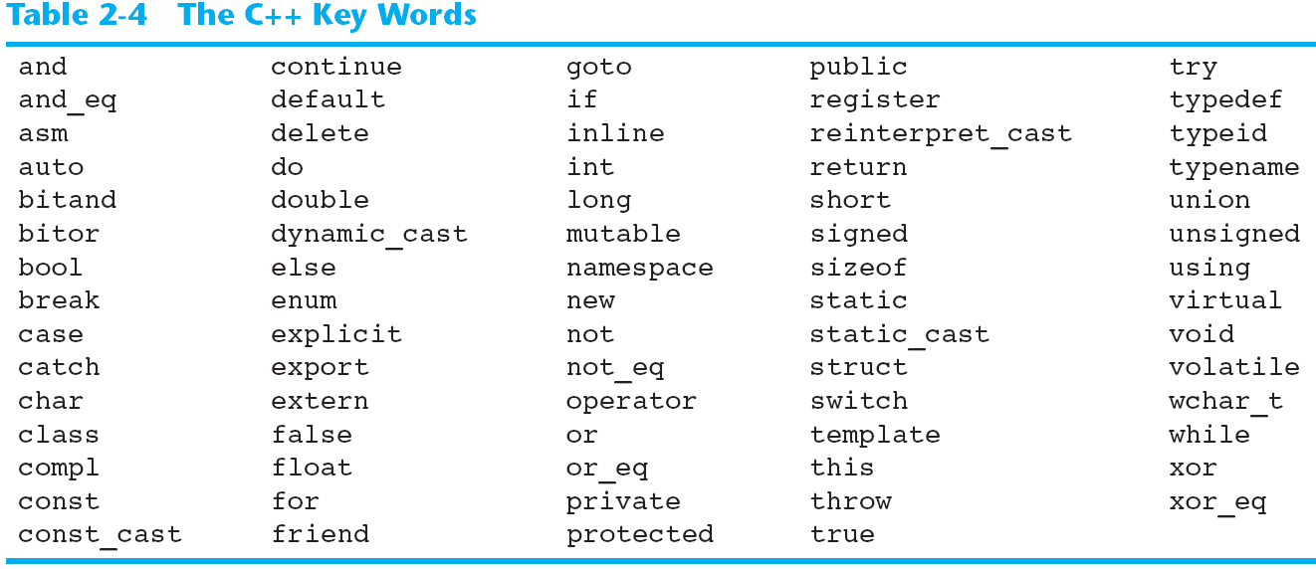
C++ Key Words
You cannot use any of the C++ key words as an identifier. These words have reserved meaning.
2-<number>

Slide 26
Variable Names
A variable name should represent the purpose of the variable. For example:
itemsOrdered
The purpose of this variable is to hold the number of items ordered.
2-<number>

Slide 27
Identifier Rules
The first character of an identifier must be an alphabetic character or and underscore ( _ ),
After the first character you may use alphabetic characters, numbers, or underscore characters.
Upper- and lowercase characters are distinct
2-<number>

Slide 28
Valid and Invalid Identifiers
IDENTIFIER | VALID? | REASON IF INVALID
totalSales | Yes
total_Sales | Yes
total.Sales | No | Cannot contain .
4thQtrSales | No | Cannot begin with digit
totalSale$ | No | Cannot contain $
2-<number>

Slide 29
2.6
Integer Data Types

Slide 30
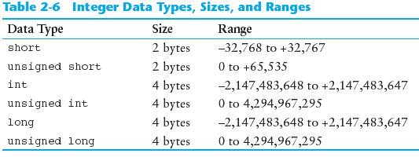
Integer Data Types
Integer variables can hold whole numbers such as 12, 7, and -99.
2-<number>

Slide 31
Defining Variables
Variables of the same type can be defined
  - On separate lines:
  int length;
  int width;
  unsigned int area;
  - On the same line:
  int length, width;
  unsigned int area;
Variables of different types must be in different definitions
2-<number>

Slide 32
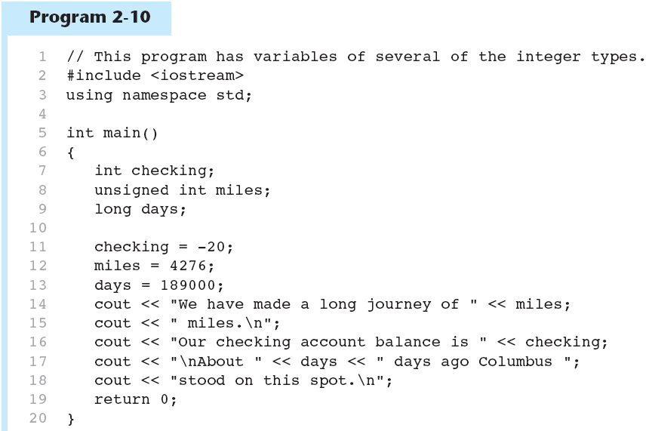
This program has three variables: checking, miles, and days
2-<number>

Slide 33
Integer Literals
An integer literal is an integer value that is typed into a program’s code. For example:
itemsOrdered = 15;
In this code, 15 is an integer literal.
2-<number>

Slide 34
Integer Literals
2-<number>

Slide 35
Integer Literals
Integer literals are stored in memory as ints by default
To store an integer constant in a long memory location, put ‘L’ at the end of the number: 1234L
Constants that begin with ‘0’ (zero) are base 8: 075
Constants that begin with ‘0x’ are base 16: 0x75A
2-<number>

Slide 36
2.7
The char Data Type

Slide 37
The char Data Type
Used to hold characters or very small integer values
Usually 1 byte of memory
Numeric value of character from the character set is stored in memory:
CODE:
char letter;
letter = 'C';
MEMORY:
letter
67
2-<number>

Slide 38
Character Literals
Character literals must be enclosed in single quote marks. Example:
'A'
2-<number>

Slide 39
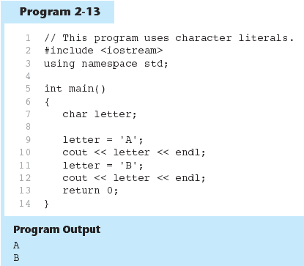
2-<number>

Slide 40
Character Strings
A series of characters in consecutive memory locations:
  "Hello"
Stored with the null terminator, \0, at the end:
Comprised of the characters between the " "
H | e | l | l | o | \0
2-<number>

Slide 41
2.8
Floating-Point Data Types

Slide 42
Floating-Point Data Types
The floating-point data types are:
float
double
long double
They can hold real numbers such as:
  12.45 -3.8
Stored in a form similar to scientific notation
All floating-point numbers are signed
2-<number>

Slide 43
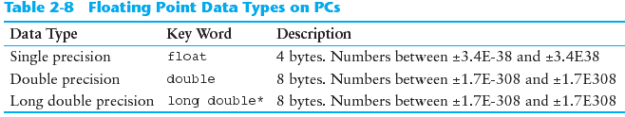
Floating-Point Data Types
2-<number>

Slide 44
Floating-point Literals
Can be represented in
  Fixed point (decimal) notation:
  31.4159 0.0000625
  E notation:
  3.14159E1 6.25e-5
Are double by default
Can be forced to be float (3.14159f) or long double (0.0000625L)
2-<number>

Slide 45
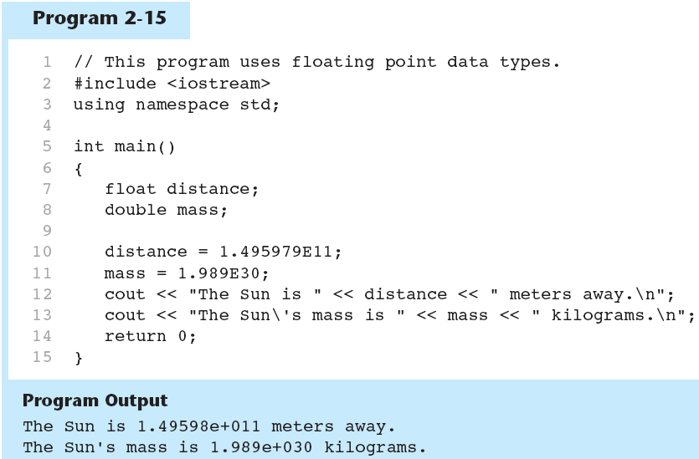
2-<number>

Slide 46
2.9
The bool Data Type

Slide 47
The bool Data Type
Represents values that are true or false
bool variables are stored as small integers
false is represented by 0, true by 1:
  bool allDone = true;
  bool finished = false;
allDone
finished
1
0
2-<number>

Slide 48
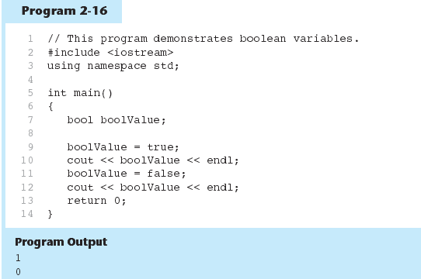
2-<number>

Slide 49
2.10
Determining the Size of a Data Type

Slide 50
Determining the Size of a Data Type
The sizeof operator gives the size of any data type or variable:
double amount;
cout << "A double is stored in "
<< sizeof(double) << "bytes\n";
cout << "Variable amount is stored in "
<< sizeof(amount)
<< "bytes\n";
2-<number>

Slide 51
2.11
Variable Assignments and Initialization

Slide 52
Variable Assignments and Initialization
An assignment statement uses the = operator to store a value in a variable.
item = 12;
This statement assigns the value 12 to the item variable.
2-<number>

Slide 53
Assignment
The variable receiving the value must appear on the left side of the = operator.
This will NOT work:
// ERROR!
12 = item;
2-<number>

Slide 54
Variable Initialization
To initialize a variable means to assign it a value when it is defined:
  int length = 12;
Can initialize some or all variables:
  int length = 12, width = 5, area;
2-<number>

Slide 55
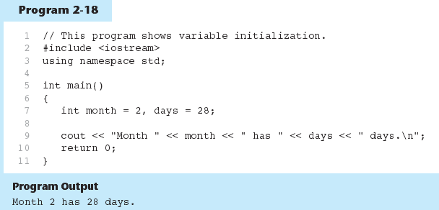
2-<number>

Slide 56
2.12
Scope

Slide 57
Scope
The scope of a variable: the part of the program in which the variable can be accessed
A variable cannot be used before it is defined
2-<number>

Slide 58
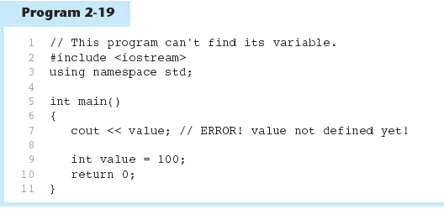
2-<number>

Slide 59
2.13
Arithmetic Operators

Slide 60
Arithmetic Operators
Used for performing numeric calculations
C++ has unary, binary, and ternary operators:
  unary (1 operand) -5
  binary (2 operands) 13 - 7
  ternary (3 operands) exp1 ? exp2 : exp3
2-<number>

Slide 61
Binary Arithmetic Operators
SYMBOL | OPERATION | EXAMPLE | VALUE OF ans
+ | addition | ans = 7 + 3; | 10
- | subtraction | ans = 7 - 3; | 4
* | multiplication | ans = 7 * 3; | 21
/ | division | ans = 7 / 3; | 2
% | modulus | ans = 7 % 3; | 1
2-<number>

Slide 62
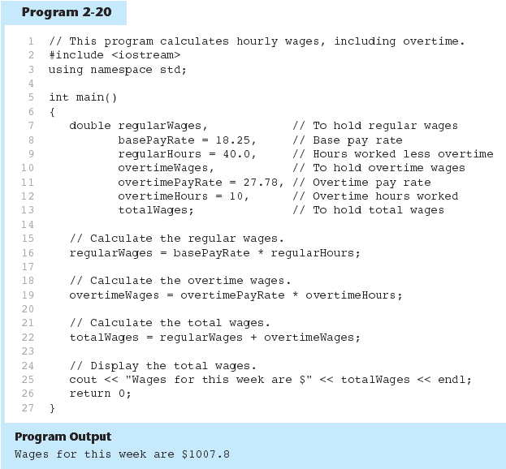
2-<number>

Slide 63
A Closer Look at the / Operator
/ (division) operator performs integer division if both operands are integers
  cout << 13 / 5; // displays 2
  cout << 91 / 7; // displays 13
If either operand is floating point, the result is floating point
  cout << 13 / 5.0; // displays 2.6
  cout << 91.0 / 7; // displays 13.0
2-<number>

Slide 64
A Closer Look at the % Operator
% (modulus) operator computes the remainder resulting from integer division
  cout << 13 % 5; // displays 3
% requires integers for both operands
  cout << 13 % 5.0; // error
2-<number>

Slide 65
2.14
Comments

Slide 66
Comments
Used to document parts of the program
Intended for persons reading the source code of the program:
  Indicate the purpose of the program
  Describe the use of variables
  Explain complex sections of code
Are ignored by the compiler
2-<number>

Slide 67
Single-Line Comments
Begin with // through to the end of line:
  int length = 12; // length in inches
  int width = 15; // width in inches
  int area; // calculated area
  // calculate rectangle area
  area = length * width;
2-<number>

Slide 68
Multi-Line Comments
Begin with /*, end with */
Can span multiple lines:
  /* this is a multi-line
  comment
  */
Can begin and end on the same line:
  int area; /* calculated area */
2-<number>

Slide 69
2.15
Programming Style

Slide 70
Programming Style
The visual organization of the source code
Includes the use of spaces, tabs, and blank lines
Does not affect the syntax of the program
Affects the readability of the source code
2-<number>

Slide 71
Programming Style
Common elements to improve readability:
Braces { } aligned vertically
Indentation of statements within a set of braces
Blank lines between declaration and other statements
Long statements wrapped over multiple lines with aligned operators
2-<number>

Slide 72
2.16
Standard and Prestandard C++

Slide 73
Standard and Prestandard C++
Older-style C++ programs:
  Use .h at end of header files:
  #include <iostream.h>
  Do not use using namespace convention
  May not compile with a standard C++ compiler
2-<number>

