Slide 1
Notes:
Entered text
1. Extra Trees Classifier:
An ensemble method using multiple decision trees for improved accuracy.
Feature importance scores are visualized to understand the significance of each feature.
2. Data Preprocessing:
Numerical features are normalized using StandardScaler.
Categorical features are one-hot encoded.
Preprocessed data is split into training and testing sets.
3. Model Training and Evaluation:
Three models are trained and evaluated:
Support Vector Classifier (SVC) with linear kernel
SVC with polynomial kernel
K-Nearest Neighbors (KNN)
Performance metrics like accuracy, precision, recall, F1-score, and classification report are used for evaluation.
4. KNN's Potential Advantages:
KNN might perform better due to:
Clear separation between normal and abnormal classes in the data.
Less susceptibility to the "curse of dimensionality" in high-dimensional datasets.
5. Conclusion:
The code demonstrates training and evaluating different models for intrusion detection. KNN achieved the highest accuracy, potentially due to the data characteristics and its handling of high dimensionality.

Slide 2
Intrusion Detection
A presentation on training and evaluating different models for intrusion detection
DONE BY:
Shilpee Maitra - 2348557
Department of Computer Sciences
Christ University, Bangalore

Slide 3
Data Preprocessing
Preprocessed data is split into training and testing sets.
Numerical features are normalized using StandardScaler.
Categorical features are one-hot encoded.

Slide 4
Extra Trees Classifier
An ensemble method using multiple decision trees for improved accuracy.
Feature importance scores are visualized to understand the significance of each feature.

Slide 5
Model Training and Evaluation
Three models are trained and evaluated:
Support Vector Classifier (SVC) with linear kernel
SVC with polynomial kernel
KNearest Neighbors (KNN)
Performance metrics like accuracy, precision, recall, F1score, and classification report are used for evaluation.

Slide 6
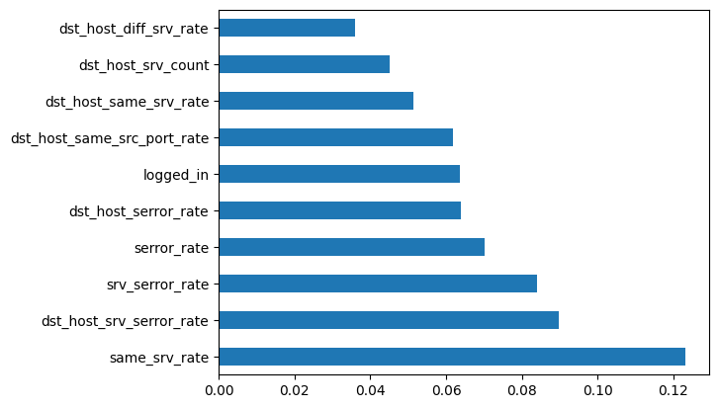
graph of feature importances for better visualization

Slide 7
KNN's Potential Advantages
KNN might perform better due to:
Less susceptibility to the "curse of dimensionality" in high-dimensional datasets.
Clear separation between normal and abnormal classes in the data.

Slide 8
Inference
KNN achieved the highest accuracy due to:
Clear separation between normal and abnormal classes.
Less susceptibility to the "curse of dimensionality."

Slide 9
Thank you for your time and attention 🙂

