Slide 1

Sprocket Central Pty Ltd
Data analytics approach
Shilpi Ghosal

Slide 2
Agenda
Introduction
Data Exploration
Model Development
Interpretation

Slide 3
Introduction
This presentation highlights the insights about the data provided by Sprocket Central Pty Ltd. The target is to predict data for more bicycle sale in the market.

Slide 4
Data Exploration Customer Analysis
Gender versus Past 3 years bike purchases
Age versus Past 3 years bike purchases
Wealth segments versus Past 3 years bike purchases
Job industry category versus Past 3 years bike purchases
Number of cars own on each states.

Slide 5
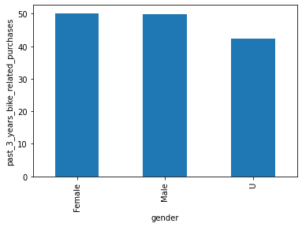
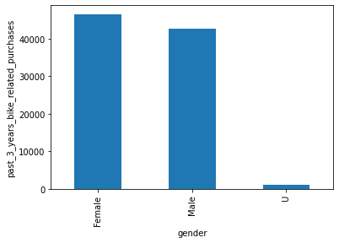
Model Development
Graph of Gender VS past 3 years purchases of bikes.
Old
New
It is evident that females have purchased more bikes than men. The old data shows quite high amount of purchases by the U( unknown category) but the new data shows that unknown have purchased very few bikes.

Slide 6
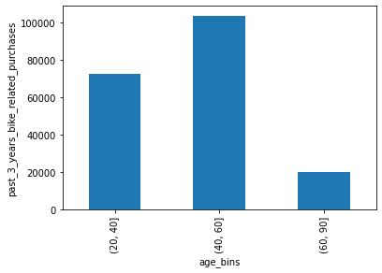
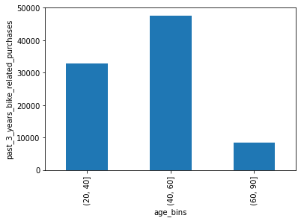
Age VS past 3 years bike purchase
Old New
From this graph , it is seen that people of the age between 40-60 have purchased more bikes followed by age group between 20-40.

Slide 7
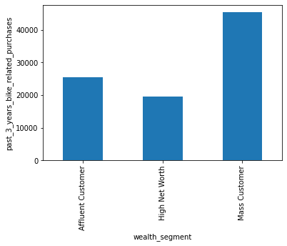
Wealth Segment VS past 3 years bike purchase
Here, Mass customer have purchased maximum number of bikes. Followed by Affluent Customer and High Net Worth

Slide 8
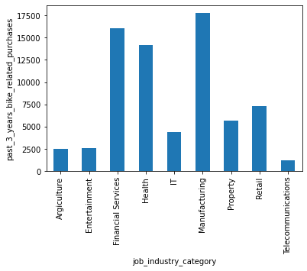
Job industry category VS Past 3 years bike purchase
Here, Manufacturing unit followed by Financial services and health have most of the purchases.

Slide 9
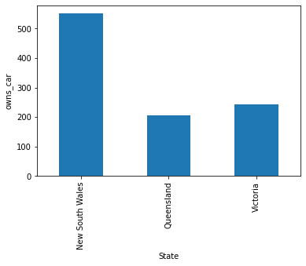
State Vs Owns car
It is evident that people of New south wales have maximum cars. Victoria is in second and least number of cars are owned by Queensland.

Slide 10
Interpretation
By the analysis of the data ,the following can be interpreted that our target customers are:
Females
Age group between 40-60
Wealth segment=‘Mass Customer’
Job Industry=‘Manufacturing’ and ‘Financial services’
State=‘New South Wales’

