Slide 1

FAKE NEWS DETECTION USING NATURAL LANGUAGE PROCESSING

Slide 2

What is Fake News?
A type of yellow journalism.
Designed to deliberately spread hoaxes, propaganda or misinformation.
Spread through traditional print and broadcast news media or online social media.
Often, fake news mimics real headlines and twist the story.

Slide 3
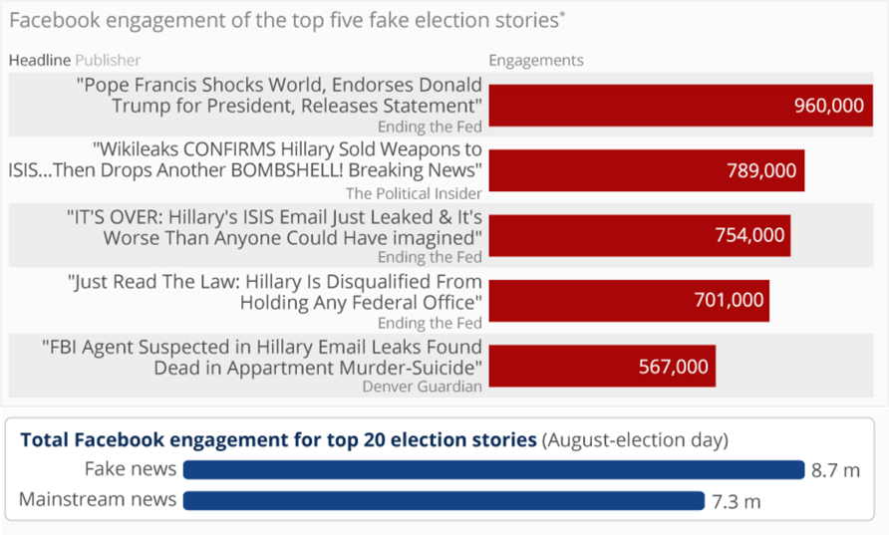
Fake News is a real problem!

Slide 4

Basic Categorization Fake News
Completely Fake News:
made up by the writers of the articles.
Fake Satire News:
main purpose is to provide humor to the readers.
Misleading or poorly written news articles:
have some degree of real news, but they are not entirely accurate. They promote certain agenda or biased opinion.

Slide 5
Related work
In “This Just In: Fake News Packs a Lot in Title, Uses Simpler,
Repetitive Content in Text Body, More Similar to Satire than Real
News”,
  It was observed that fake news titles have fewer stop-words and
  nouns. Different features like complexity, psychology and
  stylistic features were used to build a SVM classification model.
  When real news was compared against satire articles (humorous
  article), 91% accuracy was achieved.
  However, the accuracy dropped to 71% when predicting fake
  news against real news.

Slide 6
In “Automatic deception detection: Methods for finding fake news”,
  Aims to perfectly classify the misleading articles.
  It is proven that simple content-related n-grams and shallow parts-of-
  speech (POS) tagging are insufficient for the classification task, but
  can be useful only in tandem with more complex methods of analysis.
In “Fake News or Truth? Using Satirical Cues to Detect Potentially
Misleading News”,
  Aims to identify satire and humor news articles.
  An SVM classification model is proposed using mainly five features,
  Absurdity, Humor, Grammar, Negative Affect, and Punctuation.
  Highest precision of 90% was achieved using only three
  combinations of features, i.e. Absurdity, Grammar, and Punctuation.

Slide 7
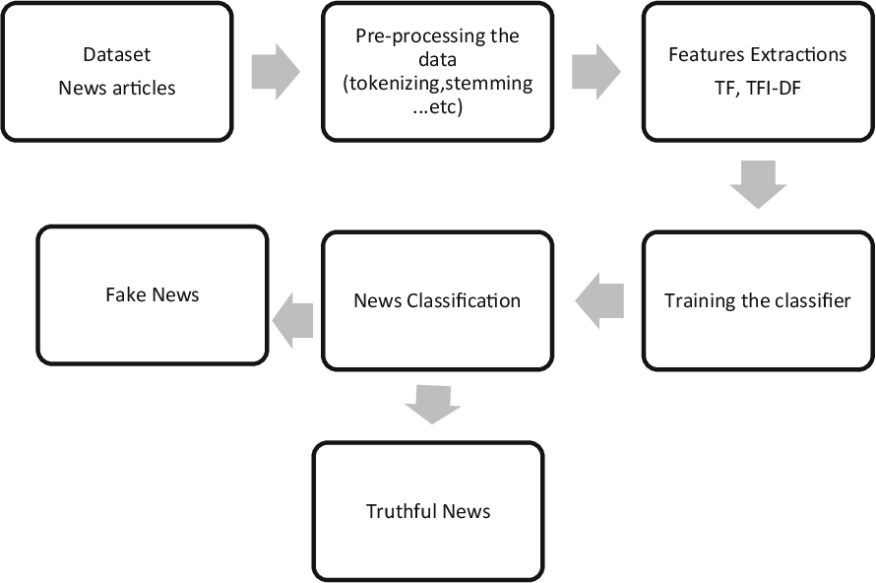
Proposed Work
Data pre-processing.
Feature extraction using Count vectorizer and TF-IDF vectorizer.
N-gram features-based approach
for text analysis.
Study and comparison of five
different text classification techniques,
  Multinomial NB
  Gradient Boosting
  Random Classifier
  Passive aggressive Classifier
  Multinomial Classifier with Hyperparameter(alpha=1).
Classification process

Slide 8
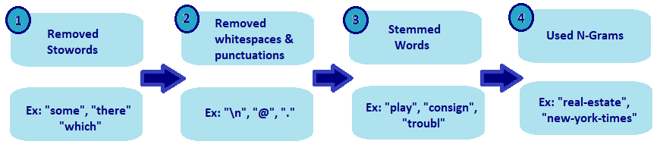
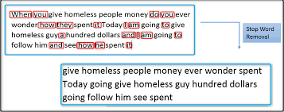
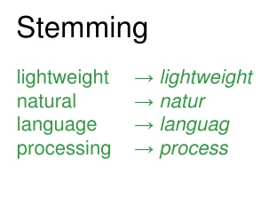
Text Data Pre-Processing
Stop Words Removal

Slide 9
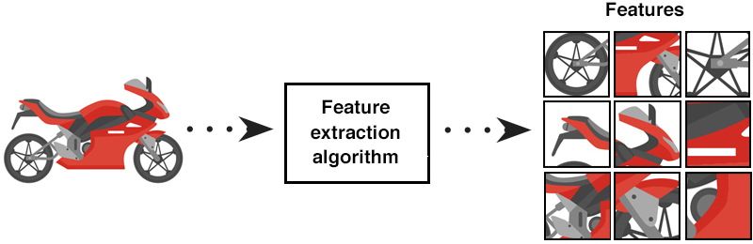
Feature Extraction
Inputs in machine learning algorithms, can only be in numbers.
Feature Extraction : Encoding words into feature vectors (integers, or
floating-point values).
Achieved using:
      Count Vectorizer : transform articles into token count matrix.
      TF-IDF Vectorizer: transform articles into token TF-IDF matrix.

Slide 10
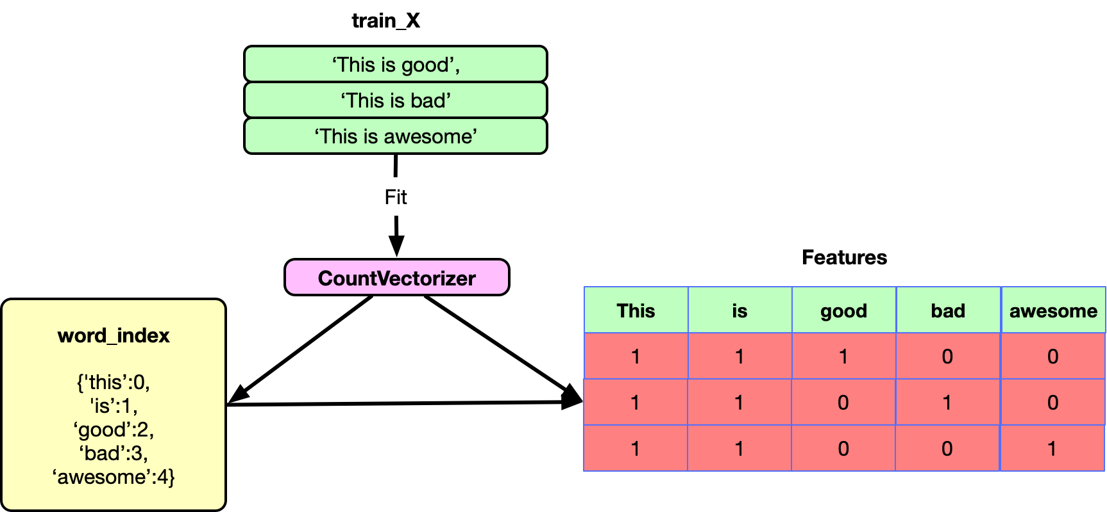
Count Vectorizer
Document matrix

Slide 11
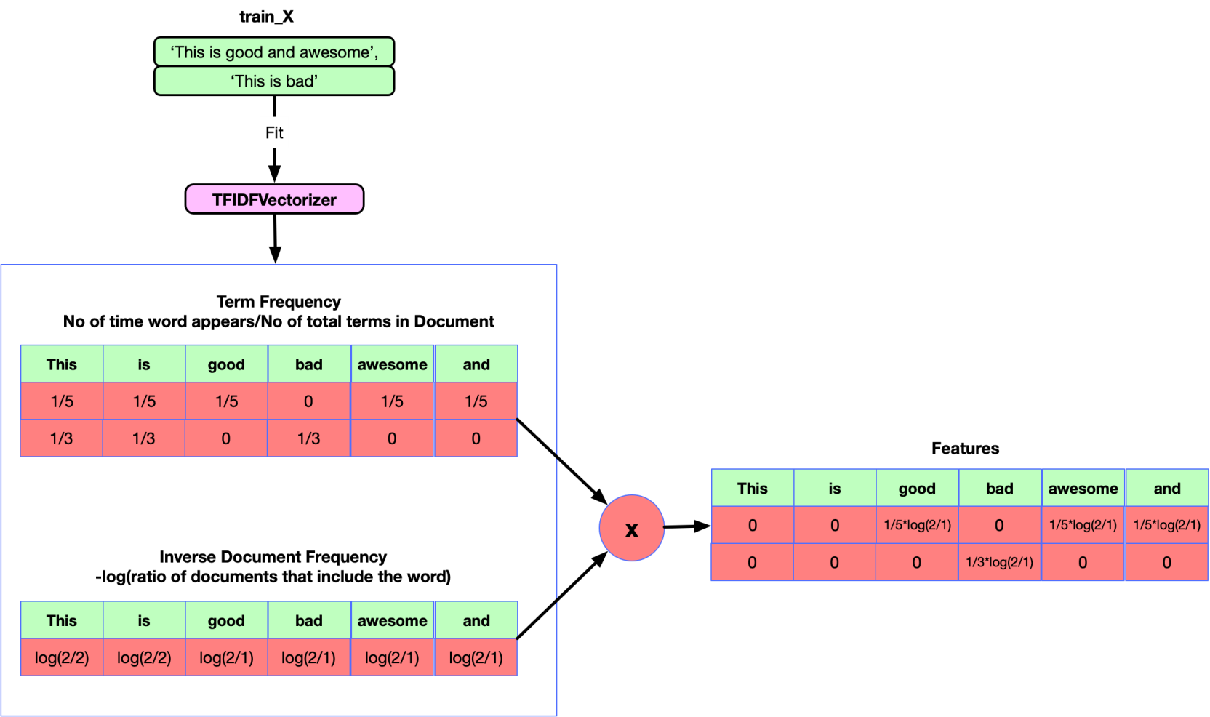
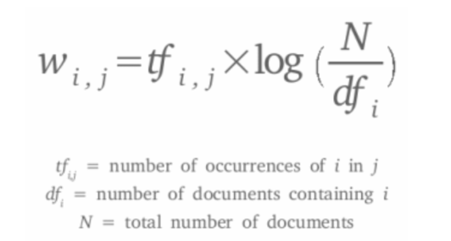
TF-IDF Vectorizer

Slide 12
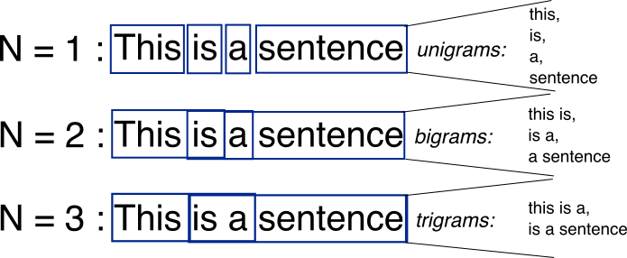
N-Gram Model
Popular feature identification and analysis approach.
N-gram is a contiguous sequence of words, bytes, syllables, or characters with length n.
The most used n-gram models in text categorization are word-based and character-based n-grams.

Slide 13
EXPERIMENTAL ANALYSIS
Goal: To predict whether the articles are real or fake.
The experiments started by studying the impact of the size (n) of
n-grams on the performance.
We started with unigram (n = 1), then bigram (n = 2), then
steadily increased n by one until reaching n = 4.
We also varied the number of features p (i.e., top features
selected), as 1,000 and 5,000.

Slide 14
Multinomial Naïve Bayes
Designed for text classification.
Can account for multiple occurrences of a word.
Treats common words differently from usual ones.
Suitable for classification with discrete features
and it requires integer values .

Slide 15
Observation table
N GRAM SIZE | TF-IDF |  | COUNT VECTORIZER
 | 1000 | 5000 | 1000 | 5000
Uni-Gram | 0.850 | 0.867 | 0.875 | 0.897
Bi-Gram | 0.665 | 0.746 | 0.665 | 0.745
Tri-Gram | 0.571 | 0.652 | 0.574 | 0.652
Four-Gram | 0.552 | 0.594 | 0.596 | 0.553

Slide 16
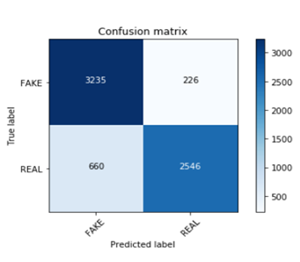
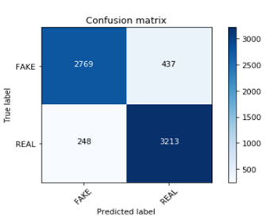
Using Count Vectorizer
Using TF-IDF Vectorizer

Slide 17
Gradient Boosting
Gradient boosting is used for regression and classification problems.
Relies on the intuition of best possible next model
When combined with previous models, minimizes the overall prediction error.
Key idea: Setting the target outcomes for this next model in order to minimize the error.

Slide 18
Observation table
N GRAM SIZE | TF-IDF |  | COUNT VECTORIZER
 | 1000 | 5000 | 1000 | 5000
Uni-Gram | 0.917 | 0.917 | 0.918 | 0.918
Bi-Gram | 0.813 | 0.813 | 0.813 | 0.815
Tri-Gram | 0.796 | 0.995 | 0.796 | 0.871
Four-Gram | 0.557 | 0.557 | 0.557 | 0.867

Slide 19
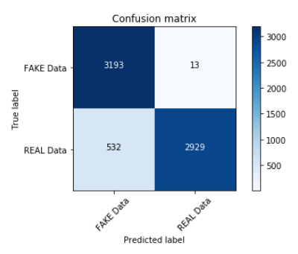
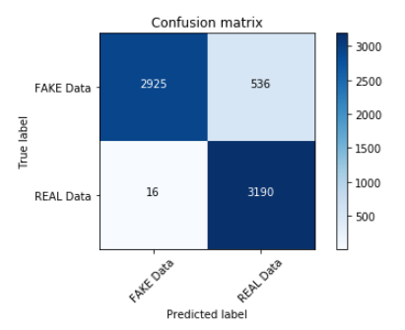
With Count Vectorizer
Using TF-IDF Vectorizer

Slide 20
Random Forest Classifier
Mainly used for classification problems.
Creates decision trees on data samples
Then gets prediction from each of them
Finally the best solution is selected by means of voting.
Ensemble method better than a single decision tree as it reduces the over-fitting by averaging the result.

Slide 21
Observation table
N GRAM SIZE | TF-IDF |  | COUNT VECTORIZER
 | 1000 | 5000 | 1000 | 5000
Uni-Gram | 0.926 | 0.935 | 0.925 | 0.934
Bi-Gram | 0.854 | 0.872 | 0.855 | 0.871
Tri-Gram | 0.803 | 0.816 | 0.803 | 0.816
Four-Gram | 0.644 | 0.691 | 0.644 | 0.691

Slide 22
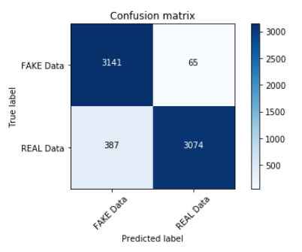
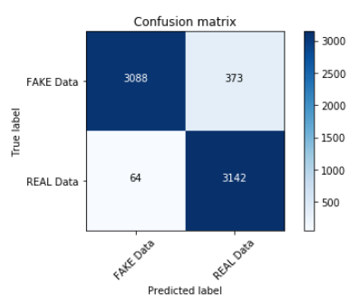
With Count Vectorizer
Using TF-IDF Vectorizer

Slide 23
Passive Aggressive Classifier
Passive-aggressive classification is one of the available incremental learning algorithms.
Simple to implement, since has a closed-form update rule.
Core concept: Classifier adjusts its weight vector for each misclassified training sample it receives, trying to correct it.

Slide 24
Observation table
N GRAM SIZE | TF-IDF |  | COUNT VECTORIZER
 | 1000 | 5000 | 1000 | 5000
Uni-Gram | 0.906 | 0.913 | 0.900 | 0.916
Bi-Gram | 0.850 | 0.872 | 0.851 | 0.867
Tri-Gram | 0.804 | 0.818 | 0.803 | 0.815
Four-Gram | 0.554 | 0.596 | 0.554 | 0.592

Slide 25
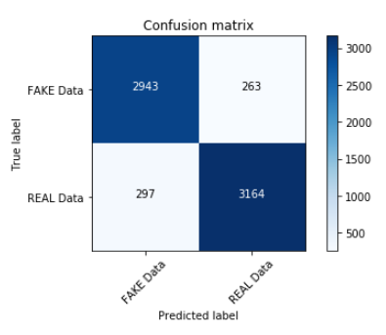
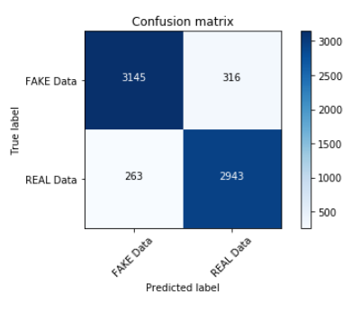
With Count Vectorizer
With TF-IDF Vectorizer

Slide 26
Multinomial Classifier with
hyperparameter (alpha = 0.1)
Estimates the conditional probability of a particular word, given a class as the relative frequency of term t in documents belonging to class(c).
The variation takes into account the number of occurrences of term t in training documents from class (c), including multiple occurrences.
the alpha parameter is what is known as a hyperparameter, i.e. a parameter that controls the form of the model itself.

Slide 27
Observation table
N GRAM SIZE | TF-IDF |  | COUNT VECTORIZER
 | 1000 | 5000 | 1000 | 5000
Uni-Gram | 0.850 | 0.886 | 0.874 | 0.897
Bi-Gram | 0.666 | 0.746 | 0.668 | 0.747
Tri-Gram | 0.572 | 0.651 | 0.575 | 0.652
Four-Gram | 0.522 | 0.594 | 0.552 | 0.596

Slide 28
Conclusion
We investigated two different features extraction techniques with
n-gram analysis and five different machine learning techniques.
The proposed model achieves its highest accuracy for Random Forest classifier when using unigram feature.
The highest accuracy score is 93.5% for 5000 feature values.
This classifier performs well no matter the number of feature values used.
Also, with the increase of n-gram (Tri-gram, Four-gram), the accuracy of the algorithm decreases.

Slide 29
THANK YOU!
Project presented by:
Shivam Ghosh
Shinja Ghosh
Shilpi Kundu
Satyam Seth

