Slide 1
Flight Price Prediction Project
Submitted by Shilpi Mohanty

Slide 2
Business Problem Framing
Flight ticket prices can be something hard to guess as they are very dynamic in nature, today we might see a price, check out the price of the same flight tomorrow, it will be a different story. Price fluctuates significantly even for nearby seats within the same cabin.We might have often heard travellers saying that flight ticket prices are so unpredictable.
Anyone who has booked a flight ticket knows how unexpectedly the prices vary. The cheapest available ticket on a given flight gets more and less expensive over time. This usually happens as an attempt to maximize revenue based on -
1.Time of purchase patterns (making sure last-minute purchases are expensive)
2.Keeping the flight as full as they want it (raising prices on a flight which is filling up in order to reduce sales and hold back inventory for those expensive last-minute expensive purchases) .So, therefor predictive model are required which can predict the prices accurately and help us to make an informed choices about flight fares with other features.

Slide 3
PHASE OF PROJECT
Data Collection Phase : We have to scrape at least 1500 rows of data. More the data better the model .We have to scrape the data of flights from different websites (yatra.com, skyscanner.com, official websites of airlines, etc). The number of columns for data doesn’t have limit, it’s up to you and your creativity. Generally, these columns are airline name, date of journey, source, destination, route, departure time, arrival time, duration, total stops and the target variable price. We can make changes to it, by adding or removing some columns, it completely depends on the website from which you are fetching the data.
Model Building Phase :After collecting the data, you need to build a machine learning model. Before model building do all data pre-processing steps. Try different models with different hyper parameters and select the best model. Follow the complete life cycle of data science. Include all the steps like. i) Data Cleaning ii) Exploratory Data Analysis iii)Data Pre-processing iv) Model Building v)Model Evaluation vi)Selecting the best mode

Slide 4
Conceptual Background of the Domain Problem
Travelling through flights has become an integral part of today’s lifestyle as more and more people are opting for faster travelling options. The flight ticket prices increase or decrease every now and then depending on various factors like timing of the flights, destination, duration of flights. various occasions such as vacations or festive season.
Therefore, having some basic idea of the flight fares before planning the trip will surely help many people save money and time. In the proposed system a predictive model will be created by applying machine learning algorithms to the collected historical data of flights. This system will give people the idea about the trends that prices follow and also provide a predicted price value which they can refer to before booking their flight tickets to save money. This kind of system or service can be provided to the customers by flight booking companies which will help the customers to book their tickets accordingly.

Slide 5
Review of Literature
From the customer point of view, determining the minimum price or the best time to buy a ticket is the key issue. The conception of “tickets bought in advance are cheaper” is no longer working (William Groves and Maria Gini, 2013). It is possible that customers who bought a ticket earlier pay more than those who bought the same ticket later. Moreover, early purchasing implies a risk of commitment to a specific schedule that may need to be changed usually for a fee. The ticket price may be affected by several factors thus may change continuously. To address this, various studies were conducted to support the customer in determining an optimal ticket purchase time and ticket price prediction (Anastasia Lantseva et al., 2015, Chawla and Kaur, 2017, Domínguez-Menchero, 2014; K. Tziridis et al., 2017, Li et al., 2014, Santana and Saulo, 2017, L. Li and K. Chu, 2017; T.Wohlfarth et al., 2011, Vu et al., 2018, Groves and Gini, 2013, William Groves and Maria Gini, 2015; Y. Chen et al., 2015, Xu and Cao, 2017).
On the airlines side, the main goal is increasing revenue and maximizing profit. According to Narangajavana et al., 2014, airlines utilize various kinds of pricing strategies to determine optimal ticket prices: long-term pricing policies, yield pricing which describes the impact of production conditions on ticket prices, and dynamic pricing which is mainly associated with dynamic adjustment of ticket prices in response to various influencing factors.

Slide 6
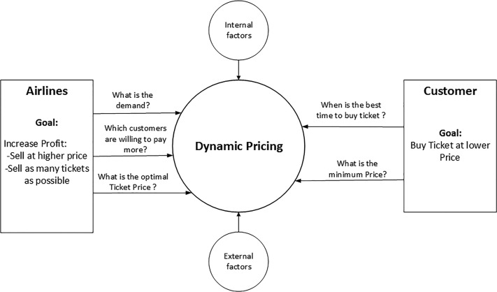
Review of Literature cont...
A diagram illustrating interactions between customers and airlines in determining dynamic pricing is given

Slide 7
Motivation for the Problem Undertaken
In the current day scenario flight companies try to manipulate the flight ticket prices to maximize their profits. There are many people who travel regularly through flights and so they have an idea about the best time to book cheap tickets. But there are also many people who are unaware and inexperienced in booking tickets and end up falling in discount traps made by the companies where actually they end up spending more than they should have.
As the price fluctuation are frequent and one has the limited time to book the tickets ,therefore it is necessary to come with a predictive model based on various features data that would predict the flight fares .
Thus, our main objective is to build a model for predicting the flight ticket using machine learning model by scraping data from websites that give information about online booking of flight tickets , and analysing the different aspects and factors that lead to the actual flight ticket price valuation. The sample data was taken from “easemytrip” website ,as there was some problem in other website and also denial error ,so I relied on this website for my dataset.

Slide 8
ANALYTICAL PROBLEM FRAMING MATHEMATICAL/ANALYTICAL MODELLING OF THE PROBLEM
Referring to the problem statement which aim is to predict the ticket price of the flight which will help the individual to make a informed choice taking into consideration of various features. Considering the above which clearly states that this case is of Regression Analysis Problem as we have to predict the price which is of continuous nature.
Regression Analysis: Regression analysis refers to assessing the relationship between the outcome variable and one or more variables. The outcome variable is known as the dependent or response variable and the risk elements, and co-founders are known as predictors or independent variables. The dependent variable is shown by “y” and independent variables are shown by “x” in regression analysis.
The most common form of regression analysis is linear regression, in which one finds the line (or a more complex linear combination) that most closely fits the data according to a specific mathematical criterion. For specific mathematical reasons this allows the researcher to estimate the conditional expectation of the dependent variable when the independent variables take on a given set of values.
Regression analysis is helpful statistical method that can be leveraged across an organization to determine the degree to which particular independent variables are influencing dependent variables. .

Slide 9
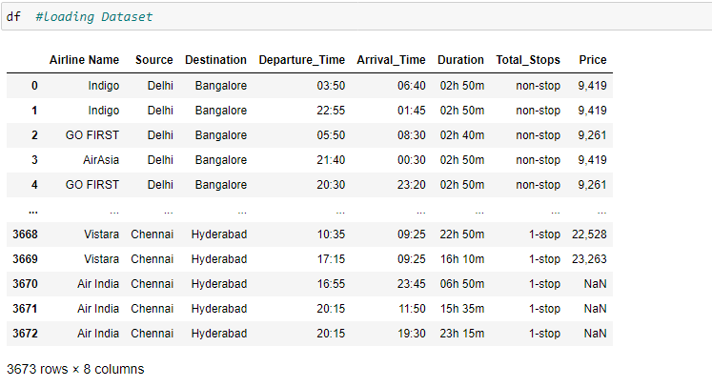
Data Sources and their formats
The dataset was scrapped from “easemytrip” website as there was some technical glith in other website and due to time constraint,I scrapped the whole data from this website.It was in the format of CSV (Comma Separated Values). The dimension of the dataset is 3673 rows and 8 columns including target variable “Price”. Data description as below:
Variable | Definition
Airline Name: | The name of the airline
Source: | The source from which the service begins
Destination: | The destination where the service ends
Depature_Time | The time when the journey starts from the source.
Arrival_Time | Time of arrival at the destination
Duration: | Total duration of the flight.
Total_Stops | Total stops between the source and destination
Price | The price of the ticket

Slide 10
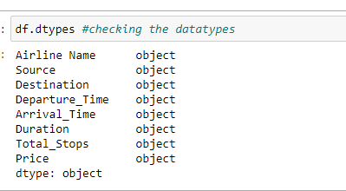
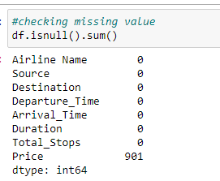
Data pre-processing
After loading I checked for dtypes and found that object column were present which need to be converted into appropriate type.
I checked for data cleaning by removing comma,converting into appropriate format,missing value and also via heatmap and found that there is missing value in Price column .

Slide 11
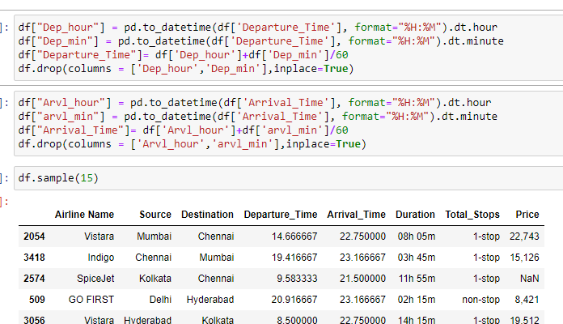
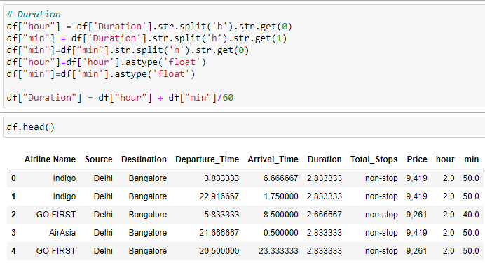
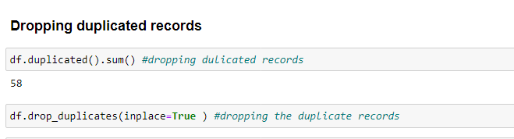
Data Cleaning
We can see that our datasets is having duplicated rows, comma, words in the column values like in duration ,formatting datatypes ,which we need to clear it before model building.so data cleaning is required.
The various data imputation performed on our data set are shown below with the code.

Slide 12
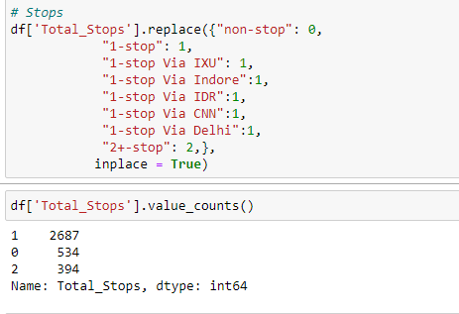
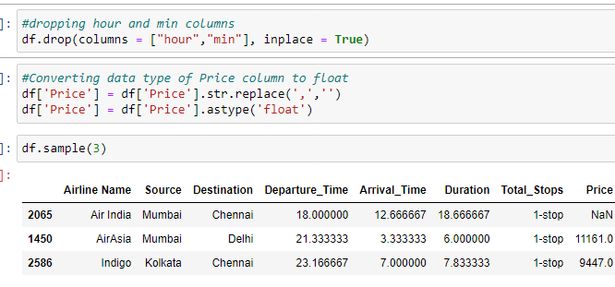
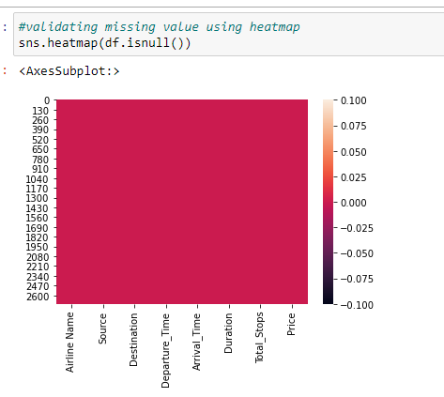
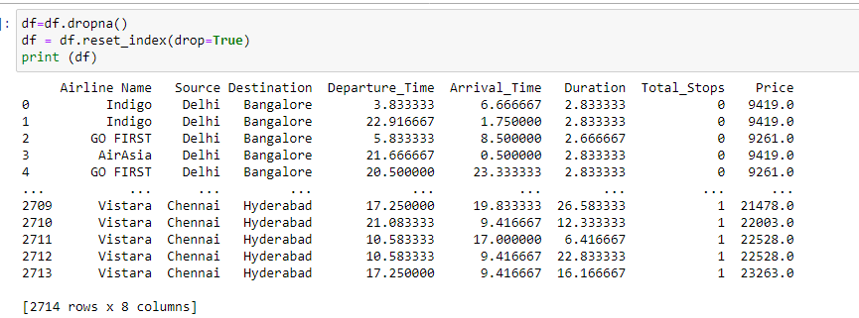
Data cleaning cont..

Slide 13
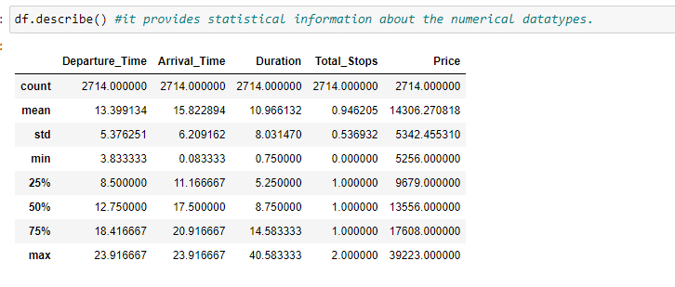
statistical summary of the dataset
1.There is high variance in price column i.e price is fluctuating significantly.
2.The mean value is greater than median value in duration, price,depature_time that means data are positively skewed.
3.The mean value is less than median value in Total_stops, departure_time, arrival_time that means data are negatively skewed(the distribution is negatively skewed).
3.The high gap between the max and 75% lead to formation of outliers that can be seen in Duration, Price column.
4.The minimum Price of the flight ticket is Rs.5256 and maximum price of the flight ticket is Rs.39223.

Slide 14
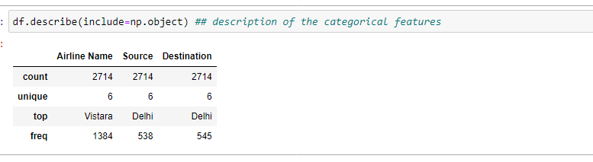
Describe for object column
There are three object column i.e Airline Name,Source and Destination
No missing value as it has been dropped.
Airline Name,source and destination each has 6 distinct columns.
Air Passenger mostly preferring Vistara .
Preferable Source and Destination is Delhi.

Slide 15
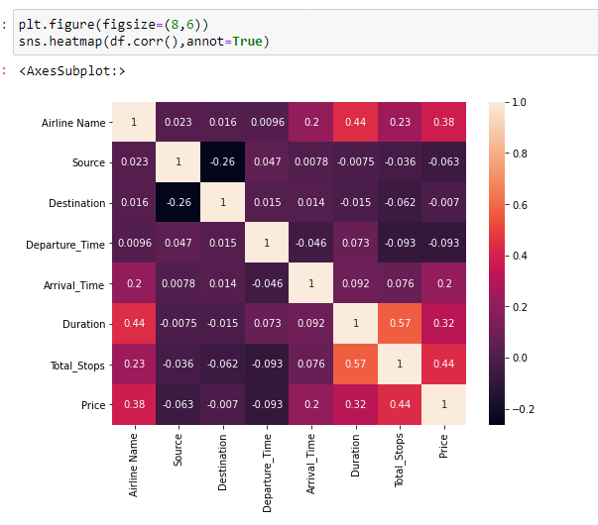
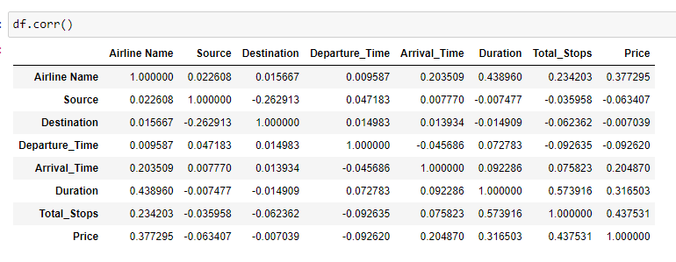
Correlation Analysis:
A positive correlation indicates that the values tend to increase with one another and a negative correlation indicates that values in one set tend to decrease with an increase in the other set.
We see that heatmap shows that price is positively correlated to Airline Name around 38%,Duration around 32% and Total_Stops around 44% and negatively correlated to Departure_Time,Source,Destination . Also Total_stops and Duration are positively correlated at 57%

Slide 16
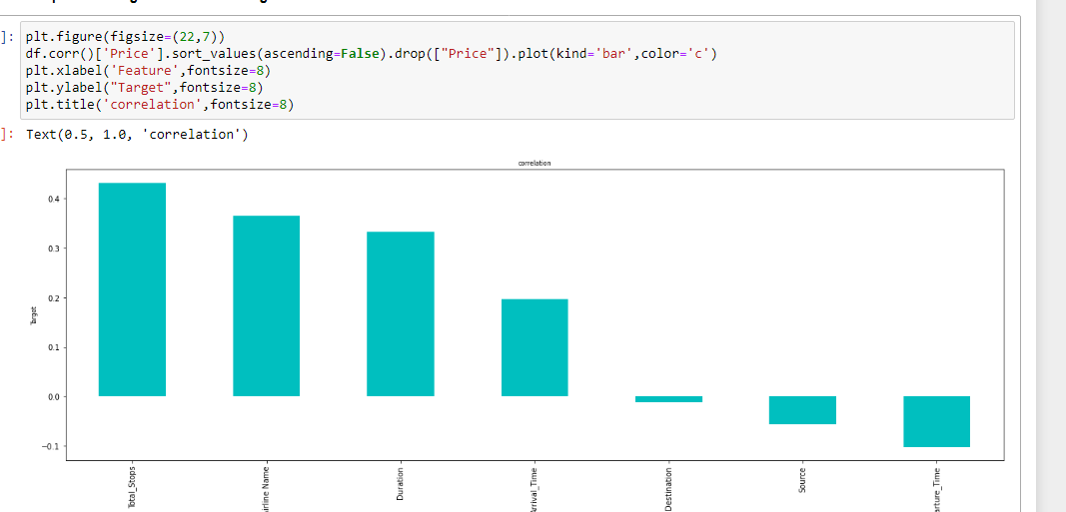
Correlation between target variable
Price is positively correlated Total_stops,Airline Name,Duration,Arrival_time and negatively correlated with Destination,Source and Departure_Time.

Slide 17
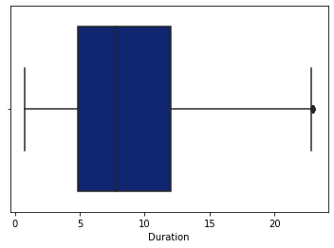
Handling outliers
An Outlier is a data-item/object that deviates significantly from the rest of the (so-called normal)objects. They can be caused by measurement or execution errors.
A box plot (or box-and-whisker plot) shows the distribution of quantitative data in a way that facilitates comparisons between variables.
Thus we see that outliers are present in Duration,Total_stops and price column,since price is our target variable,we will leave it as it is.There are maximum outlier present in duration column and have used standard deviation method to remove it. Before and after removal image shown.

Slide 18
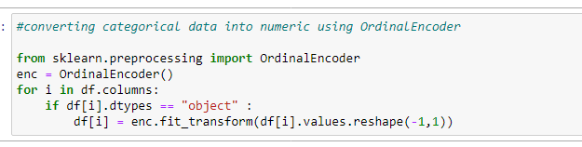
Encoding the categorical object datatype column:
An ordinal encoding involves mapping each unique label to an integer value.

Slide 19
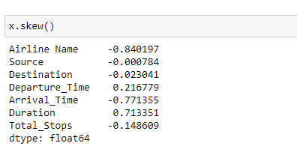
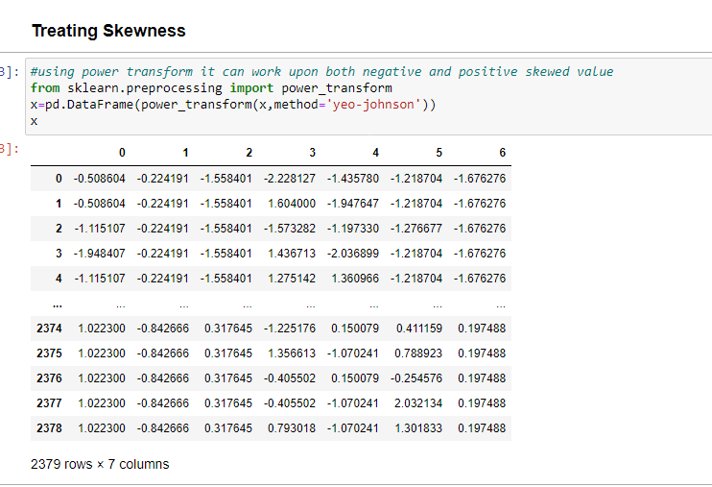
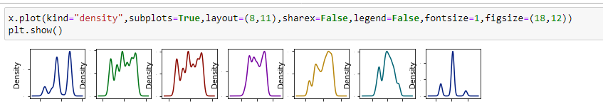
Skewness Analysis
skewness is a measure of asymmetry of the probability distribution about its mean and helps describe the shape of the probability distribution. The skewness value can be positive, zero, negative, or undefined.
I have used power transform (Power transforms are a family of parametric, monotonic transformations that are applied to make data more Gaussian-like )using yeo-johnson as it works for both positiveand negative values.

Slide 20
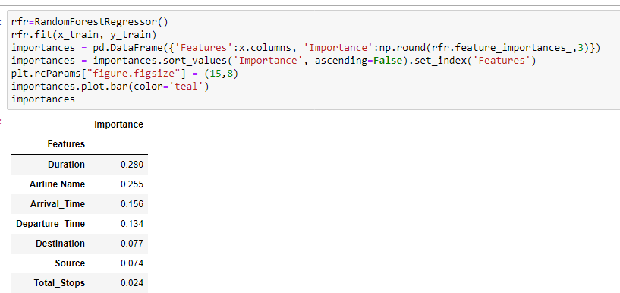
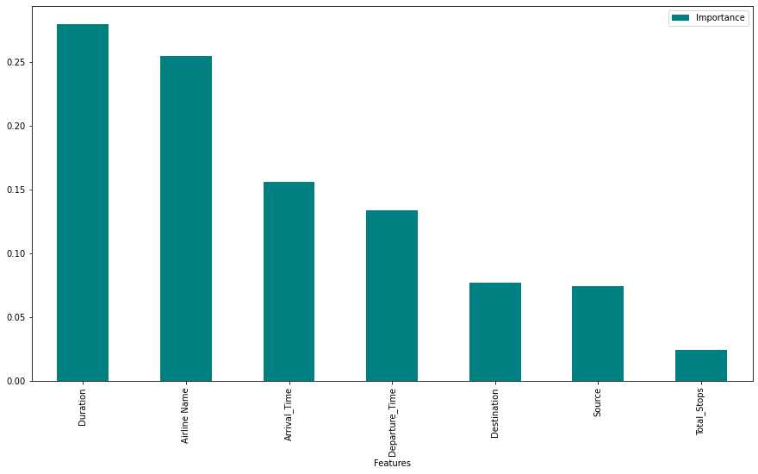
Feature Importance:
I have used random forest regressor to find out which feature are important.
We see Duration and Airline Name are the most important feature and least is Total_stops.

Slide 21
Data Inputs- Logic- Output Relationships
Thus we see original dataset contains all the column as object datatype ,the we did data cleaning with appropriate technique and made them into respective datatype. While doing correlation between target variable and input feature we found that Price is positively correlated Total_stops,Airline Name,Duration,Arrival_time and negatively correlated with Destination,Source and Departure_Time.

Slide 22
Hardware and Software Requirements and Tools Used
Hardware Used:
i. RAM: 8 GB
ii.CPU: Intel® Core™ i3-1005G1 CPU @1.20GHz
Iii. GPU: Intel® UHD Graphics
Software Used:
i. Programming language: Python
ii.Distribution: Anaconda Navigator
iii.Browser based language shell: Jupyter Notebook
Libraries/Packages Used:
1. Pandas- a library which is used to read the data, visualisation and analysis of data.
2. NumPy- used for working with array and various mathematical techniques.
3. Seaborn- visualization tool for plotting different types of plot.
4. Matplotlib- It provides an object-oriented API for embedding plots into applications.
5. Scikit-learn (Sklearn) is the most useful and robust library for machine learning in Python. It provides a selection of efficient tools for machine learning and statistical modeling including classification, regression, clustering and dimensionality reduction via a consistence interface in Python. This library, which is largely written in Python, is built upon NumPy, SciPy and Matplotlib
Pickle library:It provides utilities for saving and loading Python objects that make use of NumPy data structures, efficiently.

Slide 23
Model/s Development and Evaluation
The objective of the case study is to predict the Flight Ticket Price which is as per the dataset is continuous is nature so this will be classified as Regression problem. As this is a regression problem, so we will be loading all the libraries related to it which is as below:
Sklearn
Sklearn.linear_model
Sklearn.ensemble
Sklearn.XGBoost
Sklearn.tree
Sklearn.neighbors
Sklearn.metrics
Sklearn.model_selection

Slide 24
Testing of Identified Approaches (Algorithms)
The algorithms used on training and test data are as follows:
Linear Regression Model
Ridge Regularization Regression Model
Lasso Regularization Regression Model
Decision Tree Regression Model
Random Forest Regression Model
Gradient Boosting Regression Model
Ada Boost Regression Model
XGBoost Regression Model
KNearest neighbors Model
Support Vector Regressor

Slide 25
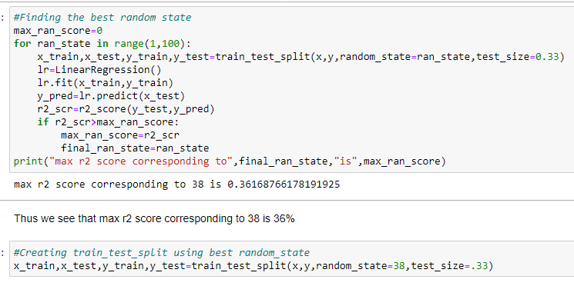
Run and Evaluate selected models
We have used here total of 10 Regression Models after choosing the random state amongst 1-100 number with test_train_split choosing 33% as test_size.We found random_state=38 suits best. Then defining a function for getting the regression model trained and evaluated. The code for the models is listed below.

Slide 26
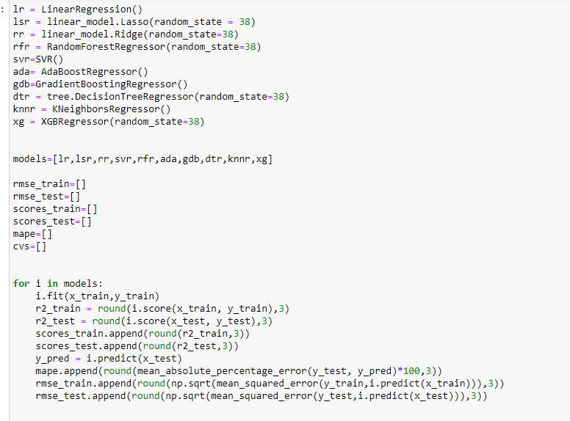
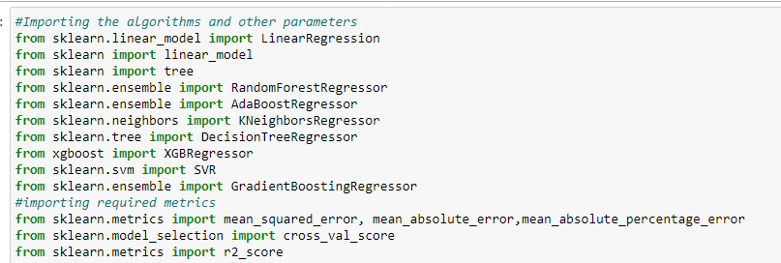
Models without tunning
Then we will modelling all the models taken by defining function for algorithms and evaluating the metrics in the same.

Slide 27
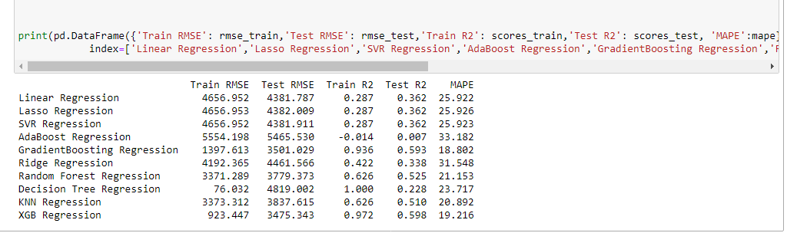
Model Analysis without tunning
For Linear Models, the MAPE(Mean absolute percentage error) states that the predicted values are ~25-31% away from actuals where ridge is performing very badly.
For Non-Linear Models / ensemble models, Decision Tree models overfits. AdaBoost model performs poor whereas gradient boosting regression model and XGB Regression is performing the best followed by random forest model among non-linear models/ensemble models, with MAPE as 18.80% ,19.21% and 21.15 % respectively .Comparing all the models, choosing XGB Regressor, Gradient Boosting Regression model and Random Forest Regressor model for hyperparameter tunning to get more accuracy and score.
RMSE indicates the absolute fit of the model or spread out of residual. R2 indicates proportion of variance for a dependent variable that is explained by independent variables. Both RMSE and R2 are relative measure of fit. MAPE indicates to what extent predicated values are away from actual.

Slide 28
Key Metrics Used
The key metrics used here were r2_score, cross_val_score, RMSE and MAPE. We tried to find out the best parameters and also to increase our scores by using Hyperparameter Tuning through GridSearchCV method.
1.Root_mean_squared_error: Root mean squared error (RMSE) is the square root of the mean of the square of all of the error. The use of RMSE is very common, and it is considered an excellent general purpose error metric for numerical predictions. RMSE is a good measure of accuracy, but only to compare forecasting errors of different models or model configurations for a particular variable and not between variables, as it is scale-dependent.
2.r2_score: It is a statistical measure that represents the goodness of fit of a regression model. The ideal value for r-square is 1. The closer the value of r-square to 1, the better is the model fitted.
3.MAPE: Mean Absolute Percentage Error (MAPE) is a statistical measure to define the accuracy of a machine learning algorithm on a particular dataset. MAPE can be considered as a loss function to define the error termed by the model evaluation. Using MAPE, we can estimate the accuracy in terms of the differences in the actual v/s estimated values. MAPE can also be expressed in terms of percentage. Lower the MAPE, better fit is the model.
4. Cross-validation is a technique used to protect against overfitting in a predictive model, particularly in a case where the amount of data may be limited. In cross-validation, you make a fixed number of folds (or partitions) of the data, run the analysis on each fold, and then average the overall error estimate.
5.Hyperparameter Tuning: Hyperparameter tuning is choosing a set of optimal hyperparameters for a learning algorithm. A hyperparameter is a model argument whose value is set before the learning process begins. The key to machine learning algorithms is hyperparameter tuning. We must select from a specific list of hyperparameters for a given model as it varies from model to model.
Hyper parameter optimisation in machine learning intends to find the hyper parameters of a given machine learning algorithm that deliver the best performance as measured on a validation set.
Using Scikit-Learn’s GridSearchCV method, we can explicitly specify every combination of settings to try. We do this with GridSearchCV, a method that, instead of sampling randomly from a distribution, evaluates all combinations we define.

Slide 29
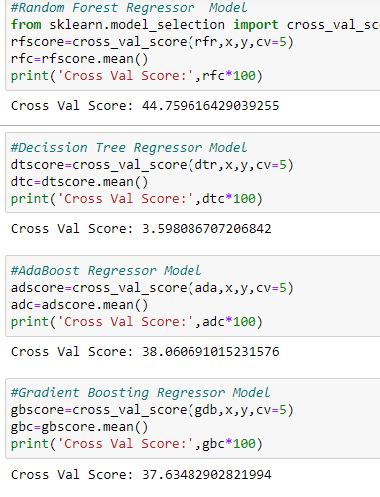
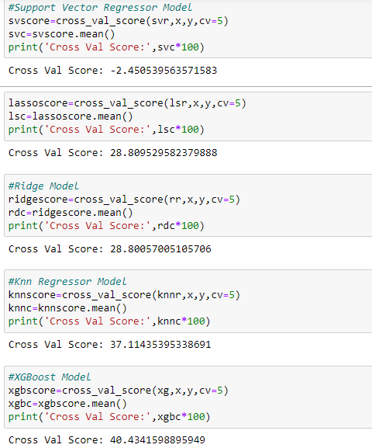
Cross validation of all the models
The score of all the models were either almost same or have been reduced which means that cross validation is not decreasing the accuracy, it is rather giving us a better approximation for that accuracy, including less overfitting.

Slide 30
Hyperparameter through GridSearchCV
Hyper parameter optimisation in machine learning intends to find the hyper parameters of a given machine learning algorithm that deliver the best performance as measured on a validation set.
Using Scikit-Learn’s GridSearchCV method, we can explicitly specify every combination of settings to try. We do this with GridSearchCV, a method that, instead of sampling randomly from a distribution, evaluates all combinations we define.
So after evaluation through key metrics and cross validation,we choose Random Forest Regresssor, Gradient Boosting Regressor and XGB Regressor for hyperparametertunning through gridsearchcv.

Slide 31
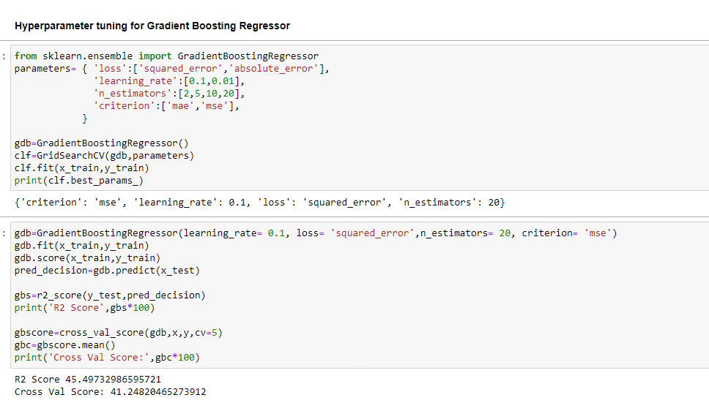
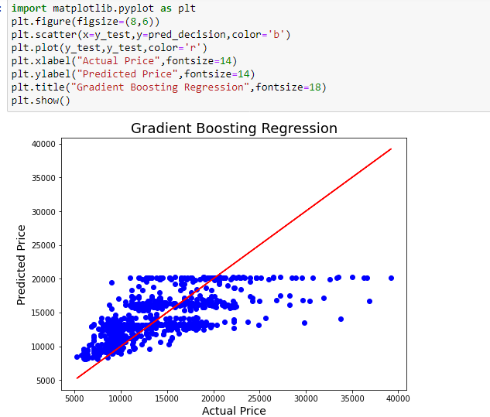
Hyperparameter tuning for Gradient Boosting Regressor
1.We see after hypertunning the R2 score has reduced to 45.49% and cross val score is 41.24% thus the model is not performing well even after hypertunning so we will drop this model.
2.Best fit curve :We can see the best fit line covering the datapoints and it is unable to cover most of the points. There are some datapoint far away from best fit line,which can increase the mse error so we can apply more techniques and regularise and add more data and features to the dataset improve the r2_score.

Slide 32
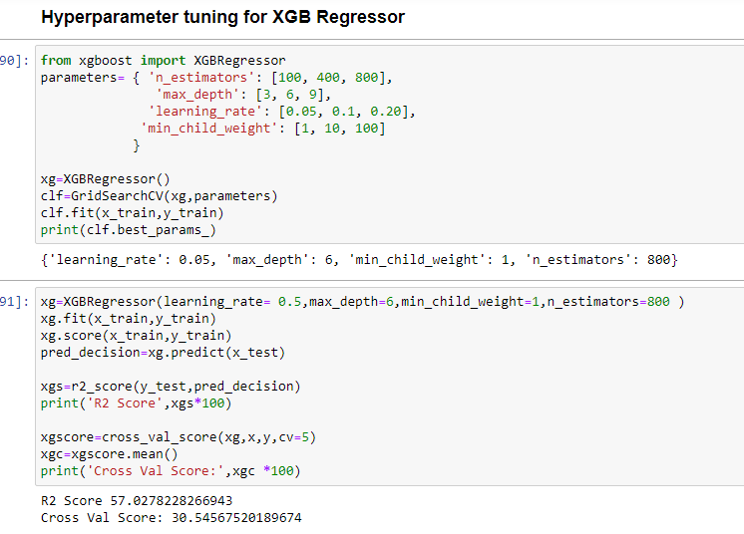
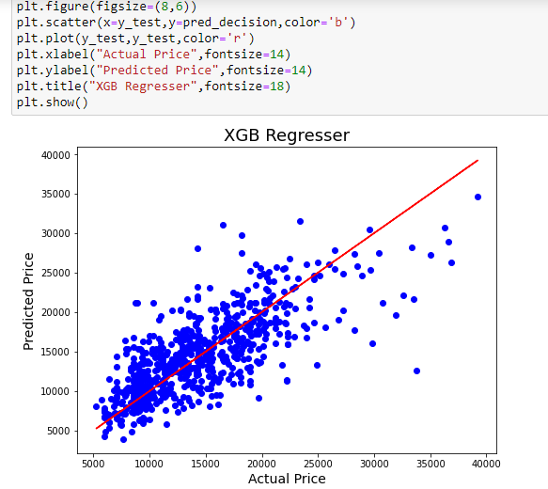
Hyperparameter tuning for XGB Regressor
we see that R2 score is 57.02%and cross val score is 30.55% after hyper tuning though the score has reduced.We find the this model is somewhat performing well in this dataset.
Thus we can see the best fit line covering the datapoints and it is covering most of the points.There are some datapoint far away from best fit line,which can increase the mse error so we can apply more techniques and regularize and improve the r2_score.

Slide 33
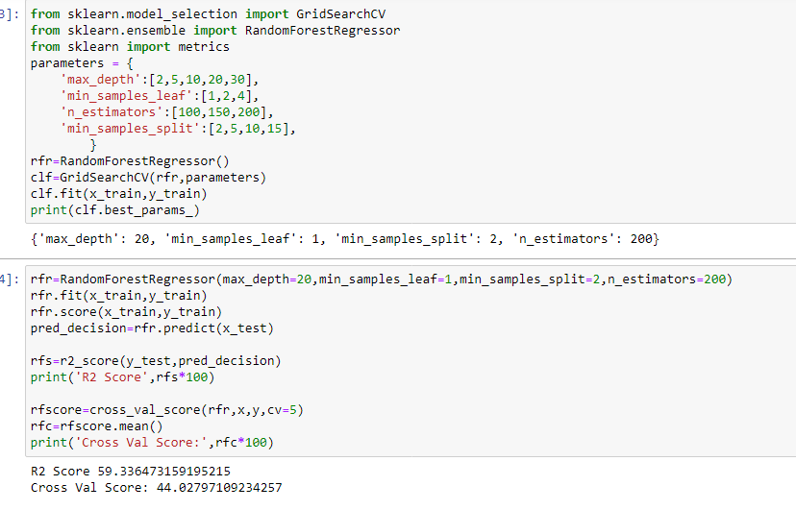
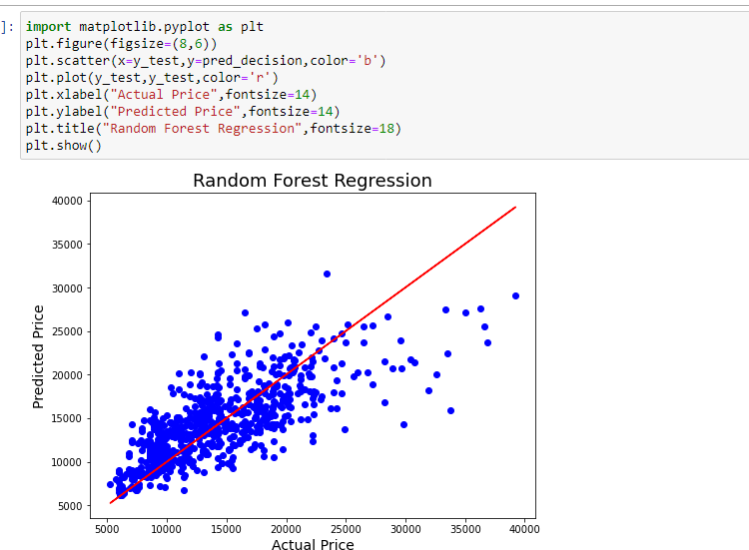
Hyperparameter tuning for Random Forest Regressor
We see that R2 score is 59.33% and cross val score is 44.02 % after hypertunning.
we see this is the best fit line covering most of the datapoints and those points which are away from the best fit line may increase the error terms so we can minimise the error by regularising or adding data or features to the dataset.

Slide 34
Model Analysis with Hyperparameter Tunning
Thus after applying hyper tunning parameter search through GridSearchCV ,we find that on comparing the models on the basis of R2 score accuracy and cross validation score ,Random Forest Regressor is performing well among the models. Though the scores has reduced but this is the best approximation after reducing overfitting and variance .Also the best fit line curve covers shows that Random Forest Regressor model is performing best among others.We will choose this as our best fit models and can be used for further deployment process.
Model | R2 score Accuracy(%) | Cross validation score(%)
Random Forest Regressor | 59.34 | 44.02
XGB Regressor | 57.02 | 30.54
Gradient Boosting Regressor | 45.49 | 41.24

Slide 35

Saving the Best model using pickle method:
I have saved the best model using pickle and dump method.

Slide 36
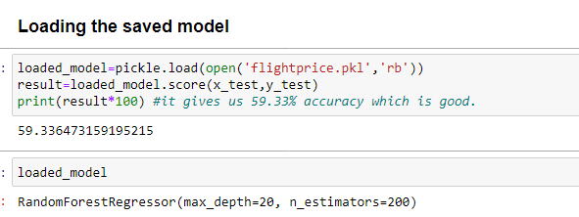
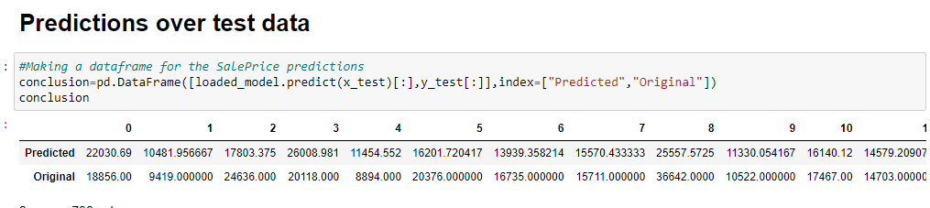
Loading the saved model and doing prediction test
We can see that Random Forest Regressor algorithm, which was finalized as best model and saved after we found that it was the best model performing, is loaded and also showing the best parameters we obtained after doing Hyperparameter Tuning.

Slide 37
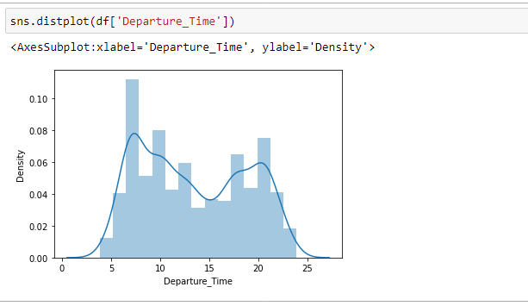
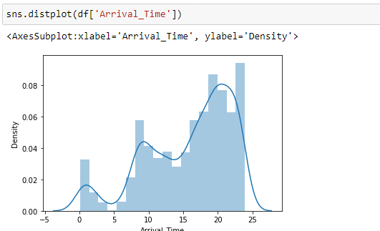
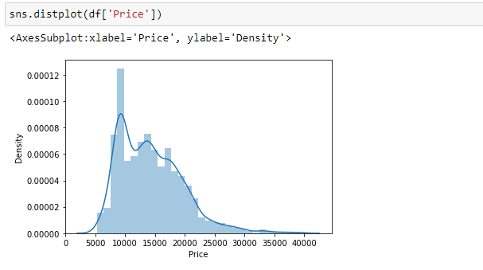
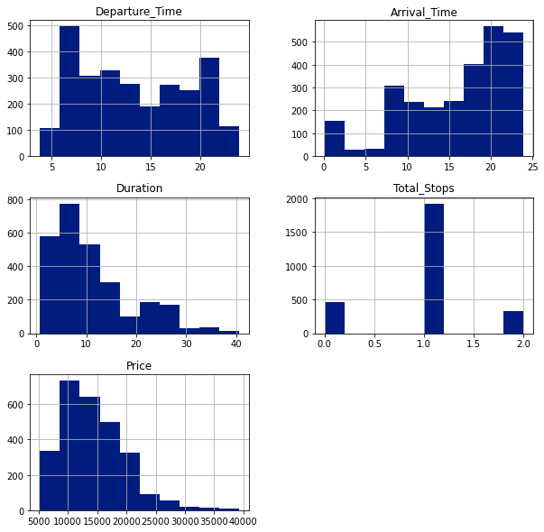
Visualizations
Univariate Analysis-by plotting some graphs
Thus we see the distribution of the data is not normally distributed and skewness present.

Slide 38
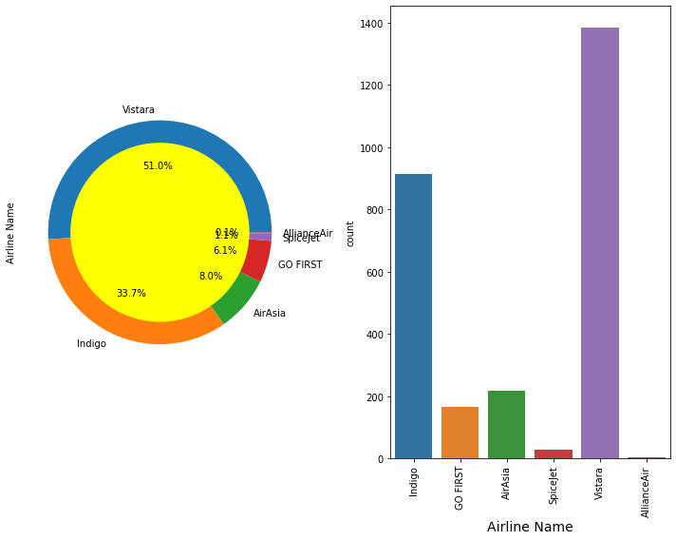
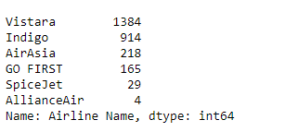
Univariate Analysis of Categorical Column
Airline Name:
Thus we see Vistara has highest number of records about 51% followed by Indigo (33.7%).Air Passenger are preferring the Vistara airways the most and least is AllianceAir.

Slide 39
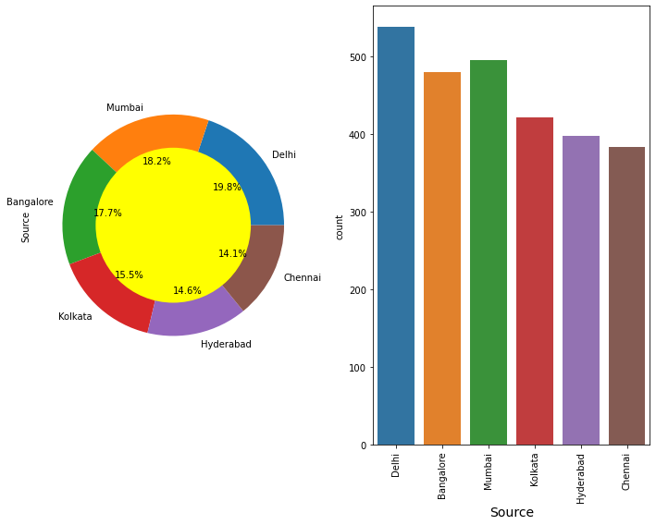
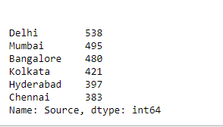
Source
Thus we see mostly people are boarding from Delhi and Mumbai about 19.8% and 18.2% respectively and least is Chennai (14.1%)

Slide 40
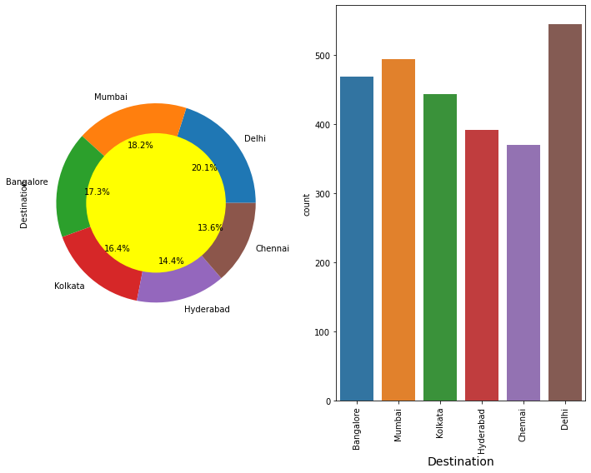
Destination
Thus we see most people are travelling to Delhi,Mumbai about 20.1% and 18.2% respectively and least is Chennai(13.6%).

Slide 41
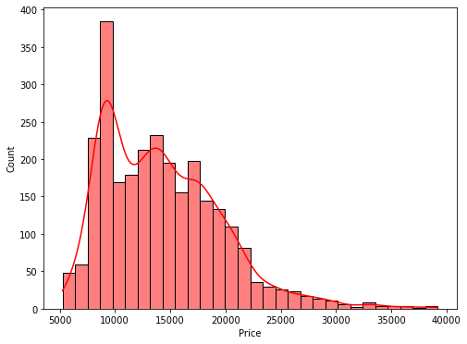
Price
Most of the price for flights lie in the range 5000 to 25000.

Slide 42
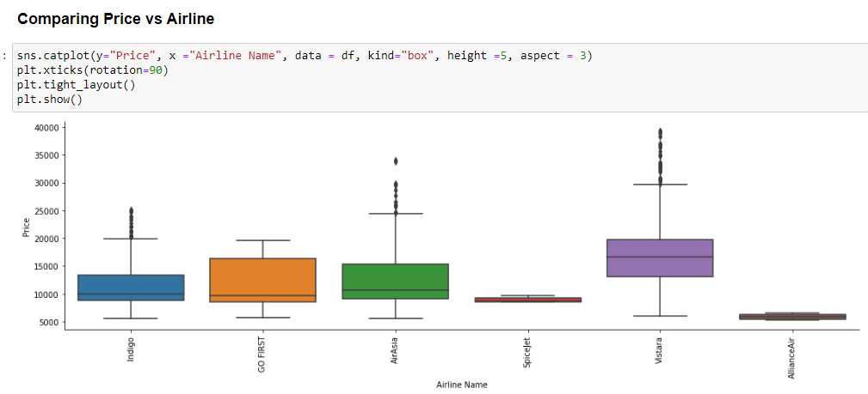
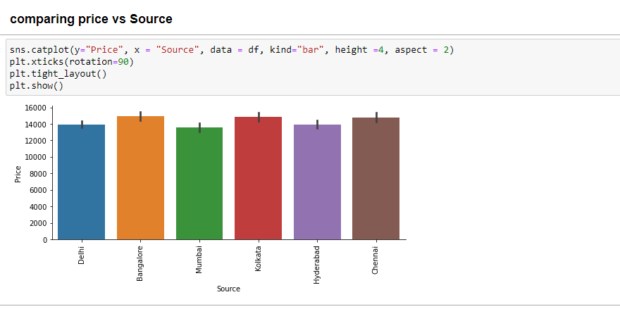
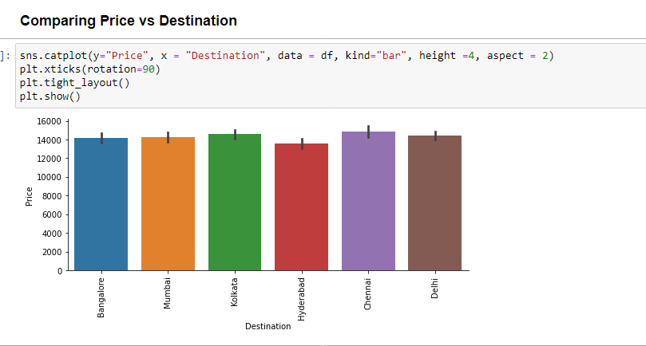
Bivariate Analysis of features with respect to Price as our Target Variable
Vistara airways is having high average price and least average price is Aliance Air.
People boarding from Bangalore are ready to pay high price followed by kolkata and least is Mumbai.
Majority of flight landed to Bangalore,Mumbai,Kolkata,Chennai,they can afford to pay high price and least is Hyderabad

Slide 43


Bivariate Analysis
Those flights having non-stop having low average price followed by one stop and those with 2 stops has high average price.
Departure hour is maximum for flight Spicejet that is 17.5 hours approx and least is Vistara that is between 10-12.5 hours.

Slide 44



Bivariate Analysis
1.Go First has less arrival time followed by Air Asia and Spicejet.
2.Majority of flight having source as delhi has only 1 stop.Non-stop flights are covering all the source.Also 2 stop flights covering all the sources
3.Vistara has high one-stop flights and least is non_stop flights which is followed by Indigo.Most of the flights are non_stop.

Slide 45



Bivariate Analysis
1.Majority of the Vistara flights has destination at Mumbai followed by Bangalore and Delhi.Chennai has the least.
2.Majoriy of the Vistara flight covering all the source.Alliance air doesnt cover Delhi,Mumbai,Kolkata
3.Highest price is charged by Vistara airways while having its destination as Mumbai.Spicejet is having destination as mumbai,delhi,kolkata charging price between 5k-10k whereas AllianceAir too charging less as 5k having destination as hyderabad,Bangalore and Chennai.

Slide 46



Bivariate Analysis
1. Thus we can see Vistara having source at Chennai is charging very high price where the price is above 20000.Spicejet having sources at chennai,mumbai,delhi,kolkata charging prices between 5k-10k. AllianceAir is also charginh less price as much as 5k where its sources are at chennai, hyderabad,bangalore
2.Non stop flights are cost less.Those flights which have one stop are price little higher followed by two stops. Vistara is having maximum one stop where price is above 10000.AllianceAir is having non stopflight and price is also around 5k.
3.Bangalore Flight having destination at chennai , hyderabad,Mumbai is priced less than the delhi.Similarly Mumbai Flight having destination at Hyderabad,Bangalore are priced less than Chennai/Kolkata. Kolkata Flight having destination at Chennai is priced less than others.Thus we came to a conclusion that its depends upon the distance coverage also.The more the distance between source and destination ,more the price.

Slide 47


Bivariate & Multivariate Analysis
1. Those which have non_stop flight are having flight tickets cheap and the price is somewhat less than 10000 in most cases. Those flights having one stop or two stop having flight tickets expensive and price having more than 10k in most of the cases.
2.Multivariate Analysis by Pair plot:
Pairplot visualizes given data to find the relationship between them where the variables can be continuous or categorical. The pairs plot builds on two basic figures, the histogram and the scatter plot.

Slide 48



Prices vs Departure Time /Arrival Time /Duration
Thus we see the comparison where flight prices are the highest during peak hours as compared to midnight (late hours) timings for departure. We can see a similar trend when it comes to arrival timing where we see a decrease in prices between 1:00 hrs and 7:00 hrs Overall flight duration increases the flight prices increase too.

Slide 49
Conclusion
The objective of the case was to create a predictive machine learning model that predicts price of flights with the available independent variables in order to make informed choices. So first I started with scrapping the data of the flights from easemytrip sites which took a very long time to scrape the details. Thus save the dataset in the csv format and loading the dataset and carry out data analysis and then did the EDA process with visualization patterns using pie-plot, box plot, distribution plot ,boxplot and learnt about different relationship between the features and target variable.
After that I did pre-processing techniques like checking outliers, removal of skewness, encoding of categorical column.
Then I did the model training, building the model and finding out the best model out of several models on the basis of different evaluation metrices scores like Mean Absolute Error, Mean squared Error, Root Mean Squared Error,MAPE etc.
We find that Random Forest Regressor/XGB/Grdaient Boosting found to be the best model among the models as it was having somewhat less MAPE(which means how much predicted results and actual results are away,Less Mape means good fit model) and good R2 score.Then I did cross validation to reduce overfitting problem and I found random forest regressor,xgb regressor gradient boosting are performing well. So I did hypertunning through GridsearchCv on these three models taking the parameters to improve the model. Thus we observe that after hypertuning ,the score has improved.Thus concluded that Random Forest was performing well and save it as best model.

Slide 50
Conclusion cont.
Thus finally concluding saying that Random Forest model was having the highest precision accuracy for prediction the price of the flights with machine learning data. Hence by implementation of this model one can make prediction of the price of the flight on the features given.
I saved the best model using pickle method and loaded the model for prediction test and find 59.33% approx accuracy which is quite good. Thus this model can be used in further deployment process.
Overall, this dataset is good for predicting the Flight prices based on regression analysis using Random Forest Regressor as the best suited model.

Slide 51
Learning Outcomes of the Study in respect of Data Science
With the help of dataset ,we came to know the how target variable is influence by different factors . We observe this using different visualization technique like distribution plot,scatter plot,box plot ,strip plot ,distribution plot for feature study related category.
We handled the raw data using data cleaning methods as the data collected was not formatted having lakhs,comma and dot which we handled and cleaned with the appropriate technique. We also cleaned outliers setting the using standard deviation method . We also removed the skewness through power transform method and finally scaled the data for further building of model.

Slide 52
Learning Outcome cont.
Therefore in this project, we present various algorithms while predicting price of the flight ticket by using regression models with good accuracy. We tested various models such as linear regression, Random Forest regressorer,AdaBoost Regressor,Descision Tree Regressor,KNearest Neighbor Regressor ,Gradient Boosting Regressor and XGB Regressor and selected the best fit among models and also done hyperparameter tuning. Some of the models performed very poorly.
A proper implementation of this project can result in saving money of inexperienced people by providing them the information related to trends that flight prices follow and also give them a predicted value of the price which they use to decide whether to book ticket now or later. In conclusion this type of service can be implemented with good accuracy of prediction. As the predicted value is not fully accurate there is huge scope for improvement of these kind of service.

Slide 53
Limitations of this work and Scope for Future Work
High skewed data can reduce the effectiveness of the model.
2.Web scrapping consumed lot of time and also some of the websites, it was very difficult to scrape the data due to technical glitch or denied error.
3.I have considered here only few features.
4.For future work, we recommend that working on large dataset would yield a better and real picture about the model.
5.We can still improve error, model accuracy with some feature engineering and by doing some extensive hyperparameter tuning on it or by adding more features.
6.We can consider the booking timing while booking the ticket (i.e how many days he is booking ticket prior to his journey).

Slide 54
THANK YOU

