Slide 1
Housing Price Prediction Project
Submitted by Shilpi Mohanty

Slide 2
Business Problem Framing
Houses are one of the necessary needs of each and every person around the globe and therefore housing and real estate market is one of the markets which is one of the major contributors in the world’s economy. It is a very large market and there are various companies working in the domain.
Data science comes as a very important tool to solve problems in the domain to help the companies increase their overall revenue, profits, improving their marketing strategies and focusing on changing trends in house sales and purchases.
Predictive modelling, Market mix modelling, recommendation systems are some of the machine learning techniques used for achieving the business goals for housing companies. Our problem is related to one such housing company.
We are required to model the price of houses with the available independent variables. This model will then be used by the management to understand how exactly the prices vary with the variables. They can accordingly manipulate the strategy of the firm and concentrate on areas that will yield high returns. Further, the model will be a good way for the management to understand the pricing dynamics of a new market.

Slide 3
Conceptual Background of the Domain Problem
A US-based housing company named Surprise Housing has decided to enter the Australian market. The company uses data analytics to purchase houses at a price below their actual values and flip them at a higher price. For the same purpose, the company has collected a data set from the sale of houses in Australia. The data is provided in the CSV file below.
The company is looking at prospective properties to buy houses to enter the market. You are required to build a model using Machine Learning in order to predict the actual value of the prospective properties and decide whether to invest in them or not.
For this company wants to know:
• Which variables are important to predict the price of variable?
• How do these variables describe the price of the house?

Slide 4
Review of Literature
The sample dataset which is provided to us by client database where we came to know that the US housing company is looking at prospective properties to buy houses to enter the market.
Looking at the dataset which clearly says that this is a regression problem as we have to predict the target variable “SalePrice” which is continuous value so we need to build a model using Machine Learning to predict the actual value of the prospective properties and decide whether to invest in them or not.
Also, we have other independent features that would help to decide which all variables are important to predict the price of the variable and how do these variables describe the price of the house.

Slide 5
Motivation for the Problem Undertaken
Real estate sector is one of the most globally recognized sectors. It is increasingly expanding and developing, playing a more important role in the country's market economy thereby contributing to the socio-economic stability. It comprises of four sub sectors - housing, retail, hospitality, and commercial.
With the rapid population growth, the need is arising for housing. It is critical to provide accurate predictions of housing prices. Housing price Index is used to estimate the changes in housing price. Since housing price is strongly correlated to other factors such as location, area, population, it requires other information apart from HPI to predict individual housing price.
The sample data is provided by our client database. In order to improve the selection of customers, the client wants some predictions that could help them in further investment and improvement in selection of customers.
There has been large number of papers following the traditional machine learning approach to predict the housing prices and concerned very little for individual models’ performance and neglect the complex models. So here we will be focussing on both traditional and advance machine learning models and compare them. This paper will also comprehensively validate multiple techniques in model implementation on regression and provide an optimistic result for housing price prediction.

Slide 6
ANALYTICAL PROBLEM FRAMING MATHEMATICAL/ANALYTICAL MODELLING OF THE PROBLEM
Referring to the problem statement which aim is to predict the sales price of the house which will help the housing company to invest or not in Australian market. And also, to find out which features are more important to the sales price and how these features describe the sales price. After understanding this, they will accordingly manipulate the strategy of the firm and concentrate on areas that will yield high returns. Considering the above which clearly states that this case is of Regression Analysis Problem as we have to predict the sales price which is of continuous nature.
Regression Analysis: Regression analysis refers to assessing the relationship between the outcome variable and one or more variables. The outcome variable is known as the dependent or response variable and the risk elements, and co-founders are known as predictors or independent variables. The dependent variable is shown by “y” and independent variables are shown by “x” in regression analysis.
The most common form of regression analysis is linear regression, in which one finds the line (or a more complex linear combination) that most closely fits the data according to a specific mathematical criterion. For specific mathematical reasons this allows the researcher to estimate the conditional expectation of the dependent variable when the independent variables take on a given set of values.
Regression analysis is helpful statistical method that can be leveraged across an organization to determine the degree to which particular independent variables are influencing dependent variables.
The possible scenarios for conducting regression analysis to yield valuable, actionable business insights are endless and thus make more informed business decisions, allocate resources more efficiently, and ultimately boost your bottom line.

Slide 7
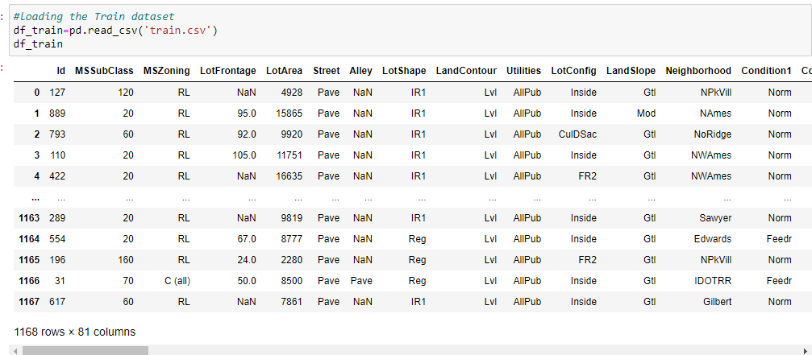
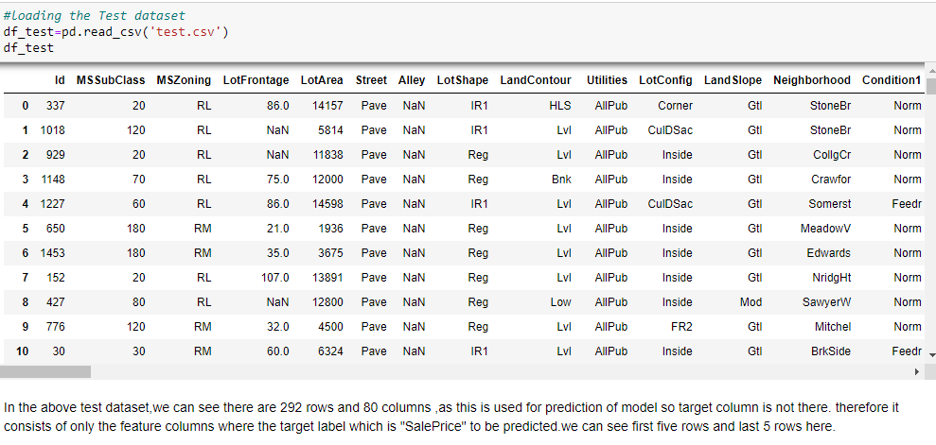
Data Sources and their formats
Data set provided by Flip Robo was in the format of CSV (Comma Separated Values). Two dataset are provided.The dimension of training dataset is 1168 rows and 81 columns and testing dataset is 292 and 80 columns.
Training and Testing dataset as provided below

Slide 8
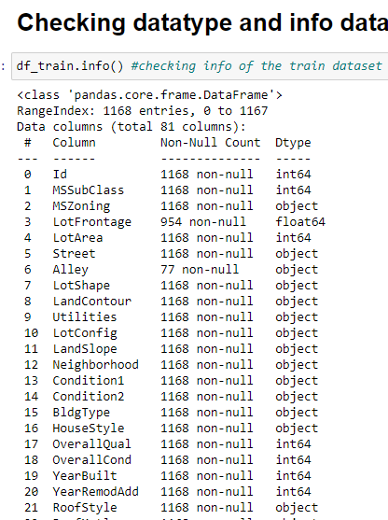
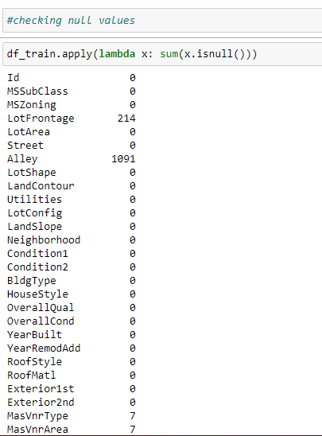
Data pre-processing

Slide 9
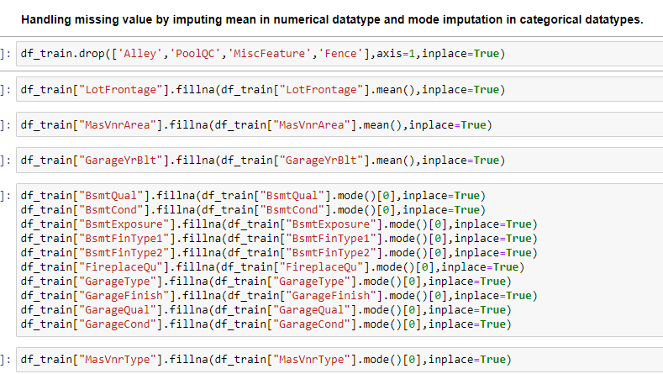
Checking and Handling Missing Value

Slide 10
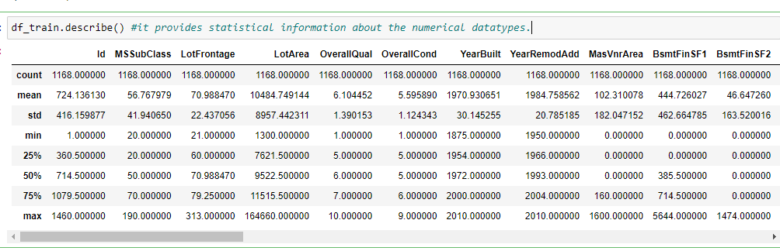
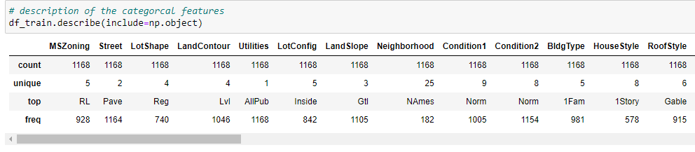
statistical summary of the dataset
The Describe function returns the statistical summary of the dataframe or series. It Analyzes both numeric and object series, as well as DataFrame column sets of mixed data types. The output will vary depending on what is provided.
For numeric data, the result’s index will include count, mean, std, min, max as well as lower, 50 and upper percentiles. By default the lower percentile is 25 and the upper percentile is 75. The 50 percentile is the same as the median.
For object data (e.g. strings or timestamps), the result’s index will include count, unique, top, and freq. The top is the most common value. The freq is the most common value’s frequency. Timestamps also include the first and last items.

Slide 11
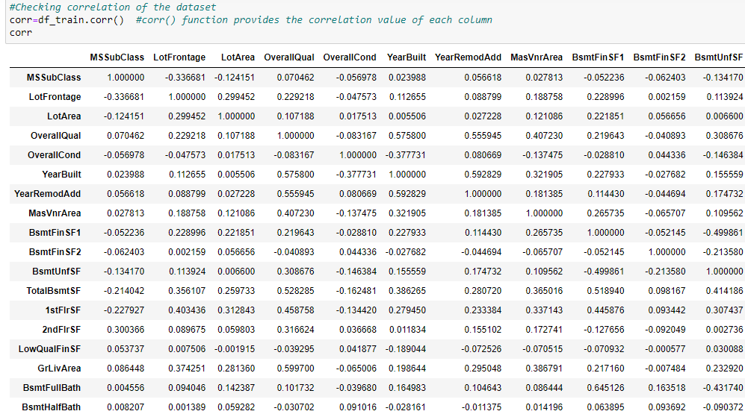
Correlation Analysis:
Correlation analysis is a statistical method used to measure the strength of the linear relationship between two variables and compute their association.
A positive correlation indicates that the values tend to increase with one another and a negative correlation indicates that values in one set tend to decrease with an increase in the other set.

Slide 12
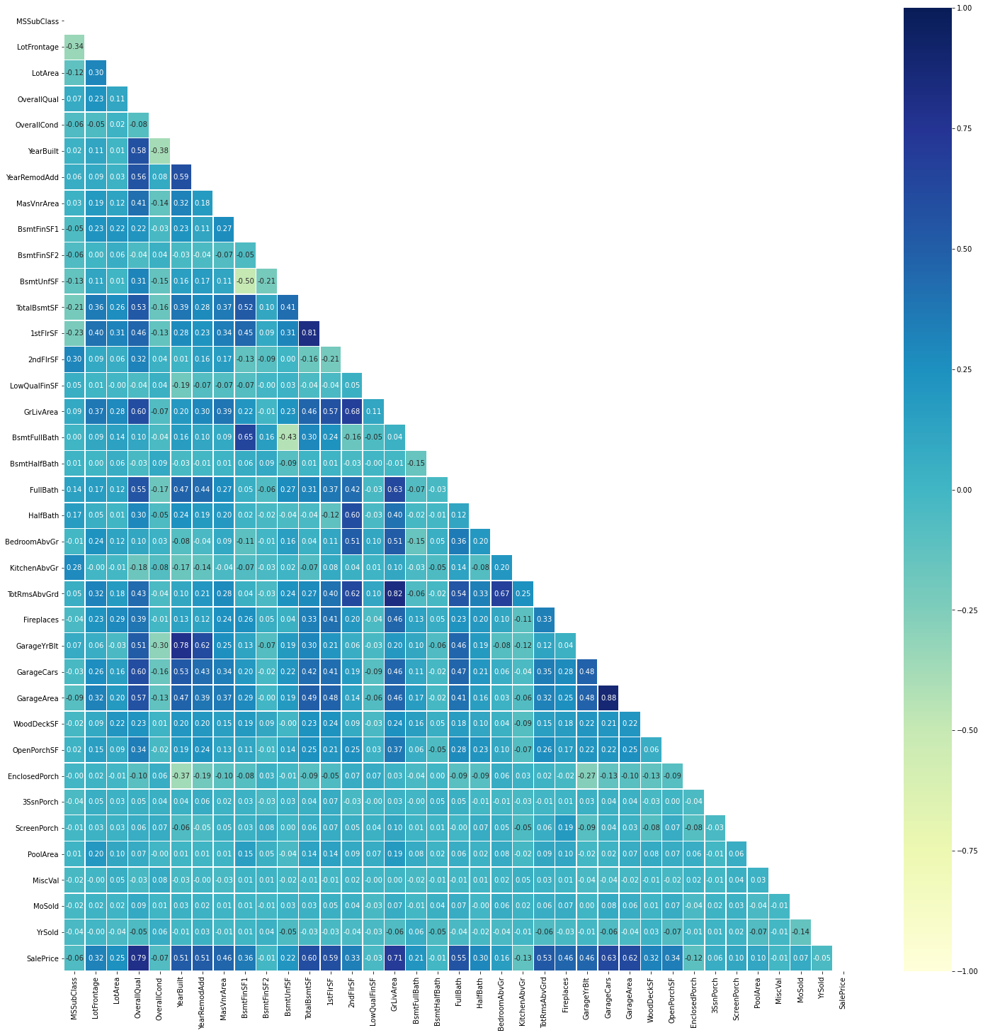
Correlation using Heatmap
Correlation heatmaps are a type of plot that visualize the strength of relationships between numerical variables. Correlation plots are used to understand which variables are related to each other and the strength of this relationship.
SalePrice is highly positively correlated with the features like OverallQual, YearBuilt, YearRemodAdd, TotalBsmtSF, 1stFlrSF, GrLivArea, FullBath, TotRmsAbvGrd, GarageCars, GarageArea.
SalePrice is negatively correlated with OverallCond, KitchenAbvGr, Encloseporch, YrSold.

Slide 13
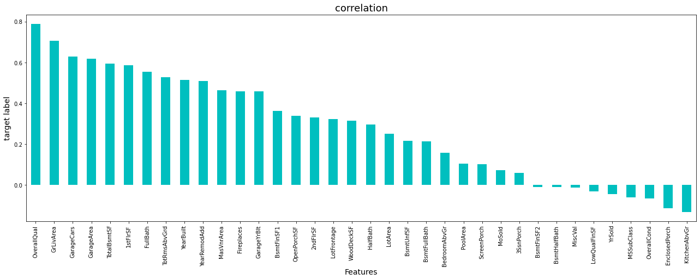
Correlation between target variable
Target label Salesprice is highly positively correlated with OverallQual and GrLivArea.
Sales price is negatively correlated with KitchenAbvGr, EnclosedPorch, OverallCond ,Mssubclass,Yrsold,LowQualFinsf,Miscval,Bsmithhalfbatch and rest all positvely correlated

Slide 14
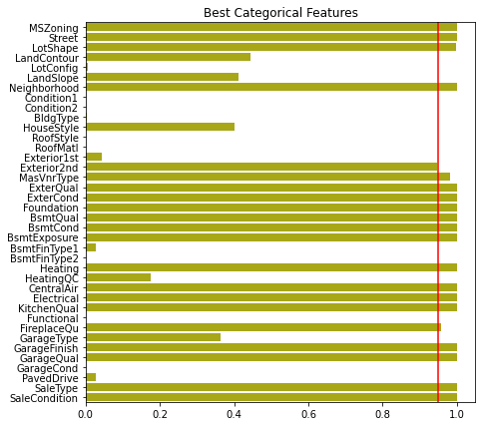
Best Categorical Features using Chi-square test :
Chi Square test is used to identify significant categorical variables i.e. variables with p value less than 5%

Slide 15
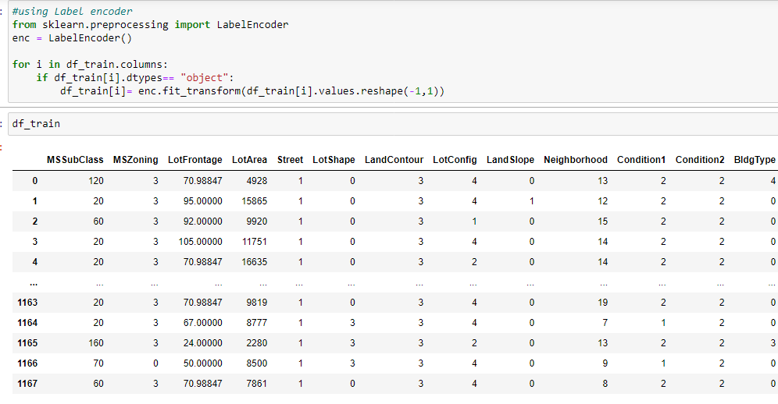
Encoding the categorical object datatype column:
Label encoders transform non-numerical labels into numerical labels. Each category is assigned a unique label starting from 0 and going on till n_categories – 1 per feature.

Slide 16
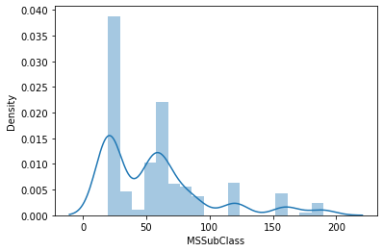
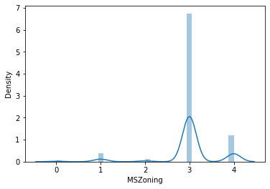
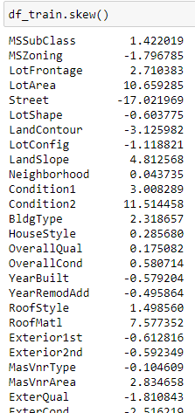
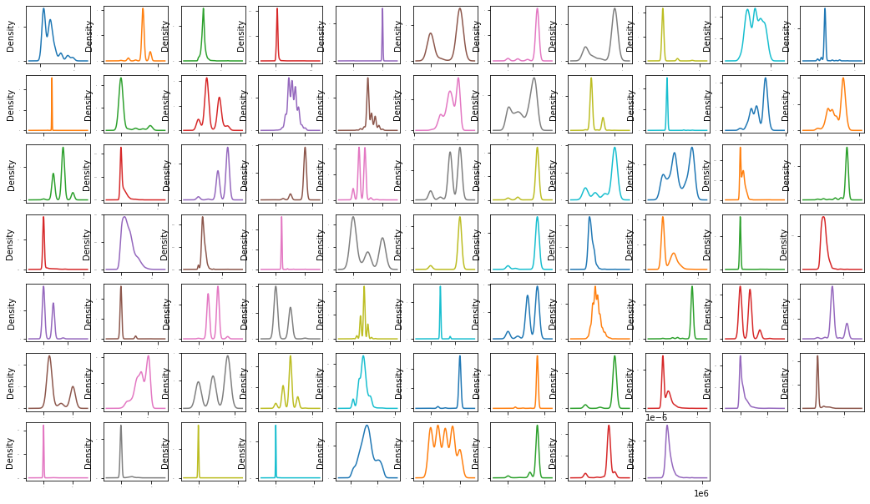
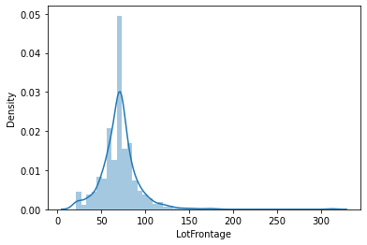
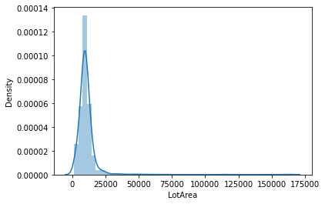
Skewness Analysis
skewness is a measure of asymmetry of the probability distribution about its mean and helps describe the shape of the probability distribution. The skewness value can be positive, zero, negative, or undefined.

Slide 17
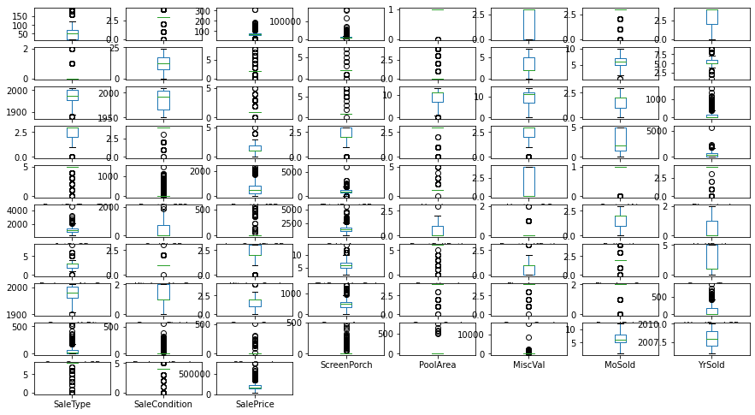
Checking outliers
An Outlier is a data-item/object that deviates significantly from the rest of the (so-called normal)objects. They can be caused by measurement or execution errors.
A box plot (or box-and-whisker plot) shows the distribution of quantitative data in a way that facilitates comparisons between variables. The box shows the quartiles of the dataset while the whiskers extend to show the rest of the distribution, except for points that are determined to be “outliers” using a method that is a function of the inter-quartile range.

Slide 18
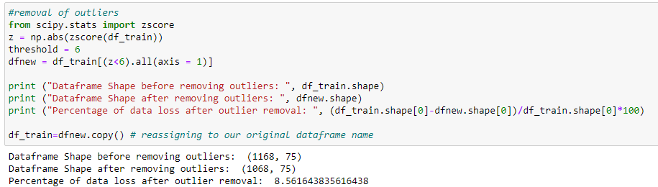
Handling outliers
A Z-score is a numerical measurement that describes a value's relationship to the mean of a group of values. Z-score is measured in terms of standard deviations from the mean. In most cases a threshold of 3 or - 3 is used i.e., if the Z-score value is higher than or less than 3 or -3 respectively, that particular data point will be identified as outlier.Here we took threshold as 6 as the percentage of data loss was 8% around.

Slide 19
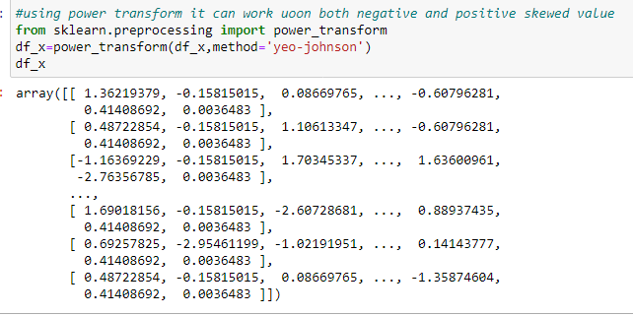
Treating skewness using Power transform
Power transform :Power transforms are a family of parametric, monotonic transformations that are applied to make data more Gaussian-like. The method i have used here is yeo-johnson as it works with both positive and negative values

Slide 20
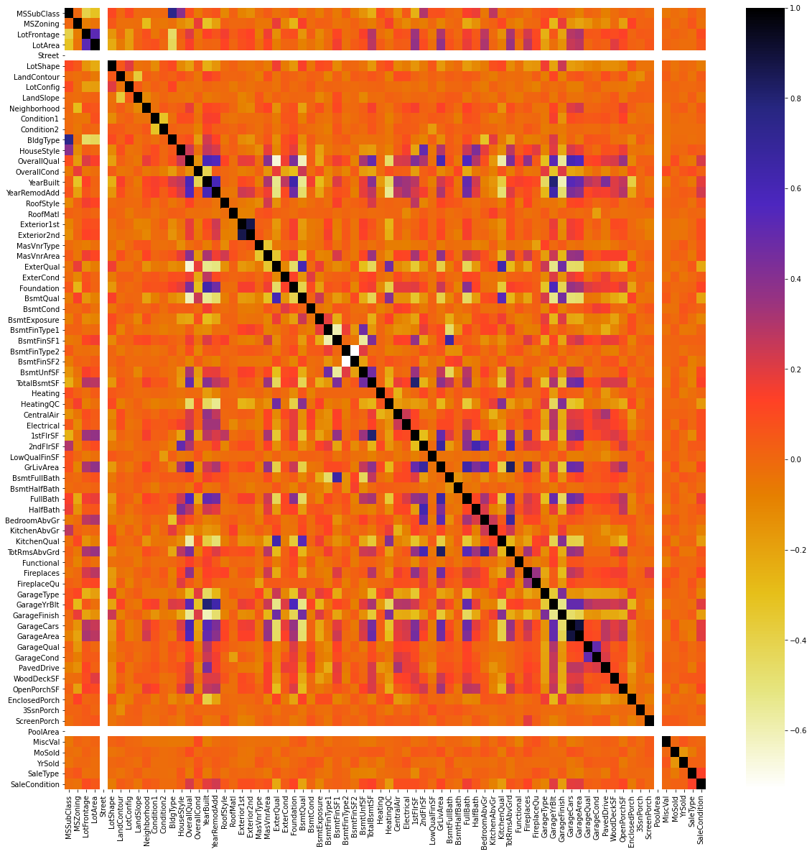
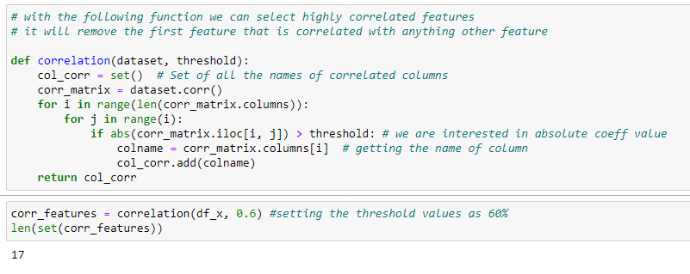
Feature Selection with Pearson Correlation
With the help of following function,It will remove the first features which are highly correlated and thereby helps in reducing multicollinearity problem.

Slide 21
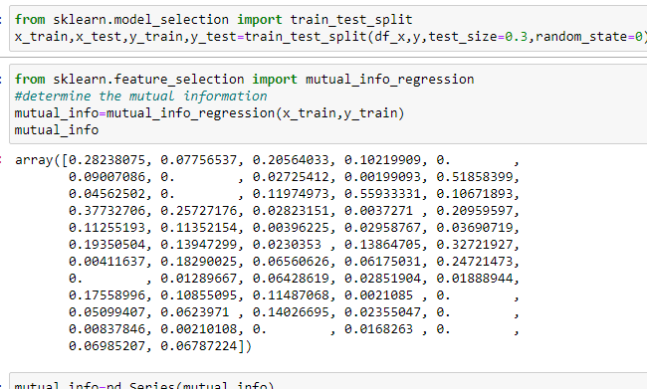
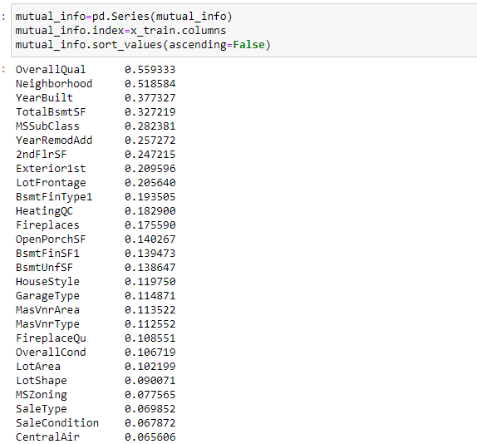
Selecting Top Feature using mutual Gain information
Mutual Information: It measures the amount of information one can obtain from one random variable given another. In other words, Information gain or mutual information measures how much information the presence/absence of a feature contributes to making the correct prediction on the target
.

Slide 22

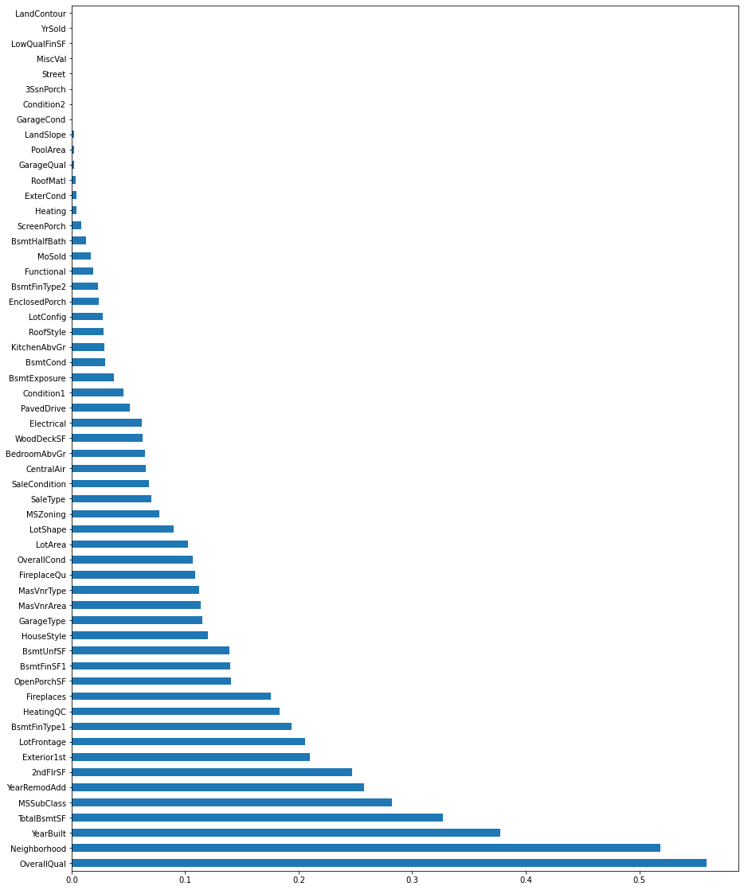
Mutual Information bar graph
We can infer that the OverallQual is having the highest mutual information gain(0.57) then Neighborhood(0.52) followed by GrLivArea(0.50), and so on. So OverallQual give 57% of the information about the target variable SalePrice in this case.

Slide 23
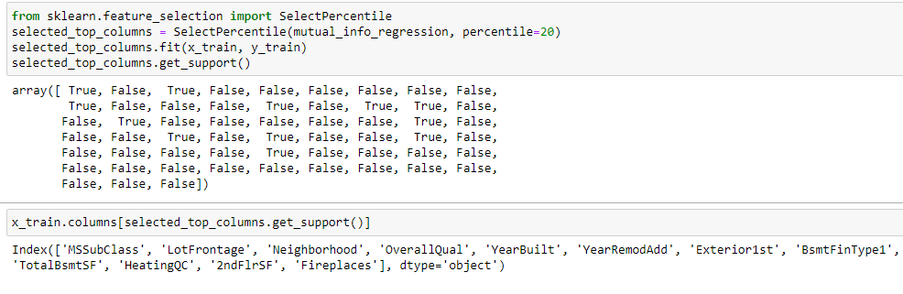
Selecting Top columns using SelectPercentile
So the features which are in the top 20th percentile, which means that after Fireplaces the remaining features which are 80% have a dependence of at least less than that of Fireplaces.

Slide 24
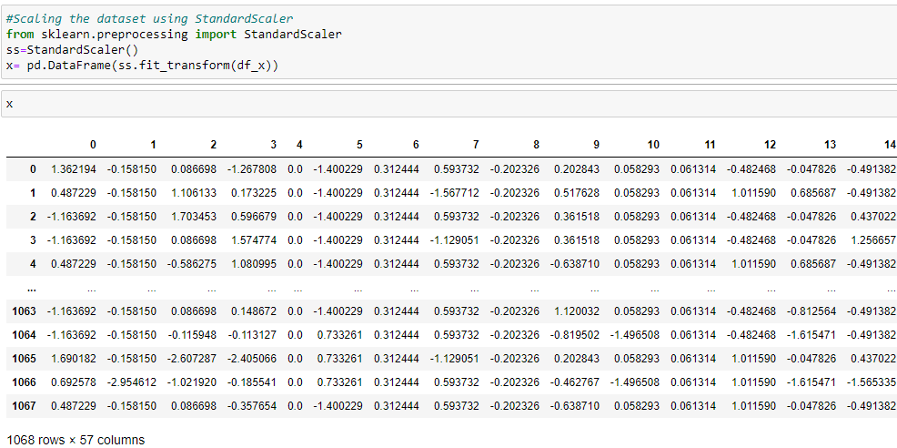
Feature Scaling:
Feature Scaling is a technique to standardize the independent features present in the data in a fixed range. It is performed during the data pre-processing to handle highly varying magnitudes or values or units. In standardaization, using StandardScaler(Z-score normalization),here all the features will be transformed in such a way that it will have properties of standard normal distribution mean =0 and standard deviation =1. I have used here standardScaler to scaled the data values .

Slide 25
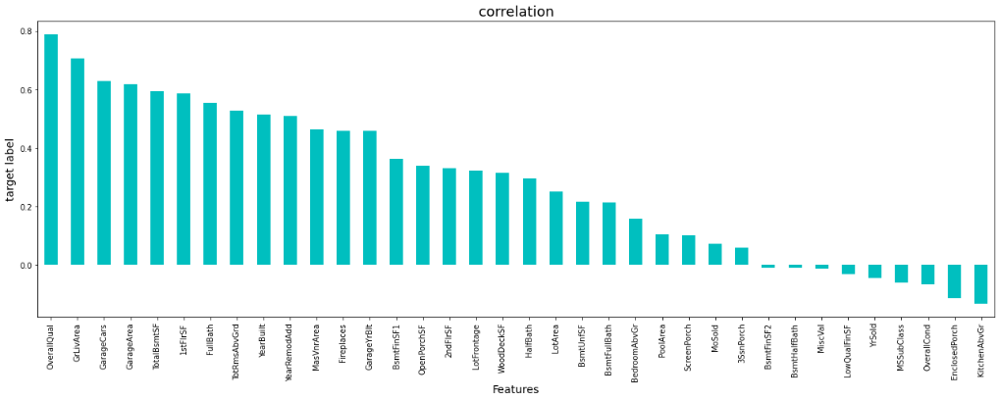
Data Inputs- Logic- Output Relationships
After loading of the training and testing dataset ,we check their datatypes ,well,it was consists of int,float and object datatype.Then we see that the our goal is to predict salesprice of the houses on the bases of which housing company will be able to make decision to investment or not,whether their investment is feasible or not.Also they want to see that what are most features affecting the salesprice and how they are related to sales price.
To check this, we carry our correlation of features with target variable which was done in pre-processing stage above. We found that using mutual information gain technique, OverallQual has the highest mutual information gain(0.57) then Neighborhood(0.52) followed by GrLivArea(0.50), and so on. So OverallQual give 57% of the information about the target variable SalePrice .
Graph showing correlation of target variable saleprice with the input features which has been also explained in pre-dataprocessing.

Slide 26
State the set of assumptions (if any) related to the problem under consideration
Most of the Z_score problem handling outlier, we normally take thresholds as +/-3 but here I have taken threshold as 6 since data loss was 8% while taking 3, it was showing data loss more than 50%.
I have set the percentile as 20 using selectPercentile as I want to see top features which are under this percentile

Slide 27
Hardware and Software Requirements and Tools Used
Hardware Used:
i. RAM: 8 GB
ii.CPU: Intel® Core™ i3-1005G1 CPU @1.20GHz
Iii. GPU: Intel® UHD Graphics
Software Used:
i. Programming language: Python
ii.Distribution: Anaconda Navigator
iii.Browser based language shell: Jupyter Notebook
Libraries/Packages Used:
1. Pandas- a library which is used to read the data, visualisation and analysis of data.
2. NumPy- used for working with array and various mathematical techniques.
3. Seaborn- visualization tool for plotting different types of plot.
4. Matplotlib- It provides an object-oriented API for embedding plots into applications.
5. Scikit-learn (Sklearn) is the most useful and robust library for machine learning in Python. It provides a selection of efficient tools for machine learning and statistical modeling including classification, regression, clustering and dimensionality reduction via a consistence interface in Python. This library, which is largely written in Python, is built upon NumPy, SciPy and Matplotlib

Slide 28
Model/s Development and Evaluation
The objective of the case study is to predict the SalePrice of the house which is as per the dataset is continuous is nature so this will be classified as Regression problem. As this is a regression problem, so we will be loading all the libraries related to it which is as below:
Sklearn
Sklearn.linear_model
Sklearn.ensemble
Sklearn.XGBoost
Sklearn.tree
Sklearn.neighbors
Sklearn.metrics
Sklearn.model_selection

Slide 29
Testing of Identified Approaches (Algorithms)
The algorithms used on training and test data are as follows:
Linear Regression Model
Ridge Regularization Regression Model
Lasso Regularization Regression Model
Decision Tree Regression Model
Random Forest Regression Model
Gradient Boosting Regression Model
Ada Boost Regression Model
XGBoost Regression Model
KNearest neighbors Model
Support Vector Regressor

Slide 30
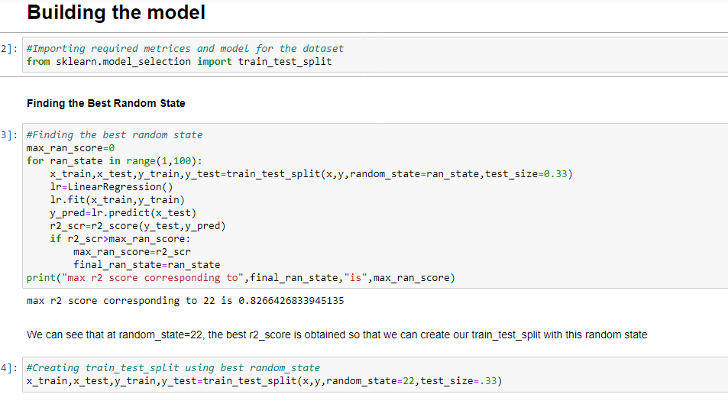
Run and Evaluate selected models
We have used here total of 10 Regression Models after choosing the random state amongst 1-100 number with test_train_split choosing 33% as test_size.We found random_state=22 where the accuracy was highest. Then defining a function for getting the regression model trained and evaluated. The code for the models is listed below.

Slide 31
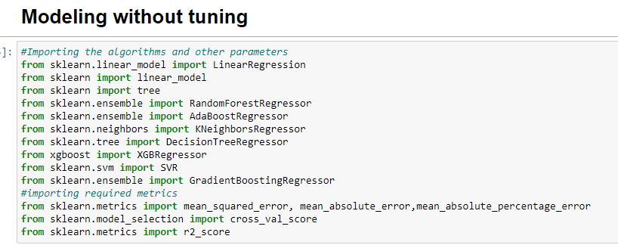
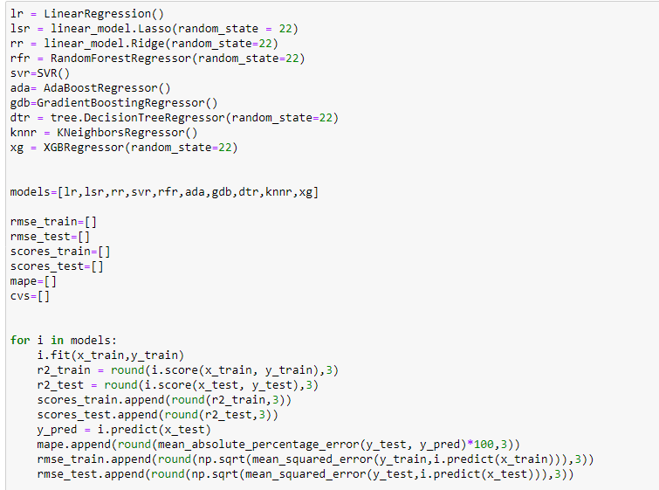
Models without tunning
Then we will modelling all the models taken by defining function for algorithms and evaluating the metrics in the same.

Slide 32
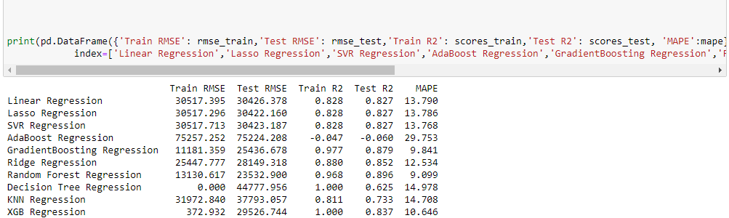
Model Analysis without tunning
For Linear Models, the MAPE(Mean absolute percentage error) states that the predicted values are ~13% away from actuals.
For Non-Linear Models / ensemble models, Decision Tree models overfits. AdaBoost model performs very poor whereas Random forest model and Gradient Boosting Regression are performing the best among non-linear models, with approx lowest RMSE score and MAPE as 9.09% and 9.84% respectively .Comparing all the models,choosing Random Forest Regressor and Gradient Boosting Regression model for hyperparameter tunning to optimse the model.
RMSE indicates the absolute fit of the model or spread out of residual. R2 indicates proportion of variance for a dependent variable that is explained by independent variables. Both RMSE and R2 are relative measure of fit. MAPE indicates to what extent predicated values are away from actual.

Slide 33
Key Metrics Used
The key metrics used here were r2_score, cross_val_score, RMSE and MAPE. We tried to find out the best parameters and also to increase our scores by using Hyperparameter Tuning through GridSearchCV method.
1.Root_mean_squared_error: Root mean squared error (RMSE) is the square root of the mean of the square of all of the error. The use of RMSE is very common, and it is considered an excellent general purpose error metric for numerical predictions. RMSE is a good measure of accuracy, but only to compare forecasting errors of different models or model configurations for a particular variable and not between variables, as it is scale-dependent.
2.r2_score: It is a statistical measure that represents the goodness of fit of a regression model. The ideal value for r-square is 1. The closer the value of r-square to 1, the better is the model fitted.
3.MAPE: Mean Absolute Percentage Error (MAPE) is a statistical measure to define the accuracy of a machine learning algorithm on a particular dataset. MAPE can be considered as a loss function to define the error termed by the model evaluation. Using MAPE, we can estimate the accuracy in terms of the differences in the actual v/s estimated values. MAPE can also be expressed in terms of percentage. Lower the MAPE, better fit is the model.
4. Cross-validation is a technique used to protect against overfitting in a predictive model, particularly in a case where the amount of data may be limited. In cross-validation, you make a fixed number of folds (or partitions) of the data, run the analysis on each fold, and then average the overall error estimate.
5.Hyperparameter Tuning: Hyperparameter tuning is choosing a set of optimal hyperparameters for a learning algorithm. A hyperparameter is a model argument whose value is set before the learning process begins. The key to machine learning algorithms is hyperparameter tuning. We must select from a specific list of hyperparameters for a given model as it varies from model to model.
Hyper parameter optimisation in machine learning intends to find the hyper parameters of a given machine learning algorithm that deliver the best performance as measured on a validation set.
Using Scikit-Learn’s GridSearchCV method, we can explicitly specify every combination of settings to try. We do this with GridSearchCV, a method that, instead of sampling randomly from a distribution, evaluates all combinations we define.

Slide 34
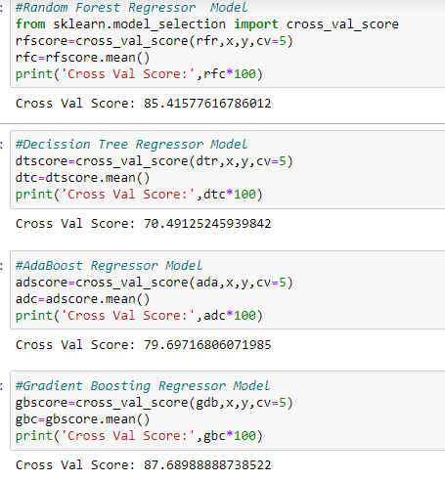
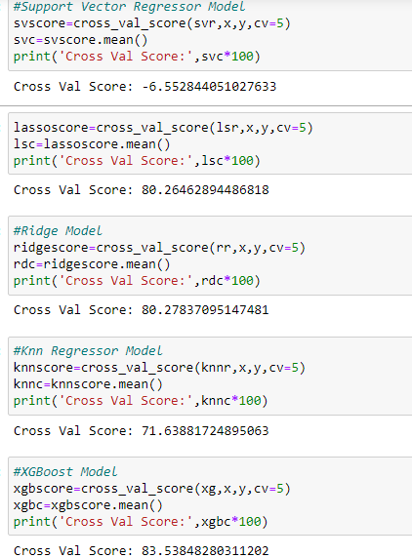
Cross validation of all the models
The score of all the models were either almost same or have been reduced which means that cross validation is not decreasing the accuracy, it is rather giving us a better approximation for that accuracy, including less overfitting.

Slide 35
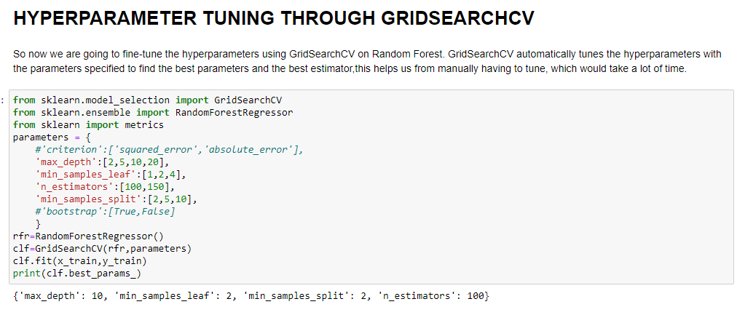
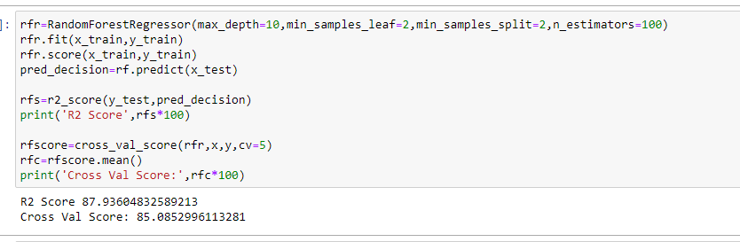
Hyperparameter through GridSearchCV
Hyper parameter optimisation in machine learning intends to find the hyper parameters of a given machine learning algorithm that deliver the best performance as measured on a validation set.
Using Scikit-Learn’s GridSearchCV method, we can explicitly specify every combination of settings to try. We do this with GridSearchCV, a method that, instead of sampling randomly from a distribution, evaluates all combinations we define.
So after evaluation through key metrics and cross validation,we choose Random Forest Regresssor and Gradient Boosting Regressor for hyperparametertunning through gridsearchcv. First Random Forest as below:

Slide 36
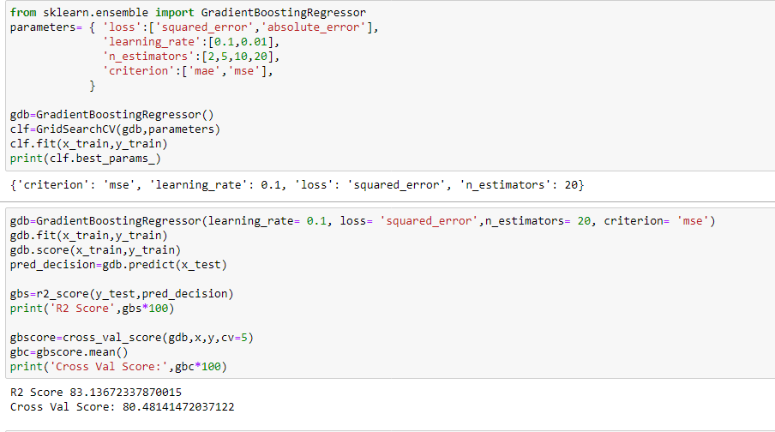
Hyperparameter tunning –Gradient Boosting

Slide 37
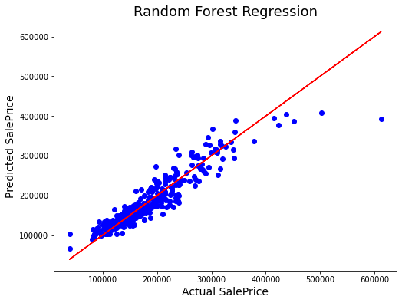
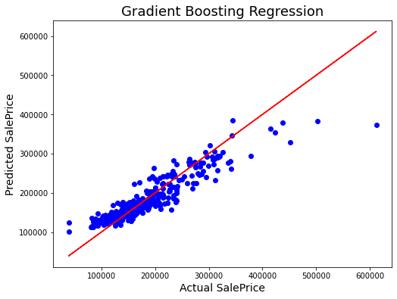
Best Fit Line Curve for both models
Thus we can see the best fit line covering the datapoints There are some datapoint far away from best fit line,which can increase the mse error so we can apply more techniques and regularise and improve the r2_score.

Slide 38
Model Analysis with Hyperparameter Tunning
After applying hyperparameter search through GridSearchcv we find that r2_score accuracy and cross validation score of Random Forest is performing better than gradient boosting which is 87.47% and 85.07 % for random forest and 83.13% and 80.47% for gradient boosting regression. Though the scores has reduced very slight for random forest but this is the best approximation after reducing overtting and variance. So we will select Random Forest as our best performing model for further deployment process. Also best fit line of Random forest shows better fit than gradient boosting regression model.

Slide 39
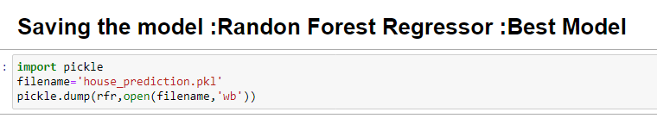
Saving the Best model using pickle method:

Slide 40
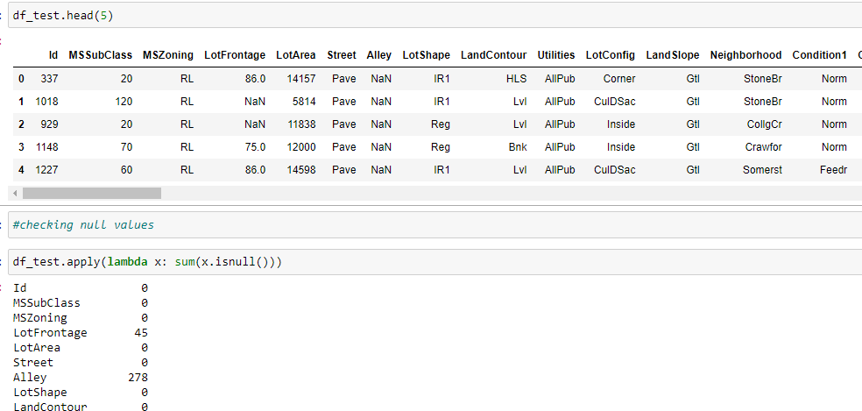
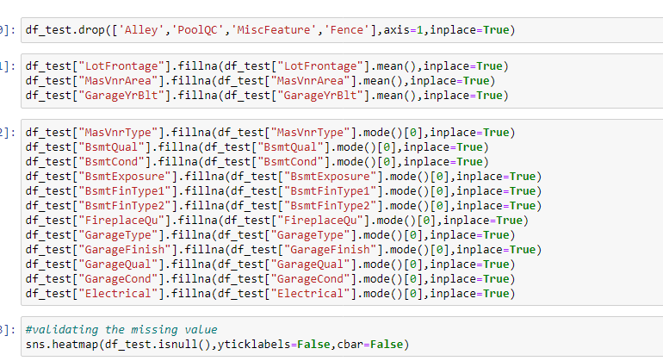
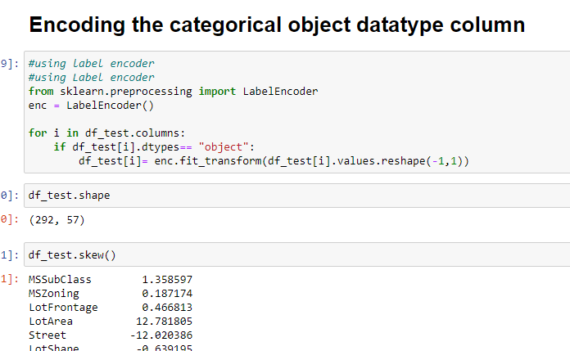
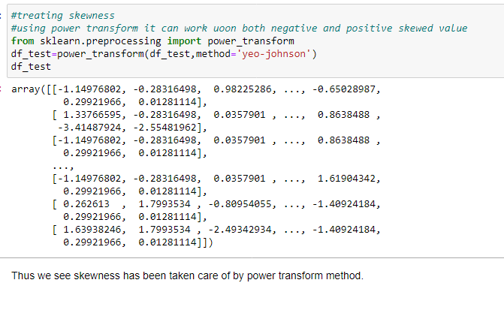
Using Test Data set and doing pre-processing
Here we will perform the same steps as we did for training dataset like handling missing data, dropping unnecessary columns, encoding non-categorical data, treating skewness, etc. Then, we will scale the data according to the best model requirements.

Slide 41
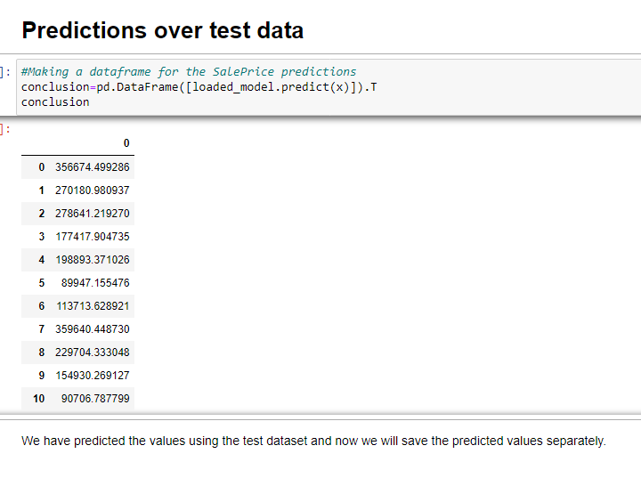
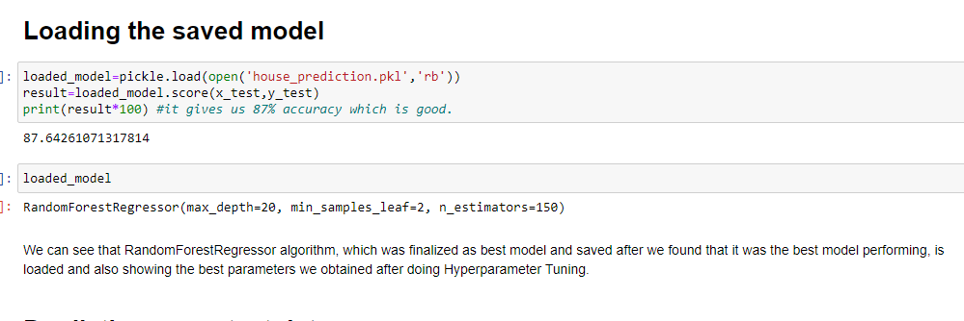
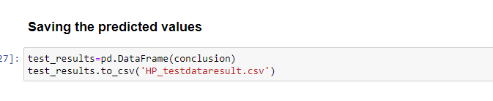
Loading the saved model and doing prediction test

Slide 42
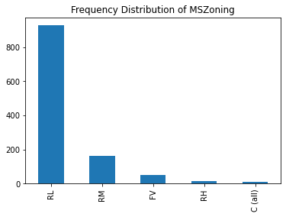
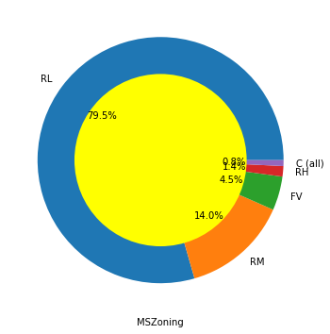




Visualizations
Univariate Analysis-by plotting some graphs of categorical data

Slide 43




Univariate Analysis for non_object data i.e continuous data:
Below are the some of distribution plot,boxplot of the continuous data

Slide 44



Bivariate Analysis of features with respect to SalePrice as our Target Variable
Some of the graphs as shown :

Slide 45






Scatter Plot (Sales price with respect to features)

Slide 46
Conclusion
The objective of the case was to create a predictive model that predicts saleprice of houses with the available independent variables which will be used by the management to understand how exactly the prices vary with the variables. So first I started with loading the dataset and carry out data analysis and then did the EDA process with visualization patterns using pie-plot, box plot, distribution plot, scatter plot and learnt about different relationship between the features and target variable.
After that I did pre-processing techniques like checking outliers, removal of skewness, encoding of categorical column, handling multicollinearity using Pearson correlation technique and find out the most important features using mutual information gain and SelectPercentile with respect to target variable and finally scaling of data for standardization.
Then I did the model training, building the model and finding out the best model out of several models on the basis of different evaluation metrices scores like Mean Absolute Error, Mean squared Error, Root Mean Squared Error,MAPE etc.
We find that Random Forest Regressor was the best fitted model as it was having less MAPE(which means how much predicted results and actual results are away,Less Mape means good fit model) ,more R2 score.Then I did cross validation to reduce overfitting problem and I found random forest regressor and gradient boosting are performing well. So I did hypertunning through GridsearchCv on these two models taking the parameters to improve the model. As the score was bit less which means that it may have reduced the overfitting problem. Thus concluded that Random Forest was performing well than gradient Boosting Model with the help of best fit line curve which was showing most the datapoints are covered by the best fit line and some are away from the line showing error which can be improved by doing selecting more parameters or taking more models.

Slide 47
Conclusion cont.
Thus finally concluding saying that Random Forest model was having the highest precision accuracy for prediction the sales price of the house with machine learning data. Hence by implementation of this model company can strategise the plans for firm growth and concentrate on areas that will yield high returns in short duration of time and limited manual intervention.
I saved the best model using pickle method and loaded the model for prediction test and find 87% accuracy which is very good. Thus this model can be used in further deployment process.
Then I have used the test dataset and performed all the pre-processing methods to it and then loaded the saved model that we have earlier obtained from train dataset and did the predictions over the test data and then saving the predictions separately in a csv file.
Overall, this dataset is good for predicting the Housing prices based on regression analysis using Random Forest Regressor as the best suited model.

Slide 48
Learning Outcomes of the Study in respect of Data Science
The case study pertains to the real-life scenario of the real estate -Housing category. Houses are not only shelters but also a relatively profitable investment tool. At this point, a realistic prediction of real estate sales prices is important for buyers/sellers and for those who want to invest in real estate (Bin, 2004). However, it is quite difficult to predict the exact value of a residential real estate because it includes a variety of features (environmental, spatial, structural, quality of materials used inside a house, etc.) that are difficult to measure and gather information about.
With the help of dataset provide to us ,we came to know the how saleprice of the houses influences different features of the house ,neighbourhoods, pavement, amenities ,basement, garage etc and how these features impact the cost using different visualization technique like distribution plot,scatter plot,,box plot ,distribution plot,pie-plot for feature study related category. We also came to know which are the top most features out of the lot influencing sales price of the house. We handled the raw data having nan values,missing values,outliers with the suitable imputation technique and zscore method respectively.We also removed the skewness through power transform method and finally scaled the data for further building of model

Slide 49
Learning Outcome cont.
Therefore in this project,we present various algorithms while predicting housing price with good accuracy. We tested various regression models such as linear regression, lasso regression, ridge regression, Random Forest regression, support vector regression , gradient boosting regression,XGBoost regression,AdaBoost regression,Descisiion Tree Regressor and selected the best fit among models and also done hyperparameter tuning. This project directs us that it can be the best application of the machine learning model in order to optimise the result.
Housing price prediction can help developer to determine the selling price of the house and can help customer to arrange right time to purchase or invest in the house.

Slide 50
Limitations of this work and Scope for Future Work
The dataset contains more than 50% of the missing value in many columns which we have to drop and rest we imputed with mean and mode imputation technique which can lead to biasness.
2.High skewed data can reduce the effectiveness of the model.
3.The case study did not take into consideration economic factors, interest rate, government subsidies and population.
4.For future work, we recommend that working on large dataset would yield a better and real picture about the model.
5. We can still improve error, model accuracy with some feature engineering and by doing some extensive hyperparameter tuning on it.

Slide 51
THANK YOU

