Slide 1

Malignant Comment Classifier Project
Submitted by Shilpi Mohanty

Slide 2
Business Problem Framing
The proliferation of social media enables people to express their opinions widely online. However, at the same time, this has resulted in the emergence of conflict and hate, making online environments uninviting for users. Although researchers have found that hate is a problem across multiple platforms, there is a lack of models for online hate detection.
Online hate, described as abusive language, aggression, cyberbullying, hatefulness and many others has been identified as a major threat on online social media platforms. Social media platforms are the most prominent grounds for such toxic behaviour. This can take a toll on anyone and affect them mentally leading to depression, mental illness, self-hatred and suicidal thoughts. .
Internet comments are bastions of hatred and vitriol. While online anonymity has provided a new outlet for aggression and hate speech, machine learning can be used to fight it. The problem we sought to solve was the tagging of internet comments that are aggressive towards other users. This means that insults to third parties such as celebrities will be tagged as unoffensive, but “u are an idiot” is clearly offensive.
Our goal is to build a prototype of online hate and abuse comment classifier which can used to classify hate and offensive comments so that it can be controlled and restricted from spreading hatred and cyberbullying.

Slide 3
Conceptual Background of the Domain Problem
Information and communication technology has changed rapidly over the past 20 years, with a key development being the emergence of social media.
Platforms that aggregate user content are the foundation of knowledge sharing on the Internet. Blogs, forums, discussion boards, and, of course, Wikipedia. But the catch is that not all people on the Internet are interested in participating nicely, and some see it as an avenue to vent their rage, insecurity, and prejudices.
In most of the online conversation platforms, social media users often face abuse, harassment, and insults from other users. Accordingly, a jargon word has been coined recently to address such behaviours as “cyberbullying”. The problem with this is that people will frequently write things they shouldn’t, and to maintain a positive community this toxic content and the users posting it need to be removed quickly. But they don’t have the resources to hire full-time moderators to review every comment. Due to which, many users stop expressing their ideas and opinions. Platforms struggle to facilitate conversations effectively.
To solve this problem, we are now building a model that identifies all the foul language and foul words, using which the online platforms like social media principally stops these mob using the foul language in an online community or even block them or block them from using this foul language.

Slide 4
Review of Literature
There is lot of information being delivered every time on social media sites. There is increase in hate speech that both may promotes violence towards. There was survey conducted asking American adult about problem of online harassment or bullying. Roughly four-in-ten Americans have personally experienced online harassment. 62% percent of participant in study considered it as major problem whereas 33% considered as minor problem. A total of 95% called it problem and 35% agreed for online companies to build better policies and tools for their platforms. Due to negativity, civilized conversations via social media are not present since hateful remarks are limiting individual to communicate and to have contradicting feelings.
There were endeavours by people to build the online wellbeing by moderating websites through crowd- sourcing schemes and remark criticizing, much of the time these procedures neglect to recognize the toxicity. Along these lines, we need to track down a potential method that can recognize the online toxicity of client content successfully.
As Computer understands binary information and in real world we have information in different structures for example pictures or text. So, we need to change over the information of real world into binary for legitimate processing through the computer. In this paper, they have utilized this changed over information and apply Machine learning strategies to arrange online remarks.
Nguyen and Nguyen made model consisting of 2 components Deep Learning Classifier and Tweet Processor. Tweet Processor is used for applying semantic rules and preprocessing on datasets to capture important information. They used character-level embeddings to increase information for word-level embedding. They then used DeepCNN for character level embeddings. After that a Bidirectional Long Short-Term Memory network (BiLSTM) produces a sentence-wide feature representation from the global fixed size feature and word- level embedding. Their model produce an accuracy of 86.63% on Standford Twitter Sentiment Corpus.

Slide 5
Review of Literature cont.
Liang-Chih Yu et al. proposes a word vector refinement model. This refinement can be applied to any of already trained word vectors. Based on semicolon lexicon, their model gives high rank to sentimentaly similar neighbour and vice versa. Their experimental results show that their proposed method can perform better for various neural networks. It also have better performance for both sentimental embedding and conventional word embeddings.
A method was introduced by Wulczyn et al. develop method to analyze personal attacks. Theygenerated over 63M machine labeled and 100k human labeled comments. They found that attacks on Wikipedia are not limited to a set of users.
Hossein Hosseini et al. [15] apply the attack on the Perspective toxic comment detection website. This website gives toxic score to any phrase. They tried to modify a toxic phrase having same meaning so that model will give it very low toxic scores. This existence is harmful for toxic detection system.
In another methodology, Convolutional Neural Networks (CNN) was utilized in text characterization over online substance [16], with no information on syntactic or semantic language.
Y. Chen et al. [17] propose the Lexical Syntactic Feature (LSF) architecture to distinguish offensive content and recognize likely offensive clients in web-based media. Their experiments shows that LSF algorithms for sentence and user offensiveness outperformed traditional learning- based methods. Their LSF can adapt to various writing styles of English language and can tolerate informal and misspelled content.
Jigsaw and Googles Counter Abuse Technology team introduce project named Perspective. It uses machine learning models to identify abusive comments. The models score a phrase based on the perceived impact the text may have in a conversation and have capability to classifying comments.

Slide 6
Motivation for the Problem Undertaken
Detecting Toxic comments has been a great challenge for the all the scholars in the field of research and development. This domain has drawn lot of interests not just because of the spread of hate but also people refraining people from participating in online forums which diversely affects for all the creators/content-providers to provide a relief to engage in a healthy public interaction which can be accessed by public without any hesitation.
There have been sure turns of developments in this area which includes couple of models served through API. But the models still make errors and still fail to provide an accurate solution to the problem.
Our goal is to build a prototype of online hate and abuse comment classifier which can used to classify hate and offensive comments so that it can be controlled and restricted from spreading hatred and cyberbullying.

Slide 7
ANALYTICAL PROBLEM FRAMING MATHEMATICAL/ANALYTICAL MODELLING OF THE PROBLEM
There are two different datasets i.e. train and test dataset provided to us.
The training data consist of both dependent and independent variables. As it is a multiclass-label problem it has 6 independent/target variables. Here the target variables are named as “malignant”, “highly malignant”, “rude”, “threat”, “abuse” and “loathe”. The label can be either 0 or 1, where 0 denotes a NO while 1 denotes a YES. There are various comments which have multiple labels. The first attribute is a unique ID associated with each comment.
Clearly it is a binary classification problem as the target columns giving binary outputs and all independent variables have text so it is clear that it is a supervised machine learning problem where we can use the techniques of NLP and classification-based algorithms of Machine Learning. Here we will use NLP techniques like word tokenization, lemmatization, stemming and tfidf vectorizer then those processed data will be used to create best model using various classification based supervised ML algorithms like Logistic Regression, Multinomial NB, LGBM Classifier, LinearSVC, Passive aggressive Classifier.

Slide 8
Data Sources and their formats
Data set provided by Flip Robo was in the format of CSV (Comma Separated Values). The data set contains the training set, which has approximately 1,59,000 samples and the test set which contains nearly 1,53,000 samples. All the data samples contain 8 fields which includes ‘Id’, ‘Comments’, ‘Malignant’, ‘Highly malignant’, ‘Rude’, ‘Threat’, ‘Abuse’ and ‘Loathe’.
The label can be either 0 or 1, where 0 denotes a NO while 1 denotes a YES. There are various comments which have multiple labels. The first attribute is a unique ID associated with each comment.
Thus, data consists of one input feature, the string data for the comments, and six labels for different categories of toxic comments: Malignant, ‘Highly malignant’, ‘Rude’, ‘Threat’, ‘Abuse’ and ‘Loathe’.
Columns | Description
Malignant: | It is the Label column, which includes values 0 and 1, denoting if the comment is malignant or not.
Highly Malignant: | It denotes comments that are highly malignant and hurtful.
Rude: | It denotes comments that are very rude and offensive.
Threat: | It contains indication of the comments that are giving any threat to someone.
Abuse: | It is for comments that are abusive in nature.
Loathe: | It describes the comments which are hateful and loathing in nature.
ID: | It includes unique Ids associated with each comment text given.
Comment text: | This column contains the comments extracted from various social media platforms.

Slide 9
Data pre-processing
Step in data preprocessing
We did the text processing using Natural language processing techniques.
In pre-processing we started off checking null values,duplicate values,then removing of punctuation and special character from the comments and removing column which are not important like column id,conversion of comments to lowercase. We removed the stop words which are useless as they do not add any value to the dataset. Further we performed stemming for the words. Lastly, we applied TFIDF vectorizer and afterward split the information into preparing and testing for the further use.
Dataset
Remove white spaces,numbers,urls,digits,stopwords
Lemmatization
Classification Model Building
Model evaluation
Final label malignant/toxic or not

Slide 10
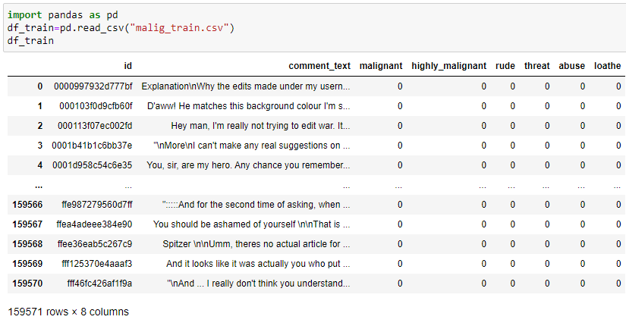
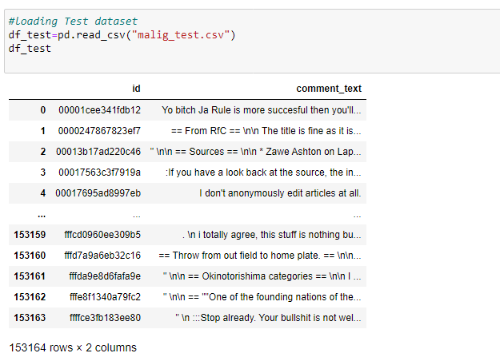
Data Preprocessing
First loading the train and test dataset and checking their datatypes/info

Slide 11
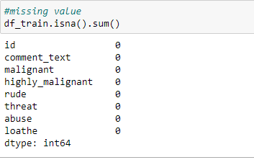
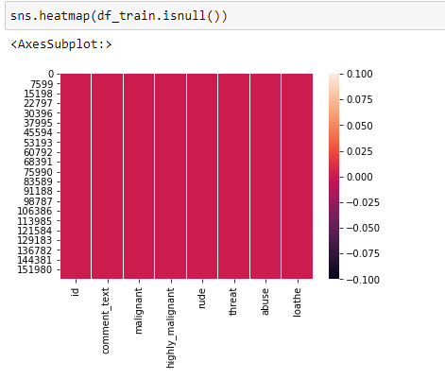
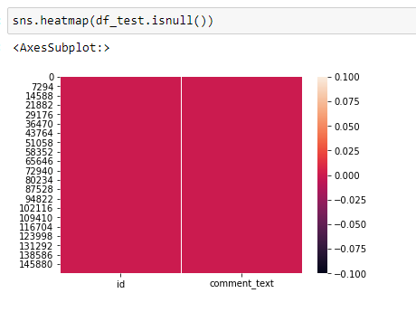
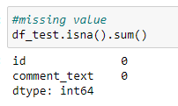


Checking Null values and duplicate values
We found that there is no null values present in the train and test dataset
We found that there is no duplicated values present in the train and test dataset.

Slide 12
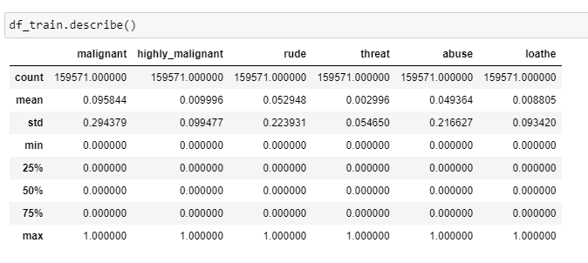
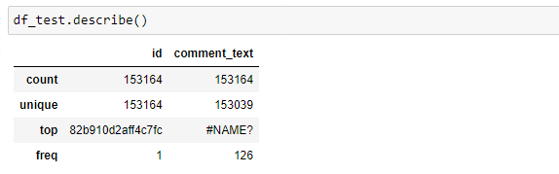
statistical summary of the dataset
The Describe function returns the statistical summary of the dataframe or series. It Analyzes both numeric and object series, as well as DataFrame column sets of mixed data types. The output will vary depending on what is provided.
For numeric data, the result’s index will include count, mean, std, min, max as well as lower, 50 and upper percentiles. By default the lower percentile is 25 and the upper percentile is 75. The 50 percentile is the same as the median.
For object data (e.g. strings or timestamps), the result’s index will include count, unique, top, and freq. The top is the most common value. The freq is the most common value’s frequency. Timestamps also include the first and last items.

Slide 13
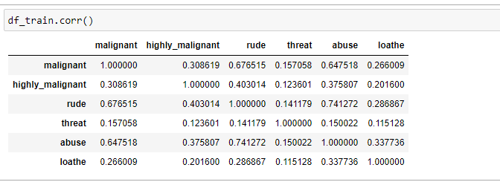
Correlation Analysis:
Correlation analysis is a statistical method used to measure the strength of the linear relationship between two variables and compute their association.
A positive correlation indicates that the values tend to increase with one another and a negative correlation indicates that values in one set tend to decrease with an increase in the other set.
: Thus we see that malignant is 67% positively correlated with rude and 64% positively correlated with abuse. Also ruse is 74% positively correlated with abuse. While others are less correlated less than 40%. Interesting things to be observed is that though, highly_malignant is also a malignant comment, the correlation between them is only 0.31

Slide 14
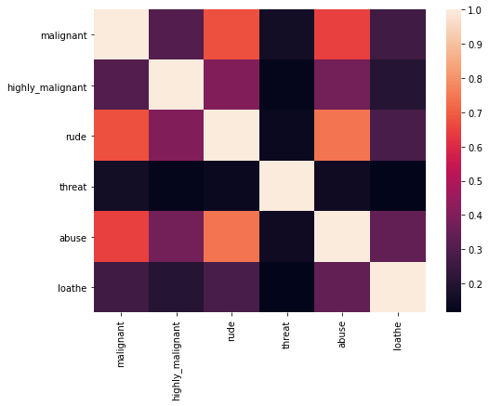
Correlation using Heatmap
Correlation heatmaps are a type of plot that visualize the strength of relationships between numerical variables. Correlation plots are used to understand which variables are related to each other and the strength of this relationship.
We get to know from heatmap that there is no strong relationship between label and features.
Dark shades are highly positively correlated with the label and light shades are highly negatively correlated with the label.

Slide 15
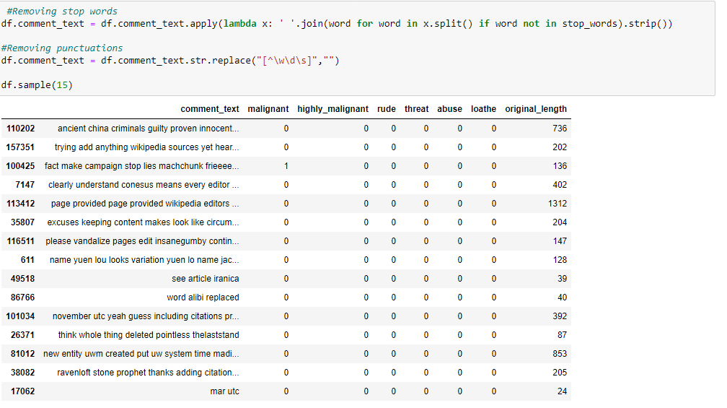
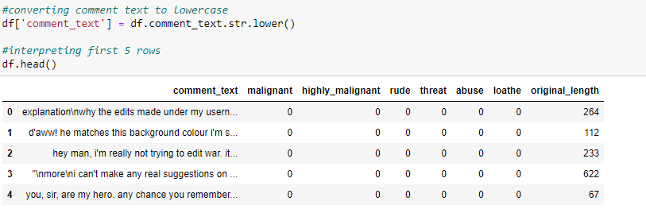
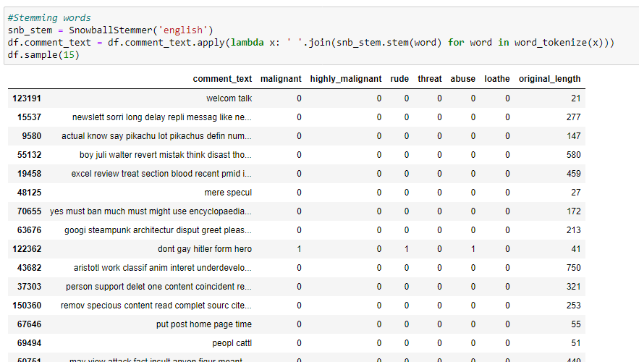
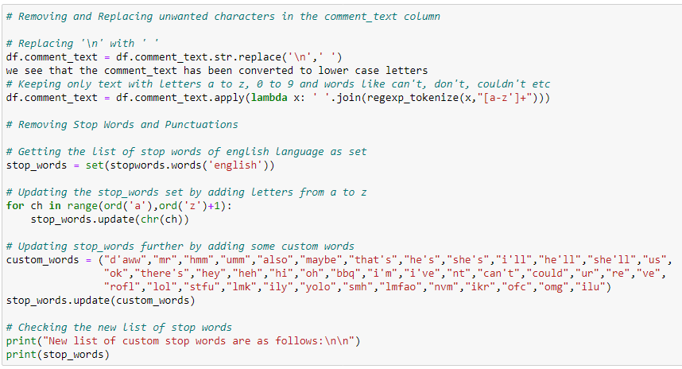
Removing unwanted columns and text
Removal of id column
Conversion to lowercase
Handling unwanted characters(stopwords)
Stemming

Slide 16
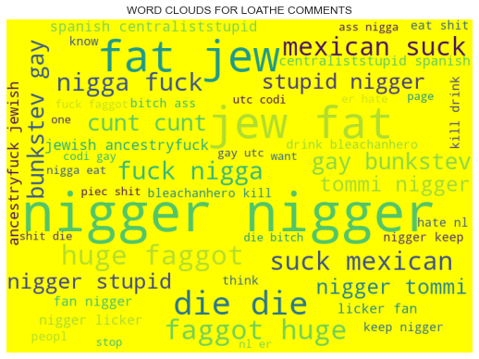
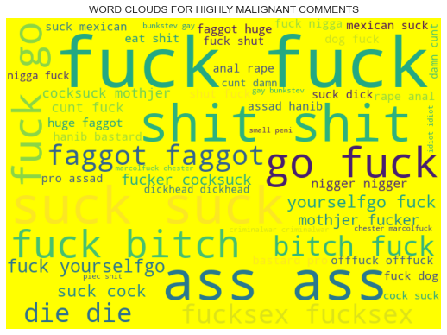
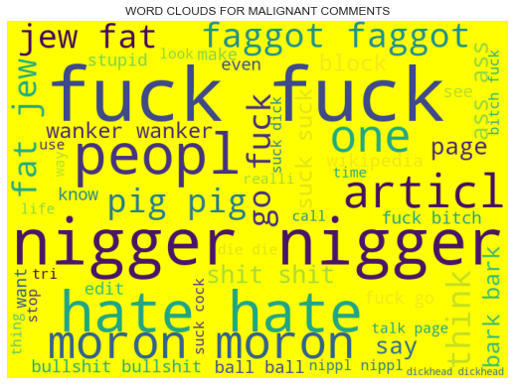
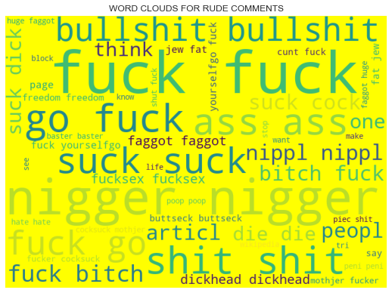
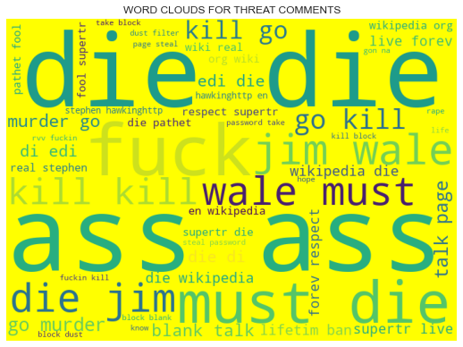
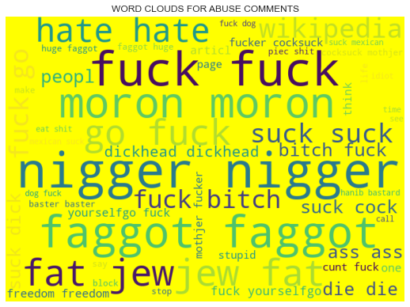
Data Inputs- Logic- Output Relationships
With the help of wordcloud,we can see loud words in each label.
We also carry out correlation of target variable and features.

Slide 17
Hardware and Software Requirements and Tools Used
Hardware Used:
i. RAM: 8 GB
ii.CPU: Intel® Core™ i3-1005G1 CPU @1.20GHz
Iii. GPU: Intel® UHD Graphics
Software Used:
i. Programming language: Python
ii.Distribution: Anaconda Navigator
iii.Browser based language shell: Jupyter Notebook
Libraries/Packages Used:
1. Pandas- a library which is used to read the data, visualisation and analysis of data.
2. NumPy- used for working with array and various mathematical techniques.
3. Seaborn- visualization tool for plotting different types of plot.
4. Matplotlib- It provides an object-oriented API for embedding plots into applications.
5. Scikit-learn (Sklearn) is the most useful and robust library for machine learning in Python. It provides a selection of efficient tools for machine learning and statistical modeling including classification, regression, clustering and dimensionality reduction via a consistence interface in Python. This library, which is largely written in Python, is built upon NumPy, SciPy and Matplotlib

Slide 18
Model/s Development and Evaluation
The objective of the case study is to build a prototype of online hate and abuse comment classifier which can used to classify hate and offensive comments so that it can be controlled and restricted from spreading hatred and cyberbullying. Thus this is a classification binary problem so we will be loading all the libraries related to it which is as below:
Sklearn
Sklearn.linear_model
Sklearn.metrics
Sklearn.model_selection
Lightgbm
Sklearn.naive_bayes

Slide 19
Testing of Identified Approaches (Algorithms)
1.Logistic Regression Model
2.LinearSVC
3.MultimonialNB
4.Passive Aggressive Classifier
5. SDGClassifier(Stochastic Gradient Classifier)
6.LGBMClassifier(Light gradient boosting machine)

Slide 20
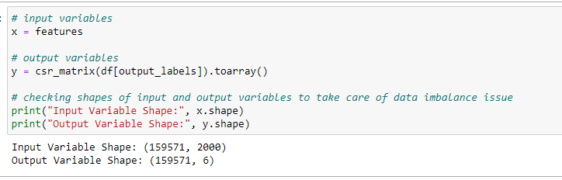
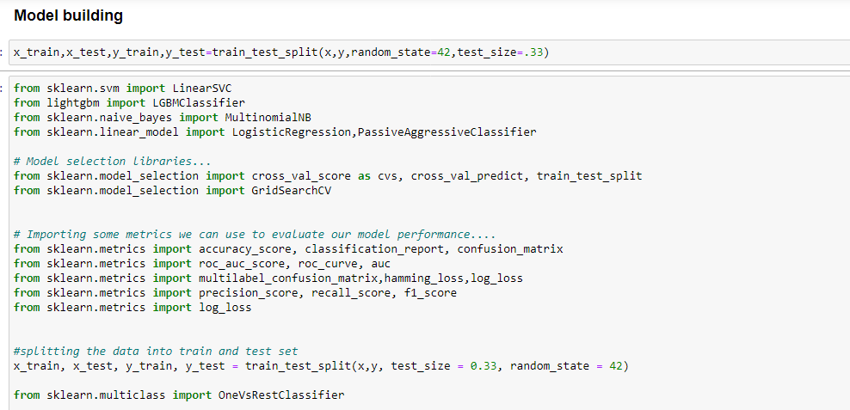
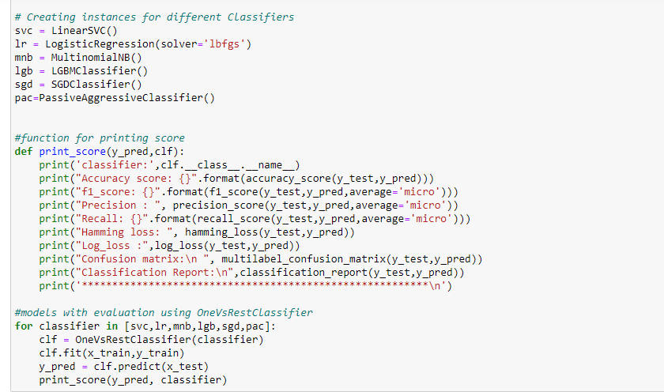
Run and Evaluate selected models
We have used here total of 6 classification Models with logistic regression as our base model with test_train_split choosing .33% as test_size.First we convert the string into numerical vectors using TF_IDF(Term frequency-inverse document frequency)

Slide 21
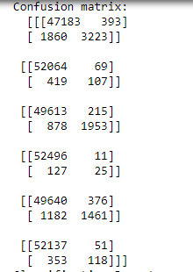
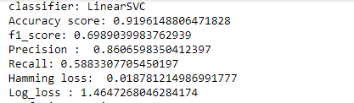
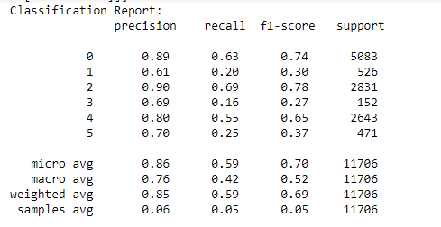
Model 1:LinearSVC
The Linear Support Vector Classifier (SVC) method applies a linear kernel function to perform classification and it performs well with a large number of samples.The objective of a Linear SVC (Support Vector Classifier) is to fit to the data you provide, returning a "best fit" hyperplane that divides, or categorizes, your data. From there, after getting the hyperplane, you can then feed some features to your classifier to see what the "predicted" class is.
The model give the accuracy of 91.96% ,F1_score of 69.89%,Precison rate of 86.06%.,Recall rate of 58.83%
Hamming loss of 0.018 & Log_loss of 1.46.

Slide 22
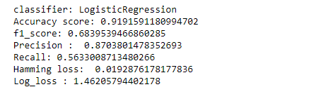
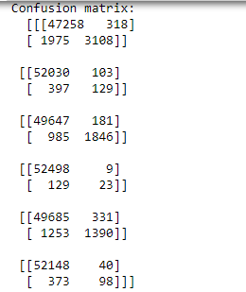
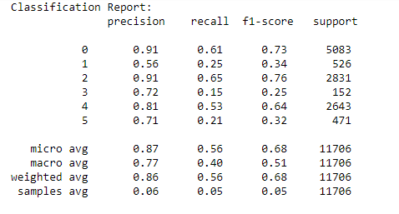
Model 2.Logistic Regression
It can be used to solve problems with binary and multi-class categorization. Because it can generate probabilities and classify new data using both continuous and discrete datasets, logistic regression is a key machine learning approach.
The model give the accuracy of 91.91% F1_score of 68.39%,Precision rate of 87.03,Recall rate of 56.33%
Hamming loss of 0.019 & Log_loss of 1.46

Slide 23
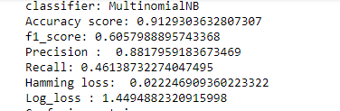
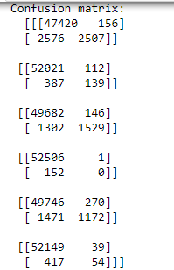
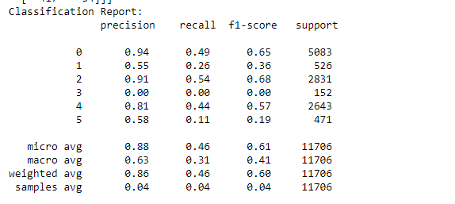
Model 3.MultinomialNB
The multinomial Naive Bayes classifier is suitable for classification with discrete features (e.g., word counts for text classification). The multinomial distribution normally requires integer feature counts. However, in practice, fractional counts such as tf-idf may also work. The Multinomial Naive Bayes algorithm is a Bayesian learning approach popular in Natural Language Processing (NLP). The program guesses the tag of a text, such as an email or a newspaper story, using the Bayes theorem. It calculates each tag's likelihood for a given sample and outputs the tag with the greatest chance
The model give the accuracy of 91.29% ,F1_score of 60.57% ,Precision of 88.17%,Recall of 46.14%
Hamming loss of 0.022 and log_loss of 1.45

Slide 24
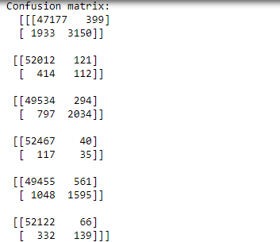
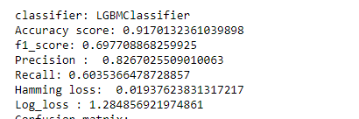
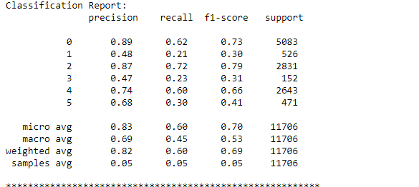
Model 4:LGBMClassifier
LightGBM is a fast, distributed, high performance gradient boosting framework based on decision tree algorithms, used for ranking, classification and many other machine learning tasks. LightGBM classifier helps while dealing with classification problems.
The model give the accuracy of 91.70% ,f1_score of 69.77%,Precision of 82.67%,Recall of 60.35%.
Hamming loss of 0.019 and Log_loss of 1.28.

Slide 25
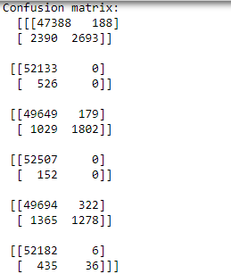
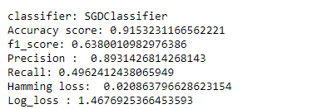
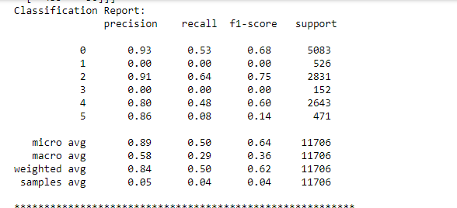
Model 5:SDGClassifier
Stochastic Gradient Descent (SGD) is a simple yet very efficient approach to fitting linear classifiers and regressors under convex loss functions such as (linear) Support Vector Machines and Logistic Regression. Even though SGD has been around in the machine learning community for a long time, it has received a considerable amount of attention just recently in the context of large-scale learning.
SGD has been successfully applied to large-scale and sparse machine learning problems often encountered in text classification and natural language processing.
The model give the accuracy of 91.53% ,f1_score of 63.80%,Precision of 89.31%,Recall of 49.62%.
Hamming loss of 0.020 and Log_loss of 1.46.

Slide 26
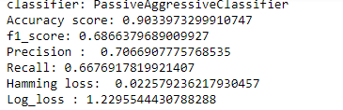
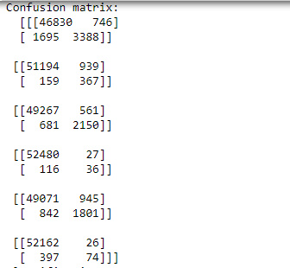
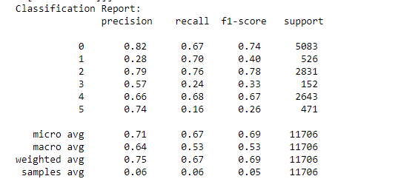
Model 6:Passive Aggressive Classifier
Passive-Aggressive algorithms are generally used for large-scale learning. This is very useful in situations where there is a huge amount of data and it is computationally infeasible to train the entire dataset because of the sheer size of the data.
The model give the accuracy of 90.33%,F1_score of 68.66%,Precision of 70.66,Recall of 66.76%.
Hamming Loss:0.022 & Log loss of 1.22.

Slide 27
Key Metrics Used
The key metrics used here were Accuracy Score, Precision, Recall, F1 score,Hamming loss,Log_loss,Roc_Auc score of final model and Confusion Matrix. We tried to find out the best parameters and also to increase our scores by using Hyperparameter Tuning and used GridSearchCV method.
Accuracy Score:Model accuracy is a machine learning model performance metric that is defined as the ratio of true positives and true negatives to all positive and negative observations.
Precision:The model precision score measures the proportion of positively predicted labels that are actually correct. Precision is also known as the positive predictive value.
Recall:Model recall score represents the model’s ability to correctly predict the positives out of actual positives.
F1: Model F1 score represents the model score as a function of precision and recall score. The F1 score becomes especially valuable when working on classification models in which your data set is imbalanced.
Roc Auc Score: The Receiver Operator Characteristic (ROC) curve is an evaluation metric for binary classification problems. It is a probability curve that plots the TPR against FPR at various threshold values.
Confusion Matrix is one of the evaluation metrics for machine learning classification problems, where a trained model is being evaluated foraccuracy and other performance measures.
Hamming loss: Hamming loss is the fraction of wrong labels to the total number of labels. In multi-class classification, hamming loss is calculated as the hamming distance between y_true and y_pred.It is always between 0 and 1, lower being better.
Log loss: Log Loss is the most important classification metric based on probabilities. For any given problem, a lower log loss value means better predictions.Log-loss is indicative of how close the prediction probability is to the corresponding actual/true value (0 or 1 in case of binary classification). The more the predicted probability diverges from the actual value, the higher is the log-loss value.

Slide 28

Model Analysis
From the above 6 models comparison, it is clear that Linear Support Vector Classifier performs better with Accuracy Score: 91.96% and Hamming Loss: 0.018 and F1_score is 70% than the other classification models,we are considering specially F1 score and hamming loss as the basis of evaluation of best model,as f1_score can goes well with imbalance dataset.
Therefore we will use Linear Support Vector Classifier for further Hyperparameter tuning process.
LinearSVC Model

Slide 29
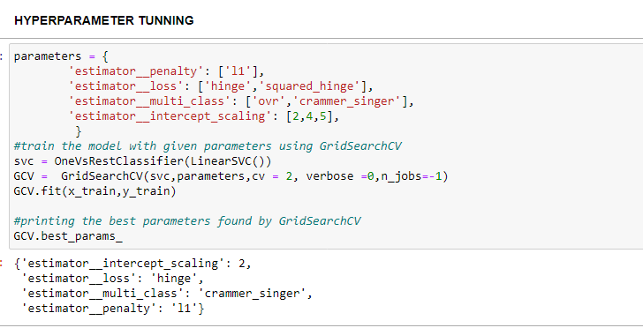
Hyperparameter through GridSearchCV
Hyper parameter optimisation in machine learning intends to find the hyper parameters of a given machine learning algorithm that deliver the best performance as measured on a validation set.
GridsearchCV: GridSearchCV is a technique to search through the best parameter values from the given set of the grid of parameters. It is basically a cross-validation method. the model and the parameters are required to be fed in. Best parameter values are extracted and then the predictions are made.
Thus on 4 parameters have been used under the varaible parametrs that is used in gridsearchcv for finding the best result. we see the best parameters which will help in improving the performance of the model using gridserachcv.Then we use this best parameters to the gridseacrhcv function.

Slide 30
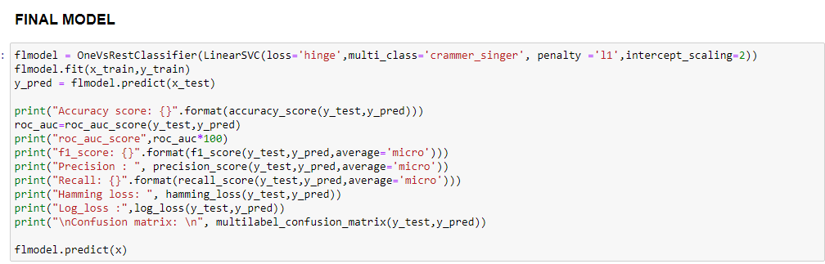
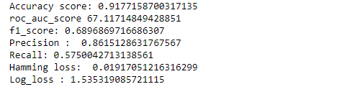
Hyperparameter tunning –with best parameters-LinearSVC
So we create final model through best parameters using Gridsearchcv.
Thus our final models shows the accuracy score of 91.77%,f1_score of 69%,roc_auc_score 67.12%, Precision:86.15%,Recall:57.50%,Hamming loss:0.019,Log_loss : 1.53.

Slide 31
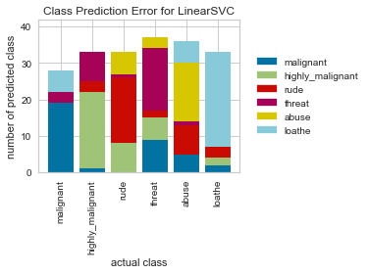
Class Prediction Error:
The Yellowbrick ClassPredictionError plot is a twist on other and sometimes more familiar classification model diagnostic tools like the Confusion Matrix and Classification Report. Like the Classification Report, this plot shows the support (number of training samples) for each class in the fitted classification model as a stacked bar chart. Each bar is segmented to show the proportion of predictions (including false negatives and false positives, like a Confusion Matrix) for each class. We can use a ClassPredictionError to visualize which classes the classifier is having a particularly difficult time with, and more importantly, what incorrect answers it is giving on a per-class basis. This can often enable us to better understand strengths and weaknesses of different models and particular challenges unique to the dataset.
TheLinearSVC appears to be fairly good at correctly predicting malignant based on the features of the toxic comments, it often incorrectly labels rude as hihly_malignant and mistakes highly malignant for loathe.Using these new insights, one could easily detect the features causing issues and quickly address the problem

Slide 32
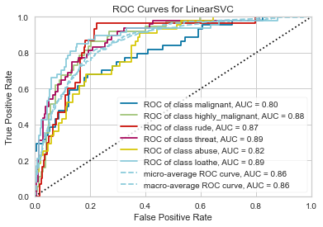
AUC_ROC of Final Model
ROC curves are typically used in binary classification, and in fact the Scikit-Learn roc_curve metric is only able to perform metrics for binary classifiers. As a result, it is necessary to binarize the output or to use one-vs-rest or one-vs-all strategies of classification. The visualizer does its best to handle multiple situations, but exceptions can arise from unexpected models or outputs.
Thus we can see for malignant, auc_roc score is 80%,for highly_malignant,its 88%,for class rude ,its 87%,for class threat-it is showing 89%,for class abuse, it is 82% and for class loathe is 89%.Thus it is well able to distinguish toxic comments for the different classes.

Slide 33
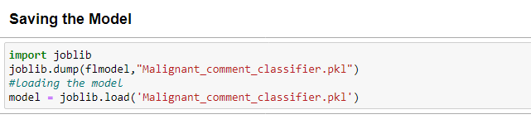
Saving the Best model using joblib method:

Slide 34
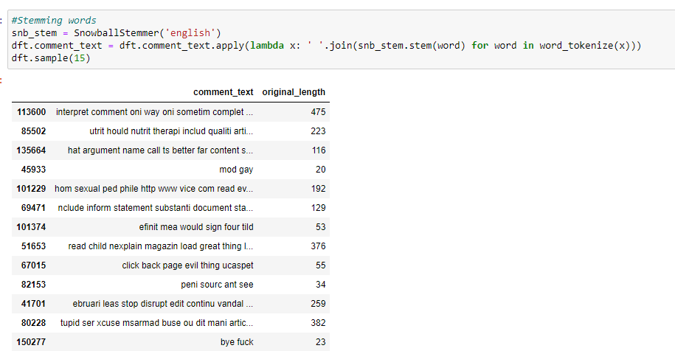
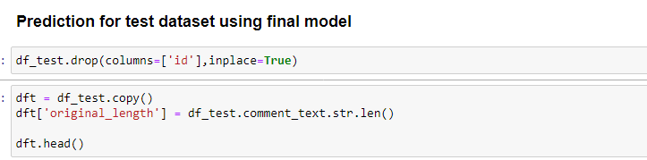
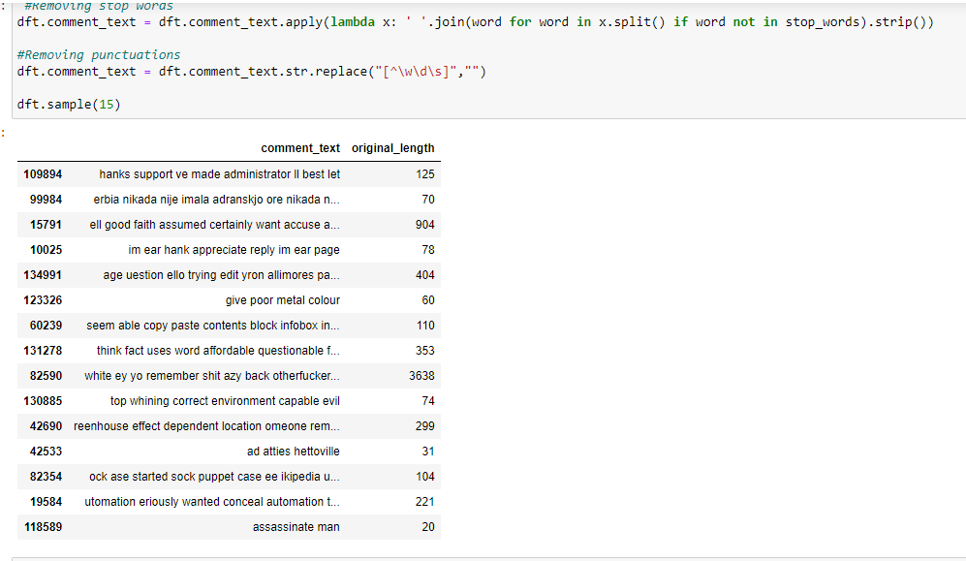

Loading the saved model and doing prediction test
We are performing the same action of data cleaning as we perform in train dataset.

Slide 35

Visualizations
Now, we will see the different plots done with this train dataset in order to know the insight of the data present. Below are the codes given for the plots and the output obtained:
As we see, there are higher number of comments belonging to malignant label followed by rude and abuse and comments in highly_malignant, loathe and threat are low. So, here we have the problem of imbalanced data and therefore we will have to be careful in selecting the correct evaluation metric later. We can further check to see number of labels that a comment have.

Slide 36






CountPlot
Below are the some of count plot:-
Thus we see that malignant comment has occurred 15294 times, highly_malignant comment has occurred around 1595 times, loathe comment has occurred 1405 times, rude comment has occurred 8449 times,abuse comment has occurred 7877 times and threat comment has occurred 478 times.

Slide 37

Pie-Plot
Thus we see that malignant comment occupies around 44% of the total toxic comment followed by rude comment of about 24.07% followed by abuse of 22.44 % and the least is threat of about 1.36%.

Slide 38
Visualization of most frequent words used in the tweets:
From wordcloud of malignant comments, it is clear that it mostly consists of words like fuck, nigger, moron, hate, suck etc.
From wordcloud of highly_malignant comments, it is clear that it mostly consists of words like ass, fuck, bitch, shit, die, suck, faggot ect.
From wordcloud of loathe comments, it is clear that it mostly consists of words like nigga, stupid, nigger, die, gay cunt etc.
From wordcloud of rude comments, it is clear that it mostly consists of words like nigger, ass, fuck, suck, bullshit, bitch etc.

Slide 39
Visualization through Wordcloud-continue
From wordcloud of threat comments, it is clear that it mostly consists of words like die, must die, kill, murder etc.
From wordcloud of abuse comments, it is clear that it mostly consists of words like moron, nigger, fat, jew, bitch etc.

Slide 40
Conclusion:Key Findings
The objective of the case was to build a prototype of online hate and abuse comment classifier which can used to classify hate and offensive comments so that it can be controlled and restricted from spreading hatred and cyberbullying. We are given huge number of comments having multiple labels and also, they are in binary form.
So first I started with loading the dataset and carry out data analysis and then did the EDA process by removing all the unwanted words,stopwords etc from the toxic comments with visualization patterns using pie-plot, count plot, bar plot and visualize through wordcloud and learnt about different relationship between the features and target variable.
Then I did the model training first using TFIDFvectoriser, I converted comments into vectors first , building the model and finding out the best model out of several classification models on the basis of different evaluation metrices scores like accuracy score,cross validation,f1,confusion matrix,auc_roc plot ,hamming loss,log loss.

Slide 41
Conclusion cont.
We find that LinearSVC Classifier model was the best fitted model as it was having high accuracy,high F1_score and low hamming loss among other models.Then I did hyperparameter tunning through GridSearchCv on best model taking the parameters to improve the score.Also the ROC_AUC score was 90% which is very good.Thus, concluded that LinearSVC was performing well among other models.
Thus, finally concluding saying that LinearSVC was having the highest precision accuracy for prediction of toxic comments with machine learning data. Hence by implementation of this model ,
I saved the best model using joblib method and loaded the model for prediction test. Thus, this model can be used in further deployment process.
Therefore in this project, we present various algorithms while predicting toxic comments using classification models with good accuracy. We tested various models such as logistic regression, LinearSVC,SDG Classifier,LightGBMClassifier,MultinomialNB,PaasiveAgrressiveClassifier and selected the best fit among models and also done hyperparameter tuning.Also we applied different evaluation metrics like hamming loss and log loss apart from accuracy.
This project directs us that it can be the best application for predicting the toxic and malignant comments using NLP and machine learning model.

Slide 42
Learning Outcomes of the Study in respect of Data Science
Among 159,000 comments in the main database, there were about 8% of the cases that were labelled as toxic, while the remaining 92% were labelled as nontoxic.
Harmful or toxic comments in the social media space have many negative impacts to society. The ability to readily and accurately identify comments as toxic could provide many benefits while mitigating the harm.
The case study pertains to cases of cyberbullying and trolls on various social media platforms having toxic and abusive comments. With the help of dataset provide to us, we came to know the which are the loud words affecting the social media space. We observe this using different visualization technique like wordcloud, bar plot, pie plot etc.
We knew about different Natural Language Processing techniques to be applied for text processing for data cleaning like conversion to lowercase, removal of stopwords,removal of unwated words like question mark,punctuation etc,stemming and finally converting the strings into vectors using TFIDF vectorizer for building of model.

Slide 43
Limitations of this work and Scope for Future Work
The dataset was imbalance and having bad comments texts.
Time consumption was more for model building and there was issue of space also, so I limited max_feature to 2000 instead of taking more values because there was memory issue and google_colab too,it took time and many times crashed or hanged.
Deep Learning architecture like LSTM, Transformers, BERT can be used to solve the same problem.
It can also be experimented with clustering — an unsupervised learning approach.skmultilearn.cluster module provides various clustering algorithms to solve multi-label classification.
We suggest a plan to improve the NLP classifiers: first by using otheralgorithms which such as Support Vector Clustering (SVC) and Convolutional Neural Networks (CNN).We can use more classification models to study the same.
We can still improve error, model accuracy with some feature engineering and by doing some extensive hyperparameter tuning on it.

Slide 44
THANK YOU

