Slide 1

Rating Review Prediction Project
Submitted by Shilpi Mohanty

Slide 2
Business Problem Framing
The rapid development of Web 2.0 and e-commerce has led to a proliferation in the number of online user reviews. Online reviews contain a wealth of sentiment information that is important for many decision-making processes, such as personal consumption decisions, commodity quality monitoring, and social opinion mining. Mining the sentiment and opinions that are contained in online reviews has become an important topic in natural language processing, machine learning, and Web mining.
Customer reviews and eCommerce website profits go hand in hand. Good reviews are a sign of customer loyalty, and businesses that have a lot of positive reviews tend to grow their revenues twice as fast as their competitors. By understanding exactly how your business will benefit from customer reviews, you can work on a strategy that will help you to get more of them.
We have a client who has a website where people write different reviews for technical products. Now they are adding a new feature to their website i.e. the reviewer will have to add stars (ratings) as well with the review. The rating is out 5 stars and it only has 5 options available 1 star, 2 stars, 3 stars, 4 stars and 5 stars. Now they want to predict ratings for the reviews which were written in the past and they don’t have a rating. So, we have to build an application which can predict the rating by seeing the review.

Slide 3
Conceptual Background of the Domain Problem
Sentiment is an attitude, thought, or judgment prompted by feeling. Sentiment analysis, which is also known as opinion mining, studies people’s sentiments towards certain entities. From a user’s perspective, people are able to post their own content through various social media, such as forums, micro-blogs, or online social networking sites. From a researcher’s perspective, many social media sites release their application programming interfaces (APIs), prompting data collection and analysis by researchers and developers. However, those types of online data have several flaws that potentially hinder the process of sentiment analysis. The first flaw is that since people can freely post their own content, the quality of their opinions cannot be guaranteed. he second flaw is that ground truth of such online data is not always available. A ground truth is more like a tag of a certain opinion, indicating whether the opinion is positive, negative, or neutral.
Rating prediction is a well-known recommendation task aiming to predict a user’s rating for those items which were not rated yet by customers. Predictions are computed from users’ explicit feedback i.e., their ratings provided on some items in the past. Another type of feedback are user reviews provided on items which implicitly express users’ opinions on items. Recent studies indicate that opinions inferred from users’ reviews on items are strong predictors of user’s implicit feedback or even ratings and thus, should be utilized in computation. As far as we know, all the recent works on recommendation techniques utilizing opinions inferred from users’ reviews are either focused on the item recommendation task or use only the opinion information, completely leaving users’ ratings out of consideration. The approach proposed in this project is filling this gap, providing a simple, personalized and scalable rating prediction framework utilizing both ratings provided by users and opinions inferred from their reviews. Experimental results provided on dataset containing user ratings and reviews from the real-world Amazon and Flipkart Product Review Data show the effectiveness of the proposed framework.

Slide 4
Review of Literature
When you think about buying something online, how do you decide whether to follow through with your purchase? If you’re like most shoppers, you might turn to on online reviews for guidance.
According to research from Nielsen, 73% of online respondents use reviews to make purchase decisions. “Perhaps nothing is more important than word-of-mouth testimonials from satisfied customers, whether in person or online via reviews and social media,” added Patrick Dodd, chief commercial offer at Nielsen.
If online reviews aren’t available, 92% of customers are impacted, according to a survey from marketing agency Fan & Fuel. That group expressed a lot of hesitation in what would happen next; Thirty-five percent said they were less likely to buy, 32% said they’d wait until they could do more research, 23% said their buying decision would be difficult, and 2% said that they simply wouldn’t buy the product/service.
The goal of the project is to build an application which can predict the rating by seeing the review. In the long term, this would allow people to better explain and review their purchase with each other in this increasingly digital world

Slide 5
Review of Literature cont.

Slide 6
Motivation for the Problem Undertaken
We have a client who has a website where people write different reviews for technical products. Now they are adding a new feature to their website i.e. the reviewer will have to add stars (ratings) as well with the review. The rating is out 5 stars and it only has 5 options available 1 star, 2 stars, 3 stars, 4 stars and 5 stars. Now they want to predict ratings for the reviews which were written in the past and they don’t have a rating. So, we have to build an application which can predict the rating by seeing the review.
Many projects review are not accompanied by scale rating system and it is herculean task to compare between different products and make a good choice between them Therefore, building a model which can predict the user rating from text review have gain importance .This in turn improves the customer buying and long lasting relationship with the brand.

Slide 7
ANALYTICAL PROBLEM FRAMING MATHEMATICAL/ANALYTICAL MODELLING OF THE PROBLEM
I have scraped reviews and ratings from well-known e-commerce sites like amazon and flipkart and this was saved into CSV format file.
After that, I loaded this data into a data frame and did some of the important natural language processing steps and gone through several EDA steps to analyse the data. After all the necessary steps I have built an NLP ML model to predict the ratings.
In our scrapped dataset our target variable column "Ratings" is a categorical variable i.e., it can be classified as 1, 2, 3, 4 and 5 stars. Therefore, we will be handling this modelling problem as a multi-class classification project.
Thus it is a supervised machine learning problem where we can use the techniques of NLP and classification-based algorithms of Machine Learning. Here we will use NLP techniques like word tokenization, lemmatization, stemming and tfidf vectorizer then those processed data will be used to create best model using various classification based supervised ML algorithms like Logistic Regression, Multinomial NB, Decision Tree classifier,SDGClassifier.

Slide 8
Data Sources and their formats
We collected the data from difference e-commerce websites like Amazon and Flipkart. The data is scrapped using Web scraping technique and the framework used is Selenium. I scrapped nearly 45931 records of the reviews data and saved it in a CSV format file. Thus, data consists of one input feature, the string data for the comments, and Ratings as label.
The data set includes:
There is one unnamed column which was irrelevant for model building so it has been deleted.
The dataset has 45931 rows and mainly 2 columns i.e Review_Text and Ratings.
Columns | Description
Review_text : | Content of the review text
Ratings | Ratings out of 5 stars

Slide 9
Data pre-processing
Step in data preprocessing
We did the text processing using Natural language processing techniques.
In pre-processing we started off checking null values,dropping the unnamed column which are not important ,then removing of punctuation and special character from the comments ,conversion of comments to lowercase. We removed the stop words which are useless as they do not add any value to the dataset. Further we performed stemming and lemmatization for the words. Lastly, we applied TFIDF vectorizer and balanced the dataset using smote oversampling method afterward split the information into preparing and testing for the further use.
Dataset
Remove white spaces,numbers,urls,digits,stopwords
Lemmatization
Classification Model Building
Model evaluation
Prediction review rating

Slide 10
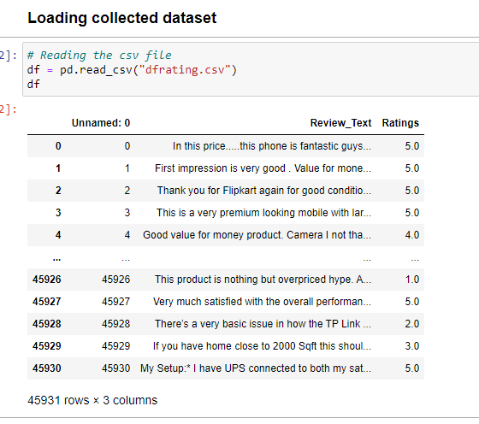
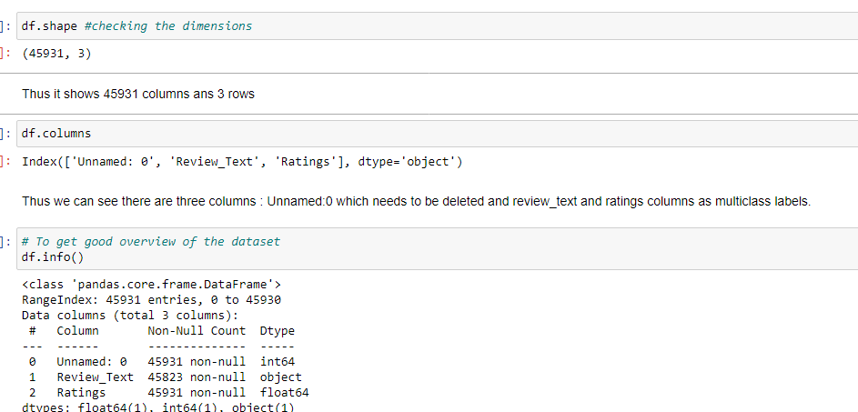
Data Preprocessing
First loading the dataset and checking their datatypes/info
Thus we see that there are 3 columns having int,object and float datatype and some missing value are present in review_text .Unammed 0 column was irrelevant so needs to be deleted.

Slide 11

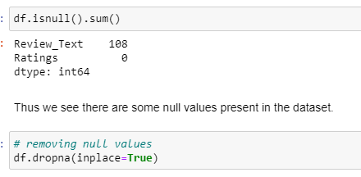
Checking Null values and dropping unwanted column
We found that there is some null values present in the dataset.
We dropped the unnamed :0 column as it was irrelevant.

Slide 12
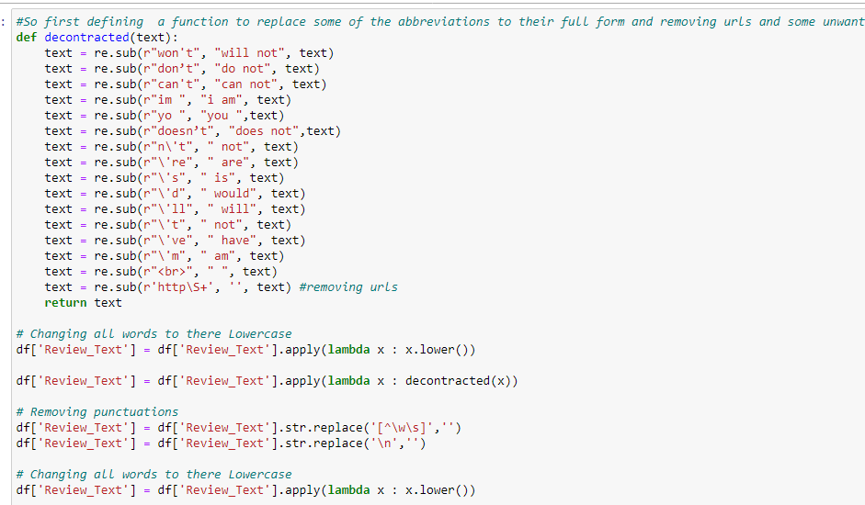
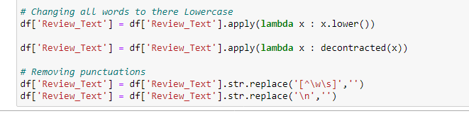
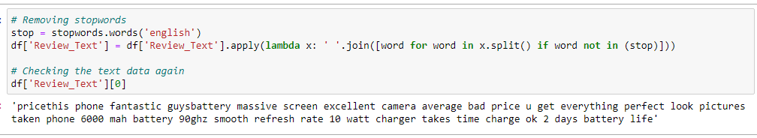
Feature Engineering
1)Text case conversion
2)Removing Punctuations and other special characters
3)Splitting the comments into individual words
4)Removing Stop Words

Slide 13
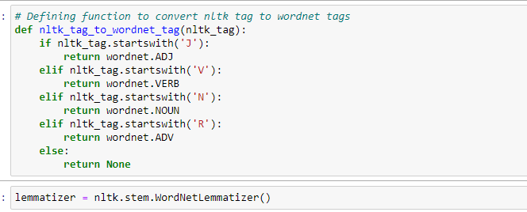
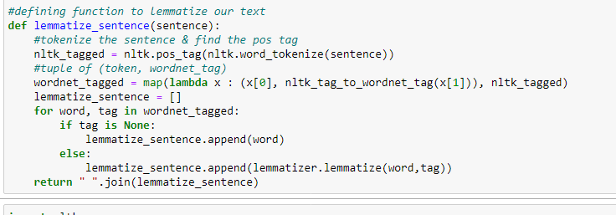
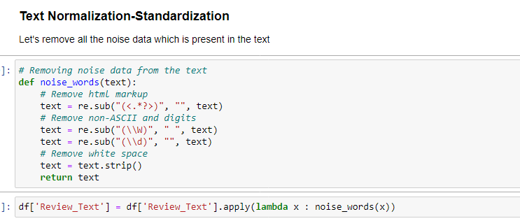
Feature Engineering
5)Stemming and Lemmatization
6)Text Standardization-Normalization

Slide 14
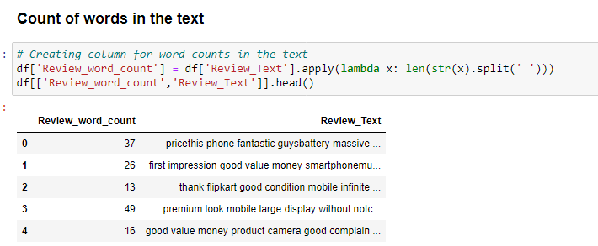
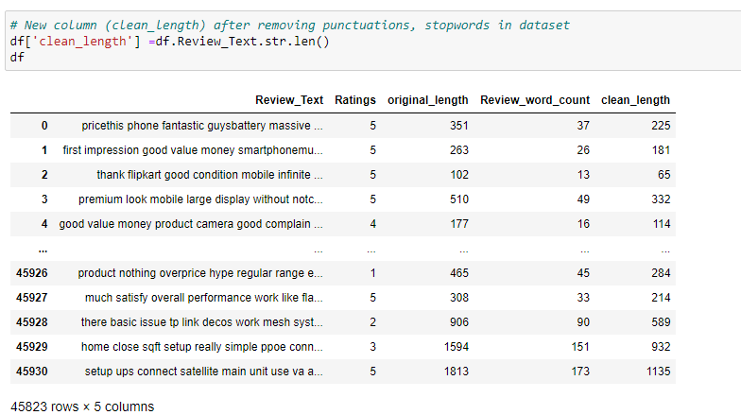
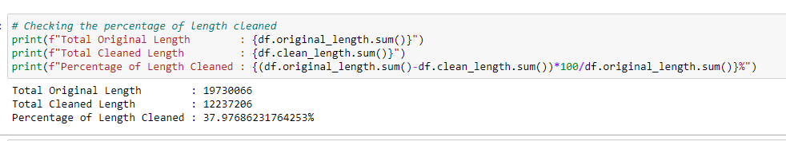
Count of length of text
Observation:
1)After removal of irrelevant characters ,thus we count the word in the text.
2)We see cleaned_length after removing the unwanted charters from the comment text. We can clearly compare the original_length with cleaned_length thus see the characters removed from dataset.
3)We see that 37.97% of the text length has been cleaned.

Slide 15
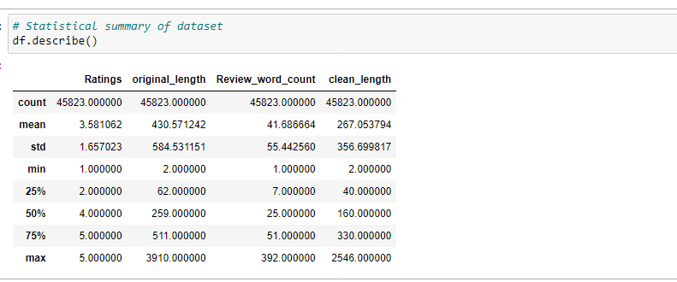
Describe method
1)There is a huge difference between 75% percentile and max values in original_length and clean_length ,so, we can say there are some outliers present in the data.
2)The mean value is greater than the median in all the columns except the column Ratings. So, the data in these columns are skewed to right and in target it is skewed to left.
3)The counts of every column is same which means there are no missing values present in the dataset.

Slide 16
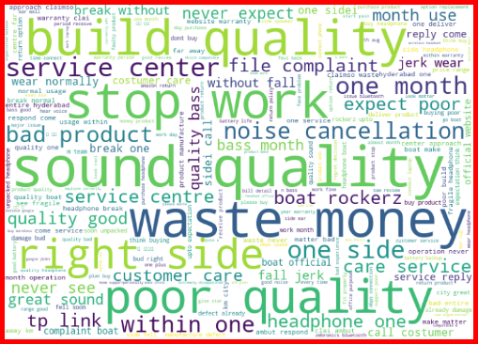
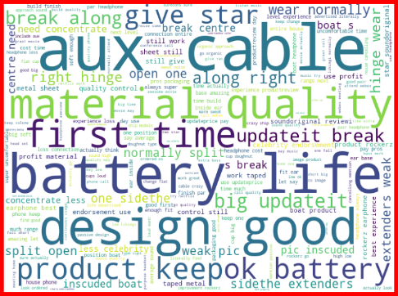
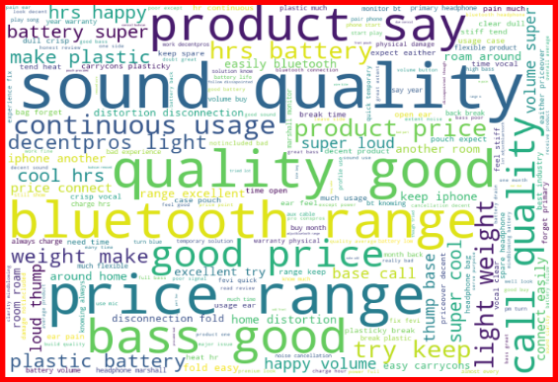
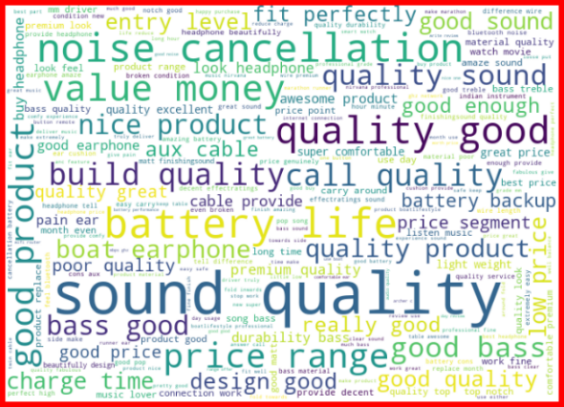
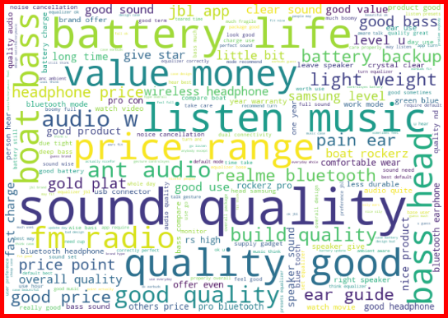
Data Inputs- Logic- Output Relationships
Rating 1
Rating 2
With the help of wordcloud,we can see loud words in each rating.
We also carry out correlation of target variable and features.
Rating 3
Rating 4
Rating 5

Slide 17
Hardware and Software Requirements and Tools Used
Hardware Used:
i.RAM: 8 GB
ii.CPU: Intel® Core™ i3-1005G1 CPU @1.20GHz
Iii.GPU: Intel® UHD Graphics
Software Used:
i.Programming language: Python
ii.Distribution: Anaconda Navigator
iii.Browser based language shell: Jupyter Notebook
Libraries/Packages Used:
1. Pandas- a library which is used to read the data, visualisation and analysis of data.
2. NumPy- used for working with array and various mathematical techniques.
3. Seaborn- visualization tool for plotting different types of plot.
4. Matplotlib- It provides an object-oriented API for embedding plots into applications.
5. Scikit-learn (Sklearn) is the most useful and robust library for machine learning in Python. It provides a selection of efficient tools for machine learning and statistical modeling including classification, regression, clustering and dimensionality reduction via a consistence interface in Python. This library, which is largely written in Python, is built upon NumPy, SciPy and Matplotlib
Nlp :

Slide 18
Model/s Development and Evaluation
The objective of this project is to build an application which can predict the rating by seeing the review. In the long term, this would allow people to better explain and review their purchase with each other in this increasingly digital world.
Thus this is clearly a multiclass classification problem considering the rating as our label.So we will be loading all the libraries related to it .Scikit-learn library is focused on modeling the data
Sklearn
Sklearn.linear_model
Sklearn.metrics
Sklearn.model_selection
Lightgbm
Sklearn.naive_bayes
NLP

Slide 19
Testing of Identified Approaches (Algorithms)
1.LinearSVC
2.MultimonialNB
3.Desicion Tree Classifier
4. SDGClassifier(Stochastic Gradient Classifier)

Slide 20
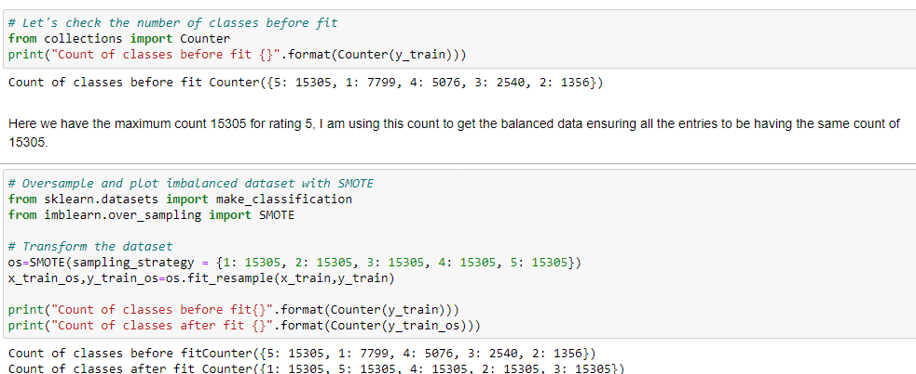
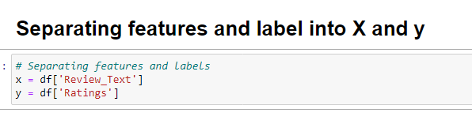
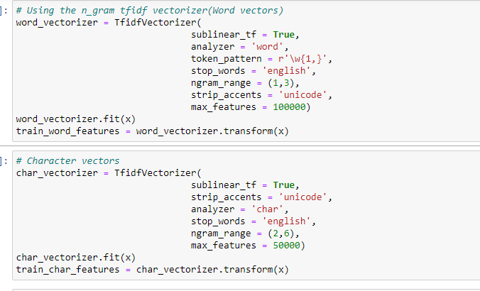
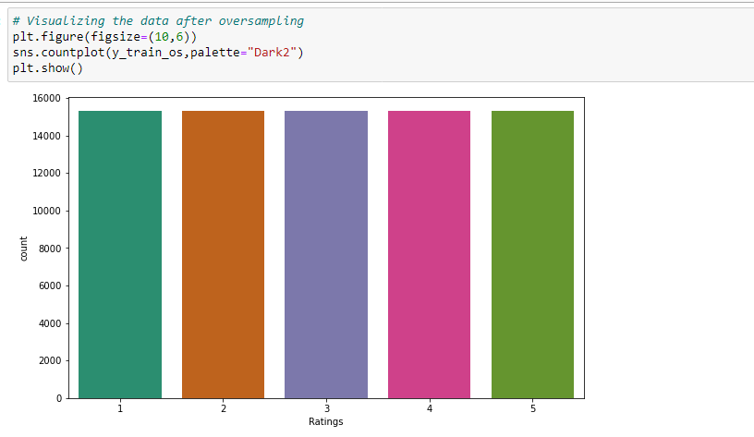
Run and Evaluate selected models
We have used here total of 4 classification Models with train_train_split choosing .33% as test_size.First we convert the string into numerical vectors using TF_IDF(Term frequency-inverse document frequency) and then balancing the dataset with smote oversampling technique.

Slide 21
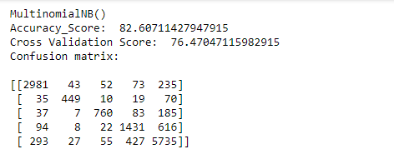
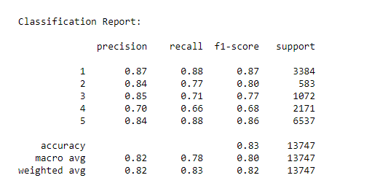
Model 1.MultinomialNB
The multinomial Naive Bayes classifier is suitable for classification with discrete features (e.g., word counts for text classification). The multinomial distribution normally requires integer feature counts. However, in practice, fractional counts such as tf-idf may also work. The Multinomial Naive Bayes algorithm is a Bayesian learning approach popular in Natural Language Processing (NLP). The program guesses the tag of a text, such as an email or a newspaper story, using the Bayes theorem. It calculates each tag's likelihood for a given sample and outputs the tag with the greatest chance
The model give the accuracy of 82.60% ,cross_val_score of 76.47%.

Slide 22
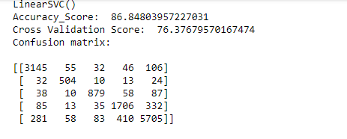
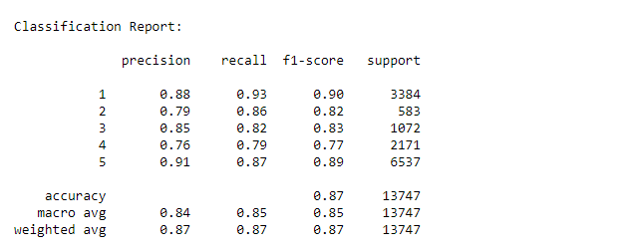
Model 2:LinearSVC
The Linear Support Vector Classifier (SVC) method applies a linear kernel function to perform classification and it performs well with a large number of samples.The objective of a Linear SVC (Support Vector Classifier) is to fit to the data you provide, returning a "best fit" hyperplane that divides, or categorizes, your data. From there, after getting the hyperplane, you can then feed some features to your classifier to see what the "predicted" class is.
The model give the accuracy of 86.85% and cross_val_score of 76.37%.

Slide 23
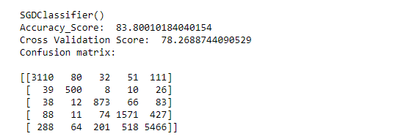
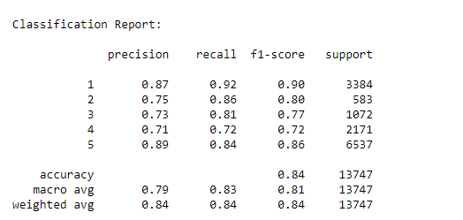
Model 3:SDGClassifier
Stochastic Gradient Descent (SGD) is a simple yet very efficient approach to fitting linear classifiers and regressors under convex loss functions such as (linear) Support Vector Machines and Logistic Regression. Even though SGD has been around in the machine learning community for a long time, it has received a considerable amount of attention just recently in the context of large-scale learning.
SGD has been successfully applied to large-scale and sparse machine learning problems often encountered in text classification and natural language processing.
The model give the accuracy of 83.80% and cross_val_score of 78.26%.

Slide 24
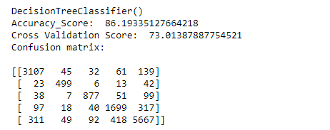
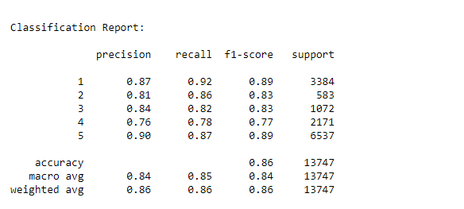
Model 4:Decision Tree Classifier
Decision Tree Learning is supervised learning approach used in statistics, data mining and machine learning. In this formalism, a classification or regression decision tree is used as a predictive model to draw conclusions about a set of observations. Tree models where the target variable can take a discrete set of values are called classification trees; in these tree structures, leaves represent class labels and branches represent conjunctions of features that lead to those class labels.
The model give the accuracy of 86.19% and cross_val_score is 73.01%.

Slide 25
Key Metrics Used
The key metrics used here were Accuracy Score, Precision, Recall, F1 score,Cross validation score and Confusion Matrix. We tried to find out the best parameters and also to increase our scores by using Hyperparameter Tuning and used GridSearchCV method.
Accuracy Score:Model accuracy is a machine learning model performance metric that is defined as the ratio of true positives and true negatives to all positive and negative observations.
Precision:The model precision score measures the proportion of positively predicted labels that are actually correct. Precision is also known as the positive predictive value.
Recall:Model recall score represents the model’s ability to correctly predict the positives out of actual positives.
F1: Model F1 score represents the model score as a function of precision and recall score. The F1 score becomes especially valuable when working on classification models in which your data set is imbalanced.
Confusion Matrix is one of the evaluation metrics for machine learning classification problems, where a trained model is being evaluated foraccuracy and other performance measures.
Cross validation score:Cross-validation is a technique used to protect against overfitting in a predictive model, particularly in a case where the amount of data may be limited. In cross-validation, you make a fixed number of folds (or partitions) of the data, run the analysis on each fold, and then average the overall error estimate.

Slide 26
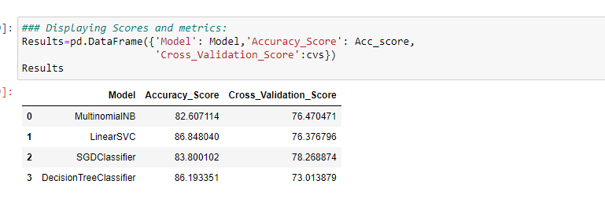

Model Analysis
Thus we see that after modelling different classification algorithms,We choose SGDClassifier as the best fitting model as the difference between accuracy_score and cross validation score is less among other models. Now ,we will try Hyperparameter Tuning to find out the best parameters and using them to improve the scores and metrics values.
SDG CLassifier Model

Slide 27
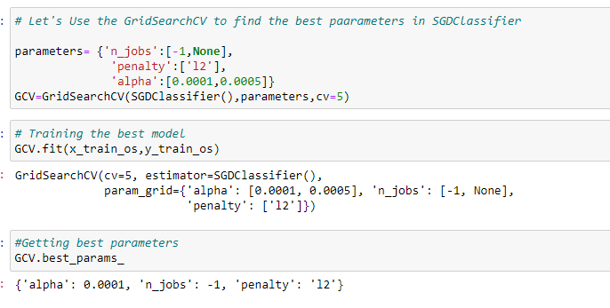
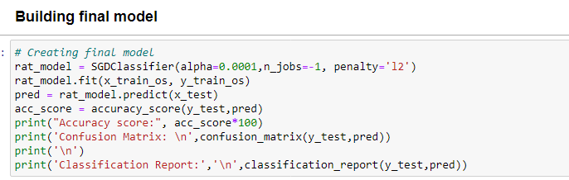
Hyperparameter through GridSearchCV
Hyper parameter optimisation in machine learning intends to find the hyper parameters of a given machine learning algorithm that deliver the best performance as measured on a validation set.
GridsearchCV: GridSearchCV is a technique to search through the best parameter values from the given set of the grid of parameters. It is basically a cross-validation method. the model and the parameters are required to be fed in. Best parameter values are extracted and then the predictions are made.
Thus on 3 parameters have been used under the varaible parametrs that is used in gridsearchcv for finding the best result. we see the best parameters which will help in improving the performance of the model using gridserachcv.Then we use this best parameters to the gridseacrhcv function.

Slide 28
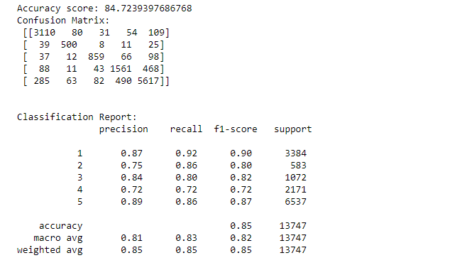
Hyperparameter tunning –with best parameters-SDG Classifier
So we create final model through best parameters using Gridsearchcv.
Thus our final models shows the accuracy score of 85% which has been improved from 84% which is a positive sign.

Slide 29
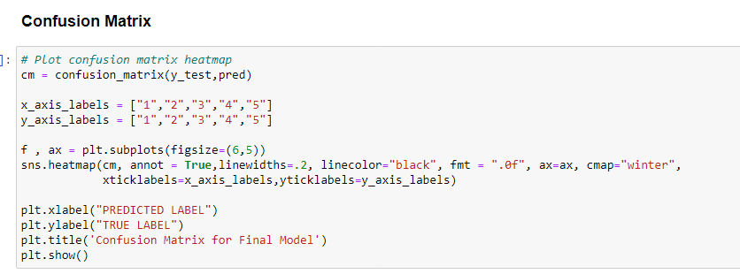
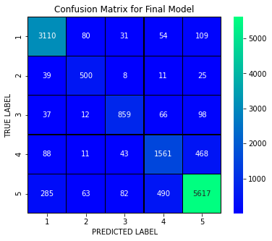
Confusion matrix-Final Model
With the help of confusion matrix we can able to see actual and predicted values for the final model. And also we can understand the number of times we got the correct outputs and the number of times my model missed to provide the correct prediction.

Slide 30
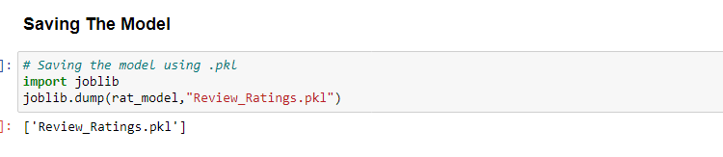
Saving the Best model using joblib method:

Slide 31
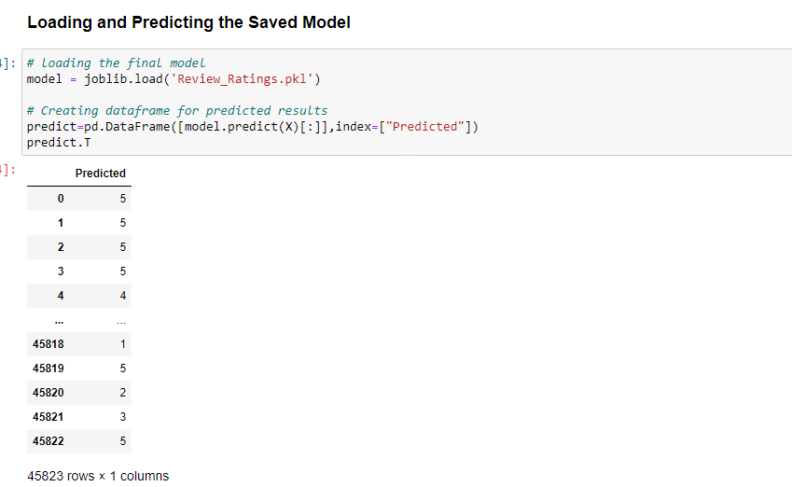
Loading the saved model and doing prediction test

Slide 32
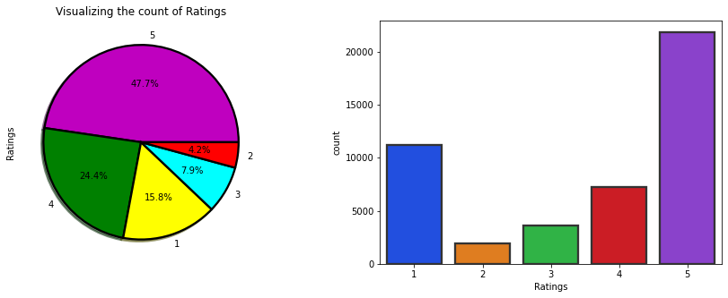
Visualizations
Now, we will see the different plots done with this dataset in order to know the insight of the data present.
we have an idea that more of the customers review pointed towrds 5 star followed by 1 star and least is 2 star .Around 47.7% of the texts are rated as 5 and only 4.2% of the texts rated as 2 stars.So, we can say that this is an "imbalance problem" which we need to make it balance to build our model.

Slide 33
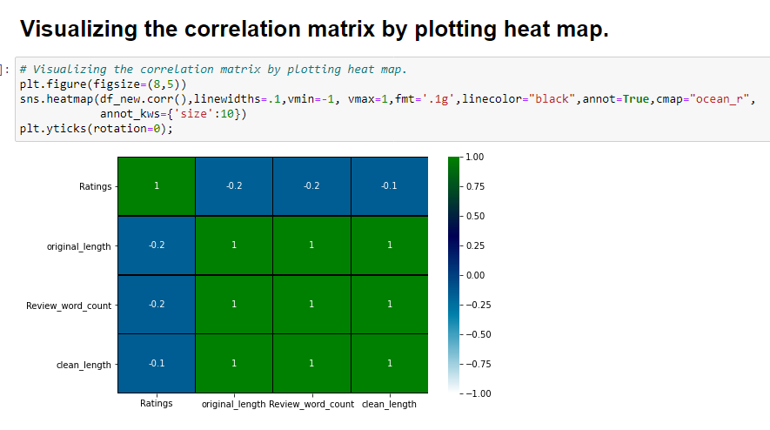
Correlation Matrix
The heat map gives the correlation between features and label. We can also observe the correlation between one feature to another.

Slide 34
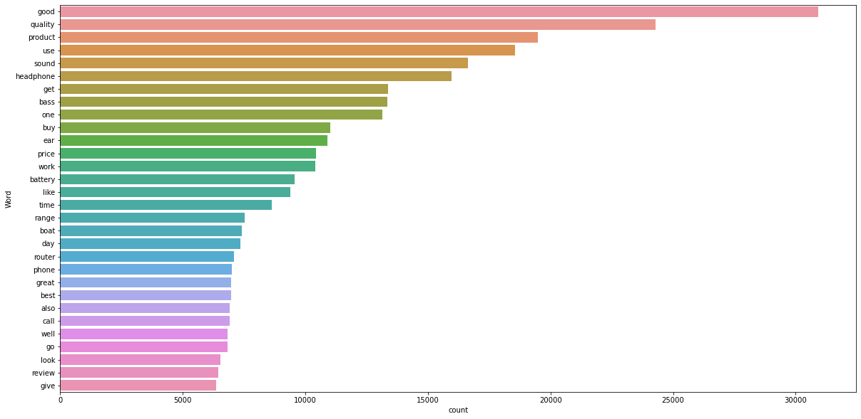
Top 30 most occuring words
Thus we observe that the topmost accuring word is “Good” followed by “quality” and least is “give” .

Slide 35
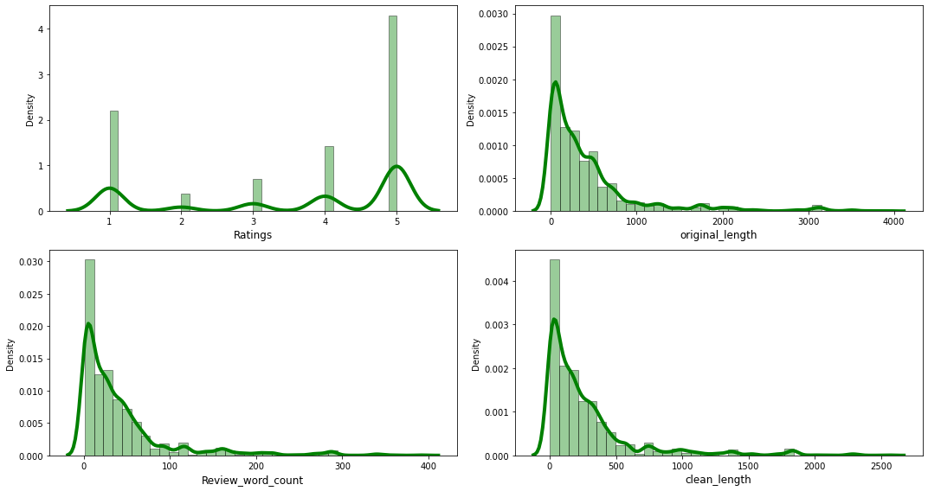
Histogram and density plots
From the dist plot we can notice that data in all the columns are skewed to right except the target column. Which means the mean value is greater than the median in these columns.
The plot of Review_word_count shows that most of the text is having the no. of words in the range of 0 to 100,some of the text beyond acts as outlier.
Also, the plot of clean_length shows that most of our text is having the number of words in the range of 0 to 500, and some of the text are too lengthy which are out of range which acts as outliers in our data.

Slide 36
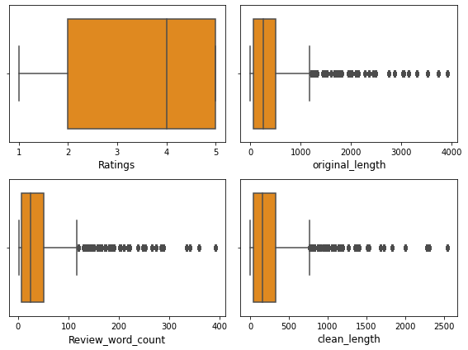
Outliers
As we can observe all the columns contains outliers except the target column that is "Ratings" so we have handled the outliers using appropriate techniques.

Slide 37
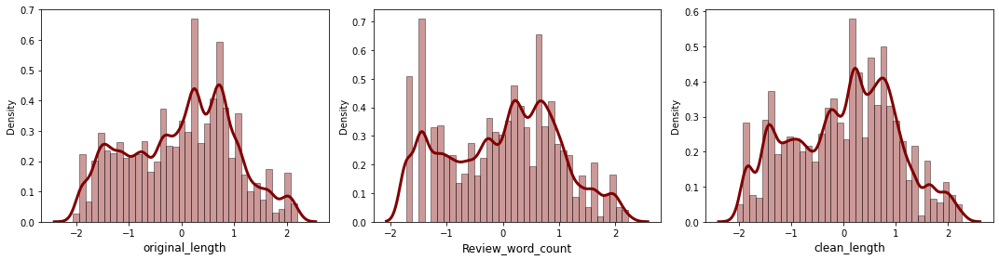
Data distribution
The data looks almost normal after removing the skewness compared to the previous data.

Slide 38
Conclusion:Key Findings
The objective of this project is to build an application which can predict the rating by seeing the review. In the long term, this would allow people to better explain and review their purchase with each other in this increasingly digital world. This model helps us to understand the ratings of the products. On the basis of product review ratings one can be aware of the positive and negative review of the products and thereby be extra precautioned in buying that product.
Thus this is clearly a multiclass classification problem considering the rating as our label.So we will be loading all the libraries related to it.
So first I scrapped the data using different websites like amazon and flipkart. and saved them in csv format.I started with loading the dataset and carry out data analysis and then did the EDA process by removing all the unwanted words,stopwords etc from the review comments with visualization patterns using pie-plot, count plot, bar plot and visualize through wordcloud and learnt about different relationship between the features and target variable.

Slide 39
Conclusion cont.
Then I did the model training first using TF_IDFvectoriser, I converted comments into vectors first , then check for imbalanced class then balanced it using smote oversampling method building the model and finding out the best model out of several classification models on the basis of different evaluation metrices scores like accuracy score, cross validation,f1,confusion matrix.
We find that SDGClassifier model was the best fitted model as the difference between accuracy score and cross validation score was less. Then I did hyperparameter tunning through GridSearchCV on best model taking the parameters to improve the score. Thus, concluded that SDGClassifier was performing well among other models.
Thus, finally concluding saying that SDGClassifier was having the highest precision accuracy for prediction of rating of review comments with machine learning data.
I saved the best model using joblib method and loaded the model for prediction test. Thus, this model can be used in further deployment process.

Slide 40
Learning Outcomes of the Study in respect of Data Science
1.We knew about different Natural Language Processing techniques to be applied for text processing for data cleaning like conversion to lowercase, removal of stopwords,removal of unwated words like question mark,punctuation etc,stemming and finally converting the strings into vectors using TFIDF vectorizer for building of model.
2.In this project, we present various algorithms while predicting classification models with good accuracy. We tested various models such as LinearSVC,SDGClassifier,Decision Tree Classifier,MultinomialNB, and selected the best fit among models and also done hyperparameter tuning.Also we applied different evaluation metrics like hamming loss and log loss apart from accuracy.

Slide 41
Limitations of this work and Scope for Future Work
1.The dataset was imbalance and lot of comments texts.
2.Time consumption was more for model building, so I limited to only 4 models instead of taking more models because the processing time was more than beyond 1-2 hours
3.More models like Random Forest, Bernoulli Classifier can be taken can be used to solve the same problem.
4. While scrapping also, there were some technical glitch from the websites so scrapped from two website for review rating .
5.We can still improve error, model accuracy with some feature engineering and by doing some extensive hyperparameter tuning on it.

Slide 42
THANK YOU

