Slide 1


Hacky Easter 2016

Slide 2


Welcome!
Hacky Easter 2016 is coming soon!
24 brand new challenges are waiting
event is starting March 14 10:00 CET
powered by Hacking-Lab

Slide 3

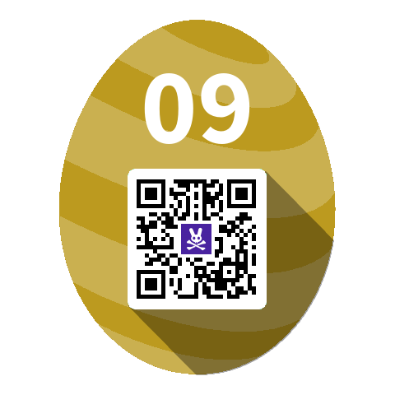

How it works
Solve IT security challenges…
  Cryptography
  Web Security
  Mobile Apps
  Reverse Engineering
  Forensics and Steganography
  and more
… and get Easter Eggs as a reward!

Slide 4



How it works
Install the Hacky Easter mobile app
  iOS and android
  scan easter eggs to get points
  solve the in-app challenges
  check the ranking
  check your score
the app will be ready upon event start (March 14)

Slide 5

What’s new in 2016?
24 completely new challenges!
Buddies!
  Want to play Hacky Easter in a group?
  Add your buddies…
  … and get a ranking just for your group!
Manual code submission
  For those having issues with the app’s scanner

Slide 6





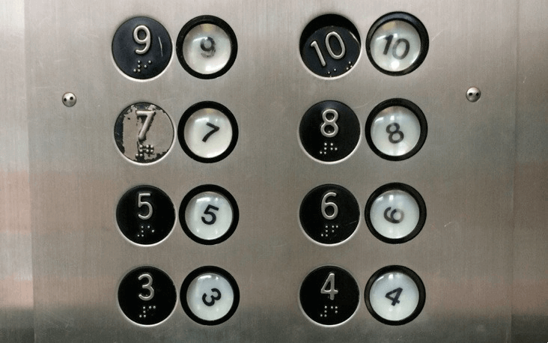
Challenges

Slide 7




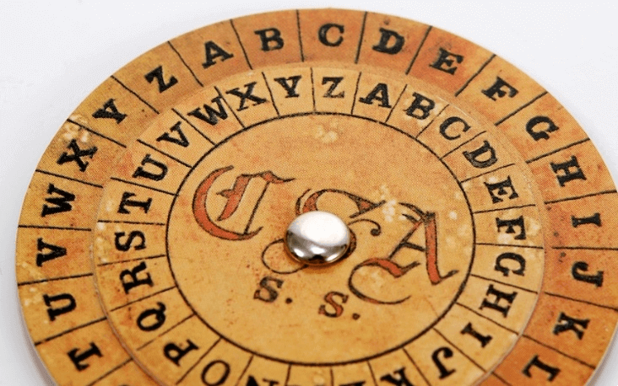
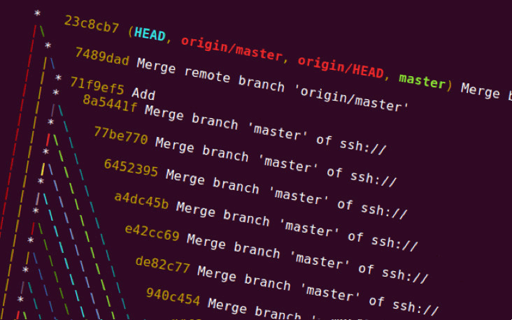
Challenges

Slide 8






Challenges

Slide 9
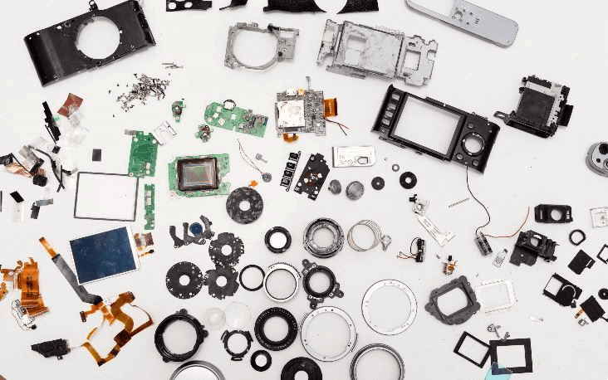





Challenges

Slide 10


See you on March 14!

