Slide 1



final_visualization
View in Power BI
Last data refresh:
10/5/2024 7:20:37 PM UTC
Downloaded at:
10/5/2024 7:34:21 PM UTC

Slide 2
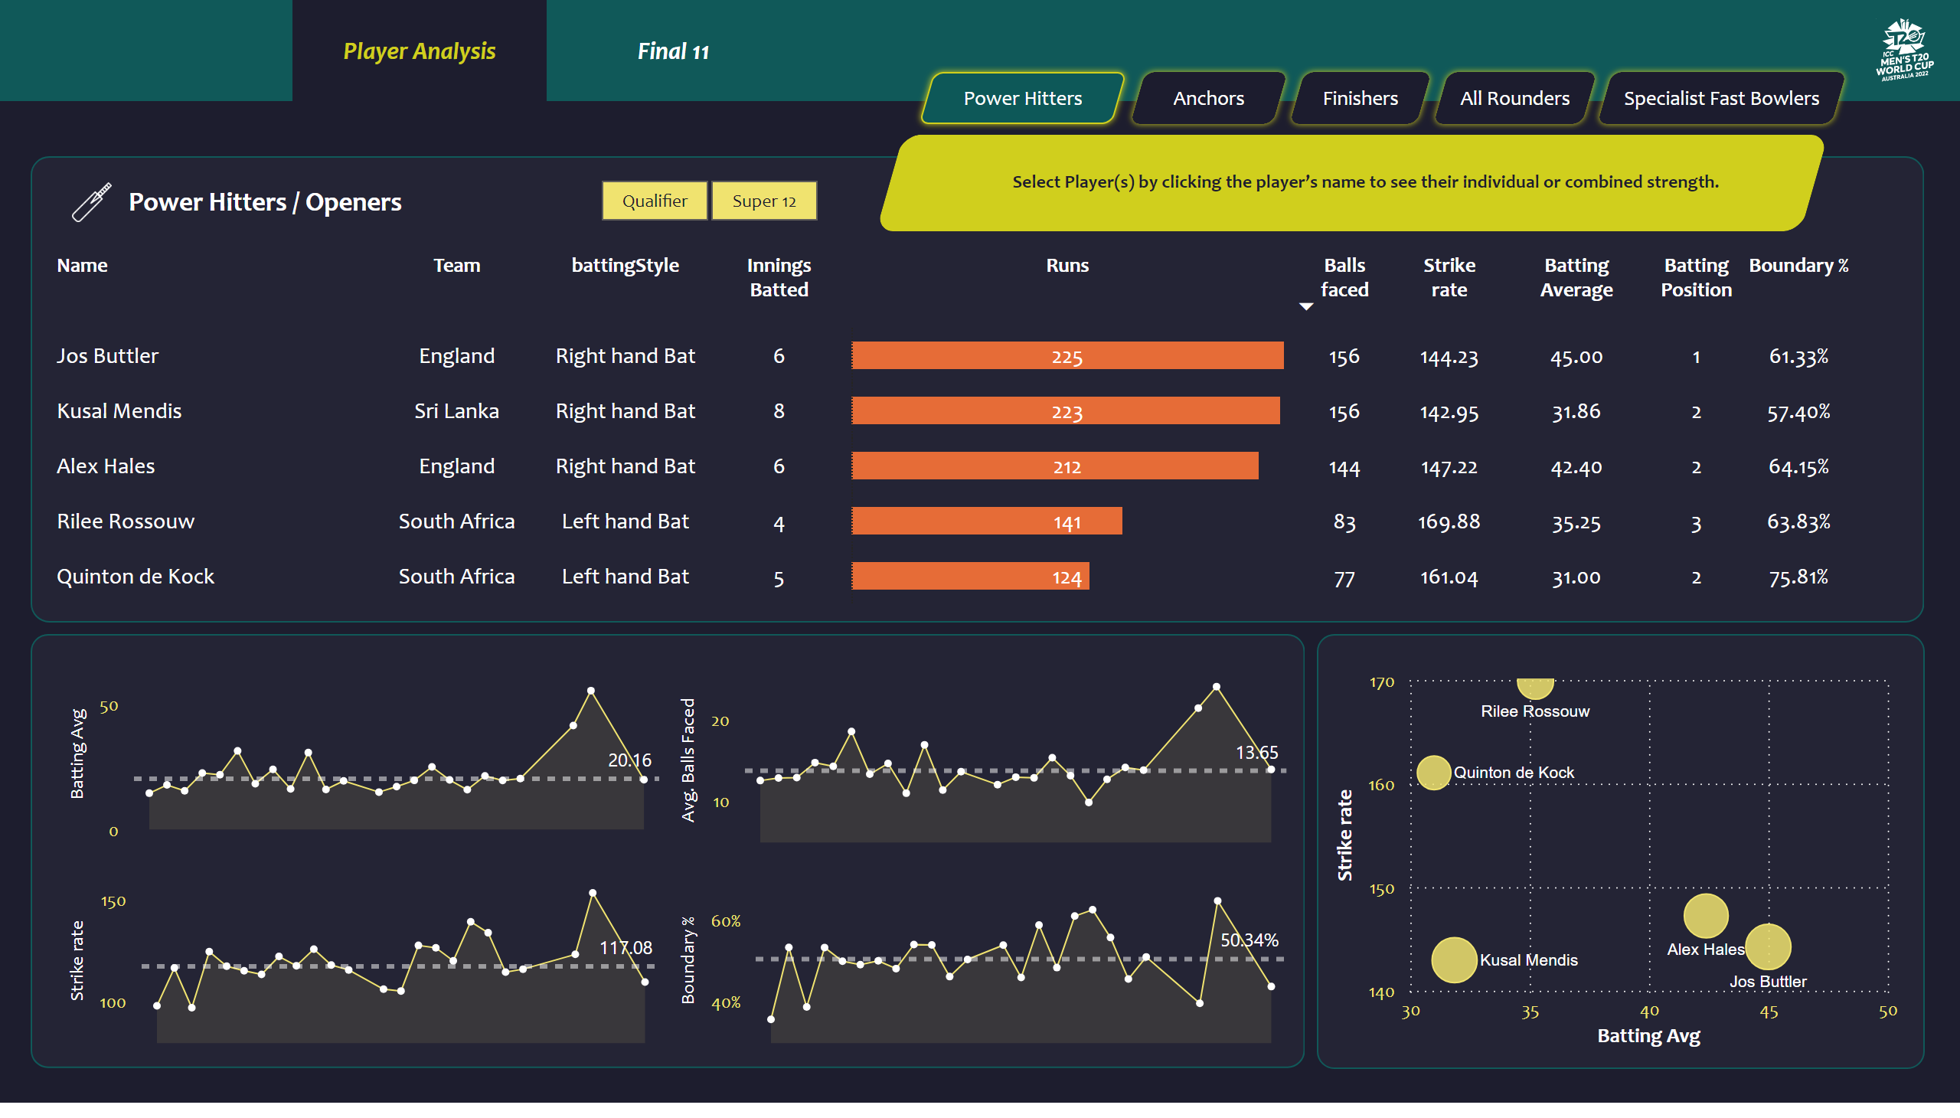
Project - Sportan
Notes:
slicer
No alt text provided
shape
No alt text provided
actionButton
No alt text provided
actionButton
No alt text provided
actionButton
No alt text provided
actionButton
No alt text provided
actionButton
No alt text provided
shape
No alt text provided
shape
No alt text provided
card
No alt text provided
card
No alt text provided
card
No alt text provided
card
No alt text provided
shape
No alt text provided
areaChart
No alt text provided
shape
No alt text provided
areaChart
No alt text provided
areaChart
No alt text provided
areaChart
No alt text provided
shape
No alt text provided
image
No alt text provided
shape
No alt text provided
tableEx
No alt text provided
scatterChart
No alt text provided
Button Player Ana selected
No alt text provided
Button Player Ana selected
No alt text provided
shape
No alt text provided
image
No alt text provided

