Slide 1
Steganography: Hiding Information in Digital Media
Group Members:
Shima Vosoogh Rafia Riana Gulpari Alandarova

Slide 2

What is Steganography?
Steganography is the practice of hiding information inside another information object (called carrier), such as a text message that is hidden inside an image.
The goal is to make sure the hidden information remain invisible to unintended receivers.
Hi, Seneca!

Slide 3
Steganography Types
Text Steganography: hiding information inside text documents.
Image Steganography: hiding information inside digital images.
Audio Steganography: hiding information inside audio files.
Video Steganography: hiding information inside video files.

Slide 4
Introduction to Image Steganography
Image steganography is a technique used to hide secret information inside digital images without noticeably changing their appearance.
The hidden information may include text messages, passwords, documents, or other data.
Because the modifications are very small, the image appears unchanged to the human eye.
Why use images?
Images are widely shared online.
They contain millions of pixels.
Small changes are difficult to detect.
They can store a significant amount of hidden information.

Slide 5
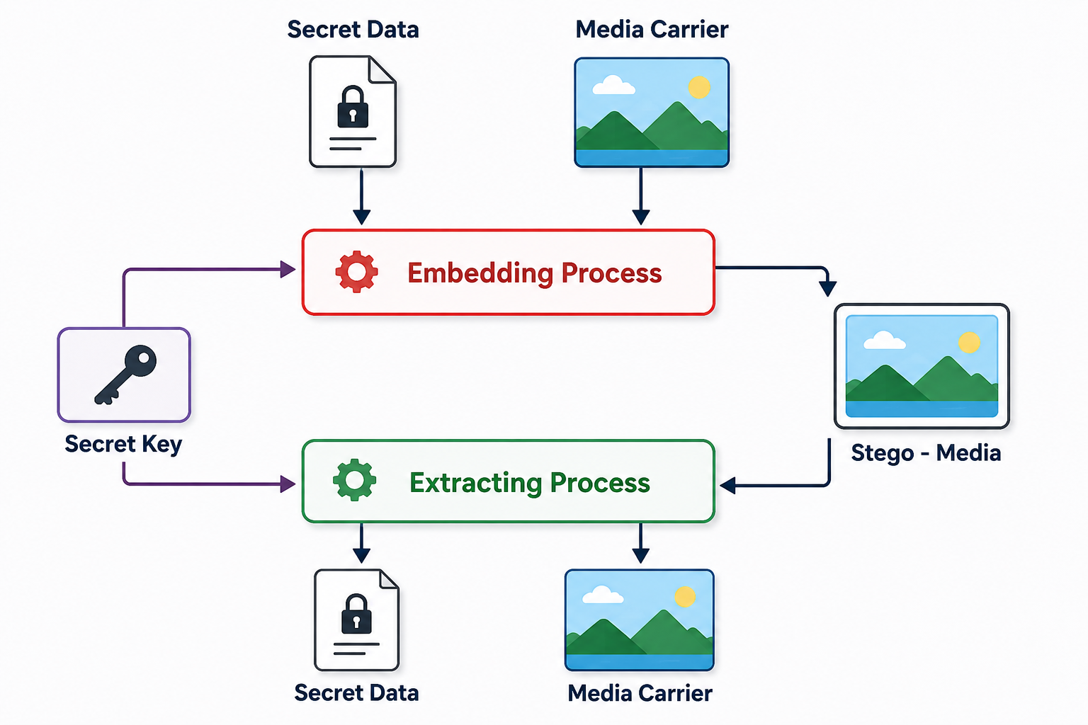
How Image Steganography Works
Select a cover image.
Prepare the secret message.
Convert the message into binary format.
Embed the data into image pixels.
Generate a stego image.
Extract the hidden information when needed.

Slide 6
What is Text Steganography?
Text Steganography is the practice of hiding text information inside another text object such as a digital book or a document.
Text steganography can be done by hiding non-text information inside text objects like audio in text. However, that first requires an audio to text conversion!
Text steganography is also one of the ancient forms of hiding information.

Slide 7
Common Text Steganography Methods?
Using sentence features
Taking advantage of punctuative letters like “,” and “.” to represent 0 and 1 of the ASCII codes for the hidden text letter.
Using the structure of the carrier object
Taking advantage of the tabs and spacing to represent the bits of the ASCII codes for the letters of the hidden text.

Slide 8
Common Text Steganography Methods?
Using semantic modifications
Replacing highly frequent words in the carrier with their synonyms that contain letter of the hidden text.
Using file formats
Taking advantage of programming source code files to include hidden texts where applicable such as case-sensitive statements and variable names.
New: Generative AI
Taking advantage of generative AI capabilities to hide messages. Generative AI can produce invisible patterns and combine various methods like semantic and sentence features to hide the message.

Slide 9
Text Steganography Benefits
Unlike text cryptography which makes information non-understandable, steganography hides information from an ordinary eye.
Therefore, text steganography can be used to:
Hide the existence of a message
Lowering the chance of auditing
Digitally signing a document for authenticity
As an additional layer of security alongside encryption

