Slide 1
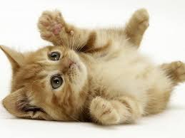
male
male2-34
male35-49
male50-

Slide 2
female
female2-34
female35-49
female50-

