Slide 1

Note: The data and information in this document is reflective of a hypothetical situation and client. This document is to be used for KPMG Virtual Internship purposes only.
Sprocket Central Pty Ltd
Data analytics approach
[28/8/2023]- [Alshimaa Abdelraof]

Slide 2
Note: The data and information in this document is reflective of a hypothetical situation and client. This document is to be used for KPMG Virtual Internship purposes only.
Agenda
Introduction
Data Exploration
Model Development
Interpretation

Slide 3
Note: The data and information in this document is reflective of a hypothetical situation and client. This document is to be used for KPMG Virtual Internship purposes only.
Introduction
Problem statement:
Sprocket Central Pty Ltd is a long-standing KPMG client that specializes in high-quality bikes and accessible cycling accessories for riders. Provide us with 1000 new customers we should target the most value for the organization.
Our Goals:
marketing team in Sprocket Central Pty Ltd is looking to boost business by analyzing their existing customer dataset to determine customer trends and behavior

Slide 4
Note: The data and information in this document is reflective of a hypothetical situation and client. This document is to be used for KPMG Virtual Internship purposes only.
Introduction
We will implement 3 stages :
1- data Exploration
2- Model development
3-Interpretation

Slide 5
Data Exploration
To do data exploration:
-We first clean the dataset according to these criteria :
- Accuracy
- completeness
- consistency
- currency
- relevancy
- validity
- uniqueness

Slide 6
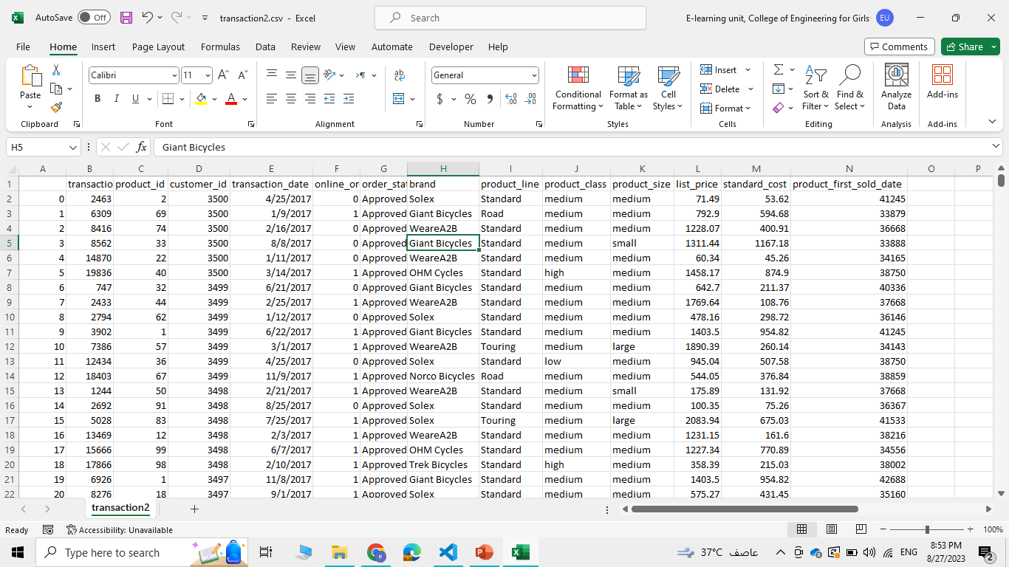
Data Exploration
In the Transaction sheet :
1)accuracy
customer_id: We found some customer id in the transaction table and in the customer address but didn’t find them in the customer demographic table.
For example : Customer_id=5034
So we remove these rows from transaction
2) Completence:
We found that
online _orders :360 missing value ,brand :197 missing value ,product_line:197 missing values,product_class:197 missing values ,product_size:197 missing values
So we remove the null values

Slide 7
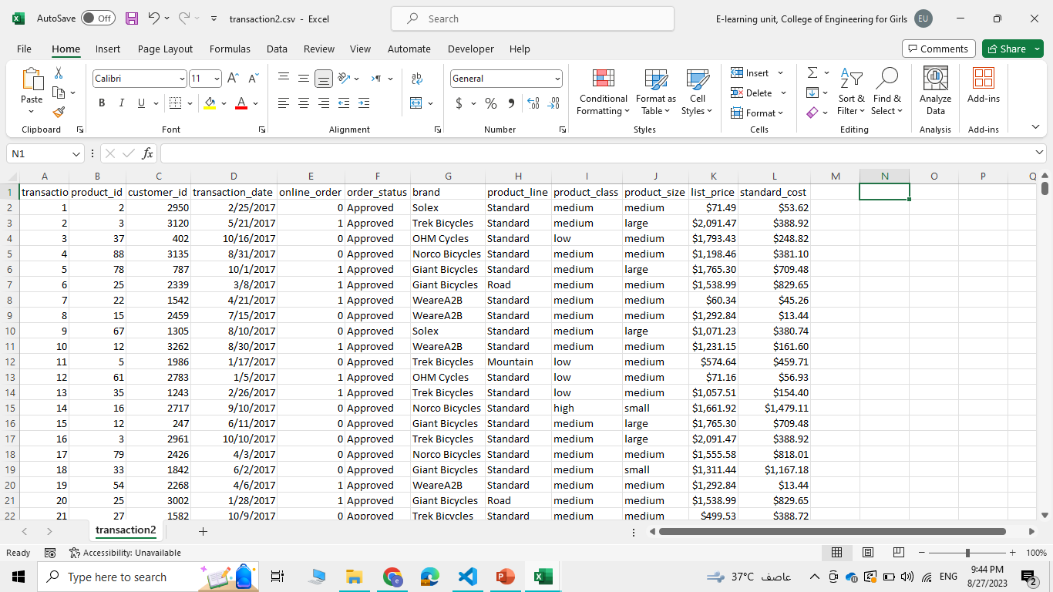
Data Exploration
In the Transaction sheet :
3)Validity
product_first_sold_date not in right format
so we delete it
- We put list_price in currency format

Slide 8
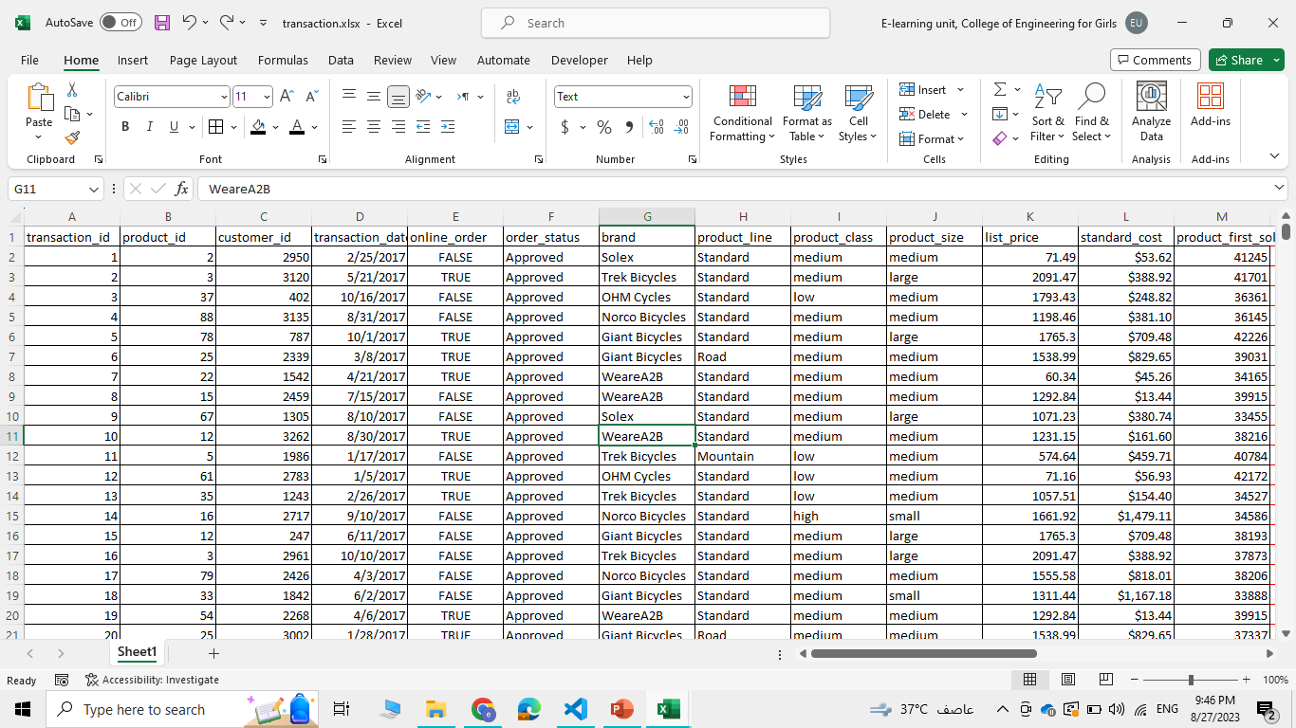
Data Exploration
In the customer demographic sheet :
1)accuracy
customer_id: We found some
customers whose date of birth is 1843
Customer_id=34
So we remove this row
2) Completence:
We found that:
Last_name: with missing values125
,DOP:with missing values:87
,Jop_title: with missing values506 ,
Jop_industry_category :with missing values 656
So we remove the null values
3) validity:
Drop column default – unreadable column

Slide 9
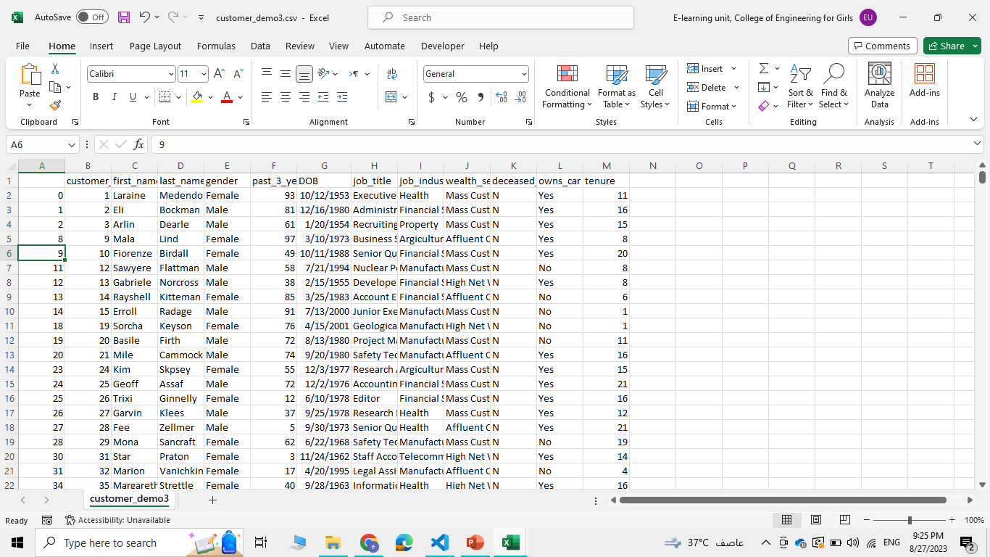
Data Exploration
In the customer demographic sheet :
4) Consistency
Gender: contains inconsistent data “M”,”F”,”Male”,”Female”
we standardize data with only:
Male and Female and Unknown

Slide 10
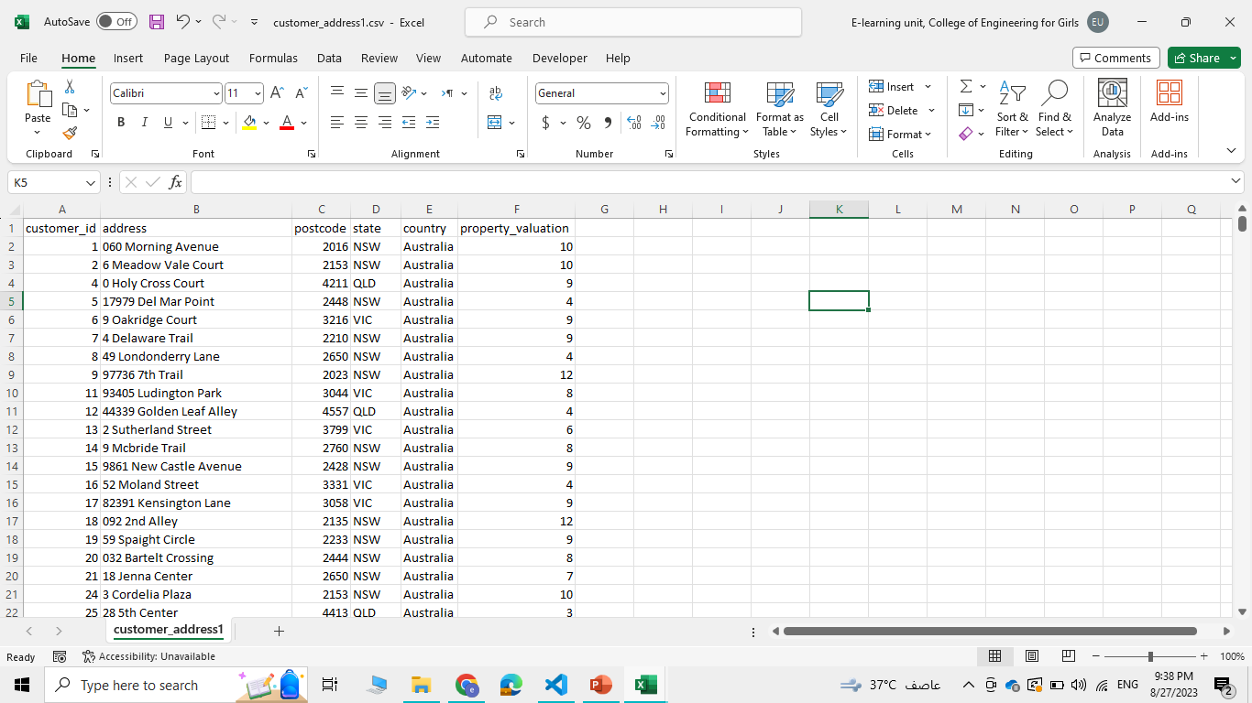
Data Exploration
In the customer address sheet :
1)accuracy:
Some customer id found in
customer address but not found
in customer demographic
so we remove them
Customer_id=4000,4001,4002,4003
2) State: inconsistent in the same state
For example “Victoria” has been written with
two different way
So we standardize
“Victoria “ to “VIC”
And “New South Wales” to “NSW”

Slide 11
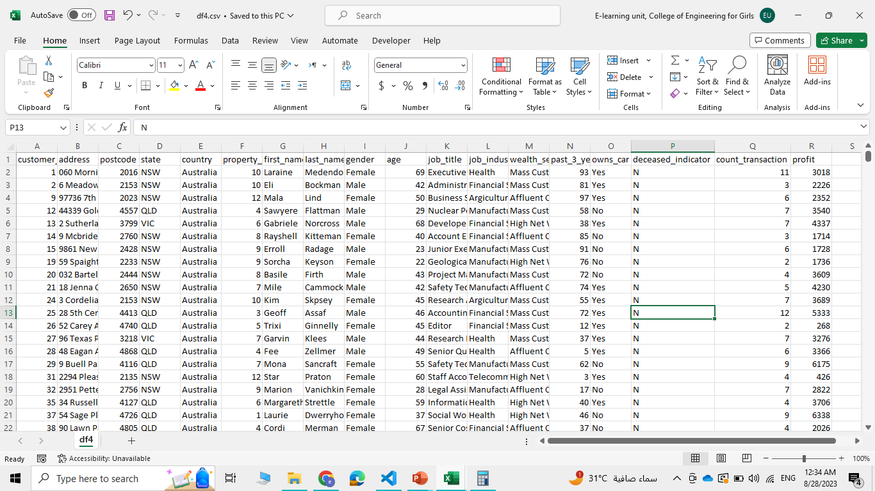
Data Exploration
data after we clean it:
Join 3 sheet
Calculate profit group
by customer_id
Calculate age using DOP

Slide 12
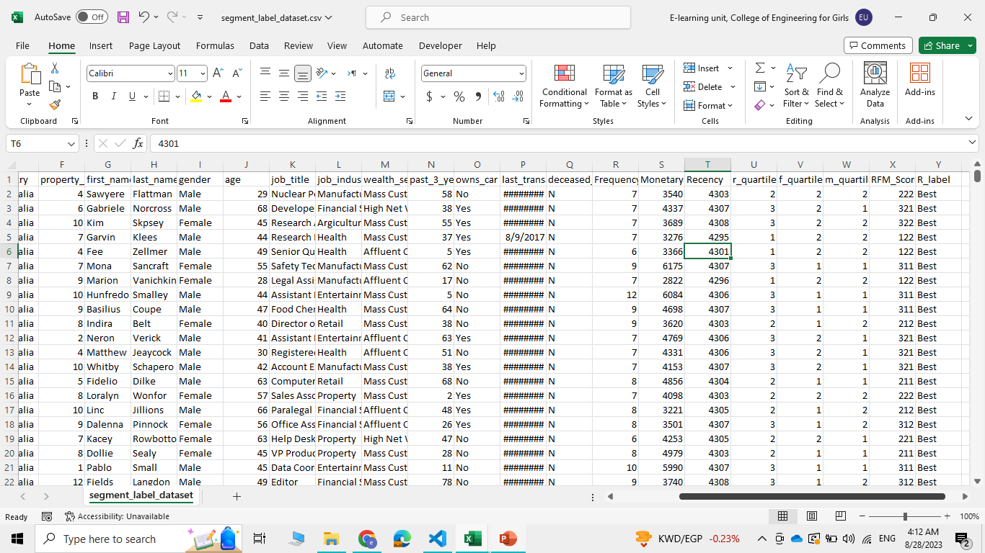
Model Development
We start with the labeled data :
We calculate:
Steps use RFM with
this steps:
- Calculate the Recency,
Frequency and Monetary values
for each customer.
Add segment values to
RFM table using quartile.
Sort the customer RFM score
in ascending order.

Slide 13
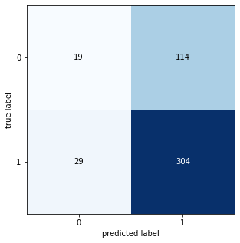
Model Development
Then we create a classification machine-learning model
We tried several machine-learning algorithms and we choose Random forest which gives 0.6931330472103004 Accuracy
And the confusion matrix was:

Slide 14
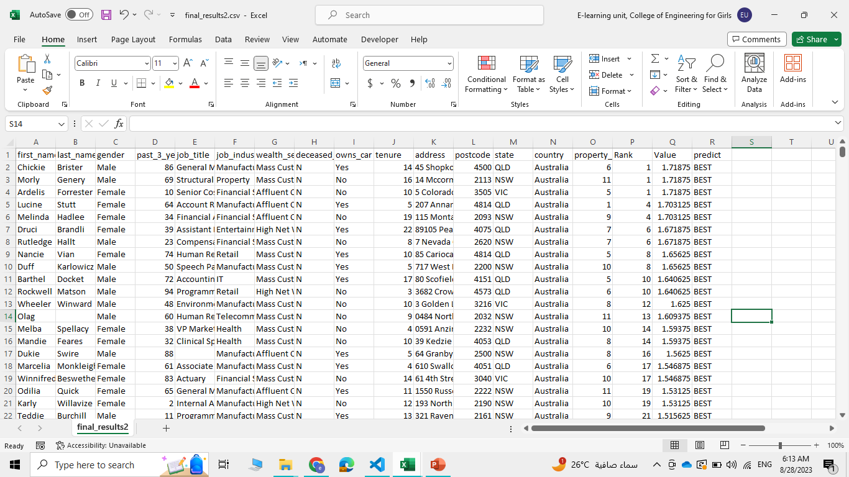
Note: The data and information in this document is reflective of a hypothetical situation and client. This document is to be used for KPMG Virtual Internship purposes only.
Interpretation
Finally, we test our model
in the new customer
data sheet and display
The best customer trends
and behavior

Slide 15
Note: The data and information in this document is reflective of a hypothetical situation and client. This document is to be used for KPMG Virtual Internship purposes only.
Appendix

