Slide 1
Cov-2019: Analysis and forecasting
Capstone Project - The Battle of Neighborhoods (Week 2)

Slide 2
INTRODUCTION
COVID-2019 is an infectious disease that comes from large family of viruses that cause illness ranging from the common cold to more severe diseases called Coronaviruses (CoV). This Presentation will help people to understand cov-2019 and the statistics behind it.
In this project, I will use Johns Hopkins dataset to achieve the following:
Data Preprocessing
Preforming exploratory data analysis on the world data, especially China data where the outbreak started, using Plotly, Matplotlib and seaborn
Visualizing the geospatial data concerning china using Folium
Building Linear Regression model to forecast the recovered cases

Slide 3
Data
The data used is Johns Hopkins dataset which contain the following fields:
County/Region
Province/State
Latitude
Longitude
Confirmed: Number of Confirmed Cases
Recovered: Number of Recovered Cases
Deaths
Date: Date of the report

Slide 4
1. Exploratory Data Analysis (EDA) 2. Geospatial Data Visualization
Data Analysis

Slide 5
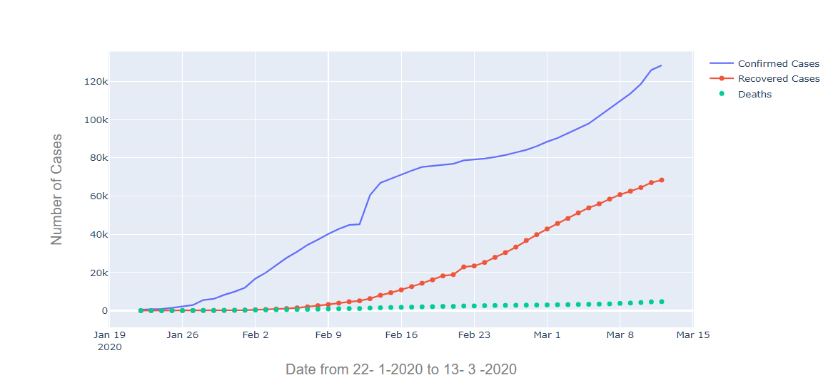
Exploratory Data Analysis
Visualized the confirmed, recovered, and death cases worldwide

Slide 6
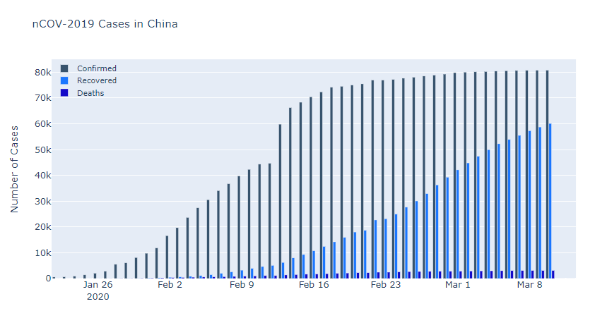
Exploratory Data Analysis
Visualized the confirmed, recovered, and death cases only in China

Slide 7
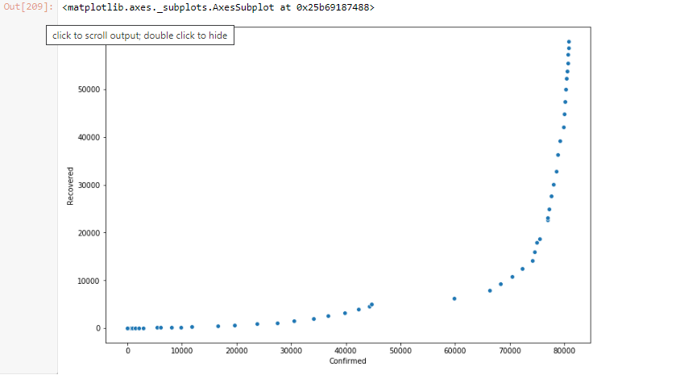
Exploratory Data Analysis
Confirmed VS recovered cases in China

Slide 8
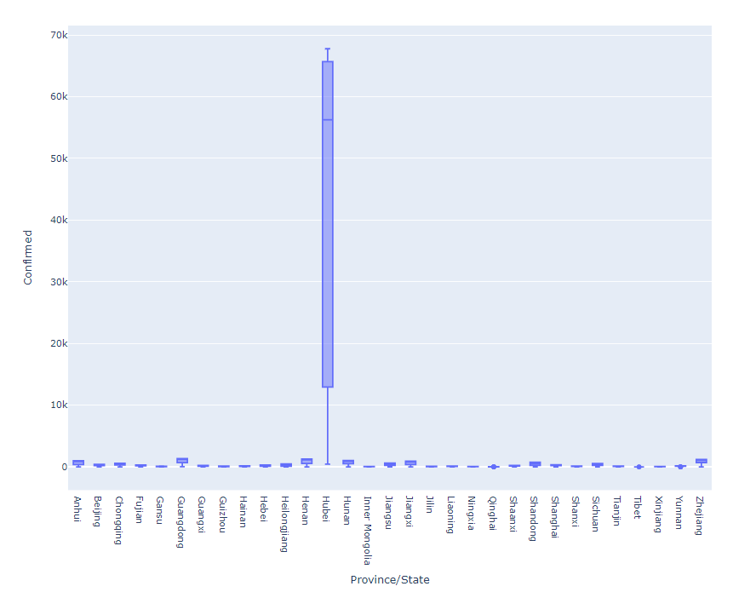
Exploratory Data Analysis
Boxplot to show the confirmed cases grouped by provinces. Hubei has the highest number of cases.

Slide 9
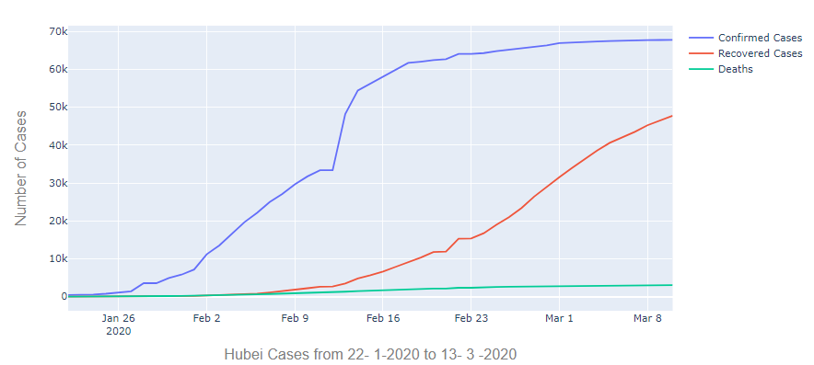
Exploratory Data Analysis
Visualized the confirmed, recovered, and death cases only in Hubei

Slide 10
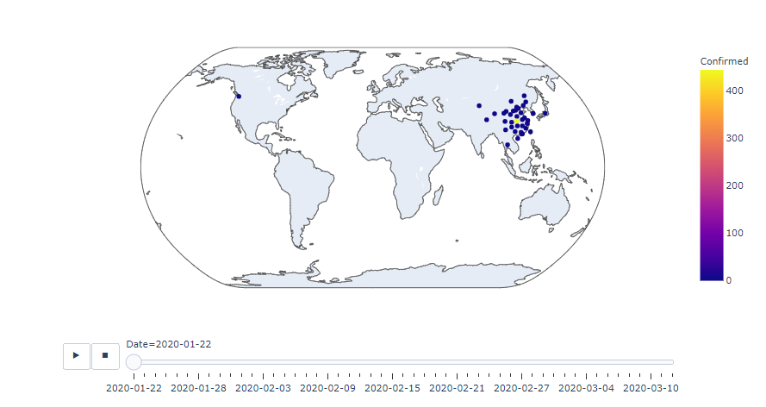
Geospatial Data Visualization
Visualization of the outbreak of the virus with time slider using Folium

Slide 11
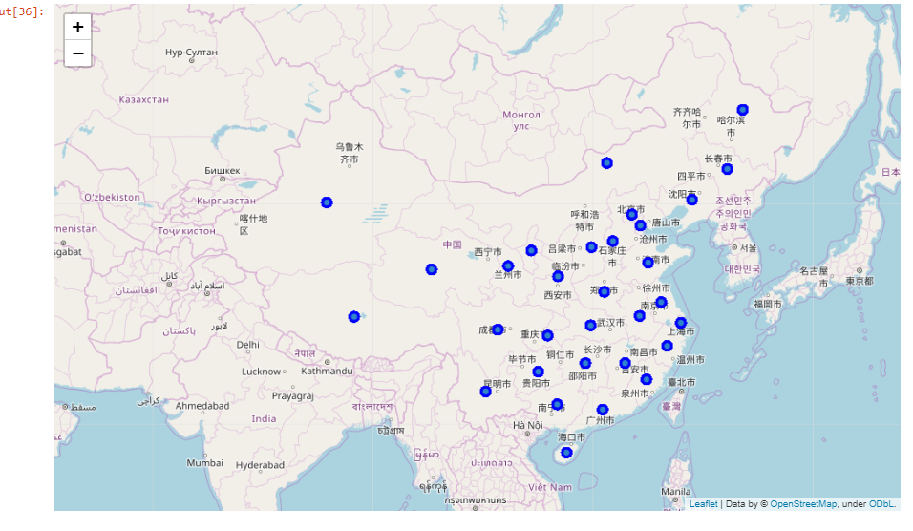
Geospatial Data Visualization
Visualization of the provinces and the confirmed cases in China

Slide 12
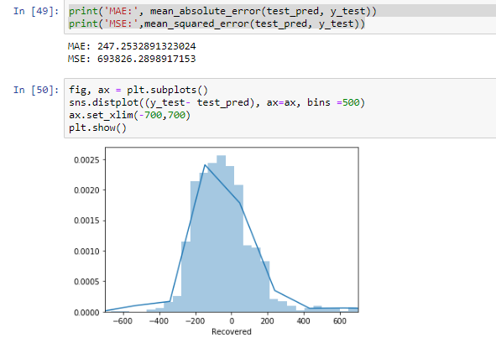
Linear Regression Model
The model forecast the number of recovered cases. The data into two groups:
Training set which consists of 3451 instances
Testing set which consists of 1701 instances.

