Slide 1
Vuejs-D02
Registration for events : $event as a parameter
V-cloak :
Hooks : life cycle for vue instance
Binding for form elements
Vue Cli : components : sfc

Slide 2
Life cycle hooks
beforeCreate: explore properties
Created : assign values for properties
Beforemount : compile for template
Mounted : display for template
Beforeupdate
Updated
Beforeunmount : beforedestriy in v2.0
Unmounted : destroyed in v2

Slide 3
Vue cli : create vue project with structure components ,
Entry point : main.js : including : importing for Vue from node modules
Use createApp(component).mount(‘#app’)
Public folder:
src folder:
SPA :
One html file :
steps
1- Npm I –g vue-cli
2- create project vue using vue create
Ex: vue create osproject

Slide 4
header
wrappercomponent
Links
body
footer

Slide 5
To use component inside another component you have to follow the following steps ex: use header inside wrapper
1- inside wrapper import header : .vue
2- add imported component inside components member of wrapper
3- use added component as html tag inside wrapper

Slide 6
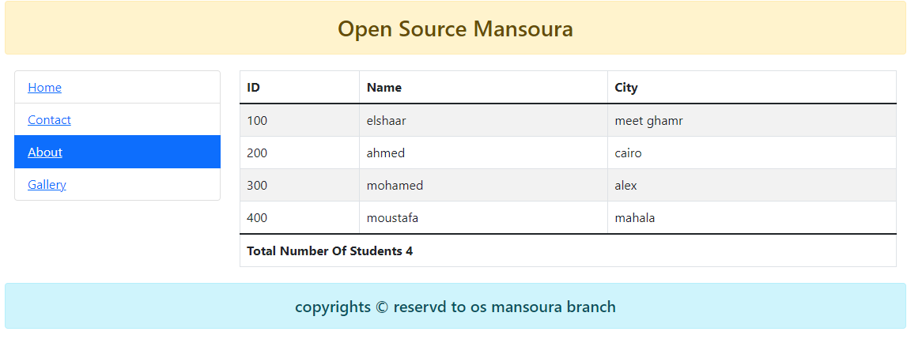
Open modal dialoge contains form :
Id
Name
City
Close : dismiss modal dialoge and push created object stduents array
Add

