Slide 1


Psychological Games
Transaction Analysis

Slide 2
TABLE OF CONTENTS
01
Introduction
02
Ego States
03
psychological assumptions
04
Games people play

Slide 3
01
Introduction

Slide 4

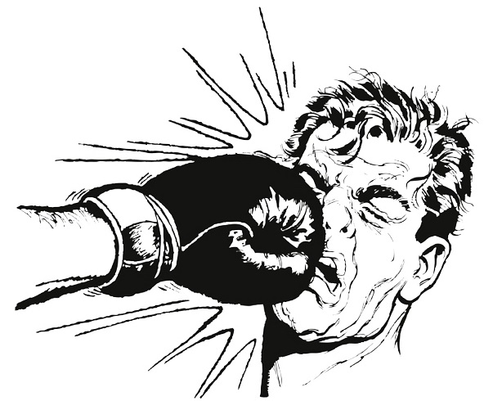
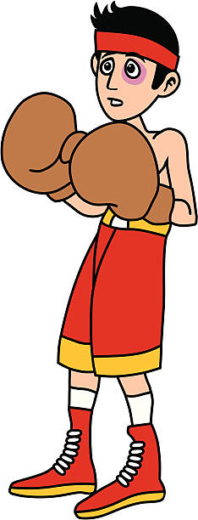
Introduction

Slide 5

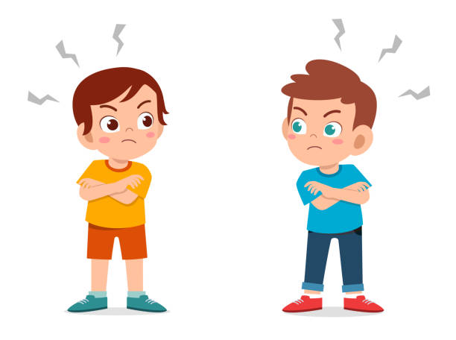
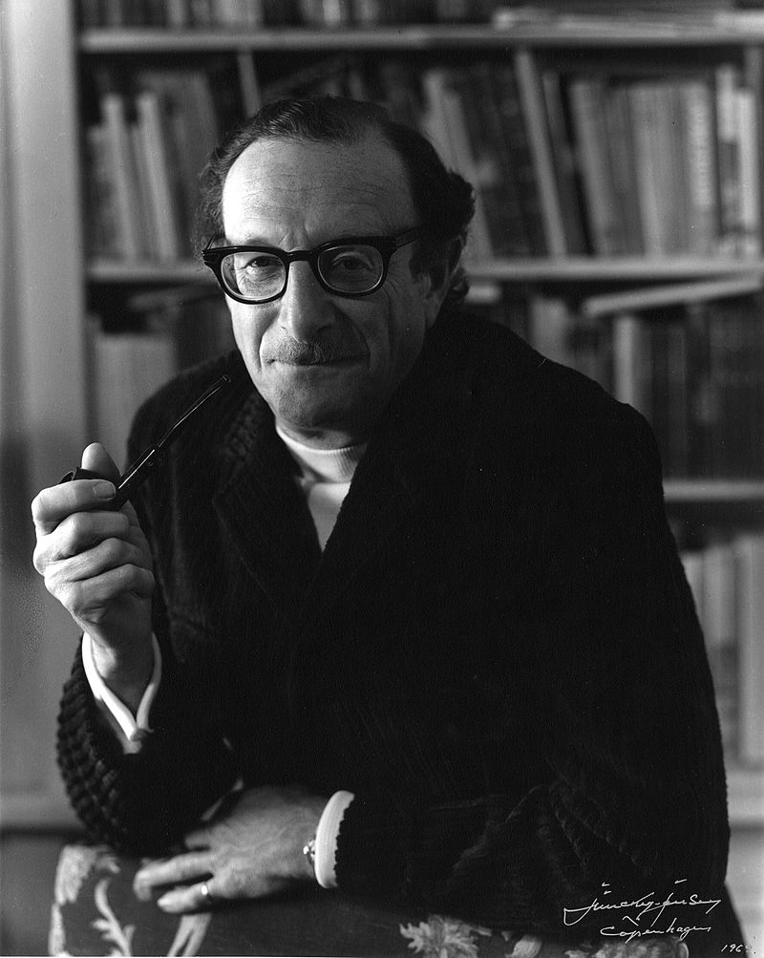
Introduction
Cont`d
People play games every day
Games sounds like normal human transactions but inside, it contains social suffering.
First appear in transaction analysis theory
Eric Berne was a psychiatrist who created the theory of transactional analysis as a way of explaining human behavior

Slide 6
02
Ego States

Slide 7

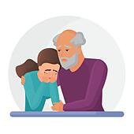

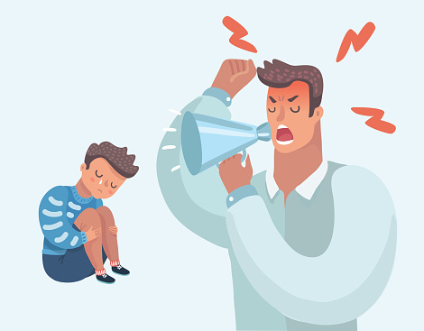


Ego States (P,A,C)
Adult
Free Child
Creative, Curious, and intuitive
Parent
Child
Neutering parents
show thoughtfulness and
Affection to others
Rebellious child
Defiant attitude
Critical parent
Obey rules, pursue ideas,
accept no mistakes
Think, judge, and make
decisions objectively
Adapted child
obedient and easy to control

Slide 8
03
psychological assumptions

Slide 9
psychological assumptions
I am Okay
People are okay
I am not Okay
People are okay
I am Okay
People are not okay
I am not Okay
People are not okay

Slide 10
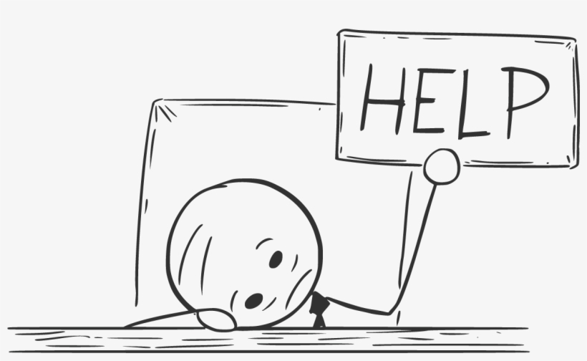

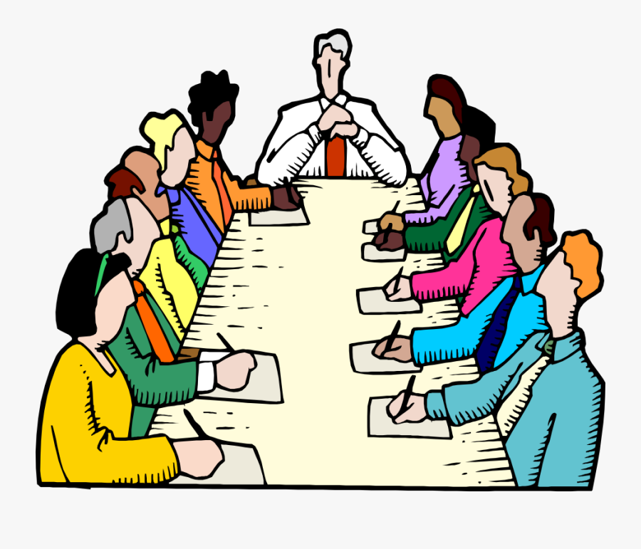
Games people play
I am Okay People are not okay
Game: Yes Bravo , But

Slide 11
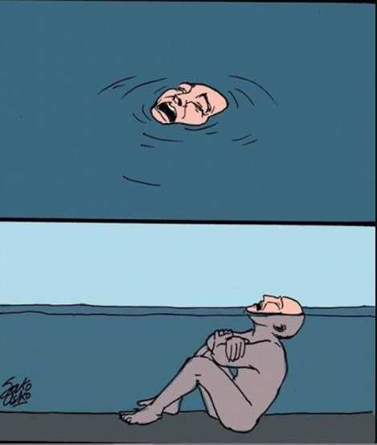

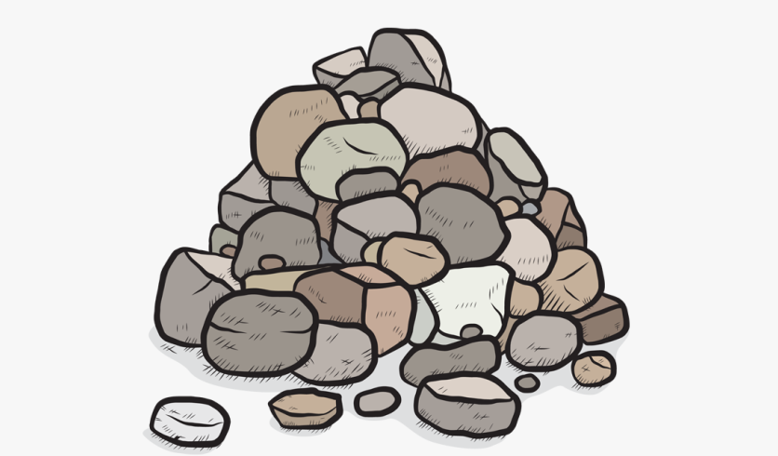
Games people play
Cont`d
I am not Okay People are okay
Game: Victim

Slide 12
Games people play
Cont`d
I am not Okay People are not okay
Game: what a problem !!!

Slide 13
Thanks
Any Question?

Slide 14
REFERENCES
“Psychological Games” Dr.Adel Sadeq

