Slide 1

Music genre classification
Team members:
Arwa Ahmed
Salma Hossam
Shaimaa Hamdy
Nada Walid
Youmna Hesham
DR: May Salama

Slide 2

Problem statement:
We have different type of music files like classical ,rock , pop and jazz and want to classify it.
Our datset:
We used The GTZAN dataset which is a famous dataset for music genre recognition (MGR).
It consists of, Genres original files ( 10 type of music each one has 100 file of sound )

Slide 3


Dataset preprocessing:
Using librosa :is a python package for music and audio analysis.

Slide 4
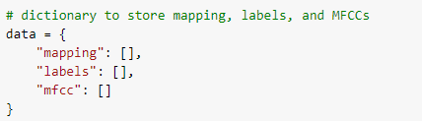
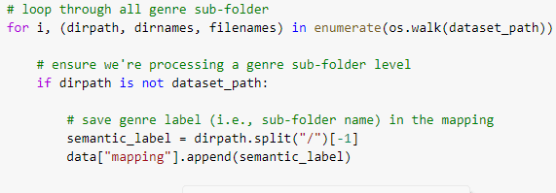
make dictionary to store mapping, labels, and MFCCs
mapping

Slide 5


Convert wav files to signal array.
Calculate the start and the end of the segment (10 segment )

Slide 6
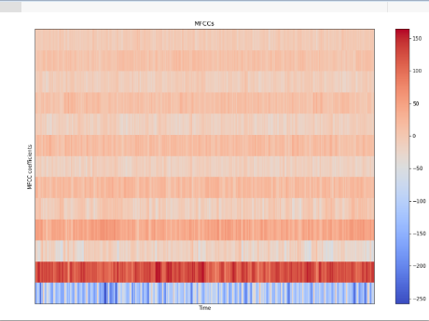
Mel-frequency cepstral coefficients (MFCCs)

Slide 7

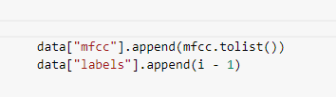
Extract mfcc
Mfcc as a list and get the labels

Slide 8

save MFCCs to json file

Slide 9
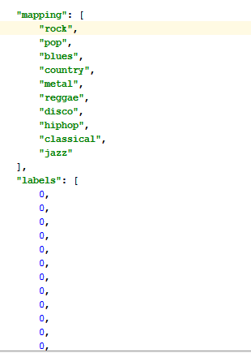
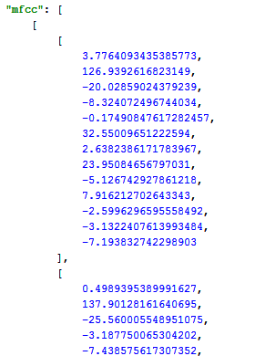
The joson file

Slide 10
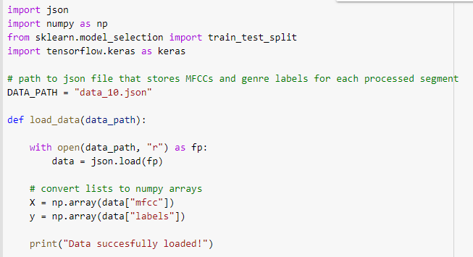
Loading Data

Slide 11
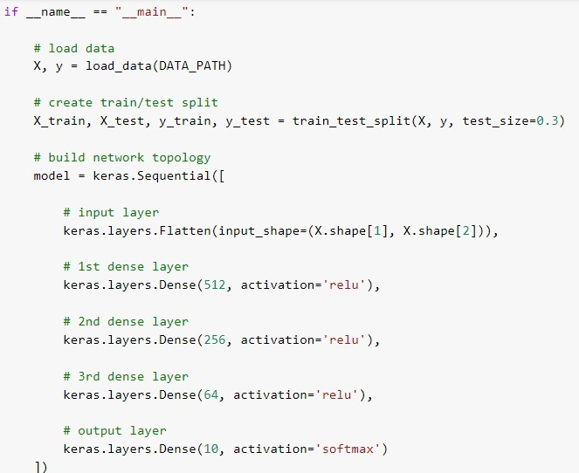
Building Network

Slide 12
Keras Flatten
This is how Flatten works converting Matrix to single array.

Slide 13
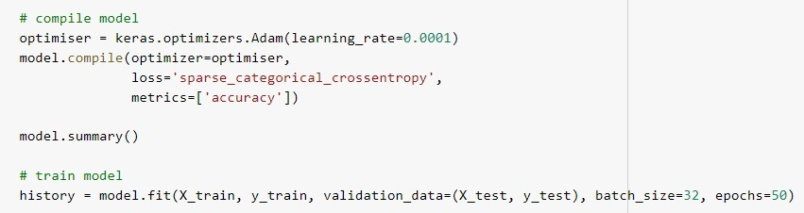

Slide 14
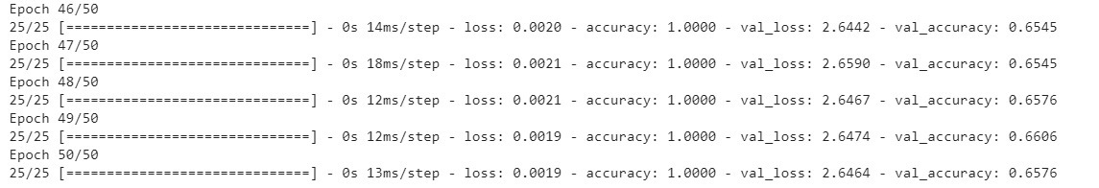
output
We noice that there is a huge difference between training set accuracy and testing set accuracy that means our model overfitts.

Slide 15
Solving overfitting

Slide 16
What is overfitting problem?
Our model weights are perfectly determined for the training set.
The model fits the training set typically so it doesn’t work effciently with data it didn’t see before like the test set.
We want our model to be generalized for data it didn’t see before.

Slide 17
How can we overcome overfitting?
Technique | Main idea | How it is work?
Data augmentation | The more data, the better model performance. | It is not easy to have more data so we will generate more data by applying transformation to audio files like pitch shifting, time stretching or adding back ground noise etc.
Early stopping | Stop training early after certain number of iterations. | Here you can decide how many epochs when you notice that after this point no improvement in test loss.
*Dropout | Randomly droping neurons while training. | We decide he dropout ratio ( 0<= p <= 1 ) to detrmine how many neurons will be active in every layer.
*Reularization (L2) | Certain complixities in our model may not make our model to generalize well and it will fit the training data. | 1. Add term to loss function so it penalize large weights. 2.That term is the sum of square norms of weights multiplied by a constant. 3.That constant is λ (regularization parameter) over 2*m (number of inputs).

Slide 18
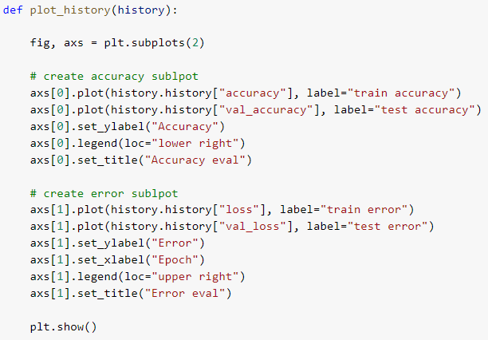
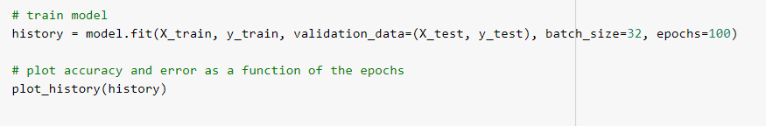
Plotting:
1. Import “matplot” library.
2.Return of fit function is object “history” which stores accuracy and loss of train and test sets.
3.Call “plot_history” function which we wrote to show us the plotting of accurcy and loss before and after applying dropout and regularization.

Slide 19
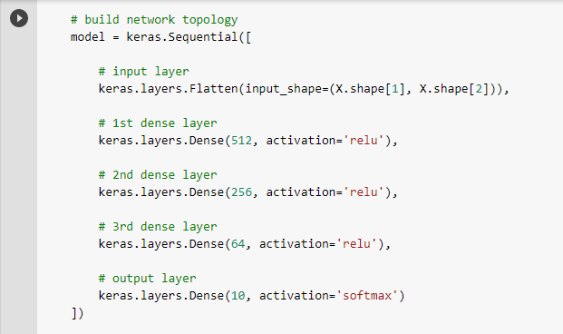
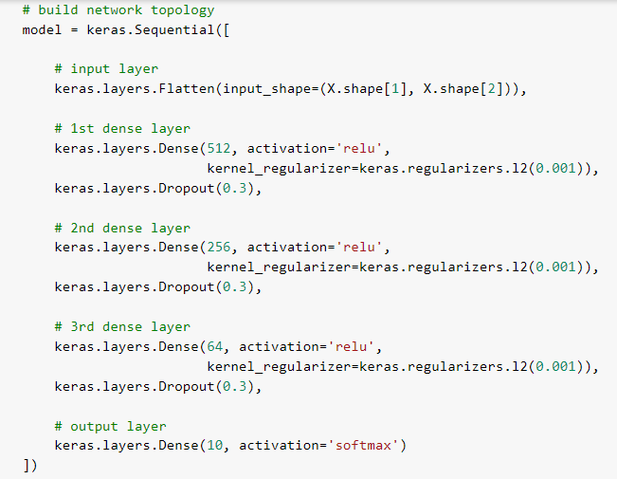
Before solving overfitting
After solving overfitting

Slide 20
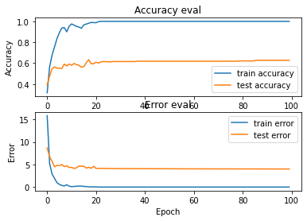
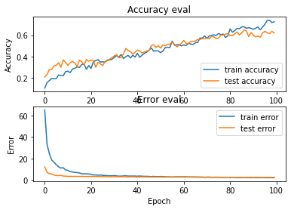
Before solving overfitting
After solving overfitting
Before
After

Slide 21
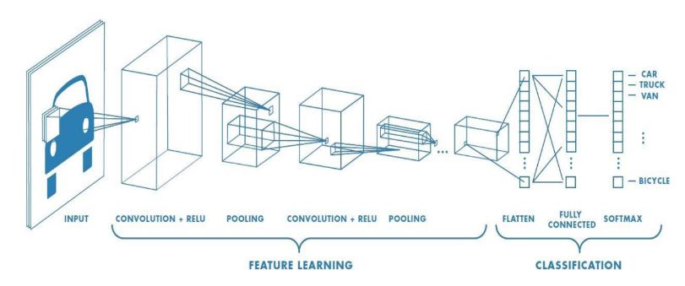
CNNS
Perform better than MLP
Less parameter in dense layers than MLP
CNNs are wonderful for images but what about audio?

Slide 22
How does CNN apply to audio ?
+We can think of audio as image
(we use usually for audios in deep learning networks features/ representation as :
-Spectrogram/MFCC = Audio to image
+Both of them can be visualized as 2d array which is very comparable to an image.
More over audios is also structured (each value related other values not random as well in images)

Slide 23
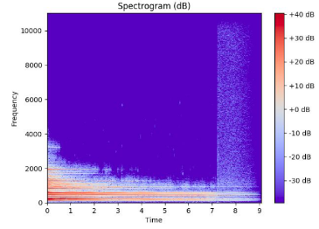

For spectrogram:
Time , frequency = x , y
Amplitude = pixel value
Note :
CNNs doesn't work well with spectrogram representation as MFCCs does because:
particular observed frequency in a spectrogram cannot be assumed to belong to a single sound as the magnitude of that frequency could have been produced by any number of sounds
The axes of spectrograms do not carry the same meaning

Slide 24
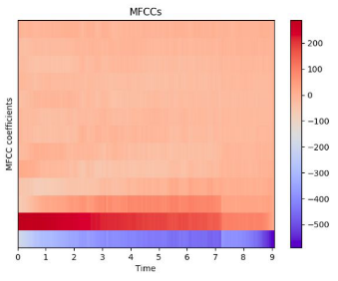
Preparing MFCCs for a CNN:
13 MFCCs
Traditional MFCC systems use only 8–13 cepstral coefficients
Hop Length 512 samples
The number of samples between successive frames
Input data for CNNs:
Data shape = 100*13*1
100 time windows (sliding window) with 13 MFCC feature we extract and depth is 1 (one channel as gray scale not RGB or something)

Slide 25
Code structure:
1-Create train/validation and test sets
2-Build CNN Network
3-Compile network
4-Train CNN
5-Evaluate CNN on test set
6-Predict on a sample

Slide 26
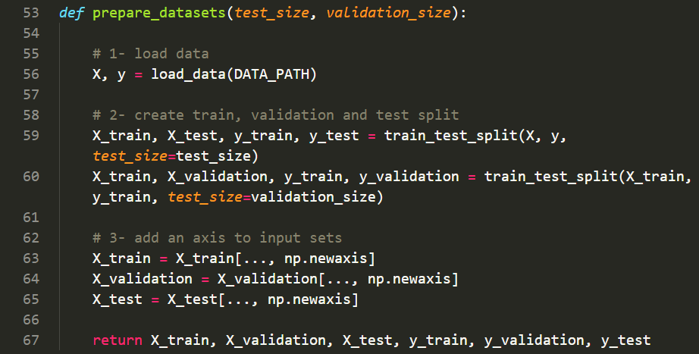
Create train validation/test set
Load the dataset
Splits the data into train/validation (25%)
Splits the data into train/test (20%)
Add new axis (depth) for the input array (as CNN needs 3d array as input)

Slide 27
Build an CNN Network
Build network topology
Three conv layers with Relu
Fully connected layer with ReLu
Output Layer with SoftMax

Slide 28
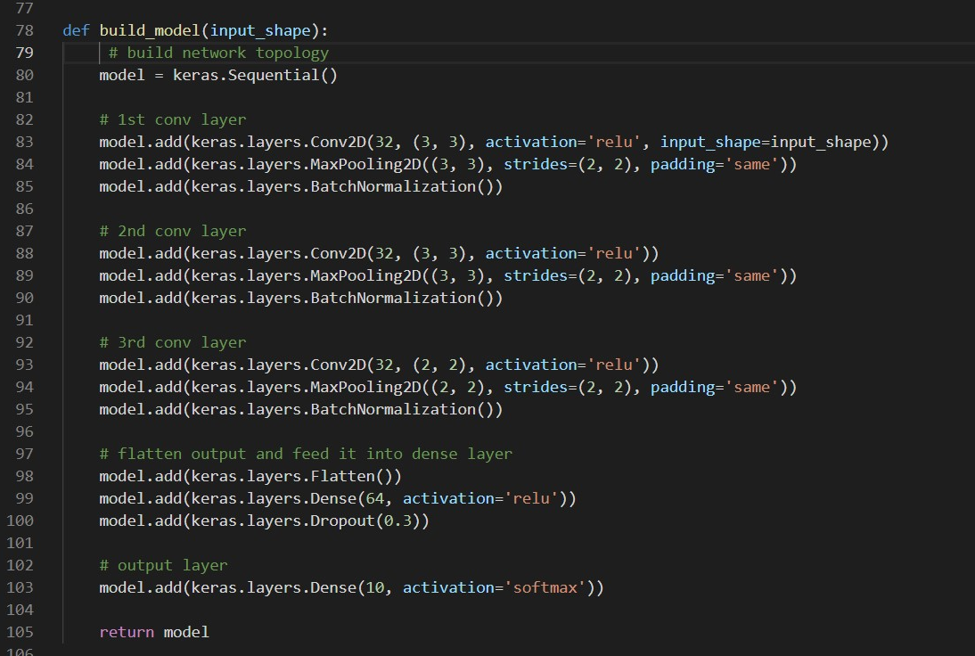

Slide 29
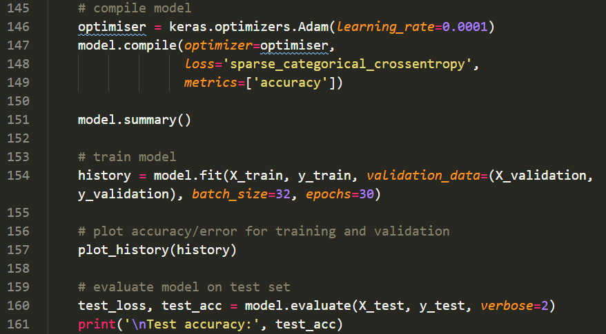
Compile
define network hyper paraments [ loss function learning rate , accuracy ]
Train
Plotting [ Next slide ]
Evaluating

Slide 30
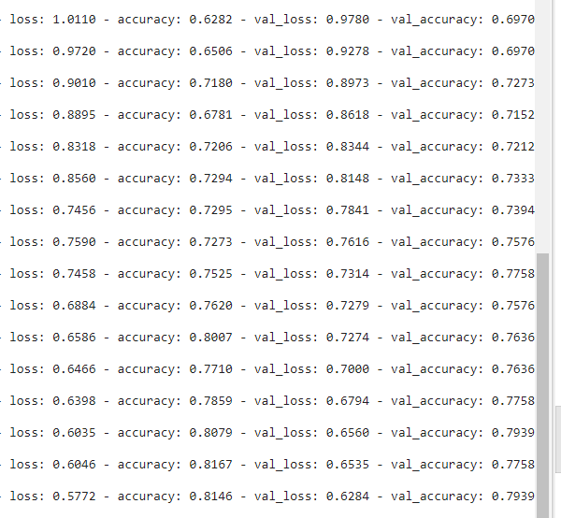


Output on Colab
Accuracy reach to 77%

Slide 31
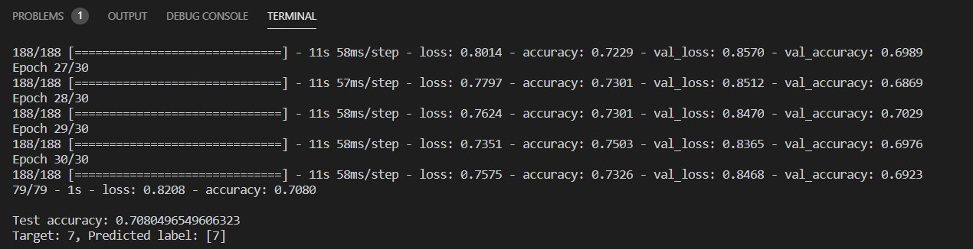
Output on local device
Accuracy reach to 70%

Slide 32
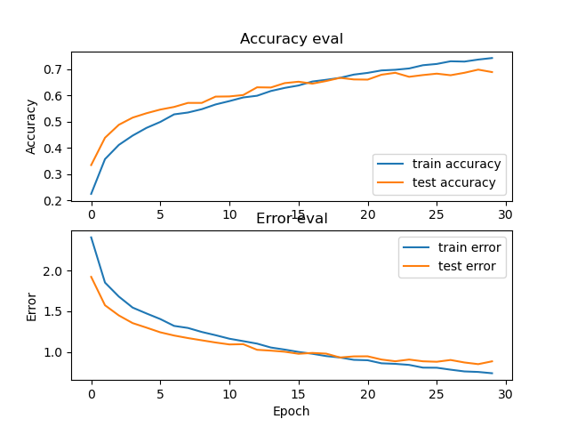
Plotting

Slide 33
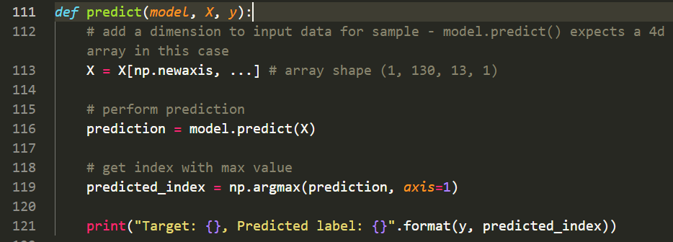
Predict on a sample

Slide 34

GitHub repo for coding:
https://github.com/shimaahamdy/music-genre-classification

Slide 35
Thank you!

